Slide 1
Reproductive Toxicity- Males
Chapter 11-
Dr. Basma Damiri

Slide 2
Reproductive disorders in males
Abnormalities of the genitals
Decreased sperm production
Cryptorchidism
Possible increase in testicular cancer

Slide 3
Cell-type Specific Toxicity
Toxicant can affect the reproduction system by affecting:
Developing Sperm Cells
Sertoli cells
Leydig Cells
Disrupting the endocrine axis(hypothalamic-pituitary-gonadal axis)
Endocrine Feedback and Potential Dysregulation

Slide 4
Male Reproduction Introduction
There are many industrial and pharmaceutical compounds that are potential male reproductive toxicants (Table 11.1).
Such chemicals may interfere with the development of germ cells directly, or indirectly, by disrupting the cellular and endocrine factors involved in supporting and regulating spermatogenesis.
The regulatory roles of the neuroendocrine system are also important to the delivery of sperm.

Slide 6
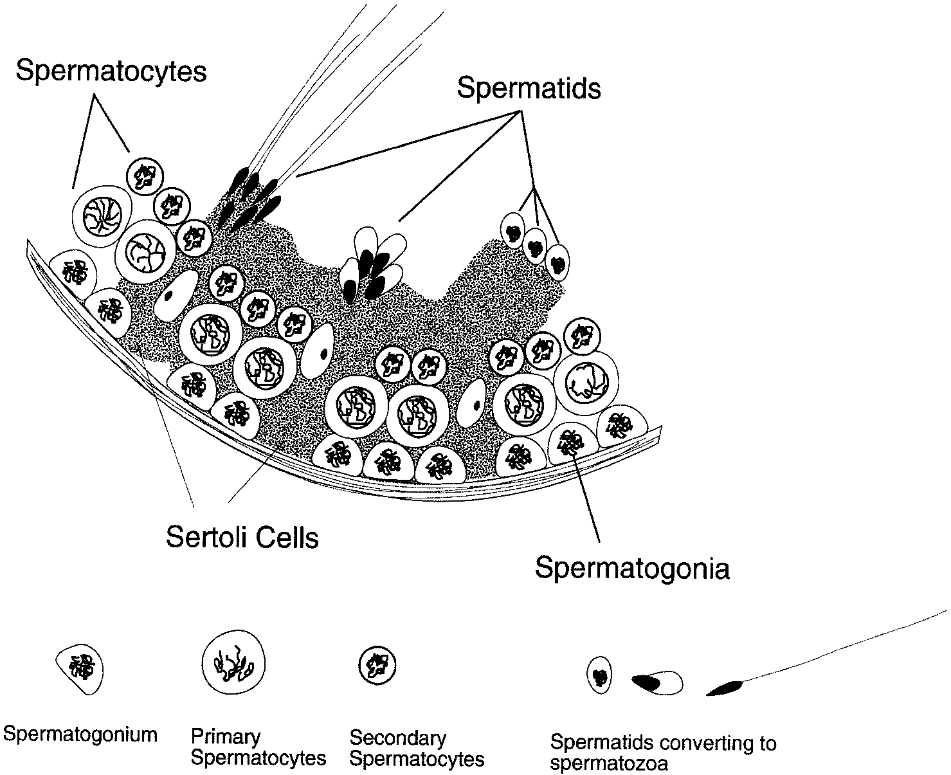
Figure 11.1 Drawing of seminiferous tubule showing the migration of germ cells to the center during development and stages of spermatogenesis.

Slide 7
Cell type susceptibility to toxic injury can be roughly generalized with germ cells as the most sensitive, followed by Sertoli cells and then Leydig cells.
The hierarchical regulation of spermatogenesis underlies this since development of germ cells is often affected by toxicants acting on the Sertoli and Leydig cells. In turn, Sertoli cells are often affected by both Sertoli cell and Leydig cell-specific toxicants.
Reproductive function is susceptible to agents that interfere with the central nervous system and autonomic nervous function because of the importance of neuroendocrine regulation.

Slide 8
Drugs cause failures of germ cell production.
Anti-neoplastic drugs used in chemotherapy, such as methotrexate, adriamycin, cyclophosphamide, vincristine, and vinblastine

Slide 9
Reactive chemicals with common occupational or environmental exposures and particular concerns with regard to rapidly dividing spermatogenic tissues include:
Acrylamide & ethylene oxide—extensively industrial use.
Polynuclear aromatic hydrocarbons (PAHs)—combustion products
Ethylene dibromide & dibromochloropropane—fumigants/pesticides
Not every alkylating agent or reactive metabolite will actually act as a specific reproductive toxicant.

Slide 10
Direct and Indirect Modes of Toxicity
Lead and cadmium→ direct mode of action.
Lead can damage genetic material, disrupting cell division and resulting in cell death. While many different cell types are susceptible to damage from lead, the importance of continual division during spermatogenesis makes this process particularly vulnerable.

Slide 11
Cadmium
Cd has an interesting direct mode of action on the vasculature surrounding the testis and epididymis.
Extensive and specialized vascularization is provided to remove heat from the testis. This vasculature is extremely vulnerable to direct damage by cadmium. When such damage occurs, the remaining vessels are unable to carry away as much blood, and thus as much heat. The combination of reduced perfusion with oxygenated blood and higher temperatures can subsequently destroy the spermatogenic cells.

Slide 12
Other chemicals have direct mode of action
Alkylating chemotherapeutic drugs -Busulfan and cyclophosphamide.
Ethylene oxide, used extensively as a chemical intermediate in industry and for gas sterilization of medical devices and even foods.

Slide 13
Activation of compounds to reproduce reproductive effect
Some chemicals need to be activated
n-hexane
Glycol ether
pthalates, a chemical class used extensively as plasticizers and distributed widely in the environment

Slide 14
Cell-type Specific Toxicity
Toxicant can affect the reproduction system by affecting:
Developing Sperm Cells
Sertoli cells
Leydig Cells
Disrupting the endocrine axis(hypothalamic-pituitary-gonadal axis)
Endocrine Feedback and Potential Dysregulation

Slide 15
1-Developing Sperm Cells
Spermatogonia- sterility among workers handling the pesticide dibromochloropropane (DBCP).
Spermatocytes-ethylene glycol monoethyl ether (EGME)
Spermatids-ethylene dibromide (EDB).
-----------------------------------------------------------------------------Sperm motility: Epichlorohydrin (widely used intermediate in plastics/rubbers)
Agents such as mercury and lead may have a combined effect on both sperm cell membrane dynamics and on the epididymis.
Freezing of sperms damage anti-oxidant pathway (lipids peroxidation)

Slide 16
2- Sertoli cells
The solvent n-hexane is a demonstrated reproductive toxicant. Its testicular toxicity is related to interference with microtubule formation in Sertoli cells by the metabolite 2,5-hexanedione.
Phthalate plasticizers- a breakdown of the attachments between Sertoli cells and germ cells.
Bioactivation of tri-o-cresyl phosphate (TOCP) is required prior to its effects on Sertoli cells.
dinitrobenzene (DNB).
The Sertoli cell tight junctions can also be affected by toxic agents, disrupting the blood/testis barrier.
Platinum-based anti-neoplastic drugs, such as cisplatin, appear to operate in this manner.

Slide 17
Leydig Cells ( testosterone production)
Ethane-1,2-dimethanesulfonate (EDS). This compound affects androgen production by the Leydig cells and appears to interfere with specific early steps in the synthesis of steroid hormones.
In addition to their Sertoli cell effects, the phthalates also appear capable of interfering with steroid synthesis and Leydig cell function.

Slide 18
Toxicants that can disrupt the endocrine axis (hypothalamic-pituitary-gonadal axis)
Ethanol-alcohol interferes with male reproduction by affecting endocrine regulation (LH), and ultimately, in part, Leydig cell production of testosterone.
Anti-hypertensive drug propanolol, the opiates, and tetrahydrocannabinol (THC).
Carbon disulfide, the pesticide chlordecone, and the phthalates are examples of industrial chemicals that can disrupt the endocrine axis.

Slide 19
Endocrine Feedback and Potential Dysregulation
chlordecone ( a pesticide) has estrogenic activity
Dioxin
A variety of pesticides, including DDT, the carbamates, and mirex, are reported to possess endocrine activity as are some of the polychlorinated biphenyls (PCBs).

