Slide 1
Modern Systems Analysis and Design
Ninth Edition
Chapter 14
Maintaining Information Systems
Copyright © 2020, 2017, 2014 Pearson Education, Inc. All Rights Reserved

Slide 2
Learning Objectives
14.1 Explain and contrast four types of maintenance
14.2 Describe several factors that influence the cost of maintaining an information system and apply these factors to the design of maintainable systems; and
14.3 Describe maintenance management issues, including alternative organizational structures, quality measurement, processes for handling change requests, and configuration management

Slide 3
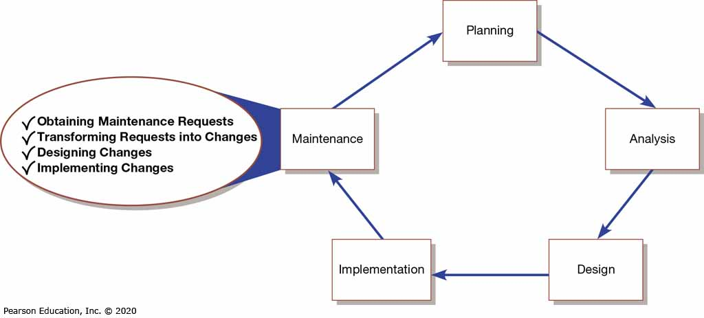
Figure 14-1: Systems Development Life Cycle

Slide 4
Maintaining Information Systems
14.1 Explain and contrast four types of maintenance
Four major activities occur within maintenance:
Obtaining maintenance requests
Transforming requests into changes
Designing changes
Implementing changes

Slide 5
What is system maintenance?
System maintenance refers to changing an existing information system to fix errors or enhance functionality.
The primary goal of software maintenance is to modify and update software applications after they have been delivered(after it is put in use) in order to fix bugs and improve performance.
It helps in upgrading, modifying, and updating software to stay up with client - user needs.
system maintenance involves advancement in the existing solution as there are requirements of new software development as the market shifts.
Software maintenance enhances the growth of your software.

Slide 6
purpose of the maintenance
The purpose of the maintenance is to sustain the capability of a system to provide a service. This process monitors the system's capability to deliver services, records problems for analysis.

Slide 7
Types of Maintenance (1 of 2)
14.1 Explain and contrast four types of maintenance
Corrective maintenance
Adaptive maintenance
Perfective maintenance
Preventative maintenance

Slide 8
Corrective Maintenance
Identifying errors in the existing solution and correcting them to make it works more accurately.
corrective software maintenance occurs when there are errors and faults in logic, code, and design. It is about correcting software bugs, errors, and defects.
It refers to changes made to a system to repair flaws in its design, coding, or implementation
It aims to eliminate and fix bugs or issues in the software.
Corrective software maintenance is usually done in the form of small updates frequently.

Slide 9
You can implement corrective software maintenance when:
1- Software doesn’t function properly due to some faulty logic flow.
2- wrong implementation.
3- invalid or incomplete tests.

Slide 10
Adaptive Maintenance
Adaptive software maintenance is the process of conversion in the system to keep the software compatible with changing business needs and technical evolution.
It refers to changes made to a system to evolve its functionality to changing business needs or technologies
It is made in response to new operating systems, platforms, and hardware to retain continuity with the software.
Adaptive software maintenance is about changing software in response to changes in its environment.

Slide 11
The primary goal of adaptive software maintenance is to update and modify the software when:
1-The operating system on which your software executes is evolving (due to technology, laws, policies, rules, operating system, etc.)
2-End-users require the product to work with new hardware or software.

Slide 12
Perfective Maintenance
Perfective Maintenance is a process of modifying all elements, functionalities, and abilities to enhance system operations and performance.
It refers to changes made to a system to add new features or to improve performance.
It includes altering current software functionality by improving, removing, or inserting new features or functions.
Perfective software maintenance focuses on functional enhancements to improve the user experience.

Slide 13
If you want to update the software system to improve its value as needed by the user requirements, you can execute the perfective software maintenance. This includes:
Performance enhancement
Enhanced user interfaces and software usability
Better software functionality and performance

Slide 14
Preventive Maintenance
Preventive software maintenance service helps in preventing the system from any forthcoming vulnerabilities.
It refers to changes made to a system to avoid possible future problems.
Preventive maintenance defines improvements of the software, which is done to safeguard the software for the future.
It is carried out to prevent the product from any potential software alteration.

Slide 15
Preventive Software Maintenance defines the adaptions and modifications of the software that mitigate the deterioration risk.
Preventive maintenance offers:
Document updating as the existing state of the system
Code optimization for better software execution
Reconstructing or reducing the code of the software to make it understandable

Slide 16
Why Software Requires Maintenance?
1-Bug Fixing
In maintenance management, bug fixing comes at a priority to run the software seamlessly. This process contains searching out for errors in code and correcting them. The issues can occur in hardware, operating systems, or any part of the software. This must be done without hurting the rest of the functionalities of existing software.

Slide 17
2- Capability Enhancement
This comprises an improvement in features and functions to make solutions compatible with the varying market environment. It enhances software platforms, work patterns, hardware upgrades, compilers, and other aspects that affect system workflow. Boost your business using a technically updated solution applying software maintenance services regularly.

Slide 18
3- Removal of Outdated Functions
The unwanted functionalities are useless. Moreover, by occupying space in the solution, they hurt the efficiency of the solution. Using a software maintenance guide, such UI and coding elements are removed and replaced with new development using the latest tools and technologies. This elimination makes the system adaptive to cope with changing circumstances.

Slide 19
4- Performance Improvement
To improve system performance, developers detect issues through testing and resolve them. Data and coding restricting as well as reengineering are part of software maintenance. It prevents the solution from vulnerabilities. This is not any functionality that performs in operations, but it develops to stop harmful activities like hacking.

Slide 20
Software Maintenance Processes
In the life cycle of software development, a software maintenance plan is a very crucial phase. Hence, it is executed in the system through a well-planned software maintenance process which is known as Software Maintenance Life Cycle (SMLC). SMLC is implemented in seven different phases. Those are:
Phase 1 – Identification
As the name goes, in this phase of the software maintenance life cycle, the modifications are ‘identified’. Before implementing the changes for the requests raised, the modifications are first analysed and classified according to the attention or maintenance it requires. This phase can be automated or manually done by a user.

Slide 21
Phase 2 – Analysis
The practicality and feasibility of each verified modification request are planned to incorporate changes in the software. The analysis includes validated changes or input where the cost of modification is also estimated.
Phase 3 – Design
The new framework of the software is determined according to the result of the analysis. Survey or test software is also developed for the purpose of safety and security.

Slide 22
Phase 4 – Implementation
This is where the main or new software framework is implemented; as in, the codes are crafted, and in the new support system, specifications are added.
Phase 5 – System Testing
In this testing, the implementation of codes and specifications are tested. This stage determines if any further changes or additions are required in the new model of software.

Slide 23
Phase 6 – Acceptance Testing
This stage is performed by third-party end-users. They run a dummy software test, also known as a dry run test, to check if the implemented specifications are working properly, which was mentioned in the modification request.
Phase 7 – Delivery
As and when the testing phase is cleared and the developers get a green signal from the third-party users, they deliver the software to the primary users.

Slide 24
The Cost of Maintenance (1 of 2)
Many organizations allocate 60-80% of information systems budget to maintenance
Because many organizations have accumulated more and more older so-called legacy systems that require more and more maintenance

Slide 25
The Cost of Maintenance (2 of 2)
several factors that influence the cost of maintaining an information
Maintainability is the ease with which software can be understood, corrected, adapted, and enhanced
Factors influencing maintainability:
Latent defects: unknown errors after installation (increases corrective maintenance)
Number of system customers: the greater the number of customers the greater the maintenance costs
Quality of system documentation: lack of documentation makes maintenance harder
Maintenance personnel: high quality programmers required for maintenance
Tools: automated documentation and code tools
Well-structured programs: well designed programs are easier to understand and fix

Slide 26
Managing Maintenance Personnel who carries out maintenance?
Traditionally, maintenance and development were separately staffed
Organizations are rethinking this. Maybe combine development and maintenance into one role?
Another possibility: spread maintenance personnel in different functional units (marketing, accounting, human resources, etc.)

Slide 27
Measuring Maintenance Effectiveness
14.3 Describe maintenance management issues, including alternative organizational structures, quality measurement, processes for handling change requests, and configuration management
In measuring maintenance effectiveness you must measure the following factors:
Number of failures
Time between each failure
Type of failure
Mean time between failures (M T B F) – measurement of error occurrences that can be tracked over time to indicate the quality of a system

