Slide 1
Chapter 3 - Stoichiometry
Copyright ©2017 Cengage Learning. All Rights Reserved.

Slide 2
Table of contents
(3.1) Counting by weighing
(3.2) Atomic masses
(3.3) The mole
(3.4) Molar mass
(3.6) Percent composition of compounds
(3.7) Determining the formula of a compound

Slide 3
Table of contents (Continued)
(3.8) Chemical equations
(3.9) Balancing chemical equations
(3.10) Stoichiometric calculations: Amounts of reactants and products
(3.11) The concept of limiting reactant

Slide 4
Chemical Stoichiometry
The study of quantities of materials consumed and produced in chemical reactions
Requires the understanding of the concept of relative atomic masses

Slide 5
An Overview of Stoichiometry
The average mass of objects is required to count the objects by weighing
Objects behave as though they are all identical
Chemists deal with samples of matter that contain huge numbers of atoms
Number of atoms in a sample can be determined by finding its mass

Slide 6
Figure 3.1 - Schematic Diagram of a Mass Spectrometer

Slide 7
Mass Spectrometer and the Mass of an Ion
In a mass spectrometer, the amount of path deflection of an ion depends on its mass
Massive ions are deflected in the smallest amount
Causes separation of ions
Position where the ions hit the detector plate provides accurate values of their relative masses

Slide 8
Average Atomic Mass of Elements
Atomic mass or average mass of an element
All elements occur in nature as mixtures of isotopes
Atomic masses of all elements are average values based on the isotopic composition of naturally occurring elements

Slide 9
Average Atomic Mass of Carbon
Natural carbon is a mixture of three isotopes - ¹²C, ¹³C, and ¹⁴C
Atomic mass of carbon is an average value of the three isotopes
Natural carbon is composed of:
98.89% ¹²C atoms (mass = 12 u)
1.11% ¹³C atoms (mass = 13.003355 u)

Slide 10
Average Atomic Mass of Carbon (Continued)
The average atomic mass of natural carbon can be calculated as follows:
For stoichiometric purposes, assume that carbon is composed of only one type of atom with a mass of 12.01

Slide 11
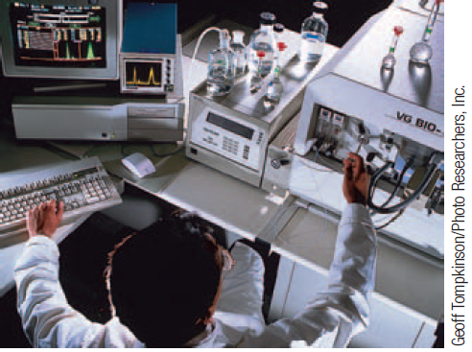
Uses of Mass Spectrometer
Helps determine accurate mass values for individual atoms
Ascertains the isotopic composition of naturally occurring elements

Slide 12
Exercise
An element consists of:
1.40% of an isotope with mass 203.973 u
24.10% of an isotope with mass 205.9745 u
22.10% of an isotope with mass 206.9759 u
52.40% of an isotope with mass 207.9766 u
Calculate the average atomic mass, and identify the element
Mass = 207.2 u
The element is lead (Pb)

Slide 13
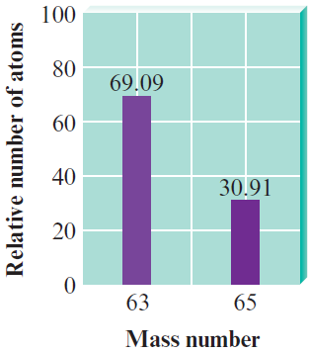
Example 3.1 - The Average Mass of an Element
When a sample of natural copper is vaporized and injected into a mass spectrometer, the results shown in the graph are obtained
Use these data to compute the average mass of natural copper
The mass values for ⁶³Cu and ⁶⁵Cu are 62.93 u and 64.93 u, respectively

Slide 14
Example 3.1 - Solution
Where are we going?
To calculate the average mass of natural copper
What do we know?
⁶³Cu mass = 62.93 u
⁶⁵Cu mass = 64.93 u
How do we get there?
As shown by the graph, of every 100 atoms of natural copper, 69.09 are ⁶³Cu and 30.91 are ⁶⁵Cu

Slide 15
Example 3.1 - Solution (Continued 1)
Thus, the mass of 100 atoms of natural copper is
The average mass of a copper atom is
This mass value is used in doing calculations involving the reactions of copper

Slide 16
Example 3.1 - Solution (Continued 2)
Reality check
The answer of 63.55 u is between the masses of the atoms that make up natural copper
This makes sense
The answer could not be smaller than 62.93 u or larger than 64.93 u

Slide 17
Mole (mol)
Number of carbon atoms in exactly 12 grams of pure ¹²C
Determined to be 6.02214 ×10²³ using the technique of mass spectrometry
Avogadro’s number: 1 mole of something consists of 6.022 ×10²³ units of that substance

Slide 18
Figure 3.4 - One Mole Samples of Several Elements

Slide 19
Critical Thinking
What if you were offered $1 million to count from 1 to 6 × 10²³ at a rate of one number each second?
Determine your hourly wage
Would you do it? Could you do it?

Slide 20
Using the Mole in Chemical Calculations
Avogadro's number is defined as the number of atoms in exactly 12 g of ¹²C
1 mol C = 6.022×10²³ atoms
12.01-g sample of natural carbon contains 6.022×10²³ atoms

Slide 21
Using the Mole in Chemical Calculations (Continued)
Ratio of masses of both samples - 12 g/12.01 g
Ratio of masses of individual components - 12 u/12.01 u
Therefore, both samples contain the same number of atoms

Slide 22
Table 3.1 - Comparison of 1 Mole Samples of Various Elements

Slide 23
Defining the Mole
Sample of a natural element whose mass equals the element’s atomic mass expressed in grams contains 1 mole of atoms
Relationship between the atomic mass unit and the gram:
Exact number

Slide 24
Critical Thinking
What if you discovered Avogadro’s number was not 6.02×10²³ but 3.01×10²³?
Would this affect the relative masses given on the periodic table?
If so, how?
If not, why not?

Slide 25
Interactive Example 3.5 - Calculating the Number of Moles and Mass
Cobalt (Co) is a metal that is added to steel to improve its resistance to corrosion
Calculate both the number of moles in a sample of cobalt containing 5.00 × 10²⁰ atoms and the mass of the sample

Slide 26
Interactive Example 3.5 - Solution
Where are we going?
To calculate the number of moles and the mass of a sample of Co
What do we know?
Sample contains 5.00 × 10²⁰ atoms of Co

Slide 27
Interactive Example 3.5 - Solution (Continued 1)
How do we get there?
Note that the sample of 5.00 × 10²⁰ atoms of cobalt is less than 1 mole (6.022 × 10²³ atoms) of cobalt
What fraction of a mole it represents can be determined as follows:

Slide 28
Interactive Example 3.5 - Solution (Continued 2)
Since the mass of 1 mole of cobalt atoms is 58.93 g, the mass of 5.00 × 10²³ atoms can be determined as follows:

Slide 29
Interactive Example 3.5 - Solution (Continued 3)
Reality check
The sample contains 5 × 10²⁰ atoms, which is approximately 1/1000 of a mole
The sample should have a mass of about (1/1000)(58.93) 0.06
The answer of ~ 0.05 makes sense

Slide 30
Exercise
Diamond is a natural form of pure carbon
What number of atoms of carbon are in a 1.00-carat diamond (1.00 carat = 0.200 g)?
1.00×10²² atoms C

Slide 31
Molar Mass - An Introduction
Mass in grams of one mole of a substance
Obtained by finding the sum of masses of a compound’s constituent atoms
Example - Mass of 1 mole of methane (CH₄) can be computed by summing the masses of C and H
Mass of 1 mol of C = 12.01 g
Mass of 4 mol of H = 4×1.008 g = 4.03 g
Therefore, mass of 1 mol CH₄ = 16.04 g

Slide 32
Interactive Example 3.7 - Calculating Molar Mass II
Calcium carbonate (CaCO₃), also called calcite, is the principal mineral found in limestone, marble, chalk, pearls, and the shells of marine animals such as clams
Calculate the molar mass of calcium carbonate
A certain sample of calcium carbonate contains 4.86 moles
What is the mass in grams of this sample? What is the mass of the CO₃^{2–} ions present?

Slide 33
Interactive Example 3.7 - Solution (a)
Calcium carbonate is an ionic compound composed of Ca²⁺ and CO₃^{2–} ions
In 1 mole of calcium carbonate, there are 1 mole of Ca²⁺ ions and 1 mole of CO₃^{2–} ions
Molar mass is calculated by summing the masses of the components

Slide 34
Interactive Example 3.7 - Solution (a) (Continued)
1 Ca²⁺: 1 × 40.08 g = 40.08 g
1 CO₃^{2–}:
1 C: 1 × 12.01 g = 12.01 g
3 O: 3 × 16.00 g = 48.00 g
Mass of 1 mol CaCO₃ = 100.09 g
Thus, the mass of 1 mole of CaCO₃ (1 mole of Ca²⁺ plus 1 mole of CO₃^{2–}) is 100.09 g
This is the molar mass

Slide 35
Interactive Example 3.7 - Solution (b)
The mass of 1 mole of CaCO₃ is 100.09 g
The sample contains nearly 5 moles, or close to 500 g
The exact amount is determined as follows:

Slide 36
Interactive Example 3.7 - Solution (b) (Continued 1)
To find the mass of carbonate ions (CO₃^{2–}) present in this sample, realize that 4.86 moles of CaCO₃ contains 4.86 moles of Ca²⁺ ions and 4.86 moles of CO₃^{2–} ions
The mass of 1 mole of CO₃^{2–} ions is calculated as follows:
1 C: 1 × 12.01 = 12.01 g
3 O: 3 × 16.00 = 48.00 g
Mass of 1 mol CO₃^{2–} = 60.01 g

Slide 37
Interactive Example 3.7 - Solution (b) (Continued 2)
Thus, the mass of 4.86 moles of CO₃^{2–} ions is

Slide 38
Interactive Example 3.8 - Molar Mass and Numbers of Molecules
Isopentyl acetate (C₇H₁₄O₂) is the compound responsible for the scent of bananas
Interestingly, bees release about 1 μg (1 × 10^{–6} g) of this compound when they sting
The resulting scent attracts other bees to join the attack
How many molecules of isopentyl acetate are released in a typical bee sting?
How many atoms of carbon are present?

Slide 39
Interactive Example 3.8 - Solution
Where are we going?
To calculate the number of molecules of isopentyl acetate and the number of carbon atoms in a bee sting
What do we know?
Mass of isopentyl acetate in a typical bee sting is 1 microgram = 1 ×10^{–6} g

Slide 40
Interactive Example 3.8 - Solution (Continued 1)
How do we get there?
Since we are given a mass of isopentyl acetate and want to find the number of molecules, we must first compute the molar mass of C₇H₁₄O₂

Slide 41
Interactive Example 3.8 - Solution (Continued 2)
This means that 1 mole of isopentyl acetate (6.022×10²³ molecules) has a mass of 130.18 g
To find the number of molecules released in a sting, we must first determine the number of moles of isopentyl acetate in 1×10^{–6} g

Slide 42
Interactive Example 3.8 - Solution (Continued 3)
Since 1 mole is 6.022 × 10²³ units, we can determine the number of molecules

Slide 43
Interactive Example 3.8 - Solution (Continued 4)
To determine the number of carbon atoms present, we must multiply the number of molecules by 7, since each molecule of isopentyl acetate contains seven carbon atoms

Slide 44
Interactive Example 3.8 - Solution (Continued 5)
Note
In keeping with our practice of always showing the correct number of significant figures, we have rounded after each step
However, if extra digits are carried throughout this problem, the final answer rounds to 3×10¹⁶

Slide 45
Exercise
Calculate the molar mass of the following substances:
17.03 g/mol
32.05 g/mol

Slide 46
Exercise (Continued)
What number of atoms of nitrogen are present in 1.00 g of each of the following compounds?
3.54×10²² atoms
3.76×10²² atoms

Slide 47
Methods of Describing a Compound’s Composition
In terms of the numbers of the compound’s atoms
In terms of mass percent (weight percent)

Slide 48
Interactive Example 3.9 - Calculating Mass Percent
Carvone is a substance that occurs in two forms having different arrangements of the atoms but the same molecular formula (C₁₀H₁₄O) and mass
One type of carvone gives caraway seeds their characteristic smell, and the other type is responsible for the smell of spearmint oil
Compute the mass percent of each element in carvone

Slide 49
Interactive Example 3.9 - Solution
Where are we going?
To find the mass percent of each element in carvone
What do we know?
Molecular formula is C₁₀H₁₄O
What information do we need to find the mass percent?
Mass of each element (we’ll use 1 mole of carvone)
Molar mass of carvone

Slide 50
Interactive Example 3.9 - Solution (Continued 1)
How do we get there?
Determine the mass of each element in 1 mole of C₁₀H₁₄O

Slide 51
Interactive Example 3.9 - Solution (Continued 2)
What is the molar mass of C₁₀H₁₄O?
What is the mass percent of each element?
Find the fraction of the total mass contributed by each element and convert it to a percentage

Slide 52
Interactive Example 3.9 - Solution (Continued 3)
Reality check
The percentages add up to 100%

Slide 53
Exercise
Calculate the percent composition by mass of the following compounds that are important starting materials for synthetic polymers:
C₃H₄O₂ (acrylic acid, from which acrylic plastics are made)
C₄H₆O₂ (methyl acrylate, from which Plexiglas is made)
50.00% C, 5.595% H, and 44.41% O
55.80% C, 7.025% H, and 37.18% O

Slide 54
Determining the Formula of a Compound
Weigh the sample of the compound
Decompose the sample into its constituent elements or react it with oxygen
Combustion device
Used to analyze substances for hydrogen and carbon
Helps determine the mass percent of each element in a compound

Slide 55
Figure 3.5 - A Schematic Diagram of a Combustion Device

Slide 56
Empirical Formula
Any molecule that can be represented as (CH₅N)_{n} has the empirical formula CH₅N
n - Integer
Molecular formula: Exact formula of the molecules present in a substance
Requires the knowledge of the molar mass

Slide 57
Problem-Solving Strategy - Empirical Formula Determination
Mass percentage gives the number of grams of a particular element per 100 g of compound
Therefore, base the calculation on 100 g of compound
Each percent will then represent the mass in grams of that element
Determine the number of moles of each element present in 100 g of compound
Use the atomic masses of the elements present

Slide 58
Problem-Solving Strategy - Empirical Formula Determination (Continued)
Divide each value of the number of moles by the smallest of the values
If each resulting number is a whole number (after appropriate rounding), these numbers represent the subscripts of the elements in the empirical formula
If the numbers obtained are not whole numbers, multiply each number by an integer so that the results are all whole numbers

Slide 59
Critical Thinking
One part of the problem-solving strategy for empirical formula determination is to base the calculation on 100 g of compound
What if you chose a mass other than 100 g?
Would this work?
What if you chose to base the calculation on 100 moles of compound?
Would this work?

Slide 60
Problem-Solving Strategy - Determining Molecular Formula from Empirical Formula
Obtain the empirical formula
Compute the mass corresponding to the empirical formula
Calculate the ratio

Slide 61
Problem-Solving Strategy - Determining Molecular Formula from Empirical Formula (Continued)
Number of empirical formula units in one molecule is represented by the integer from the previous step
Molecular formula results when the empirical formula subscripts are multiplied by this integer
This procedure is summarized as follows:

Slide 62
Interactive Example 3.11 - Determining Empirical and Molecular Formulas II
A white powder is analyzed and found to contain 43.64% phosphorus and 56.36% oxygen by mass
The compound has a molar mass of 283.88 g/mol
What are the compound’s empirical and molecular formulas?

Slide 63
Interactive Example 3.11 - Solution
Where are we going?
To find the empirical and molecular formulas for the given compound
What do we know?
Percent of each element
Molar mass of the compound is 283.88 g/mol

Slide 64
Interactive Example 3.11 - Solution (Continued 1)
What information do we need to find the empirical formula?
Mass of each element in 100.00 g of compound
Moles of each element
How do we get there?
What is the mass of each element in 100.00 g of compound?
Mass of P = 43.64 g Mass of O = 56.36 g

Slide 65
Interactive Example 3.11 - Solution (Continued 2)
What are the moles of each element in 100.00 g of compound?

Slide 66
Interactive Example 3.11 - Solution (Continued 3)
What is the empirical formula for the compound?
Dividing each mole value by the smaller one gives:
This yields the formula PO_{2.5}
Since compounds must contain whole numbers of atoms, the empirical formula should contain only whole numbers
To obtain the simplest set of whole numbers, we multiply both numbers by 2 to give the empirical formula P₂O₅

Slide 67
Interactive Example 3.11 - Solution (Continued 4)
What is the molecular formula for the compound?
Compare the empirical formula mass to the molar mass
The molecular formula is (P₂O₅)₂, or P₄O₁₀

Slide 68
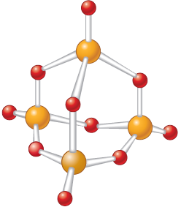
Interactive Example 3.11 - Solution (Continued 5)
Note - The structural formula for this interesting compound is given below

Slide 69
Exercise
A compound contains 47.08% carbon, 6.59% hydrogen, and 46.33% chlorine by mass
Molar mass of the compound is 153 g/mol
What are the empirical and molecular formulas of the compound?
Empirical formula - C₃H₅Cl
Molecular formula - C₆H₁₀Cl₂

Slide 70
Problem-Solving Strategy - Determining Molecular Formula from Mass Percent and Molar Mass
Use the mass percentages and the molar mass to determine the mass of each element present in 1 mole of compound
Compute the number of moles of each element present in 1 mole of compound
Integers in this step represent the subscripts in the molecular formula

Slide 71
Interactive Example 3.12 - Determining a Molecular Formula
Caffeine, a stimulant found in coffee, tea, and chocolate, contains 49.48% carbon, 5.15% hydrogen, 28.87% nitrogen, and 16.49% oxygen by mass and has a molar mass of 194.2 g/mol
Determine the molecular formula of caffeine

Slide 72
Interactive Example 3.12 - Solution
Where are we going?
To find the molecular formula for caffeine
What do we know?
Percent of each element
49.48% C
28.87% N
5.15% H
16.49% O
Molar mass of caffeine is 194.2 g/mol

Slide 73
Interactive Example 3.12 - Solution (Continued 1)
What information do we need to find the molecular formula?
Mass of each element (in 1 mole of caffeine)
Mole of each element (in 1 mole of caffeine)
How do we get there?
What is the mass of each element in 1 mole (194.2 g) of caffeine?

Slide 74
Interactive Example 3.12 - Solution (Continued 2)

Slide 75
Interactive Example 3.12 - Solution (Continued 3)
What are the moles of each element in 1 mole of caffeine?

Slide 76
Interactive Example 3.12 - Solution (Continued 4)
Rounding the numbers to integers gives the molecular formula for caffeine: C₈H₁₀N₄O₂

Slide 77
Chemical Reactions
Chemical change involves the reorganization of atoms in one or more substances
Atoms are neither created nor destroyed
Represented by a chemical equation
Reactants: Presented on the left side of an arrow
Products: Presented on the right side of the arrow
Reactants
Products

Slide 78
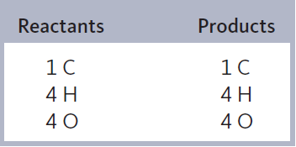
Balancing a Chemical Equation
All atoms present in the reactants must be accounted for in the products that are formed

Slide 79
Information Provided by Chemical Equations
Nature of the reactants and products
Relative numbers of reactants and products
Indicated by coefficients in a balanced equation
Physical states of reactants and products
Mass remains constant
Atoms are conserved in a chemical reaction

Slide 80
Representing Physical States in a Chemical Equation

Slide 81
Things to Remember
Refrain from considering an unbalanced equation
Experimental observation determines the identities of the reactants and products of a reaction
Formulas of compounds must never be changed while balancing a chemical equation
Do not change subscripts, and do not add or subtract atoms from a formula

Slide 82
Critical Thinking
What if a friend was balancing chemical equations by changing the values of the subscripts instead of using the coefficients?
How would you explain to your friend that this was the wrong thing to do?

Slide 83
Problem-Solving Strategy - Writing and Balancing the Equation for a Chemical Reaction
Determine what reaction is occurring
Determine the reactants, the products, and the physical states involved
Write the unbalanced equation that summarizes the reaction

Slide 84
Problem-Solving Strategy - Writing and Balancing the Equation for a Chemical Reaction (Continued)
Balance the equation by inspection, starting with the most complicated molecule(s)
Determine what coefficients are necessary
The same number of each type of atom needs to appear on both reactant and product sides
Do not change the formulas of any of the reactants or products

Slide 85
Critical Thinking
One part of the problem-solving strategy for balancing chemical equations is “starting with the most complicated molecule”
What if you started with a different molecule?
Could you still eventually balance the chemical equation?
How would this approach be different from the suggested technique?

Slide 86
Interactive Example 3.14 - Balancing a Chemical Equation II
At 1000°C, ammonia gas, NH₃(g), reacts with oxygen gas to form gaseous nitric oxide, NO(g), and water vapor
This reaction is the first step in the commercial production of nitric acid by the Ostwald process
Balance the equation for this reaction

Slide 87
Interactive Example 3.14 - Solution
Steps 1 and 2
The unbalanced equation for the reaction is
Step 3
Since all the molecules in this equation are of about equal complexity, where we start in balancing it is rather arbitrary

Slide 88
Interactive Example 3.14 - Solution (Continued 1)
Let’s begin by balancing the hydrogen
A coefficient of 2 for NH₃ and a coefficient of 3 for H₂O give six atoms of hydrogen on both sides
The nitrogen can be balanced with a coefficient of 2 for NO

Slide 89
Interactive Example 3.14 - Solution (Continued 2)
Finally, note that there are two atoms of oxygen on the left and five on the right
The oxygen can be balanced with a coefficient of for O₂
Usual custom is to have whole-number coefficients
We simply multiply the entire equation by 2
Reality check - There are 4 N, 12 H, and 10 O on both sides, so the equation is balanced

Slide 90
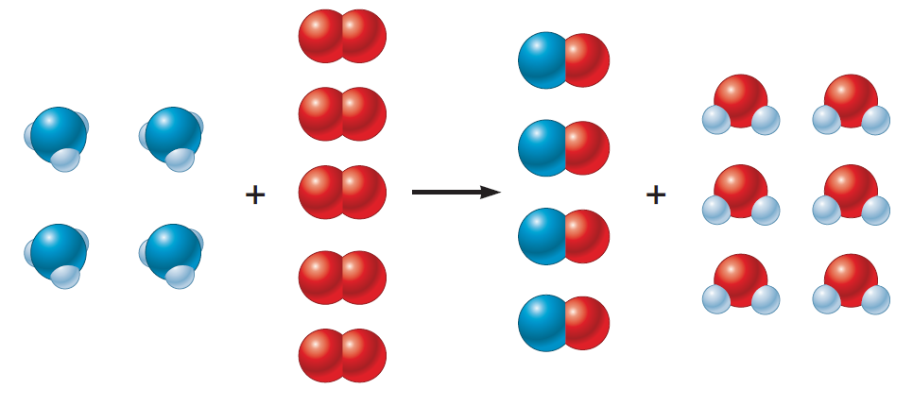
Interactive Example 3.14 - Solution (Continued 3)
Visual representation of the balanced reaction

Slide 91
Exercise
Balance the following equations:

Slide 92
Problem-Solving Strategy - Calculating Masses of Reactants and Products in Reactions
Balance the equation for the reaction
Convert the known mass of the reactant or product to moles of that substance
Use the balanced equation to set up the appropriate mole ratios

Slide 93
Problem-Solving Strategy - Calculating Masses of Reactants and Products in Reactions (Continued)
Use the appropriate mole ratios to calculate the number of moles of the desired reactant or product
Convert from moles back to grams if required by the problem

Slide 94
Critical Thinking
Your lab partner has made the observation that you always take the mass of chemicals in lab, but then you use mole ratios to balance the equation
“Why not use the masses in the equation?” your partner asks
What if your lab partner decided to balance equations by using masses as coefficients?
Is this even possible?
Why or why not?

Slide 95
Interactive Example 3.15 - Chemical Stoichiometry I
Solid lithium hydroxide is used in space vehicles to remove exhaled carbon dioxide from the living environment by forming solid lithium carbonate and liquid water
What mass of gaseous carbon dioxide can be absorbed by 1.00 kg of lithium hydroxide?

Slide 96
Interactive Example 3.15 - Solution
Where are we going?
To find the mass of CO₂ absorbed by 1.00 kg LiOH
What do we know?
Chemical reaction -
1.00 kg LiOH
What information do we need to find the mass of CO₂?
Balanced equation for the reaction

Slide 97
Interactive Example 3.15 - Solution (Continued 1)
How do we get there?
What is the balanced equation?
What are the moles of LiOH?
To find the moles of LiOH, we need to know the molar mass

Slide 98
Interactive Example 3.15 - Solution (Continued 2)
Now we use the molar mass to find the moles of LiOH
What is the mole ratio between CO₂ and LiOH in the balanced equation?

Slide 99
Interactive Example 3.15 - Solution (Continued 3)
What are the moles of CO₂?
What is the mass of CO₂ formed from 1.00 kg LiOH?
Thus, 920 g of CO₂(g) will be absorbed by 1.00 kg of LiOH(s)

Slide 100
Exercise
Over the years, the thermite reaction has been used for welding railroad rails, in incendiary bombs, and to ignite solid-fuel rocket motors
The reaction is as follows:
What masses of iron(III) oxide and aluminum must be used to produce 15.0 g iron? What is the maximum mass of aluminum oxide that could be produced?

Slide 101
Exercise (Continued)
What masses of iron(III) oxide and aluminum must be used to produce 15.0 g iron?
What is the maximum mass of aluminum oxide that could be produced?
Mass of iron (III) oxide = 21.5 g
Mass of Aluminum = 7.26 g
13.7 g Al₂O₃

Slide 102
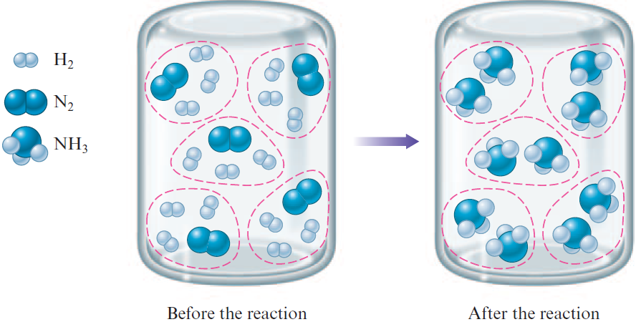
Stoichiometric Mixture
Contains relative amounts of reactants that match the numbers in the balanced equation

Slide 103
When Hydrogen is the Limiting Reactant

Slide 104
Limiting Reactants
To determine the amount of product that will be formed, ascertain the reactant that is limiting
Limiting reactant: Runs out first
Limits the amounts of products that can be formed
Some mixtures can be stoichiometric
All reactants run out at the same time
Requires determining which reactant is limiting

Slide 105
Determination of the Limiting Reactant Using Reactant Quantities
Compare the moles of reactants to ascertain which runs out first
Use moles of molecules instead of individual molecules
Method
Use the balanced equation to determine the limiting reactant

Slide 106
Determination of the Limiting Reactant Using Reactant Quantities (Continued)
Determine the amount of limiting reactant formed
Use the amount of limiting reactant formed to compute the quantity of the product
Alternative method
Compare the mole ratio of substances that are required by the balanced equation with the mole ratio of actual reactants present

Slide 107
Determination of Limiting Reactant Using Quantities of Products Formed
Use the amounts of products that can be formed by completely consuming each reactant
Reactant that produces the smallest amount of product must run out first
This is the limiting reactant

Slide 108
Interactive Example 3.17 - Stoichiometry: Limiting Reactant
Nitrogen gas can be prepared by passing gaseous ammonia over solid copper(II) oxide at high temperatures
The other products of the reaction are solid copper and water vapor
If a sample containing 18.1 g of NH₃ is reacted with 90.4 g of CuO, which is the limiting reactant?
How many grams of N₂ will be formed?

Slide 109
Interactive Example 3.17 - Solution
Where are we going?
To find the limiting reactant
To find the mass of N₂ produced
What do we know?
The chemical reaction
18.1 g NH₃ and 90.4 g CuO

Slide 110
Interactive Example 3.17 - Solution (Continued 1)
What information do we need?
Balanced equation for the reaction
Moles of NH₃
Moles of CuO
How do we get there?
To find the limiting reactant, determine the balanced equation

Slide 111
Interactive Example 3.17 - Solution (Continued 2)
What are the moles of NH₃ and CuO?
To find the moles, we need to know the molar masses
NH₃ 17.03 g/mol
CuO 79.55 g/mol

Slide 112
Interactive Example 3.17 - Solution (Continued 3)
First we will determine the limiting reactant by comparing the moles of reactants to see which one is consumed first
What is the mole ratio between NH₃ and CuO in the balanced equation?

Slide 113
Interactive Example 3.17 - Solution (Continued 4)
How many moles of CuO are required to react with 1.06 moles of NH₃?
Thus 1.59 moles of CuO are required to react with 1.06 moles of NH₃
Since only 1.14 moles of CuO are actually present, the amount of CuO is limiting; CuO will run out before NH₃ does

Slide 114
Interactive Example 3.17 - Solution (Continued 5)
We can verify this conclusion by comparing the mole ratio of CuO and NH₃ required by the balanced equation
With the mole ratio actually present
Since the actual ratio is too small (less than 1.5), CuO is the limiting reactant

Slide 115
Interactive Example 3.17 - Solution (Continued 6)
Alternatively we can determine the limiting reactant by computing the moles of N₂ that would be formed by complete consumption of NH₃ and CuO

Slide 116
Interactive Example 3.17 - Solution (Continued 7)
As before, we see that the CuO is limiting since it produces the smaller amount of N₂
To find the mass of N₂ produced, determine the moles of N₂ formed
Because CuO is the limiting reactant, we must use the amount of CuO to calculate the amount of N₂ formed

Slide 117
Interactive Example 3.17 - Solution (Continued 8)
What is the mole ratio between N₂ and CuO in the balanced equation?
What are the moles of N₂?

Slide 118
Interactive Example 3.17 - Solution (Continued 9)
What mass of N₂ is produced?
Using the molar mass of N₂ (28.02 g/mol), we can calculate the mass of N₂ produced

Slide 119
The Concept of Yield
Theoretical yield: Amount of product formed after the limiting reactant is entirely consumed
Amount of product predicted is rarely obtained due to side reactions and other complications
Percent yield: Actual yield of product

Slide 120
Interactive Example 3.18 - Calculating Percent Yield
Methanol (CH₃OH), also called methyl alcohol, is the simplest alcohol
It is used as a fuel in race cars and is a potential replacement for gasoline
Methanol can be manufactured by combining gaseous carbon monoxide and hydrogen

Slide 121
Interactive Example 3.18 - Calculating Percent Yield (Continued)
Suppose 68.5 kg CO(g) is reacted with 8.60 kg H₂(g)
Calculate the theoretical yield of methanol
If 3.57 × 10⁴ g CH₃OH is actually produced, what is the percent yield of methanol?

Slide 122
Interactive Example 3.18 - Solution
Where are we going?
To calculate the theoretical yield of methanol
To calculate the percent yield of methanol
What do we know?
The chemical reaction
68.5 kg CO(g) and 8.60 kg H₂ (g)
3.57×10⁴ g CH₃OH is produced

Slide 123
Interactive Example 3.18 - Solution (Continued 1)
What information do we need?
Balanced equation for the reaction
Moles of H₂
Moles of CO
Which reactant is limiting
Amount of CH₃OH produced

Slide 124
Interactive Example 3.18 - Solution (Continued 2)
How do we get there?
To find the limiting reactant, balance the chemical equation
What are the moles of H₂ and CO?
To find the moles, we need to know the molar masses
H₂ 2.016 g/mol
CO 28.02 g/mol

Slide 125
Interactive Example 3.18 - Solution (Continued 3)

Slide 126
Interactive Example 3.18 - Solution (Continued 4)
Determination of limiting reactant using reactant quantities
What is the mole ratio between H₂ and CO in the balanced equation?
How does the actual mole ratio compare to the stoichiometric ratio?

Slide 127
Interactive Example 3.18 - Solution (Continued 5)
To determine which reactant is limiting, we compare the mole ratio of H₂ and CO required by the balanced equation with the actual mole ratio
Since the actual mole ratio of H₂ to CO is smaller than the required ratio, H₂ is limiting

Slide 128
Interactive Example 3.18 - Solution (Continued 6)
Determination of limiting reactant using quantities of products formed
We can also determine the limiting reactant by calculating the amounts of CH₃OH formed by complete consumption of CO(g) and H2(g)

Slide 129
Interactive Example 3.18 - Solution (Continued 7)
Since complete consumption of the H₂ produces the smaller amount of CH₃OH, the H₂ is the limiting reactant as we determined above

Slide 130
Interactive Example 3.18 - Solution (Continued 8)
To calculate the theoretical yield of methanol
What are the moles of CH₃OH formed?
We must use the amount of H₂ and the mole ratio between H₂ and CH₃OH to determine the maximum amount of methanol that can be produced:

Slide 131
Interactive Example 3.18 - Solution (Continued 9)
What is the theoretical yield of CH₃OH in grams?
Thus, from the amount of reactants given, the maximum amount of CH₃OH that can be formed is 6.86 × 10⁴ g

Slide 132
Interactive Example 3.18 - Solution (Continued 10)
What is the percent yield of CH₃OH?

Slide 133
Problem-Solving Strategy
Solving a stoichiometry problem involving masses of reactants and products
Write and balance the equation for the reaction
Convert the known masses of substances to moles
Determine which reactant is limiting and its amount
Use this amount and the appropriate mole ratios to compute the number of moles of the desired product
Convert from moles to grams, using the molar mass

