Slide 1
Cardiovascular system

Slide 2
Function of the cardiovascular system
1. supplying the tissue and cells of the organism by the needed oxygen and nutrients 2. helping it to get rid of carbon dioxide and waste products of metabolism. 3. participating in protection of the body and wound healing . 4. regulation of body temperature , fluid - electrolytes balance , and acid -base balance

Slide 3
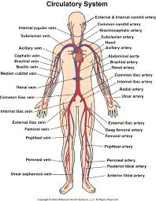

Slide 4
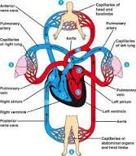

Slide 5
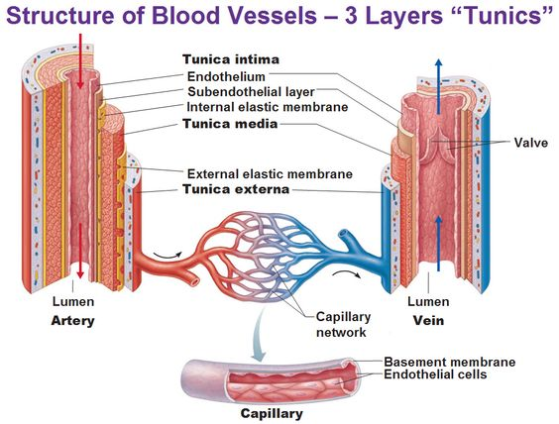

Slide 6
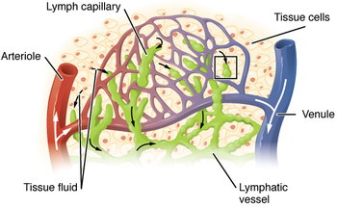

Slide 7
Major components
Cardiovascular system is composed of three major components , that form the circulation :
1- The heart : as a pumping organ of the system.
2- Blood vessels : as containers, through which the circulation occurs .
3- The blood : as transport medium of the circulation.

Slide 8
HEART
Heart is a hollow muscular organ , that is located in the middle mediastinum between the two bony structures of the sternum and the vertebral column . It has a shape of clenched fist , which weighs about 300 grams ( with mild variation between male and female ).
Heart has an apex that is anteriorly , inferiorly , and leftward oriented , and a base , that is posteriorly , superiorly and rightward oriented . In addition to its apex and base the heart has anterior , posterior and left surfaces

Slide 9
The wall of the heart is composed of three layers :
1. Endocardium : The innermost layer , which lines the heart chambers and is in direct contact with the blood . It is composed of endothelial cells that are similar to those , that line the blood vessels , and of connective tissue too. Endocardium has a smooth surface that prevents blood clotting
Endocarditis is the inflammation of the endocardium , which is resistant to antibiotic treatment and difficult to cure.

Slide 10
2. Myocardium : The middle layer of the cardiac wall . It is the thickest among the three layers , and is composed of two types of cardiac muscles a. contractile muscle cells (form about 98-99% of the cardiac muscle ) . b- non-contractile muscle cells ( form about 1-2 % of the cardiac muscles and are the cells that form excitatory-conductive system of the heart).
The cardiac muscle cells are similar to the skeletal muscles in that they are striated , but similar to the smooth muscles in being involuntary
3- Epicardium : is the outermost and protective layer of the heart . It is composed of connective tissue , and form the inner layer of the pericardium

Slide 11
pericardium:
The heart is surrounded by a fluid-fill sac , which is known as pericardium .
Pericardium is composed of two layers ( doubled layer membrane ) , between which a fluid-fill pericardial cavity exist .
The outer layer is called fibrous pericardium , while the inner layer is called serous pericardium, which is subdivided into parietal pericardium and visceral pericardium .
The visceral pericardium is the previously mentioned outermost layer of heart ( epicardium) .
Pericardial sac plays an important role in protection of heart from external hazards and infections , as it fixes the heart and limits its motion. It also prevents excessive dilation of the heart

Slide 12
When there is excessive fluid in the pericardial cavity as a result of pericardial effusion , a cardiac tamponade will develop .
cardiac tamponade means compression of the heart within the pericardial sac , which will prevent the relaxation of the heart ( heart will not be able to fully expand ) , and thus the circulating blood volume will be decreased (obstructive shock) . This is a life threatening situation which has to be urgently cured by pericardiocentesis
Pericardiocentesis is the aspiration of fluid from the pericardial space that surrounds the heart

Slide 13
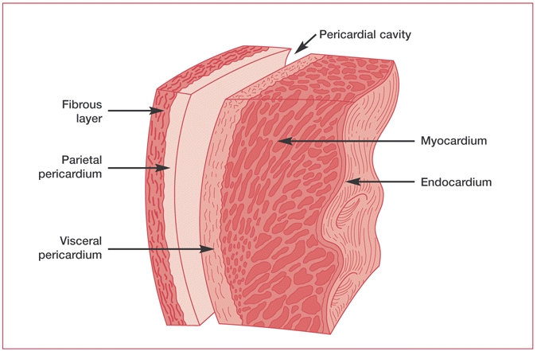

Slide 14
Chambers of the heart : Heart has four chambers : two atria and two ventricles .
The two right and left atria are separated from the two ventricles by the fibrous skeleton , which involves the right ( tricuspid ) and left ( bicuspid ) valves.
Right and left atria are separated from each other by the interatrial septum .
The two ventricles are separated by the interventricular septum. Interventricular septum is muscular in its lower thick part and fibrous in its upper thin part.
The two atria holds the blood returning from the veins and empty it only in a given right moment into the ventricles. Ventricles pump the blood into the arteries

Slide 15
Heart valves : There are four valves in the heart : Two atrioventricular valves and two semi-lunar valves: 1. Atrioventricular ( AV ) valves: These valves are found between the atria and ventricles , depending on the number of the leaflets , the right atrioventricular valve is also called tricuspid valve (has three leaflets ) , while the left one is called bicuspid valve (has two leaflets ) .
These valves prevent backward flow of blood from ventricles during the systole.
2. Semi-lunar valves : These valves are located on the base of the arteries ( aorta and pulmonary artery ) . They prevent the backward flow of blood from the arteries into ventricles

Slide 16
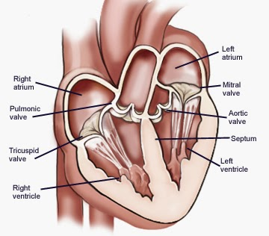

Slide 17
Cardiac muscle
Cardiac muscle is a striated muscle like the skeletal muscle , but it is different from the skeletal muscle in being involuntary.
Cardiac muscle has four properties , due to which the heart is able to fulfill its function as a pumping organ.
1.Rhythmicity
2- Excitability
3-Conductivity
4-Contractility

Slide 18
Cardiac muscle
1.Rhythmicity: means the ability of heart to beat regularly ( due to repetitive and stable depolarization and repolarization ) . Rhythmicity of heart is a myogenic in origin , because cardiac muscles are automatically excited muscles and does not depend on the nervous stimulus to initiate excitation and then contraction . The role of nerves is limited to the regulation of the heart rate and not to initiate the beat.

Slide 19
Evidence
* transplanted heart continues to beat regularly without any nerve supply. * Embryologically the heart starts to beat before reaching any nerves to them. * Some drugs that paralyze the nerves ( such as cocaine ) do not stop the heart in given doses.

Slide 20
Factors , affecting the rhythmicity of the cardiac muscle : I. Factors that increase the rate 1. sympathetic stimulation (neurotransmitter) 2. moderate warming : moderate warming increases temperature by 10 beats for each 1 Fahrenheit degree increase in body temperature. 3. Catecholaminic drugs 4. Thyroid hormones adrenaline and noreadrenaline . 5. mild hypoxia. 6. mild alkalemia 7. hypocalcemia. ( low calcium level in blood 8. mild hypokalemia ( low potassium level in blood)

Slide 21
II. Factors that decrease rhythmicity ( 1.Vagal stimulation : stimulation of vagus nerve 2. moderate cooling 3. severe warming : due to cardiac damage , as a result of intercellular protein denaturation. 4. Cholenergic drugs. 5. Digitalis : these drugs causes hyperpolarization . This effect is similar to that of vagal stimulation. 6. Hypercapnia ( excessive CO2 production ) 7. Acidemia. 8. hyper- and hyponatremia . 9. hyperkalemia 10. hypercalcemia 11. Typhoid or diphteria toxins.

Slide 22
Excitability: Excitability means the ability of cardiac muscle to respond to signals. Here we are talking about contractile muscle cells that are excited by the excitatory conductive system and generate an action potential.
Conductivity : Means ability of cardiac muscle to propagate electrical impulses through the entire heart ( from one part of the heart to another) by the excitatory -conductive system of the heart.

Slide 23
Contractility : Means ability of cardiac muscle to convert electrical energy of action potential into mechanical energy ( work). The excitation- contraction coupling of cardiac muscle is similar to that of skeletal muscle , except the lack of motor nerve stimulation.
There are many rules that control the contractility of the cardiac muscles, which are: 1. All or none rule: 2. Staircase phenomenon : means gradual increase in muscle contraction following rapidly repeated stimulation.. 3. Starling`s law of the heart: The greater the initial length of cardiac muscle fiber , the greater the force of contraction. The initial length is determined by the degree of diastolic filling .

Slide 24
Cardiac cycle
Cardiac cycle : The mechanical events , occurring in the heart within one beat ( from the beginning of a heart beat the next beat ).
Cardiac cycle involves five stages
The first two of five are responsible for filling the ventricles. During these two stages , the blood moves from the atria to fill the ventricles.
The other three stages are responsible for emptying the ventricles and ejecting blood into the arterial system.

Slide 25
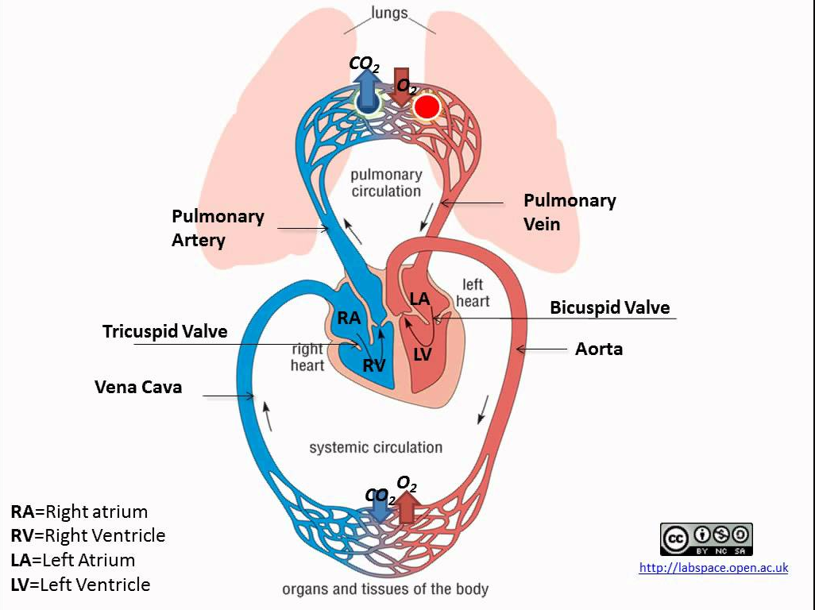

Slide 26
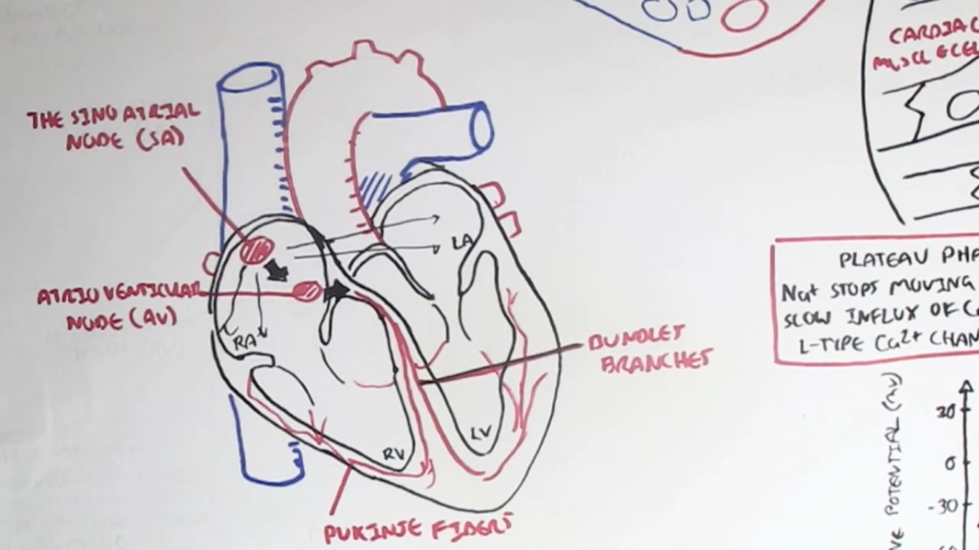
SA node start the action potential (70-80 beats / min)
AV node continue ( can generate action potential of SA node stop working ( 40-60 beats / min)
Bundle of His (20-40 beats/min)

Slide 27
1. Early diastole ( also called the atrial diastole , or complete heart diastole)
During this phase: * Atria are relaxed * Ventricles are relaxed * Semilunar valves are closed * Atrioventricular valves are open During this phase the blood moves passively from the venous system into the ventricles ( about 80 % of blood fills the ventricles during this phase

Slide 28
2. Atrial systole : During this phase : * Atria are contracting * Ventricles are relaxed * AV valves are open * Semilunar valves are closed * Atrial pressure increases. the A wave of atrial pressure appears here. * P wave of ECG starts here * Intraventricular pressure increases due to the rush of blood then decrease due to continuous relaxation of ventricles. The remaining 20% of blood is moved to fill the ventricles during this phase , due to atrial contraction

Slide 29
3. Isovolumetric contraction : During this phase : * Atria are relaxed * Ventricles are contracting * AV valves are closed * Semilunar valves are closed * First heart sound The ventricular fibers start to contract during this phase , and the intraventricular pressure increases. This result in closing the AV valves , but the pressure is not yet enough to open the semilunar valves , so the blood volume remain unchanged , and the muscle fibers length also remain unchanged , so we call this phase as isovolumetric contraction ( iso : the same , volu= volume , metric= length).

Slide 30
. Ejection phase : Blood is ejected from the ventricles into the aorta and pulmonary artery . During this phase : * Ventricles are contracting * Atria are relaxed * AV valves are closed * Semilunar valves are open * First heart sound * Intraventricular pressure is increased , due to continuous contraction * increased aortic pressure . * T wave starts.

Slide 31
5. Isovolumetric relaxation: This phase due to backflow of blood in aorta and pulmonary system after the ventricular contraction is up and the ventricles relax . This backflow closes the semilunar valves . During this phase : * Ventricles are relaxed * Atrial are relaxed * Semilunar valves are closed . * AV valves are closed. * Ventricular pressure fails rapidly * Atrial pressure increases due to continuous venous return. the v wave appears here. * Aortic pressure : initial sharp decrease due to sudden closure of the semilunar valve ( diacrotic notch) , followed by secondary rise in pressure , due to elastic recoil of the aorta ( diacrotic wave) . * T wave ends in this phase

Slide 32
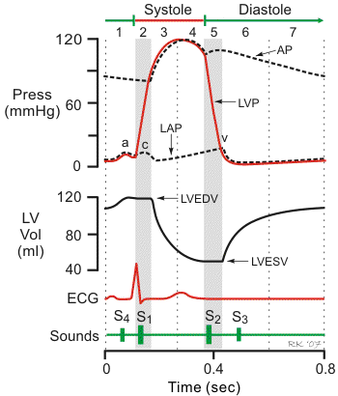

Slide 33
Heart sounds
Heart sounds are a result of beating heart and resultant blood flow . that could be detected by a stethoscope during auscultation . Auscultation is a part of physical examination that doctors have to practice them perfectly
Characteristic of heart sounds : 1. First heart sound (S1 , lub ) : a soft and low pitch sound, caused by closure of AV valves.Usually has two components ( M1( mitral ) and T1 ( tricuspid ). Normally M1 preceads T1. 2. Second heart sound ( S2 , dub) : sharp and high pitch sound . caused by closure of semilunar valves. It also has two components A2 ( aortic) and P2 ( pulmonary) . A2 preceads P2. 3. Third heart sound (S3) : low pitched sound. 4. Fourth heart sound ( S4) very low pitched sound.

Slide 34
Cardiac output
Cardiac output is the amount of blood , pumped by each ventricle within one minute of time. It is also called minute volume. Cardiac output has two determinants , which are : 1- Stroke volume : The amount of blood , pumped by the heart within one beat ( one cardiac cycle) . So the stroke volume equals the difference between end diastolic volume and end systolic volume. 2- Heart rate : The frequency of heart beating within one minute of time. So: Cardiac output ( CO ) = Stroke volume ( SV) X Heart rate ( HR).

Slide 35
Heart Diseases
Heart Failure : Heart failure is inability of the heart to pump the enough amount of blood needed to sustain the needs of organism . It is usually called congestive heart failure ( CHF) .
Myocardial infraction (heart attack) is the irreversible death (necrosis) of heart muscle secondary to prolonged lack of oxygen supply (ischemia).
Angina pectoris (stable angina) is the medical term for chest pain or discomfort due to coronary heart disease. It occurs when the heart muscle doesn't get as much blood as it needs. This usually happens because one or more of the heart's arteries is narrowed or blocked.

Slide 36
Arterial Blood pressure
Definitions
Arterial blood pressure is the lateral force exerted by moving column of blood on the wall of lateral arteries. It is necessary to keep the blood flowing , as it also provides enough hydrostatic pressure inside the capillaries to helps the exchange of nutrients and vital gases as well as to form the interstitial tissue , urine , ..etc
ABP reaches its maximum during the systole (systolic pressure ) and its minimum during the diastole (diastolic pressure ) .

Slide 37
Systolic blood pressure : Is a result of rapid ejection of blood into the aorta . It ranges between 90-140 mmHg . Two thirds of the ejected blood during the cardiac cycle distends the arteries and raise the pressure , while only one third leaves the arteries in blood flow.
The diastolic blood pressure is a result of recoiling of the stretched ( during systole) arterial walls ) this will keep the blood pressure high enough to drive the blood through the arterioles .. It ranges between 60-90- mmHg
Pluse pressure: is the difference between systolic and diastolic pressure

Slide 38
Blood pressure is directly proportional to cardiac output and total peripheral resistance .
BP= CO X TPR
CO: Cardiac output is determined by heart rate and stroke volume , so any factors , affecting one or both of them , will affect the arterial blood pressure
TPR: peripheral resistance is determined by many factors : * Diameter of blood vessels * Viscosity of blood. ( decreases in anemia or malnutrition) *length of blood vessels: It is constant in the human organism , so it would not involved in the determinants.

Slide 39
Physiologic Variations of blood pressure:
1. Age:.
In the newborn it is about 80/40 mmHg . At the age of 5 years it is about 100/60 mmHg . At the age of 20 years it is about 120/80 mmHg . By aging the ABP increases and at the age of 60 it is about 150/90 mmHg.
2- Gender: In female it is slightly lower under the age of 45 years.
3- Race : The BP of oriental people is lower than that of american and european due to different climate m stress of life and high cholestrole diet of western people.
4- Body built : ABP is higher in obese people.
5- Meals: After meals , there is a vasodilation in the splanchnic area , which will increase both the venous return and cardiac output , so it will increase the ABP especially the systolic .

Slide 40
7. Site of measurement :In recumbent position : the pressure in arteries of the lower limb is higher due to the larger diameter and because they constitute direct continuation of the aorta. ABP is slightly higher in the right arm in right-handed people .
8. Emotions : Due to increased sympathetic activity , strong emotions increase the ABP especially the systolic. 9. Exercise . 10 . Sleep: ABP is decreased during sleeping . In the stressful dreams it is increased. .

Slide 41
Regulation of ABP
Short term regulatory mechanism
Intermediate-term regulatory mechanisms
Long term regulatory mechanisms

Slide 42
Regulation of ABP
I. Short-term regulatory mechanisms
Occurs through different circulatory reflexes within few seconds after the change in arterial blood pressure and last for few minutes to hours then decline. These reflexes adjust the arterial blood pressure through adjustment of vasomotor center and cardiac inhibitory centers from the following receptors:
A- Baroreceptors
B- Peripheral Chemoreceptor
C- Atrial baroreceptors
D-. Ischemic response

Slide 43
I. Short-term regulatory mechanisms
1. Baroreceptors : They are found in carotid and aorta ( major blood vessels). They are normally stimulated by normal ABP .
When the pressure is increased , the response of the stimuli caused by these receptor is:
decrease in heart rate
vasodilation of the arterioles in skeletal muscles
venodilation ( cause decrease in venous return )
The final result of these responses is : decreasing cardiac output and decreasing of peripheral resistance , and thus decreasing of arterial pressure.

Slide 44
I. Short-term regulatory mechanisms
When the Blood pressure is decreased , opposite effects occur: Increased power of contractility
arteriolar vasoconstriction
Venoconstriction
secretion of catecholamines
The final result: increasing both : cardiac output and peripheral resistance , and thus increasing ABP. The baroreceptors have the following properties: * rapid response ( within seconds) , respond much more to rapid changes than to gradually developing changes of BP. * negative feed back mechanisms . * stimulated at pressure levels of 50 mmHg up to 180 mm Hg . * slowly adapting receptors.

Slide 45
I. Short-term regulatory mechanisms
2. The peripheral chemoreceptors
They are also located on the carotid and aorta .
The are sensitive to changes in blood gases especially the decrease pressure of O2.
When the BP drops below critical levels ( below 60 mm Hg ) they are stimulated and send nerve impulses to both respiratory center and vasomotor center in the medulla oblongata .
This will lead to vasoconstriction , increased heart rate , increased respiratory rate and increased catecholamine concentration . The net result: returning of ABP toward its normal level

Slide 46
I. Short-term regulatory mechanisms
Atrial baroreceptors (low-pressure receptors )
They are stretch receptors found in the wall of atria and pulmonary arteries .
They are stimulated in response to changes in blood volume .
When there is an increased blood volume in the atria , the atrial baroreceptors are stimulated and this leads to vasodilation to decrease the ABP .
Vasodilation of afferent arteriole in the kidney causes increase in glomerular filtration rate , and the loss of fluid by the kidney . Atrial baroreceptors also send impulses to the hypothalamus to decrease the secreation of ADH and thus decrease the reabsorption of water from the renal tubules and increase water loss by the kidney more and more. Opposite response occur when the blood volume is decreased

Slide 47
I. Short-term regulatory mechanisms
4. Ischemic response : This response acts only at a very low level of ABP starts at 60 mm Hg and reaches its highest degree of action at 20 mm Hg . Its mechanism of action occurs as follows: marked decrease in blood pressure , decreases the blood flow and causes cerebral ischemia .Local ischemia causes strong stimulation of vasomotor center and leads to vasoconstriction and tachycardia , and thus leads to increased ABP.

Slide 48
Regulation of ABP
II. Intermediate-term regulatory mechanisms: Start within few minutes and are effective for few hours to days . Most important are
Capillary fluid shift mechanism
Renin -angiotensin -aldosterone system
Atrial Natriuretic peptide
Stress- relaxation mechanism

Slide 49
I. Intermediate - term regulatory mechanisms
Capillary fluid shift mechanism:
Correct the changes of blood pressure by shifting of fluid between the blood plasma and interstitial fluid.
When there is an increase in blood volume , there is an increase in blood pressure which will increase the capillary pressure at the arterial end ( which leads to increase the rate of fluid filtration ) , in the same time it will increase the capillary pressure at the venous end and thus decrease the rate of the fluid reabsorption.
The net result : decrease the plasma volume and thus decrease the arterial blood pressure. When the blood volume is decreased , the opposite effect occurs : Decrease blood volume will lead to a decrease in blood pressure , and decrease pressure in the capillaries , and this will decrease rate of filtration at the arterial end , and increase the rate of reabsorption at the venous end , and thus increase the blood volume and ABP.

Slide 50
I. Intermediate -term regulatory mechanisms
2. Renin -angiotensin -aldosterone system : When the blood pressure is decreased , this will decrease the renal blood flow , and this will stimulate the juxtaglomerular apparatus in the kidney to release Renin ( a proteolytic enzyme). Renin in blood acts on a plasma globulin called Angiotensinogen (inactive protein ) and activates it to Angiotensin I . Angiotensin I is then activated by Angiotensin Converting Enzyme ( ACE) in the lungs by converting it to Angiotensin II. Angiotensin II has the following effects : * vasoconstriction ( this will increase the peripheral resistance and thus increase the arterial blood pressure ) . * Stimulates the release of Aldosterone from the renal cortex . Aldosterone acts on the distal renal tubule to enhance reabsorption of sodium .The water will follow sodium as a result of osmosis and thus the blood volume will be increased and thus the blood pressure. * Stimulates the ADH release and thus increase water reabsorption in kidney . This will lead to increase in blood volume.

Slide 51
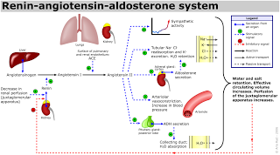
I. Intermediate -term regulatory mechanisms

Slide 52
I. Intermediate - term regulatory mechanisms
3. Atrial Natriuretic peptide : When arterial blood volume ( and respectively blood pressure) is increased , the bl0od will stretch the atrial wall . This will release ANP . * ANP acts on the kidney to increase excretion of sodium and water , which will decrease the blood volume and thus return blood pressure to normal. * ANP also promotes vasodilation, and thus decrease the peripheral resistance and return the blood pressure to normal. 4. Stress- relaxation mechanism:
When the pressure in blood vessels becomes too high the vessels become stretched and keeping on stretching more and more for minutes or hours , as a result the pressure in the vessels falls toward normal. On the other hand , when the pressure falls inside the vessels will decrease the tension in its wall , the wall then will recoil and gradually contracts.

Slide 53
Regulation of ABP
III. Long-term regulatory mechanisms
Slow mechanisms operate through the kidney. They start within hours and last fully active as long as required . They regulate ABP by adjusting body fluid volume, they act via:
1. Renal- body fluid system. 2- Accessory mechanisms

Slide 54
Hypertension
Pathologically increased arterial blood pressure is called hypertension , while pathologically decreased blood pressure is called hypotension. Hypertension is the pathologically increased blood pressure : It has two forms: 1. Primary (Essential) hypertension : The most common (90%) : Without known underlying cause , but probably due to atherosclerosis . 2. Secondary hypertension : due to underlying cause , which could be * a tumor like pheochromocytoma , a benign tumor in the chromaffin cells in the adrenal medulla that secrete epinephrin and causes malignant hypertension . * Endocrine conditions * Renal disease : such as renal artery stenosis. * Drugs and other factor

Slide 55
Atherosclerosis and Peripheral Artery Disease
Coronary arteries supply blood to heart muscle.
Peripheral arteries carry blood to other tissues and organs throughout the body.
Both can have deposits of fat, cholesterol, and other substances on their inside walls.
These deposits are known as plaque. Over time, plaque can build up, narrowing the vessel and making it hard for blood to flow.
Eventually, the artery will be so narrow that the body's tissues don't get enough blood. Depending on where it happens, leading to different symptoms and problems. For example:
Blockage in coronary arteries can cause chest pain (angina) or a heart attack.
If it's in the carotid arteries that supply your brain, it can lead to a stroke or mini stroke, which is called a transient ischemic attack or TIA.
Blockage in the kidneys can lead to trouble with how they work, uncontrolled high blood pressure, and heart failure.

Slide 56
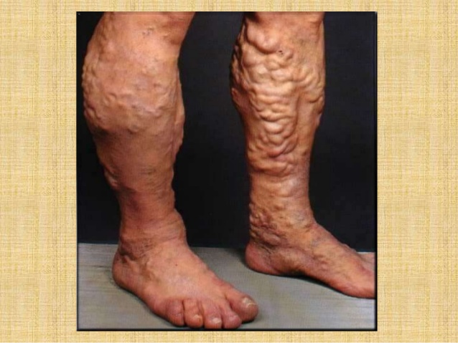
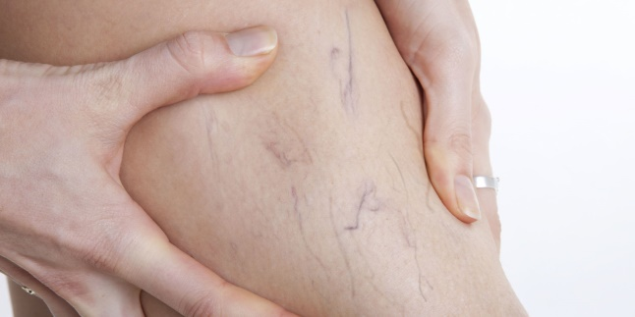
Varicose veins
Varicose veins are gnarled, enlarged veins.
Any vein may become varicose, but the veins most commonly affected are those in the legs and feet.
That's because standing and walking upright increases the pressure in the veins of the lower body.
For many people, varicose veins and spider veins — a common, mild variation of varicose veins — are simply a cosmetic concern.
For other people, varicose veins can cause aching pain and discomfort.
Sometimes varicose veins lead to more-serious problems.
Varicose veins may also signal a higher risk of other circulatory problems.
Treatment may involve self-care measures or procedures by doctor to close or remove veins

Slide 57
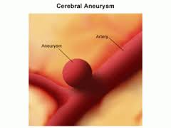
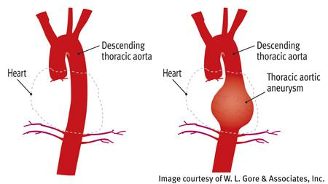
Aneurism
An aneurysm is an excessive localized enlargement of an artery caused by weakness in the arterial wall. Aneurysms may remain silent or rupture, causing serious problems and even death.

Slide 58
The etiology (causes) of aneurysms are not fully understood
A variety of arteries can be affected by aneurysms, including peripheral arteries.
The most significant aneurysms affect the arteries supplying the brain, and the aorta (the largest artery in the body, which originates in the heart).
If an aortic aneurysm ruptures, this causes internal bleeding; if a cerebral aneurysm ruptures, this causes bleeding in the brain.
Not all aneurysms need treatment - some can be monitored while risk factors are managed.
High-risk aortic aneurysms may warrant surgical treatment to prevent rupture, but the risks of brain surgery mean that most brain aneurysms are not treated surgically until absolutely necessary.
Many aneurysms are asymptomatic, but ruptured aneurysms do produce life-threatening bleeds that need emergency hospital care.
The risk of developing an aneurysm in the first place, and of an aneurysm rupturing is increased by smoking, excessive alcohol intake and drug abuse, especially cocaine use.
Aneurysms are more common in males and in older people, especially in people with high blood pressure and/or arteriosclerosis (hardening of the arteries).

Slide 59
Hemorrhoids
Hemorrhoids are swollen veins in the lower part of the anus and rectum. When the walls of these vessels are stretched, they become irritated.
Hemorrhoids are very common problem, can be unpleasant and painful, but they are easily treated and very preventable. As hemorrhoids generally get worse over time, they should be treated as soon as they appear.
They can be internal and external

Slide 60
Deep vein thrombosis (DVT)
occurs when a blood clot (thrombus) forms in one or more of the deep veins in the body, usually in the legs.
Deep vein thrombosis can cause leg pain or swelling, but may occur without any symptoms
Deep vein thrombosis can develop in certain medical conditions that affect the blood clotting.
Deep vein thrombosis can also happen if the patients don't move for a long time, such as after surgery, following an accident
Deep vein thrombosis is a serious condition because blood clots in the veins can break loose, travel through the bloodstream and lodge in the lungs, blocking blood flow (pulmonary embolism)

Slide 61
BLOOD
Blood components : Blood is composed of: Plasma and cellular components . 1. Plasma : forms about 55% of total volume of blood . It is composed of : a. water: about 97% of plasma is water , which form the intravascular component of the extracellular fluid . b. Plasma proteins : dissolved proteins that serve for different functions as follows : * Albumins : the most numerous plasma proteins that serve mainly for transport of hormones, drugs , and biologically active substances. * Globulins : that serve for immune functions * Fibrinogens : That serve for blood clotting and homeostasis. * Prothrombin : also serves for blood clotting and hemostasis All plasma proteins are produced in liver except one type of globulin ( gama globulin ) , which is produced in the plasma cells of lymphatic tissue.
Plasma proteins also have buffering function and regulatory effect on blood volume ( oncotic pressure). c. Organic materials : such as glucose , amino acids , and fat . d. Nonorganic materials such as ions e. others: hormones , blood gases and others.

Slide 62
BLOOD
Functions of Plasma : 1- Transport of hormones , vitamins , minerals , and drugs . Examples: albumin is a universal transporter , while other plasma proteins are specific for transport of some substances like transferrin ( transport of iron) , transcobalamine (transport of Vit. B12 ) , Apolipoprotein B ( transport of lipoproteins) . 2- Control of capillary permeability. 3- Contribution to acid-base- balance : Plasma proteins contribute to about 15% of the buffer activity of blood. 4- Contribution to regulation of arterial blood pressure , as follows: * Plasma proteins contribute to blood viscosity , which is important in production of peripheral resistance . * Plasma proteins exert oncotic pressure , which tends to pull water water into the blood ( at capillaty level) , which maintains the blood volume. 5- Blood coagulation : Most of clotting factors are plasma proteins. 6- Immune functions . 7- Contribution to gas transport : Plasma proteins participate in CO2 transport in blood.

Slide 63
BLOOD

Slide 64
BLOOD
Cellular components : Blood cells are subdivided into : 2.1 Red blood cells ( erythrocytes) : The most numerous ( form 98% of the blood cells) , that have the vital function of gas transport ( O2 and CO2) as well as participating in acid base balance. Erythrocytes have a life span of 120 days after they get destructed by hemolysis in the spleen .They are oval biconcave disk in shape , lack nucleus and many organelles . and full of hemoglobin ( Hb forms 34% of the erythrocyte`s weight) . Red blood cells have no mitochondria , they obtain energy via anaerobic glycolysis. The biconcave disk shape of erythrocytes produces large surface area , as it allows erythrocytes to be squeezed in small capillaries without rupture , due to enhanced cell flexibility. In addition to their vital function ( transport of blood gases) , erythrocytes contributes to acid-base balance via the hemoglobin.

Slide 65
BLOOD
White blood cells ( leukocytes) : The blood cells that protect the organism from the foreign invaders such as microorganism.They form 1-2% of blood cells volume . Depending on the presence of staining granules under the microscope , they are subdivided into : a. granular leukocytes : such as neutrophils (62% of leukocytes, fight bacteria and fungi ) , basophils (0.4% of leukocytes , produce and release histamine and heparine ) , and eosinophils (1-5 % of leukocytes , fight parasites and modulate allergic response ) . Neutrophils reach the site of infection , as follows : * Margination : sticking of neutrophils to capillary wall. * Diapedesis : neutrophils squeeze themselves through the capillaries to the tissue space . * Amoeboid movement . * Chemotaxis : Attraction of neutrophils by chemical substances , such as bactrial toxins , leukotriens , components of the immune compliment and breakdown products of the inflammed tissue.

Slide 66
BLOOD
* Phagocytosis : Ingestion of bacteria by the neutrophil . It occurs as follows: 1. The immune antibody adheres to the bacterial membrane . 2- The antibody combines with C3 molecules of the immune compliment , the the C3 molecules attach themselves to receptors on the phagocytes membrane . 3- The neutrophil then engulfs the bacteria by endocytosis, using pseudopods . 4- After being phagocytized , the bacteria can be killed either by lysosomal proteolytic enzymes of the neutrophils , or by bactericidal agents formed inside the neurrophils like free radicals and hypochlorate.

Slide 67
BLOOD
b. agranular leukocytes : such as lymphocytes (30% of white blood cells , subdivided into T and B lymphocytes who have important immune functions) , and monocytes (5.3% of white blood cells , migrate into tissues to become macrophages and Kupffer cells in the liver , they have immune function and have the largest life span -months to years ) . Platelets ( thrombocytes) : That serve for hemoostasis ( stopping of bleeding) as for source of growth factors. They are also anuclear cell fragments .their life span is 7-9 day

Slide 68
Blood cells formation ( Hematopoiesis)
All blood cells are derived from self-renewing hematopoetic stem cells m which reside in the bone marrow, after which they proliferate and differentiate in different mature blood cells . Hematopoiesis occur in different organs , depending on the stage of development. In developing embryo it occurs in the yolk sac, after the development progress it occurs in liver, spleen and lymph nodes. After birth and maturation of bone marrow , it occurs in the bone marrow of long bones ( humerus , femur, tibia, and fibula for example , while in adults it occurs in bone marrow of flat and short bones ( pelvis, sternum, vertebrates, and cranium for example). After the hematopoiesis stops occurring in bone marrow of long bone , the hematopoietic tissue is replaced by fat tissue and is then called yellow bone marrow instead of red bone marrow

Slide 69
Hematopoiesis needs growth factors to happen such as glycoprotein growth factors , which regulates the proliferation and maturation of blood cells entering the blood from the bone marrow. Colony-stimulating factors stimulate the production of comitted stem cells hematopoetin is a hormone that is produced by liver(20% ) and kidneys (80%) . It is necessary for formation of red blood cells. The mentioned growth factors start a signal transduction pathways , which alter the transcription factors , that activate genes that determine the differentiation of blood cells.

Slide 70
In case of renal failure the kidney would not be able to produce hematopoetin , so the liver increase its production rate three folds, this will temporarily compensate the lack of hematopoetin , so the signs and symptoms of anemia would not be immediately obvious . Later on the liver hematopoetin would not be enough to compensate the shortage of hematopoetin and the signs would appear.

Slide 71
Hematocrit
The percentage of red blood cells volume to the total blood volume is called hematocrit . It could be calculated dividing the red blood cells volume by total blood volume and multiplying by 100. The normal average is about 46% in male and 42% in female
An increase in hematocrit is called polycythemia , while a decrease in hematocrit is called anemia . Polycythemia could be physiological as in high altitude or pathological as in polycythemia vera ( a neoplastic disease that cause abnormal increase in red blood cells count). Hematocrit is also increased in dehydration and decreased in overhydration.

Slide 72
Hemostasis
We mean by hemostasis : prevention of blood loss after injury , causing a cut in blood vessels. The physiological response to cutting or rupturing of blood vessel includes: 1- Vasospasm : occurs as a result of nerve reflex and myogenic contraction. The nerve reflex usually is stimulated by pain sensation , while the intrinsic myogenic contraction is a result of direct damage. The more traumatized the vessel , the greater is the degree of the spasm. Vasospasm reduces the blood flow from the vessel rupture. 2- formation of platelet plug : results from adhering of platelets to the exposed subendothelial collagen fibers in the injured blood vessels(platelets adhesion ) . This binding initiates platelet activation , which then swell and become sticky and release granules containing ADP and Thromboxane A , which from their side activate the nearby platelets (platelets activation ) . This step will continue in a vicious circle (platelets aggregation ) until formation of platelet plug. Platelet plug is important in closing minute ruptures in the very small vessels of our organism that occurs many thousands of time daily.

Slide 73
3- formation of blood clot: this occur by biologically active substances released from the ruptured blood vessel , platelets , and blood proteins. The clot fill the entire hole of ruptured vessel or the broken end of vessel , within 3-6 minutes. 4- fibrosis of the blood clot to close the hole in the vessel .

Slide 74
Clot formation
The clot formation starts in 15-20 s. after injury if the trauma was severe , and in 1-2 minutes if the trauma was minor. The opening in the vessel or its broken end will be closed after 3-6 minutes. After being formed the clot retracts. * Mechanism of clot formation: A blood clotting to occur , clotting factors have to be activated. Clotting factors are mostly plasma proteins in an inactive state.

Slide 75
Clot formation
1. Extrinsic pathway : which begins with trauma in the vascular wall or extravascular tissue : A complex of tissue factors released from traumatized tissue activates factor VII . The later activates factor X . Factor X immediately complexes with platelets phospholipids in presence of calcium ions and factor V to form prothrombin activator . Prothrombine activator splits prothrombin to thrombin . Thrombin then acts on soluble fibrinogen to transform it into insoluble fibrin thread. 2. Intrinsic pathway : Which begins with trauma to the blood itself or contact of blood with water -wettable surface. This will lead to activation of factor XII and release of platelets phospholipids. Factor XII then activates factor XI , the activated factor XI activates factor IX , which will then activate factor VIII. The activated factors VIII , IX , and the platelets phospholipids will activate factor X. Factor X will combine with factor V , phospholipds and calcium ions to form prothronbine activator.

Slide 76
Clot formation
Fibrin threads form a meshwork , which is weak and breakable . But a factor called fibrin stabilising factor ( Factor III ) is released from the platelets . Factor XIII after being released will be activated by thronbin. It will add more and more bonds between the fibrin monomer molecules and form multiple cross-linkage between the fibrin threads. The strong meshwork entraps blood cells , platelets , and plasma . * Clot retraction : After being formed , the clot then contracts and squeezes most of its fluid ( the fluid is plasma protein- free and called serum ) . As the clot retracts it pulls the edges of of the broken blood vessels together . The clot will be then invaded by fibroblast which form connective tissue and the clot will completely be organized into fibrous tissue within 1-2 weeks.

Slide 77
Clinical Physiology: * Aspirin inhibits Thromboxane A2 and thus impair platelets aggregation . * Vitamin K is very important for liver formation of 5 of clotting factors incluiding Prothrombin , factor VII , factor IX , factor X. So : Vitamin K deficiency may causes serious bleeding tendencies. * Calcium ions are required for acceleration of most of the clot formation steps , so the blood removed from the body can be prevented from clotting by deionizing of calcium ions by addition of citrate , or by precipitating of calcium with oxalates .

Slide 78
Hemophilia, also called factor VIII deficiency or classic hemophilia, is a genetic disorder caused by missing or defective factor VIII, a clotting protein. Although it is passed down from parents to children, about 1/3 of cases are caused by a spontaneous mutation, a change in a gene
People with hemophilia A often, bleed longer than other people. Bleeds can occur internally, into joints and muscles, or externally, from minor cuts, dental procedures or trauma. How frequently a person bleeds and the severity of those bleeds depends on how much FVIII is in the plasma, the straw-colored fluid portion of blood.
Normal plasma levels of FVIII range from 50% to 150%. Levels below 50%, or half of what is needed to form a clot, determine a person’s symptoms.

Slide 79
Mild hemophilia A- 6% up to 49% of F VIII in the blood.
People with mild hemophilia generally experience bleeding only after serious injury, trauma or surgery. In many cases, mild hemophilia is not diagnosed until an injury, surgery or tooth extraction results in prolonged bleeding. The first episode may not occur until adulthood. Women with mild hemophilia often experience menorrhagia, heavy menstrual periods, and can hemorrhage after childbirth.
Moderate hemophilia A. 1% up to 5% of F VIII in the blood. People with moderate hemophilia A tend to have bleeding episodes after injuries. Bleeds that occur without obvious cause are called spontaneous bleeding episodes.
Severe hemophilia A. <1% of FVIII in the blood. People with severe hemophilia A experience bleeding following an injury and may have frequent spontaneous bleeding episodes, often into their joints and muscles.

Slide 80
The main medication to treat hemophilia is concentrated FVIII product, called clotting factor or simply factor. Recombinant factor products, which are are developed in a lab through the use of DNA technology, , preclude the use of human-derived pools of donor-sourced plasma. And while plasma-derived FVIII products are still available, approximately 75% of the hemophilia community takes a recombinant FVIII product
This factor therapies are infused intravenously through a vein in the arm or a port in the chest.

