Slide 1
Ocean Thermal Energy Conversion

Slide 2
Content
Introduction to OTEC
How OTEC Works
OTEC Plant Design & Location
OTEC Application
Benefit of OTEC
Potential and Market of OTEC

Slide 3
Introduction
Ocean Thermal Energy Conversion (OTEC) is a process which utilizes the heat energy stored in the tropical ocean.
OTEC utilizes the difference in temperature between warm surface seawater and cold deep seawater to produce electricity.
Because the oceans are continually heated by the sun and cover nearly 70% of the Earth's surface, this temperature difference contains a vast amount of solar energy which could potentially be tapped for human use.

Slide 4
Basic Principal
OTEC is Manifestation of solar energy
Top layers of ocean receive solar heating
Bottom layers receive water from polar regions
OTEC Uses the vertical temperature gradient in the ocean as a heat sink/source
OTEC system is based on the Rankine Cycle

Slide 5
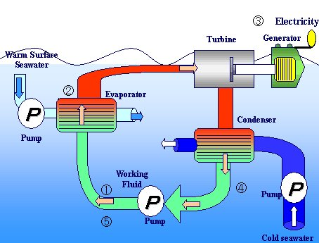
Main Component
Evaporators
Condensers
Turbines
Working fluid
Cold-water pipe

Slide 6
How OTEC Works
The warm surface ocean water is pumped to the evaporator, which transfers heat to the working fluid
Working fluid is turning into a high-pressure vapor.
The turbine generator spins as the vapor rushes through it.
In the low-pressure condenser, the vapor is cooled by the nearly freezing water brought up from the ocean depths.
After condensing, the working fluid is sent back to the boiler to be reused and to repeat the cycle.

Slide 7
Electricity production
3 basic OTEC system designs have been demonstrated to generate electricity:
Closed cycle
Open cycle
Hybrid Cycle

Slide 8
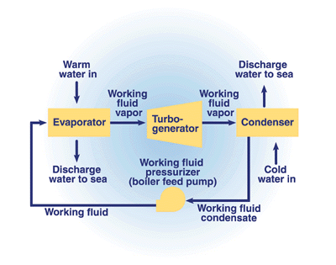
Closed Cycled
In the closed-cycle OTEC system, warm seawater vaporizes a working fluid, such as ammonia, flowing through a heat exchanger (evaporator).
The vapor expands at moderate pressures and turns a turbine coupled to a generator that produces electricity.
The vapor is then condensed in condenser using cold seawater pumped from the ocean's depths through a cold-water pipe.
The condensed working fluid is pumped back to the evaporator to repeat the cycle.
The working fluid remains in a closed system and circulates continuously

Slide 9
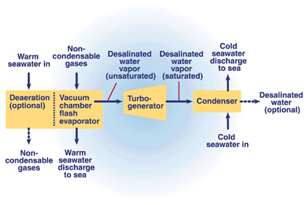
Open Cycle
In an open-cycle OTEC system, warm seawater is the working fluid.
The warm seawater is "flash"-evaporated in a vacuum chamber to produce steam at an absolute pressure of about 2.4 kilopascals (kPa).
The steam expands through a low-pressure turbine that is coupled to a generator to produce electricity.
The steam exiting the turbine is condensed by cold seawater pumped from the ocean's depths through a cold-water pipe.
If a surface condenser is used in the system, the condensed steam remains separated from the cold seawater and provides a supply of desalinated water.

Slide 10
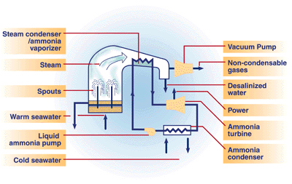
Hybrid Cycle
A hybrid cycle combines the features of both the closed-cycle and open-cycle systems.
In a hybrid OTEC system, warm seawater enters a vacuum chamber where it is flash-evaporated into steam, which is similar to the open-cycle evaporation process.
The steam vaporizes the working fluid of a closed-cycle loop on the other side of an ammonia vaporizer.
The vaporized fluid then drives a turbine that produces electricity.
The steam condenses within the heat exchanger and provides desalinated water.

Slide 11
OTEC Classification
Depending on the location
Land based plant
Shelf based plant
Floating plant
Submerged plant
Depending on the cycle used
Open cycle
Closed cycle
Hybrid cycle

Slide 12
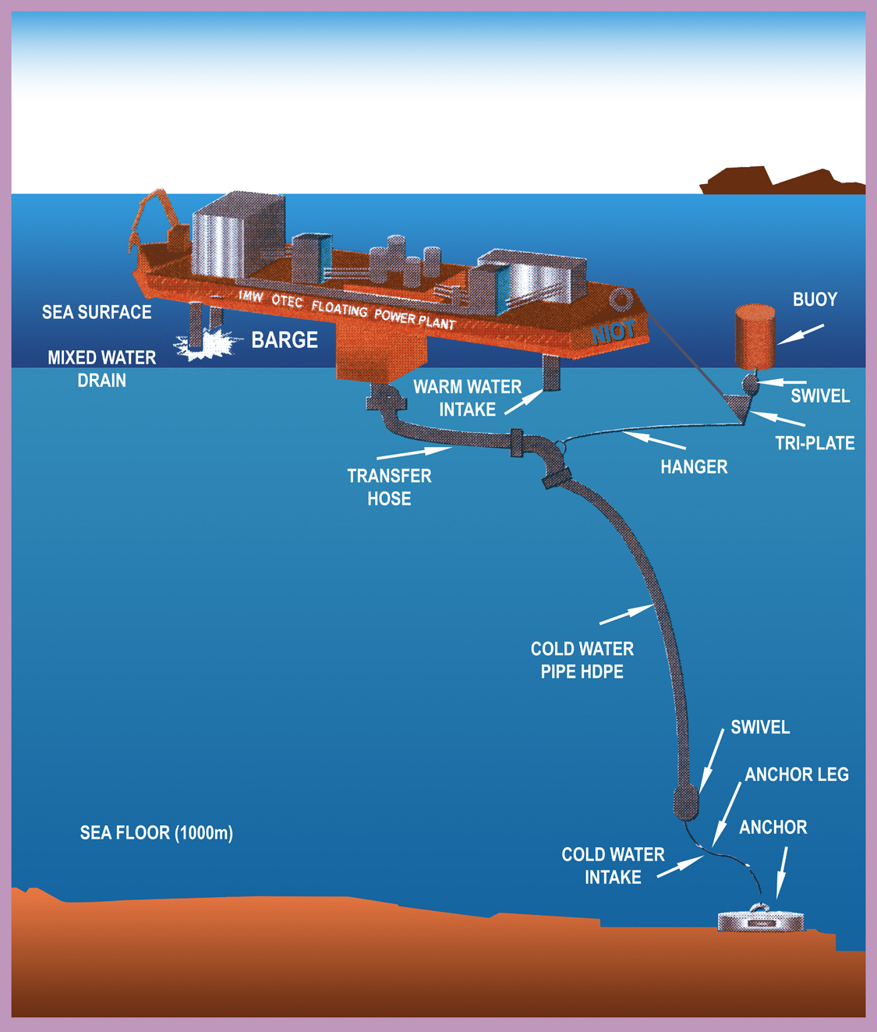

Slide 13
Site Consideration
Factors to be considered while choosing a site:
Thermal gradient in the ocean
Topography of the ocean floor
Meteorological conditions – hurricanes
Seismic activity
Availability of personnel to operate the plant
Infrastructure – airports, harbors, etc.
Local electricity and desalinated water demand.
Political, ecological constraints
Cost and availability of shoreline sites

Slide 14
OTEC Application
Ocean thermal energy conversion (OTEC) systems have many applications or uses.
OTEC can be used to :
generate electricity,
desalinate water,
support deep-water mariculture,
provide refrigeration and air-conditioning
mineral extraction.
These complementary products make OTEC systems attractive to industry and island communities even if the price of oil remains low
OTEC can also be used to produce methanol, ammonia, hydrogen, aluminum, chlorine, and other chemicals.

Slide 15
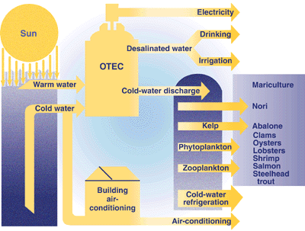
OTEC Application

Slide 16
Deep-Water-Supported Mariculture
Deep-drawn seawater from an OTEC plant is cold, rich in nutrients, relatively free of pathogens, and available in large quantity.
It is an excellent medium for growing phytoplankton and microalgae, which in turn support a variety of commercially valuable fish and shellfish.
The large, constant flow of water pumped from an OTEC plant will reduce disease and contamination in the ponds; marine life, therefore, can be grown in high densities.
In addition, deep-drawn cold water can be mixed with warm surface water, allowing local communities to culture a broad variety of species.

Slide 17
Desalinated Water
Desalinated water can be produced in open- or hybrid-cycle plants using surface condensers.
In a surface condenser, the spent steam is condensed by indirect contact with the cold seawater.
This condensate is relatively free of impurities and can be collected and sold to local communities where natural freshwater supplies for agriculture or drinking are limited.

Slide 18
Refrigeration and Air-Conditioning
The cold [5°C (41ºF)] seawater made available by an OTEC system creates an opportunity to provide large amounts of cooling to operations that are related to or close to the plant.
The cold seawater delivered to an OTEC plant can be used in chilled-water coils to provide air-conditioning for buildings.

Slide 19
Benefit of OTEC
No fuel burned , carbon di oxide emission - less than 1% of fossil fuel plant : has significant potential to provide clean, cost-effective electricity for the future
Nutrient rich cold water promotes mariculture
Produces desalinated water for industrial, agricultural, and residential uses.
Cold water for air conditioning
Fishing - Cold water, drawn from the depths, is nutrient-rich and can significantly increase fishing yields
Fresh water production (1 MW plant -> 4500 m³)

Slide 20
Disadvantage
An OTEC facility requires a substantial initial capital outlay
OTEC has not been demonstrated at full scale over a prolonged period with integrated power, mariculture, fresh-water, and chill-water production.
OTEC is only feasible at relatively isolated sites (deep tropical oceans); from such sites, the power and marine products must be transported to market.
OTEC is ecologically controversial--at least untested--in large scale and over a long period.

Slide 22
Market of OTEC
Ocean thermal energy conversion (OTEC) plants may be competitive :
In the small island with the relatively high cost of diesel-generated electricity and desalinated water
For floating, closed-cycle plants rated at 40 MWe or larger that house a factory or transmit electricity to shore via a submarine power cable.

Slide 23
Conclussion
OTEC uses the difference in temperature between warm surface seawater and cold deep seawater to produce electricity.
With Ocean cover 70% of earth’s surface that’s absorb sunlight, OTEC is a prospective alternative source of energy for human use.
Beside can be used to generate electricity, OTEC can also be used to desalinate water, support deep-water mariculture, provide refrigeration and air-conditioning and mineral extraction.
The capital cost of installation is still extremely high and at the present time the technology remains at the planning/feasibility study stage.

