Slide 1
An-Najah National University
Faculty of Medicine
Department of Physiology
Anatomy and Physiology 1
7102101
Instructor: Heba Salah
Chapter 1:
The human Body: An Orientation
Part 2: Organ System Overview

Slide 2
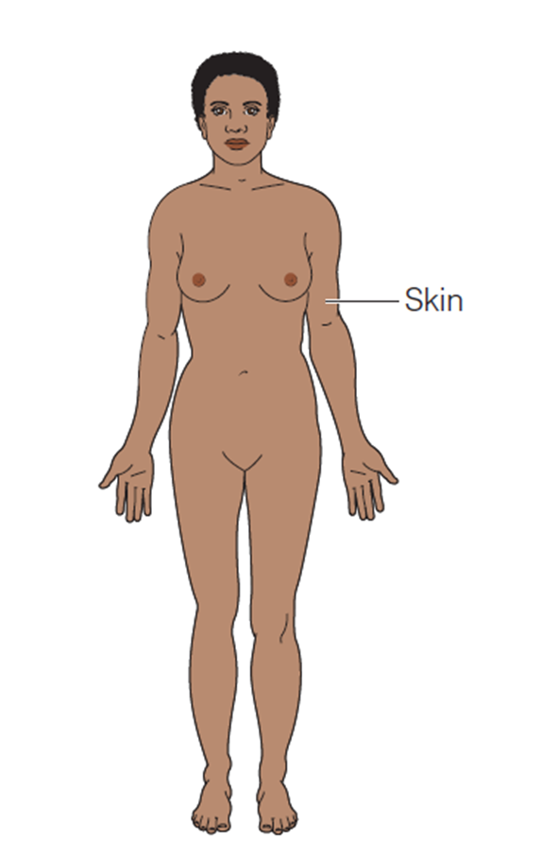
Organ System Overview
Integumentary System:
Forms the external body covering
Protects deeper tissue from injury and drying out
Synthesizes vitamin D
Location of cutaneous nerve receptors

Slide 3
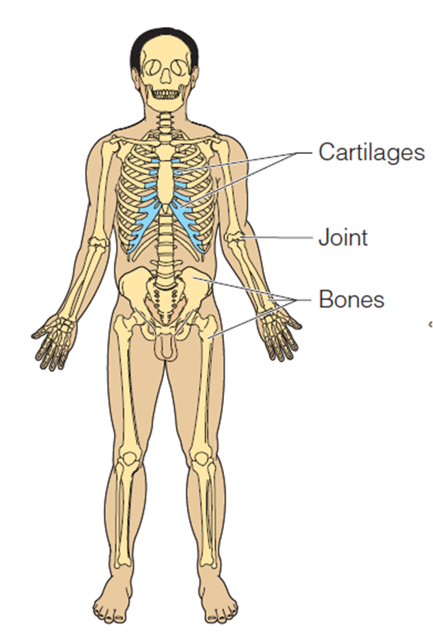
Organ System Overview
Skeletal System:
Protects and supports body organs
Provides muscle attachment for movement
Site of blood cell formation
Stores minerals

Slide 4
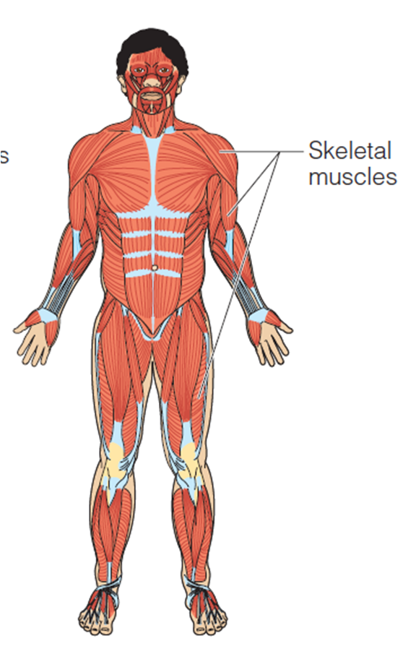
Organ System Overview
Muscular System:
Allows locomotion
Maintains posture
Produces heat

Slide 5
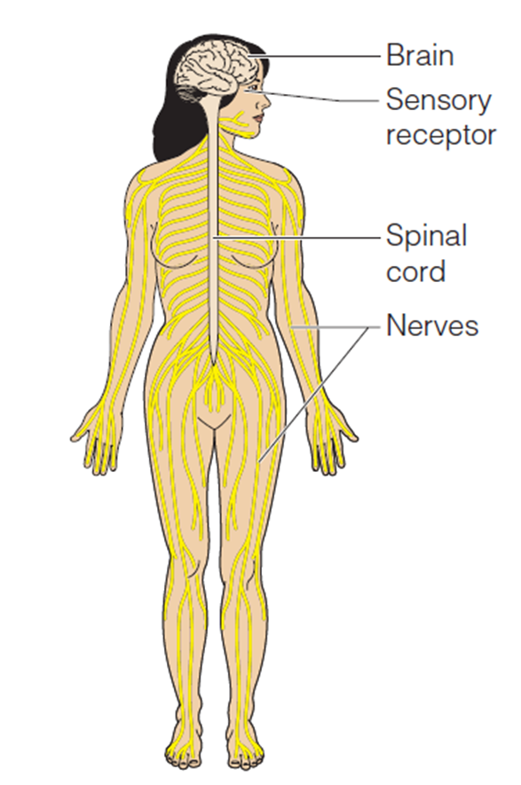
Organ System Overview
Nervous System:
Fast-acting control system
Responds to internal and external change
Activates muscles and glands

Slide 6
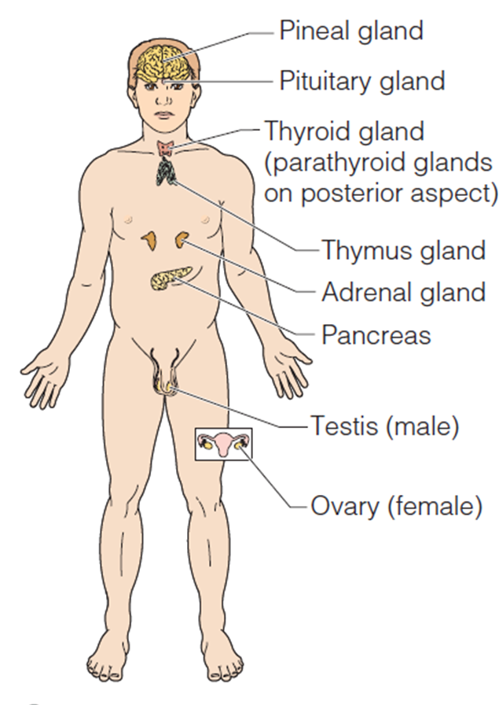
Organ System Overview
Endocrine System:
Secretes regulatory hormones
Growth
Reproduction
Metabolism

Slide 7
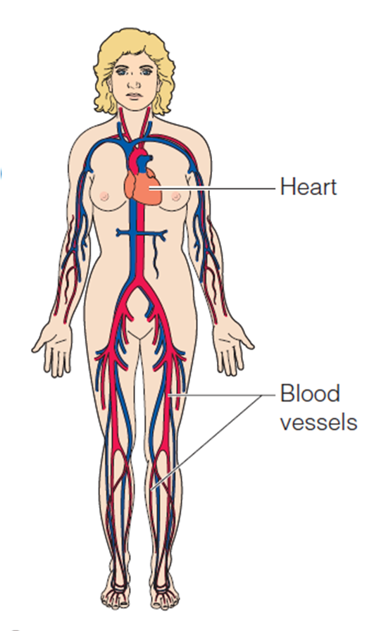
Organ System Overview
Cardiovascular System:
Transports materials in body via blood pumped by heart
Oxygen
Carbon dioxide
Nutrients
Wastes

Slide 8
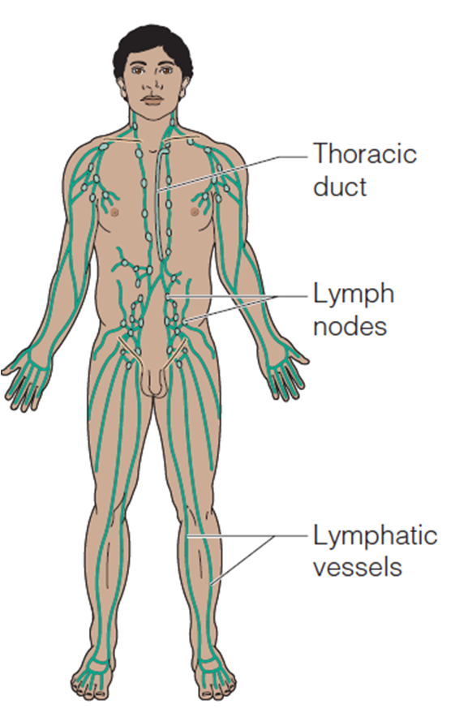
Organ System Overview
Lymphatic System:
Returns fluids to blood vessels
Disposes of debris
Involved in immunity- destroys bacteria and tumor cells

Slide 9
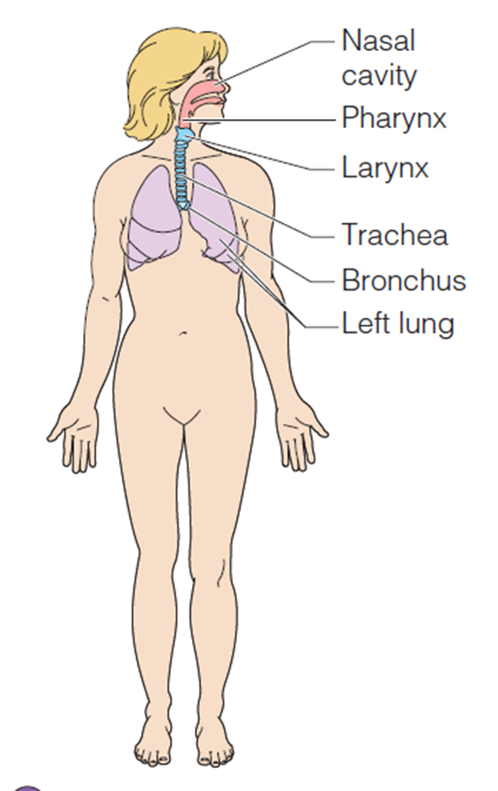
Organ System Overview
Respiratory System:
Keeps blood supplied with oxygen
Removes carbon dioxide

Slide 10
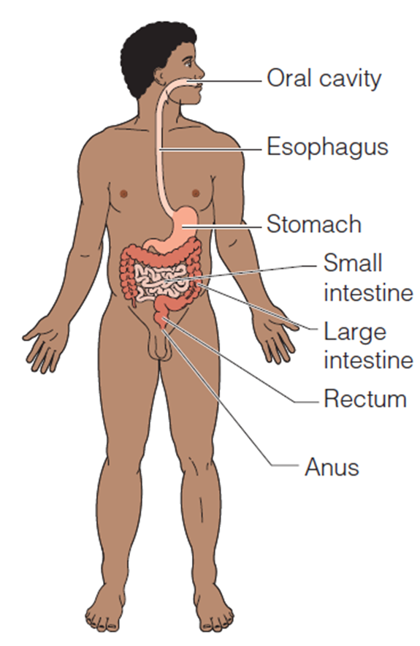
Organ System Overview
Digestive System:
Breaks down food
Allows for nutrient absorption into blood
Eliminates indigestible material

Slide 11
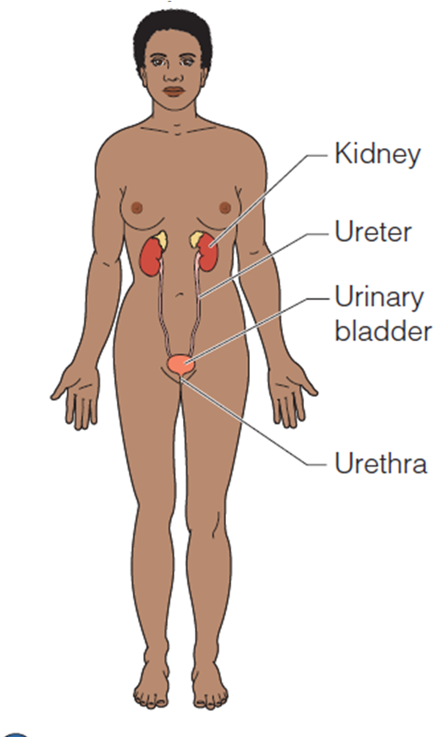
Organ System Overview
Urinary System:
Eliminates nitrogenous wastes
Maintains acid – base balance
Regulation of materials
Water
Electrolytes

Slide 12
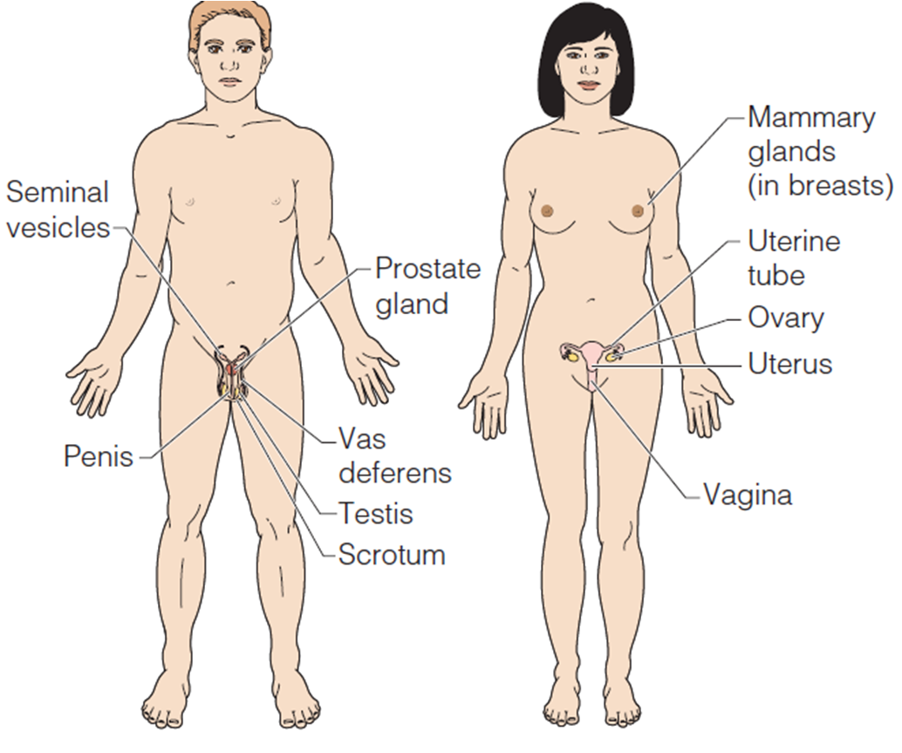
Organ System Overview
Reproductive System:
Production of offspring

