Slide 1
The Writing Process

Slide 2
The Writing Process
The writing process has 5 phases:
Brainstorming
Drafting
Revising
Editing
publishing
This characterization is a reasonable one; but like any linear, sequential model, the distinction between these phases is not always very clear. For example, you don’t know exactly when you have transitioned from brainstorming to drafting. You also might track back from one or more phases, and the cycle may be repeated in its entirety when a major revision occurs.

Slide 3
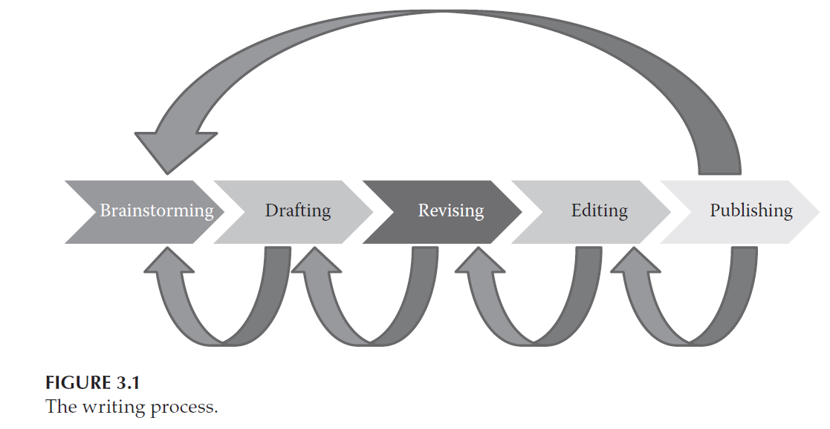
The Writing Process

Slide 4
1. Brainstorming
the process of recording your ideas on paper.
In creative writing, this process can be very free-form and can include any ideas, no matter how crazy they may seem.
In technical settings, this kind of brainstorming usually takes place in product research and development, often in project teams.
Start writing snippets of text and worry about organizing them later.
Sometimes you need to be creative, sometimes you are just collecting ideas.
During this phase, you should also consider who your audience will be—customer, management, vendor, government agency, a combination of these, or other.

Slide 5
1. Brainstorming
It can be done either in electronic form or paper, with various ideas, quotes, pointers to other resources, and so on.
Each point is something to be explained, explored, or expanded as the brainstorming continues

Slide 6
1. Brainstorming
Mind Maps
use mind maps to organize your ideas during brainstorming.
A mind map is a hierarchical representation of ideas showing the relationships from a central concept to various subconcepts and sub-subconcepts.
Mind maps (visual brainstorming) can help you identify gaps.

Slide 7
2. Drafting
Draft مسودة
begin writing full sentences, even paragraphs, around each of the topical headings that you created during brainstorming.
Then write the “connecting tissue” between these elements. You can rephrase and correct grammatical and spelling errors later (the spell-checker catches most spelling errors anyway).
rearrange sentences so that they make sense and provide “glue” or transitions between ideas that might not be obviously connected.
If things go well, you will produce something that resembles(يشبه) the final document (not final document).
If things do not go well, you may have to throw away much of the work and restart
The drafting phase is the stage where you have to just bear down, be fearless, and write, write, write.
When you think you have written enough so that your document is about 90% complete, you can start revising.

Slide 8
3. Revising
Once you have produced a complete-looking document, it is time to make the document “good” through revision.
For a fresh perspective, you can wait a few days between the time you have finished your first draft and the time you start your first revision.
Remember Pascal’s quote from Chapter 2 noting that writing a short letter takes more time than writing a longer one
You should also expect that a revised manuscript will be much shorter than an early draft.
See example page 52

Slide 9
3. Revising
It is important to have others review your work during the revising process
It is advised to have at least two people review technical writing: one who is familiar with the subject matter and one who is nontechnical but an excellent writer
The nontechnical person often finds logic errors that the technical reviewer does not
If you are going to ask others to review your writing, be prepared for criticism.
It is hard to know when to stop revising
“If I find that I am making revisions and then undoing those same revisions, then this usually signals that I should stop revising.” Laplante

Slide 10
4. Editing
Can be done by hiring a professional copyeditor (محرر)
During editing, the fine points of presentation, grammar, spelling, phrasing and formatting are perfected
The writing may also be made more precise through word substitution and reduction
The copyeditor will also identify any inconsistencies in logic and will check the references and citations. In short, the copyeditor will apply the 5 C’s.

Slide 11
4. Editing
Writing submitted to a scientific journal or magazine will also be subject to copyediting.
If you are not submitting your writing for formal publication, or there is not another person playing the role of copyeditor for you, then you must become your own copyeditor.
A copyeditor has to pay great attention to detail. If you are not such a person, seek help
Check your circle of friends: You are likely to encounter someone with a strong writing background or even professional editing experience!

Slide 12
5. Publishing
“Publish” is a legal term meaning to make the document available to the public
Publishing in the formal sense is discussed in Chapter 8. Informally, when you publish something, you are committing to a final version of the document and distributing it to some readership or placing it in an archive.
If you are a student, publishing is akin (close) to submitting your work to a professor.
In a professional setting, “publishing” means to deliver the document to some customer, manager, government, or peer.
For books and articles, “to publish” is to make the final version publicly available.

Slide 13
5. Publishing
Great delight accompanies reaching the final step of publishing
but there are dangers too.
Any errors or omissions that may have escaped your attention are now available for all to see.
If you committed plagiarism in any of the previous phases, whether accidentally or intentionally, you cannot easily undo the effects.
Once you publish something, any infraction (خرق، مخالفة) becomes part of a permanent record.

Slide 14
Environment
Some people can write in a chaotic setting with conversations
Some writers need silence
Each of us is differently affected by the environment around us.
You need to find the setting that works best for you and seek to create that environment.

Slide 15
Dealing with Writer’s Block
Every writer encounters blocks of time when they simply cannot write or they write sporadically
Every writer is different, and each uses different approaches to overcome “writer’s block.

Slide 16
Dealing with Writer’s Block
Suggestions to deal with writer’s block
Write a little every day, even if it is something not related to the project in hand
set a writing schedule: allocate time each day on your activity calendar for “writing” and honor that commitment
Alternate between writing and editing. If you already have some writing done for your current project, go back and edit that writing.
put aside the chapter or section that is giving you trouble, and focus your attention on another part of the work
Read something else: novels, poetry, science fiction, history ….etc.
identify any distractions that might hamper your writing and then remove those distractions (picture, photo…)
changing your writing environment can often help, if you usually write at home, try writing in the library or another public space, such as a coffee shop.
If you prefer writing in public, try writing at home

Slide 17
Meeting Deadlines
Even if you do not have a deadline, as when you are preparing a scholarly paper or a long-desired book, Having a deadline helps keep you on task and helps you prioritize your writing with respect to other commitments and activities.
Put “writing” periods into your schedule and stick to those commitments
When you are writing with others, a schedule becomes even more important

Slide 18
Writing Tools
There are many word-processing programs, text formatting tools, graphics preparation packages.
You can also use voice-to-text converting software to help you lay down a rough draft.

Slide 19
Permissions and Plagiarism Permissions
When a person writes something or creates a drawing or embodiment (تجسيد) of some idea, he or she is producing intellectual property (IP) (ملكية فكرية) .
Someone owns that IP, whether it is the author or artist, or their employer or customer for whom the work was done, or a third person or entity to which the IP has been sold.
When you use IP that you do not own, you must obtain permission to use that IP then cite it, or cite it without permission in case of fair use.
In some cases you may have to pay a fee for the permissions.
If you are unsure if you need to obtain permission to use some material, ask the owner for permission anyway.
Permissions can be requested in a number of ways. Many publishers provide permission request forms on their websites. Or you can create your own permission request in e-mail or letter form.

Slide 20
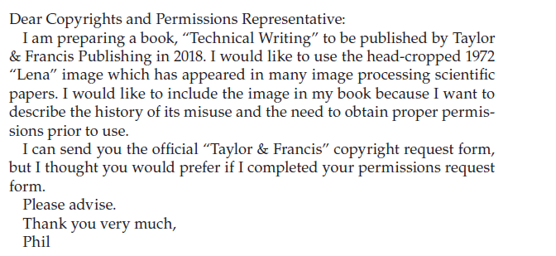

Slide 21
Permissions
When permission is granted, the publisher will indicate if a fee must be paid and if specific language must be included with the material used.
Permission is not granted until a confirming email or letter is received.
You do not always have to seek permission for using the ideas of other people if you are quoting or paraphrasing a small amount of that work (fair use) and you properly reference (cite) that work

Slide 22
Permissions
Here are some specific rules for citing and seeking permissions for published materials:
Using any verbatim text (نص حرفي بدون تغيير) from a source document must be cited and set out from other text via quotes, or different font type or indentation.
Using any idea from a copyrighted document, even if the wording is substantially changed, must be cited.
Using large portions of text (especially in commercial works (أعمال تجارية)) must be cleared by obtaining permissions from the author or publisher of the source work (whoever holds the copyright). “Large” is a relative number (to the size of the source document). It must also be cited after permission is granted.
Even in non-commercial works, if you exceed “fair use” you need to obtain permission, but the risk is higher in commercial works.
5. Figures and diagrams, if used unaltered from other sources, must be cited with permission
6. Figures and diagrams, if redrawn and altered from other sources, must be cited.
Violating any of these rules, even unintentionally, may be considered a copyright infringement or plagiarism. If you have any questions about proper citation, consult with your professor, editor, publisher, or employer.
You can ask publishers via email

Slide 23
Permissions & Fair use
Fair use is any copying of copyrighted material done for a limited purpose, such as to comment upon or criticize that material. Such uses can be done without permission from the copyright owner if the portion of text is not large (relative to the size of the source)
Fair use is relative, it can be 400-800 words (400 words in single-text extracts, or 800 words in a series of text extracts)
Fair use limits differ based on country, subject …..etc.
400 words from a short text is not a fair use
If you quote a text within fair use limits, cite it.
If you quote a text exceeding fair use limits, get permission + cite it.

Slide 24
Plagiarism (السرقة الأدبية)
There are many ways to steal ideas, both flagrant and subtle
The obvious ways include direct copying of text and ideas, or rewriting of text or figures taken from others without attribution (citation).
it is common practice to cut-and-paste from other sources into a draft document with the intention of quoting and citing this material, then forgetting to include the citations.
See example page 54
Being found guilty of plagiarism may expose you to various sanctions (عقوبات), ranging from criminal or civil prosecution to termination from a job, blacklisting from publishing in certain publications, or grade reduction and course failure, even expulsion from school.

Slide 25
Self-Plagiarism
When publishing your work, you may have to transfer the IP (i.e., the copyright) to a publisher, then in order to reuse this material, you may need to obtain proper permissions from the publisher
In some cases, the publishing agreement will allow you to reuse your own material in any way you choose; however, you must still follow the rules for quoting and citation
When working with co-authors, and you want to reuse material from that work in another work, ask for permission or make citation (or both, based on fair use).
Note: Even if you use your own previous work and you have the IP, it is better to reference it

Slide 26
Citation Rules:
Use quotes “ “ if it is verbatim
Use offset (different font/italic font) if the quote is very long
In both cases, put the reference (citation)

Slide 27
Detection Tools Papers Generators

Slide 28
Read the following articles on fair use and plagiarism
https://praeclaruspress.com/write-now/do-i-need-permission-to-cite-that/
https://www.janefriedman.com/permissions-and-fair-use/

