Slide 1
An-Najah National University
Faculty of Medicine
Department of Physiology
Anatomy and Physiology 1
7102101
Instructor: Heba Salah
Chapter 5:
The Nervous System
Part 4: Central Nervous System: Cerebral Hemisphere

Slide 2
Central Nervous System (CNS)
CNS develops from the embryonic neural tube:
The neural tube becomes the brain and spinal cord
The opening of the neural tube becomes the ventricles

Slide 3
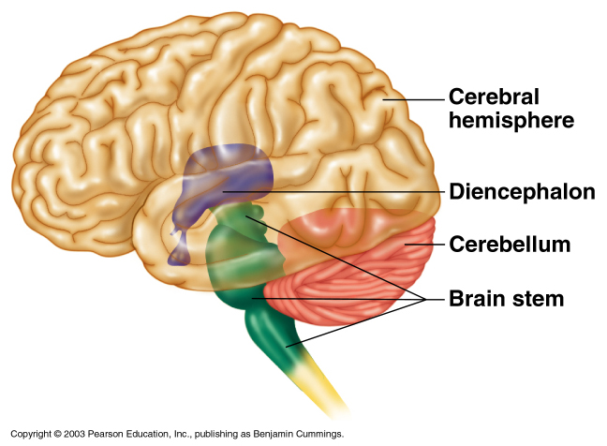
Regions of the Brain
Cerebral hemispheres
Diencephalon
Brain stem
Cerebellum

Slide 4
Cerebral Hemispheres (Cerebrum)
Lobes of the cerebrum
Layers of the cerebrum

Slide 5
Functional Area of the Cerebral Hemispheres

Slide 6
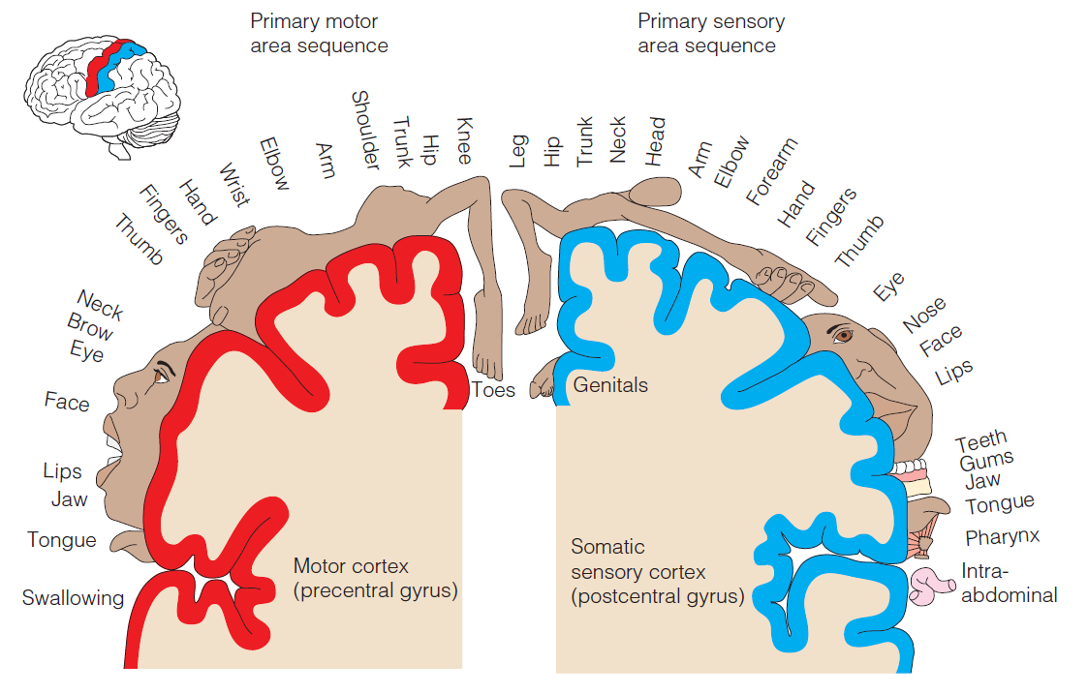
Sensory and Motor Area of the Cerebral Cortex

