Slide 1
Chapter 12
Return, Risk, and the Security Market Line
© McGraw Hill LLC. All rights reserved. No reproduction or distribution without the prior written consent of McGraw Hill LLC.

Slide 2
Return, Risk, and the Security Market Line 1
“To win, you have to risk loss.”
–Franz Klammer

Slide 3
Learning Objectives
Studying some topics will yield an expected reward. For example, make sure you know:
The difference between expected and unexpected returns.
The difference between systematic risk and unsystematic risk.
The security market line and the capital asset pricing model.
The importance of beta.

Slide 4
Return, Risk, and the Security Market Line 2
In this chapter, we first define risk more precisely and discuss how to measure risk.
Then, we quantify the relation between risk and return in financial markets.
We find two types of risk: systematic and unsystematic.
This distinction is crucial, as you will see.

Slide 5
Expected and Unexpected Returns
The return on any stock traded in a financial market is composed of two parts:
The normal, or expected, part of the return is the return that investors predict or expect.
The uncertain, or risky, part of the return comes from unexpected information revealed during the year.
Total Return = Expected Return + Unexpected Return
Unexpected Return = Total Return − Expected Return
U = R − E(R)

Slide 6
Announcements and News
Firms make periodic announcements about events that may significantly impact the profits of the firm.
Earnings.
New Products.
Personnel.
The impact of an announcement depends on how much of the announcement represents new information.
When the situation is not as bad as previously thought, what seems to be bad news is actually good news.
When the situation is not as good as previously thought, what seems to be good news is actually bad news.
News about the future is what really matters.
Market participants put predictions into the expected part of the stock return.
Announcement = Expected News + Surprise News.

Slide 7
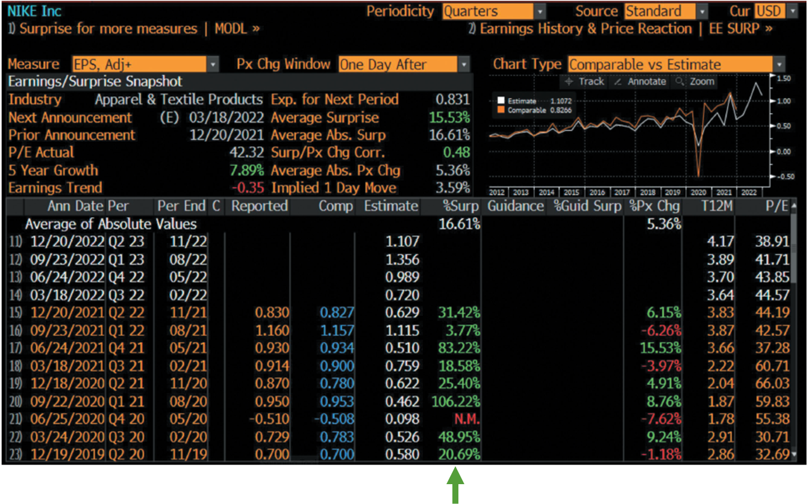
Earnings Surprises Source: Bloomberg
Access the text alternative for slide images.

Slide 8
Systematic and Unsystematic Risk
Systematic risk is risk that influences a large number of assets. Also called market risk.
Unsystematic risk is risk that influences a single company or a small group of companies. Also called unique risk or firm-specific risk.
Total risk = Systematic risk + Unsystematic risk

Slide 9
Systematic and Unsystematic Components of Return
Recall:
= Systematic portion + Unsystematic portion
So,
The surprise, U, has two parts: one that relates to the
market, m, and one that relates only to the security,

Slide 10
Diversification and Risk
In a large portfolio:
Some stocks will go up in value because of positive company-specific events, while.
Others will go down in value because of negative company-specific events.
Unsystematic risk is essentially eliminated by diversification, so a portfolio with many assets generally has almost no unsystematic risk.
Unsystematic risk is also called diversifiable risk.
Systematic risk is also called non-diversifiable risk.

Slide 11
The Systematic Risk Principle
What determines the size of the risk premium on a risky asset?
The systematic risk principle states:
The expected return on an asset depends only on its systematic risk.
No matter how much total risk an asset has, only the systematic portion is relevant in determining the expected return (and risk premium) on that asset.

Slide 12
Measuring Systematic Risk
To be compensated for risk, the risk has to be special.
Unsystematic risk is not special.
Systematic risk is special.
The Beta coefficient
measures the relative systematic risk of
an asset.
Assets with Betas larger than 1.0 have more systematic risk than average.
Assets with Betas smaller than 1.0 have less systematic risk than average.
Because assets with larger betas have greater systematic risks, they will have greater expected returns.
Note that not all Betas are created equally.

Slide 13
Published Beta Coefficients
Table 12.1 Beta Coefficients
Beta.
Company | MarketWatch | Yahoo!
ExxonMobil | 1.03 | 1.35
IBM | .94 | 1.10
Starbucks | 1.01 | .82
Walmart | .53 | .52
Microsoft | 1.19 | .87
Harley-Davidson | 1.31 | 1.47
Tesla | 1.38 | 2.04
Southwest Airlines | 1.05 | 1.12
Nike | .97 | .94
Source: finance.yahoo.com and www.marketwatch.com. Accessed January 2022.

Slide 14
Finding a Beta on finance.yahoo.com: Southwest Airlines (L U V)
Beta (5Y Monthly) | 1.12
52-Week Change | −7.06%
S&P500 52-Week Change | 23.58%
52 Week High | 64.75
52 Week Low | 38.66
50-Day Moving Average | 45.23
200-Day Moving Average | 52.54
The reported Beta for Southwest Airlines is 1.12, which means that Southwest Airlines has about 1.12 times the systematic risk of a typical stock. So, with respect to Beta, Southwest Airlines is above average.

Slide 15
Portfolio Betas
The total risk of a portfolio has no simple relation to the total risk of the assets in the portfolio.
Recall the variance of a portfolio equation.
For two assets, you need two variances and the covariance.
For four assets, you need four variances and six covariances.
In contrast, a portfolio Beta can be calculated just like the expected return of a portfolio.
That is, you can multiply each asset’s Beta by its portfolio weight and then add the results to get the portfolio’s Beta.

Slide 16
Example: Calculating a Portfolio Beta
Using MarketWatch data from Table 12.1:
Beta for Starbucks (S B U X) is 1.01
Beta for Nike (N K E) is .97
You put half your money into S B U X and half into N K E.
What is your portfolio Beta?

Slide 17
Beta and the Risk Premium 1
Consider a portfolio made up of asset A and a risk-free asset.
For asset A,
The risk-free rate
For a risk-free asset,
by definition.
Suppose an investor places 25% in the risky asset and 75% in the riskless asset.
We can calculate other possible portfolio expected returns and betas by changing the percentages invested in these two assets.
Note: If an investor borrows at the risk-free rate and invests the proceeds in asset A, the investment in asset A exceeds 100%.

Slide 18
Beta and the Risk Premium 2
Percentage of Portfolio in Asset A | Portfolio Expected Return | Portfolio Beta
0% | 4% | .0
25 | 7 | 4
50 | 10 | .8
75 | 13 | 1.2
100 | 16 | 1.6
125 | 19 | 2.0
150 | 22 | 2.4

Slide 19
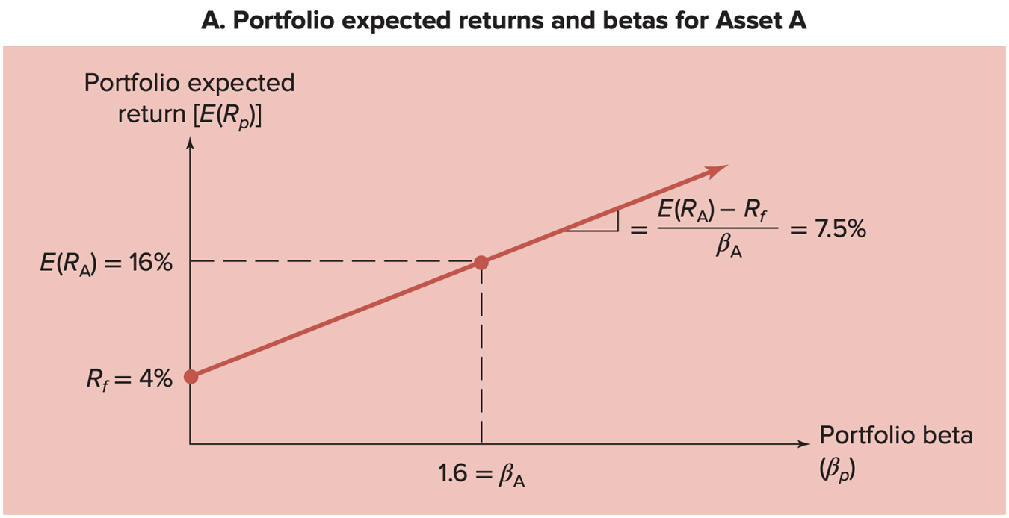
Portfolio Expected Returns and Betas for Asset A
A. Portfolio expected returns and beats for Asset A
Access the text alternative for slide images.

Slide 20
The Reward-to-Risk Ratio
Notice that all the combinations of portfolio expected returns and betas fall on a straight line.
commonly written as:
What this calculation tells us is that asset A offers a reward-to-risk ratio of 7.50%. In other words, asset A has a risk premium of 7.50% per “unit” of systematic risk.

Slide 21
The Basic Argument 1
Recall that for asset A:
Suppose there is a second asset, asset B.
For asset B:
Which investment is better, asset A or asset B?
Asset A has a higher expected return.
Asset B has a lower systematic risk measure.

Slide 22
The Basic Argument 2
As before with Asset A, we can calculate some different possible portfolio expected returns and betas by changing the percentages invested in asset B and the risk-free rate.
Percentage of Portfolio in Asset B | Portfolio Expected Return | Portfolio Beta
0% | 4% | .0
25 | 6 | 3
50 | 8 | .6
75 | 10 | 9
100 | 12 | 1.2
125 | 14 | 1.5
150 | 16 | 1.8

Slide 23
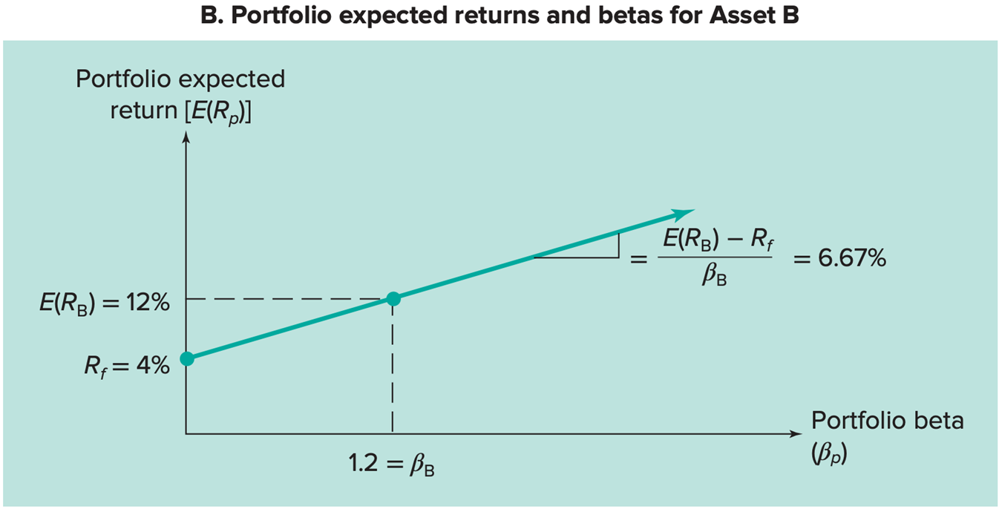
Portfolio Expected Returns and Betas for Asset B
B. Portfolio expected returns and beta for Asset B
Access the text alternative for slide images.

Slide 24
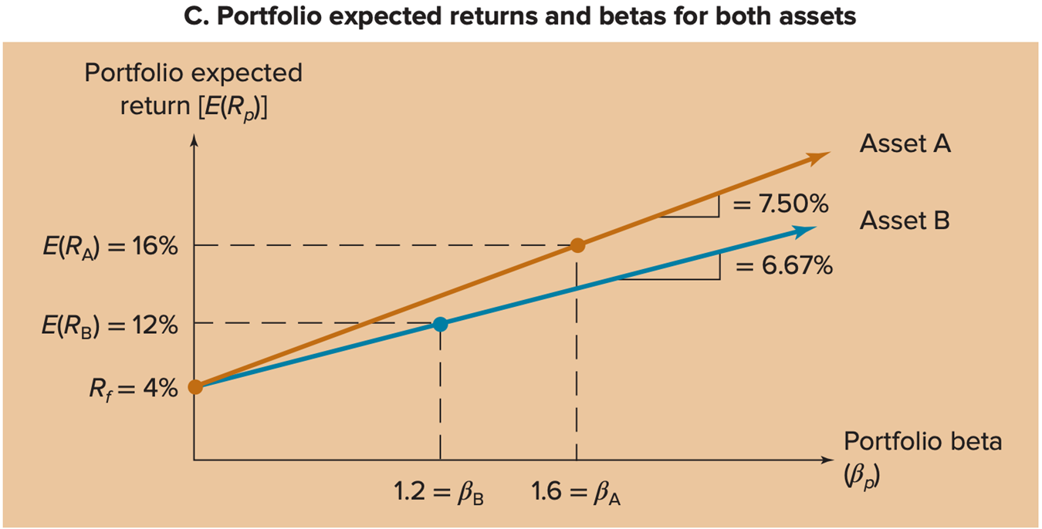
Portfolio Expected Returns and Betas for Both Assets
C. Portfolio expected returns and betas for assets
Access the text alternative for slide images.

Slide 25
The Fundamental Result 1
The situation we have described for assets A and B cannot persist in a well-organized, active market.
Investors will be attracted to asset A (and buy A shares).
Investors will shy away from asset B (and sell B shares).
This buying and selling will make:
The price of A shares increase.
The price of B shares decrease.
This price adjustment continues until the two assets plot on exactly the same line.
That is, until:

Slide 26
The Fundamental Result 2
In general . . .
The reward-to-risk ratio must be the same for all assets in a competitive financial market.
If one asset has twice as much systematic risk as another asset, its risk premium will simply be twice as large.
Because the reward-to-risk ratio must be the same, all assets in the market must plot on the same line.

Slide 27
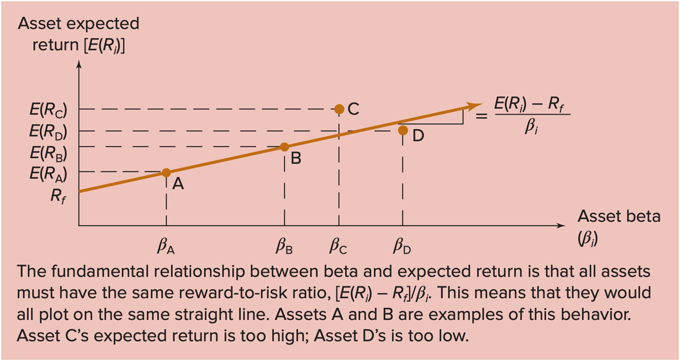
The Fundamental Result 3
Access the text alternative for slide images.

Slide 28
The Security Market Line (S M L)
The Security market line (S M L) is a graphical representation of the linear relationship between systematic risk and expected return in financial markets.
For a market portfolio,
(because the market beta equals 1.)

Slide 29
The Security Market Line 2
is often called the market risk premium
because it is the risk premium on a market portfolio.
For any asset i in the market:
Setting the reward-to-risk ratio for all assets equal to the market risk premium results in the equation for the Capital Asset Pricing Model.

Slide 30
The Security Market Line 3
The Capital Asset Pricing Model (C A P M) is a theory of risk and return for securities in a competitive capital market.
The C A P M shows that
depends on:
the pure time value of money.
the reward for bearing systematic risk.
the amount of systematic risk.

Slide 31
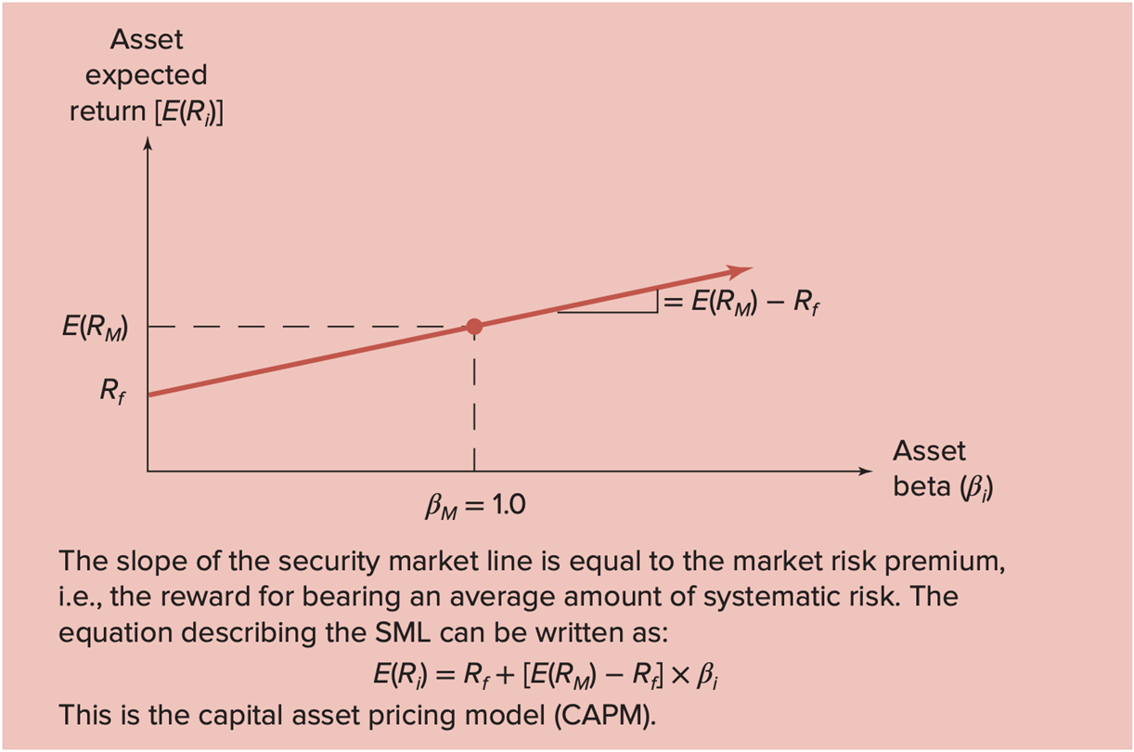
The Security Market Line 4
Access the text alternative for slide images.

Slide 32
Risk and Return Summary 1
Total risk. The total risk of an investment is measured by the variance or, more commonly, the standard deviation of its return.
Total return. The total return on an investment has two components: the expected return and the unexpected return. The unexpected return comes about because of unanticipated events. The risk from investing stems from the possibility of an unanticipated event.
Systematic and unsystematic risks. Systematic risks (also called market risks) are unanticipated events that affect almost all assets to some degree because the effects are economywide. Unsystematic risks are unanticipated events that affect single assets or small groups of assets. Unsystematic risks are also called unique or asset-specific risks.
The effect of diversification. Some, but not all, of the risk associated with a risky investment can be eliminated by diversification. The reason is that unsystematic risks, which are unique to individual assets, tend to wash out in a large portfolio, but systematic risks, which affect all of the assets in a portfolio to some extent, do not.

Slide 33
Risk and Return Summary 2
The systematic risk principle and beta. Because unsystematic risk can be freely eliminated by diversification, the systematic risk principle states that the reward for bearing risk depends only on the level of systematic risk. The level of systematic risk in a particular asset, relative to the average, is given by the beta of that asset.
The reward-to-risk ratio and security market line. The reward-to-risk for
Asset i is the ratio of its risk premium,
In a well-functioning market, this ratio is the same for every asset. As a result, when asset expected returns are plotted against asset betas, all assets plot on the same straight line, called the security market line (S M L).
The capital asset pricing model. From the S M L, the expected return on Asset i can be written:

Slide 34
Risk and Return Summary 3
This is the capital asset pricing model (C A P M). The expected return on a risky asset thus has three components: The first is the pure time value of
money
The second is the market risk premium,
and the third is the beta for the asset

Slide 35
A Closer Look at Beta
where m is the systematic portion of the unexpected
return.
So,
In other words:
A high-Beta security is simply one that is relatively sensitive to overall market movements
A low-Beta security is one that is relatively insensitive to overall market movements.

Slide 36
Decomposition of Total Returns
Table 12.3 Decomposing Total Returns
Actual Returns
Unexpected Returns
Systematic Portion
Unsystematic Portion

Slide 37
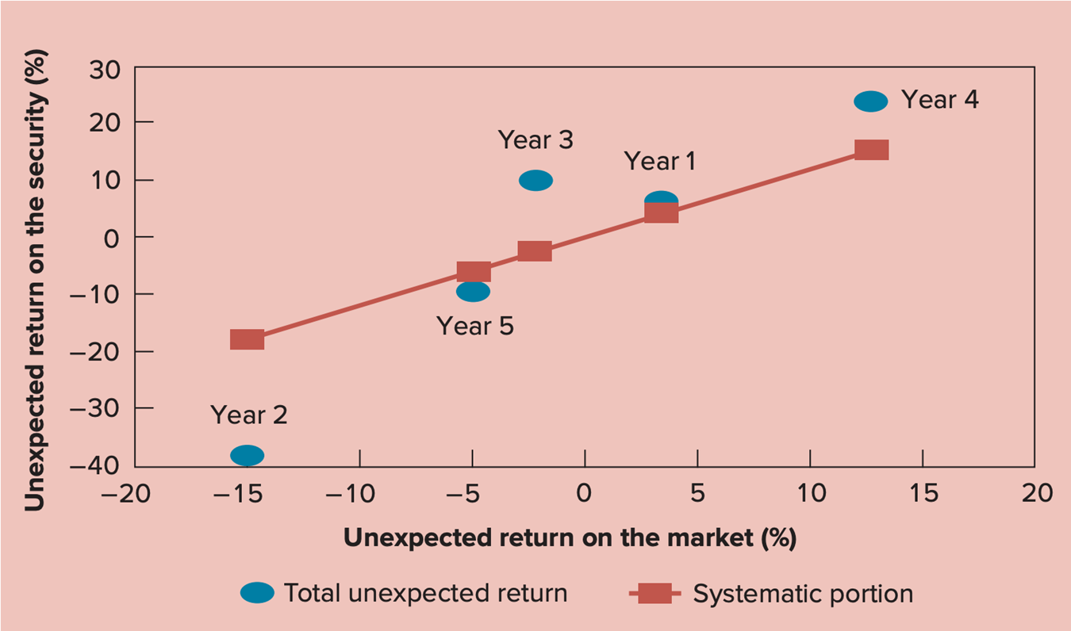
Unexpected Returns and Beta
Access the text alternative for slide images.

Slide 38
Where Do Betas Come From?
A security’s Beta depends on:
How closely correlated the security’s return is with the overall market’s return
and
How volatile the security is relative to the market.
Beta equals the correlation of the security returns with the market returns times the ratio of the standard deviations.

Slide 39
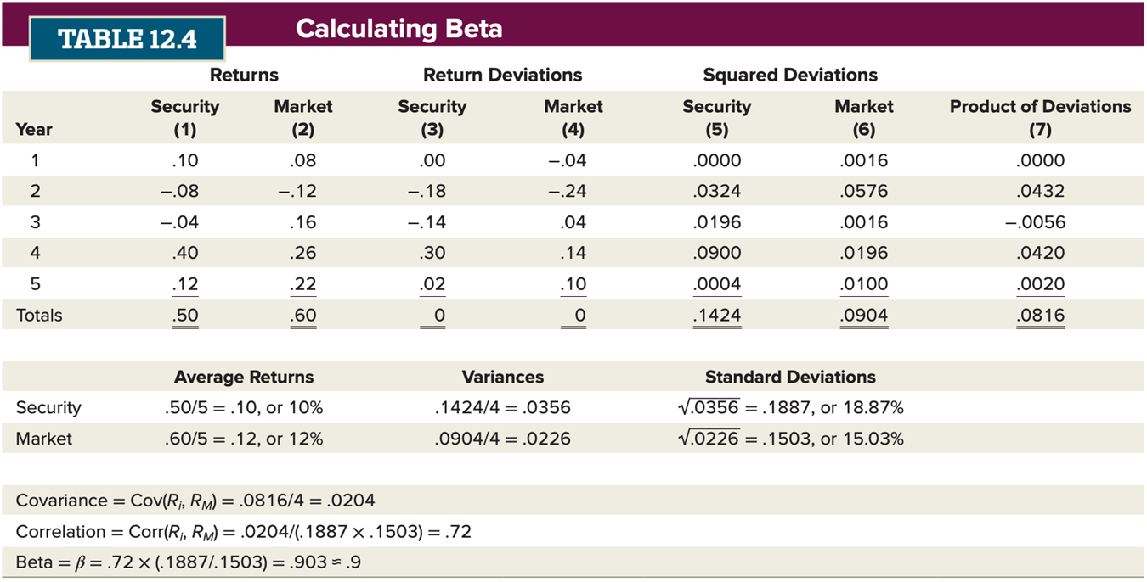
From Where Do Betas Come?
Access the text alternative for slide images.

Slide 40
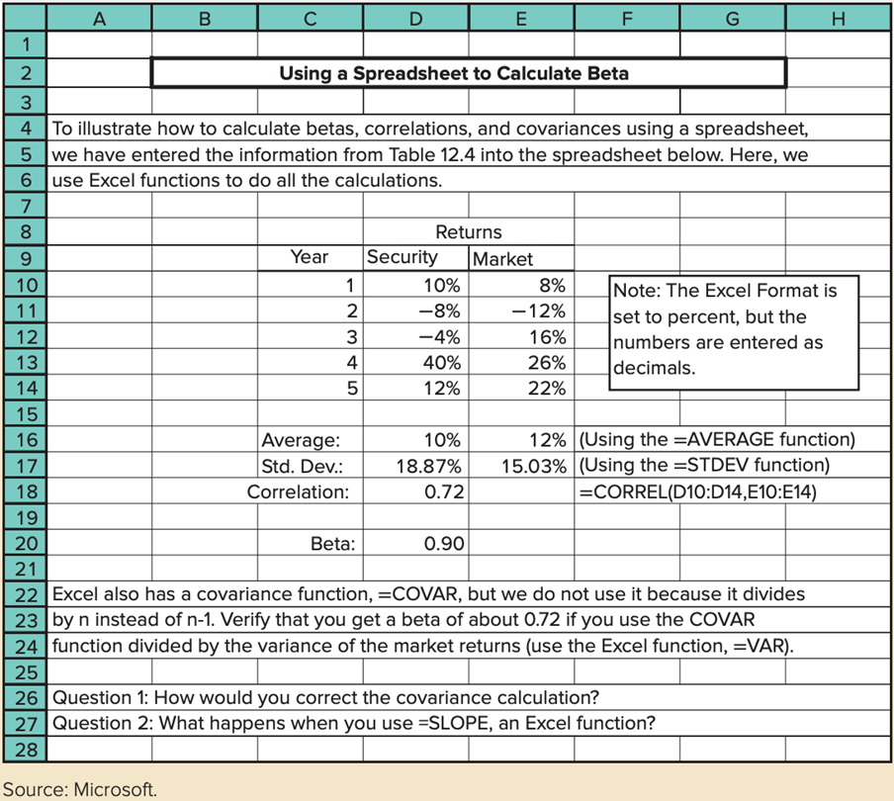
Using a Spreadsheet to Calculate Beta
Access the text alternative for slide images.

Slide 41
Beta Measures Relative Movement 1
A security with a beta of 1 is expected to move, on average, with the market.
In this case, the characteristic line would have a 45 degree angle, or a slope of 1.
This slope means that if the market goes up, say, 3%, we expect the stock to go up 3%.
In mathematics, we measure slope as “the rise over the run.”
If the market return is the “x data” and the stock return is the “y data,” the slope is the security’s beta.
Look at the scatter plot on the next slide. What do you think the beta is?
When the market has a 10% return, the security return is slightly less than 10%.
The characteristic line suggests that the beta for this security is less than 1. Why?

Slide 42
Beta Measures Relative Movement 2
You might recall from your statistics class an alternative method for estimating a “line of best fit” is a simple linear regression.
We regress the returns of the security (y data) on the returns of the market (x data).
Excel has a built-in regression function.
The output has an estimate of the “Market Returns” coefficient, that is, the slope.
The highlighted “Market Returns” coefficient is the beta estimate.

Slide 43
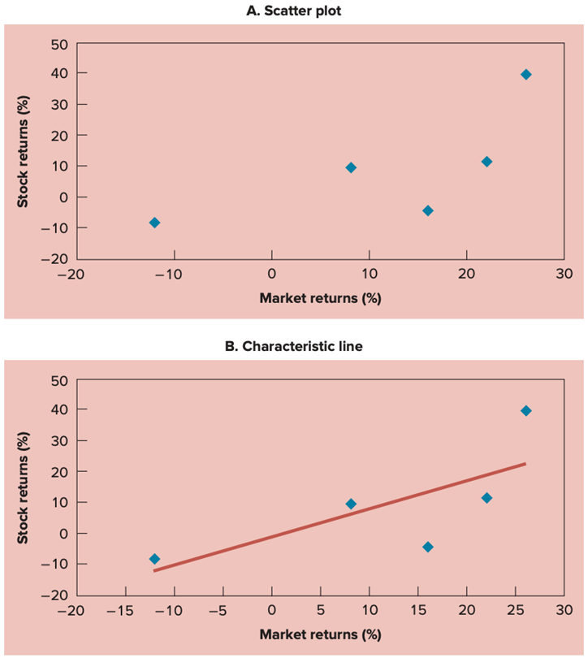
Another Way to Calculate Beta (The Characteristic Line)
Access the text alternative for slide images.

Slide 44
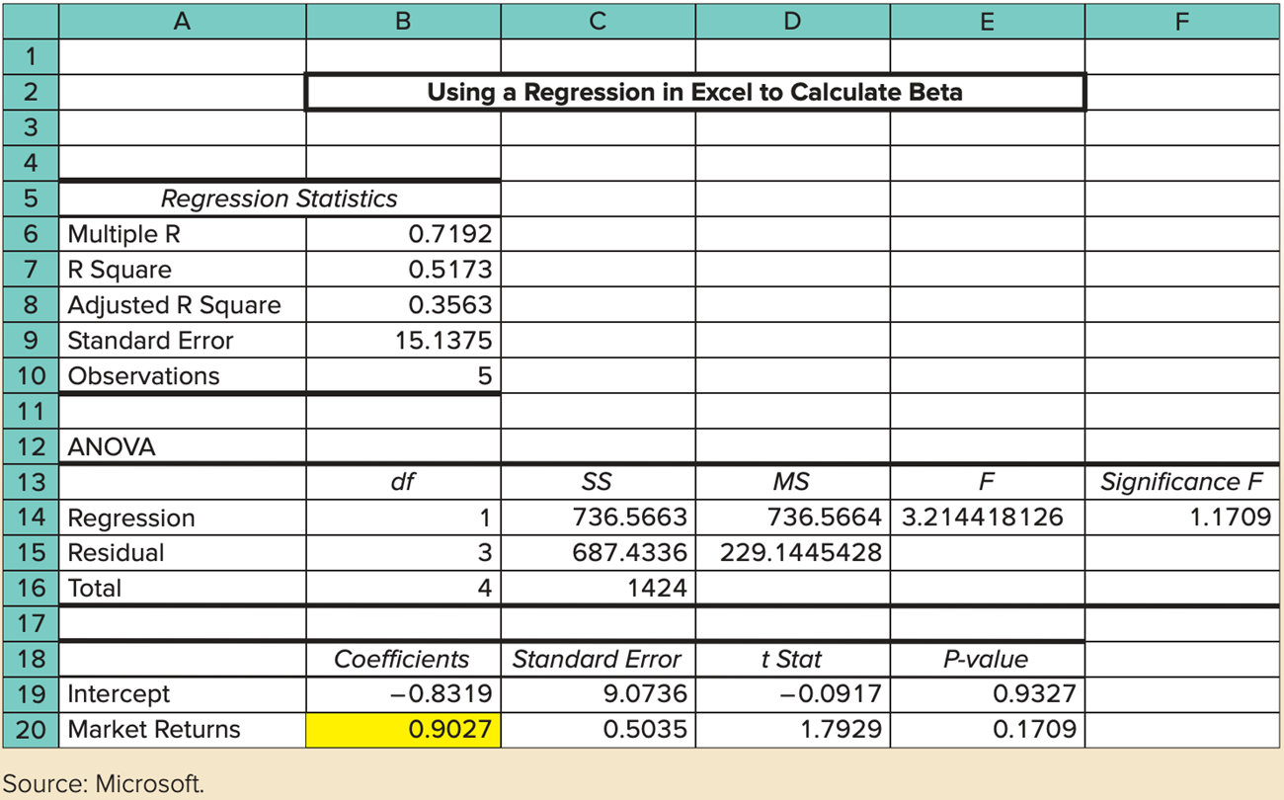
Build a Beta
Access the text alternative for slide images.

Slide 45
Beta Calculation Source: Bloomberg
Bloomberg uses two years of weekly data in their regression for returns for the S&P 500 and Microsoft (M S F T).
Doing so results in a Beta estimate of .848.
The Bloomberg system allows the user to change the assumptions.
Access the text alternative for slide images.

Slide 46
Why Do Betas Differ?
We estimate Betas from actual data. Different sources estimate betas differently, possibly using different data.
For data, the most common choices are three to five years of monthly data, or a single year of weekly data.
To measure the overall market, the S&P 500 stock market index is commonly used.
The calculated betas can be adjusted for various statistical reasons.
The bottom-line lesson: We are interested in knowing what the beta of the stock will be in the future, but we estimate betas using historical data.
Anytime we use the past to predict the future, there is the danger of a poor estimate.

Slide 47
Extending C A P M
The C A P M has a stunning implication:
What you earn on your portfolio depends only on the level of systematic risk that you bear.
As a diversified investor, you do not need to worry about total risk, only systematic risk.
But, does expected return depend only on Beta? Or, do other factors come into play?
The above bullet point is a hotly debated question.

Slide 48
Important General Risk-Return Principles
Investing has two dimensions: risk and return.
It is inappropriate to look at the total risk of an individual security.
It is appropriate to look at how an individual security contributes to the risk of the overall portfolio.
Risk can be decomposed into nonsystematic and systematic risk.
Investors will be compensated only for systematic risk.

Slide 49
The Fama-French Three-Factor Model
Professors Gene Fama and Ken French argue that two additional factors should be added.
In addition to beta, two other factors appear to be useful in explaining the relationship between risk and return.
Size, as measured by market capitalization.
The book value to market value ratio, that is, B/M
Whether these two additional factors are truly sources of systematic risk is still being debated.

Slide 50
Returns from 25 Portfolios Formed on Size and Book-to-Market, 19 27 to 2021
(Lowest B/M)
(Highest B/M)
 | 1 | 2 | 3 | 4 | 5
1(smallest cap) | 9.07 | 13.47 | 16.45 | 19.52 | 21.39
2 | 12.14 | 15.63 | 16.02 | 17.53 | 19.26
3 | 12.74 | 15.02 | 15.36 | 16.42 | 17.58
4 | 12.59 | 13.36 | 14.37 | 15.92 | 16.72
5 (largest cap) | 11.46 | 11.05 | 12.46 | 11.83 | 14.67
Source: Author calculations using data from the website of Ken French.
Look across the rows from left to right. What do you see?
Look down the columns from top to bottom. What do you see?
Note that the portfolio with the highest returns is the one with the smallest market cap and the highest book-to-market ratio.

Slide 51
Useful Internet Sites
www.earningswhispers.com (visit the earnings calendar)
www.morningstar.com (a source for betas)
finance.yahoo.com (another source of betas)
http://mba.tuck.dartmouth.edu/pages/faculty/ken.french/ (source for data behind the FAMA-French model)
jmdinvestments.blogspot.com (reference for current financial information)

Slide 52
Chapter Review 1
Announcements, Surprises, and Expected Returns.
Expected and unexpected returns.
Announcements and news.
Risk: Systematic and Unsystematic.
Systematic and unsystematic risk.
Systematic and unsystematic components of return.
Diversification, Systematic Risk, and Unsystematic Risk.
Diversification and unsystematic risk.
Diversification and systematic risk.
Systematic Risk and Beta.
The systematic risk principle.
Measuring systematic risk.
Portfolio Betas.

Slide 53
Chapter Review 2
The Security Market Line.
Beta and the risk premium.
The reward-to-risk ratio.
The basic argument.
The fundamental result.
The Security Market Line.
More on Beta.
A closer look at Beta.
Where do Betas come from?
Ways to calculate Beta
Why do Betas differ?
Extending C A P M: The Fama-French three-factor model

Slide 54
End of Main Content
© McGraw Hill LLC. All rights reserved. No reproduction or distribution without the prior written consent of McGraw Hill LLC.

Slide 55
Accessibility Content: Text Alternatives For Images

Slide 56
Earnings Surprises Source: Bloomberg – Text Alternative
Return to parent-slide containing images.
A tracking surprises chart for Nike incorporated lists quarters for periodicity, standard for source, U S D for currency, E P S and a d j plus for measures, one day after for P x change window, and comparable versus estimate for chart type. The top left table titled earnings slash surprise snapshot list the following data for measures. Industry, apparel, and textile products. Next announcement, E 03 slash 18 slash 2022. Prior announcement, 12 slash 20 slash 2021. P slash E actual. 42.32. 5-year growth, 7.89 percent. Earning trend, negative 0.35. The table lists the following values for P x change window. E x p for next period, 0.831. Average surprise, 15.53 percent. Average a b s surprise, 16.61 percent. Surprise slash p x change C o r r, 0.48. Average a b s p x change. 5.36 percent. Implied 1-day move, 3.59 percent. There are fluctuating lines for the estimate and comparable in the line graph on the top right. Below are columns for A N N date, per absolute, per end values, reported, c o m p, estimate, percent surprise, guidance, percent guide surprise, percent p x change, T 1 2 M, and P slash E.
Return to parent-slide containing images.

Slide 57
Portfolio Expected Returns and Betas for Asset A – Text Alternative
Return to parent-slide containing images.
The y-axis of the line graph shows the portfolio expected return [E (R sub p)] and the x-axis shows the portfolio beta (beta sub p). Graph A on the top is titled portfolio expected returns and betas for asset A. There is an upward-sloping arrow that starts from R sub f equals 4 percent on the y-axis. There is a dashed horizontal line that starts from E (R sub A) equals 16 percent on the y-axis and ends at the middle point of the upward-sloping arrow. There is a vertical dashed line that starts from the middle point of the upward-sloping arrow and ends at 1.6 equals beta sub A on the x-axis. A small section of the upper side of the upward-sloping arrow is labeled as follows. Start fraction E (R sub A) minus R sub f over beta sub A end fraction equals 7.5 percent.
Return to parent-slide containing images.

Slide 58
Portfolio Expected Returns and Betas for Asset B – Text Alternative
Return to parent-slide containing images.
The y-axis of the line graph shows the portfolio expected return [E (R sub p)] and the x-axis shows the portfolio beta (beta sub p). There is an upward-sloping arrow that starts from R sub f equals 4 percent on the y-axis. There is a horizontal dashed line that starts from E (R sub B) equals 12 percent on the y-axis and ends at the middle point of the upward-sloping line. There is a vertical dashed arrow that starts from the middle point of the arrow and ends at 1.2 equals beta sub B on the x-axis. A small section on the upper side of the upward-sloping arrow is labeled as follows: Start fraction E (R sub B) minus R sub f over beta sub B end fraction equals 6.67 percent.
Return to parent-slide containing images.

Slide 59
Portfolio Expected Returns and Betas for Both Assets – Text Alternative
Return to parent-slide containing images.
The y-axis of the line graph shows the portfolio expected return [E (R sub p)] and the x-axis shows the portfolio beta (beta sub p). There is an upward-sloping line labeled asset B that starts from R sub f equals 4 percent on the y-axis. There is a dashed horizontal line that starts from E (R sub B) equals 12 percent on the y-axis and ends at a point below the middle of the arrow for asset B. There is a vertical dashed arrow that starts below the middle of the asset B and ends at 1.2 equals beta sub B on the x-axis. A small section on the upper side of asset B is labeled equal to 6.67 percent. There is another upward-sloping arrow labeled asset A. There is another horizontal dashed arrow that starts from E (R sub A) equals 16 percent on the y-axis and ends at a point higher than the middle of asset A. There is another vertical dashed arrow that starts at a point higher than the middle of asset A and ends at 1.6 equals beta sub A on the x-axis. A small section on the upper side of asset A is labeled equal to 7.50 percent.
Return to parent-slide containing images.

Slide 60
The Fundamental Result 3 – Text Alternative
Return to parent-slide containing images.
The y-axis of the line graph shows the asset expected return [E (R sub i)] and the x-axis shows the asset beta (beta sub i). There is an upward-sloping arrow that starts from R sub f on the y-axis. There is a dashed horizontal line that starts from E (R sub A) on the y-axis and ends at point A which is below the middle of the upward-sloping arrow. There is a vertical dashed line that starts from point A and ends at beta sub A on the x-axis. There is another horizontal dashed line that starts from E (R sub B) on the y-axis and ends at point B which is in the middle of the upward-sloping arrow. There is another vertical dashed line that starts from point B and ends at beta sub B on the x-axis. There is a third horizontal dashed line that starts from E (R sub D) on the y-axis and ends at point D which is below the upward-sloping line. There is a third vertical dashed line that starts from point D and ends at beta sub D on the x-axis. There is a fourth horizontal dashed line that starts from E (R sub C) on the y-axis and ends at point C which is above the upward-sloping arrow. There is a fourth vertical dashed line that starts from point C and ends at beta sub c on the x-axis. A small section on the upper end of the upward-sloping arrow is labeled equal start fraction to E (R sub i) minus R sub f over beta sub i end fraction. The text below the graph reads as follows: The fundamental relationship between beta and expected return is that all assets must have the same reward to risk ratio, [E (R sub i) minus R sub f] over beta sub i. This means that they would all plot on the same straight line. Assets A and B are examples of this behavior. Asset C’s expected return is too high; Asset D’s is too low.
Return to parent-slide containing images.

Slide 61
The Security Market Line 4 – Text Alternative
Return to parent-slide containing images.
The y-axis of the line graph shows the asset expected return [E (R sub i)] and the x-axis shows the asset beta (beta sub i). There is an upward-sloping arrow that starts from R sub f on the y-axis and ends in the middle of the upward-sloping arrow. There is a vertical dashed line that starts from the middle point of the upward-sloping arrow and ends at beta sub M equals 1.0 on the x-axis. There is also another horizontal dashed line that starts from the same point and ends at E (R sub M) on the y axis. A small section on the upper side of the arrow is labeled equal to E (R sub M) minus R sub f. The text on the bottom with the equation reads as follows. The slope of the security market line is equal to the market risk premium, that is, the reward for bearing an average amount of systematic risk. The equation describing the S M L can be written as: E left parenthesis R sub i right parenthesis equals R sub f plus left bracket E left parenthesis R sub M right parenthesis minus R sub f right bracket times beta sub i. This is the capital asset pricing model (C A P M).
Return to parent-slide containing images.

Slide 62
Unexpected Returns and Beta – Text Alternative
Return to parent-slide containing images.
The y-axis of the graph shows an unexpected return in percentage on the security and the x-axis shows an unexpected return on the market in percentage. There are fluctuating blue dots for total unexpected return with the following estimated values. Year 2 (negative 15, negative 40). Year 5 (negative 5, negative 10), year 3 (negative 3, 10), year 1 (4, 8), year 4 (12, 25). There is an upward-sloping line for the systematic portion with some of the following estimated values. (Negative 15, negative 19), (negative 5, 2), (negative 3, 0), (4, 0), (14, 15).
Return to parent-slide containing images.

Slide 63
From Where Do Betas Come? – Text Alternative
Return to parent-slide containing images.
The table consists of 5 columns and 6 rows. The column headings are year, returns, return deviations, squared deviations, and product of deviations. Each of the column headings Returns, Return deviations, and squared deviations is subdivided into security and market. The row entries are as follows. Row 1. Year 1. Security: .10. Market: .08. Security: .00. Market: negative .04. Security: .0. Market: .0016. Product of deviations: .0. Row 2. Year 2. Security: negative .08. Market: negative.12. Security: negative .18. Market: negative .24. Security: .0324. Market: .0576 Product of deviations: .0432. Row 3. Year 3. Security: negative .04. Market: negative.16. Security: negative .14. Market: negative .04. Security: .0196. Market: .0016. Product of deviations: negative.0056. Row 4. Year 4. Security: .40. Market: .26. Security: .30. Market: .14. Security: .0900. Market: .0196. Product of deviations: .0420. Row 5. Year 5. Security: .12. Market: .22. Security: .02. Market: .10. Security: .0004. Market: .0100. Product of deviations: .0020. Row 6. Totals. Security: .50. Market: .60. Security: 0. Market: 0. Security: .1424. Market: .0904. Product of deviations: .0816. Security. Average returns: .50 over 5 = .10 or 10%. Variances: .1424 over 4 = .0356. Standard deviations: square root of .0356 = .1887, or 18.87%. Market. Average returns: .60 over 5 = .12, or 12%. Variances: .0904 over 4 = .0226. Standard deviations: square root of .0226 = .1503, or 15.03%. Covariance = C o v (R sub I, R sub M) = .0816 over 4 = .0204. Correlation = C o r r (R sub I, R sub M) = .0204 over (.1887 times .1503) = .72. Beta = beta =.72 times (.1887 over .1503) = .903 = .9.
Return to parent-slide containing images.

Slide 64
Using a Spreadsheet to Calculate Beta – Text Alternative
Return to parent-slide containing images.
Using a spreadsheet to calculate Beta. To illustrate how to calculate betas, correlations, and covariances using a spreadsheet, we have entered the information from Table 12.4 into the spreadsheet below. Here, we use Excel functions to do all the calculations. The table below consists of 2 columns namely, year and returns. The column heading returns is subdivided into security and market. The row entries are as follows. Row 1. Year 1. Security: 10%. Market: 8%. Row 2. Year 2. Security: negative 8%. Market: negative 12%. Row 3. Year 3. Security: negative 4%. Market: 16%. Row 4. Year 4. Security: 40%. Market: 26%. Row 5. Year 5. Security: 12%. Market: 22%. Note: The Excel format is set to percent, but the numbers are entered as decimals. Average. Security: 10%. Market: 12%. Using the = AVERAGE function. Standard deviation. Security: 18.87%. Market: 15.03%. Using the = S T D E V function. Correlation: 0.72. = C O R R E L (D 10: D 14, E 10: E 14). Beta: 0.90. Excel also has a covariance function = C O V A R, but we do not use it because it divides by n instead of n minus 1. Verify that you get a beta of about 0.72 if you use the C O V A R function divided by the variance of the market returns, use the Excel function, = V A R. Question 1: How would you correct the covariance calculation? Question 2: What happens when you use = SLOPE, an Excel function?
Return to parent-slide containing images.

Slide 65
Another Way to Calculate Beta (The Characteristic Line) – Text Alternative
Return to parent-slide containing images.
The y-axes of the two dot plots show stock returns in percentages and the x-axes shows market returns. Graph A on top is titled scatter plot. There are blue dots with the following estimated values. (Negative 12, negative 9), (9, 10), (17, negative 2), (23, 14), and (27, 41). Graph B on the bottom is titled characteristic line. There is an upward-sloping line that starts from (negative 13, negative 12) and rises with the following estimated values. (Negative 10, negative 10), (negative 5, negative 5), (0, 0), (5, 5), (10, 10), (15, 15), (20, 20), (25, 25). There are blue dots with the following estimated values. (negative 13, negative 9), (8, 10), (16, negative 5), (23, 10), and (26, 40).
Return to parent-slide containing images.

Slide 66
Build a Beta – Text Alternative
Return to parent-slide containing images.
Data in a spreadsheet are titled Using a Regression in Excel to Calculate Beta. The following data are shown under the Regression Statistics panel, from rows 6 to 10 of column B: Multiple R, 0.7192; R square, 0.5173; Adjusted R square, 0.3563; standard error, 15.1375; and observations, 5. The data are shown under the ANOVA panel in columns B to F. d f, S S, M S, F, Significance F are the column heads from columns B to F. The row heads and entries are as follows: Row 14: Regression: d f, 1. S S, 736.5663. M S, 736.5664. F, 3.214418126. Significance F, 1.1709. Row 15: Residual: d f, 3. S S, 687.4336. M S, 229.1445428. Row 16: Total: d f, 4. S S, 1424. Coefficients, standard error, t Stat, and P value are shown from columns B to E as follows: Row 19: Intercept: negative 0.8319, 9.0736, negative 0.0917, and 0.9327. Row 20: Market returns: 0.9027, 0.5035, 1.7929, and 0.1709. 0.9027 is highlighted in yellow. Source: Microsoft.
Return to parent-slide containing images.

Slide 67
Beta Calculation Source: Bloomberg – Text Alternative
Return to parent-slide containing images.
The top of the screenshot reads as follows: M S F T U S Equity, Relative Index, S P X Index, Actions dropdown, and Edit dropdown. Relative Index is selected. Historical Beta is indicated at top right. The following lines are shown as follows: Data textbox, last price. Data textbox, last price. Weekly dropdown. Linear checkbox is selected. Beta plus or minus checkbox. Non Param checkbox. Reg on dropdown is set to Percent. 01 06 2020 to 01 05 2022. 01 07 2019 to 01 06 2021. Lag textbox, 0. Winsorize, 2. Standard deviation dropdown set to Local. Among 6 months, Y T D, 1 year, 2 years, 5 years, Max, and Weekly dropdown, 2 years is selected. Legend option is then selected. Track, Annotate, Zoom, Select, and Copy are the other options. On the right, Statistics tab is selected. Transformations is the other tab. Y equals Microsoft Corp. X equals S and P 500 Index. Linear Beta, Range 1. Raw Beta, 0.848. Adjusted Beta, 0.899. Alpha (Intercept), 0.427. R cap 2 (Correlation cap 2), 0.560. R (correlation), 0.749. Standard deviation of error, 2.511. Standard error of alpha, 0.249. Standard error of beta, 0.075. t Test, 11.346. Significance, 0.000. Last T value, negative 0.264. Last P value, 0.396. Number of points, 103. Last Spread, 4429.86. In the content pane, the vertical axis represents M S F T U S Equity Percent ranging from negative 14 to 10 in increments of 4. Bars are shown over the axis forming a bell shaped curve reaching its peak between negative 2 and 2. The horizontal axis represents S P X Index Percent ranging from negative 16 to 12 in increments of 2. Vertical bars form a bell shaped curve over the axis showing peak between negative 2 and 2. Cluster of dots are shown in the graph between negative 6 and 6 of both the axes. A line connecting the low point (negative 15, negative 14) to the high point (12, 10) represents the equation Y equals 0.848 X plus 0.427. The line shows positive correlation drawn along the dots plotted.
Return to parent-slide containing images.

