Slide 1
Standards for Nutrient Intake
Instructor: Alma Irshaid. MPH. ANutr
Chapter2

Slide 2
Chapter outline:
Standards and recommendations.
RDA
RDI
Dietary guidelines
My pyramid, my plate and food exchange lists.

Slide 3
Characteristics of a Healthy Diet Include:
Balance
Variety
Moderation

Slide 4
Tools to Help Consumers Improve Diets
Dietary Reference Intakes (DRIs)
Dietary Guidelines for Americans
My Plate
Food Label Information

Slide 5
Resources for Planning a Healthy Diet
Dietary Reference Intakes (DRIs)
Reference values that are quantitative estimates of nutrient intakes to be used for planning and assessing diets for healthy people.
These reference values are used to
suggest nutrient intake levels for different population groups.
plan and evaluate the diets of healthy people in the United States and Canada where it originally developed.

Slide 6
Dietary Reference Intakes (DRIs)
Focus on
Maintaining good health
Reducing the risk of developing chronic disease
Avoiding unhealthy excess (toxic amounts of nutrients)
Establish nutrient recommendations for different life stages
Age
Gender
Pregnant
Lactating
Are periodically updated

Slide 7
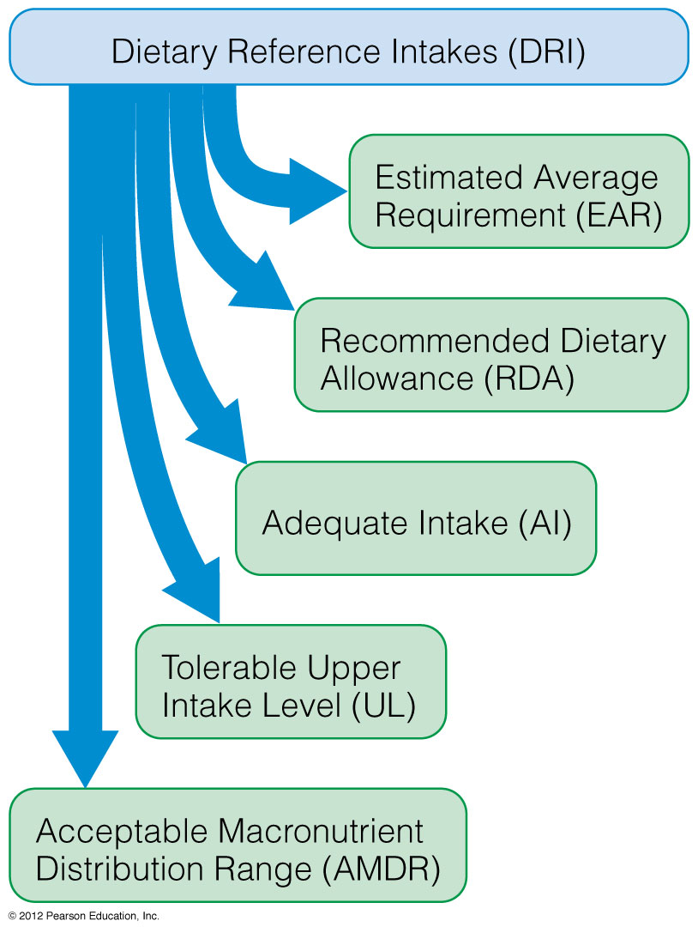

Slide 8
DRI Reference Values
Estimated Average Requirements (EAR)
Amount of a nutrient projected to meet the needs of 50% of the healthy population by age and gender.
Requirements are based on measurements that indicate whether the individual is at risk of a deficiency.
If there isn’t enough research to develop appropriate measurements for a nutrient, EAR is not established.
EAR is used to calculate RDAs.

Slide 9
DRI Reference Values
Adequate Intakes (AI)
Set when there is not enough scientific evidence to determine an RDA.
Estimate based on the judgment of the FNB members when an EAR cannot be determined.
Next best scientific estimate of the amount of a nutrient that groups of similar individuals should consume to maintain good health.

Slide 10
DRI Reference Values
Recommended Dietary Allowance (RDA)
Recommendation for each nutrient that should meet the needs of nearly all (97.5 %) the healthy individuals in a specific gender and age group.
Allowances are set higher than the EARs.
Not established for all nutrients.
RDA = EAR + 2 SD _{EAR} OR RDA = 1.2 x EAR

Slide 11
Using the DRIs:
Danger
of toxicity
Danger
of Toxicity
Marginal
Marginal
Tolerable Upper Intake
Level
Safety
Safety
Safety
Safety
RDA or AI
Estimated
Average
Requirement
RDA
Marginal
Marginal
Danger
Deficiency
Danger of Deficiency
Naive view
Accurate view

Slide 12
DRI Reference Values
Tolerable Upper Intake Level (UL)
Highest amount of a nutrient that is unlikely to cause harm if consumed daily
Consumption above this level increases risk of toxicity
Not all nutrients have ULs
Estimated Energy Requirements (EER)
Amount of daily energy needed to maintain a healthy body and meet energy needs based on
Age
Gender
Height
Weight
Activity Level

Slide 13
DRI Reference Values
Acceptable Macronutrient Distribution Ranges (AMDR)
Addresses the recommended balance of fuel nutrients to meet physiological needs
Carbohydrates 45–65% of daily kcal
Fats 20–35% of daily kcal
Proteins 10–35% of daily kcal

Slide 14
DRIs: Acceptable Macronutrient Distribution Ranges
Range (%)
Macronutrients | Children 1-3 y | Children 4-18 y | Adults
Fat n-6 PUFA N-3 PUFA | 30-40 5-10 0.6 – 1.2 | 25-35 5-10 0.6-1.2 | 20-35 5-10 0.6-1.2
Carbohydrates | 45-65 | 45-65 | 45-65
Protein | 5-20 | 10-30 | 10-35

Slide 15
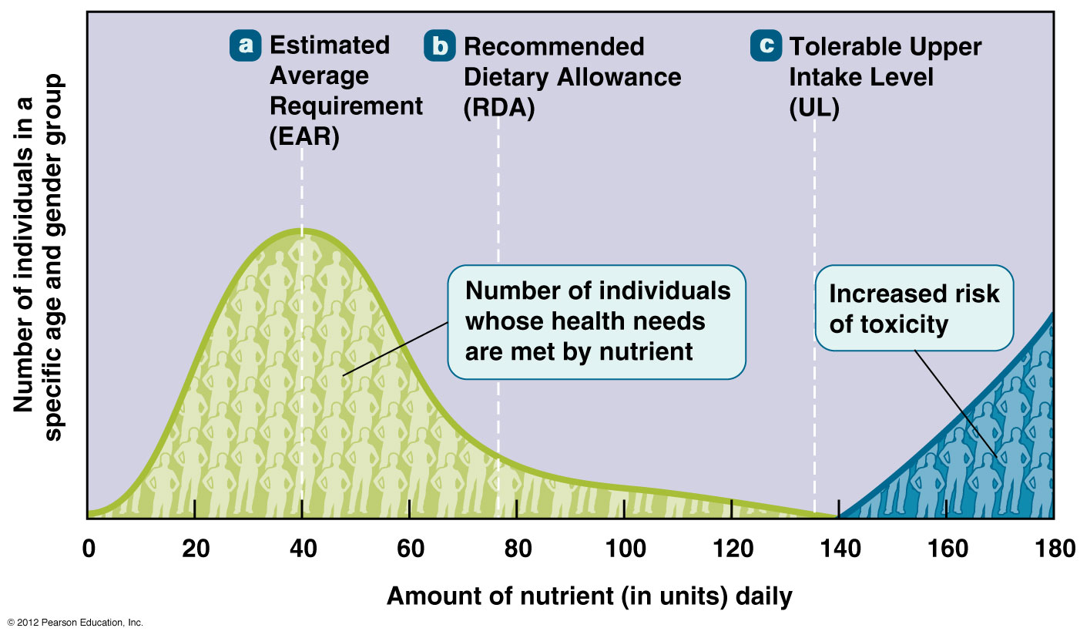
The DRIs in Action

Slide 16
Goal of the Dietary Reference Intakes: Defining a Safe or Optimal Zone for Nutrient Intake

Slide 17
How to Use the DRIs
To plan a quality diet and make healthy food choices
Goals:
To meet the RDA or AI of all nutrients
Not exceed the UL
Consume the energy-yielding nutrients within the ranges of the AMDR

Slide 18
Dietary Guidelines for Americans
Set nutritional goals for Americans based on current scientific evidence
By law must be updated every five years by committee appointed by the U.S. Department of Agriculture (USDA) and the Department of Health and Human Services (DHHS)
Shapes all federally funded nutrition programs.
Educates and guides consumers concerning healthy diet and lifestyle choices.

Slide 19
Dietary Guidelines for Americans 2010
The most current nutrition and physical activity recommendations for good health
Designed to help individuals age 2 and over
Improve the quality of diet
Lower the risk of chronic disease and unhealthy conditions
You can find Selected messages for consumers: http://www.cnpp.usda.gov/Publications/DietaryGuidelines/2010/PolicyDoc/SelectedMessages.pdf

Slide 20
Dietary Guidelines for Americans, 2010
There are two overarching concepts in the most
recent guidelines:
Maintain calorie balance over time to achieve and sustain a healthy weight.
Consume more nutrient-rich foods and beverages.

Slide 21
What Is MyPlate?
Food guidance system
Graphics used to summarize guidelines to healthy eating
Visual depiction of the recommendations in the Dietary Guidelines for Americans 2010
Online components provide personalized diet plan based on the latest nutrition and health recommendations from
Dietary Guidelines Advisory Committee Report
DRIs
Illustrates the diet and lifestyle themes

Slide 22
MyPlate:
www.choosemyplate.gov

Slide 23
Nutrient-Dense Foods
Nutrient density refers to
The measurement of the nutrients in a food compared to its kilocalorie content
Foods which provide more nutrients per kilocalorie
Foods which are lower in fat and added sugar

Slide 24
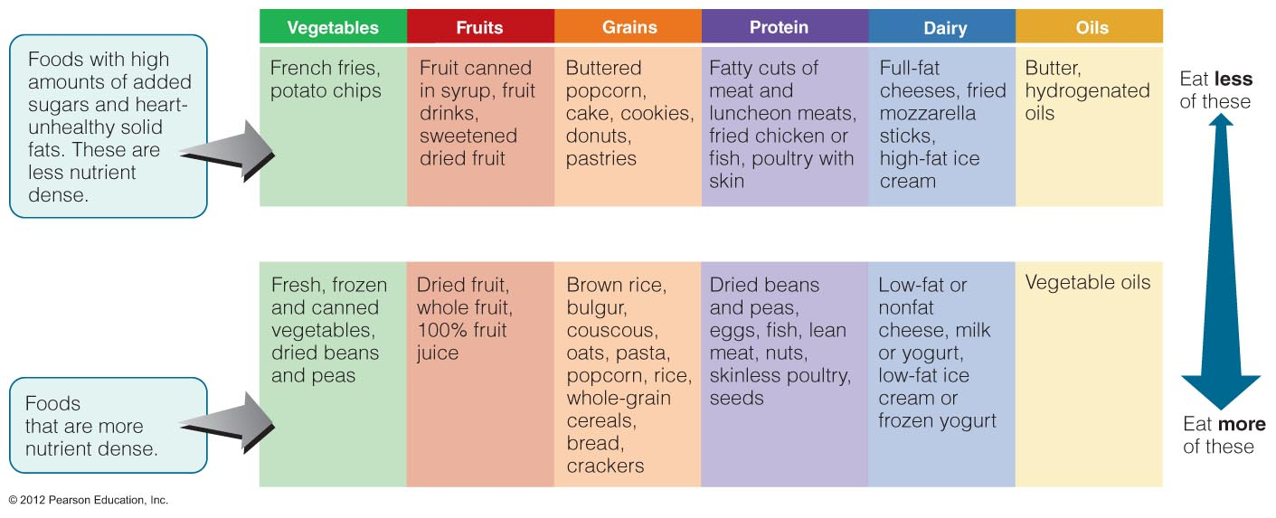
Nutrient-Dense Food Choices

Slide 25
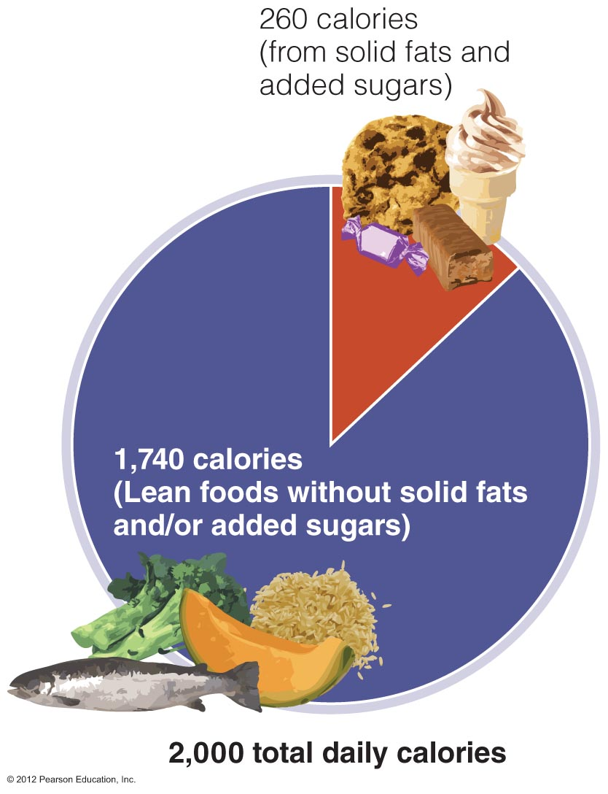
How Solid Fats and Added Sugars Fit into a Balanced Diet

Slide 26
Which Is the Healthier Way to Enjoy Your Potatoes?

Slide 27
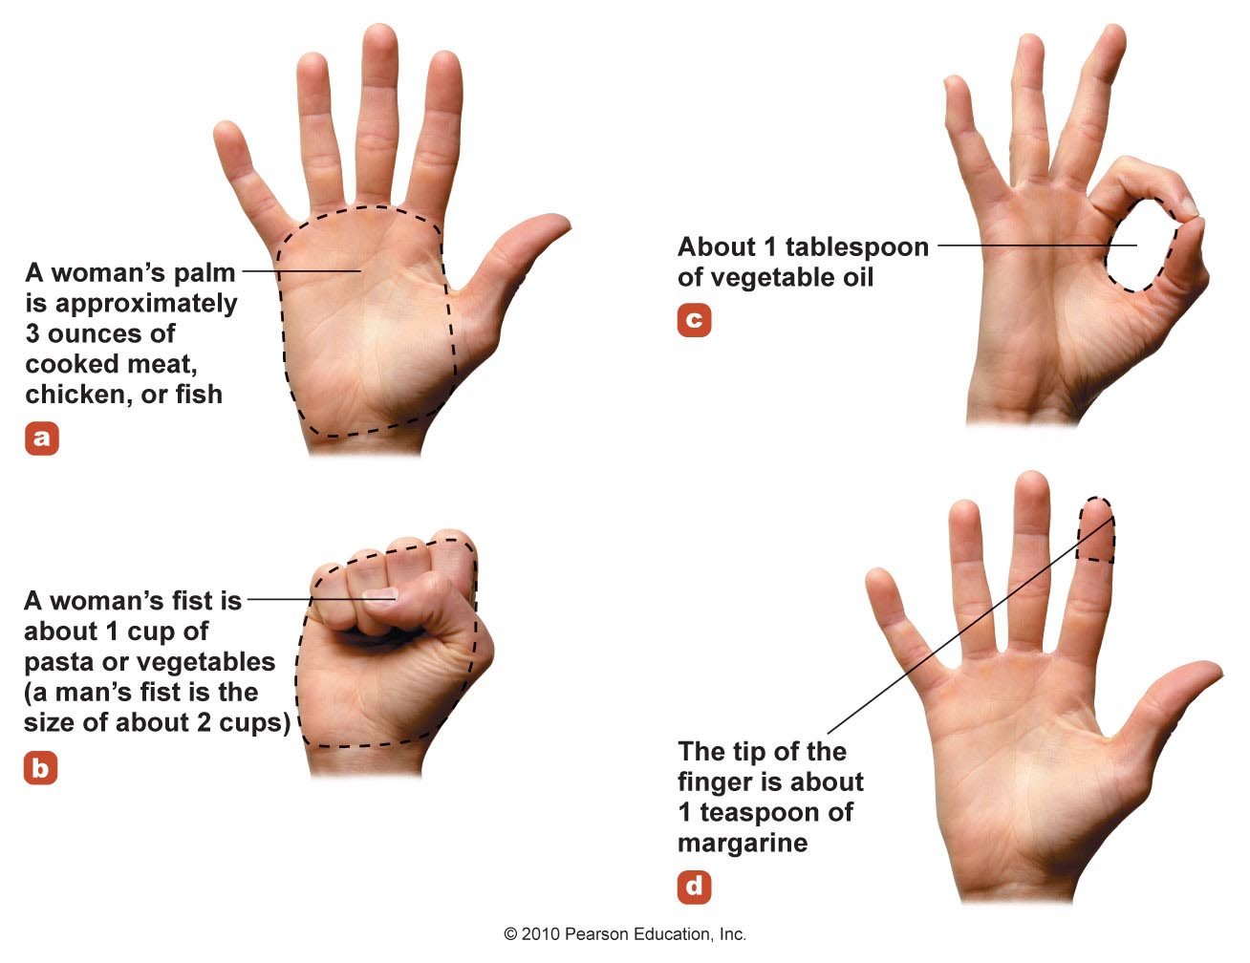
What’s a Serving Size?

Slide 28
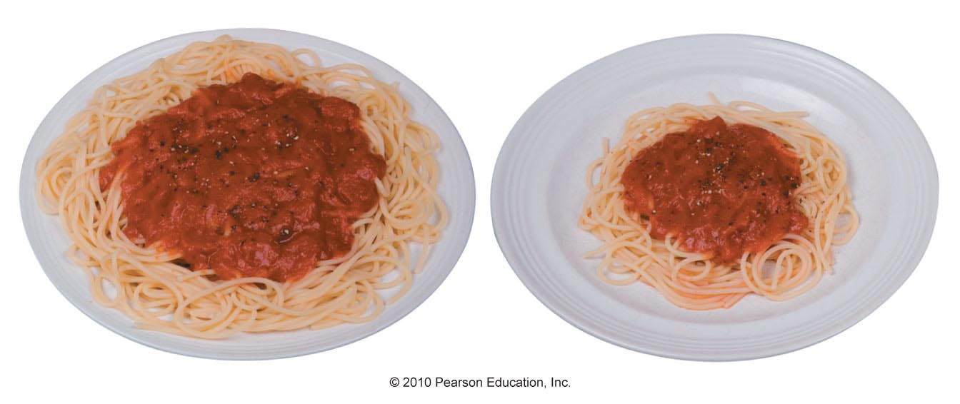
Serving Size vs Portion Size
Serving size – the standard amount or recommended portion of food for which the nutrient composition is presented
Portion – the amount of a food eaten in one sitting
Portion sizes have increased over the years

Slide 29
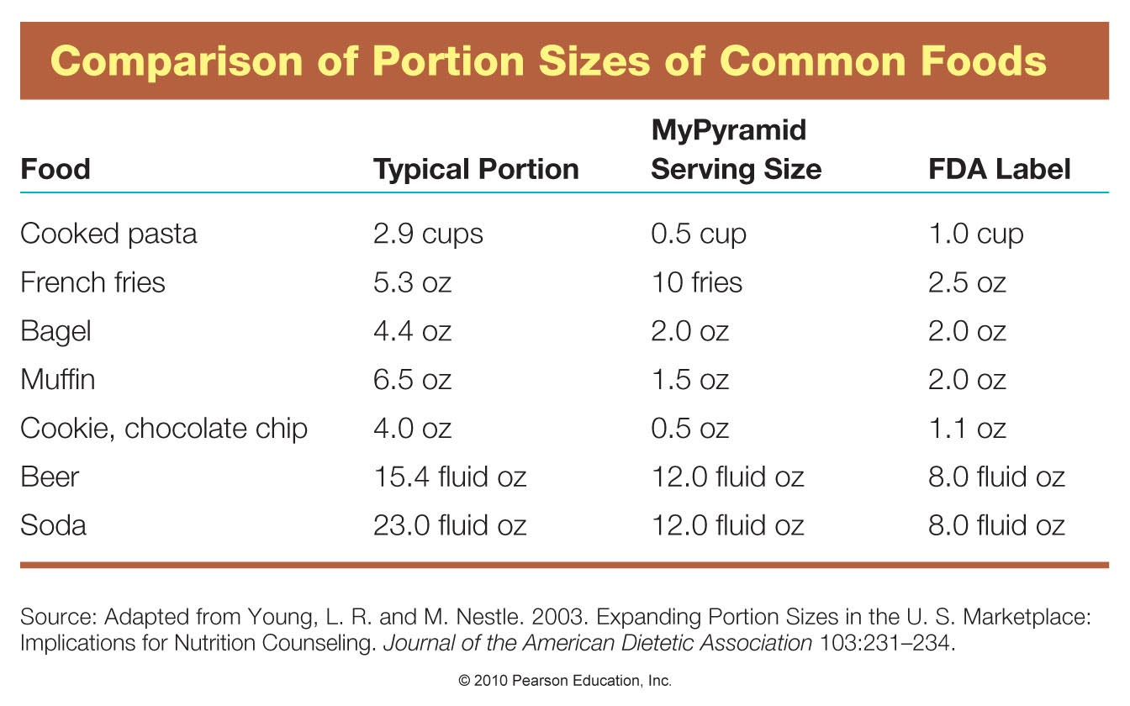

Slide 30
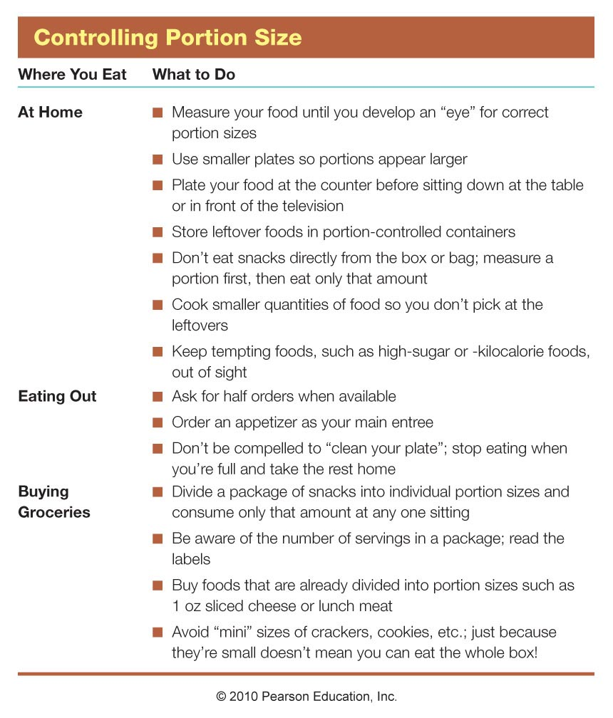

Slide 31
Most Food Labels Are Regulated by the FDA
Every packaged food must be labeled with
Name of food
Net weight, the weight of the food in the package, excluding weight of the package or packing material
Name and address of the manufacturer or distributor
List of ingredients in descending order by weight
Nutrition Labeling and Education Act mandated in 1990
Uniform nutritional information format
Serving sizes
Set criteria for most label claims and health claims

Slide 32
Food labels regulated by the USDA
Meats
Poultry
Some differences in label requirements

Slide 33
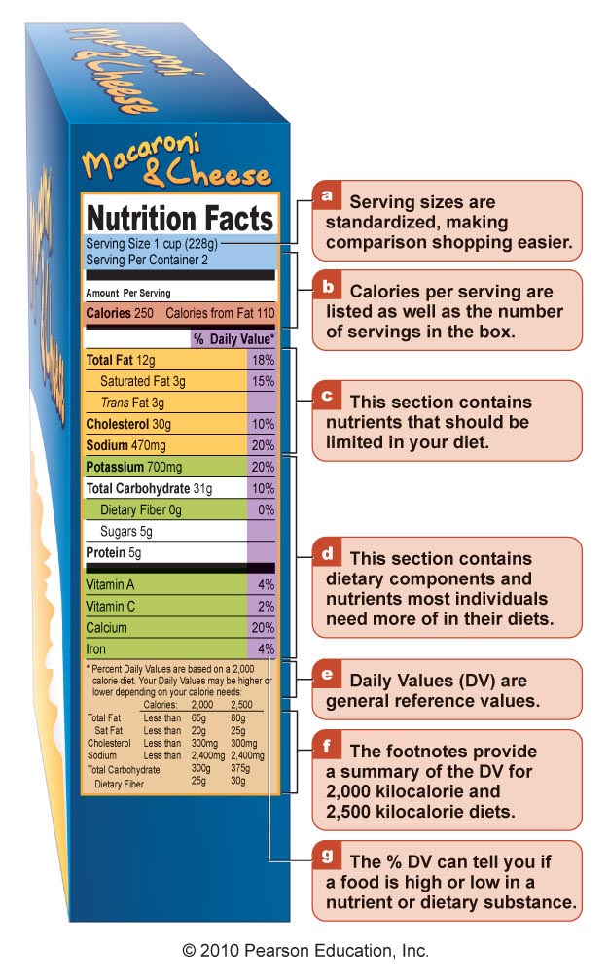
Nutrition Fact Panel
Area on the food label that provides a list of specific nutrients obtained in one serving of food
Very few foods are exempt from carrying the nutrition fact panel
Use as a shopping guide to make healthier decisions

Slide 34
Food Labels Regulated by the FDA
Requirements include:
Nutrition information: total kilocalories, kilocalories from fat, total fat, saturated fat, trans fats, cholesterol, sodium, total carbohydrate, dietary fiber, sugars, vitamin A, vitamin C, calcium, and iron
Uniform serving sizes among similar products
Indication of how a serving of the food fits into an overall daily diet (Daily Value)
Uniform definitions for descriptive label terms such as “light” and “fat free”
Health claims that are accurate and science based, if made about the food or one of its nutrients

Slide 35
Daily Values (DVs)
General idea of how the nutrients in the food fit into the overall diet
Based on a 2,000 kilocalorie diet
Food is considered high in nutrient if DV is > 20%
Food is considered low in nutrient if DV is < 5%
There is no DV for trans fat, sugars, and protein
Some Nutrient Facts Panels have a footnote at the bottom that provides a summary of DVs for 2,000 and 2,500 kilocalorie diets

Slide 36
Label Claims
Nutrient Content Claims:
Describe the level or amount of a nutrient in food product
Health Claims:
Describe a relationship between a food or dietary compound and a disease or health-related condition
Authorized, Authoritative, or Qualified
Structure/Function claims:
Describe how a nutrient or dietary compound affects the structure or function of the human body

Slide 37
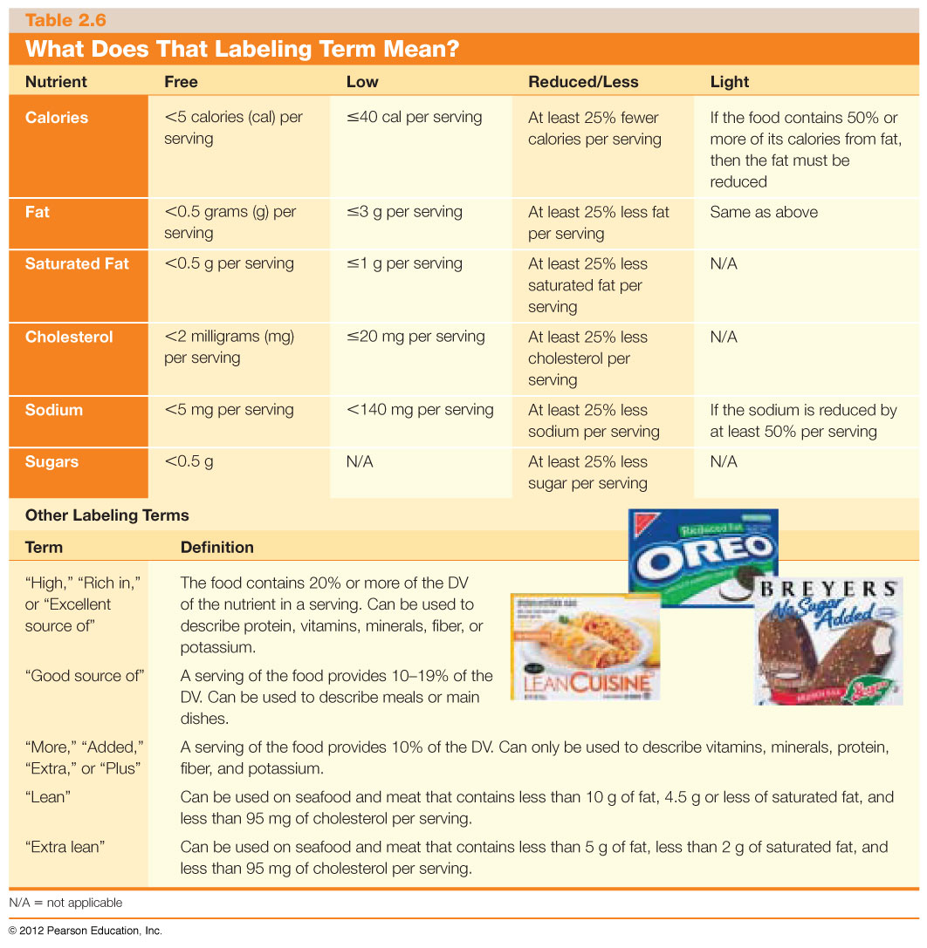

Slide 38
This Label Term Not Defined
Natural
Can mean just about anything.
Always read the ingredient and nutrition information when you see “Natural” on the label.

Slide 39
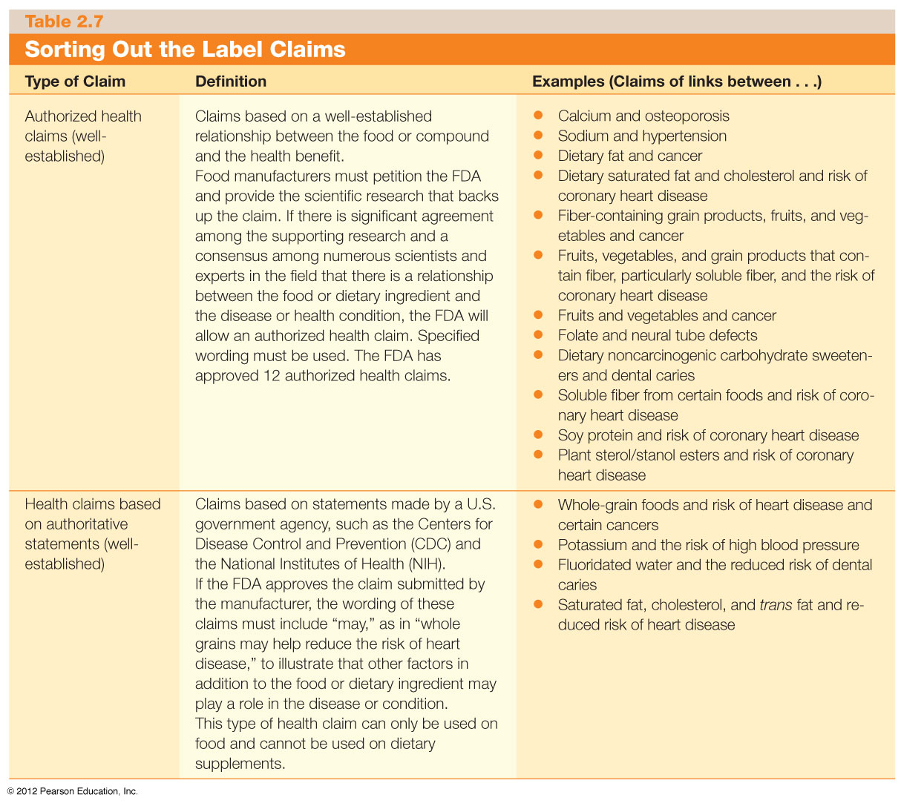

Slide 41
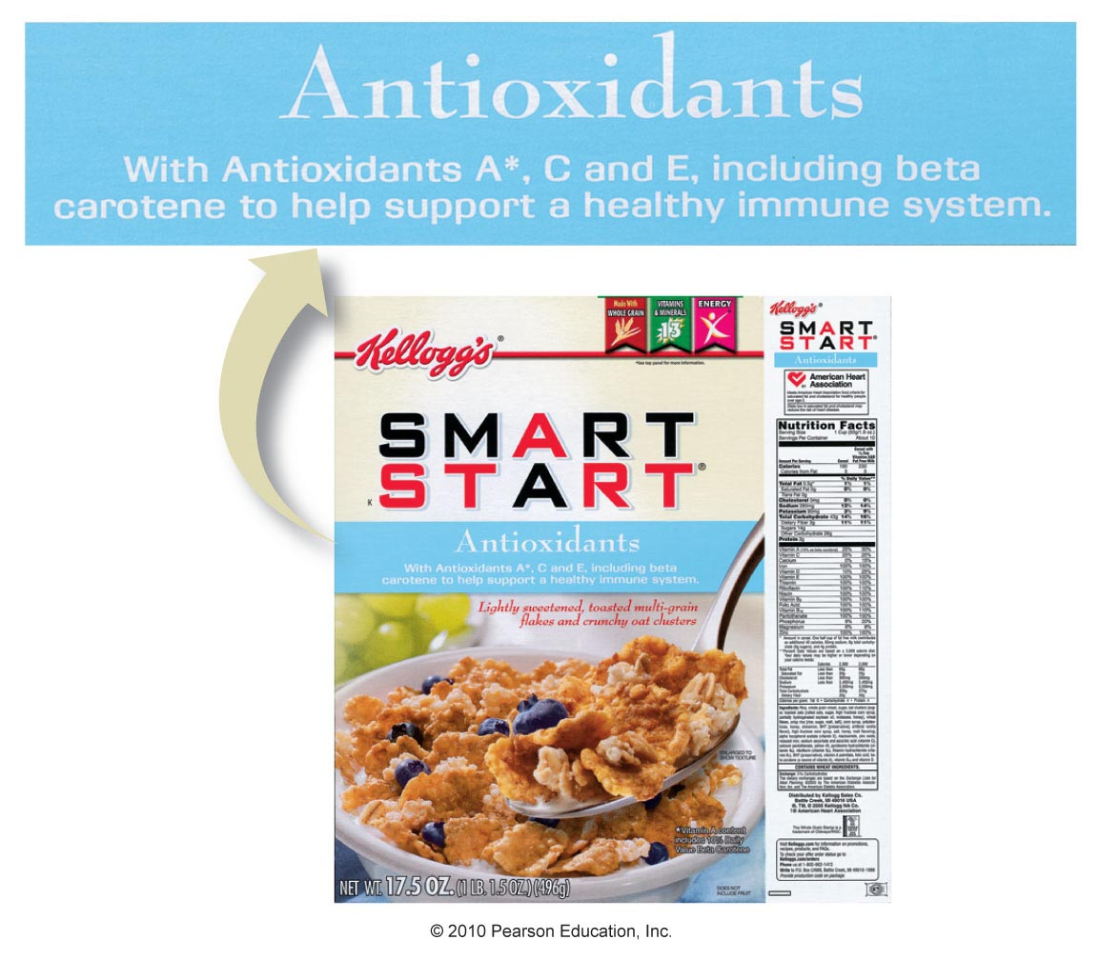
A Structure/Function Label Claim

Slide 42
Functional Foods
Functional foods = foods that provide health benefits beyond their normal nutrient contributions
Whole foods
Fortified foods
Modified foods

Slide 43
Functional Foods: What Role Do They Play in Your Diet?
Functional Foods: have a positive effect on health beyond providing basic nutrients
Example: Carrots, which contain beta-carotene, a phytochemical that protects cells from damaging substances that increase risk of some chronic diseases, including cancer
Zoochemicals: compounds in animal food products that benefit health
Example: Omega-3 fatty acids in fatty fish
Manufacturers also fortify food products with phyto- or zoochemicals

Slide 45
Any Questions?

