Slide 1
Line codes
There are several line codes can be used for the electrical representation of binary data stream
Many codes are available
Only five codes will be considered in these slides
A more detailed line codes can be found in reference books

Slide 2
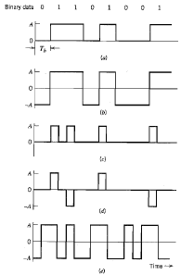
Basic line codes
Unipolar NRZ
Polar NRZ
Unipolar RZ
Bipolar RZ
Split phase or Manchester code

Slide 3
Unipolar non return to zero (NRZ)
In this code symbol $1$ is represented by transmitting a pulse of amplitude A for the duration of the symbol
Symbol $0$ is represented by switching off the pulse
This line code is referred to on-off signaling
Disadvantage of this line code is the waste of power due to the transmission of DC level

Slide 4
Polar non return to zero
In this line code, symbols $1$, $0$ are represented by transmitting a pulse of $+A$ and $–A$, respectively
The disadvantage of this line code is the large power spectrum of the signal near to zero frequency (waste of power transmission)
Advantage: easy to generate

Slide 5
Unipolar return to zero
In this line code, symbols $1$ is represented by a rectangular pulse of amplitude A for half of the bit width
$0$ is represented by transmitting no pulse
The disadvantage of this line code is that it requires 3 dB more power than polar-return to zero

Slide 6
Unipolar return to zero
Advantage: this line code contains a delta function at $f=0,±\frac{1}{T_{b}}$ in the power spectrum of the transmitted signal
This can be used for timing recovery at the receiver

Slide 7
Bipolar return to zero
In this line code symbol 1 is represented by +A and –A for half symbol width
Symbol 0 is represented by the transmission of no pulse
Advantage of this line code is that the power spectrum of the transmitted signal has no DC component
This code is sometimes called alternate mark inversion

Slide 8
Split phase (Manchester code)
Advantage of this line code is that the power spectrum of the transmitted signal has no DC component
Also this line code is self clocking

Slide 9
Differential encoding
This method is used to encode information in terms of the signal transition
A transition is used to present logic zero while no transition is used to present logic one

Slide 10
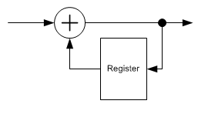
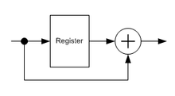
Differential encoder and decoder
Differential encoding process equivalent XNOR operation between the original bits to passing the original

Slide 11
Purpose of differential encoding
In the demodulation of BPSK, the carrier in the demodulator must have the same phase as the carrier in the modulator
If a phase error is presented in the carrier demodulator, the received data bits are inverted
Differential encoding ensures that the correct data bits are received whether the data bit stream inverted or not

Slide 12
Application of differential encoding
This type of modulation is used in satellite and radio relay communications with pass band modulation schemes PSK and QAM

Slide 13
Disadvantageous of differential encoding
The disadvantage of differential encoding is the error multiplication
If an error occurs to one bit during transmission, then two bits would be interpreted incorrectly in the receiver

