Slide 1
Lab Part II

Slide 2
Environmental Factors in Plant Prop.
Fiberglass (resin reinforced fiberglass)
long-lasting
light-weight
should only use clear as it yellows quickly
burns readily
brittle with age

Slide 3
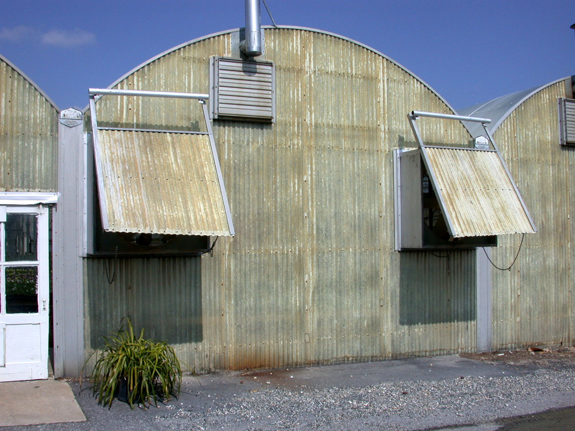

Slide 4
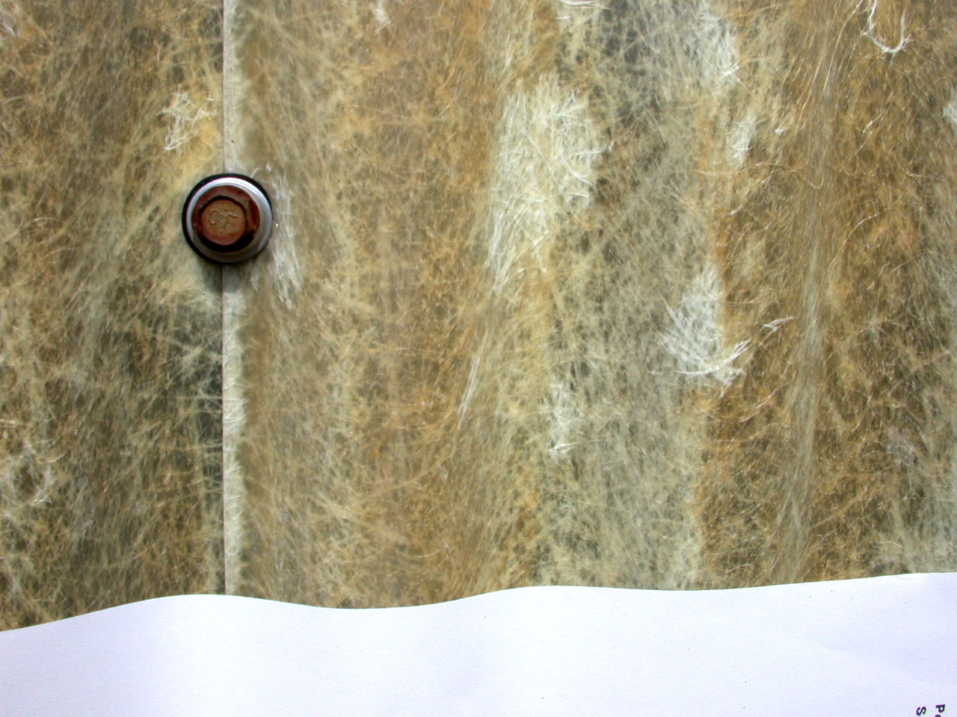

Slide 5
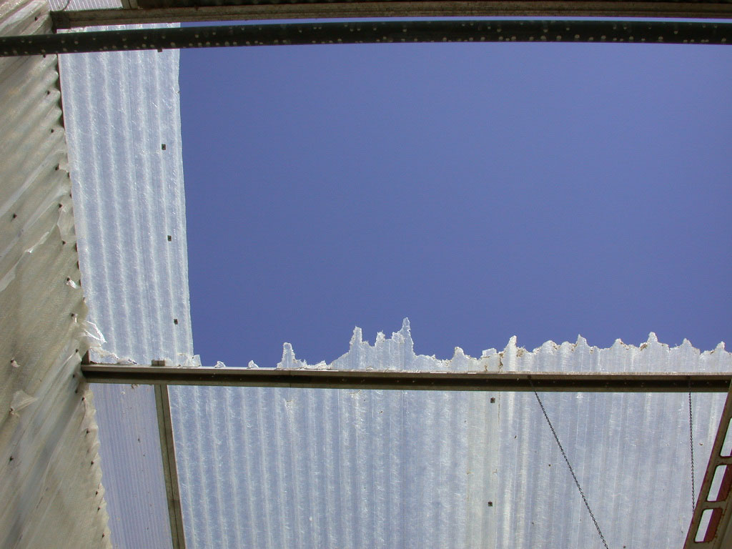

Slide 6
Environmental Factors in Plant Prop.
Cold frame: used for passive propagation (hardening rooted cuttings & over-wintering)
Hotbed: used for active propagation
Lathhouse: outdoor shade protects new seedlings/rooted cuttings from high summer temperatures and high irradiance
For hardening-off seedlings and acclimatization
For shade-requiring plants

Slide 7
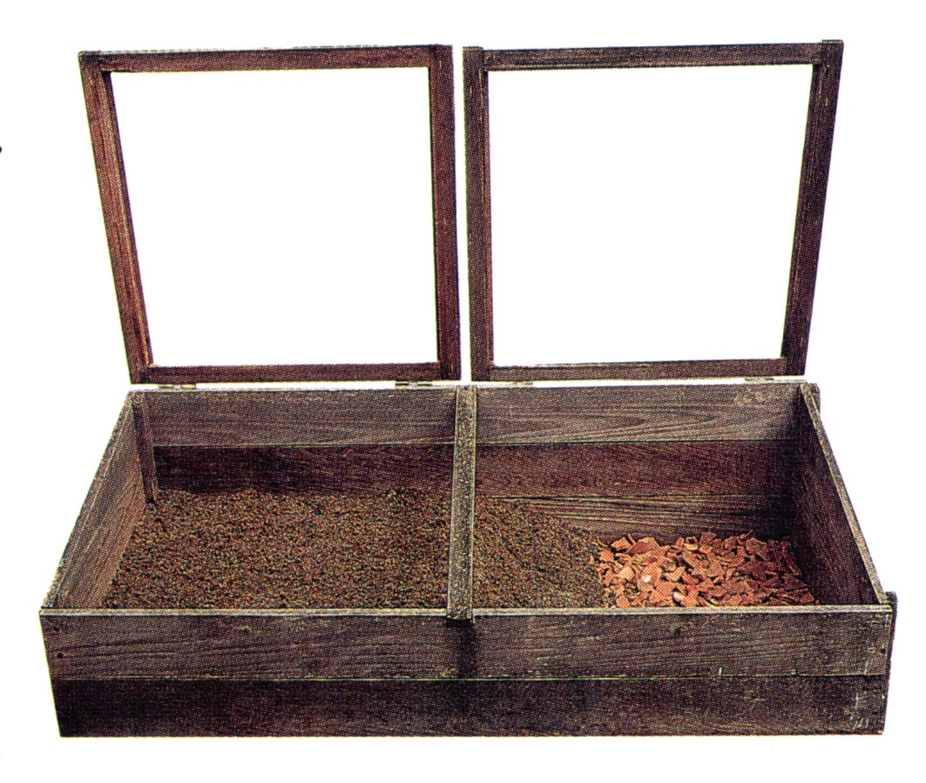
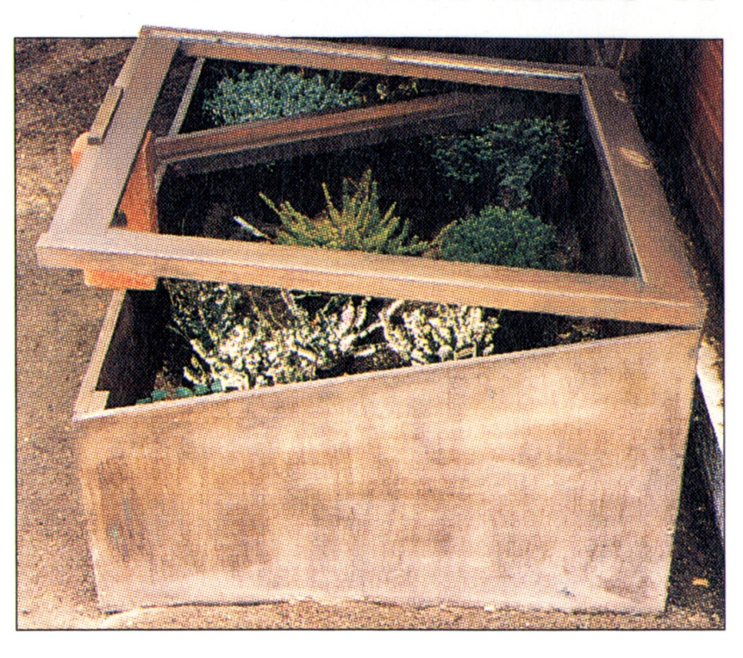
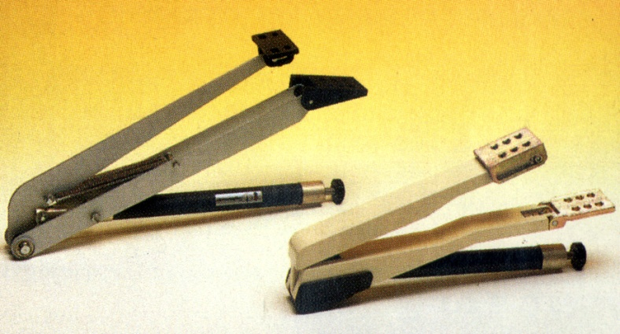
Cold frames
Hydraulic vent-openers

Slide 8
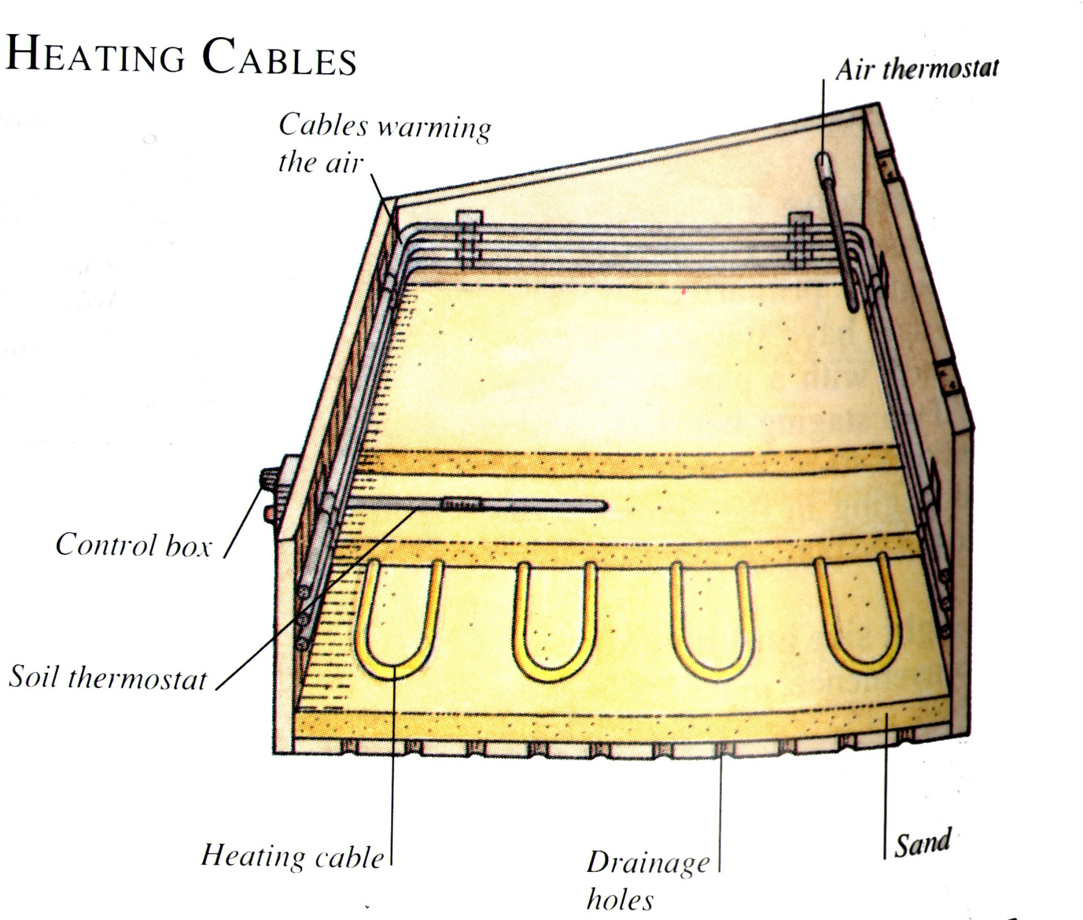
Hotbed

Slide 9
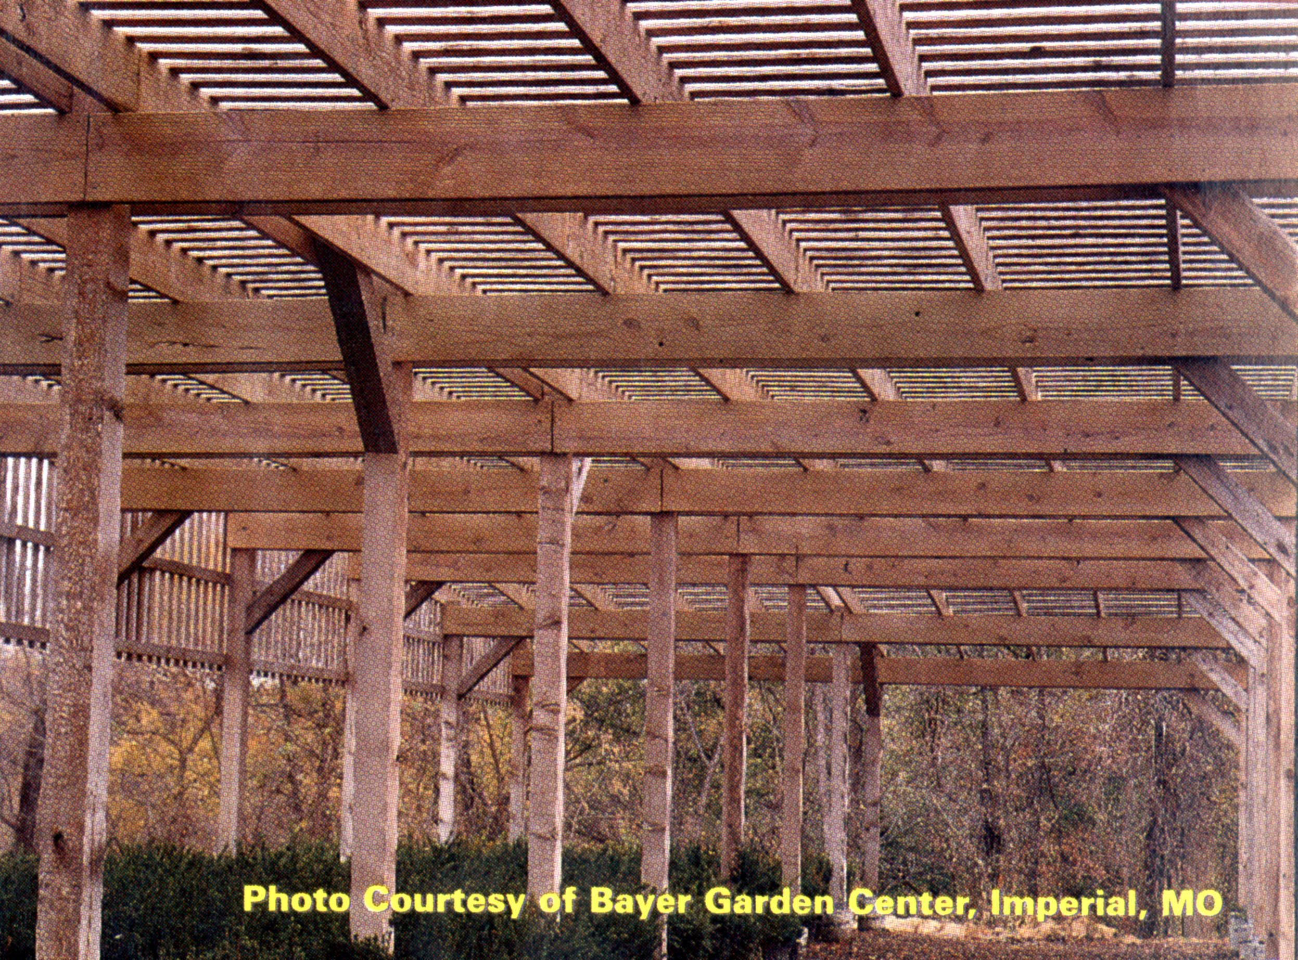

Slide 10
Environmental Factors in Plant Prop.
Containers
Flats:
plastic (polyethylene and polystyrene),
styrofoam
wood (typically cedar, NOT pressure-treated lumber! This contains arsenic and toxic levels of copper)
For germinating seeds or rooting cuttings

Slide 11
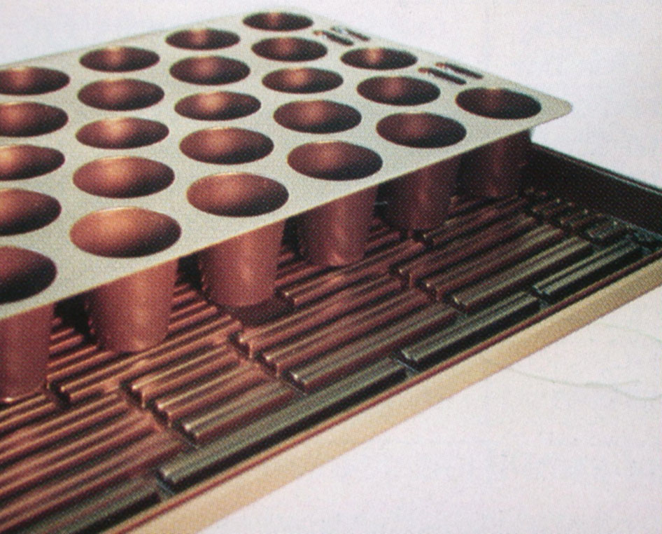
Plug-flat with tray to catch water

Slide 12
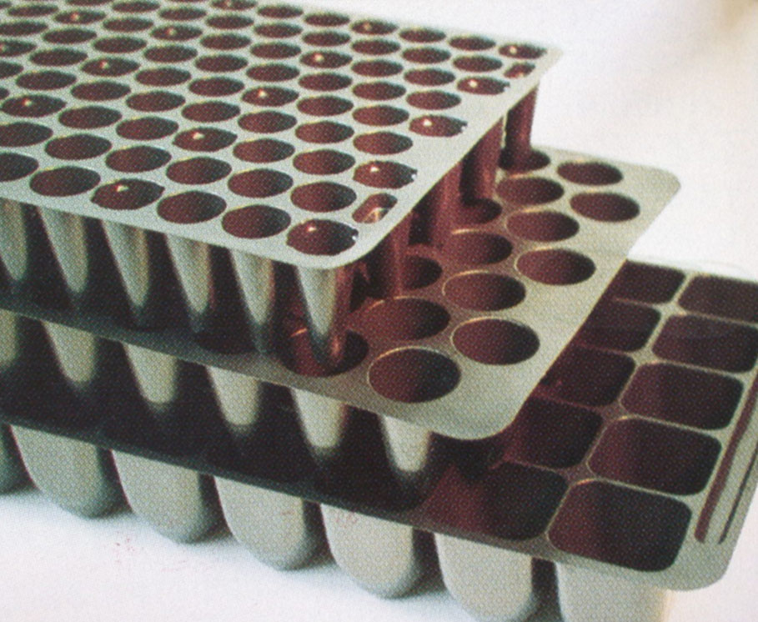
Assorted plug trays

Slide 13
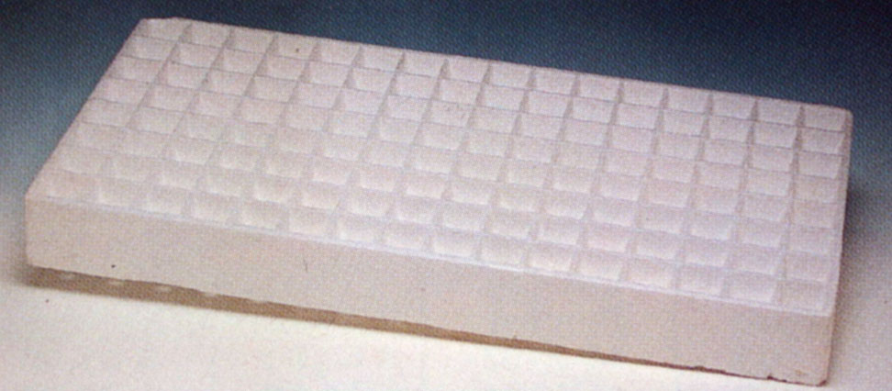
Styrofoam plug trays

Slide 14
Environmental Factors in Plant Prop.
Containers
Clay pots
heavy
breakable
lose water
shape not economical
salts accumulate

Slide 15
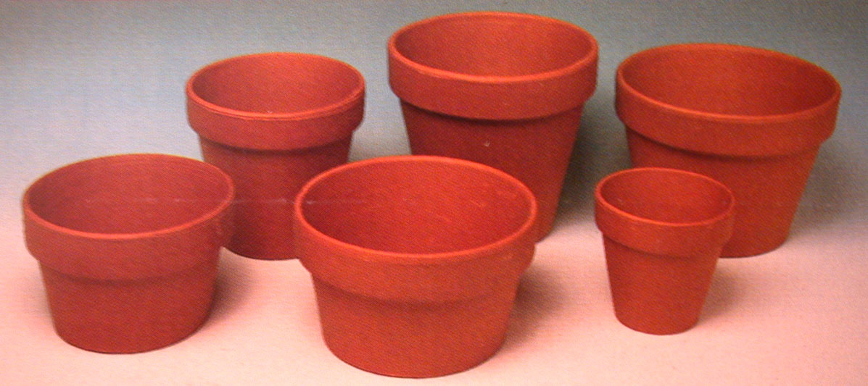

Slide 16
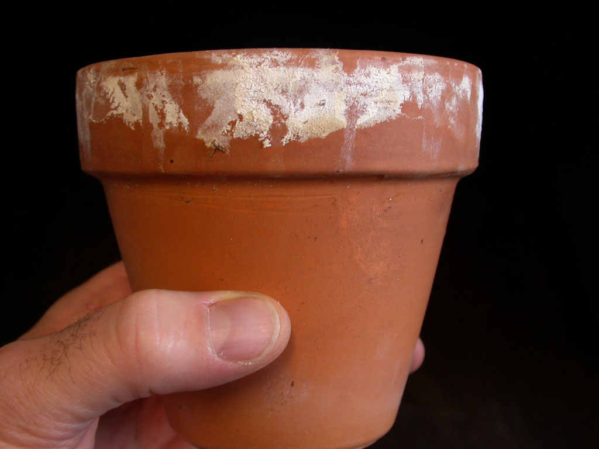

Slide 17
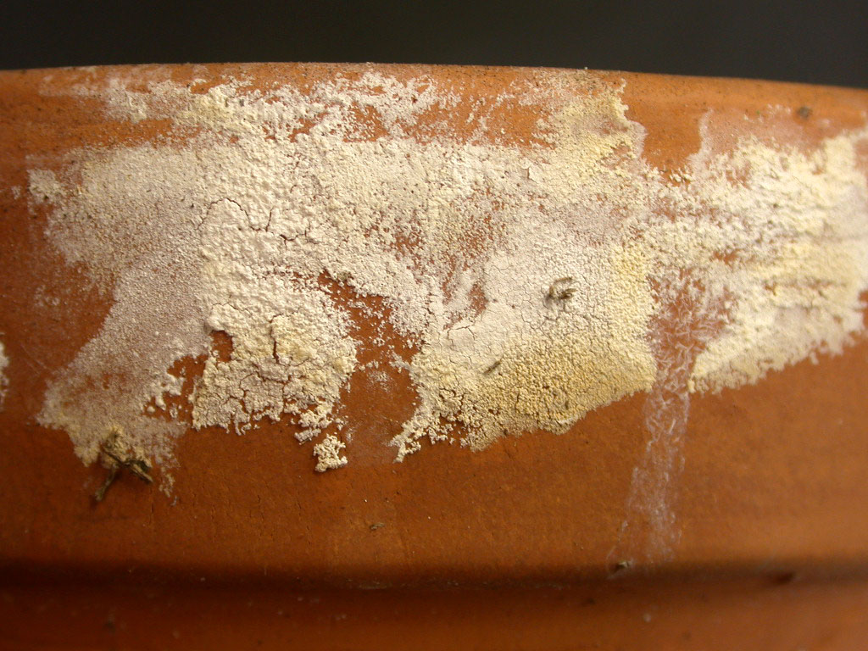

Slide 18
Environmental Factors in Plant Prop.
Plastic pots - round or square
reusable (can be treated with hot water but NOT steam)
lightweight
require little storage area (stackable)
sturdy yet flexible
variety of colors, ribbed to channel roots,
can be treated with copper hydroxide (CuOH₂)
can reduce irrigation needs
brittle in cold weather
sometimes difficult to recycle/dispose of

Slide 19
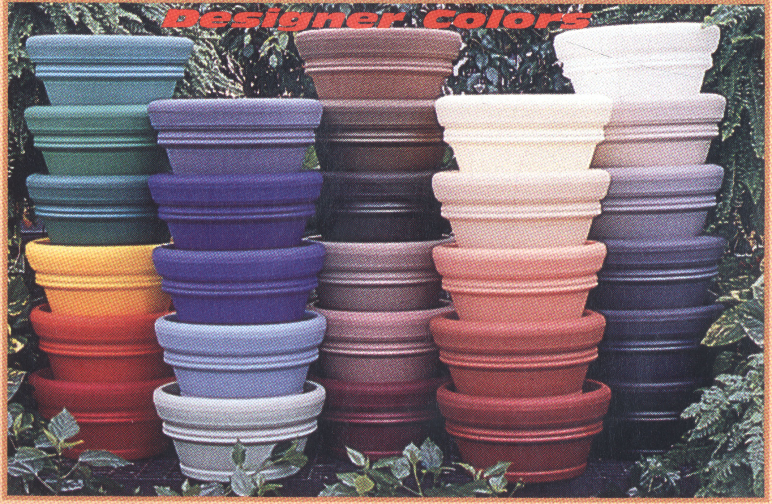

Slide 20
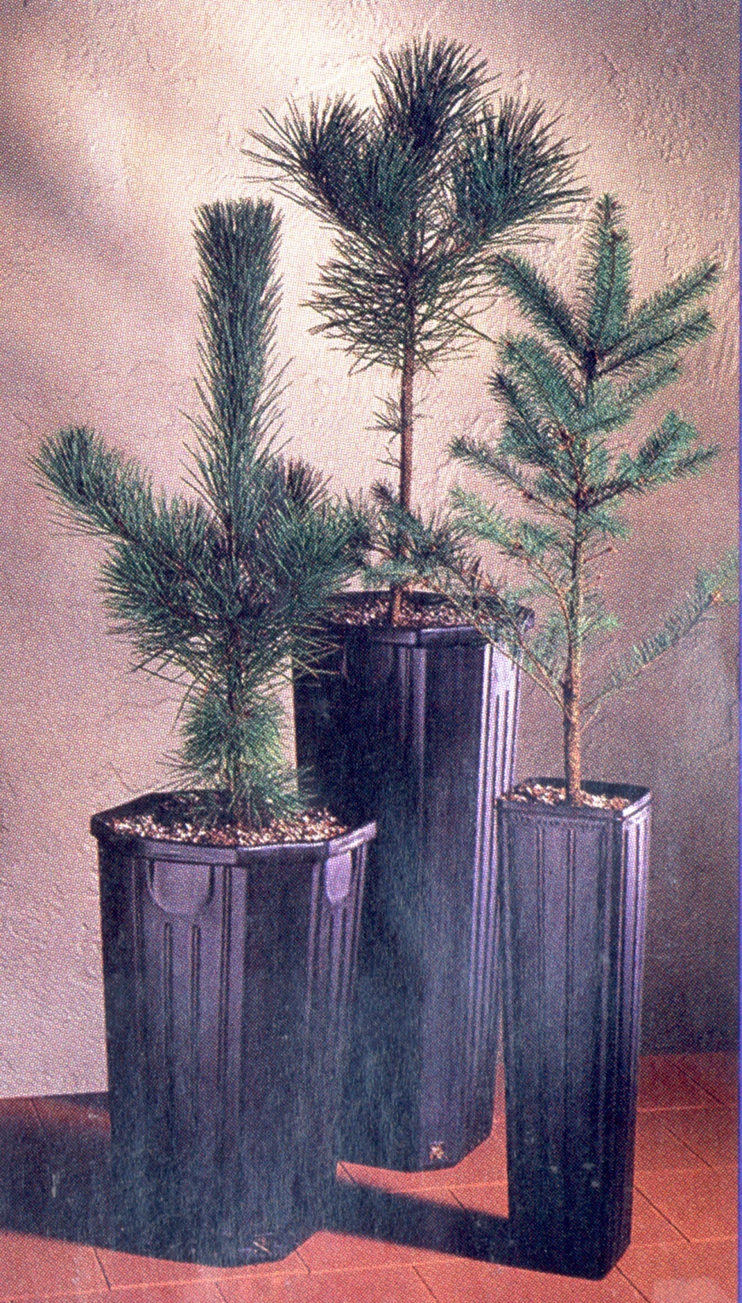

Slide 21
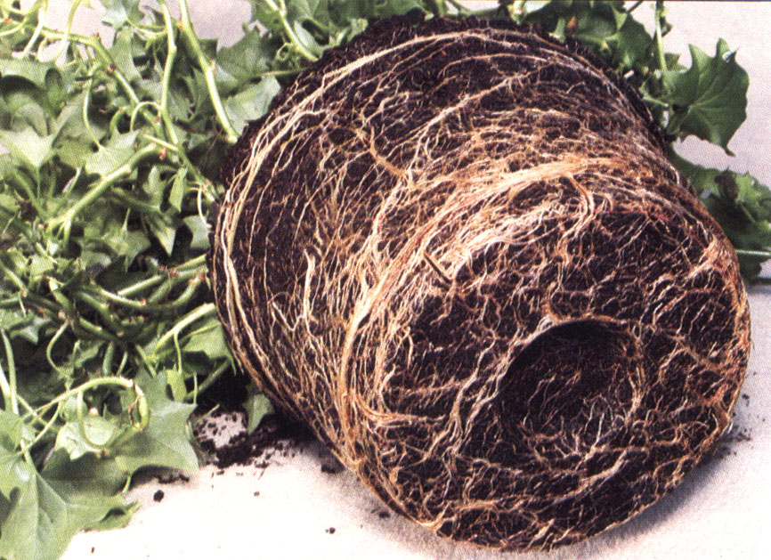
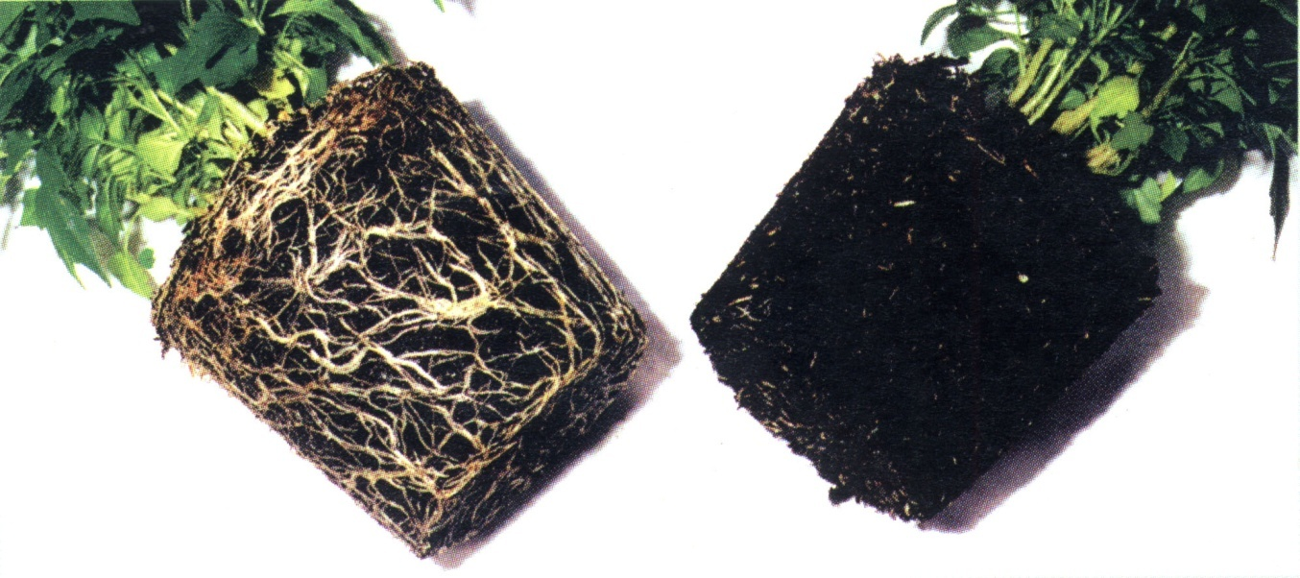
Copper hydroxide in pots
to control spiraling roots
Pot-bound
or
Root-bound
No treatment
Treated

Slide 22
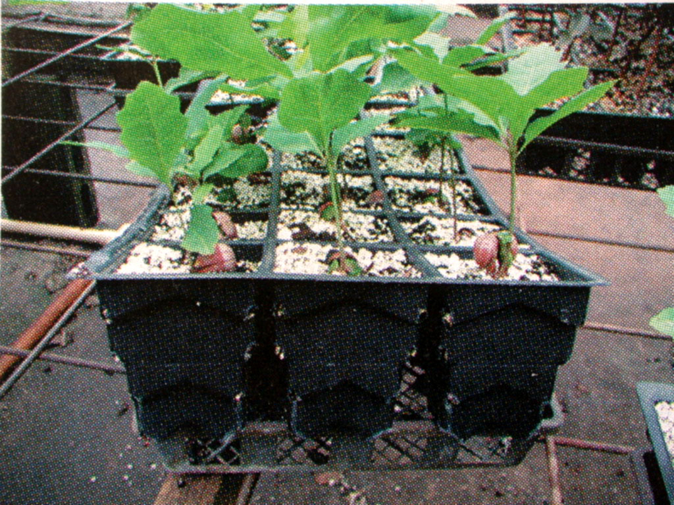
Whitcome system of air root pruning

Slide 23
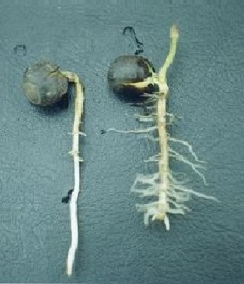
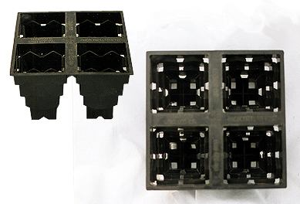
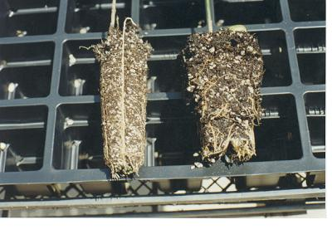
Whitcome System “Rootmaker”

Slide 24
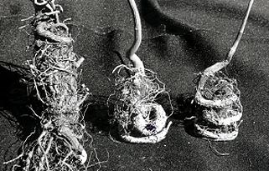
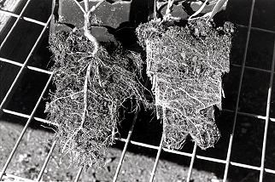
Whitcome System “Rootmaker”
Roots from Whitcome pots
Roots from conventional pots

Slide 25
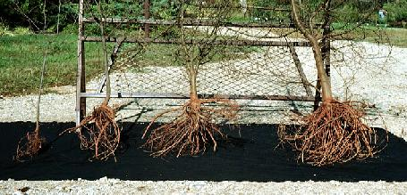
Whitcome System “Rootmaker” All plants are the same age!

Slide 26
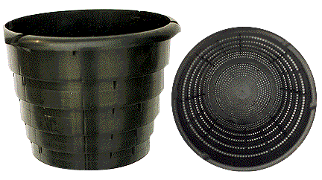
Whitcome System “Rootmaker”

Slide 27
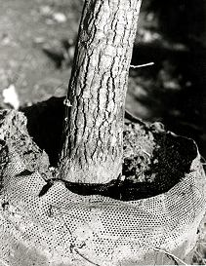
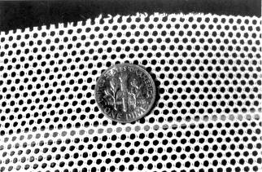
Whitcome System “Rootmaker”

Slide 28
Environmental Factors in Plant Prop.
Fiber pots
Peat and wood fiber
Biodegradable
Short life-span
Exposed to air causes wicking of water
If pot dries out, roots will not penetrate
Coir pots
Paper
Mostly used in forestry

Slide 29
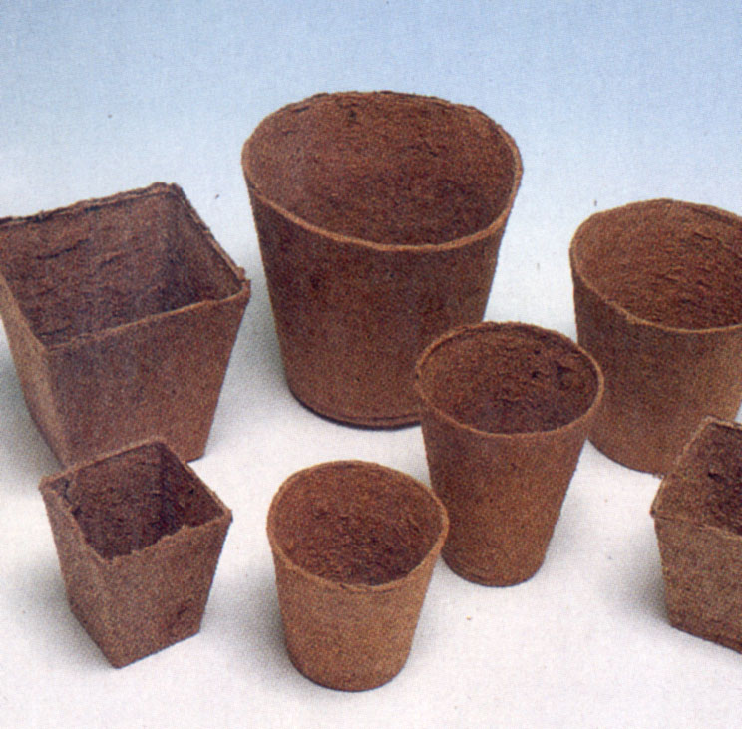
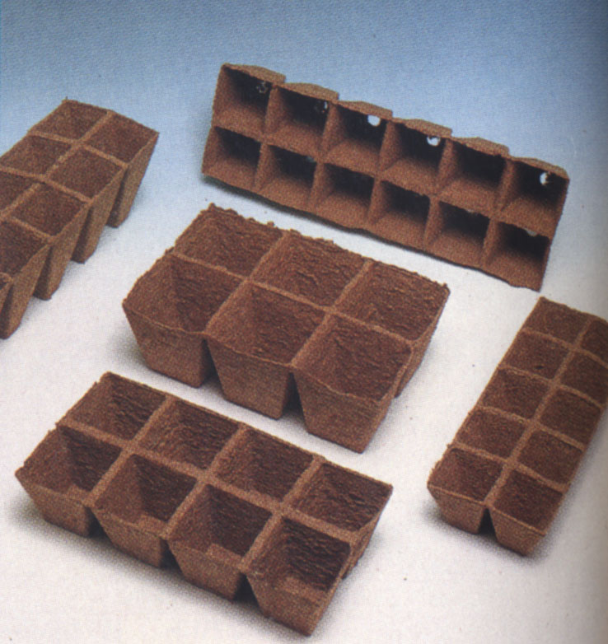
Fiber/peat pots and cell packs

Slide 30
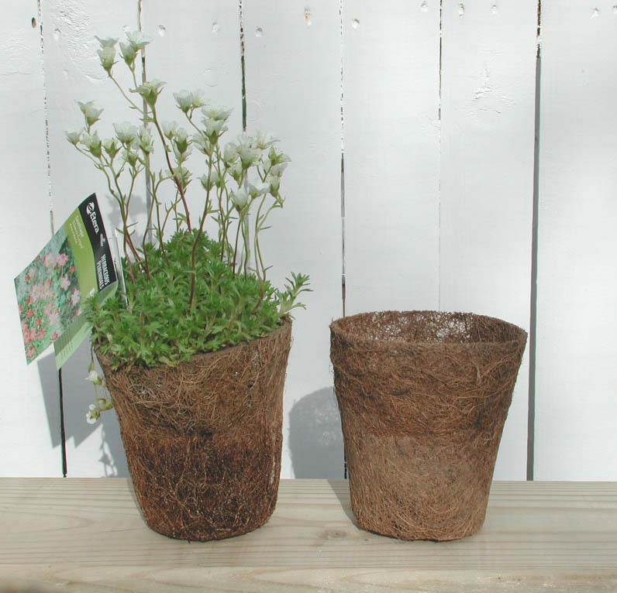
Coir pot

Slide 31
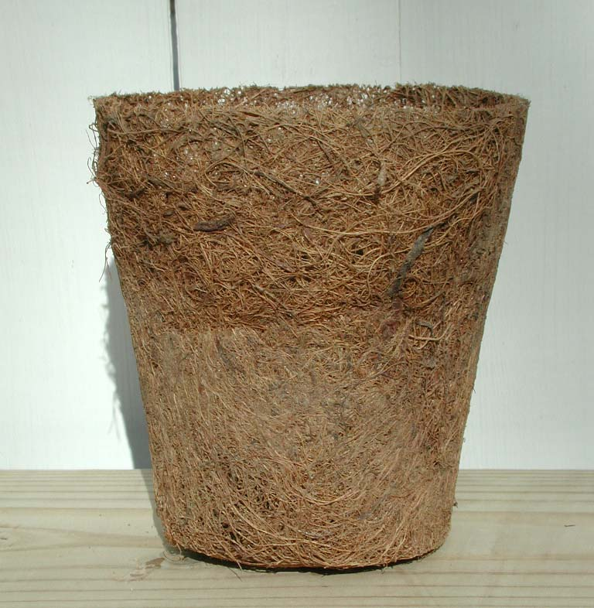
Coir pot

Slide 32
Environmental Factors in Plant Prop.
Speciality containers:
Peat pots - “Jiffy” pots and “Ellepots”
Seedlings
Rooting cuttings
Expanded foam = oasis
Rooting cuttings
Hydroponics
Rockwool
Rooting cuttings
Hydroponics
Polyethylene bags : rare in US but inexpensive
Grow-bags (often impregnated with copper)

Slide 33
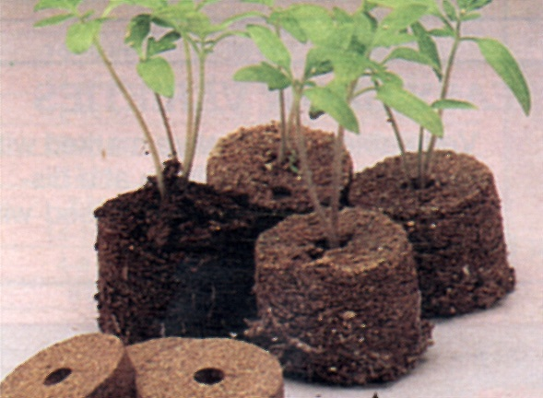
Expanded Jiffy peat pellets for seedlings or cuttings

Slide 34
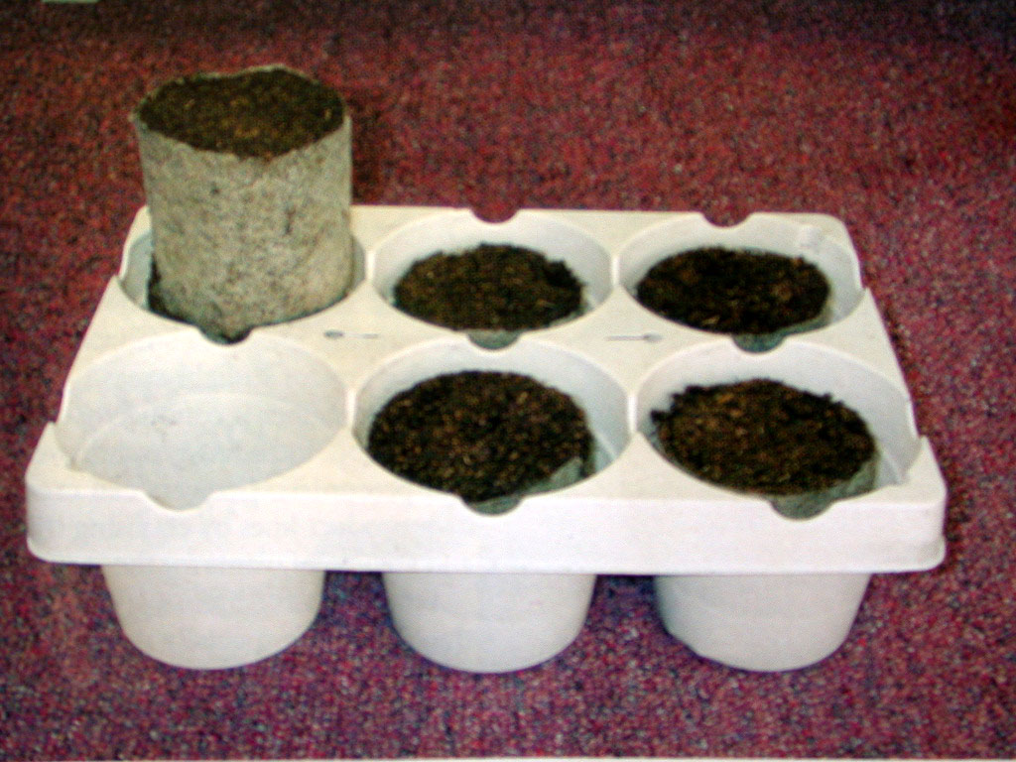
Expanded larger-size Jiffy peat pellets for seedlings

Slide 35
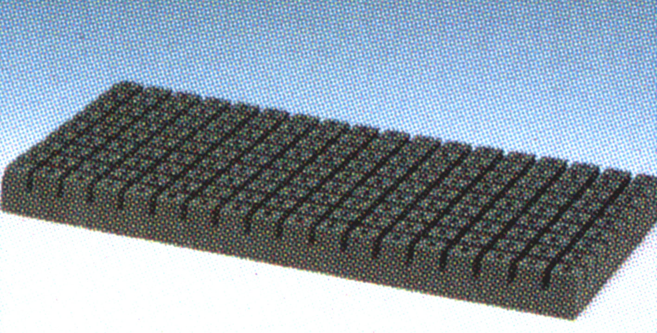
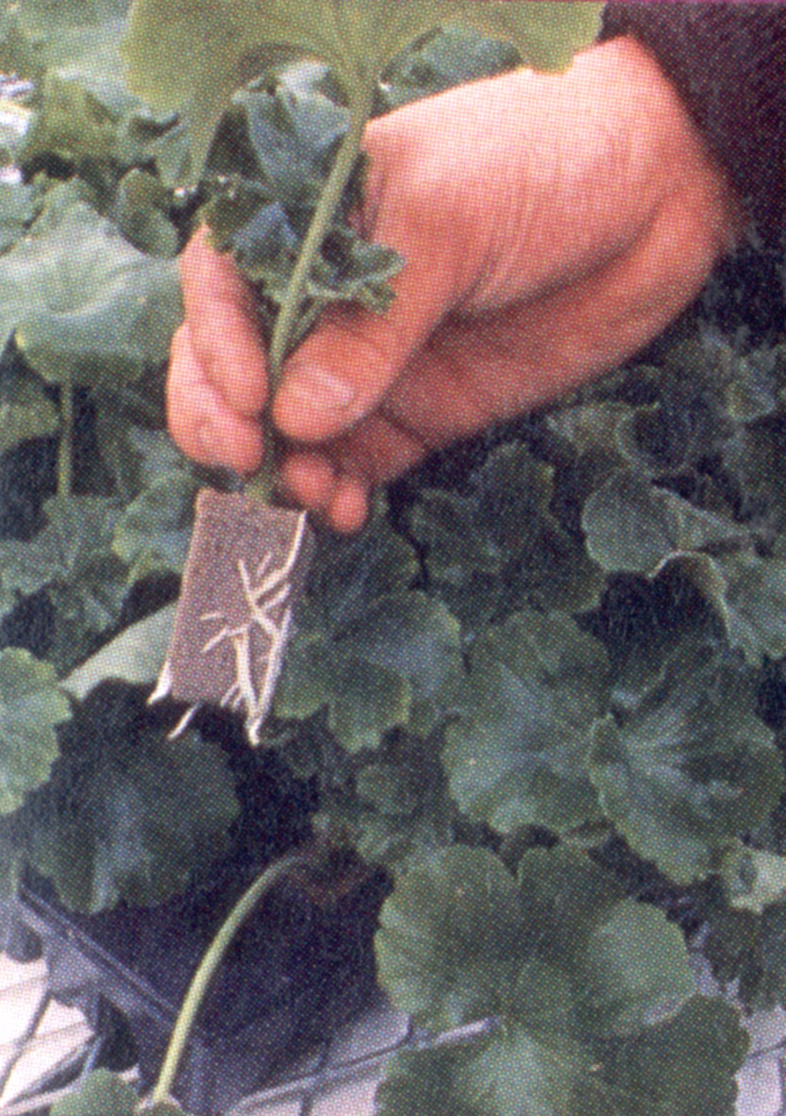
Oasis rooting medium

Slide 36
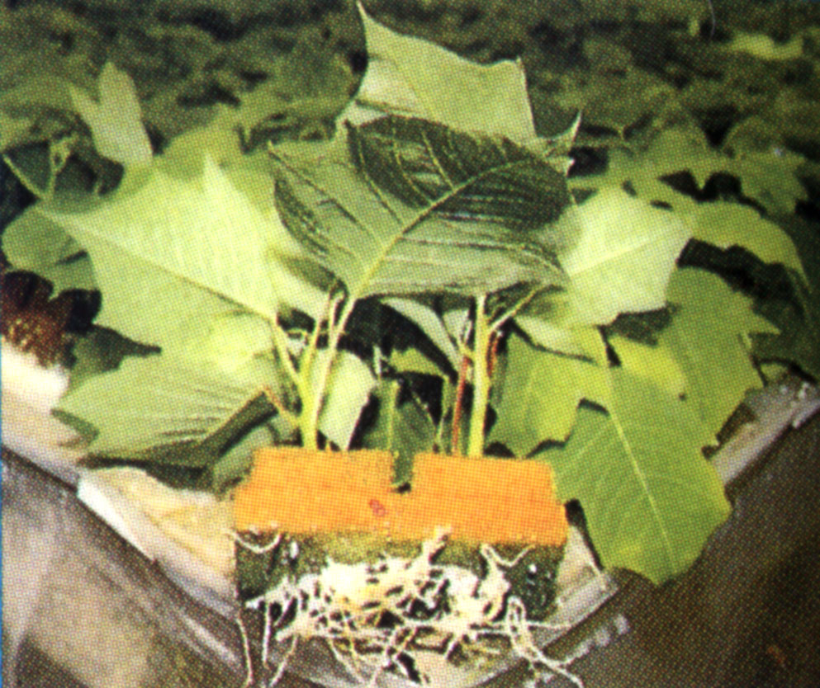
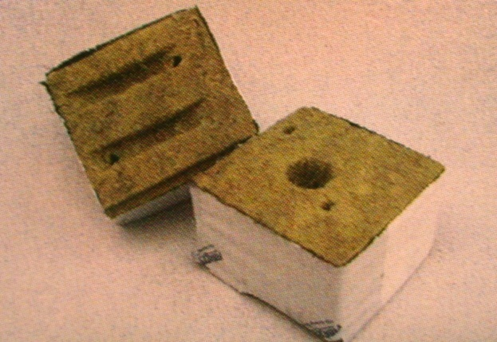
Rockwool cube and rooted poinsettia cuttings

Slide 37
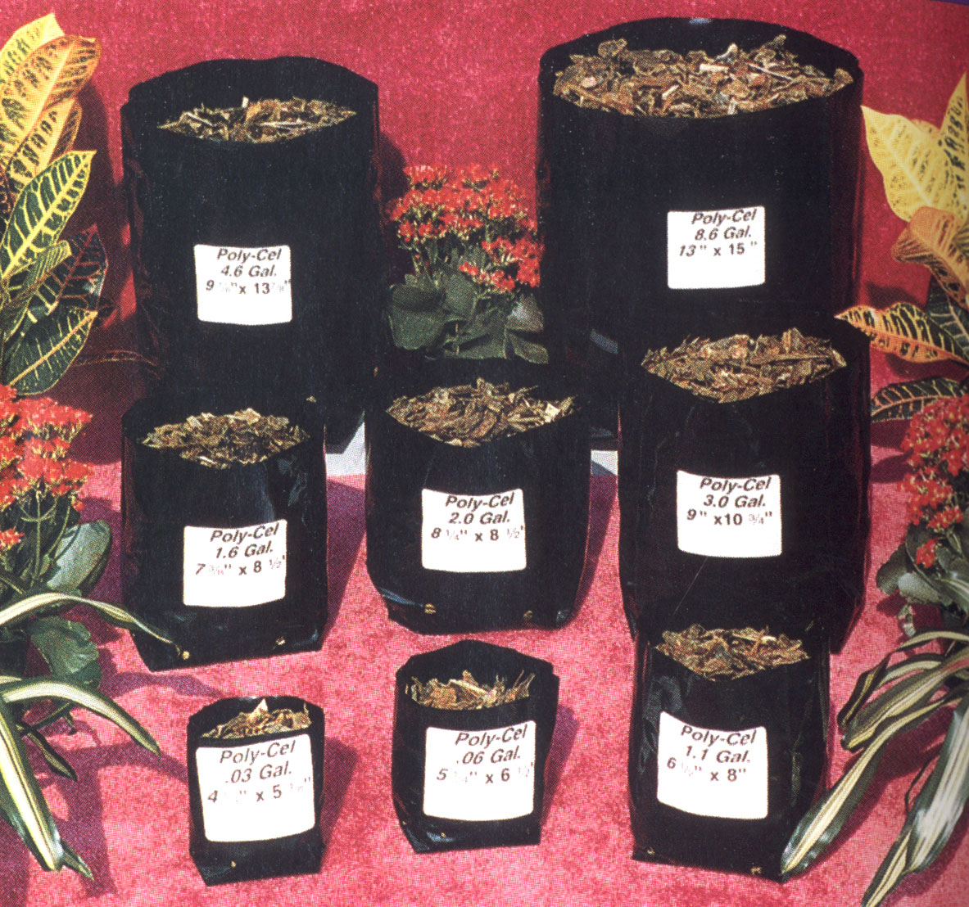

Slide 38
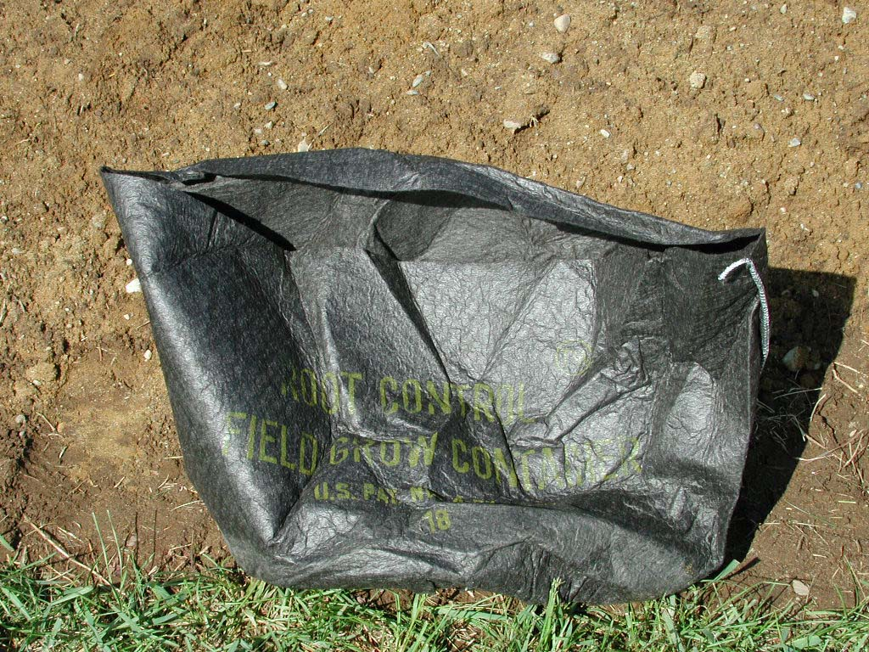

Slide 39
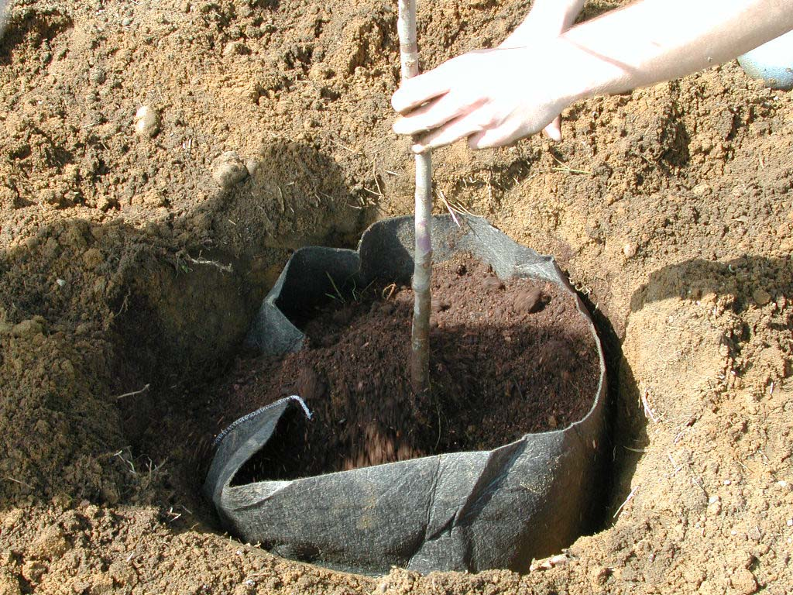

Slide 40
Environmental Factors in Plant Prop.
Edaphic factors (root zone)
Media
firm and dense
consistent volume (wet or dry)
highly decomposed (reduces shrinkage)
easy to wet and moisture retentive
sufficiently porous (allow excess to drain)
free from weed seeds, nematodes, pathogens

Slide 41
Environmental Factors in Plant Prop.
Media (continued)
low salinity
capable of steam pasteurizing or chemically treating
high CEC for retention of nutrient
consistent quality
readily available
reasonable cost

Slide 42
Environmental Factors in Plant Prop.
Components
Organic:
peat
bark
sphagnum moss
coir
compost
composted rice hulls

Slide 43
Environmental Factors in Plant Prop.
Components
Inorganic:
( mineral components for drainage and aeration)
Sand
Perlite
Vermiculite
Calcined clay
Polystyrene
Rockwool

Slide 44
Environmental Factors in Plant Prop.
Soil: seldom used- variable, heavy
Sand:
typically quartz rock
heavy
no nutrients
no CEC
no pH buffering
easy to steam sterilize/pasteurize

Slide 45
Environmental Factors in Plant Prop.
Peat
Remains of marsh, bog or swamp vegetation
partially decomposed
Can have weeds, insects, pathogens
Types:
Peat moss - least decomposed, tan/brown, high water retention, highly acidic (≈3.5), some nitrogen
peat humus- advanced decomposition, dark brown, low water retention, highly acidic, more available nitrogen
Expensive and limited supply

Slide 46
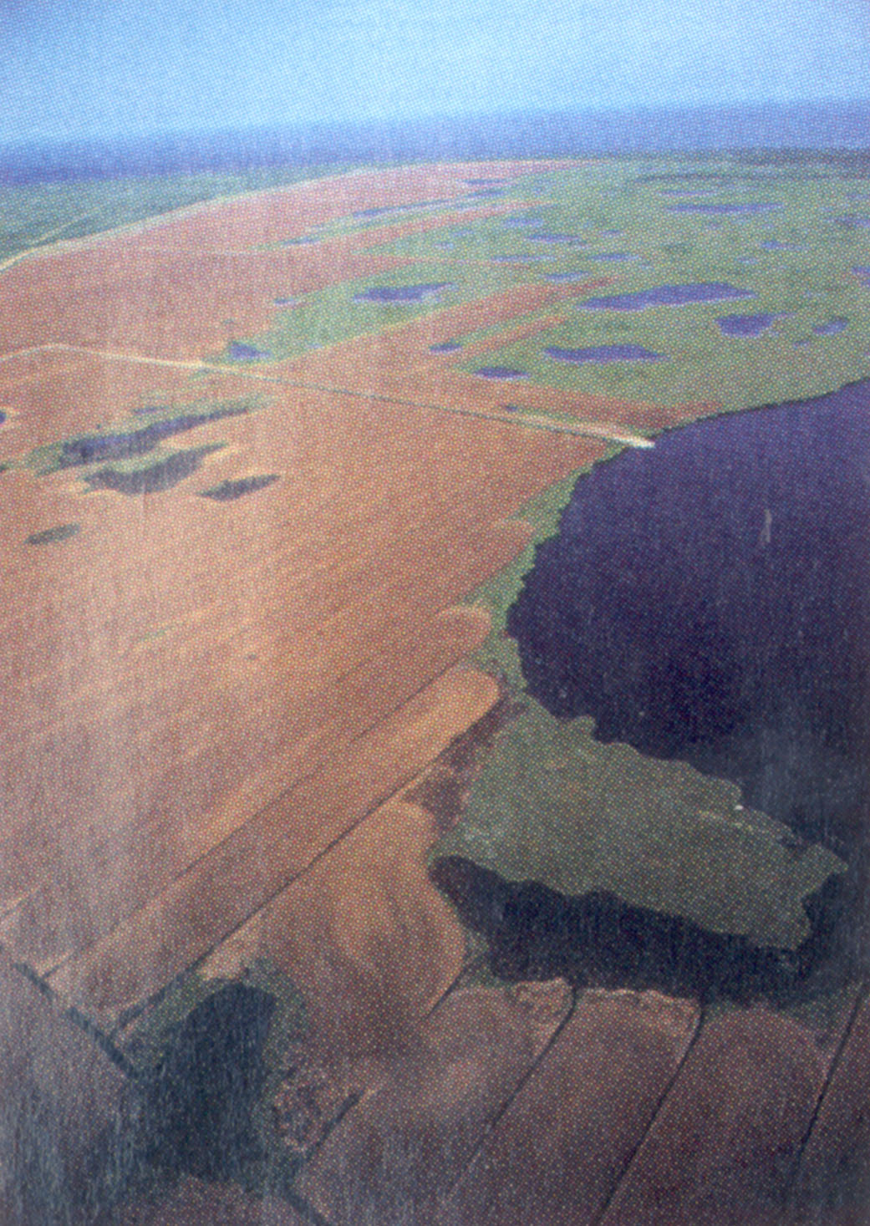
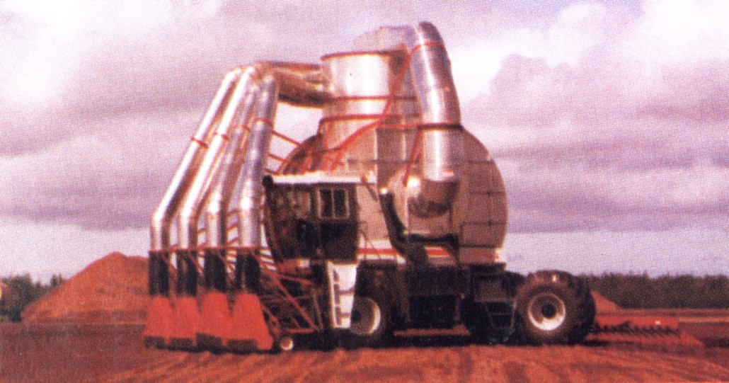
Peat bog in Canada
Harvester

Slide 47
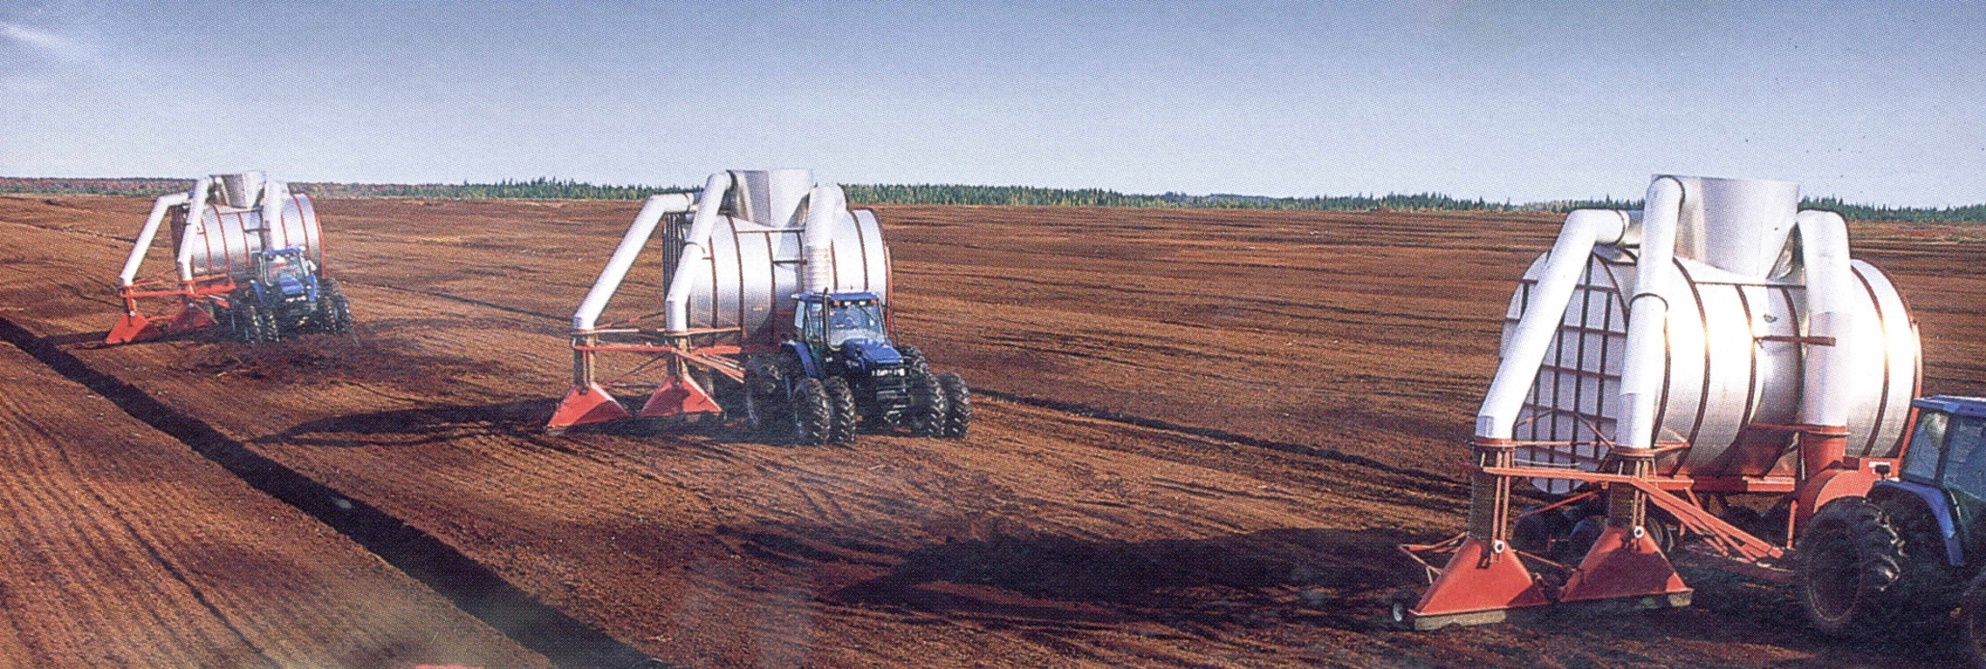
Peat harvesters at work

Slide 48
Environmental Factors in Plant Prop.
Sphagnum moss peat
Dehydrated plants of the genus Sphagnum
Pathogen-free
Light weight
High water retention
Highly acidic
Fungistatic properties
Desirable medium

Slide 49
Environmental Factors in Plant Prop.
Vermiculite
Hydrated magnesium-aluminum-iron silicate
Tan in color
Lightweight
Good pH buffer
High water retention
High CEC
Available nutrients (Mg & K)
Sterile (heated to 2,000F)
Use a dust mask and moisten when mixing!!

Slide 50
Environmental Factors in Plant Prop.
Perlite
Silicaceous materials (volcanic)
White in color
Lightweight
Moderate water retention
No buffering capacity
No CEC
No nutrients available
Increases aeration in mix
Sterile (heated to 1,400F)
Can release fluoride
Use a dust mask and moisten when mixing!!

Slide 51
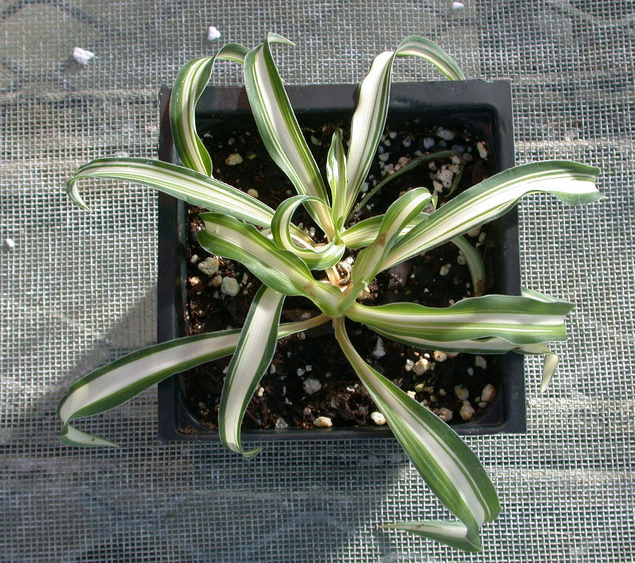
Spider plant (fluorine sensitive)

Slide 52
Environmental Factors in Plant Prop.
Calcined clay (Turface®)
Retains water
Heavy but adds stability for field containers
Sterile (heated)
Pumice
Volcanic
Provides aeration and drainage
Regionally used (Hawaii)

Slide 53
Environmental Factors in Plant Prop.
Shredded bark
Softwood
Fir, pine, hemlock
May contain phenols, resins, terpenes & tannins
Must be composted
Low pH (acidic)
Hardwood
Oak and maple
Must be composted
High pH (basic)

Slide 54
Environmental Factors in Plant Prop.
Synthetic plastic aggregates
Polystryrene “peanuts”
Polyethylene chips
Compost: product produced from the biological decomposition of bulk organic wastes under controlled conditions
Typically high in salts
Variable

Slide 55
Environmental Factors in Plant Prop.
Preplant amendments
Dolomitic limestone
Wetting agents (surfactants)
Fertilizer
Peat-lite mixes
Peat & perlite
Peat & vermiculite
Developed at Cornell University in mid-1960’s

Slide 56
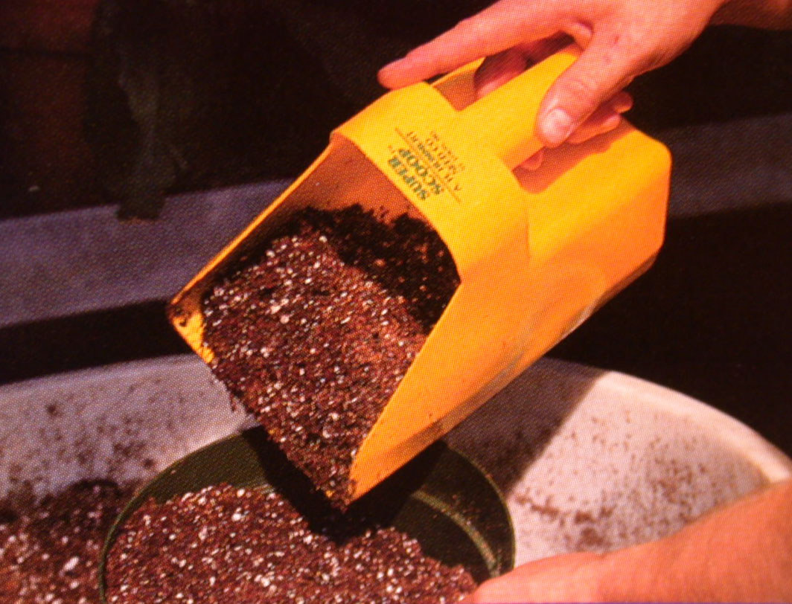

Slide 57
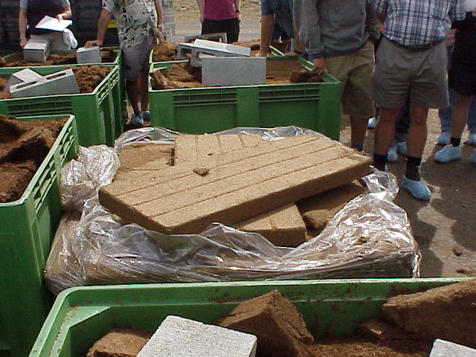
Coco Peat – a compressed coconut fibre which is widely used as a peat substitute

Slide 58
Selecting Ingredients for Media
Simplicity of the mix formula
Complex mixes are difficult to prepare;
The complexity often leads to mistakes;
KISS – Keep it Simple Stupid

Slide 59
Examples of commercial prop mixes
1 part peat : 1 part sand
1 part peat : 1 part perlite
1 part peat : 1 part vermiculite
1 part peat : 1 part pine bark
1peat : 1 perlite : 1 vermiculite

Slide 60
Environmental Factors in Plant Prop.
Nutrition
Fertigation - liquid fertilizers
Only fertigate crops using plastic/PVC piping!
Controlled-release (slow-release)
Resin-coated = Osmocote
Sulfur coated
Slowly soluble = MagAmp and Urea formaldehyde

