Slide 1
An-Najah National University
Faculty of Medicine
Department of Physiology
Anatomy and Physiology 1
7102101
Instructor: Heba Salah
Chapter 6:
The DigestiveSystem
Part 4: The Accessory Digestive Organs: Liver, and Gallbladder, Gastrointestinal Tract Processes

Slide 2
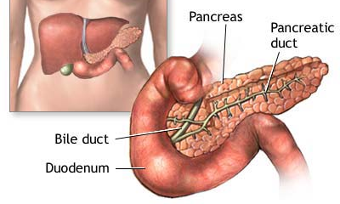
Pancreas
Produces a wide spectrum of digestive enzymes that break down all categories of food
Enzymes are secreted into the duodenum
Alkaline fluid introduced with enzymes neutralizes acidic chyme
Endocrine products of pancreas:
1. Insulin
2. Glucagons

Slide 3
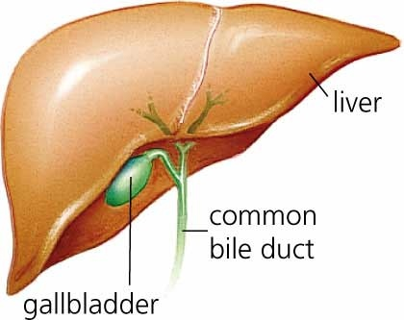
Liver and Gallbladder
1. Liver:
Consists of four lobes suspended from the diaphragm and abdominal wall by the falciform ligament
Connected to the gall bladder via the common hepatic duct
2. Gallbladder:
Sac found in hollow fossa of liver
Stores bile from the liver by way of the cystic duct

Slide 4
Processes of the Digestive System
1. Ingestion:
getting food into the mouth
2. Propulsion:
moving foods from one region of the digestive system to another

Slide 5
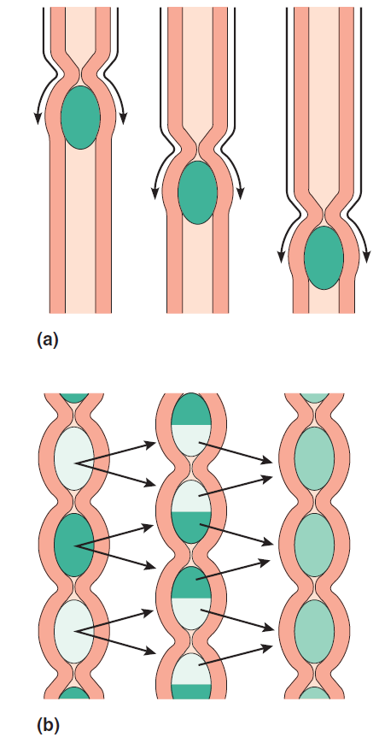
Processes of the Digestive System
Peristalsis – alternating waves of contraction
Segmentation – moving materials back and forth to aid in mixing

Slide 6
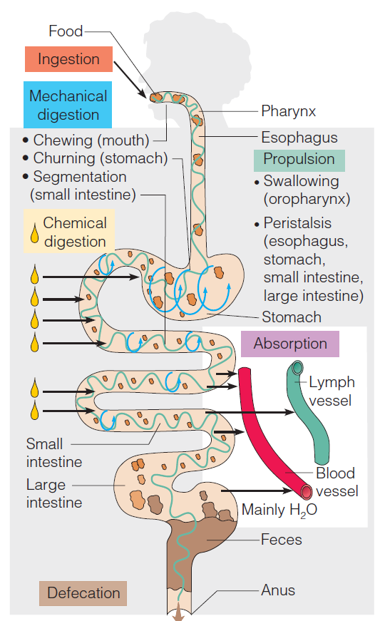
Processes of the Digestive System

Slide 7
Control of Digestive Activity
Mostly controlled by reflexes via the parasympathetic division
Chemical and mechanical receptors are located in organ walls that trigger reflexes
Stimuli include:
Stretch of the organ
pH of the contents
Presence of breakdown products
Reflexes include:
Activation or inhibition of glandular secretions
Smooth muscle activity

