Slide 1
Digital multiplexers
In TDM a group of analog signals are sampled sequentially in time at a common sampling rate and then multiplexed for transmission over a common line
In this section the multiplexing of digital signals at different rates will be considered
Multiplexing of digital signals is accomplished by using a bit-by bit interleaving

Slide 2
Digital multiplexers
A selector switch is used sequentially takes a bit from each incoming line, then applies it to a high speed common line
At the receiving end of the system the output of this common line is separated out into its low speed individual components and then delivered to their destination

Slide 3
Digital multiplexers block diagram

Slide 4
Digital multiplexers groups- group 1
Digital multiplexers are divided into two major groups
One group is used to take relatively low bit-rate data streams originating from computers and multiplex them for TDM transmission over the public switched telephone network. This group requires the use of modulators and demodulators

Slide 5
Digital multiplexers groups- group 2
The second group forms part of the data transmission services
These multiplexers constitute a digital hierarchy that time division multiplexes low rate bit streams into much higher rate bit streams

Slide 6
Digital signal zero (DS0) hierarchy
The DS0 standard takes one voice signal, then samples it at a sampling frequency of 8 kHz/s, the samples are converted into PCM using 8-bit quantizer
This means that the DS0 produces data at a rate of 64 kbit/s

Slide 7
Digital signal one (DS1) hierarchy
DS1 is the first level of the hierarchy
DS1 combines 24 DS0 bit streams to obtain a digital signal one at 1.544 Mb/s
The bandwidth of the DS1 is computed from the following equation
$R_{B}=number of bits×sampling rate$
$$R_{B}=\left(8×24+1\right)×8000=1.544 Mbit/second$$

Slide 8
Digital signal two (DS2) hierarchy
DS2 is the second level multiplexer
DS2 combines 4 DS1 bit streams to obtain a digital signal one at 6.312 Mb/s
The bandwidth of the DS2 is computed from the following equation

Slide 9
Digital signal three (DS3) hierarchy
DS3 is the third level multiplexer
DS3 combines 7 DS2 bit streams to obtain a digital signal one at 44.736 Mb/s

Slide 10
Digital signal four (DS4) hierarchy
DS4 is the fourth level multiplexer
DS4 combines 6 DS3 bit streams to obtain a digital signal one at 274.176 Mb/s

Slide 11
Digital signal five (DS5) hierarchy
DS5 is the fifth level multiplexer
DS5 combines 2 DS4 bit streams to obtain a digital signal one at 560.16 Mb/s

Slide 12
Problems involved in the design of a digital multiplexer
Synchronization between receiver and receiver
The multiplexed signal must include some form of framing so that its individual components can be identified at the receiver
The multiplexer has to handle small variations in the bit rates of the incoming digital signals

Slide 13
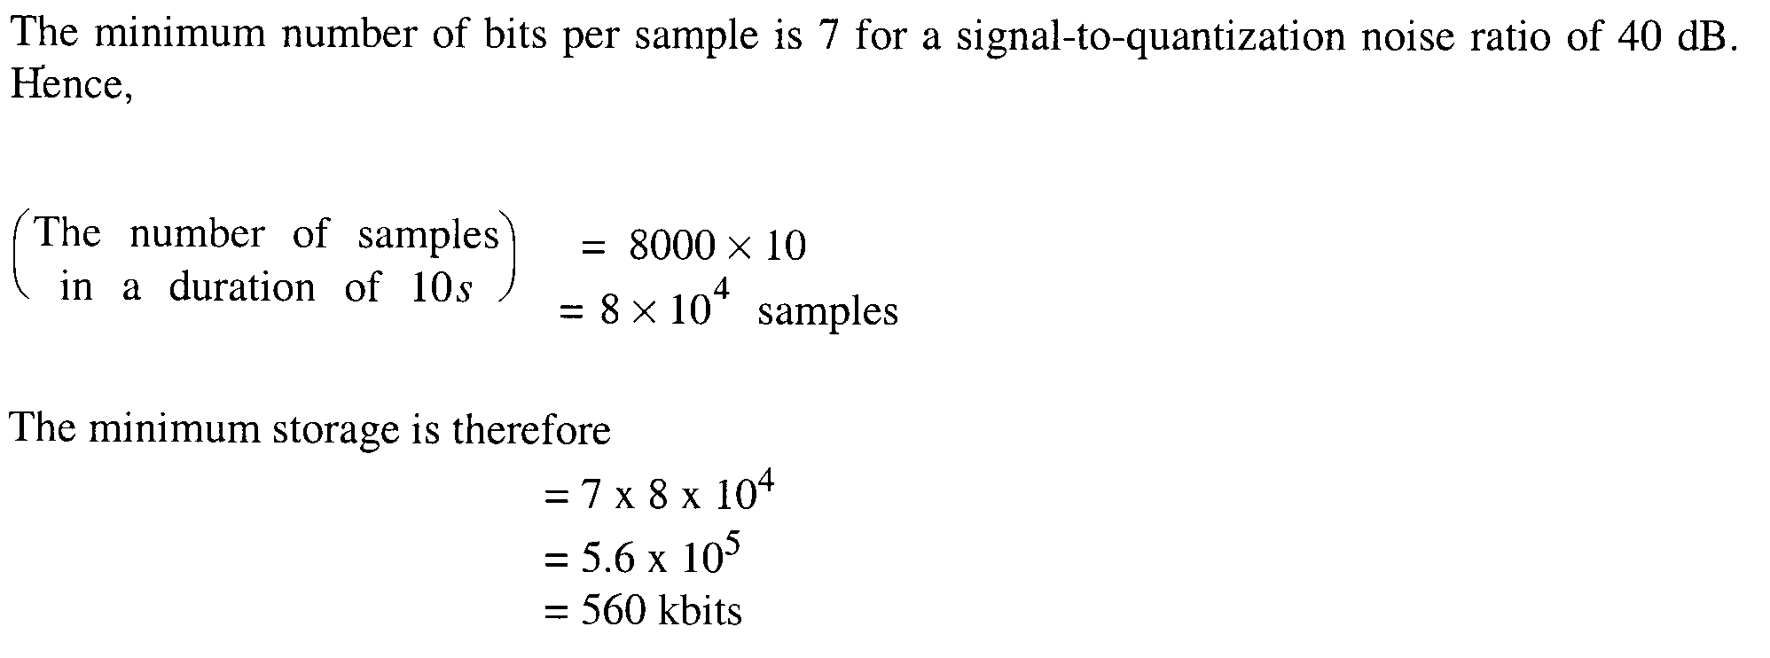

Slide 14
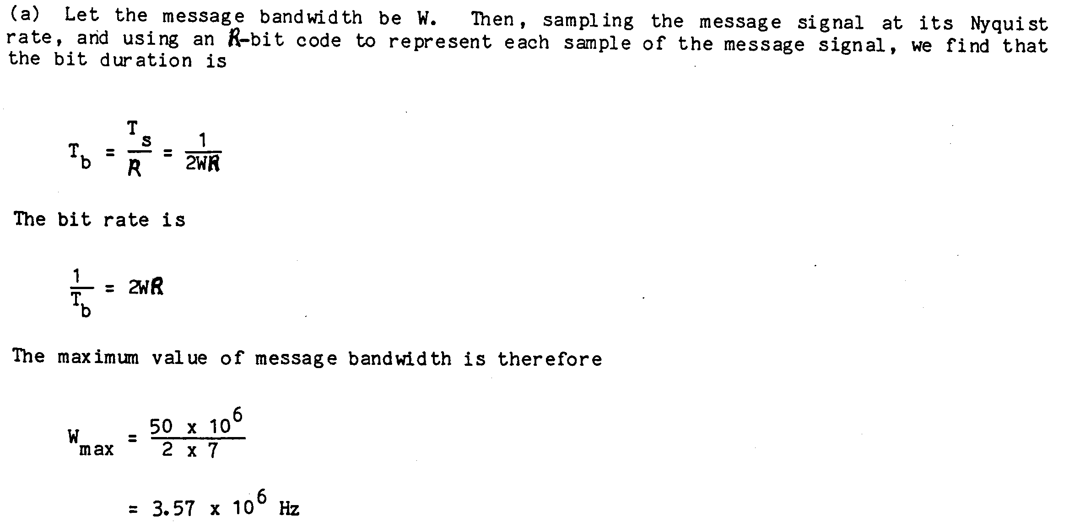

Slide 15
Virtues, limitations and modifications of PCM
Why someone use digital communications (PCM) even though it introduces complications in the design of communication system?
PCM system has many advantages
some of these advantages are

Slide 16
Advantages of PCM
Robustness to channel noise
Efficient regeneration of the coded signal along the transmission path
Efficient exchange of increased channel bandwidth for improved signal to noise ratio, obey an exponential law

Slide 17
Advantages of PCM
A uniform format for the transmission of different kinds of base band signals, hence their integration with other forms of digital data in a common network
Comparative ease with which message sources may be dropped or reinserted in time division multiplex system
Secure communication through the use of special modulation schemes or encryption

