Slide 1
Digital Communications
Other forms of Pulse Modulation
DM, DSM, DPCM, ADPCM, LP,…
2

Slide 2
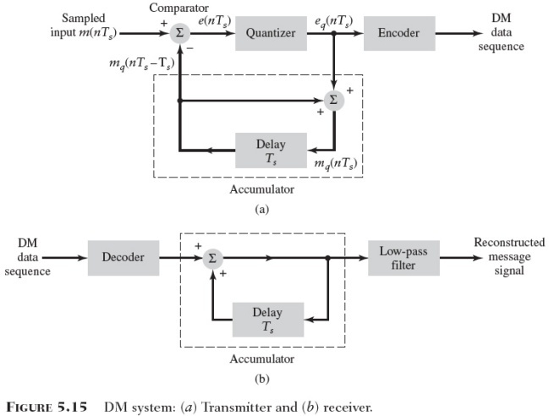
1) Delta Modulation
PCM has certain limitations So, we use other forms like;
DM (Delta Modulation)
An incoming message signal is oversampled to purposely increase the correlation between adjacent samples of the signal
The difference between the input signal and its approximation is quantized into only two levels - corresponding to positive and negative differences

Slide 3
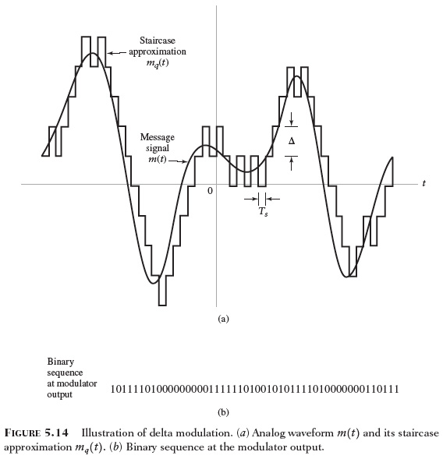
Fig.5.14
Back
Next

Slide 4
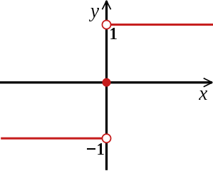
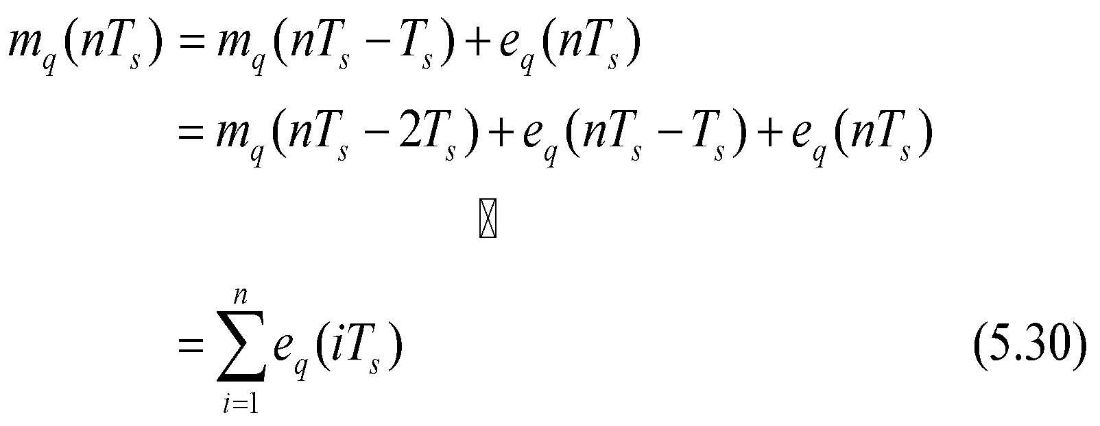
System Details for DM
Comparator
Computes the difference between its two inputs
Quantizer
Consists of a hard limiter with an input-output characteristic that is a scaled version of the signum function
Accumulator
Operates on the quantizer output so as to produce an approximation to the message signal.

Slide 5
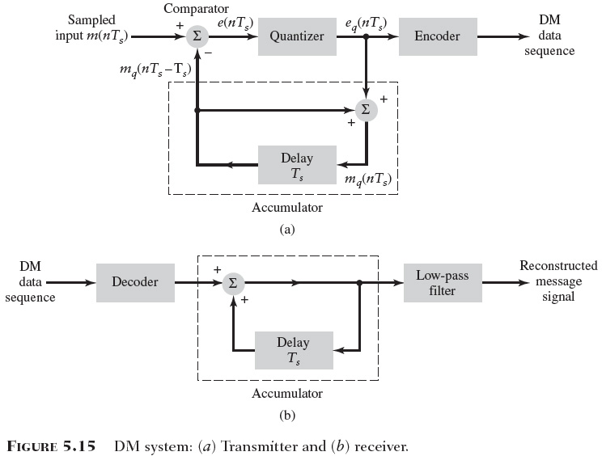
Fig. DM Tx & Rx
Back
Next

Slide 6
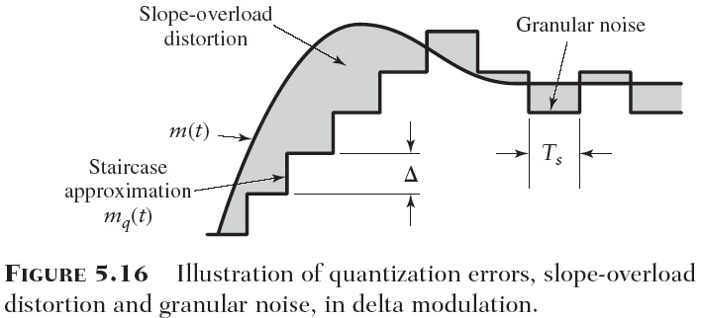
Quantization Errors
Slope-overload distortion
The step size is too small for the staircase approximation to follow a steep segment of the original message signal
The result that the approximation signal falls behind the message signal
Granular noise
When the step size is too large relative to the local slope characteristic of the original message signal
The staircase approximation to hunt around a relatively flat segment of the message signal.
Fig. 5.16

Slide 7
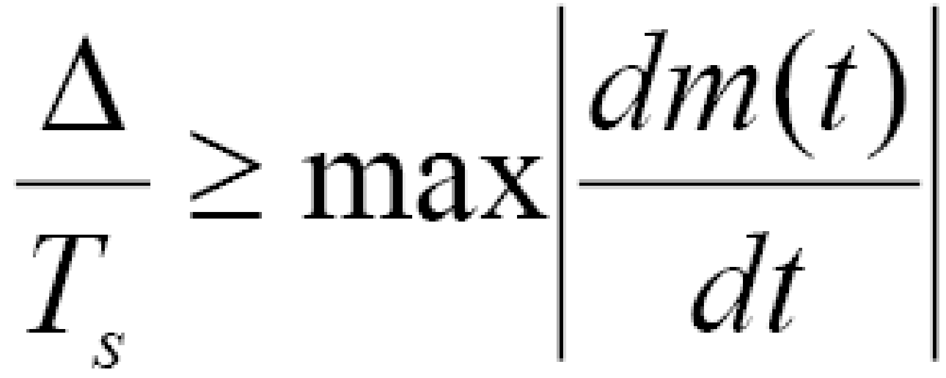
Fig.5.16
Back
Next
Solution:

Slide 8
Advantages:
Delta modulation is simple and requires minimal hardware, making it suitable for low-complexity implementations.
It achieves high compression ratios since only the change (delta) between consecutive samples is transmitted, especially for slowly varying signals like speech.
Limitations:
Delta modulation suffers from slope overload distortion, which occurs when the input signal changes rapidly and exceeds the quantization step size, leading to signal distortion.
It is sensitive to noise and quantization errors, which can degrade the quality of the reconstructed signal, especially at low bit rates.
Adaptive Delta Modulation (ADM): To overcome the limitations of basic delta modulation, adaptive delta modulation adjusts the step size of the quantizer dynamically based on the characteristics of the input signal. This helps mitigate distortion and improve the performance of the modulation scheme.

Slide 9
In order for the sequence of samples {mq[n]} to increase as fast as the input sequence of samples {mq[n]} in a region of maximum slope of m(t), the following condition must be satisfied,
- Otherwise; Delta is too small for the stair case approximation.
- granular noise occurs when Delta is too large & it is similar to quantization noise in PCM .
- We need large Delta to solve slope overload distortion
- We need small Delta to solve granular distortion
The Solution is Adaptive Delta Size (ADM)

Slide 10
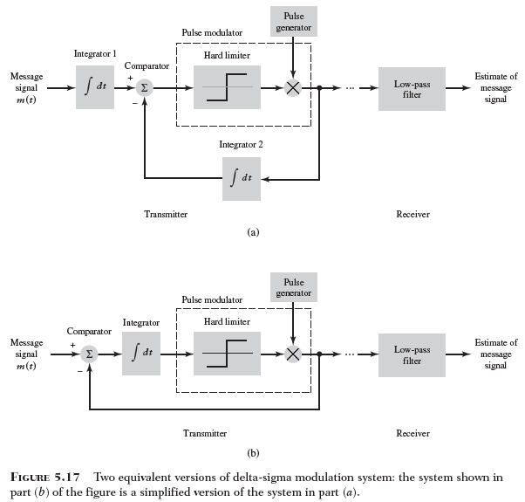
2) Delta-Sigma Modulation (Sigma-delta modulation)
In DM noise result in an accumulative error in the demodulated signal
This draw back can be over come by integrating the message signal prior to DM
SDM is a delta modulation system that incorporates integration at its input
Benefit of the integration
The low-frequency content of the input signal is pre-emphasized
Correlation between adjacent samples of the delta modulator input is increased
Design of the receiver is simplified

Slide 11
Fig.5.17
Back
Next

Slide 12
3) Differential Pulse Code Modulation (DPCM)
Often voice and video signals do not change much from one sample to the next.
Such signals has energy concentrated in lower frequency.
Sampling faster than necessary generates redundant information.
Hence, we Can save bandwidth by not sending all samples, but:
- Send true samples occasionally. - In between, send only the change from previous value. - This change is sent using a fewer number of bits than true samples.
Examples (CCITT standards) (CCITT, now ITU-T) * 32 k bits / s (4-bit quantization and 8 k samples /s) for 3.2kHz
* 64 k bits / s (4-bit quantization and 16 k samples /s) for 7 kHz

Slide 13
Delta-sigma modulation offers several advantages:
High Resolution: Delta-sigma modulation can achieve high-resolution analog-to-digital conversion using relatively simple circuitry.
High SNR: The oversampling and integration stages help suppress quantization noise, resulting in a high SNR even with a low-resolution quantizer.
Robustness to Noise: The oversampling and feedback loop make delta-sigma modulation inherently robust to noise, making it suitable for applications in noisy environments.
Delta-sigma modulation is commonly used in various applications, including audio and speech processing, digital audio converters (DACs), digital radio receivers, and instrumentation. It has become a popular choice for high-resolution, high-accuracy analog-to-digital conversion in many modern electronic systems.

Slide 14
Differential Pulse-Code Modulation- DPCM
(DPCM) is a form of lossy data compression used to digitally represent analog signals, particularly in speech and audio processing applications. It is a variant of Pulse-Code Modulation (PCM) where the quantized value of each sample is represented as the difference between the current sample and a predicted value based on the previous sample(s). This encoding method reduces the number of bits required to represent the signal, resulting in data compression.

Slide 15
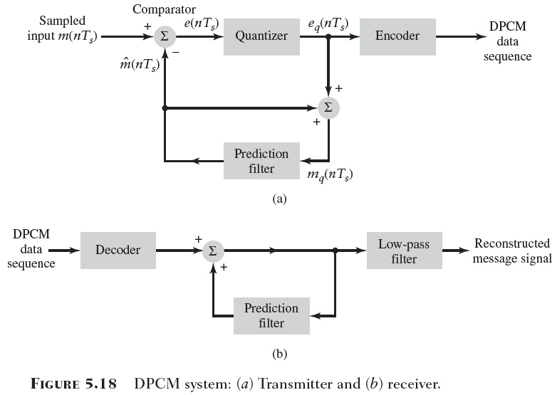
Differential Pulse-Code Modulation- DPCM
Prediction
If we know the past behavior of a signal up to a certain point in time, it is possible to make some inference (prediction) about its future values
Tapped-delay-line filter (discrete-time filter)
A simple and yet effective approach to implement the prediction filter
With the basic delay set equal to the sampling period
The quantizer output may be expressed as
Fig. 5.19

Slide 16
Fig.5.18
Back
Next
For slowly varying signals, a future sample can be predicted from past samples.

Slide 17
DPCM advantages:
Compression: DPCM achieves compression by representing the signal as the difference between consecutive samples, reducing the number of bits required to represent the signal compared to PCM.
Simplicity: DPCM is relatively simple to implement compared to other compression techniques like adaptive differential pulse-code modulation (ADPCM).
Low Complexity: DPCM encoding and decoding processes have lower computational complexity compared to other compression methods, making it suitable for real-time processing applications.

Slide 18
DPCM limitations:
Error Propagation: DPCM is sensitive to errors in the predicted values, which can accumulate and lead to significant distortion in the reconstructed signal.
Limited Compression: DPCM provides limited compression compared to more advanced compression techniques like ADPCM and transform coding.
Predictor Design: The performance of DPCM heavily relies on the accuracy of the prediction algorithm, which may require careful design and optimization for different types of signals.

Slide 19
Comparing the DPCM with DM system,
The use of a one-bit (two-level) quantizer in the DM system
Replacement of the prediction filter in the DPCM by a single delay element in DM.
Noise is concerned
DPCM, like DM, is subject to slope-overload distortion whenever the input signal changes too rapidly for the prediction filter to track it
Like PCM, DPCM suffers from quantization noise

Slide 20
Comparing the DPCM with DM system
Basic Principle:
DPCM: DPCM encodes the difference between the current sample and a predicted value based on previous samples. It quantizes and encodes this difference to represent the signal.
DM: Delta Modulation, on the other hand, directly quantizes and encodes the difference between consecutive samples without explicitly predicting the next sample.
Prediction:
DPCM: DPCM involves a prediction stage where the value of each sample is estimated based on previous samples. The prediction can be based on simple schemes like using the previous sample or more sophisticated prediction algorithms.
DM: DM does not involve explicit prediction. It simply quantizes the difference between consecutive samples without considering any prediction.
Quantization:
DPCM: In DPCM, the quantization is performed on the difference between the actual sample and the predicted value. The quantization step size can vary based on the characteristics of the signal and the desired compression ratio.
DM: Delta Modulation quantizes the difference between consecutive samples directly. The quantization step size is typically fixed and may lead to higher quantization noise compared to DPCM.

Slide 21
Comparing the DPCM with DM system
Encoding:
DPCM: DPCM encodes the quantized difference values into binary representations for transmission or storage. It may use variable-length or fixed-length codes depending on the application.
DM: Delta Modulation directly encodes the quantized difference values into binary representations without additional processing.
Complexity:
DPCM: DPCM typically involves a prediction stage, quantization, and encoding processes, which may introduce some computational complexity.
DM: Delta Modulation is relatively simpler compared to DPCM since it does not involve explicit prediction. It mainly consists of quantization and encoding stages.
Error Propagation:
DPCM: DPCM may suffer from error propagation since the quantization error at one sample can affect the prediction and encoding of subsequent samples.
DM: Delta Modulation is prone to slope overload distortion, where rapid changes in the input signal can cause quantization errors to accumulate and distort the signal.
Applications:
DPCM: DPCM is commonly used in applications where moderate compression with relatively low complexity is sufficient, such as telecommunications, digital audio processing, and video compression.
DM: Delta Modulation is often used in low-bit-rate speech coding applications where simplicity and real-time processing are prioritized, such as wireless communication systems and low-quality voice transmission.

Slide 22
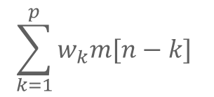
Differential Pulse Code Modulation (DPCM)
fs >>fN highly correlated samples .
highly correlated
samples
PCM
Encoded signal with redundant information
Symbols that are not essential to the transmission are generated as a result of PCM encoding
Removing the redundancy before encoding more efficient coded signal
DPCM Depends on Linear Prediction (we send (we code)) only the difference between samples not like PCM nor like DM).
^
m[n]=

Slide 23
PCM
Applied to channel input
m(t)
LPF
SAMPLER
QUANTIZER
ENCODER
PCM
REGENE
DECODER
LPF
reconst
Distination
e[n]
eq[n]
DPCM
Wave
Sampled input m[n]
Quantizer
Encoder
+
^
-
m[n]
+
eq[n]=e[n]+q[n]
+
^
prediction
mq[n]=m[n]+eq[n]
Fig. DPCM Tx
mq[n]
input
decoder
+
+
Fig. DPCM Rx
Prediction
filter

Slide 24
^
e[n] = m[n] – m[n]
eq[n] = e[n] + q[n]
mq[n] = m[n] + eq[n]
= m[m] + e[n]+ q[n]
mq[n] = m[n] + q[n] mq[n] is the quantize version of the input signal .
q[n] can be +
^
^
-
The prediction filter in the Tx & Rx operates on the same sequence of sample, mq[n]. So we have a feedback path added to the quantizer in the Tx.

Slide 25
The variance of the prediction error e[n] is smaller than the variance of the message signal m[n], so we have a smaller quantization error.
m[n] mq [n]
OR e[n] eq [n].
Q
Q
m[n]
+
e[n]
1- Quantizer (DPCM)
OR
2- One bit Q (DM)
eq [n]
DPCM
OR
DM
-
Encoder
+
mh[n] (DPCM)
OR
mq[n-1] (DM)
+
Comparing
DM with DPCM
Prediction filter -DPCM
OR
Z^-1 ( DM)
mq [n]

Slide 26
So, DM is a special case of DPCM BUT
DM uses one –bit (two-level) quantizer.
DM prediction filter is a single delay element (zero prediction order).
DM and DPCM Transmitters use feedback but PCM does not.
DM and DPCM are subject to slope-over load distortion .
PCM and DPCM suffers from quantization noise.

Slide 27
Adaptive Differential Pulse Code Modulation (ADPCM)
(ADPCM) is an extension of the Differential Pulse Code Modulation (DPCM) technique used for analog-to-digital signal conversion. ADPCM improves upon DPCM by adapting the quantization step size (also known as the step size or step size coefficient) dynamically based on the characteristics of the input signal. This adaptive adjustment of the quantization step size allows ADPCM to achieve higher compression ratios while maintaining acceptable audio quality compared to fixed-step-size DPCM.

Slide 28
Adaptive Differential Pulse Code Modulation (ADPCM)
Standard PCM 64 kb/s HENCE, large B.W is required .
To reduce bit rate, we can use coding :
1) Remove redundancies from the signal (speech) as far as possible.
2) Assign the available bits to code the non redundant parts of the signal in a perceptually efficient manner .
Reducing bit rate increasing the complexity .
ADPCM 32kb/s adaptive quantization .
adaptive prediction.

Slide 29
4) Adaptive Delta Modulation
Inappropriate step size δ creates noise. Make delta (δ or D) adaptive. number of successive 1’s or 0’s step size 1 δ 2 δ 3 2δ 4 4δ … ...

Slide 30
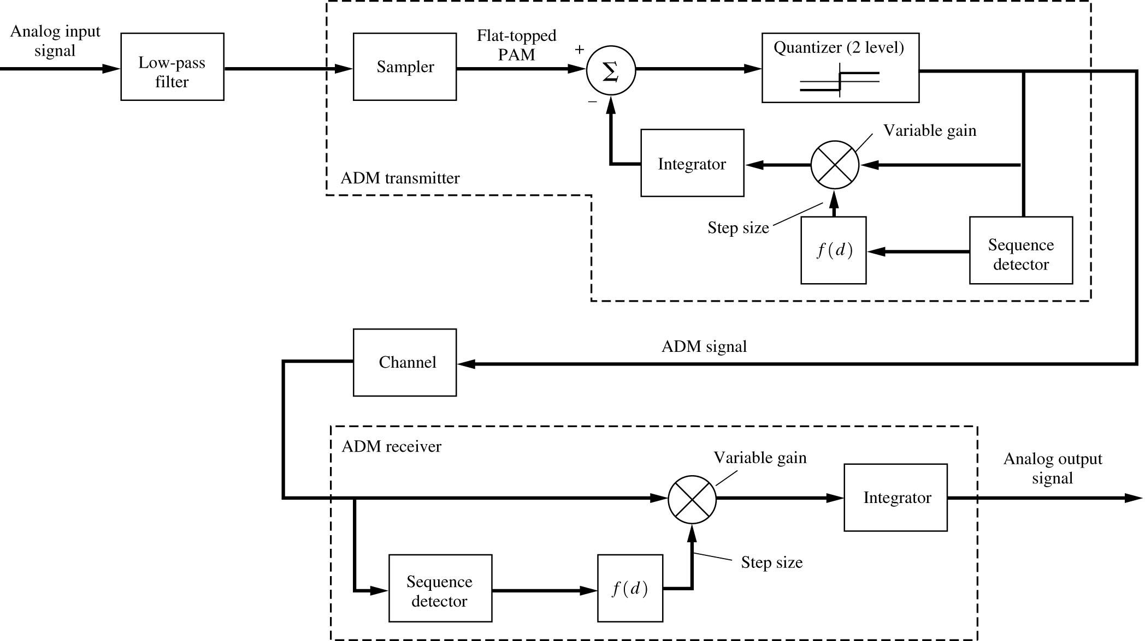
ADM Block Diagram.

Slide 31
Computer Experiment: Adaptive Delta Modulation
In DM ,
1) If successive errors are of opposite polarity then DM is in the granular mode, so we may reduce the step size.
2) if successive errors are of the same polarity then, DM is in the slop – over load mode, so we may increase the step size.
In ADM
For (1) above, we may increase or decrease the step size D to be 2D, 3D, 4D,…
OR
D ➔ Dmin
i.e., delta adaptation
NEED the equation ??

Slide 32
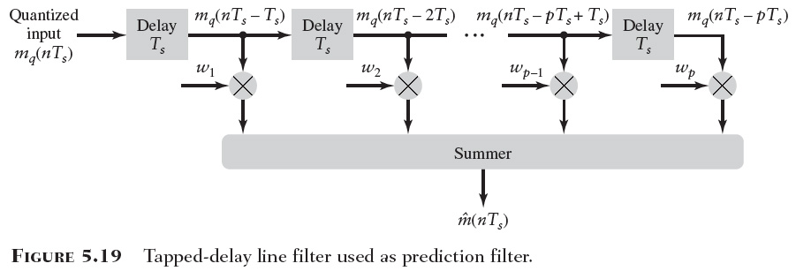
More techniques to be discussed later
Liner Prediction
Liner Adaptive Prediction
Adaptive Differential Pulse Code Modulation
Fig. 5.20

Slide 33
Speech Coding
Waveform coders: output approximates original voice signal. * PCM, DPCM, DM, CVSD (24 – 64 k bits/s) - Vocoder: parameterize voice signals based on speech models * CELP, VSELP (2 -16 k bits/s)

Slide 34
Comparing Encoding Techniques to speech signal (fs=8kHz.)

Slide 35
Table: PCM Vs DM Vs ADM Vs DPCM
BASIS OF COMPARISON | PCM | DM | ADM | DPCM
Number of Bits | It can use 4,8 or 16 bits per sample. | It uses one bit for one sample. | It uses only one bit for one sample. | Bits can be more than one but are less than PCM.
Levels And Step Size | The number of levels depends on number of bits. Level size is fixed. | Step size is kept fixed and cannot be varied. | Step size varies according to the signal variation. | Number of levels is fixed.
Quantization Error & Distortion | Quantization error depends on the number of levels. | Slope-overload distortion is present. | Quantization noise is present but no other errors. | Slope overload distortion and quantization noise is present.
Bandwidth | Highest bandwidth is required since the number of bits is high. | Lowest bandwidth is required. | Lowest bandwidth is required. | Bandwidth required is less than PCM.
Feedback | There is no feedback in transmitter or receiver. | Feedback exists in the transmitter. | Feedback exists in the transmitter. | Feedback exists in the transmitter.
Complexity | Complex system to implement. | Simple to implement | Simple to implement. | Simple to implement.

Slide 36
The sampling theorem states that a given message signal 𝑚(𝑡) can be transmitted as a sequence of samples of 𝑚(𝑛𝑇_{𝑠}) as shown
m(t)
5T_{s} 6T_{s} 7T_{s}
T_{s} 2T_{s} 3T_{s}
4T_{s}

Slide 37
TDM graphical representation for two signals
This leaves space for other samples to be interleaved in the same sampling interval
4/26/2015

Slide 38
Time Division Multiplexing - TDM
In TDM N signals can be transmitted simultaneously using a single channel
This can be achieved by using the block diagram shown below

Slide 39
Time Division Multiplexing - TDM
Time-division Multiplexing
Enables the joint utilization of a common communication channel by a plurality of independent message sources without mutual interference among them
Highly sensitive to dispersion in the common channel – a non-constant magnitude response of the channel and a nonlinear phase response.
Synchronization
Keep the same time as a distant standard clock at the transmitter
One possible procedure to synchronize the transmitter and receiver clocks is to set aside a code element or pulse at the end of a frame and to transmit this pulse every other frame only

Slide 40
Concept (TDM)
1. Restricting each input by low-pass anti-aliasing filter
2. Commutator – takes sample from each input message (fs > 2W); interleave samples in a frame T_{s};
3. Pulse modulator – transformation for transmission over common channel
4. Pulse demodulator
5. Decommutator – synchronized with the commutator

Slide 41
Synchronization
TDM - Easy to add and drop sources
Pulses duration considerations
time interval limited by the sampling rate (reciprocal)
more users – shorter pulses – difficult to generate; highly influenced by impairments
upper limit of number of independent sources
Transmitter-receiver clock sync – very important – two local clocks
separate code element or pulse at the end of a frame
orderly procedure for detecting sync pulses – searching procedure

Slide 42
Two signals are to be transmitted using PAM TDM. The first signal has a bandwidth of 0-8 kHz, the second signal bandwidth is 0-10 kHz. The two signals are sampled equally. The sampled signals are passed through a low-pass filter before transmission
4/26/2015

Slide 43
What is the minimum clock frequency of the PAM system (commutator clock).
What is the minimum cutoff frequency of the low pass filter used before transmission that will preserve the low pass filter amplitude?
What would be the minimum bandwidth these theses two signals were frequency multiplexed using normal AM techniques and SSB techniques

Slide 44
a) The minimum clock frequency of the PAM system can be found from
clock frequency= N*(Nyquist frequency)
Clock freq. (i.e., overall sampling frequency) =2 * (2*10)=40 kHz.
Hint, N=number of signals & Nyquist freq. is twice the maximum frequency
b) The minimum bandwidth of the transmission filter can be found from
BW=1/(2TN)== fN/2=40/2= 20kHz.

Slide 45
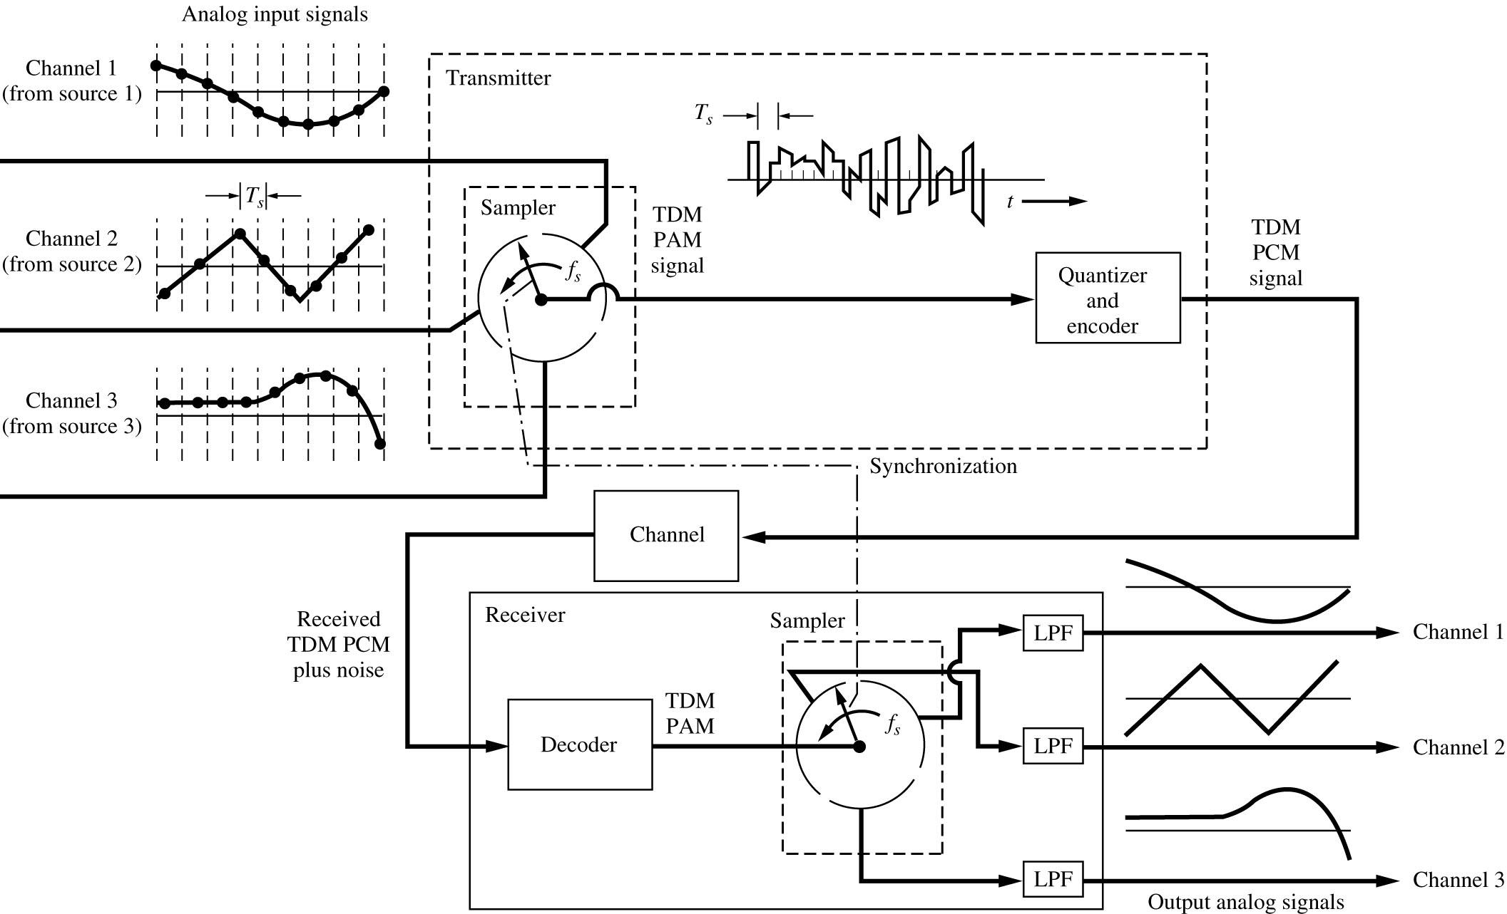
Time Division Multiplexing
Time interleaving of samples from different sources to be transmitted over a single communication channel.

Slide 46
1)The commutator
1-Takes a narrow sample of each of the N signals at a rate fs>2W.
2-Sequentially interleave these N samples inside the sampling interval Ts.
TDM Bandwidth expansion factor N.
S11 S21 S31 S41 S51 S12 S22 S32 S42 S52
Frame Ts
2) Pulse modulator
Transfers the multiplexed signal into a form suitable for transmission over the communication channel.
3) Pulse demodulator +Decommulator (reverse process at the receiver)

Slide 47
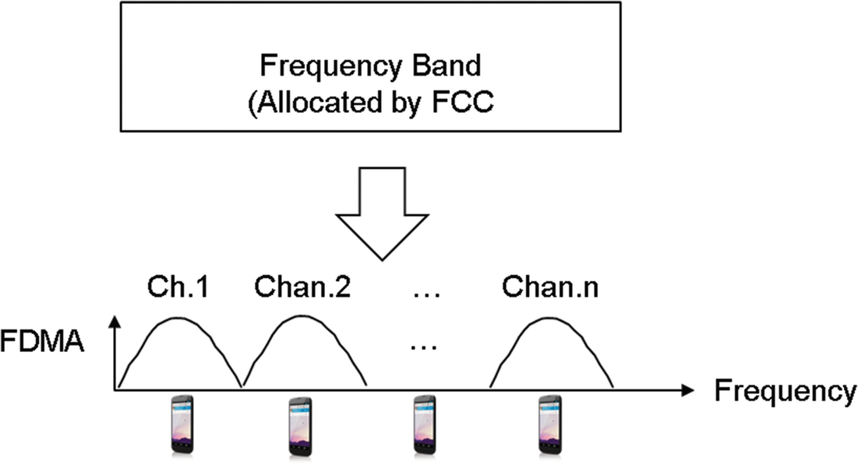
T1 TDM Format for One Frame.
(8000 samples / s)

Slide 48
Synchronization
For PCM. System :
As the number of signals to be TDM increases, the duration of a codeword representing a single sample is reduced. Hence pulse duration is reduced. So it is more difficult for generating or transmitting.
For short pulses, we have more noise in the Tx media .
So, we have a restricted number of signals to be TDM .
The time operation at the Rx follow closely the time operation at the Tx. (except for transmission time…)
How to synchronize the Tx + Rx?
Set a pulse at the end of a frame and transmit this pulse every other frame only.

Slide 49
Example: The T1 System - (Compare it to E1 system?)
24 voice channels; separate pairs of wires; regeneration every 2 km; basic to the North American Digital Switching Hierarchy.
Voice signal (300 – 3100 Hz) – low pass filter (cutoff frequency 3.1 kHz) – Nyquist sampling rate = 6.2 kHz – actual sampling rate is 8 kHz.
Each of the 24 voice channels uses binary code with 8-bit word.
Frames
for 8 kHz, each frame occupies a period of 125 µs
contains 24 X 8 =192 bit words; plus 1 bit for sync = 193 bits
bit duration = 0.647 µs (125µs/193bits); transmission rate is 1.544 Mb/s

Slide 50
Example summery (The T1 System - a PCM system)
A TDM system is given such that:
N=24 Voice channels (300-3100) Hz.
Repeaters every (2-4) Km interval.
LPF with fc=3.1KHz
fs=8KHz.
8 bit / sample
mu-law (mu=255)
1) Find the frame length.
2) Find the number of bits/frame.
3) Find the number of bits/second.
4) Find the duration of each bit.

Slide 51
Solution:
1) fs = 8KHz 🡺 Ts=1/fs =1/8000 = 125 µs (Ts is the frame length)
2) 24 Samples + 1 bit for synch 🡺 24(8) + 1=193 bits/frame .
3) 193 bits 125 µs 193 bits * 1 sec = 1.544Mb/s
??? 1 s 125 µs
4) 193 bits 125 µs 125 µs * 1 bit = 0.647 µs
1 bit ??? 193 bit
1)Find the frame length.
2)Find the number of bits/frame.
3)Find the number of bits/second.
4)Find the duration of each bit.

Slide 52
Digital TDM Hierarchy (The North America Standard) .
DS0: Digital Signaling Zero, where the incoming signal has a 64kp/s rate (PCM).
DS1: Digital Signal one, it combines 24 DS0 bit stream to get 1.544Mb/s >(24(64)).
DS2: Combines 4-DS1 bit streams to obtain a 6.312 Mb/s >(4(1.544)).
DS3: Combines 7-DS2 bit streams to obtain a 44.736Mb/s >(7(6.312)).
DS4: combines 6-DS3 bit streams to obtain a 274.176Mb/s >6(44.736)).
DS5: combines 2-DS4 bit streams to obtain a 560.160Mb/s > 2(274.176).
Due to bit stuffing, the bit rate of a digital signaling produced by any of these multiplexers is slightly higher than the prescribed multiple of the incoming bit rate (i.e., DS1 =1.544 which is greater than 24*64)

Slide 53
North American TDM Hierarchy.

Slide 54
E1 System
E1 is a European digital transmission format devised by the ITU-TS and given the name by the Conference of European Postal and Telecommunication Administration (CEPT).
It’s an equivalent of the North American T-carrier system format.
E2 through E5 are carriers in increasing multiples of the E1 format.
E1's data rate is 2.048 Mbps, over 32 channels at 64/kbps each,
the E1 standard exceeds the transfer rates of it's equivalent system, T1 (1.544 Mbps over 24 channels.)

Slide 55
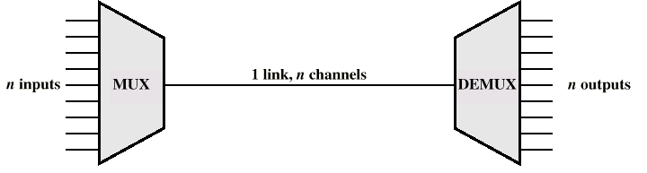
Multiplexing

Slide 56
Types of Multiplexing
Time Division Multiplexing
Code Division Multiplexing
Frequency Division Multiplexing
---------------------------------------------------------
Space Division Multiplexing
Polarization Division Multiplexing
Orbital Angular Momentum Multiplexing

Slide 57
Multiplexing
FDM
Useful bandwidth of medium exceeds required bandwidth of channel
Each signal is modulated to a different carrier frequency
Carrier frequencies are separated so signals do not overlap (guard bands)e.g. broadcast radio
Channel are allocated even if there is no data
TDM
FDM

Slide 59
Liner Prediction filter

Slide 60
Linear Prediction
Finite – duration Impulse Response (FIR) discrete – time filter .
^
X[n] = X[n-1]W1 + X[n-2]W2 + X[n-3]W3 + …………+ X[n-p]Wp
input
X[n-1]
X[n-2]
X[n-3]
X[n-p+1]
X[n-p]
-1
-1
-1
-1
X[n]
Z
Z
Z
Z
W3
Wp-1
Wp
W1
W2
^
Prediction X[n]
Block of Linear Prediction filter of order P

Slide 61
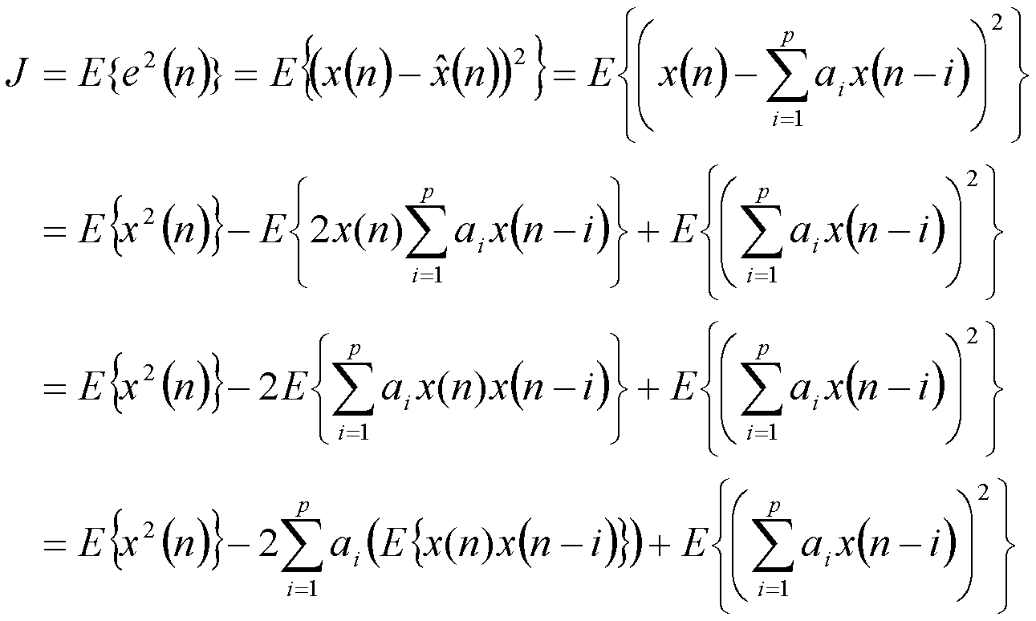
^
2
2

Slide 63
Define ,
σx : variance of a sample of the process X(t) at nTs
σx = E [x [n] ] ..
Rx(kTs) : auto correlation of the process X(t) for a lag of kTs = Rx [k]
=Rx(k)= E[x[n] x[n-k]]
So ,
J =σx …. (check the book)
2
2
P
ΣWj Rx [k – j] = Rx [k] = Rx [-k] , k = 1,2,3…….P
Optimal equations
j=1
Wiener – Hopf equations for linear prediction .

Slide 64
T
In matrix form, Let W = [ W1 W2 ……Wp ] , optimum coefficients vector
o
Px1
rx = [Rx [1] Rx[2] ………..Rx[p] ] , autocorrelation vector
Px1
Rx =
Rx[0] Rx[1]…………. Rx[p-1]
Rx[1] Rx[0] ………….Rx[p-2]
Rx[2] Rx[1] ………….Rx[p-3]
Rx[p-1] Rx[p-2] ………Rx[0]
Wiener – Hopf eqs ,can be written as :
optimum solution.
Rx Wo = rx
Wo = R rx
-1

Slide 66
Linear Adaptive prediction
-1
Wo = Rx rx requires knowledge of the autocorrelation function Rx [k] ,
k= 0,1,2,…….., P
What if Rx [k] is not a available ???
Solution : Use the “ adaptive prediction “ + recursive methods .
LMS
MSE
…
To minimize error
Linear predictor
Wk [n]
Prediction
X[n]
Input X[n]
-1
Z
^
^
Error e[n]
+
-
+
LMS
Block diagram- linear Adaptive prediction process
Least Mean Square LMS
Mean Square Error MSE

Slide 67
Comparing Encoding Techniques to speech signal

Slide 68
3.17 MPEG Audio Coding Standard
Speech (voice) and Audio are similar in that the quality of a coding scheme is based on the properties of human auditory perception.
Speech speech production model is available so we have an efficient coding scheme (ADPCM).
Audio No production model is available .
MPEG-1 : Motion Picture Expert Group 1 .
MPEG-1/audio coding standard is a lossy compression system [like ADPCM] .
BUT it can achieve transparent, perceptually, lossless compression of stereophonic audio signals at high sampling rate.
Mean Opinion Score (MOS) test is used by MPEG committee with 6-to-1 compression ratio is good (indistinguishable) .
(original and coded audio signals are indistinguishable).
This is due to the usage of the characteristics of the human auditory system

Slide 69
Digital Multiplexers (when signal is digital)
TDM is used to multiplex a group of analog signals after sampling them in time at a common (same) sampling rate .
If we have digital signals (with different bit rates) and we need to combine them into a single data stream (at a considerably higher bit rate than any of the inputs ) then we use a bit-by-bit interleaving procedure [digital multiplexing].
1
2
N
1
2
N
High-speed
Transmission
line
Multiplexer
Demultiplexer
Fig-diagram of a digital multiplexing - demultiplexing
bit-by-bit interleaving procedure.

Slide 70
Multiplexing is accomplished by bit-by-bit interleaving; selector switch – sequentially scanning incoming line; at the receiving side – separation into low speed components.
Types of multiplexers:
relatively low data bit rate user streams are TD multiplexed over the public switched telephone network.
data transmission service by telecommunication carriers; part of the national digital TDM hierarchy.
Notes:
mmmmmmm

Slide 71
m1(t)
m2(t)
mN(t)
TDM
PCM
Byte interleaved TDM .
Analog Multiplixing followed by PCM
TDM
m1(t)
m2(t)
mN(t)
PCM
PCM
Bit interleaved TDM
PCM followed by digital multiplexing
PCM
Categories Digital Multiplexing

Slide 72
Problems:
1. Digital signals cannot be directly interleaved into a format that allows for their separation automatically. Common clock or perfect synchronizations is needed.
The multiplexed signal must include some form of framing so the individual streams can be identified at the source.
The multiplexer should be able to handle small variations in bit rates – bit stuffing.

Slide 73
Bit stuffing
To make the outgoing rate of the multiplexer a little bit higher than the sum of the max expected input rates.
Each input is fed into an elastic store at the multiplexer (reading can be done at different rate).
Identify stuffed bits – example AT&T M12 Multiplexer.

Slide 74
Example: signal format of the AT&T M12 Multiplexer
Designed to combine 4 DS1 into one DS2 bit stream
Each frame contains a total of 24 control bits, separated by sequences of 48 data bits
4 frames, transmitted one after the other
12 bits from each input bit-by-bit interleaved, 48 bits
Four types of control bits – F,M and C inserted by multiplexer – total of 24 control bits

