Slide 1
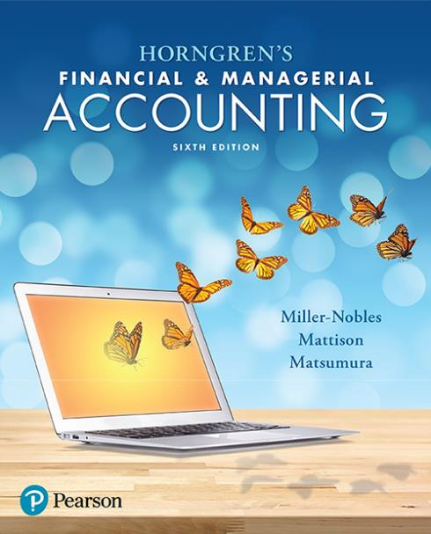
Chapter 21 Variable Costing

Slide 2
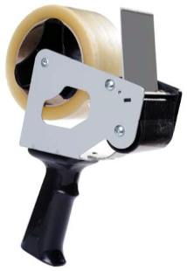
Chapter 21 Learning Objectives
Distinguish between variable costing and absorption costing
Compute operating income using variable costing and absorption costing

Slide 3
Chapter 21 Learning Objectives
Use variable costing to make management decisions for a manufacturing business
Use variable costing to make management decisions for a service business

Slide 4
Learning Objective 1
Distinguish between variable costing and absorption costing

Slide 5
HOW DOES VARIABLE COSTING DIFFER FROM ABSORPTION COSTING?
Managerial accounting provides managers with information that is useful for internal decision making.
The cost of producing products is estimated using one of two methods:
Absorption costing includes all product costs.
Variable costing considers only variable manufacturing costs.
Contribution margin is the difference between net sales revenue and variable costs. )the amount that contributes in covering fixed cos and generating operating income )
Notes:
The purpose of managerial accounting is to provide managers with information that is useful for decision making—for planning and controlling decisions. In this chapter, two methods of determining the cost of producing products are discussed.
Absorption costing is the product costing method that assigns direct materials, direct labor, variable manufacturing overhead, and fixed manufacturing overhead to products. It is required by GAAP for external reporting.
On the other hand, variable costing is the product costing method that assigns only variable manufacturing costs to products: direct materials, direct labor, and variable manufacturing overhead. It is used for internal reporting.

Slide 6
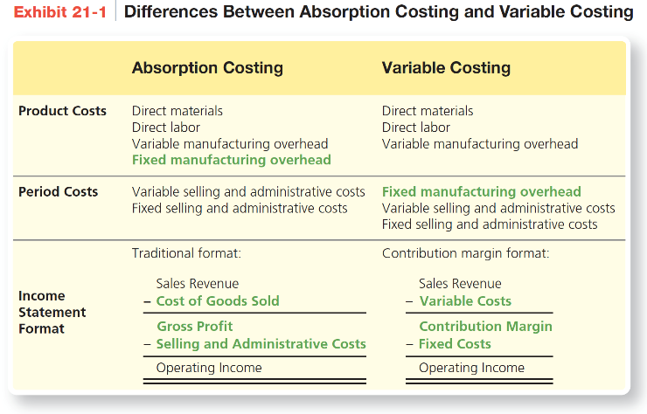
HOW DOES VARIABLE COSTING DIFFER FROM ABSORPTION COSTING?
Notes:
Exhibit 21-1 summarizes the differences between absorption costing and variable costing. Key differences between the two methods are highlighted in green.
Absorption costing is used for external reports, and variable costing is used for internal reports. Generally Accepted Accounting Principles require the use of absorption costing. Absorption costing uses a traditional income statement, whereas variable costing uses a contribution margin income statement.

Slide 7
Comparison of Unit Product Costs
Notes:
Exhibit 21-2 summarizes Smart Touch Learning’s price and cost information, based on 2,000 units produced.
The unit product cost using absorption costing includes all manufacturing costs (both variable and fixed): direct materials ($150.00), direct labor ($75.00), variable manufacturing overhead ($20.00), and fixed manufacturing overhead ($55.50, or $111,000.00 / 2,000 units). The unit product cost using variable costing includes only variable manufacturing costs: direct materials ($150.00), direct labor ($75.00), and variable manufacturing overhead ($20.00).

Slide 8
Comparison of Unit Product Costs
Notes:
The unit product costs under both absorption and variable costing are summarized in Exhibit 21-3. Notice that the variable costing per unit product costs includes only variable product costs, whereas absorption costing includes all product costs. Notice that the selling and administrative costs, both fixed and variable, are not included in the unit product cost calculations. Both costing methods consider selling and administrative costs to be period costs. Variable costing also considers fixed manufacturing overhead to be a period cost.

Slide 9
Learning Objective 2
Compute operating income using variable costing and absorption costing

Slide 10
HOW DOES OPERATING INCOME DIFFER BETWEEN VARIABLE COSTING AND ABSORPTION COSTING?
Variable costing and absorption costing will result in different operating income when:
Units produced are more than units sold
Units produced are less than units sold
The operating income result is the same under both methods when units produced equal units sold.
Notes:
Now that you know how to calculate unit product costs using variable costing and absorption costing, let’s look at the effects the two methods have on calculating operating income. There are three different scenarios to consider: (1) units produced equal units sold, (2) units produced are more than units sold, and (3) units produced are less than units sold.

Slide 11
HOW DOES OPERATING INCOME DIFFER BETWEEN VARIABLE COSTING AND ABSORPTION COSTING?
Income statements for absorption costing and variable costing:
Absorption Costing | Variable Costing
Sales | Sales
Less: Cost of Goods Sold Direct Materials Direct Labor Variable Manufacturing Overhead Fixed Manufacturing Overhead | Less: Variable Costs Direct Materials Direct Labor Variable Manufacturing Overhead Variable Selling & Admin. Expenses
Gross Profit | Contribution Margin
Less: Selling and Admin. Expenses Variable Selling & Admin. Expenses Fixed Selling & Admin. Expenses | Less: Fixed Costs Fixed Manufacturing Overhead Fixed Selling & Admin. Expenses
Operating Income | Operating Income
Notes:
This exhibit shows the income statements for absorption costing and variable costing in more detail. We see the main categories again. For absorption costing, we have Sales less Cost of Goods Sold equals Gross Profit. Gross Profit less Selling and Administrative Expenses equals Operating Income. For variable costing, we have Sales less Variable Costs equals Contribution Margin. Contribution Margin less Fixed Costs equals Operating Income. Thus, it is clear that the two approaches use different formats for the income statement.
It is evident that the two approaches classify costs differently. Under absorption costing, product costs are reported in Cost of Goods Sold, whereas under variable costing, product costs are reported in Variable Costs. Variable costing emphasizes cost behavior when classifying costs, whereas absorption costing emphasizes functional areas.
Differences in the treatment of specific costs are highlighted in red. Under absorption costing, Fixed Manufacturing Overhead is included on a per unit basis in the products that are sold during each accounting period. Under variable costing, Fixed Manufacturing Overhead is immediately expensed in total each accounting period. As a result, the amount of fixed manufacturing overhead that is expensed under the two approaches is different. Another difference is the placement of Variable Selling and Administrative Expenses. Under absorption costing, Variable Selling and Administrative Expenses are reported under Selling and Administrative Expenses. Under variable costing, variable selling and administrative expenses are reported under Variable Cost.

Slide 12
Units Produced Equal Units Sold
Assume the following:
There is no beginning Finished Goods Inventory.
The number of units produced is 2,000, and the number of units sold is also 2,000.
There is no ending Finished Goods Inventory because all units are sold.
Operating income is the same under both methods.
Notes:
Assume that there is no beginning Finished Goods Inventory. If the number of units produced equals the number of units sold, then there is no ending Finished Goods Inventory. When this situation occurs, the operating income under absorption costing equals the operating income under variable costing.

Slide 13
Notes:
Exhibit 21-4 shows that there is no difference in operating income between the two costing methods. The reason is that all fixed costs are expensed. In other words, because the ending Finished Goods Inventory balance is zero, and there are no production costs assigned to the inventory accounts, all costs incurred have been recorded as expenses and deducted from revenues on the income statement.

Slide 14
Units Produced Are More Than Units Sold
Assume the following:
There is no beginning Finished Goods Inventory.
The company produced 2,500 tablet computers.
The company sold 2,000 tablet computers.
500 units are included in ending Finished Goods Inventory.
Operating income under absorption costing is greater than under variable costing.
Notes:
Assume that there is no beginning balance in Finished Goods Inventory. If the number of units produced exceeds the number of units sold, there is an ending balance in Finished Goods Inventory. In this case, operating income under absorption costing exceeds operating income under variable costing. This is because the operating income is more under absorption costing since some of the fixed manufacturing costs are part of the ending inventory and not yet expensed.

Slide 15
Units Produced Are More Than Units Sold
Notes:
Assume that Smart Touch Learning produced 2,500 tablet computers during the year and sold 2,000 units. The ending balance in Finished Goods Inventory is 500 units (Beginning balance 0 + Units produced 2,500 – Units sold 2,000). The increase in production decreased the total unit product cost from $300 (Exhibit 21-3) to $289 under absorption costing because the total fixed costs are distributed among a greater number of units.

Slide 16
Notes:
Exhibit 21-6 shows that operating income is greater under absorption costing than under variable costing. The reason is that with absorption costing, some manufacturing fixed costs are still in ending Finished Goods Inventory on the balance sheet and have not been expensed. The difference between the operating incomes for the two methods is $22,000 ($181,000 – $159,000). This is the same difference in ending Finished Goods Inventory ($144,500 – 122,500).

Slide 17
Units Produced Are Less Than Units Sold
Assume the following:
There are 500 units in beginning Finished Goods Inventory.
The company produced 1,500 tablet computers.
The company sold 2,000 tablet computers.
There are zero units in ending Finished Goods Inventory.
Operating income under absorption costing is less than under variable costing.
Notes:
When the number of units produced is less than the number of units sold, operating income under absorption costing is less than operating income under variable costing. This is the opposite of the situation seen previously.

Slide 18
Units Produced Are Less Than Units Sold
Notes:
The fixed manufacturing overhead costs per unit is recalculated because the number of units produced is 1,500 instead of 2,000, as shown in a previous example.

Slide 19
Notes:
Exhibit 21-8 shows the income statements for Smart Touch Learning for Year 3, using absorption costing and variable costing. When more units are sold than produced, operating income is less under absorption costing.

Slide 20
Notes:
Exhibit 21-9 summarizes the income statements for the three years. In the three years illustrated for Smart Touch Learning, the only difference was the number of tablet computers produced. In each year, the number of tablets sold, the sales price per unit, the variable costs per unit, and the total fixed costs were the same. In Exhibit 21-9, operating income under absorption costing was greater than operating income under variable costing in Year 2, when production exceeded sales. Notice that the three-year total of operating income is the same under both costing methods.

Slide 21
Learning Objective 3
Use variable costing to make management decisions for a manufacturing business

Slide 22
HOW CAN VARIABLE COSTING BE USED FOR DECISION MAKING IN A MANUFACTURING COMPANY?
For decision making, some cases should use variable costing, while other cases should use absorption costing.
Manager decisions include:
Setting sales prices
Controlling costs
Planning production
Notes:
With the unit product cost information calculated under absorption costing and variable costing, managers can use the information to make decisions. In come cases, variable costing is more appropriate for decision making, but in other cases, absorption costing is more appropriate.
In the long run, the sales price charged to customers must cover the full cost of the product. The full cost includes every part of the life cycle of the product: research and development, design, production, distribution, customer service, and disposal. Any fixed manufacturing costs must be included, so absorption costing is more appropriate when determining the product costs for long-term planning. However, in the short run, variable costing should be used in some cases. Short-term pricing decisions are discussed in more detail in a later chapter.
In the long run, all costs are controllable. The production supervisor should focus on the costs that are controllable at the production level—that is, the variable manufacturing costs: direct materials, direct labor, and variable manufacturing overhead.
Production planning decisions are similar to sales price decisions: Short-term decisions should be made using variable costing, and long-term decisions should be made using absorption costing. In the short run, production is limited by capacity, so variable costing is appropriate.

Slide 23
Notes:
Exhibit 21-15 summarizes the situations in which managers must make decisions and the costing system that is appropriate for each situation.

