Slide 1
An-Najah National University
Faculty of Medicine
Department of Physiology
Anatomy and Physiology 1
7102101
Instructor: Heba Salah
Chapter 2:
Cells and Tissues
Part 5: Body Tissues: Epithelium and Connective Tissue

Slide 2
Body Tissues
Groups of cells with similar structure and function
Four primary types
1. Epithelium
2. Connective tissue
3. Nervous tissue
4. Muscle

Slide 3
Epithelial Tissues
Areas of Distribution
Functions
Characteristic:
Cells fit closely together
Tissue layer always has one free surface
The lower surface is bound by a basement membrane
Avascular (have no blood supply)
Regenerate easily if well nourished

Slide 4
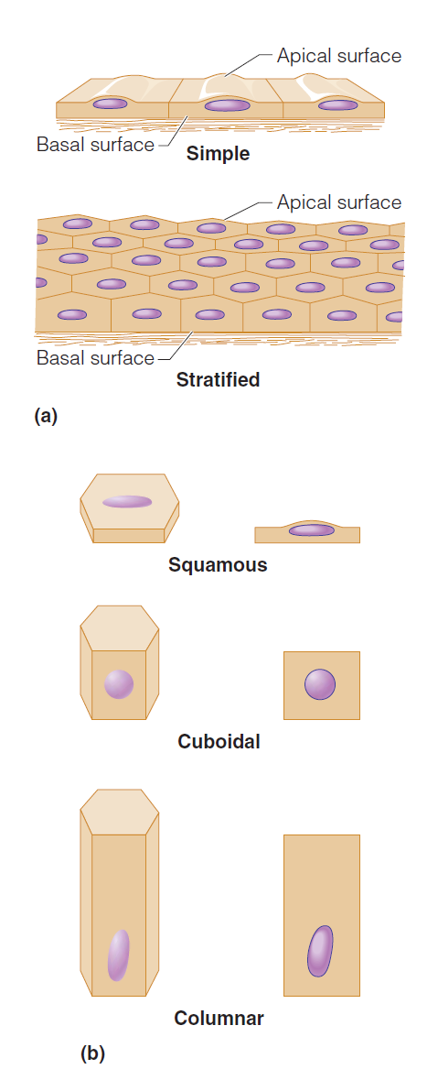
Classification of Epithelium

Slide 5
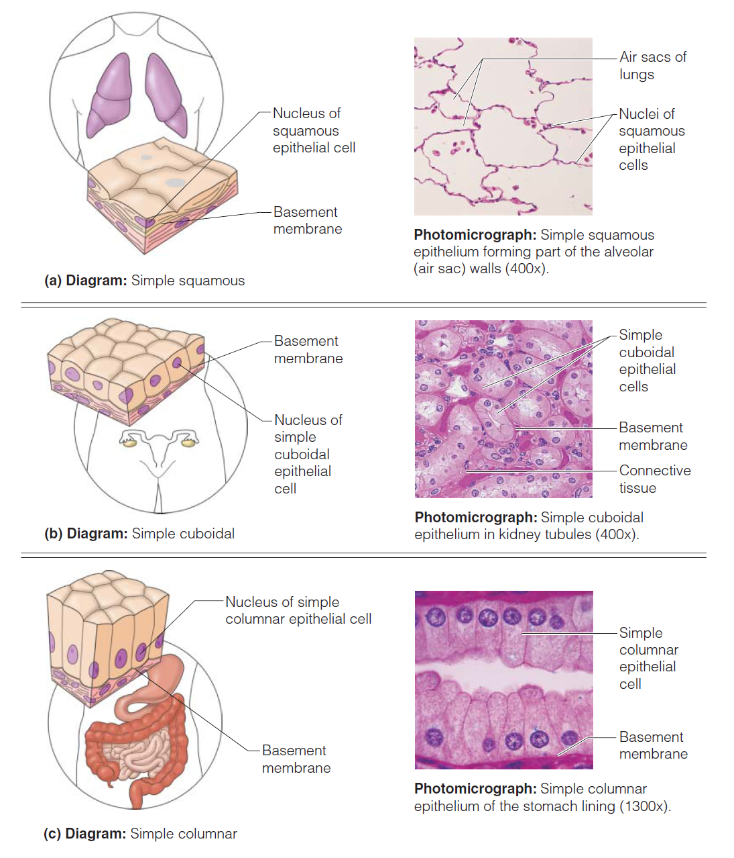
Types of Epithelia & Their Common Location in the Body

Slide 6
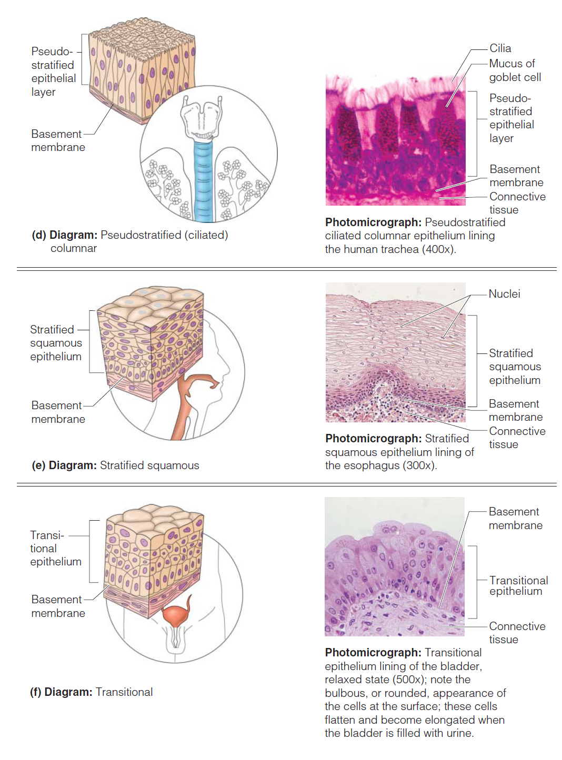
Types of Epithelia & Their Common Location in the Body

Slide 7
Connective Tissue
Areas of Distribution
Functions
Characteristic:
1. Variations in blood supply
2. Extracellular matrix: Non-living material that surrounds living cells

Slide 8
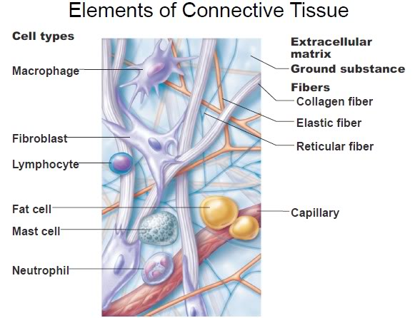
Extracellular Matrix
Two main elements
1. Ground substance – mostly water along with adhesion proteins and polysaccharide molecules
2. Fibers
Produced by the cells
Three types
1. Collagen fibers
2. Elastic fibers
3. Reticular fibers

Slide 9
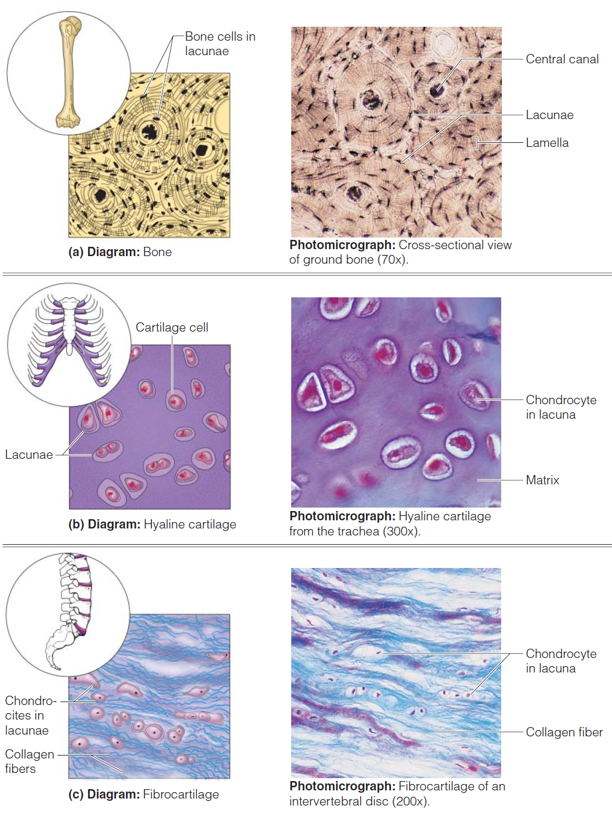
Connective Tissue Types

Slide 10
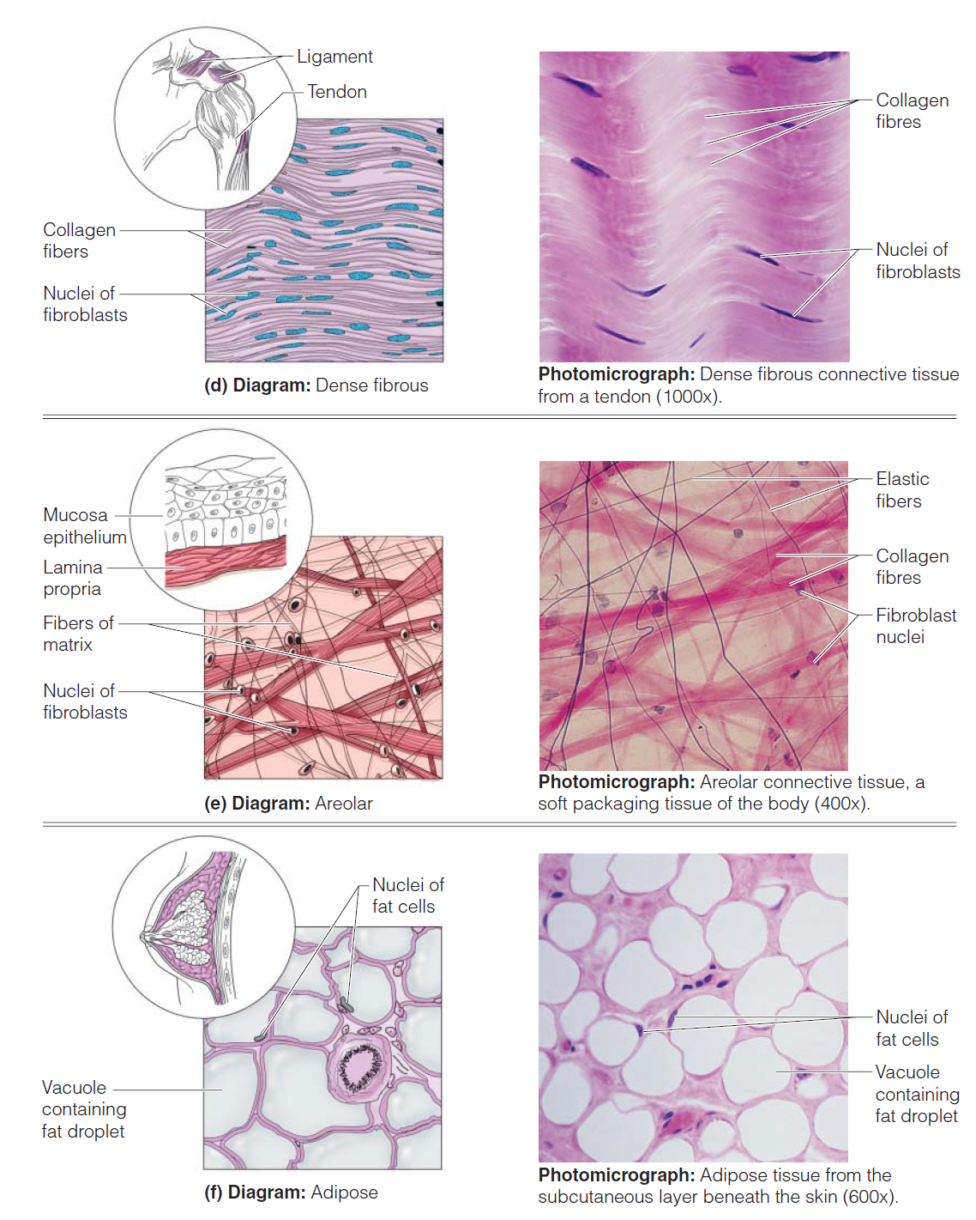
Connective Tissue Types

Slide 11
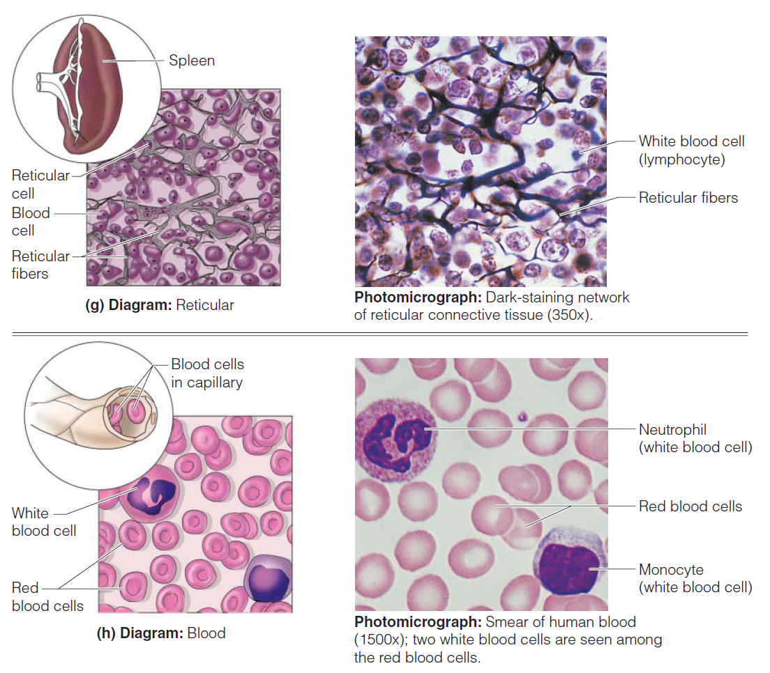
Connective Tissue Types

