Slide 1
Energy balance and needs
Instructor: Alma Irshaid. MPH. ANutr
Chapter 7
Assessment of the Hospitalized Patient
Pages: 235-241

Slide 2
Learning outcomes.
Define the concept of energy balance
Outline and list the main components of energy needs
Outline and list the determinants of energy requirements.
Explore some Methods of estimating energy requirements.

Slide 3
Energy unit
Calorie
One calorie expresses the quantity of heat necessary to raise the temperature of 1 kg (1 L) of water by 1° Celsius.
Kilocalorie (kCal)
Kilojoule
Megajoule

Slide 4
Conversion
1 cal = 4.186 J
1 kCal = 1000 cal = 4186

Slide 5
Energy balance
Basic concept of energy balance is:
Intake = Expenditure (Weight maintenance)
Intake > Expenditure (Weight gain)
Intake < Expenditure (weight loss)
Note : Energy balance status is not achieved on a daily basis, but typically over 2-3 weeks.

Slide 6
“balance energy expenditure in order to maintain body size, body composition & a level of necessary & desirable activity, consistent with long-term good healthfor all. (WHO 2004)
- Includes energy for: optimal growth & development of children deposition of tissues during pregnancy secretion of milk during lactation consistent with good health of the mother and child

Slide 7
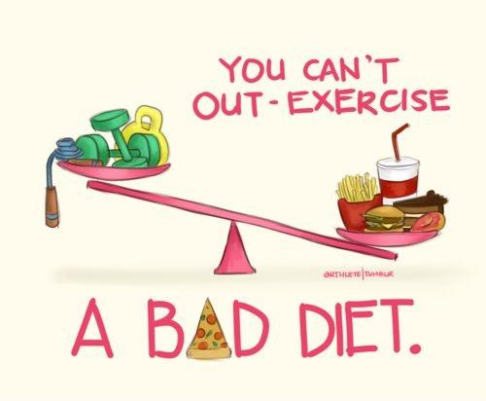

Slide 8
Components of energy Expenditure
Components of Energy Expenditure:
Basal Metabolic Rate 50-65%
Physical Activity 30-50%
Thermic effect of food 10%

Slide 9
Basal Metabolic Rate (BMR):
The rate of energy required for basic processes of life. *Men: 24 Kcal/kg/day *Women: 23 Kcal/kg/day
Measured under those conditions: 1. Overnight restful sleep (8-12 hours) 2. Thermo-neutral temperature ( room temp. 25 degrees)
3. Fasting 4. Laying still (not sleeping)
5. Physical and mental rest

Slide 10
Estimating basal metabolic rate
For individuals: need laboratory conditions
For population groups: lab methods not feasible, predictive approach needed.
Prediction of BMR:
•data collection from published literature on energy expenditure :BMR, weight & height of subjects amongst other things.
•Statistical analysis of (7173) published measurements from 114 studies used to develop predictive regression equations for BMR.
•Regression equations modelled in the form:
Basal Metabolic Rate = A x Wt + B
A & B are provided constants & Wt is the average weight of the group.
•The error introduced by using predicted rather than measured BMR for a group is +/-3-4% & for an individual about +/-15%.
•Different equations were devised for >60yrs. BMR drops 1-2%/decade

Slide 11
Factor | Effect on BMR | Factor | Effect on BMR
Age |  | Fasting/ Starving
Height |  | Malnutrition
Growth |  | Hormones
Body Composition |  | Smoking
Fever |  | Caffeine
Stress |  | Sleep
Environmental Temp.

Slide 12
Factor | Effect on BMR
Age | Lean body mass diminishes with age, slowing the BMR
Height | In tall thin people, the BMR is higher
Growth | In children and pregnant women, the BMR is higher
Body composition | The more lean tissue the higher BMR (usually higher in Males) The more fat tissue the lower BMR (usually females have more fat)
Fever | Fever raises BMR
Stress | Stress/diseases/ and certain drugs raises BMR
Environmental Temp. | Heat and cold raises BMR

Slide 13
Factor | Effect on BMR
Fasting/Starving | Lowers BMR
Malnutrition | Over and under-nutrition both lowers BMR
Hormones (gender) | Thyroid can affect BMR +/- , Premenstrual hormone raises BMR
Smoking | Nicotine increases EE
Caffeine | Caffeine increases EE
Sleep | BMR is lowest during sleep

Slide 14
Estimating Energy Expenditure
Indirect calorimetry; is based on the fact that energy metabolism ultimately depends on oxygen utilization (VO2) and carbon dioxide production (VCO2)
Direct calorimetry, the rate of heat loss from the subject to the calorimeter is measured.

Slide 15
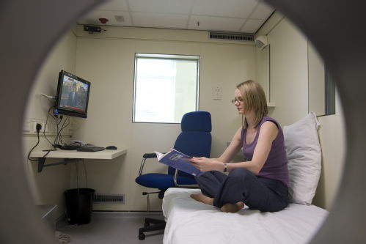
Direct Calorimetry
Metabolic rate is directly proportional to heat production
Golden standard

Slide 16
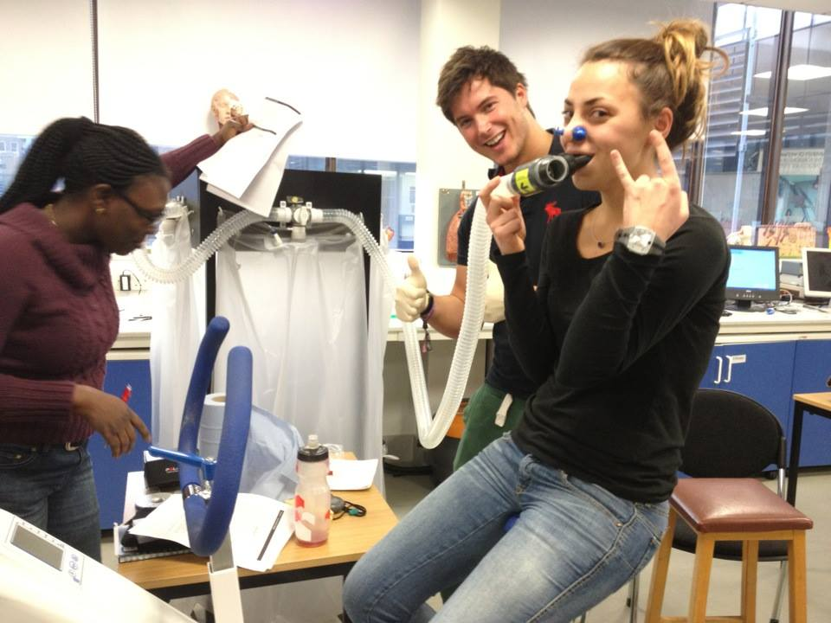
Indirect calorimetry (Douglas bag)
Food + oxygen →water + CO2 + heat
• Time collection • Volume air measured • Content of bag is analysed for
Oxygen and carbon dioxide.

Slide 18
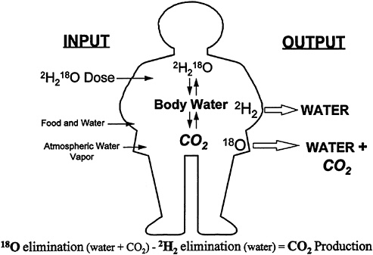
Doubly labelled water (DLW)
Subject consumes quantity of water containing known concentrations of isotopes of H & O
Mix with bodily fluids
Urine sampled periodically over 1-3 weeks

Slide 19
DLW
Labelled H leaves body as water as sweat, urine, vapour (2 H2O)
Labelled O leaves body as water and carbon dioxide
Labelled O is lost faster than labelled H
Difference between rate of loss of isotopes used to calculate CO2 production and EE

Slide 20
Bicarbonate-Urea Method
relies on an estimate of carbon dioxide production to calculate energy expenditure.
in this approach, the isotope used is ¹⁴C administered intravenously or subcutaneously (invasive) in the form of bicarbonate (H¹⁴CO₃⁻).
The labeled bicarbonate mixes freely with and becomes diluted by the endogenous CO² produced by the body. Most of the labeled carbon is eliminated from the body through expired CO², while some is eliminated as urea in urine. The amount of labeled carbon in the urea is used to estimate CO² production from which energy expenditure is estimated.

Slide 21
BMR estimation equation
Harris-Benedict (1919): -Tends to over estimate in healthy individuals.
Schofield (1985) :
- Used by the WHO/FAO
- Overestimation due to Italian population.
Henry (2005): - Developed equations using weight alone or using height and weight
- More controlled conditions for measuring BMR.

Slide 22
Estimated Average requirment
Estimated Average Requirements (EAR) = BMR x PAL
- Stress factor is included in case of disease
PAL = Physical Activity Level
- Sedentary
- Low Active
- Active
- Very Active

Slide 23
Conversion
To convert pounds to kilograms:
- Divide by 2.2 To convert feet to inches: - Multiply by 12
To convert inches to meters:
- Divide by 39.37

Slide 24
Example
E.g. Height is 5 feet 3 inches, convert to cm?
- 5x12 = 60 inches - 60+3= 63 inches - 63 inches \ 39.37 = 1.6 meters
- 1.6x100=160cm

Slide 25
Example
Estimate energy requirement using the following equation: Men EER = [662 – (9.53 x age)] + PA x [(15.91 x wt) + (539.6 x ht)]
Consider an active 20 year old man who is 170 cm and weighs 80 kg
 | Factor (Men) | Physical Activity
Sedentary | 1.0 | Typical daily living activity
Light activity | 1.11 | Plus 30-60 min moderate activity
Active | 1.25 | Plus > 60 min moderate activity
Very Active (strenuous/vigorous) | 1.48 | Plus > 60 min moderate activity and 60 min vigorous or 120 min moderate activity

Slide 26
E.g. Consider an active 20 year old man who is 170 cm and weighs 80 kg
- Answer:
EER = [662 – (9.53 x 20)] + 1.25 x [(15.91 x 80) + (539.6 x1.7)] EER= [662- 190.6] + 1.25 x [1272.8 + 917.32] EER= 471.4 + 1.25 x [2190.12] EER= 471.4 + 2737.6
EER= 3209 Kcal/day

