Slide 1
An-Najah National University
Faculty of Medicine
Department of Physiology
Anatomy and Physiology 1
7102101
Instructor: Heba Salah
Chapter 6:
The DigestiveSystem
Part 3: The Large Intestine, and Accessory Digestive Organs: Salivary Glands, and Teeth

Slide 2
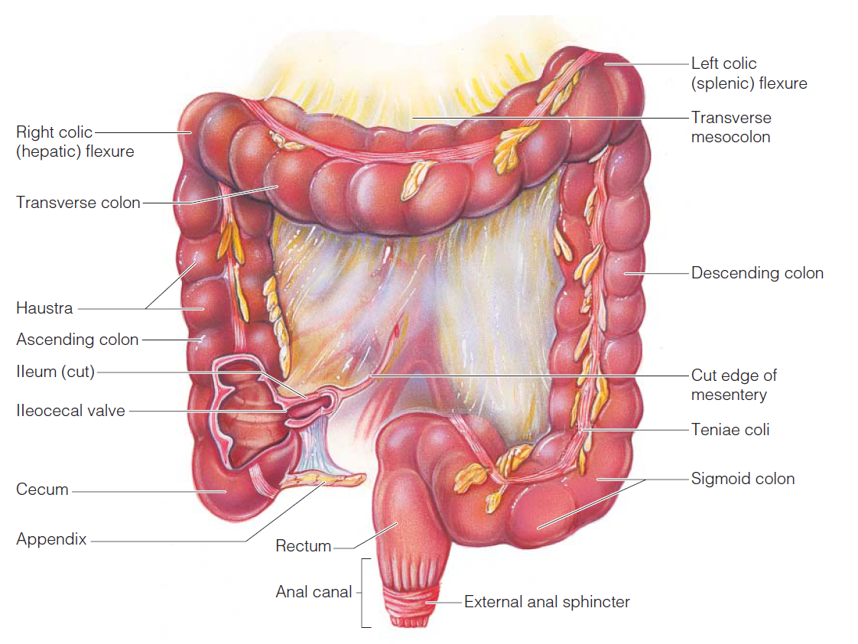
Large Intestine

Slide 3
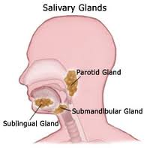
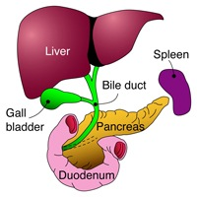
Accessory Digestive Organs
Salivary glands
Teeth
Pancreas
Liver
Gall bladder

Slide 4
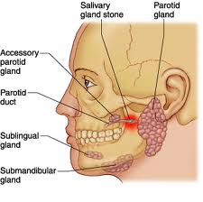
Salivary Glands
Saliva-producing glands:
1. Parotid glands
2. Submandibular glands
3. Sublingual glands

Slide 5
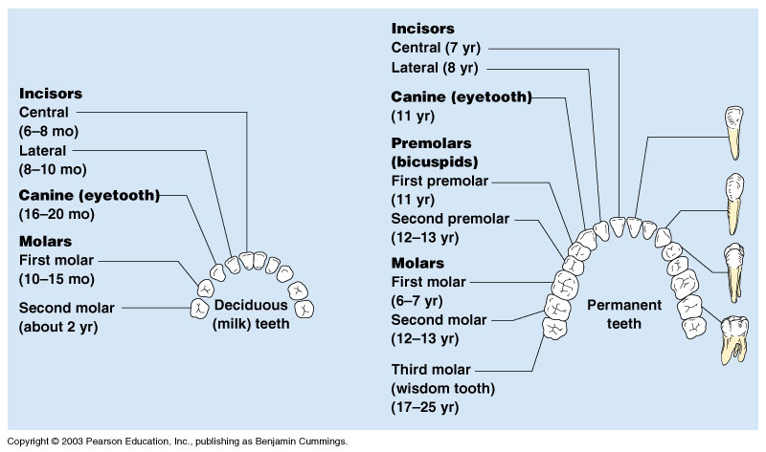
Classification of Teeth

Slide 6
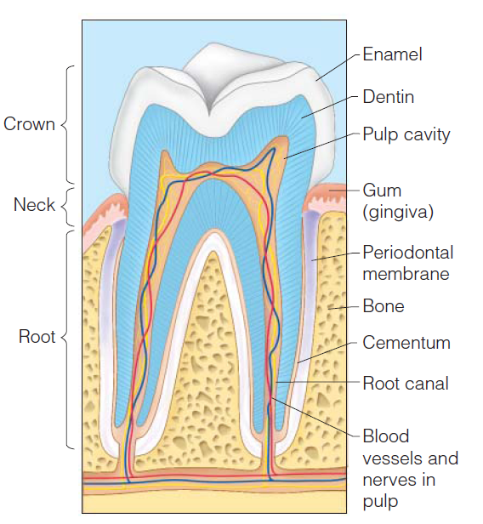
Teeth
Crown – exposed part
Outer enamel
Dentin
Pulp cavity
Neck
Region in contact with the gum
Connects crown to root
Root
Periodontal membrane attached to the bone
Root canal carrying blood vessels and nerves

