Slide 1
An-Najah National University
Faculty of Medicine
Department of Physiology
Anatomy and Physiology 1
7102101
Instructor: Heba Salah
Chapter 6:
The DigestiveSystem
Part 2: Organs of the Alimentary Canal: the Stomach, and Small Intestine

Slide 2
Stomach Anatomy

Slide 3
Structure of the Stomach Mucosa

Slide 4
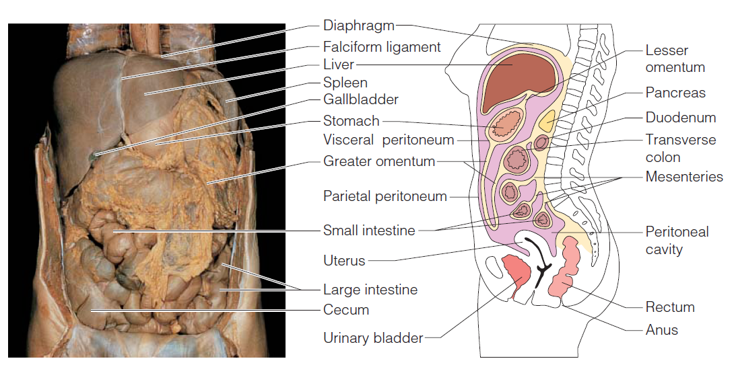
Peritoneal Attachments of the Abdominal Organs

Slide 5
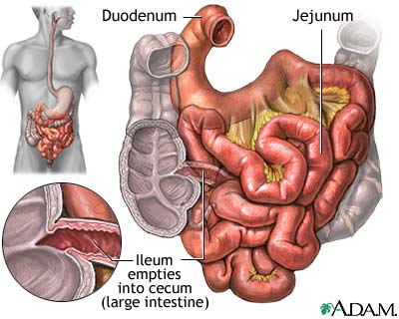
Small Intestine
1. Duodenum
Attached to the stomach
Curves around the head of the pancreas
2. Jejunum
Attaches anteriorly to the duodenum
3. Ileum
Extends from jejunum to large intestine

Slide 6
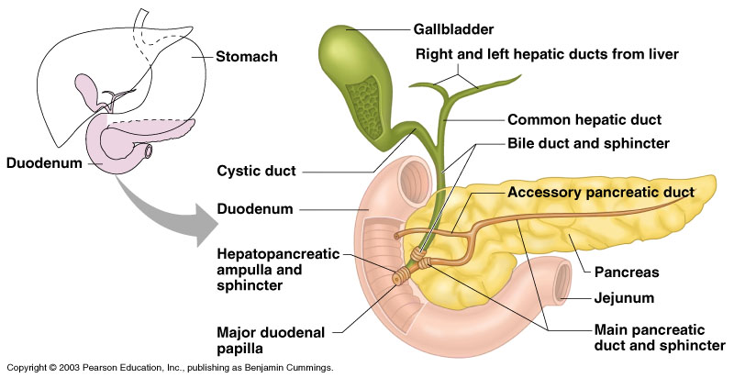
Chemical Digestion in the Small Intestine

Slide 7
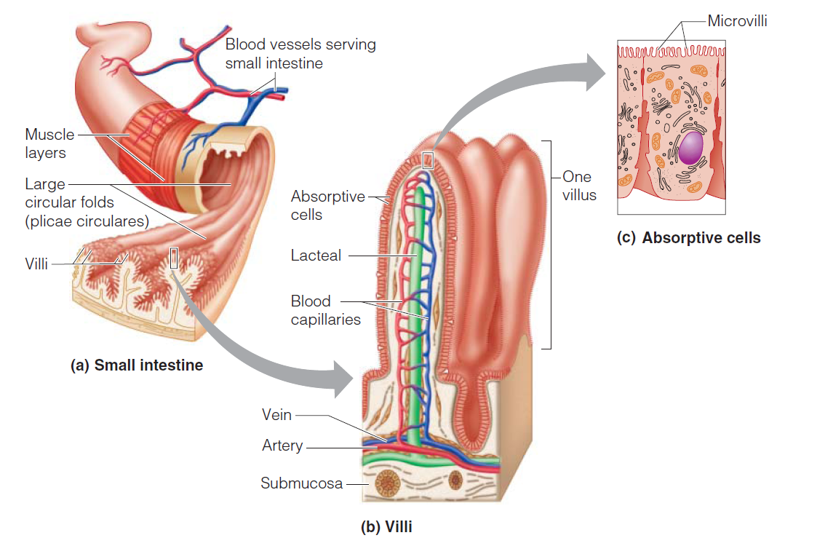
Structural Modifications of the Small Intestine

