Slide 1
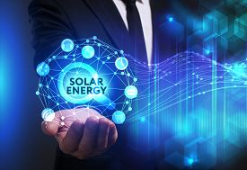
Solar Energy

Slide 2
Solar Energy: Photovoltaic (Solar cell)
Photovoltaic (PV) or Solar cell is an energy conversion system which converts the light comes from the sun into electricity.
PV's have played an important role in our life:
Such as feeding satellites with needed electricity
They have many applications & benefits.

Slide 3
Photovoltaic (Solar cell)
PV output over the time per day:
The amount of solar radiation varies with the passage of time during the day.
Solar cells can work between the hours of 6 a.m. to 6 p.m. and the value of energy generated almost remain within the normal distribution curve compared with the axis of time as shown in the following figure .

Slide 4
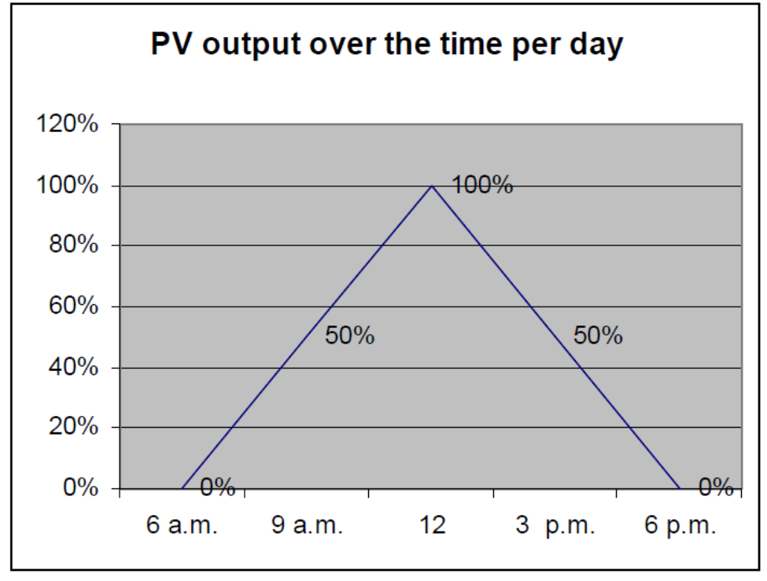
PV output over the time per day

Slide 5
How photovoltaic work?
The solar cells (PV) convert sunlight directly into electricity without the need to heat the air or water.
Photovoltaic cell made from at least 2 layers of the semiconductor material is usually silicon.
A positive layer which called p-type, the other layer negative which called n-type, & between them area that called p/n junction, see the figure.

Slide 6
How photovoltaic work?
When light falls on the cell surface & then enter the photons will be absorbed by atoms semiconductor article, which lead to liberation of electrons from the negative layer flowing across the electric circuit & then return to class with which constitutes a positive flow of electrons electricity.

Slide 7
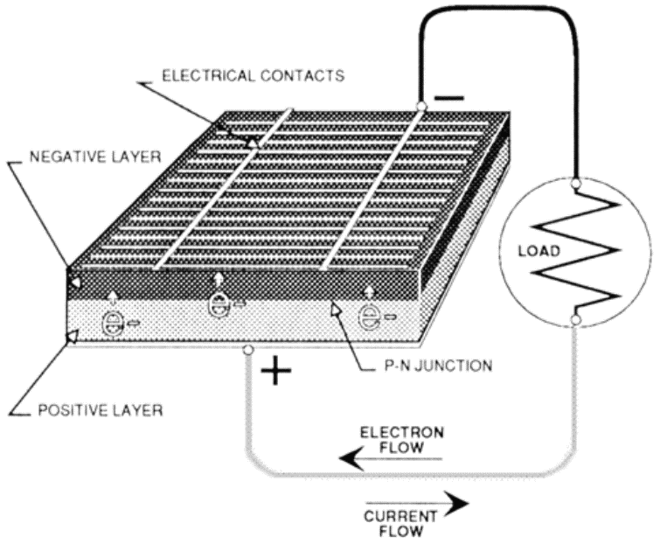
Components of PV Cell

Slide 8
Components of PV Cell
These cells are linked with each other in a sealed so-called module.
When 2 modules are linked with each other in series the voltage will be doubled, while the current remains constant, but when 2 modules are linked in parallel the current will be doubled & the voltage remains constant.
For the current & the voltage that be required many number of modules are linked to each other in a series & parallel form which called array.

Slide 9
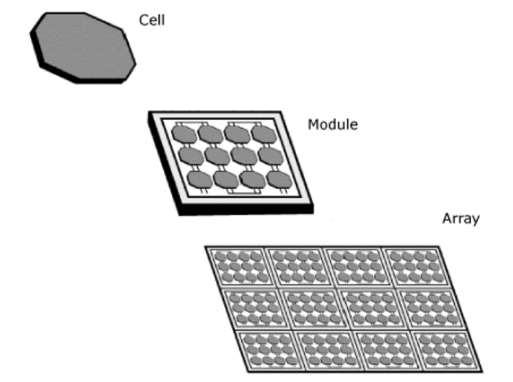
Components of PV Cell
The following figure shows photovoltaic cell, module, & array.
Photovoltaic Cell, Module, & Array

Slide 10
*The 4 General Types of Silicon PV Cells are
1. Single-crystal silicon.
15% efficient, typically expensive to make (grown as big crystal)
2. Poly-crystalline silicon (also known as multicrystal silicon).
10–12% efficient, cheaper to make (cast in ingots)
3. Amorphous silicon (also known as thin film silicon).
4–6% efficient, cheapest per Watt, easily deposited on a wide range of surface type
4. Ribbon silicon.

Slide 11
*The 4 General Types of Silicon PV Cells are
They are made by growing a ribbon from the molten silicon instead of an ingot.
These cells operate the same as single and poly-crystal cells.
The anti-reflective coating used on most ribbon silicon cells gives them a prismatic rainbow appearance.

Slide 12
*Advantages of Photovoltaic
Photovoltaic (PV) systems are an important energy technology for many reasons such as:
PV costs little to build and operate
No fuel use
PV is modular & thus flexible in terms of size and applications
PV is highly reliable & needs little maintenance
Long life
Photovoltaic system has a long life there is not a decline in the level of its performance before 15 year.
PV has virtually no environmental impact
PV is strengthening the economy & reducing trade deficit.
Development human life

Slide 13
Common Photovoltaic Applications
Photovoltaic system generates clean electric power.
As mentioned earlier from its advantages it is modular that could be connected a number of modules in parallel or serial, this operation made PV system access to different Voltage easy & this means that can be used in several applications for different voltages.

Slide 14
Common Photovoltaic Applications
The most important areas where the use photovoltaic system is remote, rural areas & where there is no electricity or generally network access to electricity is expensive.
This increase dramatically the quality of life for local population & encourage them to stay in their villages without the need to reflect on migration to big cities in order to improve the standard of living.

Slide 15
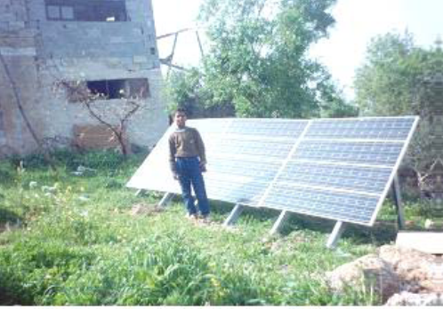
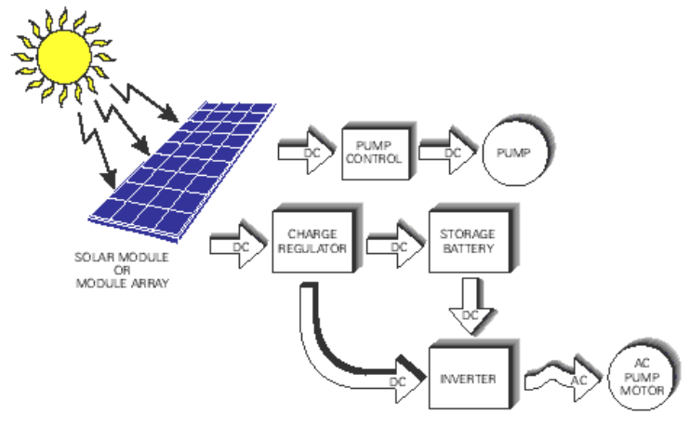
In the following some common application for PV:
Remote Village Electrification
Water pumping

Slide 16
In the following some common application for PV:
PV electrification of clinic in rural village
Lighting
PV communication
Gate Openers
Consumer Electronics
Battery Charging
Warning signal
Remote switching
Remote monitoring

Slide 17
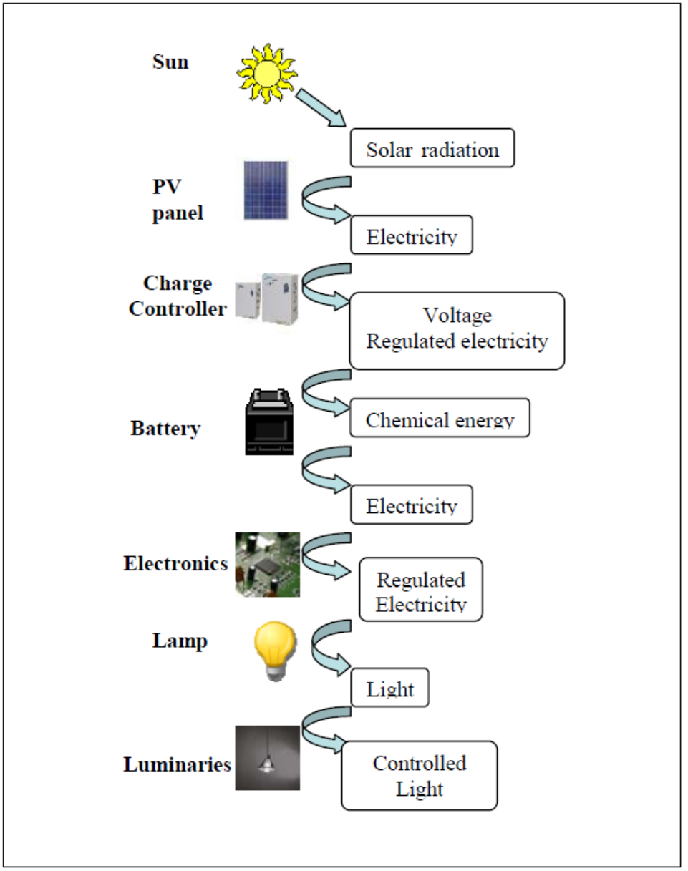
PV lighting system components and energy flow diagram

Slide 18
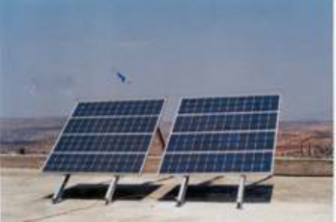
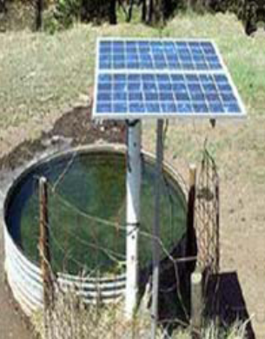
PV lighting system components and energy flow diagram
PV system, rural clinic- Kufor Thulth village in the north of West Bank.
PV water pump in one of the Palestinian villages

Slide 19
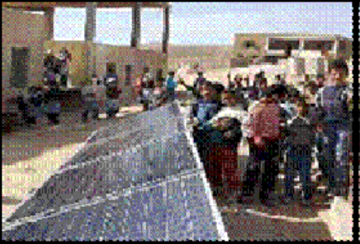
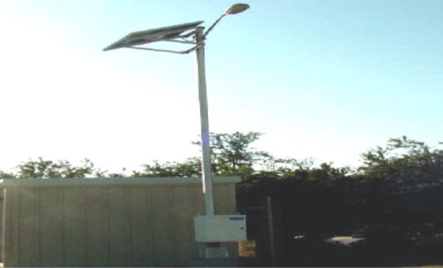
PV lighting system components and energy flow diagram
School PV system in one of Palestinian’s villages
Solar Street Lighting in Gaza

Slide 20
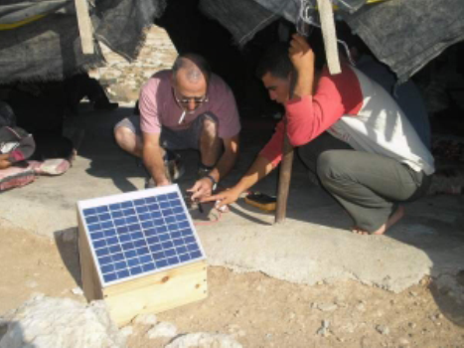
PV lighting system components and energy flow diagram
Solar Panel Charger for Video and Mobile in South Hebron

