Slide 1
Chapter 8
Transport Across Membranes: Overcoming the Permeability Barrier

Slide 2
Transport Across Membranes: Overcoming the Permeability Barrier
Overcoming the permeability barrier of cell membranes is crucial to proper functioning of the cell
Specific molecules and ions need to be selectively moved into and out of the cell or organelle
Membranes are selectively permeable or semipermeable

Slide 3
8.1 Cells and Transport Processes
Cells and cellular compartments are able to accumulate a variety of substances in concentrations that are very different from those of the surroundings
This process is known as homeostasis
Most of the substances that move across membranes are dissolved gases, ions, and small organic molecules; these are solutes

Slide 4
Transport Is Central to Cell Function
A central aspect of cell function is selective transport, the movement of ions or small organic molecules (metabolites: components of metabolic pathways)

Slide 5
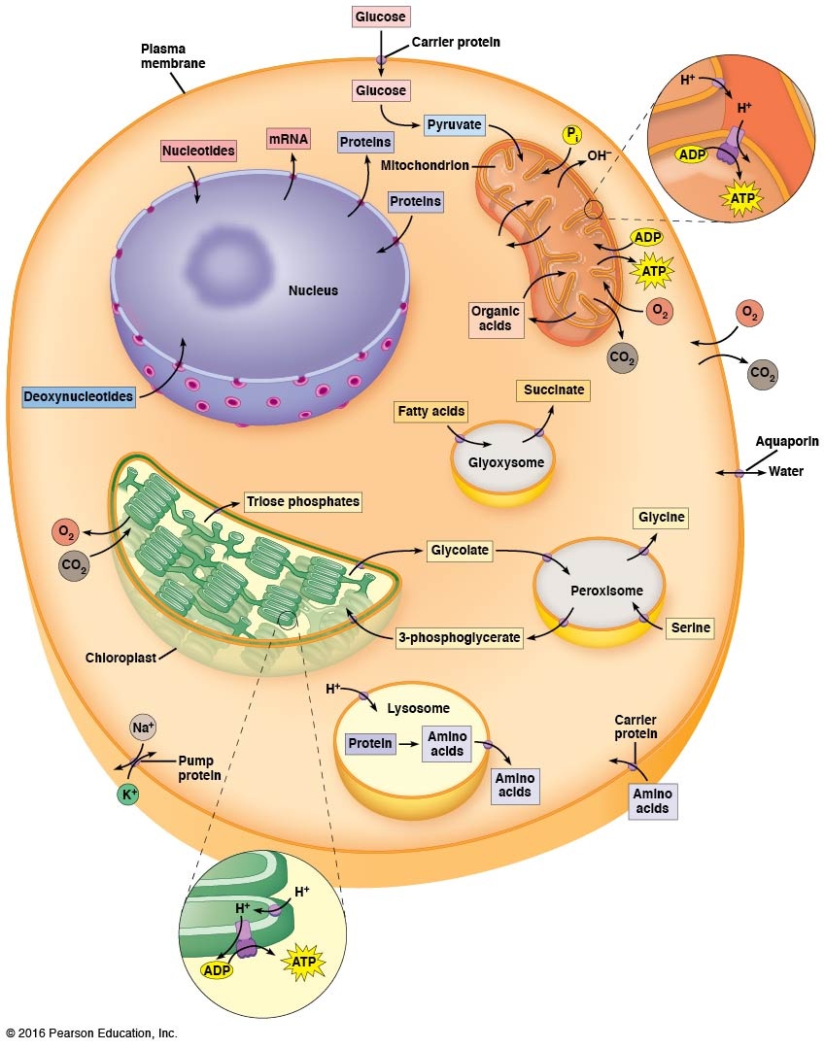

Slide 6
Solutes Cross Membranes by Simple Diffusion, Facilitated Diffusion, and Active Transport
Three quite different mechanisms are involved in moving solutes across membranes
A few molecules cross membranes by simple diffusion, the direct unaided movement dictated by differences in concentration of the solute on the two sides of the membrane
However, most solutes cannot cross the membrane this way

Slide 7
Transport Proteins
Transport proteins assist most solutes across membranes
These integral membrane proteins recognize with great specificity the substances to be transported
Some move solutes to regions of lower concentration; this facilitated diffusion (or passive transport) uses no energy

Slide 8
Active Transport
In other cases, transport proteins move solutes against the concentration gradient; this is called active transport
Active transport requires energy such as that released by the hydrolysis of ATP or by the simultaneous transport of another solute down an energy gradient

Slide 9
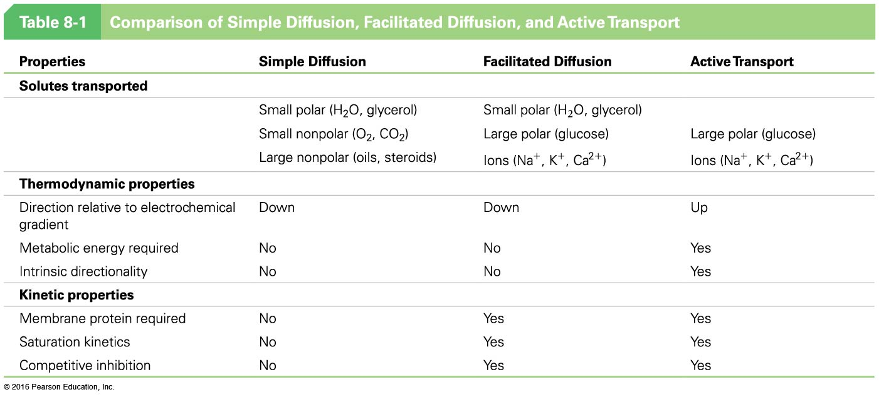

Slide 10
The Movement of a Solute Across a Membrane Is Determined by Its Concentration Gradient or Its Electrochemical Potential
The movement of a molecule that has no net charge is determined by its concentration gradient
Simple diffusion and facilitated diffusion involve exergonic movement “down” the concentration gradient (negative ΔG)
Active transport involves endergonic movement “up” the concentration gradient (positive ΔG)

Slide 11
The Electrochemical Potential
The movement of an ion is determined by its electrochemical potential, the combined effect of its concentration gradient and the charge gradient across the membrane
The active transport of ions across a membrane creates a charge gradient, or membrane potential (V_{m}), across the membrane

Slide 12
Active Transport of Ions
Most cells have an excess of negatively charged solutes inside the cell
This charge difference favors the inward movement of cations such as Na⁺ and outward movement of anions such as Cl–
In all organisms, active transport of ions across the plasma membrane results in asymmetric distribution of ions inside and outside the cell

Slide 13
The Erythrocyte Plasma Membrane Provides Examples of Transport Mechanisms
The transport proteins of the erythrocyte plasma membrane are among the best understood of all such proteins
The membrane potential is maintained by active transport of potassium ions inward and sodium ions outward
Special pores, or channels, allow water and ions to enter or leave the cell rapidly as needed

Slide 14
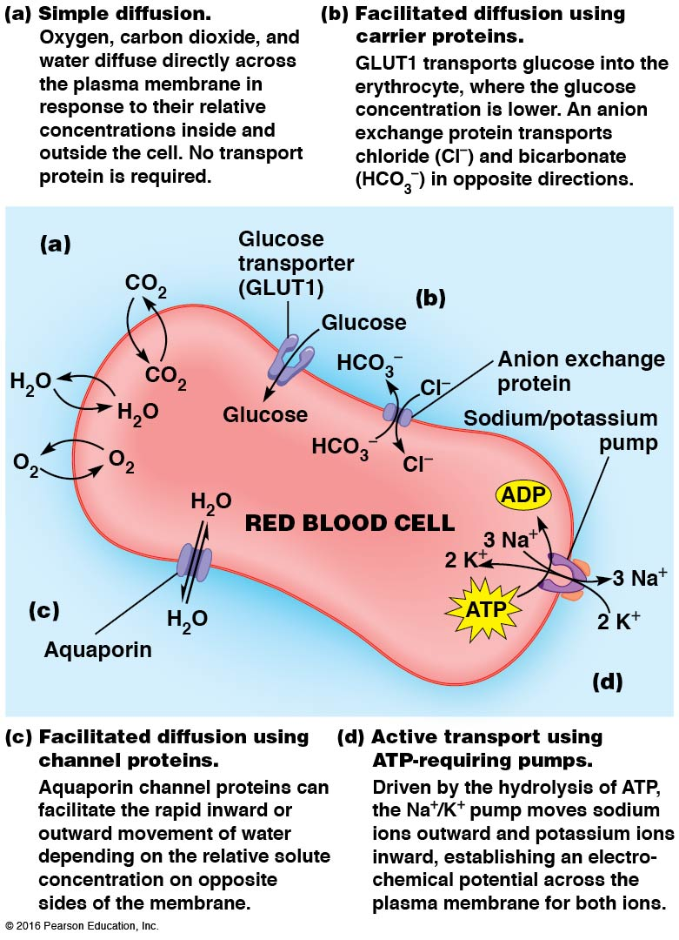

Slide 15
8.2 Simple Diffusion: Unassisted Movement Down the Gradient
The most straightforward way for a solute to cross a membrane is through simple diffusion, the unassisted net movement of a solute from high to lower concentration
Typically, this is only possible for gases, nonpolar molecules, or small polar molecules such as water, glycerol, or ethanol

Slide 16
Oxygen and the Function of Erythrocytes
Oxygen gas traverses the lipid bilayer readily by simple diffusion
Erythrocytes take up oxygen in the lungs, where oxygen concentration is high, and release it in the body tissues, where oxygen concentration is low

Slide 17
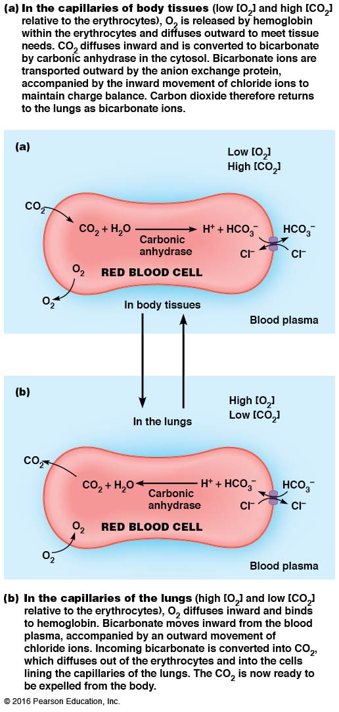

Slide 18
Diffusion Always Moves Solutes Toward Equilibrium
Diffusion always tends to create a uniform solution in which the concentration is the same everywhere
Solutes will move toward regions of lower concentration until the concentrations are equal
Thus, diffusion is always movement toward equilibrium

Slide 19
Diffusion Tends Toward Minimum Free Energy
Chemical reactions and physical processes proceed in the direction of decreasing free energy
Diffusion is the same: free energy is minimized as molecules move down their concentration gradients
At thermodynamic equilibrium, no further net movement occurs because the free energy of the system is at a minimum

Slide 20
Osmosis Is the Diffusion of Water Across a Selectively Permeable Membrane
Water molecules, being uncharged, are not affected by the membrane potential
Water concentration is not appreciably different on opposite sides of a membrane
Water will move across membranes in response to differences in solute concentration because the solutes themselves often do not readily cross the membranes

Slide 21
Osmosis
If two solutions are separated by a selectively permeable membrane, permeable to the water but not the solutes, the water will move toward the region of higher solute concentration
This movement is called osmosis
For most cells, water tends to move inward

Slide 22
Osmolarity
Osmotic movement into and out of a cell is related to the relative osmolarity, or total solute concentrations inside versus outside of the cell
If the solute concentration is higher outside the cell, the solution is called hypertonic
If the solute concentration is lower outside the cell, the solution is called hypotonic

Slide 23
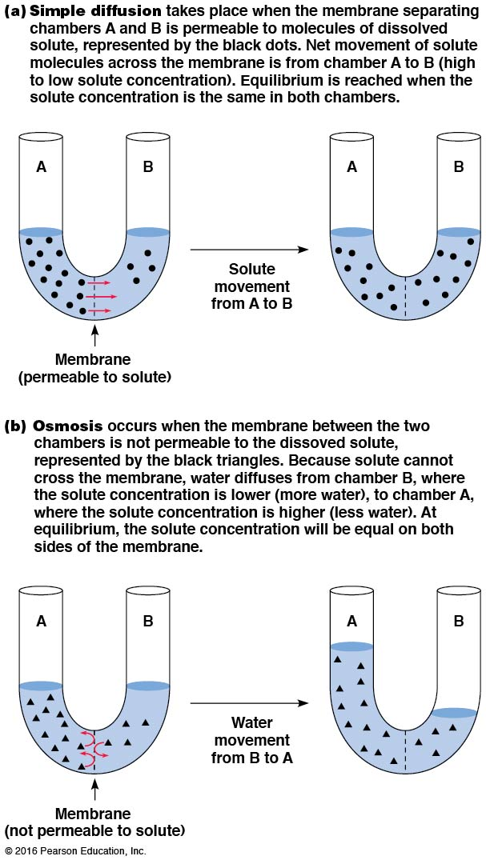

Slide 24
Cell Response to Osmolarity
Cells tend to shrink or swell as the solute concentration of the extracellular medium changes
For example, an animal cell in an isotonic solution (same solute concentration inside and outside the cell) will shrink and shrivel if moved to a hypertonic solution
The same cell will swell and perhaps burst (or lyse) if placed in a very hypotonic solution

Slide 25
Cells with Cell Walls
Cells of plants, algae, fungi, and many bacteria have cell walls that keep a cell from swelling and bursting in a hypotonic solution
Instead, the cells become very firm from the built-up turgor pressure
This results from the inward movement of water
In a hypertonic solution, the plasma membrane pulls away from the cell wall by a process called plasmolysis

Slide 26
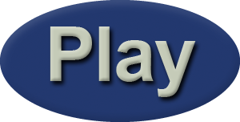
Video: Plasmolysis of Plant Cells

Slide 27
Cells Without Cell Walls
Cells without cell walls solve the osmolarity problem by pumping out inorganic ions, reducing the intracellular osmolarity
This minimizes the intracellular osmolarity and the difference in solute concentration between the cell and the surroundings

Slide 28
Simple Diffusion Is Typically Limited to Small, Nonpolar Molecules
Scientists use membrane models to study diffusion
Alec Bangham and colleagues found that when lipids from cell membranes are dispersed in water, they form liposomes
These are small vesicles forming a closed, spherical lipid bilayer lacking proteins

Slide 29
The Use of Liposomes to Study Diffusion
Bangham trapped solutes inside liposomes and measured the rate at which they diffused out
Ions were trapped inside the liposomes for days, and small uncharged molecules such as oxygen diffused too rapidly to measure
Factors affecting diffusion: size, polarity, and charge

Slide 30
Solute Size
In general, lipid bilayers are more permeable to small molecules—water, oxygen, carbon dioxide—than larger ones
But without a transporter, even these small molecules move more slowly than in the absence of a membrane
Still, water diffuses more rapidly than would be expected for a polar molecule

Slide 31
Diffusion of Water
It is thought that membranes contain tiny pores that allow water to diffuse more rapidly than predicted based on its polarity
Alternatively, perhaps membrane lipid movement creates transient “holes” through which the water can move
There is little evidence for these hypotheses

Slide 32
Solute Polarity
Lipid bilayers are more permeable to nonpolar substances than to polar ones
Nonpolar substances dissolve readily into the hydrophobic region of the bilayer
Large nonpolar molecules such as estrogen and testosterone cross membranes easily, despite their large size

Slide 33
A Measure of Solute Polarity
Polarity of a solute can be measured by the ratio of its solubility in an organic solvent to its solubility in water
This is called the partition coefficient
In general, the more nonpolar (hydrophobic) a substance is, the higher the partition coefficient

Slide 34
Solute Charge
The relative impermeability of polar substances, especially ions, is due to their association with water molecules
The molecules of water form a shell of hydration around polar substances
In order for these substances to move into a membrane, the water molecules must be removed, a process that requires energy

Slide 35
Solute Charge—Relevance to Cell Function
To function, every cell must maintain an electrochemical potential across its plasma membrane
In most cases, this potential is a gradient of either sodium ions (animal cells) or protons (other types of cells)
Membranes must still be able to allow ions to cross the bilayer in a controlled manner

Slide 36
The Rate of Simple Diffusion Is Directly Proportional to the Concentration Gradient
Thermodynamically, simple diffusion is always an exergonic process, requiring no input of energy
Kinetically, the net rate of transport for a substance is proportional to its concentration difference across the membrane

Slide 37
v_{inward}
.
v _{inward} = rate of diffusion in moles/sec-cm²
Δ[S] = [S] _{outside} – [S] _{inside}
P = permeability coefficient, which depends on thickness and viscosity of the membrane
Simple diffusion has a linear relationship between inward flux of solute and the concentration gradient of the solute

Slide 38
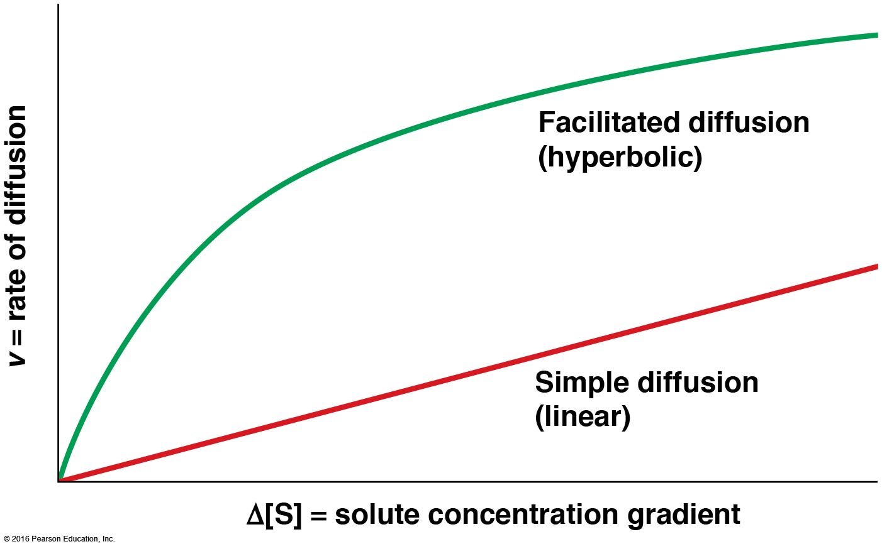

Slide 39
8.3 Facilitated Diffusion: Protein-Mediated Movement Down the Gradient
Most substances in the cell are too large or too polar to cross membranes by simple diffusion
These can move in and out of cells only with the assistance of transport proteins
If the process is exergonic, it is called facilitated diffusion; the solute diffuses as dictated by its concentration gradient

Slide 40
Transport Proteins in Facilitated Diffusion
No input of energy is needed in facilitated diffusion
The role of the transport proteins is just to provide a path through the lipid bilayer, allowing the “downhill” movement of a polar or charged solute

Slide 41
Carrier Proteins and Channel Proteins Facilitate Diffusion by Different Mechanisms
Transport proteins are large, integral membrane proteins with multiple transmembrane segments
Carrier proteins (transporters or permeases) bind solute molecules on one side of a membrane, undergo a conformation change, and release the solute on the other side of the membrane
Channel proteins form hydrophilic channels through the membrane to provide a passage route for solutes

Slide 42
Channels
Some channels are large and nonspecific, such as the pores on the outer membranes of bacteria, mitochondria, and chloroplasts
Pores are formed by transmembrane proteins called porins that allow passage of solutes up to a certain molecular weight to pass (600)
Most channels are smaller and highly selective

Slide 43
Ion Channels
Most of the smaller channels are involved in ion transport and are called ion channels
The movement of solutes through ion channels is much faster than transport by carrier proteins
This is likely because conformation changes are not required

Slide 44
Carrier Proteins Alternate Between Two Conformational States
The alternating conformation model states that a carrier protein is allosteric protein and alternates between two conformational states
In one state, the solute-binding site of the protein is accessible on one side of the membrane
The protein shifts to the alternate conformation, with the solute-binding site on the other side of the membrane, triggering solute release
Notes:
44

Slide 45
Carrier Proteins Are Analogous to Enzymes in Their Specificity and Kinetics
Carrier proteins are analogous to enzymes
Facilitated diffusion involves binding a substrate on a specific solute-binding site
The carrier protein and solute form an intermediate
After conformational change, the “product” is released (the transported solute)
Carrier proteins are regulated by external factors
Notes:
45

Slide 46
Specificity of Carrier Proteins
Carrier proteins share the property of high specificity with enzymes, too
Transport proteins are often highly specific for a single compound or a small group of closely related compounds
The carrier protein for glucose in erythrocytes is specific to a few monosaccharides and is stereospecific for only their d-isomers
Notes:
46

Slide 47
Kinetics of Carrier Protein Function
Carrier proteins can become saturated as the concentration of the solute rises
This is because the number of carrier proteins is limited and each functions at a finite maximum velocity
So, carrier-facilitated transport (like enzyme catalysis) exhibits saturation kinetics
Notes:
47

Slide 48
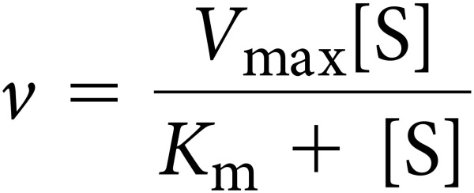
Saturation Kinetics of Carrier Proteins
Carrier-facilitated transport has an upper limiting velocity, V_{max}, and a constant K_{m} corresponding to the concentration of solute needed to achieve ½(V _{max})
Initial rate of solute transport can be described as:

Slide 49
Competitive Inhibition of Carrier Proteins
Competitive inhibition of carrier proteins can occur in the presence of molecules or ions that are structurally related to the correct substrate
For example, the transport of glucose by glucose carrier proteins can be inhibited by the other monosaccharides that the carrier accepts (such as mannose and galactose)

Slide 50
Carrier Proteins Transport Either One or Two Solutes
When a carrier protein transports a single solute across the membrane, the process is called uniport
A carrier protein that transports a single solute is called a uniporter
When two solutes are transported simultaneously, and their transport is coupled, the process is called coupled transport

Slide 51
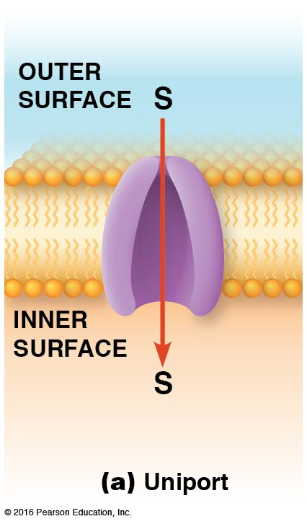

Slide 52
Coupled Transport
If the two solutes are moved across a membrane in the same direction, the process is referred to as symport (or cotransport)
If the solutes are moved in opposite directions, the process is called antiport (or countertransport)
Transporters that mediate these processes are symporters and antiporters

Slide 53
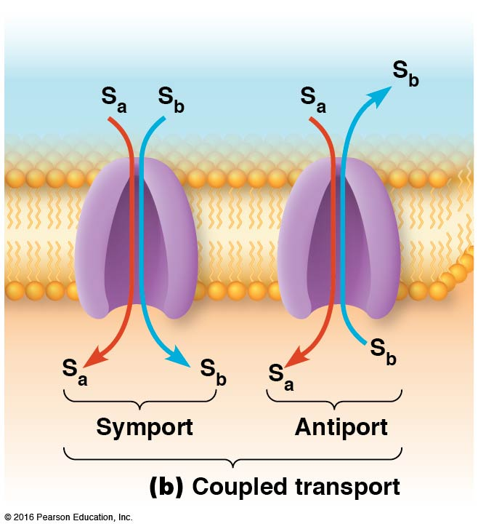

Slide 54
The Erythrocyte Glucose Transporter and Anion Exchange Protein Are Examples of Carrier Proteins
The glucose transporter is a uniport carrier for glucose
The anion exchange protein is an antiport anion carrier for Cl– and HCO₃–
Both are found in the plasma membrane of erythrocytes
Notes:
54

Slide 55
The Glucose Transporter: A Uniport Carrier
The erythrocyte is capable of glucose uptake by facilitated diffusion because the level of blood glucose is much higher than that inside the cell
Glucose is transported inward by a glucose transporter (GLUT; GLUT1 in erythrocytes)
GLUT1 is an integral membrane protein with 12 transmembrane segments, which form a cavity with hydrophilic side chains
Notes:
55

Slide 56
Mechanism of Transport by GLUT1
GLUT1 is thought to transport glucose through the membrane by the alternating conformation mechanism
One conformational state, T₁, has the binding site for glucose open on the outside of the cell
The other conformational state, T₂, has the binding site open to the inside of the cell

Slide 57
Transport by GLUT1
d-glucose collides with and binds to GLUT1 in the T₁ conformation
GLUT1 shifts to the T₂ conformation
The conformational change causes the release of glucose
GLUT1 returns to the T₁ conformation

Slide 58
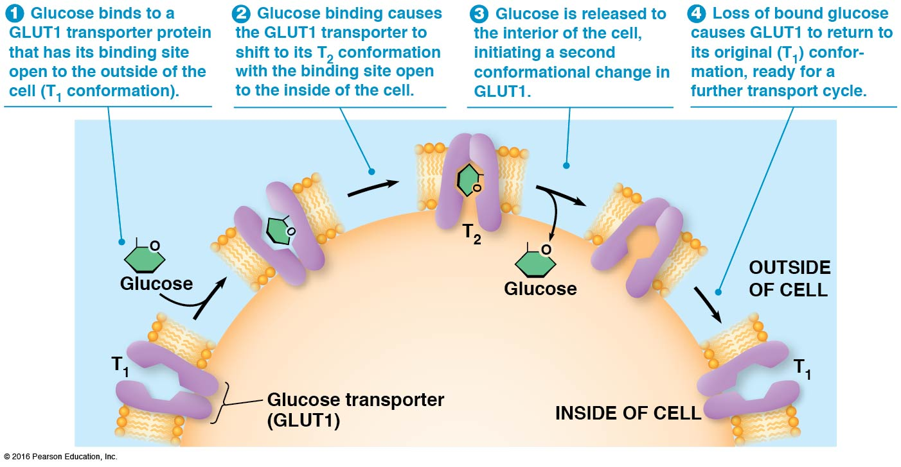
Notes:
58

Slide 59
Activity: Facilitated Diffusion

Slide 60
Transport by GLUT1 Is Reversible
A carrier protein can facilitate transport in either direction
The direction of transport is dictated by the relative solute concentrations outside and inside the cell
Glucose concentration is kept low inside most animal cells

Slide 61
Phosphorylation of Glucose
.
The immediate phosphorylation of glucose upon entry into the cell keeps the internal concentration of glucose low
Once phosphorylated, glucose cannot bind the carrier protein any longer and is effectively locked into the cell

Slide 62
The Erythrocyte Anion Exchange Protein: An Antiport Carrier
The anion exchange protein (also called the chloride-bicarbonate exchanger) facilitates reciprocal exchange of Cl– and HCO₃– ions only
Exchange will stop if either anion is absent
The ions are exchanged in a strict 1:1 ratio
Notes:
62

Slide 63
The “Ping-Pong” Mechanism
The anion exchange protein is thought to alternate between two conformational states
In the first state, the protein binds a chloride ion on one side of the membrane, which causes a change to the second state
In the second state, the chloride is moved across the membrane and released
Notes:
63

Slide 64
The “Ping-Pong” Mechanism (continued)
The release of chloride causes the protein to bind bicarbonate
The binding of bicarbonate causes a shift back to the first conformation
In this conformation, bicarbonate is moved out of the cell, allowing the carrier to bind chloride again
Notes:
64

Slide 65
Biological Relevance of Anion Exchange
In tissues, waste CO₂ diffuses into the erythrocytes, where it is converted to HCO₃– by the enzyme carbonic anhydrase
As the concentration of bicarbonate rises, it moves out of the cell, coupled with uptake of Cl– to prevent a net charge imbalance
In the lungs, the entire process is reversed
Notes:
65

Slide 66
Channel Proteins Facilitate Diffusion by Forming Hydrophilic Transmembrane Channels
Channel proteins form hydrophilic transmembrane channels that allow specific solutes to cross the membrane directly
There are three types of channels: ion channels, porins, and aquaporins

Slide 67
Ion Channels: Transmembrane Proteins That Allow Rapid Passage of Specific Ions
Ion channels, tiny pores lined with hydrophilic atoms, are remarkably selective
Because most allow passage of just one ion, separate proteins are needed to transport Na⁺, K⁺, Ca²⁺, and Cl–, etc.
Selectivity is based both on binding sites involving amino acid side chains and on a size filter

Slide 68
Gated Channels
Most ion channels are gated, meaning that they open and close in response to some stimulus
Voltage-gated channels open and close in response to changes in membrane potential
Ligand-gated channels are triggered by the binding of certain substances to the channel protein
Mechanosensitive channels respond to mechanical forces acting on the membrane

Slide 69
Patch Clamp Experiments
Patch clamping experiments allow researchers to monitor ion flow through individual channels in a small patch of membrane
This sensitive technique allows researchers to record the opening and closing of a single channel
It has allowed studies that show which parts of a channel are essential for proper functioning in living cells

Slide 70
Functions of Ion Channels
Ion channels play roles in many types of cellular communication, such as muscle contraction and electrical signaling of nerve cells
Ion channels are also needed for maintaining salt balance in cells and airways linking the lungs
A chloride ion channel, the cystic fibrosis transmembrane conductance regulator (CFTR), helps maintain the proper Cl– concentration in lungs; defects in the protein cause cystic fibrosis

Slide 71
Porins: Transmembrane Proteins That Allow Rapid Passage of Various Solutes
Pores on outer membranes of bacteria, mitochondria, and chloroplasts are larger and less specific than ion channels
The pores are formed by multipass transmembrane proteins called porins
The transmembrane segments of porins cross the membrane as β barrels

Slide 72
Structure of Porins
The β barrel has a water-filled pore at its center
Polar side chains line the inside of the pore, allowing passage of many hydrophilic solutes
The outside of the barrel contains many nonpolar side chains that interact with the hydrophobic interior of the membrane

Slide 73
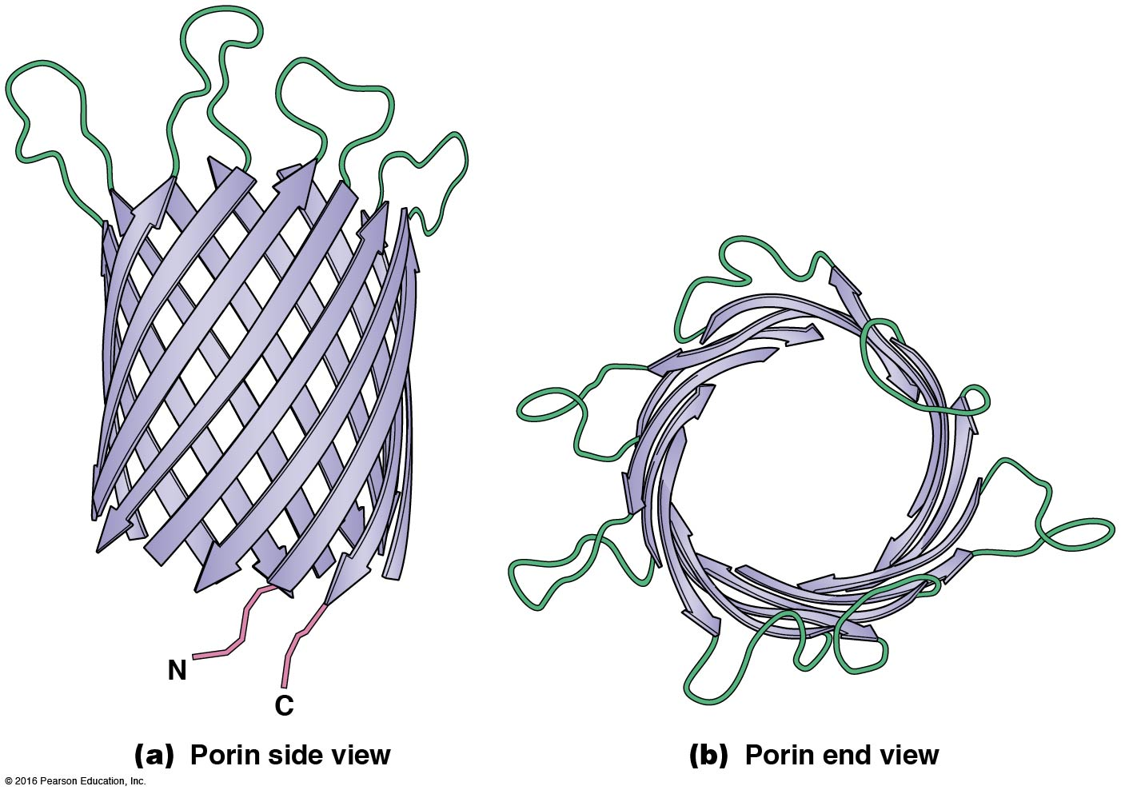

Slide 74
Aquaporins: Transmembrane Channels That Allow Rapid Passage of Water
Movement of water across cell membranes in some tissues is faster than expected given the polarity of the water molecule
Aquaporin (AQP) was discovered only in 1992
Aquaporins allow rapid passage of water through membranes of erythrocytes and kidney cells in animals, and root cells and vacuolar membranes in plants

Slide 75
Aquaporin Structure
All aquaporins are tetrameric integral membrane proteins
The identical monomers associate with their 24 transmembrane segments oriented to form four central channels
The channels, lined with hydrophilic side chains, are just large enough for water molecules to pass through one at a time

Slide 76
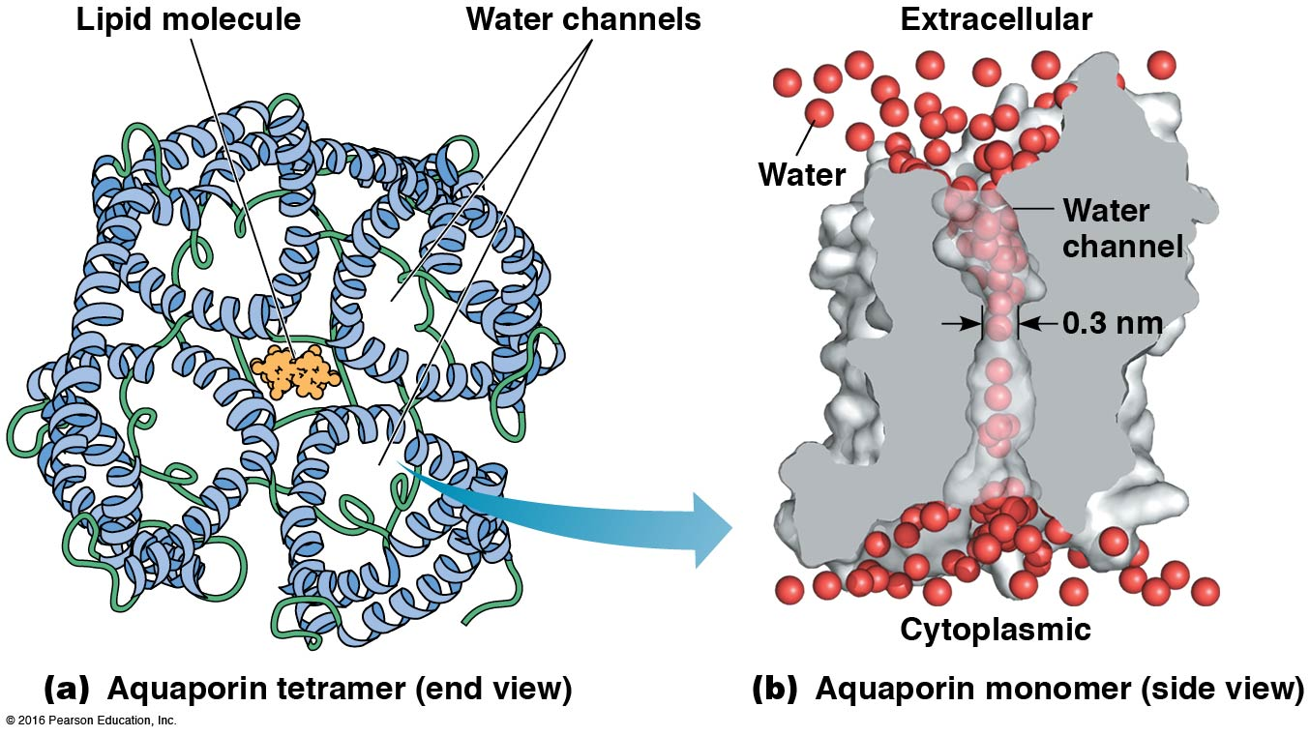

Slide 77
8.4 Active Transport: Protein-Mediated Movement Up the Gradient
Facilitated diffusion is important but accounts only for movement of molecules down a concentration gradient, toward equilibrium
Sometimes a substance must be transported against a concentration gradient
In this case, active transport is used to move solutes up a concentration gradient, away from equilibrium

Slide 78
Functions of Active Transport
Active transport couples endergonic transport to an exergonic process, usually ATP hydrolysis
Active transport performs three important cellular functions
Uptake of essential nutrients
Removal of wastes
Maintenance of nonequilibrium concentrations of certain ions

Slide 79
Nonequilibrium Conditions
Active transport allows the creation and maintenance of an internal cellular environment that differs greatly from the surrounding environment
Many membrane proteins involved in active transport are called pumps, because energy is required to move substances against their concentration gradients

Slide 80
Active Transport Is Unidirectional
Active transport differs from diffusion (both simple and facilitated) in the direction of transport
Diffusion is nondirectional with respect to the membrane and proceeds as directed by the concentrations of the transported substances
Active transport has an intrinsic directionality

Slide 81
The Coupling of Active Transport to an Energy Source May Be Direct or Indirect
Active transport mechanisms can be divided based on the sources of energy and whether or not two solutes are transported at the same time
Active transport is categorized as direct or indirect

Slide 82
Direct Active Transport
In direct active transport (primary active transport), the accumulation of solute molecules on one side of the membrane is coupled directly to an exergonic chemical reaction
This is usually hydrolysis of ATP
Transport proteins driven by ATP hydrolysis are called transport ATPases or ATPase pumps

Slide 83
Indirect Active Transport
Indirect active transport depends on the simultaneous transport of two solutes
Favorable movement of one solute down its gradient drives the unfavorable movement of the other up its gradient
This can be a symport or an antiport, depending on whether the two molecules are transported in the same or different directions

Slide 84
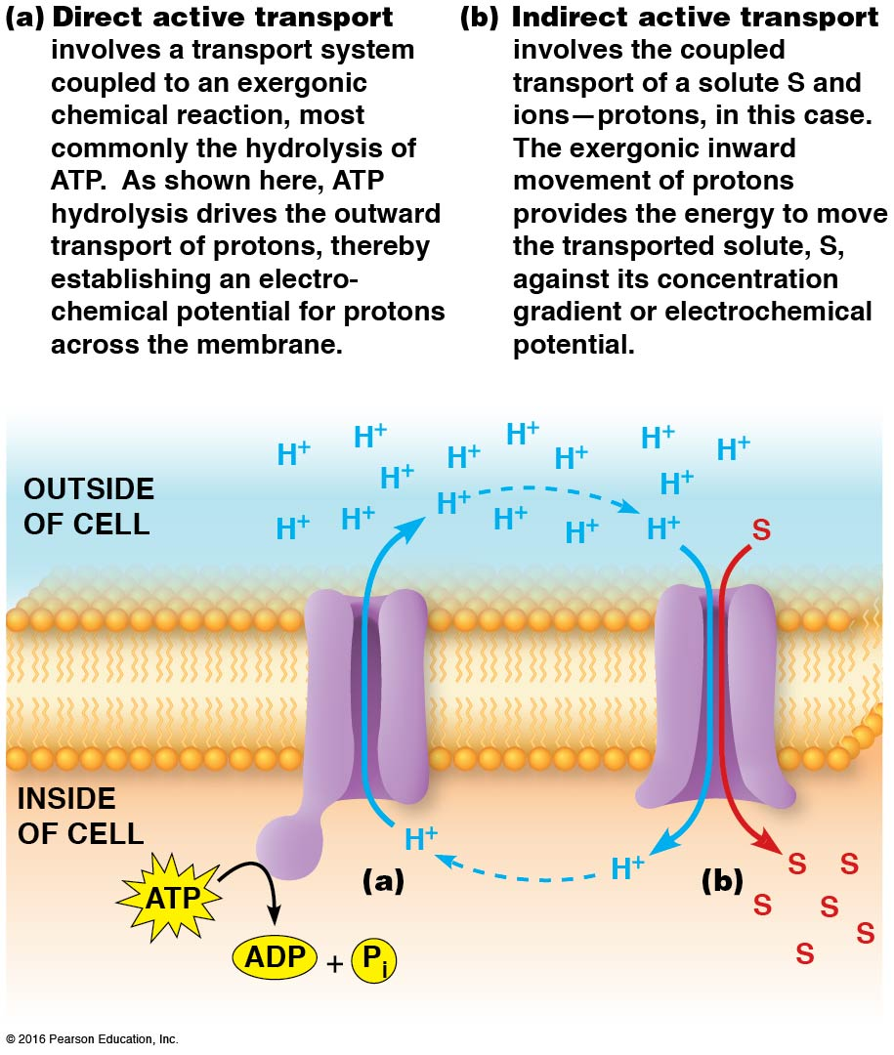

Slide 85
Direct Active Transport Depends on Four Types of Transport ATPases
Four types of transport ATPases have been identified
P-type
V-type
F-type
ABC-type
They differ in structure, mechanism, location, and roles

Slide 86
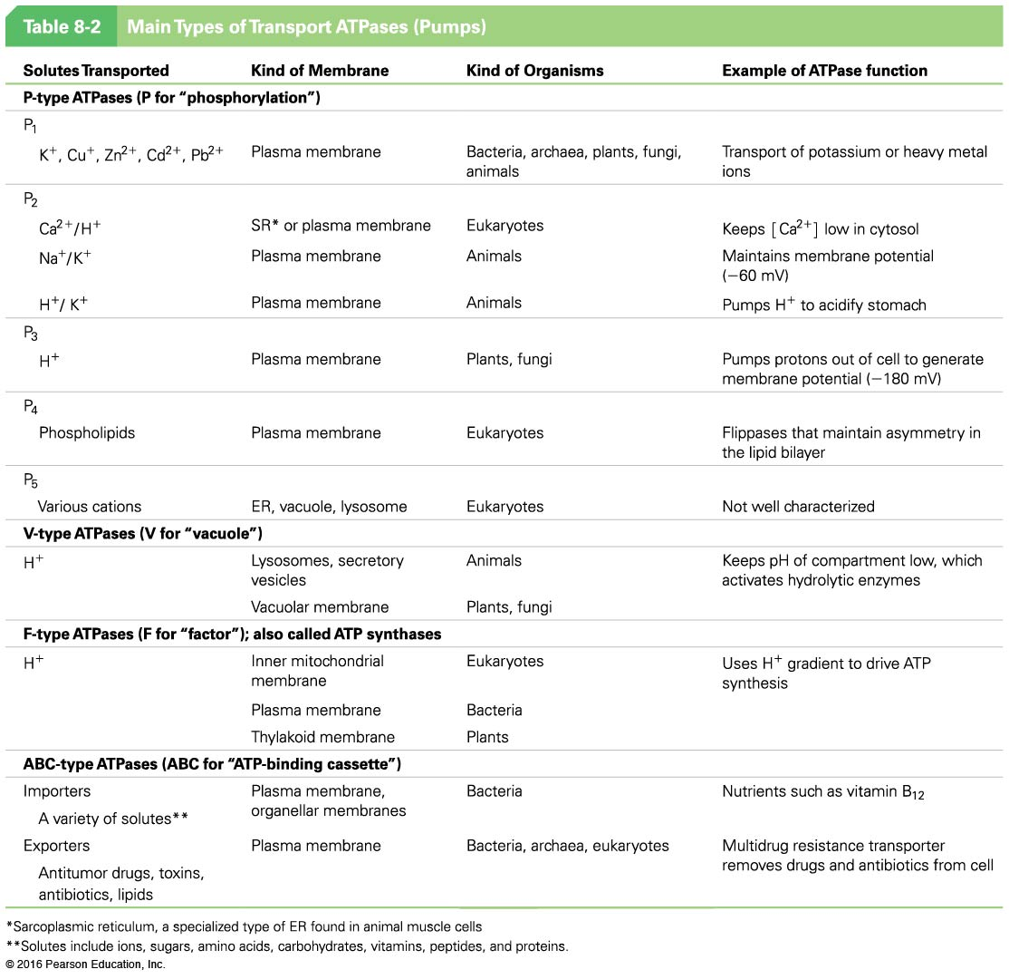

Slide 87
P-Type ATPases
P-type ATPases are members of a large family and are reversibly phosphorylated by ATP on a specific aspartic acid residue
They have eight to ten transmembrane segments in a single polypeptide, which crosses the membrane multiple times
They are sensitive to inhibition by vanadate, VO₄^{3–}, which resembles phosphate, PO₄^{3–}

Slide 88
P-Type ATPase Subfamilies
P-type ATPases fall into five subfamilies
P₁-ATPases are found in all organisms and transport heavy metal ions
P₂-ATPases are responsible for maintaining gradients of ions (Na⁺, K⁺, H⁺, Ca²⁺) across plasma membranes of eukaryotic cells
They play roles in muscle contraction and the acidification of gastric juices in the stomach

Slide 89
P-Type ATPase Subfamilies (continued)
P₃-ATPases of plants and fungi pump protons out across the plasma membrane, acidifying the external medium
P₄-ATPases pump hydrophobic molecules such as cholesterol and fatty acids; they do not transport them all the way across the bilayer but act as flippases
P₅-ATPases are not well characterized, but some are known to transport cations

Slide 90
V-Type ATPases
V-type ATPases pump protons into organelles such as vacuoles, vesicles, lysosomes, endosomes, and the Golgi complex
They have two multisubunit components: an integral component embedded in the membrane and a peripheral component that juts out from the membrane surface

Slide 91
F-Type ATPases
F-type ATPases are found in bacteria, mitochondria, and chloroplasts
They transport protons and have two components: a transmembrane pore (F_{o}) and a peripheral membrane component (F₁) that contains the ATP-binding site
Both are multisubunit components

Slide 92
F-Type ATPases Also Function in Reverse
The F-type ATPases can facilitate the reverse process
In this case, ATP is synthesized, driven by the exergonic flow of protons down their gradients
In the reverse direction, the ATPases are more accurately called ATP synthases

Slide 93
F-Type ATPases Illustrate an Important Principle
Because of the way F-type ATPases function, they illustrate the following principle:
Not only can ATP be used as an energy source to generate ion gradients, but such gradients can be used as an energy source to synthesize ATP
This is true of all eukaryotes and most prokaryotes

Slide 94
ABC-Type ATPases
The ABC-type ATPases are also called ABC (ATP binding cassette) transporters
The term cassette describes the catalytic domain that binds ATP as part of the transport process
ABC-type ATPases comprise a very large family of transport proteins found in all organisms

Slide 95
Importers and Exporters
Most of the ABC transporters initially discovered from bacteria were importers, involved in uptake of nutrients
But many are now known to be exporters, some of which are medically important

Slide 96
Structure of ABC-Type ATPases
ABC transporters typically have four protein domains, two of which are highly hydrophobic
These are embedded in the membrane
The other two domains are peripheral and are associated with the cytoplasmic side of the membrane

Slide 97
Structure and Function of ABC-Type ATPases
The peripheral domains bind ATP and couple its hydrolysis to transport
The embedded domains each consist of six membrane-spanning segments that form a channel through which solutes can pass
Sometimes all four domains are found on a single polypeptide, but usually they are separate polypeptides

Slide 98
Medical Significance of ABC-Type ATPases
ABC transporters are medically important because some of them pump antibiotics or drugs out of cells, rendering the cell resistant to the drug
Some human tumors are resistant to drugs that normally inhibit growth of tumors; the resistant cells have high concentrations of an ABC transporter called MDR (multidrug resistance) transport protein

Slide 99
MDR Transport Protein
MDR transport protein pumps hydrophobic drugs out of cells, reducing the cytoplasmic concentration and hence their effectiveness
Unlike most ABC transporters, MDR protein transports a wide range of chemically dissimilar drugs
The MDR protein of some bacteria renders them resistant to antibiotics by a similar mechanism

Slide 100
The Cystic Fibrosis Transporter
CFTR, the transporter responsible for cystic fibrosis (when defective), is similar in sequence and structure to the core domains of ABC transporters
However, CFTR is an ion channel and does not use ATP to drive transport

Slide 101
Indirect Active Transport Is Driven by Ion Gradients
Indirect active transport (secondary active transport) is not powered by ATP hydrolysis
The inward transport of molecules up their electrochemical gradients is often coupled to and driven by simultaneous inward movement of Na⁺ (animals) or protons (plants, fungi, bacteria) down their gradients

Slide 102
Symport Mechanisms of Indirect Active Transport
Most cells continuously pump either sodium ions or protons out of the cell (for example, the Na⁺/K⁺ pump in animals)
The resulting high extracellular concentration of Na⁺ is a driving force for the uptake of sugars and amino acids
This is indirectly related to ATP because the pump that maintains the sodium ion gradient is driven by ATP

Slide 103
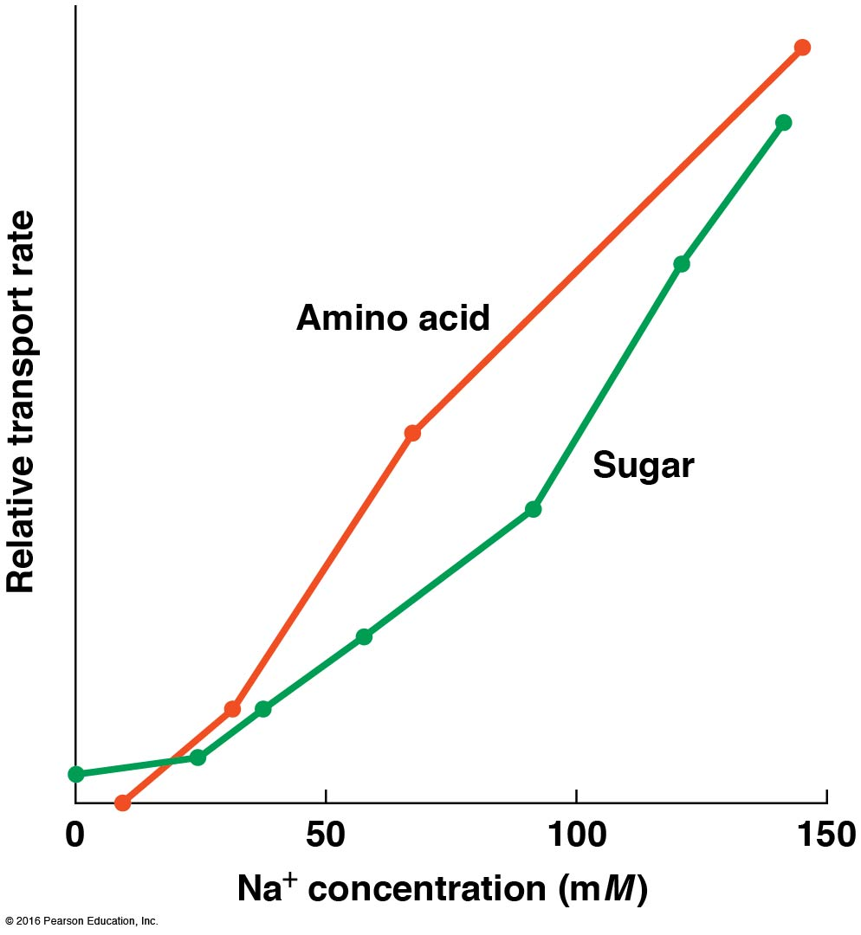

Slide 104
Proton Gradients Drive Indirect Active Transport in Many Organisms
Most organisms rely on proton gradients rather than the Na⁺ gradients used by animals
For example, fungi and plants use proton symport for the uptake of organic solutes, with ATP driving the proton pump that creates and maintains the proton electrochemical potential
Proton or ion gradients can be used for export as well as uptake
Notes:
104

Slide 105
8.5 Examples of Active Transport
The Na⁺/K⁺ ATPase (or pump) in all animal cells is a well understood example of direct active transport by a P-type ATPase
The Na⁺/glucose symporter is an example of indirect active transport
Light-driven proton transport in some bacteria is an example of an unusual type of transport
Notes:
105

Slide 106
Direct Active Transport: The Na⁺/K⁺ Pump Maintains Electrochemical Ion Gradients
In a mammalian neuron, [K⁺] _{inside}/[K⁺] _{outside} is about 30:1, and [Na⁺] _{inside}/[Na⁺] _{outside} is around 0.08:1
The electrochemical potentials for sodium and potassium are essential as a driving force for coupled transport and for transmission of nerve impulses
Notes:
106

Slide 107
Requirement for Energy
The pumping of both Na⁺ and K⁺ ions against their gradients requires energy
The pump that is responsible, the Na⁺/K⁺ ATPase (or pump), uses the exergonic hydrolysis of ATP to drive the transport of both ions
It is primarily responsible for the asymmetric distribution of ions across the plasma membrane of animal cells
Notes:
107

Slide 108
Structure of the Na⁺/K⁺ ATPase
The pump is a trimeric transmembrane protein with one α, one β, and one γ subunit
The α subunits contain binding sites for sodium and ATP on the cytoplasmic side and potassium and ATP on the external side
The functions of the other two subunits are not yet understood

Slide 109
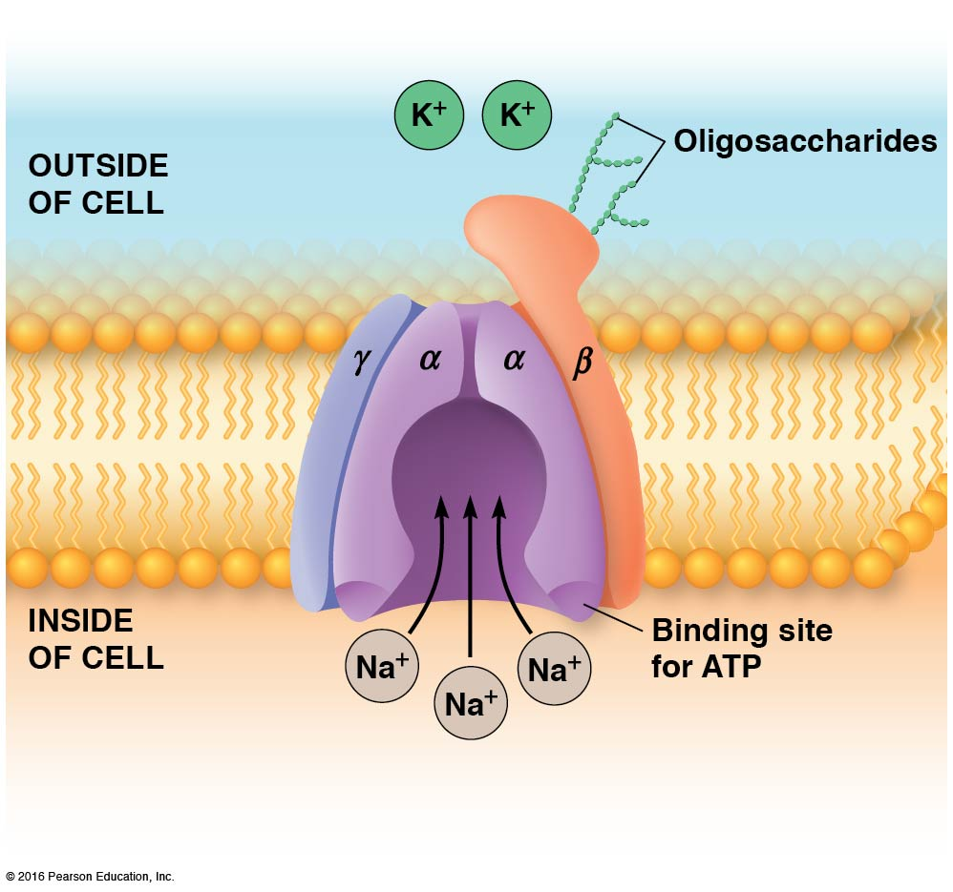

Slide 110
The Na⁺/K⁺ Pump Is an Allosteric Protein
The Na⁺/K⁺ pump has two alternative conformational states, E₁ and E₂
The E₁ conformation is open to the inside of the cell and has high affinity for Na⁺ ions
The E₂ conformation is open to the outside of the cell and has high affinity for K⁺ ions

Slide 111
Mechanism of the Na⁺/K⁺ Pump
Three Na⁺ ions bind to the E₁ conformation
This triggers phosphorylation of the α subunit by ATP
The pump undergoes a shift to the E₂ conformation, causing release of the Na⁺ ions on the outside of the cell

Slide 112
Mechanism of the Na⁺/K⁺ Pump (continued)
Then, K⁺ ions bind to the α subunit on the outside of the cell
This triggers dephosphorylation of the α subunit by ATP and a return to the E₁ conformation
In the conformational change, K⁺ ions are carried to the inside of the cell and released

Slide 113
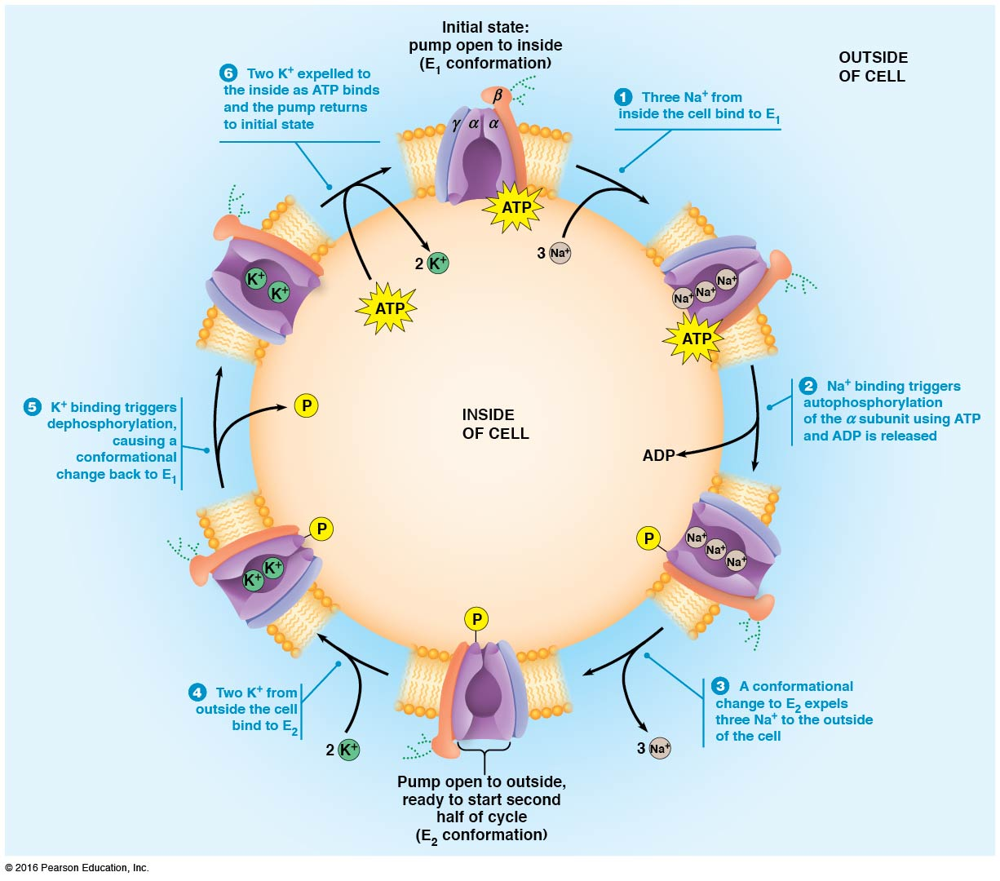

Slide 114
Activity: Active Transport

Slide 115
Indirect Active Transport: Sodium Symport Drives the Uptake of Glucose
Although most glucose transport into and out of our cells occurs by facilitated diffusion, some cells use a Na⁺/glucose symporter
For example, the cells lining the intestine take up glucose and some amino acids even when their concentrations are much lower outside than inside the cells
Notes:
115

Slide 116
Uptake of Glucose via Sodium Symport Requires Energy
A steep Na⁺ gradient that is maintained across the plasma membrane (via the Na⁺/K⁺ pump) is used to provide the energy needed
The proteins responsible for sodium symport are called sodium-dependent glucose transporters, or SGLT proteins
Notes:
116

Slide 117
Mechanism for the Na⁺/Glucose Symporter
Two external Na⁺ ions bind their sites on the symporter, which is open to the exterior
This allows one molecule of glucose to bind
A conformational change in the protein exposes the glucose and Na⁺ inside the cell

Slide 118
Mechanism for the Na⁺/Glucose Symporter (continued)
The two Na⁺ ions dissociate in response to the low internal Na⁺ concentration
This locks the symporter in its inward-facing conformation until the glucose dissociates
The loss of glucose frees the symporter to return to the outward-facing conformation

Slide 119
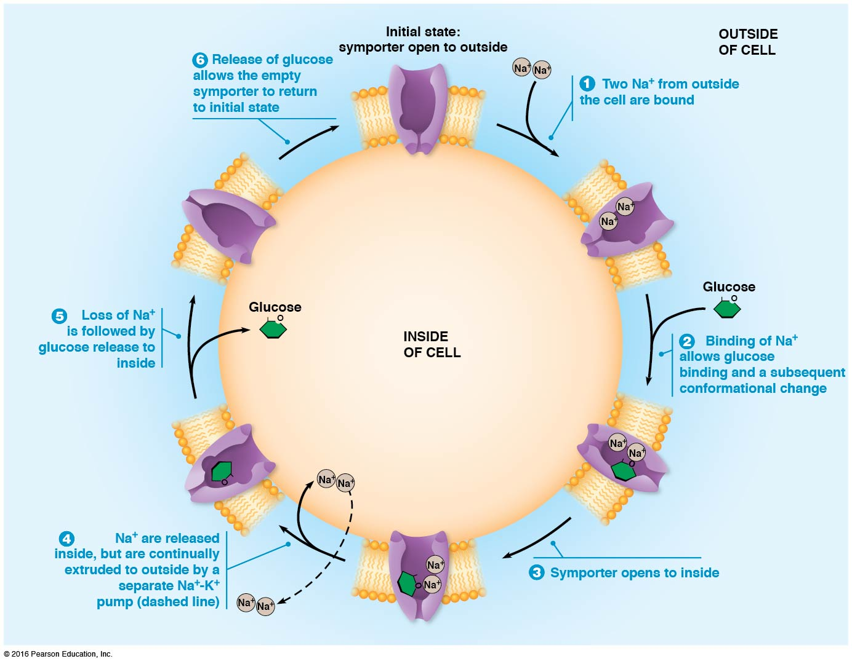

Slide 120
The Bacteriorhodopsin Proton Pump Uses Light Energy to Transport Protons
Bacteriorhodopsin is a small integral membrane protein in the plasma membrane of archaea of the genus Halobacterium
It uses energy from photons of light to drive active transport of protons out of the cells
It creates an electrochemical proton gradient that powers synthesis of ATP by an ATP synthase

Slide 121
Bacteriorhodopsin Structure and Function
The light-absorbing pigment is retinal, which is related to vitamin A
Retinal makes the bacteria purple, so Halobacteria are also called purple synthetic bacteria
Bacteriorhodopsin has seven α-helical membrane-spanning segments forming a cylindrical shape

Slide 122
Photoactivation of Bacteriorhodopsin
A molecule of retinal is attached to a lysine residue of the protein
Retinal is a chromophore, a light-absorbing pigment
It absorbs a photon and becomes photoactivated, and it is then capable of transferring protons to the outside of the cell

Slide 123
Bacteriorhodopsin Function
The proton gradient produced by pumping protons out of the cell is used to produce ATP
Protons flow back into the cell down their concentration gradient, causing ATP synthases to produce ATP
This mechanism is being researched for the relatively new field of biomolecular electronics

Slide 124
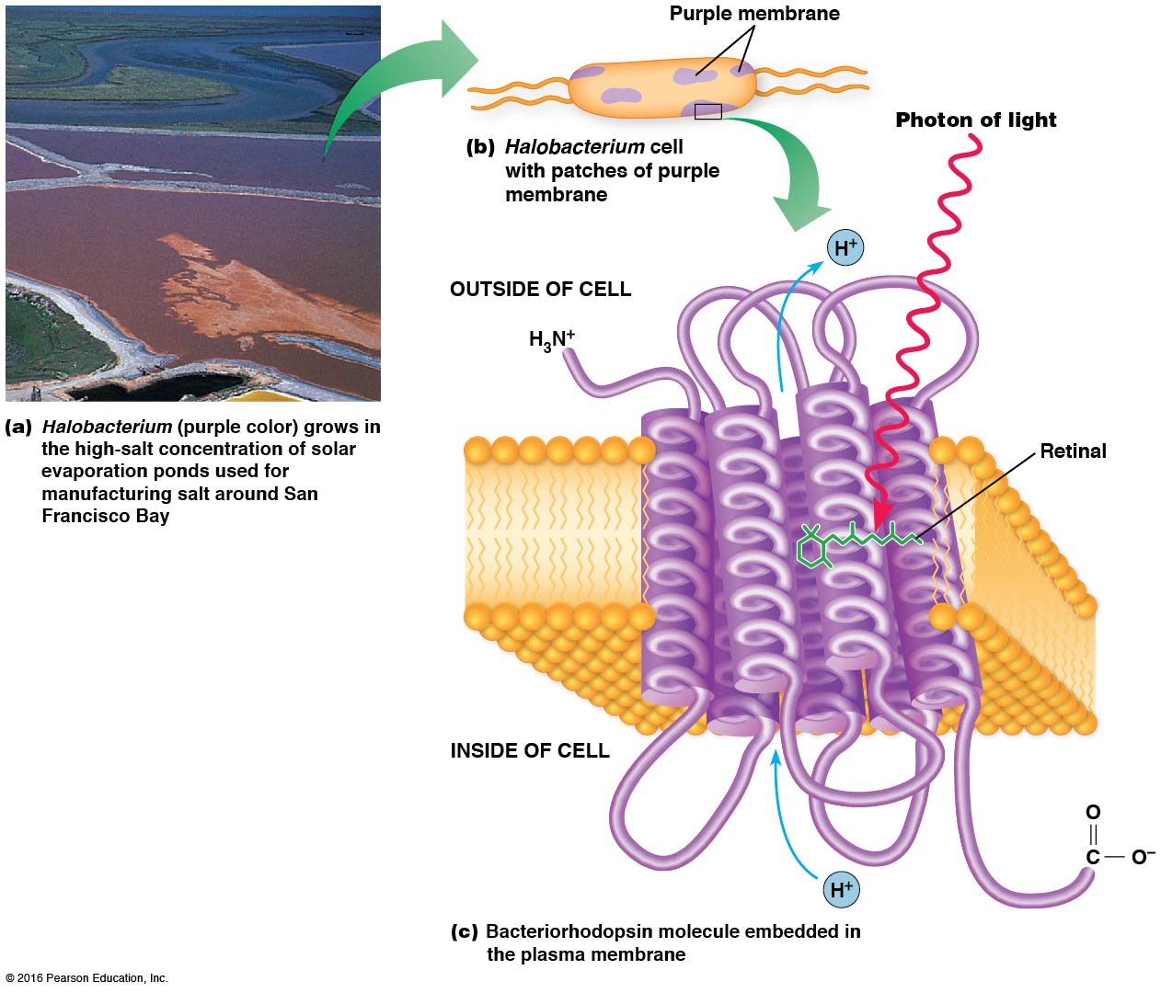

Slide 125
8.6 The Energetics of Transport
Every transport event in the cell is an energy transaction
For uncharged solutes, the only variable is the concentration gradient across the membrane
For charged solutes, both concentration and electrical potential are relevant

Slide 126
For Uncharged Solutes, the ΔG of Transport Depends Only on the Concentration Gradient
For solutes with no net charge, we are concerned only with their concentration gradient across the membrane
Because of this, the ΔG for transport of uncharged solutes is relatively easy to calculate

Slide 127
Calculating ΔG for the Transport of Molecules
The general “reaction” for solute transportation
[S] _{outside} → [S] _{inside}
And ΔG can be calculated as
Notes:
127

Slide 128
K_{eq} for Transport of Uncharged Solutes
The K_{eq} for uncharged solutes will always be 1
And ΔGº is always 0
Notes:
128

Slide 129
ΔG of Inward Transport
The ΔG of inward transport simplifies to
If [S] _{inside} < [S] _{outside}, ΔG is negative and the transport is exergonic
But, if [S] _{inside} > [S] _{outside}, ΔG is positive and transport is against the concentration gradient

Slide 130
An Example: The Uptake of Lactose
Suppose that the lactose concentration inside a bacterium must be kept at 10 mM and that the external lactose concentration is 0.20 mM
We can determine the energy requirement for inward transport of lactose

Slide 131
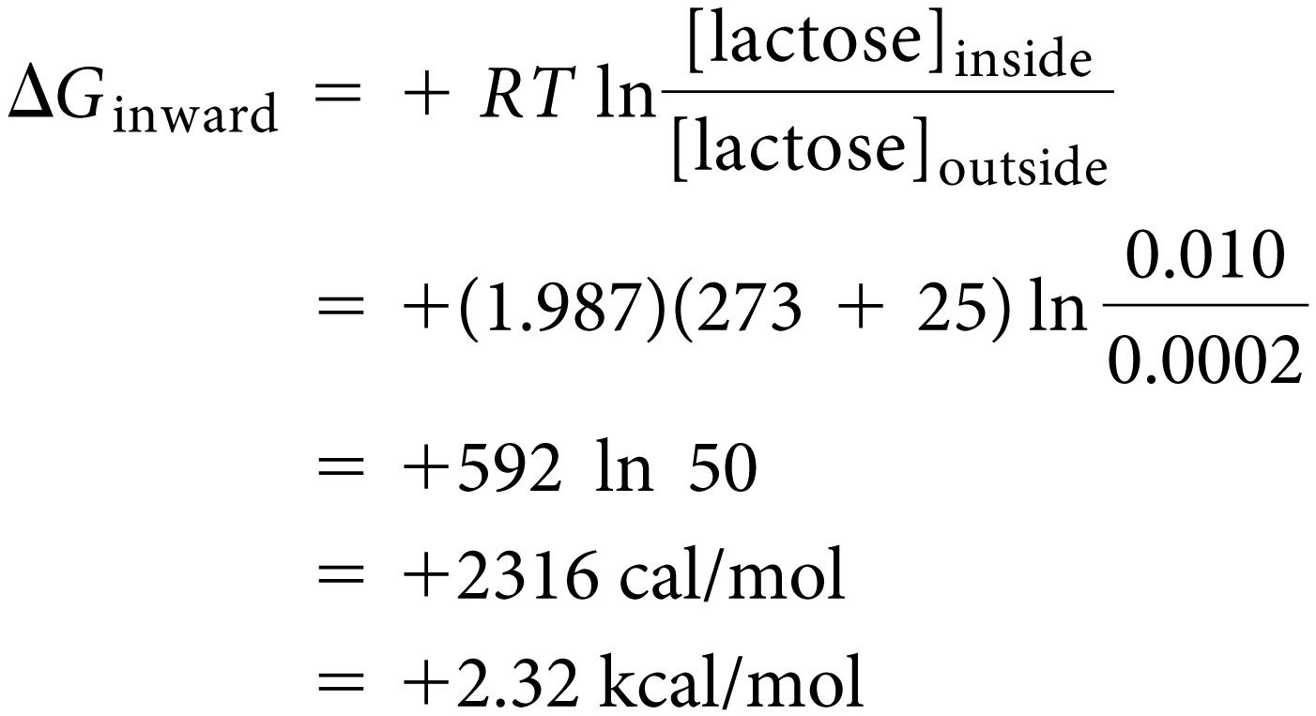
Energy Requirement for Lactose Uptake
For outward transport of lactose, [S] _{inside} and [S] _{outside} must be interchanged

Slide 132
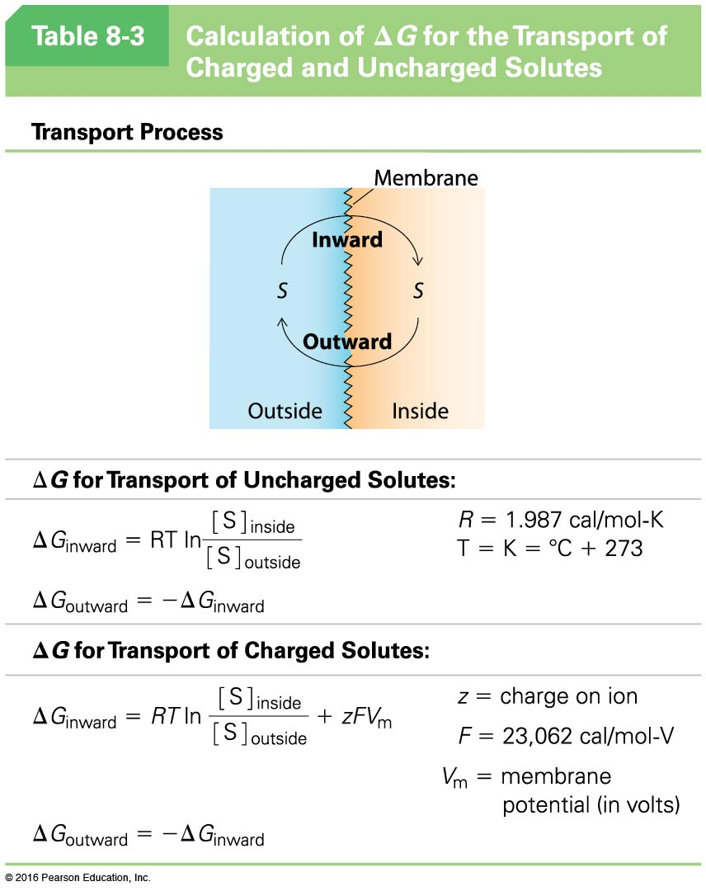

Slide 133
For Charged Solutes, the ΔG of Transport Depends on the Electrochemical Potential
For charged solutes, we must consider both concentration gradient and the membrane potential, V_{m}
Because V_{m} is nearly always negative, it usually favors the inward movement of cations and opposes their outward movement

Slide 134
Calculating ΔG for the Transport of Ions
If S^{z} is a solute with charge z, then
For a typical cell V_{m} is negative, so a positive ion will give a negative ΔG for inward transport, and a negative ion gives a positive ΔG

Slide 135
Outward Transport
For outward transport, ΔG has the same value as inward, but with the sign changed

Slide 136
An Example: The Uptake of Chloride Ions
Consider a nerve cell with [Cl–] _{inside} = 50 mM, in a solution with [Cl–] = 100 mM and membrane potential of –60 mV
The inward movement of Cl– ions is down the concentration gradient but up the charge gradient
To determine the direction of transfer, we need to take both into account

Slide 137
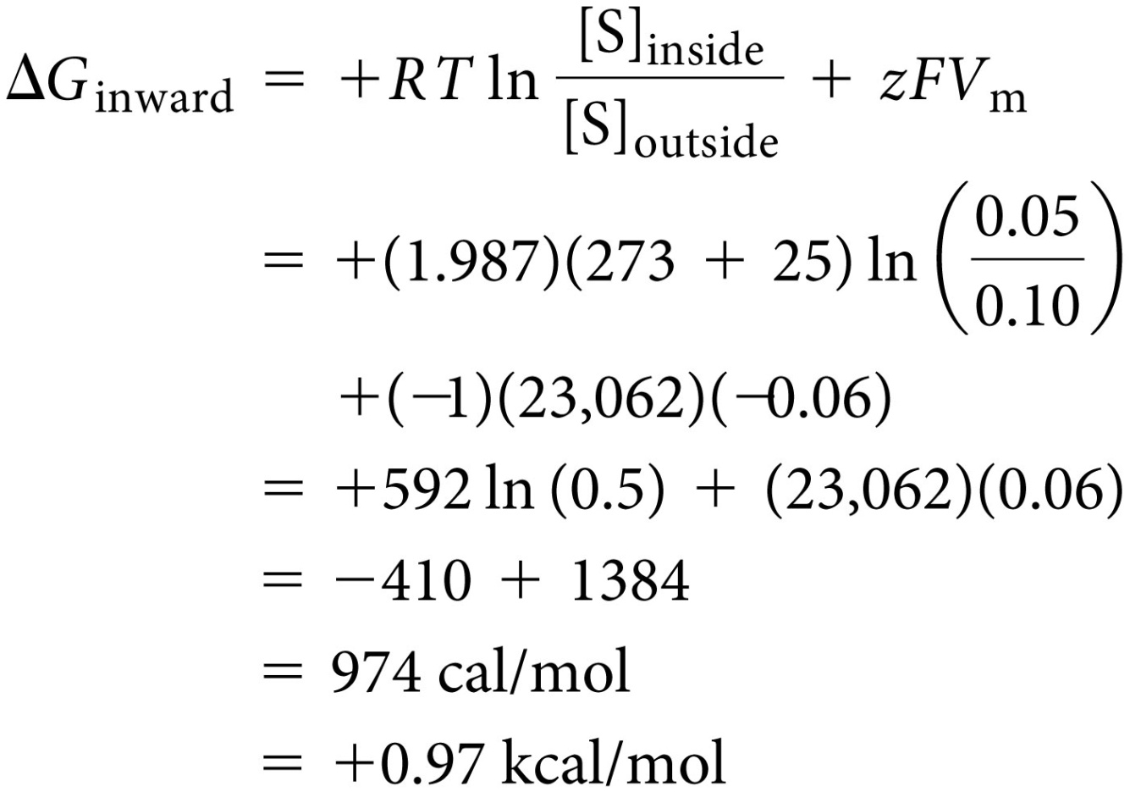
Calculate ΔG for Cl– Intake
So, though Cl– concentration is higher outside the cell, energy is still required for import

