Slide 1
minerals
Source: vitamin Village
https://rdmc.nottingham.ac.uk/handle/internal/129

Slide 2
What is a mineral?
Minerals are the building blocks of rocks
Present in the soil, rocks, water
Some minerals are ESSENTIAL
Required by the body in small quantities
Maintenance of health and life
Constitute approximately 4% of human bodyweight
Very important!

Slide 3
Mineral Classification
Classified depending on requirement and tissue quantity
Minerals
Macro
Micro
Trace
Quantity found in typical adult human body
>5g
< 5g
Trace
Quantity required by typical adult human/day
> 100 mg/day
1 -100 mg/day
< 1mg/day
Toxic if present at high levels
- Become chemically reactive

Slide 4
Minerals
Macro-minerals
Calcium
Chloride
Magnesium
Phosphorus
Potassium
Sodium
Sulfur
Micro-minerals
Iron
Zinc
Copper
Selenium
Chromium
Iodine
Manganese
Molybdenum
Fluorine
Ultra-trace
Nickel
Silicon
Vanadium
Arsenic
Boron
Cobalt

Slide 5
Bioavailability

Slide 6
Bioavailability
The degree to which the amount of an ingested mineral is absorbed and available to the body
Absorption and/or excretion can control body mineral content
IN
OUT
Absorption
control ?
Excretion
control ?
Body
mineral
pool
The quantity absorbed is influenced by it’s availability

Slide 7
Bioavailability
The degree to which the amount of an ingested mineral is absorbed and available to the body
Factors altering bioavailability
Deficiency of minerals in body
Reduced storage will increase absorption of minerals from GI tract/kidney
Chemical binding of mineral to other elements of diet
Phytates in plants bind to minerals preventing absorption
Excess of mineral
Presence of vitamins
e.g. ↑ zinc = ↓ iron/copper
e.g. vitamin C ↑ iron
Vitamin D ↑ calcium

Slide 8
Metalloproteins/enzymes
Metalloprotein
Metalloenzyme
Protein + metal
Enzyme + metal
Examples:
Haemoglobin
Myoglobin
Examples:
Glutathione peroxidase
Main roles of metal
Cofactor
Binding of atoms
Stabilize protein after the enzymatic reaction
Many enzymes that regulate the biological processes within the body are metalloenzymes

Slide 9
Metalloenzymes
Metal | Enzyme | Function
Iron | Succinate dehydrogenase | Aerobic metabolism (TCA cycle)
Zinc | Carbonic anhydrase | CO₂ formation (acid -base balance)
Manganese | Pyruvate carboxylase | Pyruvate metabolism (TCA cycle)
Selenium | Glutathione peroxidase | Removal of free radicals

Slide 10
Minerals and nutrition
Dietary Reference Values (DRVs) have been determined for minerals
Enough circulating level
Prevent deficiency disease

Slide 11
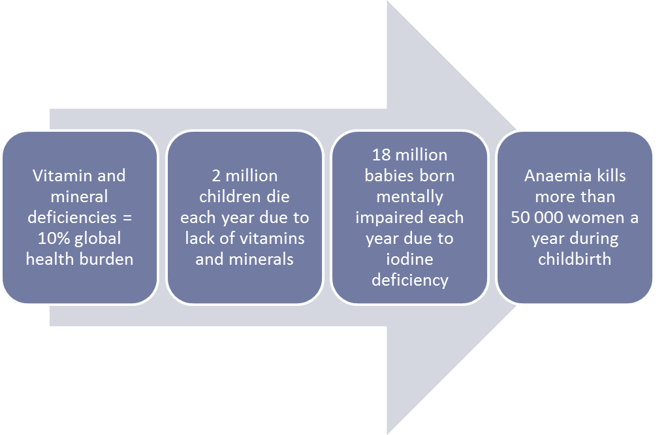
Hidden Hunger
Mineral deficiencies may occur due to;
Inadequate diet
Inability to digest or assimilate the mineral
(Data sourced from The Micronutrient Initiative)

Slide 12
Mineral nutritional requirements
Minerals are not “degraded”
Recycling can take place but losses are unavoidable
Maintenance requirements
Losses have to be replaced
Faeces (intestinal secretions), urine, sweat, blood
Variable requirement
Functions above maintenance
Pregnancy, lactation, growth, “work”, gut parasites

Slide 13
Focus on specific minerals
Sodium and chloride
Iron
Iodine
Selenium
Calcium

Slide 14
SODIUM AND CHLORIDE

Slide 16
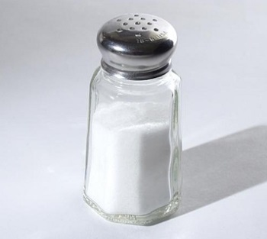
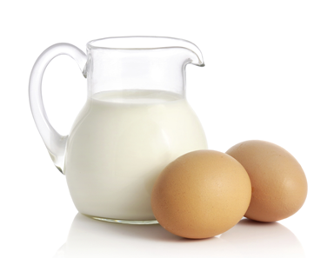
Also known as salt!
Major dietary source of sodium chloride (NaCl)
Table salt
Canned meats, soups, pickles, crisps
Natural sodium sources
Milk, eggs, meat,
Natural chloride sources
Eggs, fresh meat, seafoods

Slide 17
+
Sodium is the most abundant cation in the body (ECF)
Chloride is the most abundant anion in ECF (88 % ECF)
Majority of dietary sodium and chloride is absorbed
Excess is excreted by the kidneys
-

Slide 18
Sodium and Chlorine
Play a key role in the regulation of body fluid
Maintains osmotic pressure
Maintains blood volume
Blood pressure

Slide 19
Regulation of fluid and electrolyte balance
Thirst
Primary regulator of water intake
Decrease in blood volume activates renin/angiotensin pathways which stimulates thirst centre in the hypothalamus
Kidney is involved in the control of body water content and salt levels
In response to sodium and water loss
Increased vasoconstriction (Increased Blood pressure)
Activates kidney
Increase ECF Na+ and increase body water

Slide 20
Sodium Imbalance
Hypernatremia – Increased sodium concentration in blood plasma due to;
Disease of the kidney
Inadequate water intake
Loss of water due to diarrhoea and/or vomiting
Hyponatremia – decreased sodium concentration in blood plasma due to;
Excessive sweating with water replacement only
Inability to regulate

Slide 21
Sodium Chloride Intake (salt)
Until (relatively) recently, humans consumed <0.25 g salt/day
Today, most humans consume excess NaCl (FSA estimate approx 9 g/day)
Associated with increased blood pressure and risk of CVD and stroke
Food Standards Agency campaign (2004 ) to encourage a reduction in salt intake to below 6 g/day
Food Standards Agency intake targets
Adults 6g NaCl/day (2.4g Na)
Children (<1yr, 2g NaCl/day)
In 2005 only 9.6 % of adults met recommended guidelines for sodium intake

Slide 22
Sodium chloride
Food product | Salt serving (g)
Weetabix | 0.25
White bread (thick) | 0.5
Mature cheddar cheese | 0.9
cornflakes | 1.0
Garlic bread | 1.25
Chicken tikka masala with rice | 1.75
Baked beans | 1.9
Bolognese sauce | 1.9
Southern fried chicken | 2.25
Cream of tomato soup | 3.0
Lasagne | 3.0
Pizza | 5.75
Low salt
High salt

Slide 23
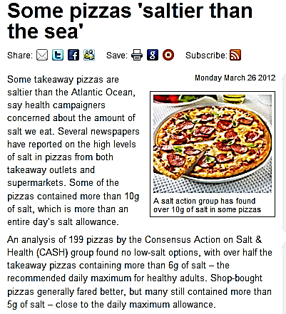
http://www.nhs.uk/news/2012/03march/Pages/takeaway-supermarket-pizza-salt-content.aspx

Slide 24
Salt intake Food Standards agency campaign http://www.salt.gov.uk/index.html

Slide 25
Overall, High NaCl intakes contribute to elevated blood pressure in most people
Associated with ⬆ plasma vol. and ⬆ BP
Degree of sensitivity varies...population vs. individual
Reduce salt intake tends to reduce BP
Diet?!

Slide 26
iron

Slide 27
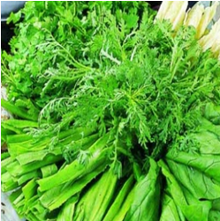
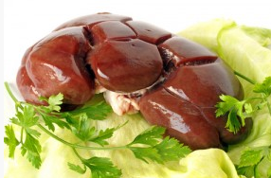
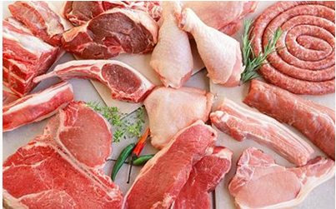
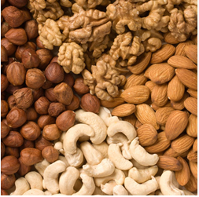
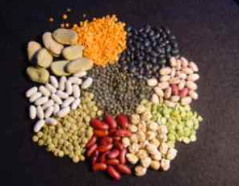
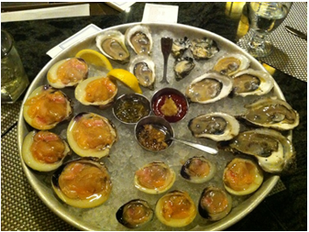
Iron
Food sources
Green leafy vegetables
Organ Meats
Meat
legumes
Nuts
Clams/oysters

Slide 28
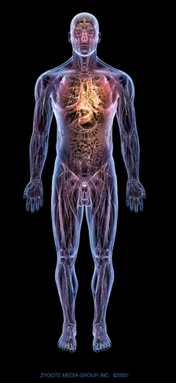
Iron in our body
Average human body contains 2-4 g iron (70 kg man 4-5g iron)
65 % haemoglobin
10 % myoglobin
1-5 % enzymes
Rest in blood or in storage
Human body
Fe2+ (Ferrous, haem)
Fe3+ (Ferric, non-haem)

Slide 29
Haem and non haem iron
25 - 50 % iron in meat is haem iron (the rest is non haem iron)
5 – 10 % of total iron intake is haem
Iron
Haem
Non-haem
Derived from haemoglobin and myoglobin
Found primarily in plant foods and dairy product
Meat, fish and poultry
Nuts, fruit, veg, grain, milk, cheese

Slide 30
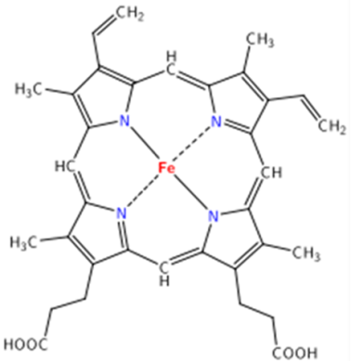
COFACTOR
Iron is a cofactor for many different enzymes e.g.
Succinate dehydrogenase (TCA cycle)
Phenylalanine mono-oxygenase (phenylalanine → tyrosine
OXYGEN TRANSPORT
Central to haemoglobin and myoglobin structure
Required for the transport of oxygen around the body
Roles of Iron
ENERGY PRODUCTION
Cytochrome contains haem
Transport of electrons through the electron transport chain
PRO-OXIDANT
Harmful at high levels
Lipid peroxidation and tissue damage
Notes:
Reduced cytochrome = iron molecule becomes oxidised to ferric state when a single electron is transferred to the next cytochrome. Iron atom on the cytochrome receiving the electron becomes reduced
Iron exists in many oxidation states (Fe⁶⁺ - Fe²⁻)
Fe²⁺ (ferrous) or Fe³⁺ (ferric) are stable in the human body and in foods
When the ferrous form of iron and protoporphyrin IX are complexed the structure is referred to as heme. There are a number of heme containing proteins involved in the transport of oxygen (hemoglobin), oxygen storage (myoglobin) and enzyme catalysis such as nitric oxide synthase (NOS) and prostagladin synthase (cycloxgenase). A number of non-heme iron containing proteins are also known such as the iron-sulfur proteins of oxidative phsphorylation and the iron transport and storage proteins, transferrin and ferritin, respectively.
Non heme iron sulfur enzymes involved in electron transport include NADH dehydrogenase and succinate dehydrogenase
Iron acts a cofactor to many other enzymes
Phenylalanine mono-oxygenase
Phenylalanine Tyrosine

Slide 31
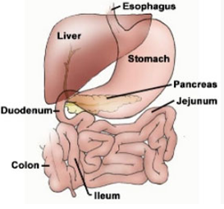
Iron Absorption
Free iron is toxic to the body
No mechanism for iron excretion –
Body uses three main mechanisms to regulate iron balance to prevent deficiency/toxicity
Iron storage
Reutilise iron from red blood cells (Dead RBC)
Regulate iron absorption in intestine
Gut absorption controls body iron
Absorbed in duodenum
Active
Controlled very tightly as excess iron cannot be lost easily

Slide 32
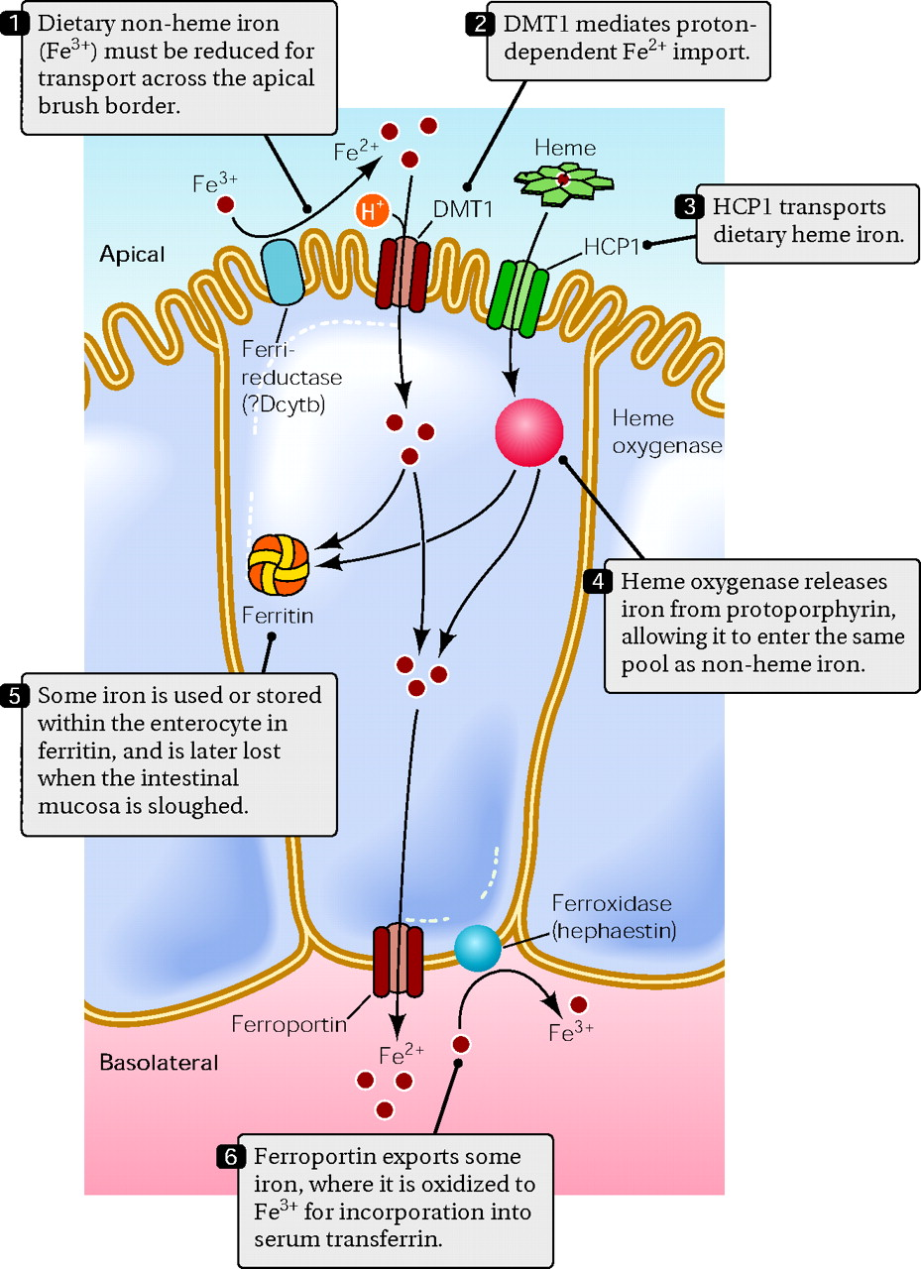
Iron in the ferrous form (Fe2+) is absorbed more readily than the ferric form (Fe3+)
HCP1: Fe +2
DMT1: Fe+3(converted)
Ferri-reductase: Fe +3 to Fe +2
Ferri-oxiadse: Fe+2 to Fe +3
Ferroprotein : basolateral membrane

Slide 33
Ferritin
Transferrin
Iron storage protein found in all cells
Ferritin is NOT an iron transport molecule
Ferric iron storage Amount of ferritin directly reflects amount of iron in body
Glycoprotein synthesised in the liver
Iron (Fe3+) is transported in the circulation bound to transferrin
Delivers iron to site of storage (liver) or utilisation (bone marrow)

Slide 34
Iron absorption
Increased absorption | Decreased absorption
Haem Low iron status Low haem iron intake | High iron status High haem iron intake Calcium (DECREASE IRON ABSORPTION)
Non-haem Depleted iron status Pregnancy Ascorbic acid (vitamin C)(INCREASE IRON ABSORPTION) anaemia | Replete iron status Phytates Iron-binding compounds Calcium

Slide 35
What influences stores ?
SUPPLY
DEMAND
STORES
Requirement
Growth
Pregnancy
Lactation
Loss
bleeding (menstruation)
parasites
Influences on dietary Fe
Food content
Bioavailability

Slide 36
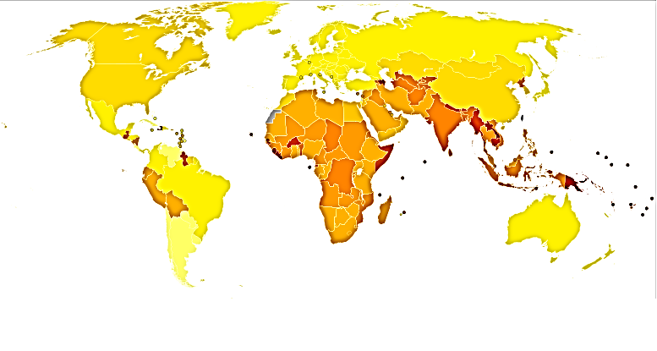
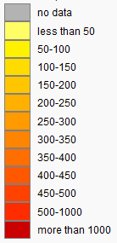
Iron Deficiency
> 2 billion people world wide suffer from iron deficiency anaemia (4-5 billion have some degree of iron deficiency)
WHO categorised iron deficiency as one of the top 10 most serious problems in the modern world
Age standardised disability adjusted life year rates for iron deficiency anaemia (per 100 000 inhabitants)
WHO, 2002

Slide 37
Iron deficiency - humans
Human deficiency is associated with
Poor bioavailability diet (diet high in unrefined cereals)
High individual metabolic demand (women and children)
Occurs in three stages
Depletion of storage iron – decreases in serum ferritin
Decrease in transported iron
Decrease in iron for haemoglobin for new blood cells

Slide 38
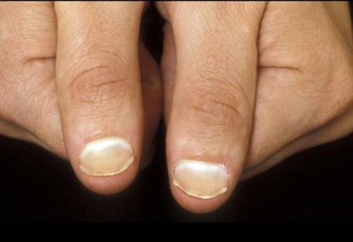
Iron deficiency - humans
The effects of Iron deficiency
listless/fatigue
Anaemia: reduced growth, “spooning” nails, behavioural problems, death
Development problems in babies born to anaemic mothers - non recoverable
Cognitive development
Poor motor skills

Slide 39
Prevention of Iron Deficiency
Fortification
Ferrous (Fe²⁺) based supplements

Slide 40
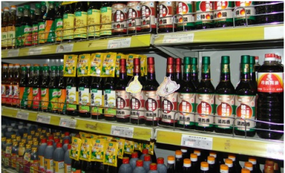
China’s ‘success’ story
2002 consensus estimated IDA present in
20.6 % women of childbearing age
24.2 % <2 years age
21.5 % > 60 years age
2003 GAIN invested $3 million to fortify soy sauce with iron (2010 further invested $1.5 million)
Soy sauce is consumed in small but consistent portions amongst 70 % China’s population
Phase 1: 2003-2008 Anaemia in women and children dropped by 1/3. Consumer knowledge also improved

Slide 41
Toxicity - overload
Fe overload (poisoning) may occur if individual supplements diet for long period of time
Only supplement if clinically approved
Increased Fe status may occur by;
Increased by parenteral administration via blood transfusion

Slide 42
iodine

Slide 43
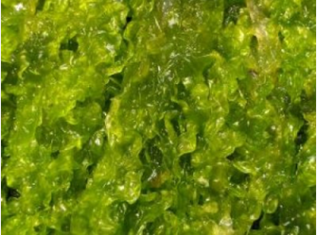
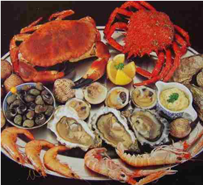
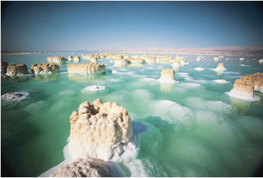
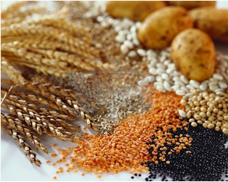
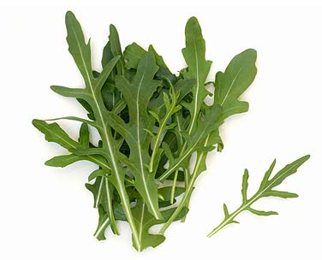
Iodine Food Sources
Seaweed
Sea food
Sea salt
Cereals?
Plants?

Slide 44
Absorption
Iodine is absorbed as iodide (I⁻)
Rapidly absorbed in the gut
Distributed throughout the whole body (unbound)
More concentrated in thyroid, saliva and gastric glands
Excess is excreted in urine
Human contain about 20-30 mg
80% present in thyroid gland

Slide 45
Roles
Synthesis of thyroid hormones in thyroid gland
Thyroxine - 3, 5, 3’, 5’ Tetraiodothryronine, T₄
3, 3’, 5’ Triiodothryronine, T₃ (active)
Thyroid hormones modulate gene expression
Bind to receptors
Major regulator of physiological functions
Metabolic rate
Growth and development
Blood cell production, nerve and muscle function

Slide 46
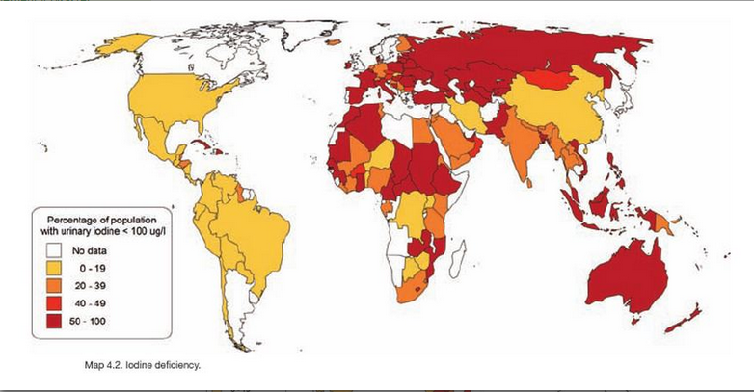
Iodine Deficiency
1.9 billion people world wide are affected
740 million people have visible goitre
Leading preventable cause of mental retardation worldwide (lower IQ 10-15 points) (McNeil 2006)
Universal Salt Iodisation (USI) – reached over 267 million people (The Micronutrient Initiative)
Basset and Winter Nelson, 2010

Slide 47
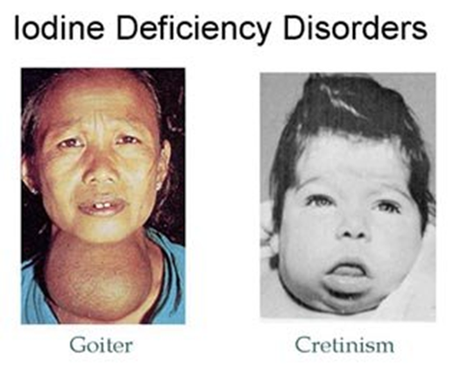
Iodine
Wide spectrum of disorders
Mild Goitre
Cretinism
Goitre
Enlargement of thyroid gland (adults)
Dietary iodine < 50 mg/day
Reversible with iodine treatment
Cretinism
Due to iodine deficiency before birth
Neurological syndrome - mental retardation, defects in hearing/speech
Stunted growth

Slide 48
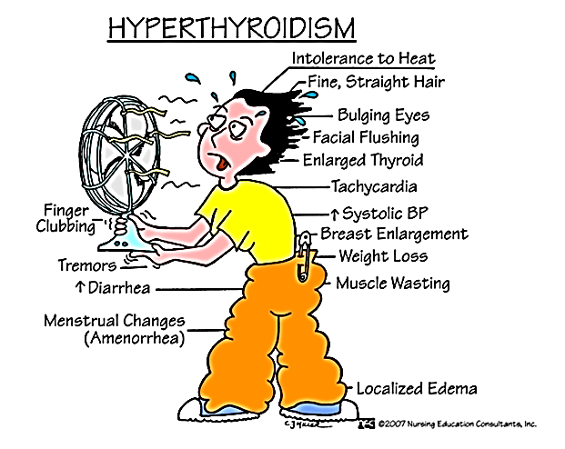
Toxicity
> 2g iodine/ day over prolonged periods
Very high seafood diets
Straight hair
Weight loss
Bulging eyes
Tachycardia
Breast enlargement
Diarrhea
Muscle wasting
Enlarged Thyroid
High SBP

Slide 49
Selenium

Slide 50
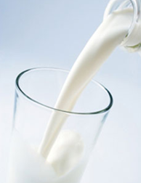
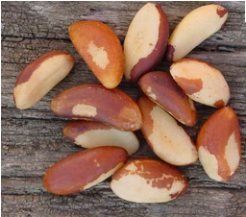
Selenium Food Sources
Brazil Nuts
Sea Food
Meat
Dairy
Cereal
Concentration in food relies greatly on soil concentration
Regional
Low soil selenium concentration is associated with increased deficiency disease

Slide 51
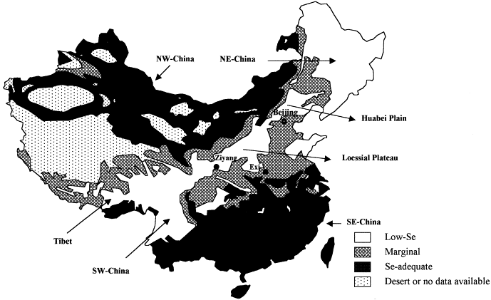
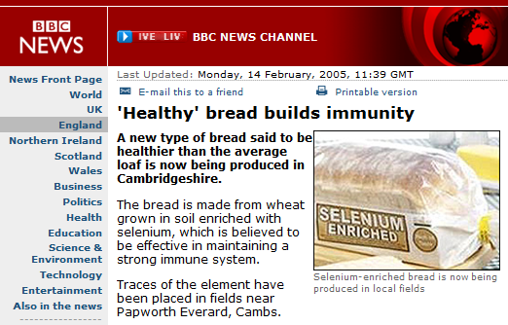
Selenium
China/ UK – low selenium regions
Supplements of Se-yeast compounds

Slide 52
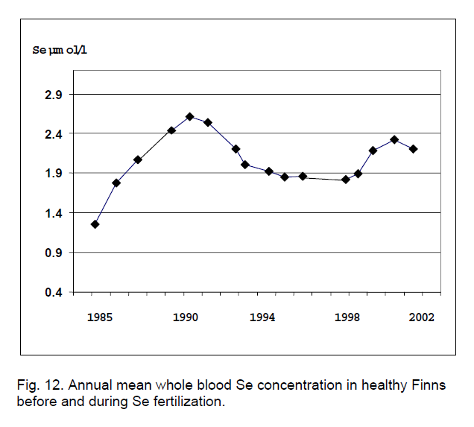
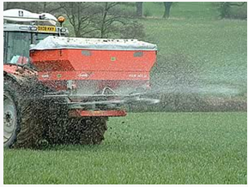
Finland Selenium Success
Trial fertiliser supplementation began in 1984
Se fertilisers have increased the Se intake of the population by 3 fold
Finland population now has satisfactory and safe level of serum selenium

Slide 53
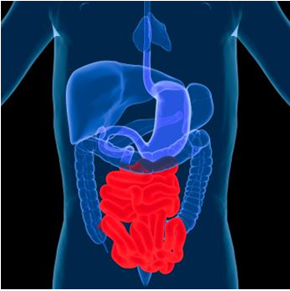
Selenium (Se) – absorption
50 – 80 % of dietary selenium is absorbed in small intestine
Selenium from plants (inorganic) tends to be more bioavailable than from animals
Organic selenium
Actively transported
Absorbed more rapidly than inorganic selenium
Inorganic selenium (supplements)
Passively absorbed

Slide 54
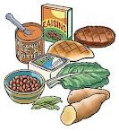
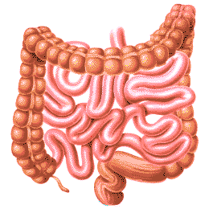
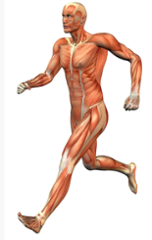
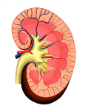
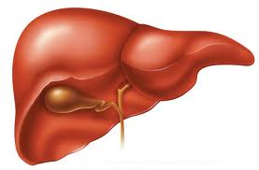
Selenium in food
Absorbed in Small Intestines
Selenium transported in blood bound to proteins (VLDL, Albumin)
Absorption of Selenium
Total body content approximately 3-15mg dependent on dietary intake
Excreted via urine and faeces

Slide 55
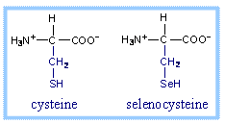
Selenoproteins
Humans – all absorbed selenium is converted to selenophosphate and then selenocysteine
Selenium can replace sulphur in cysteine
Selenoproteins are proteins that contain selenocysteine (amino acid)
Mammalian selenoproteins (enzymes)
Glutathione peroxidases (Antioxidant enzymes)
Iodothyronine (thyroid hormone synthesis)
Thioredoxin Reductase (maintenance of intracellular oxidation state)

Slide 56
Role in anti-oxidant regeneration
Vitamin E (anti oxidant) is located in the membrane
It donates electrons to free radicals
Reduced glutathione regenerates Vitamin E by donating an electron to Vitamin E radical
This process requires glutathione peroxidase (selenium containing)
The reduced gluthathione is regenerated by vitamin C (ascorbic acid)
GSHPx – glutathione peroxidase, GSSG – oxidised glutathione, GSH – reduced glutathione

Slide 57
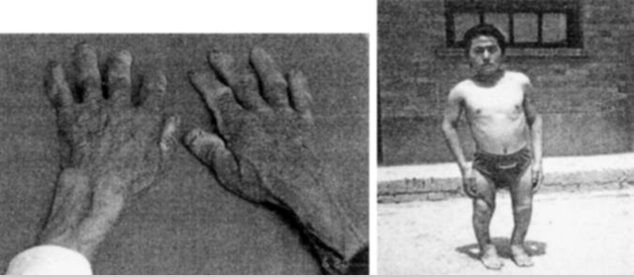
Selenium Deficiency
Occurs frequently in areas of China
Self sufficient communities
Consume 100% locally produced foods
1) Kashin-Beck Disease (along with iodine deficiency)
Symptoms
Osteoarthritis
Enlarged joints
Shortened fingers and toes

Slide 58
Selenium Deficiency
2) Keshan Disease
Prevalent in children and women of child bearing age
is a congestive cardiomyopathy caused by a combination of dietary deficiency of selenium
Prevalent in China
Symptoms
Cardiomyopathy
Cardiac enlargement and abnormal rhythm
Often fatal

Slide 59
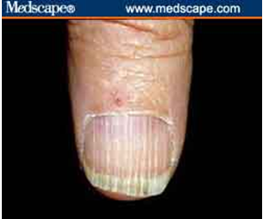
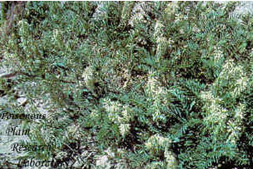
Selenium - toxicity
Toxicity selenosis (>0.9mg/day, safe intake 0.45mg/day)
A relatively narrow range between adequacy and toxicity
Symptoms
Brittle hair and nails
Skin lesions
Garlic breath! (expiration of demethyl selenide)

Slide 60
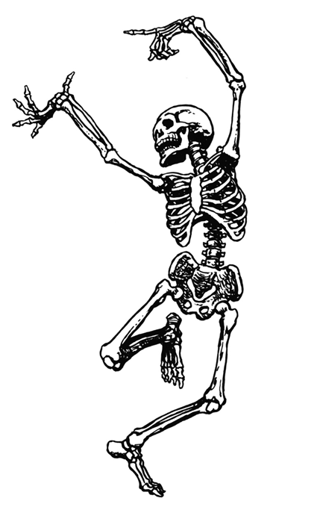
Calcium (and phosphorus)

Slide 61
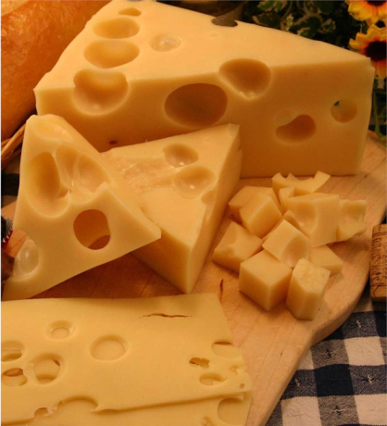
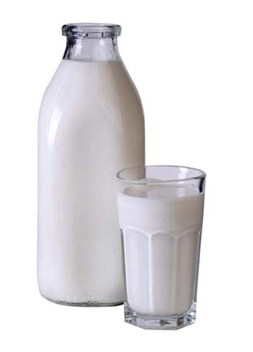
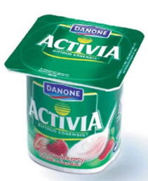
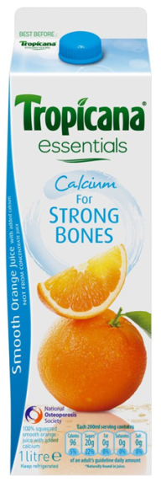
Food Sources of Calcium
Dairy products
Fortified products

Slide 62
Calcium
Most abundant divalent cation in human body
99 % in bones and teeth
1 % found in intra and extracellular fluid
Adult skeleton contains approx. 1.2 kg calcium
Factors that may affect calcium absorption
Improve calcium absorption | Inhibit calcium absorption
Vitamin D | Fibre and phytates
Lactose containing foods (ingested at same time) | Oxalates (3, spinach, squash)
 | High sodium, protein, caffeine intakes

Slide 63
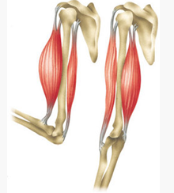
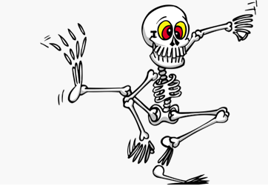
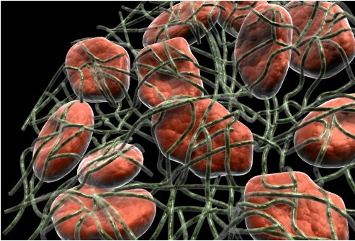
Why do we need calcium?
Bones and teeth
Muscle contraction/relaxation
Blood clotting
Neuronal transmission
Cofactor for many enzymes (a-amylase, phospholipase)

Slide 64
Calcium and Bone Health
Milk intake and bone mineral acquisition in adolescent girls. Cadogan et al, BMJ, 1997; 315:1255
Study Design
80 girls
Aged 12.2 years (st-dev 0.3 years)
18 month study
Intervention group consumed 1 pint of milk every day for 18 months
BMD measurments
Results
Intervention group (+milk) showed significant increase in BMD compared to control

Slide 65
Calcium doesn’t act alone…..
Calcium
Phosphorus
Vitamin D

Slide 66
How do we regulate plasma calcium and phosphorus?
Calcium and phosphorus are linked through their role in mineralisation of bone and the role of vitamin D in their homeostasis
In bone, calcium and phosphorus are held together as calcium phosphate
[Ca]_{plasma} ~2.5mM (9-10mg/100ml)
VERY IMPORTANT, TIGHTLY REGULATED
[P]_{plasma} ~ 1-1.5mM (3-4.5mg/100ml)
less control fluctuates

Slide 67
Phosphorus
Abundant in bone (85 % of total body P)
Present in same foods as calcium
Roles
ATP
Phospholipid membrane
DNA

Slide 68
Vitamin D, Calcium and Phosphorus
Vitamin D is involved in the regulation of availability of calcium and phosphorus in the blood
Raise blood concentration of minerals in three ways
1) Stimulate increased absorption from gastrointestinal tract
2) Increase retention at kidney
3) Movement of minerals from the bones to blood and vise versa (resorption)

Slide 69
Regulation
Levels of calcium and phosphorus are maintained by
Parathyroid hormone (PTH)
1,25 Dihydroxycholecalciferol (1,25(OH)₂D; calcitrol; vitamin D3)
↓ in [Ca]^{ECF} release of PTH
PTH stimulates
↑ Release of Ca²⁺ from bone = bone resorption
↑ renal Ca²⁺ from urine = increasing reabsorption
↑ renal PO₄ excretion from urine
↑ Ca²⁺ absorption from small intestine

Slide 70
Calcium Regulation - Summary
Plasma Calcium
HIGH
LOW
↑ calcitonin from thyroid
↑ Parathyroid hormone (PTH)
↑ 1, 25 (OH)₂D₃
Inhibit bone resorption
Inhibit renal calcium reabsorption
↑ Ca2+ GI absorption
↑ Ca2+ bone resorption
↑ Ca2+ renal reabsorption
↑ Renal PO4 excretion in urine
↓ Plasma Ca2+
↑ Plasma Ca2+

Slide 71
Deficiency
Obligatory calcium losses in urine and faeces
Small metabolic pool
99 % calcium in bones and teeth (as hydroxyapetite)
Inadequate dietary calcium
Maintain plasma calcium at expense of bones
Osteoporosis (low bone mineral density, increased risk of fracture)
Osteomalacia (rickets in children, weak/soft bones)

Slide 72
Other symptoms of deficiency…..
Diet deficient in Ca and P
Muscle cramps and twitching
Tooth decay
Brittle nails
Phosphorus deficiency is rare
Very common in foods
Extreme circumstances
Chronic gastrointestinal malabsorption
Regulated by demineralisation of bone (same as calcium)
Rickets, osteomalacia

Slide 73
Bioavailability
Factors ⬇ calcium absorption
Factor | Mechanism
Phytate | Storage form of phosphorus in plants Difficult to release phosphorus during digestion Bind to calcium (and other minerals – zinc, iron) Cooking/processing of foods can release some bound calcium
Vegetable based diets | Oxalic acid (spinach)
High sodium | Increased calcium resorption from bone
Soda | Phosphoric acid Increases calcium resorption from bone Decrease bone density
Tannin | Found in tea-Chelates calcium
Tobacco, alcohol, caffiene | Increase calcium resorption from bone

Slide 74
Zinc

Slide 75
Zinc
Virtually all cells contain zinc, but the highest concentrations are found in muscle and bone.
Role in the body:
Supports proteins in the body, such as the metalloen-zymes ; including the regulation of gene expression.
Stabilizes cell membranes, helping to strengthen their defense against free-radical attacks.
Assists in immune function and in growth and development.
Participates in the synthesis, storage, and release of the hormone insulin in the pancreas, although it does not appear to play a direct role in insulin’s action.
Interacts with platelets in blood clotting, affects thyroid hormone function, and influences behavior and learning performance.
It is needed to produce the active form of vitamin A (retinal) in visual pigments and the retinol-binding protein that transports vitamin A.
It is essential to normal taste perception, wound healing, the making of sperm, and fetal development.

Slide 77
Zinc Absorption
The rate of absorption varies from about 15-40 % depending on a person’s zinc status.
Phytates bind zinc limiting its bioavailability.
Upon absorption into an intestinal cell, zinc has two options. It may become involved in the metabolic functions of the cell itself. Alternatively, it may be retained within the cell by metallothionein, a special binding protein similar to the iron storage protein, mucosal ferritin.

Slide 78
Zinc Recycling

Slide 79
Zinc transport
Zinc’s main transport vehicle in the blood is the protein albumin.
Some zinc also binds to transferrin.
Diets that deliver more than twice as much iron as zinc leave too few transferrin sites available for zinc. The result is poor zinc absorption; The converse is also true
Large doses of zinc create a similar problem with another essential mineral, copper and calcium.

Slide 80
Zinc deficiency
Dietary causes are rare
Mild zinc deficiency can impair weight gain and can prevent children from growing taller; lowered zinc levels can interfere with the cellular response to the growth-regulating hormone insulin-like growth factor-1 (IGF-1).
Infants fed cow’s milk may be more susceptible to mild zinc deficiency. Zinc bioavailability is even lower in soy-based formulas. Breast milk has excellent bioavailability of zinc, although zinc content falls off after the first six months of breastfeeding.

Slide 81
Individuals at Greater Risk of Zinc Deficiency
Children and infants of developing countries (infectious diarrhea)
Pregnant and breastfeeding women, especially teens
People whose main diet consists of grains and legumes
People with chronic digestive disorders
Patients receiving only intravenous feedings
Alcoholics
People with sickle cell anemia
Adults 65 years and older
Malnourished people or those with anorexia nervosa

