Slide 1
An-Najah National University
Faculty of Medicine
Department of Physiology
Anatomy and Physiology 1
7102101
Instructor: Heba Salah
Chapter 7:
The Urinary System
Part 4: Maintaining Water and Electrolytes Balance in Blood

Slide 2
Maintaining Water Balance
Normal amount of water in the human body
Young adult females – 50%
Young adult males – 60%
Babies – 75%
Old age – 45%
Water is necessary for many body functions and levels must be maintained

Slide 3
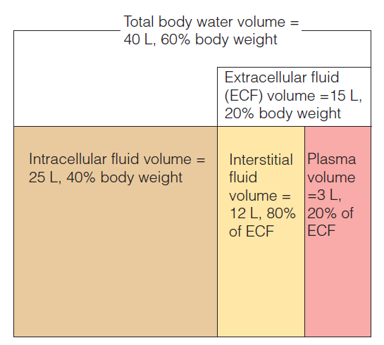
Distribution of Body Fluid
Intracellular fluid (inside cells)
Extracellular fluid (outside cells)
Interstitial fluid
Blood plasma

Slide 4
The Link Between Water and Salt
Changes in electrolyte balance causes water to move from one compartment to another
Alters blood volume and blood pressure
Can impair the activity of cells

Slide 5
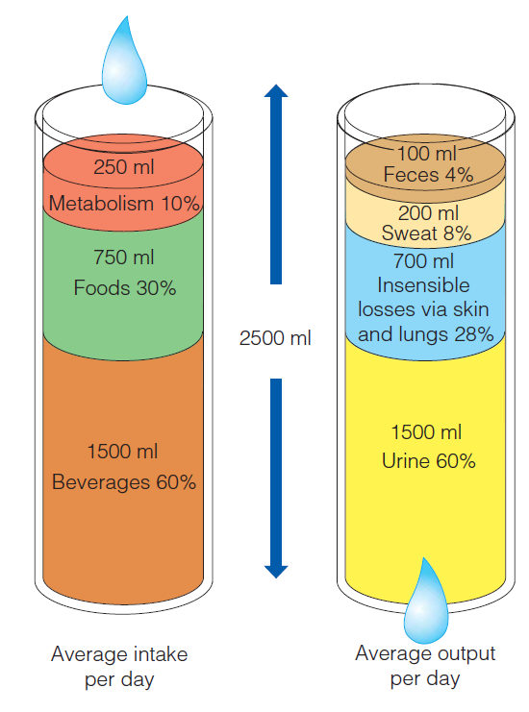
Maintaining Water Balance
Water intake must equal water output
Sources for water intake
Ingested foods and fluids
Water produced from metabolic processes
Sources for water output
Vaporization out of the lungs
Lost in perspiration
Leaves the body in the feces
Urine production

Slide 6
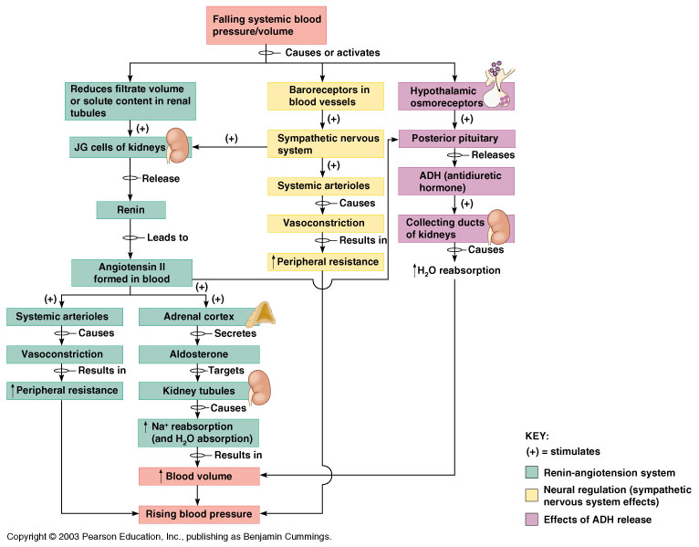
Maintaining Water/Electrolyte Balance

