Slide 1
Analog to digital Conversion (fast review A/D Conversion) 1
Dig. Comm.

Slide 2
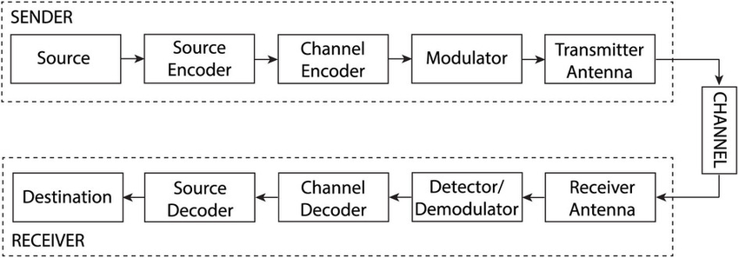
Block Diagram-Typical Communication system

Slide 3
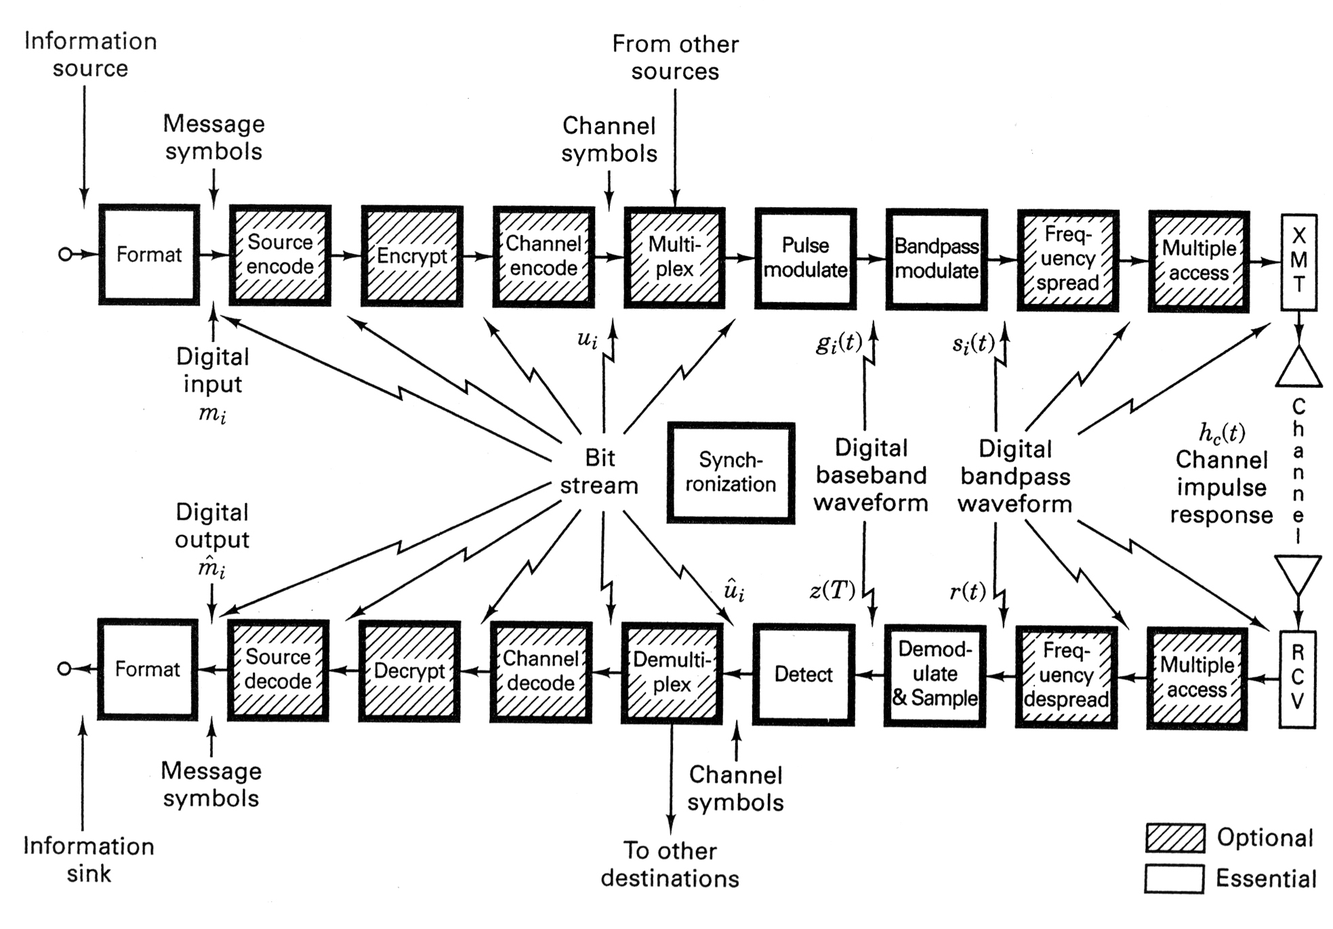
Block Diagram - Typical Communication system

Slide 4
Transmitter
Source
Encoder
Channel
Encoder
Baseband
Signaling
Source Encoder translates the out put of the source in an
efficient manner for communication (e.g., compression).
Channel Encoder transforms the coded source to enable
error detection and correction at the receiver (e.g., add
redundancy).
Baseband signaling encodes digital information in a
sequence of analog pulses (before modulation).

Slide 5
Receiver
Optimal
Filter
Channel
Decoder
Source
Decoder
Optimal filter makes “best guess” of transmitted analog pulses.
Channel decoder inverses operation of channel encoder (i.e., error detection and correction).
Source decoder inverses operation of source encoder.

Slide 6
Modulation Types
Transition from Analog to Digital Communications
Sampling Process
Analog Pulse Modulation
Pulse-Amplitude Modulation
Pulse-Position Modulation
Pulse-Duration Modulation
Completing the Transition from Analog to Digital
Quantization Process
Pulse-Code Modulation
--------------------------------------------------------------
Digital Pulse Modulation
Other forms of pulse modulation: DM, SDM, DPCM, ADPCM, LP, …
Line Codes

Slide 7
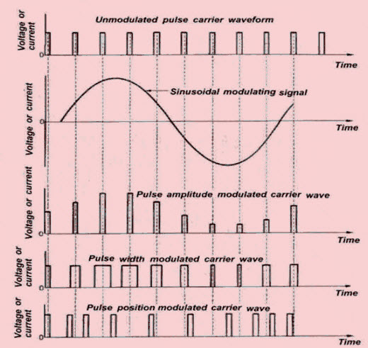

Slide 8
Bandwidth-Noise Trade-Off
PPM & FM related to the square of BW
Can we produce a trade off better than the square law?
YES but using Digital Pulse Modulation➔ exponential law
What are the advantages offered by digital pulse modulation ??

Slide 9
Analog to Digital Conversion (A/D)
- Sampling
- Quantization
- Encoding
Digital to Analog Conversion (D/A) ??

Slide 10
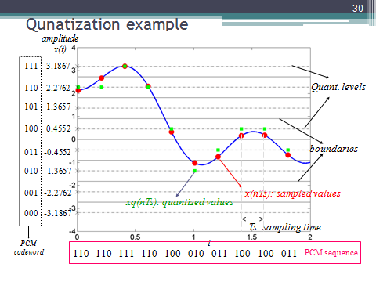
Quantization & Coding illustration

Slide 11
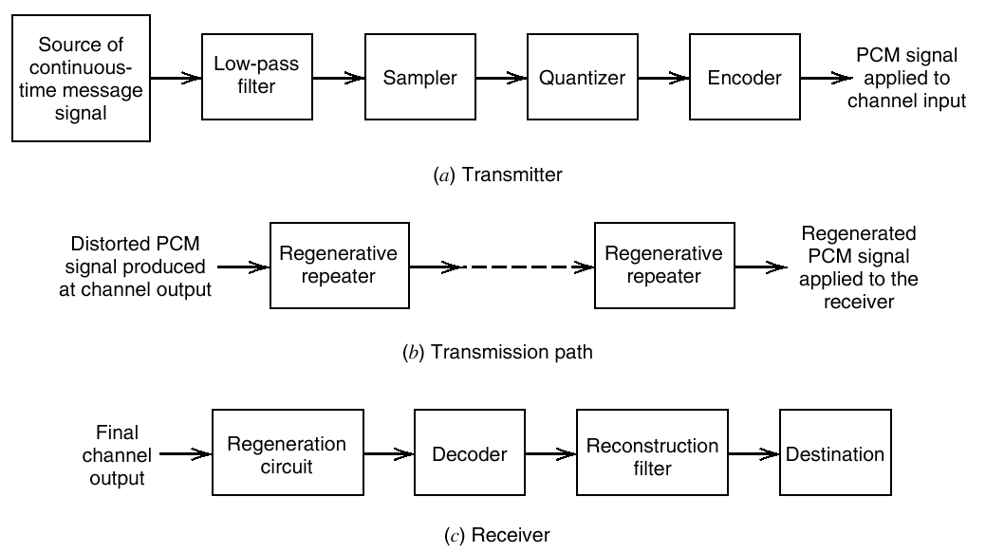
Pulse Code Modulation - PCM

Slide 12
Bandwidth of PCM
Assume m(t) is bandlimited to B hertz.
Minimum sampling rate = 2B samples / second
A/D output = n bits per sample (quantization level M=2^{n})
Assume a simple PCM without redundancy.
Minimum channel bandwidth = bit rate /2
Bandwidth of PCM signals:
B_{PCM} ≥ nB (with sinc functions as orthogonal basis)
B_{PCM} ≥ 2nB (with rectangular pulses as orthogonal basis)
For any reasonable quantization level M, PCM requires
much higher bandwidth than the original m(t).
Bandwidth depends on: bit rate and pulse shape used to represent the data
Dimensionality theorem gives the bounds:

Slide 13
Noise Considerations in PCM Systems
Two major sources:
channel noise – always present
quantization noise – signal dependent
Define : Bit Error Rate (BER )
BER is the probability that the reconstructed bit at the receiver output differs from the transmitted bit on the average.
Usually channel noise is assumed Additive, White & Gaussian (AWGN)
Quantization noise is under designer's control.

Slide 14
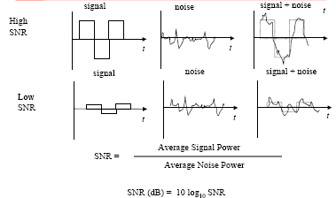
Signal-to-Noise Ratio-(metric to quantify quality of digital signal)

Slide 15
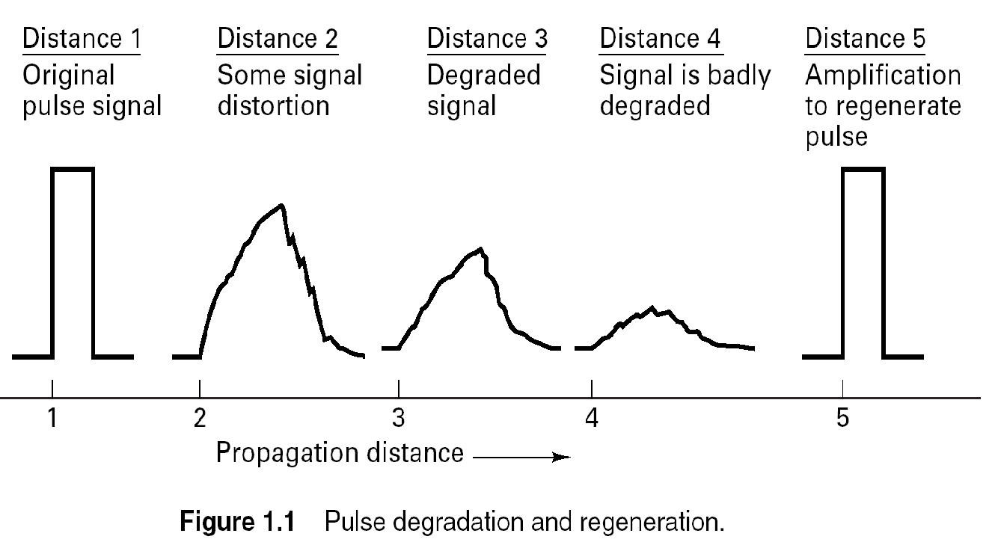

Slide 16
Error threshold :
BER depends on Eb/No ,where Eb/No is the ratio of the transmitted signal energy per bit (Eb), to the noise spectral density (No).
Table: Influence of Eb/No on the probability of error :
For a bit rate of 10^5 b/s, one error every | probability of error (Pe) | Eb/No (dB)
10-3 second | 10^-2 | 4.3
10-1 second | 10^-4 | 8.4
10 second | 10^-6 | 10.6
………………… | ………… | →11.0
20 minutes | 10^-8 | 12.0
1 day | 10^-10 | 13.0
3 months | 10^-12 | 14.0

Slide 17
The threshold is about Eb/No = 11.0 dB
If Eb/No > 11.0 dB then, channel noise has virtually no-effect on the receiver performance ( goal of PCM )
CASE: PCM vs. AM
11 dB error threshold in PCM (using NRZ signaling).
60-70 dB for AM used for high quality transmission speech.
→ PCM requires much less power (even though the average noise power in PCM system is increased by the R-fold increase in the bandwidth.
R: # of bits in a codeword
PCM is robust to channel noise & interference

Slide 18
Performance of PCM (P_{e} ≅ 0, uniform quantization steps)
B_{PCM} ≥ nB (with sinc functions as orthogonal basis)
B_{PCM} ≥ 2nB (with rectangular pulses as orthogonal basis)

Slide 19
DIGITAL-TO-DIGITAL CONVERSION
How we can represent digital data by using digital signals.
Converting a string of 1’s and 0’s (digital data) into a sequence of signals that denote the 1’s and 0’s.
For example a high voltage level (+V) could represent a “1”
and a low voltage level (-V) could represent a “0”.
This is Digital Transmission

Slide 20
Line coding and decoding

Slide 21
The Importance of Using Line Coding (Line Format)
Line coding is an essential technique in digital communication systems that is used to convert digital data into a format that can be transmitted over a communication channel. The importance of using line codes includes:
Efficient use of bandwidth: Line coding allows for efficient use of the available bandwidth by converting digital data into a format that is suitable for transmission over the communication channel. By using line codes, the data rate can be increased while minimizing the bandwidth required.
Improved signal quality: Line coding can improve the quality of the transmitted signal by minimizing the effects of noise and interference. This is achieved by using specific pulse shapes and modulation techniques that are designed to maximize the signal-to-noise ratio (SNR).
Reliable data transmission: Line coding ensures reliable data transmission by minimizing errors and ensuring that the data can be correctly decoded at the receiver end. This is achieved by using error-correcting codes, synchronization techniques, and other methods that improve the accuracy of data transmission.
Compatibility: Line coding ensures compatibility between the transmitter and receiver by using standard coding schemes that are widely used and understood. This ensures that data can be transmitted and received by different devices and systems.
Flexibility: Line coding provides flexibility in selecting the coding scheme that is most suitable for the specific application, communication channel, and performance requirements. This allows for the optimization of the transmission system for different scenarios, such as high-speed data transmission or low-power communication.

Slide 22
Line coding :
The choice of a particular pair of pulses to represent the symbols 1 & 0 is called line coding. This depends on the following:
presence or absence of DC level
power spectral density
band width (spectral occupancy)
Bit Error Rate (BER) performance
transparency (i.e., the property that any arbitrary symbol or bit pattern can be transmitted & received)
easy of recovery (synchronization)

Slide 23
Line coding :
The choice of a particular pair of pulses to represent the symbols 1 & 0 is called line coding. This depends on the following:
Transmission rate: The transmission rate or bit rate of the communication channel determines the number of bits that can be transmitted per second. The line coding scheme should be able to support the required bit rate.
Bandwidth: The bandwidth of the communication channel limits the frequency range that can be used to transmit the signal. The line coding scheme should be designed to minimize the bandwidth requirements.
Signal-to-noise ratio (SNR): The SNR of the communication channel refers to the ratio of the signal power to the noise power. The line coding scheme should be designed to maximize the SNR and minimize the effects of noise.
Complexity: The complexity of the line coding scheme should be reasonable to ensure that it can be implemented efficiently and reliably.
Error rate: The line coding scheme should be designed to minimize the error rate and ensure reliable transmission of data.
Compatibility: The line coding scheme should be compatible with the receiver's decoding scheme to ensure that the transmitted data can be correctly decoded at the receiver end.

Slide 24
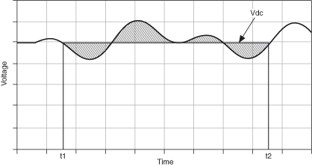
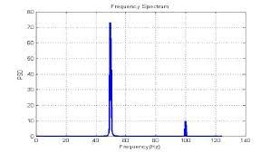
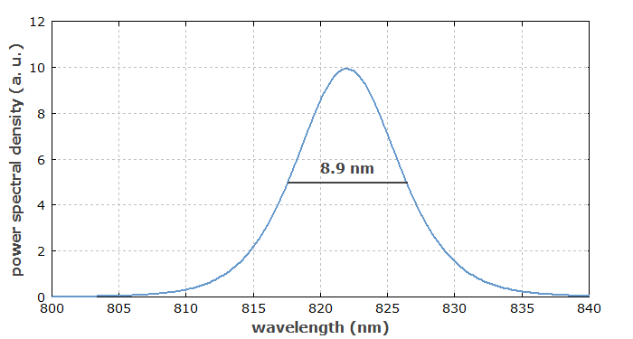
DC Level of a Signal
Fig. 1. Power Spectral Density (PSD) of a signal that is a mix of two pure tones at 50 Hz and 100 Hz, obtained by FFT. The harmonic is about 0.3 times the fundamental in amplitude.
Bandwidth

Slide 25
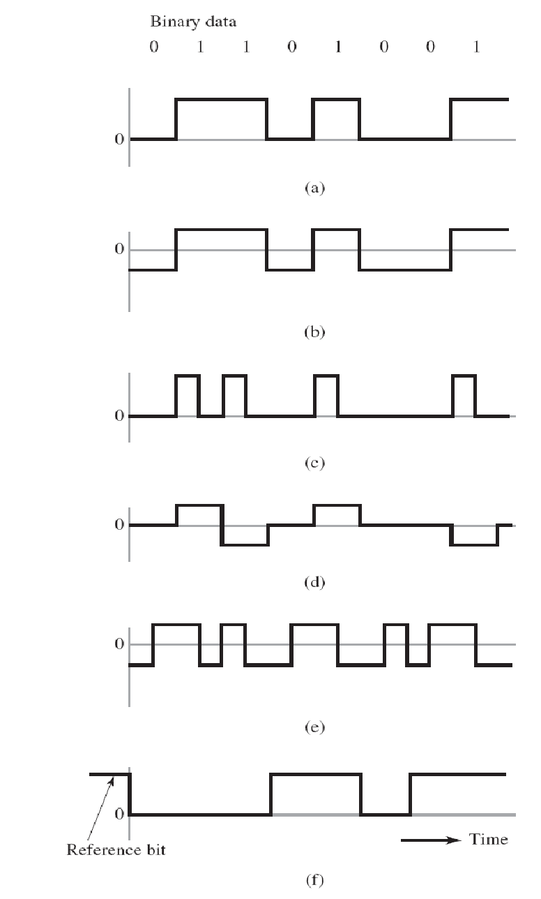
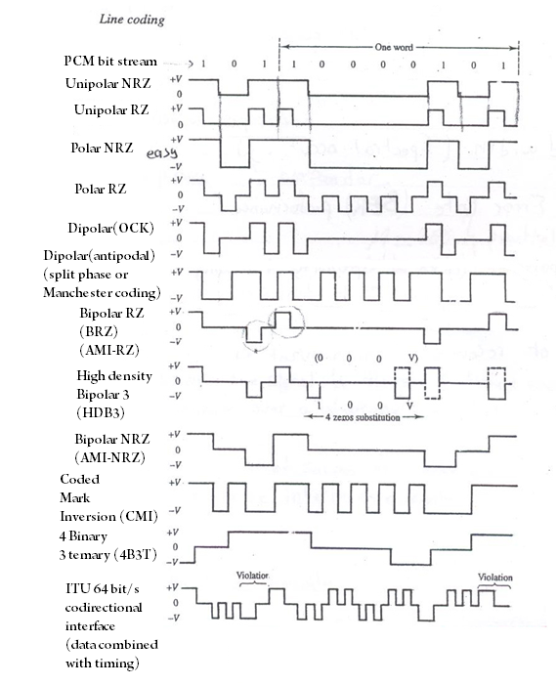
Check the reference, Iann

Slide 26
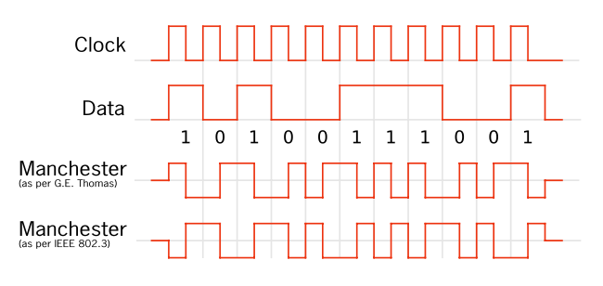

Slide 27
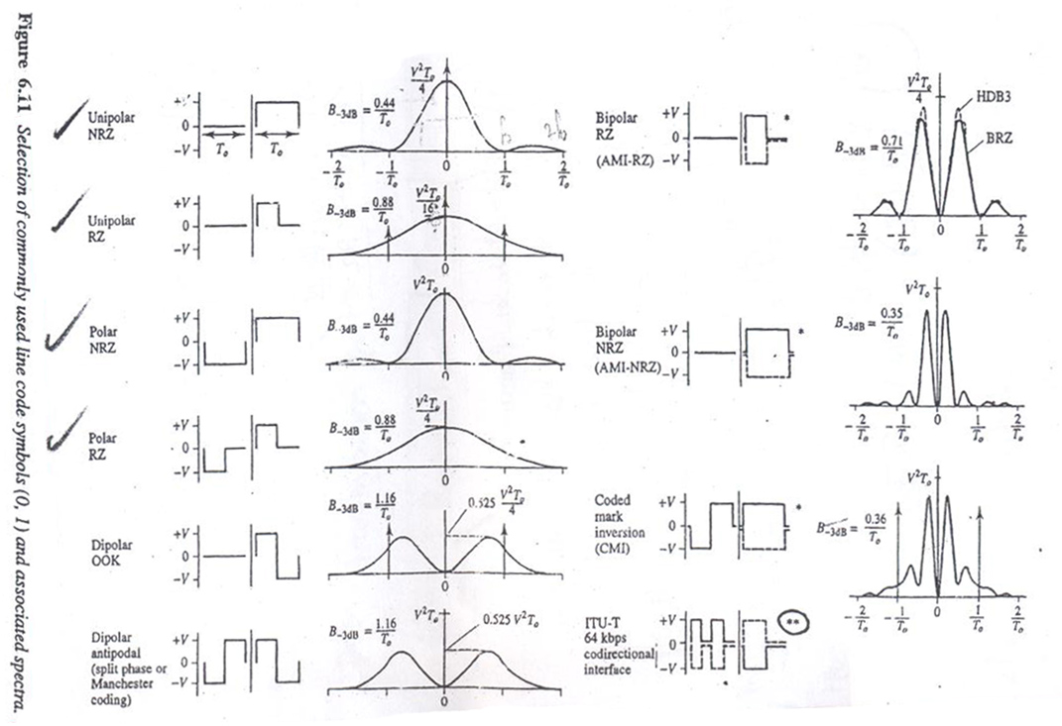
Commonly used line code symbols(0,1) and associated spectra

Slide 28
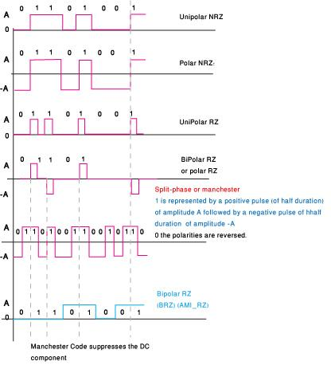
Example- check the reference

Slide 29
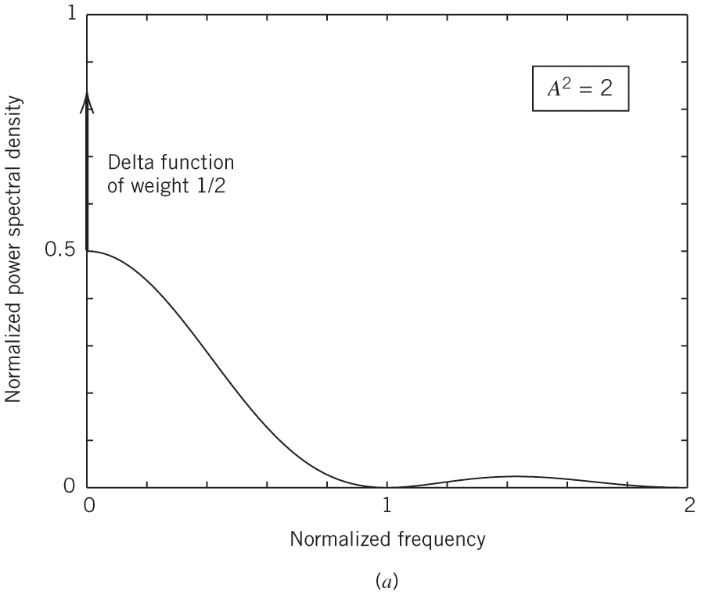
(a) Unipolar NRZ signal. Disadvantages – DC component; power spectra – not 0 at 0 freq.
Power spectra of line codes:
Assumptions:
1. Symbols 1 and 0 are equiprobable
Figure 3.16a
3. Frequency is normalized to the bit rate 1/Tb
2. Average power is normalized to unity

Slide 30
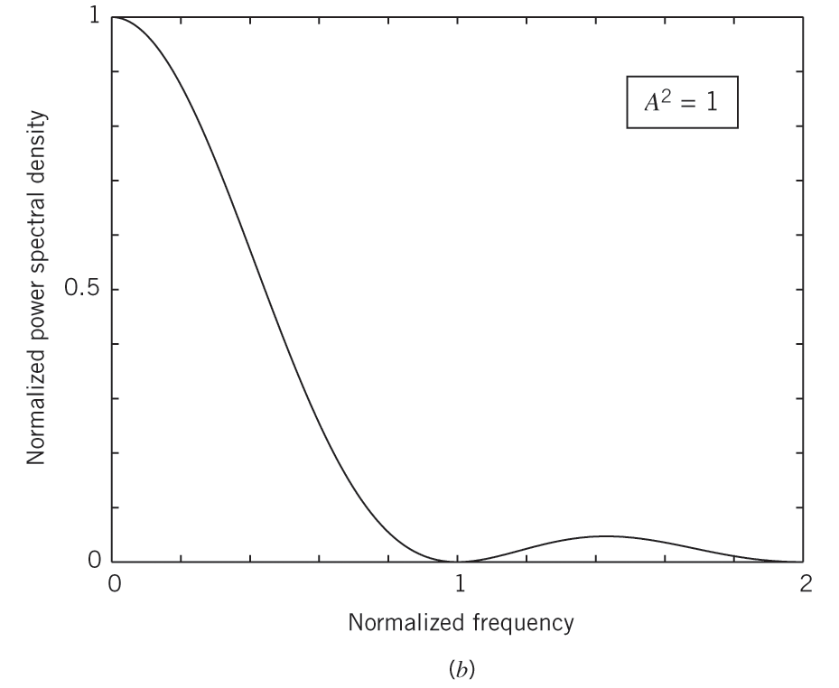
(b) Polar NRZ signal. Disadvantages – large power near zero frequency
Average power is normalized to unity
Figure 3.16b
Frequency is normalized to the bit rate 1/Tb

Slide 31
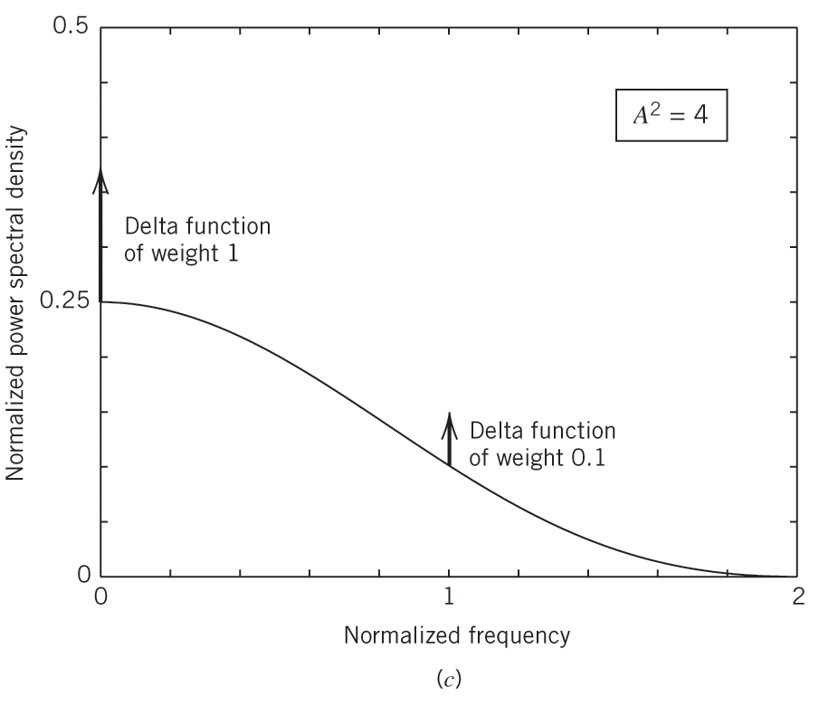
(c) Unipolar RZ signal. Advantages – presence of delta function at f=0, 1/T_{b}- used for sync Disadvantage – 3dB more power polar RZ for same error probability
Figure 3.16c

Slide 32
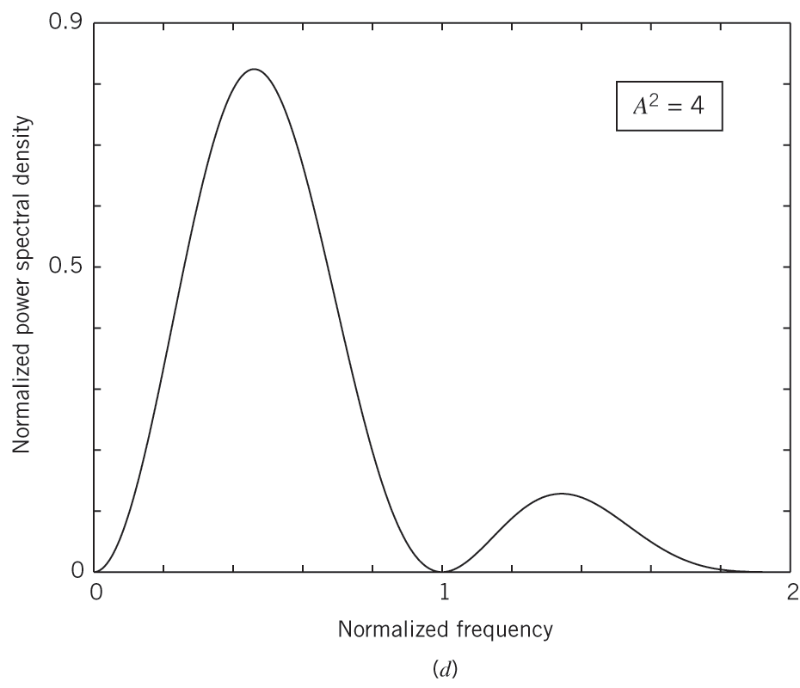
(d) Bipolar RZ signal. Advantages – no DC component; bipolar AMI
Figure 3.16d

Slide 33
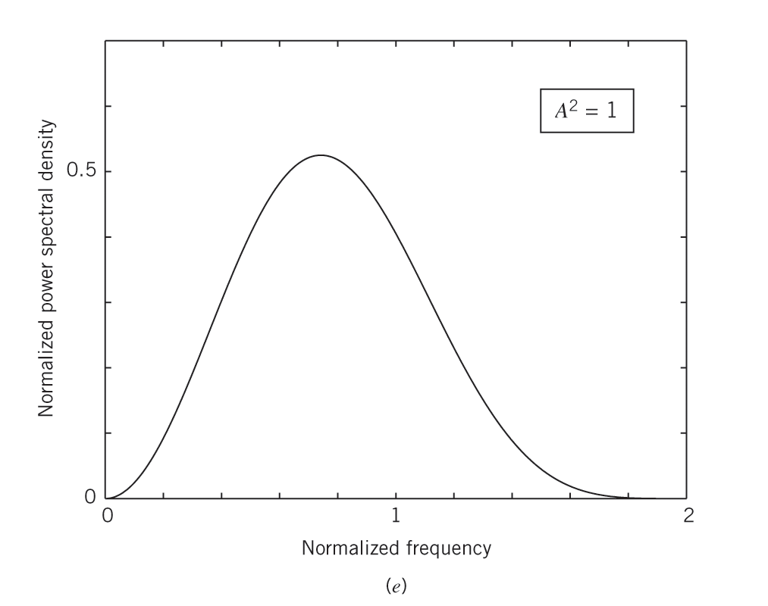
(e) Manchester-encoded signal. Advantages – no DC; insignificant low-frequency components
Figure 3.16e

Slide 34
Differential Encoding
A transition is used to designate symbol 0 in the incoming steam of data & no transition is used to designate symbol 1 .
Whenever you encounter a zero in the incoming signal then you apply transition in the encoded signal .
The decoder compares the polarity of adjacent binary symbols to establish whether or not a transition has occurred (a reference bit is required )
(a) Original binary data. (b) Differentially encoded data, assuming reference bit 1. (c) Waveform of differentially encoded data using unipolar NRZ signaling.

Slide 35
Main purpose of Differential Encoding is to protect against polarity reversals of input bit sequences.
Hence Differentially Encoded data sequences have a slightly superior error performance
It makes the transmitted data to depend not only on the current signal state, but also on the previous one.

Slide 36
why do we use differential encoding
Differential encoding is a technique used in communications and data storage to encode the difference between successive data elements rather than the absolute values of the elements themselves. This can be useful because it often allows for more efficient transmission or storage of the data, as the difference between consecutive values is often much smaller than the values themselves. Additionally, differential encoding can also be used to improve the robustness of the transmitted or stored data, as errors in the transmission or storage process may be more likely to affect the absolute values of the data elements rather than the differences between them.

Slide 37
Virtues, Limitations and Modifications of PCM
Advantages:
1. Robustness to channel noise and interference.
2. Signal regeneration possibilities along the path.
3. Efficient trade-off between increased bandwidth and improved SNR (exponential law)
4. Integration of different base-band signals.
5. Comparative easy of add and drop sources.
6. Secure communication (special modulation, encryption).

Slide 38
Disadvantages:
Increases complexity - VLSI technology
Increased bandwidth – satellites and fiber optic cables; data compression techniques;
Hence we need to find other ways to represent our signal….
END OF Review

