Slide 1
Speech Compression (after first coding)
By
Allam Mousa
Department of Telecommunication Engineering
An Najah University

Slide 2
Why do we need compression
Raw PCM speech has data rate of 64 kbps (8x8)
Speech coding reduces the bit rate of a speech file
Speech coding enables a telephone company to carry more voice calls in a single fiber or cable
Necessary for cellular phones, which has limited data rate for each user (<=16 kbps is desired!).
The lower the bit rate for a voice call, the more other services can be accommodated (data/image/video).
Is necessary for VoIP, audio-visual teleconferencing, etc, to reduce the bandwidth consumption over the Internet

Slide 3
Speech Coding Families

Slide 4
Communication system Block Diagram
source coding
source decoding
speech
speech
channel coding
channel decoding
interleaving
de-interleaving
burst
formatting
burst
de-formatting
ciphering
deciphering
modulation
demodulation

Slide 5
Speech Production Mechanism
Speech is produced by the interaction of the vocal tract with the vocal chords in the glottis

Slide 6
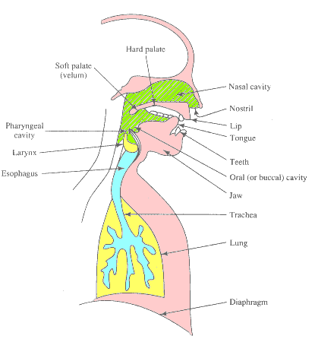
Engineering Model for human speech production mechanism
Vocal tract- time varying digital filter Filter parameters estimated by using LP algorithm

Slide 7
Electronic Signal Generation
Linear predictive (LP) coder using a simple pulse train or noise excitation.
The LP coefficients and gain must be updated for each frame of speech.

Slide 8
A sampled speech signal: the word today

Slide 9
Voiced section of a speech signal
A considerable degree of periodicity is evident

Slide 10
Unvoiced section of a speech signal
The waveform is not visibly periodic and contains noise like components

Slide 11
Some speech properties

Slide 12
Some speech Properties
Instantaneous spectral representation of speech as a set of formant frequencies

Slide 13
Speech Coding Principles
The main schemes of speech coding are;
Analyzing the signal
Removing the redundancies
Efficiently coding the non-redundant parts.

Slide 14
Analysis-synthesis
Analysis of speech: the input speech has the predictable component removed to yield a noise like residual
All-pole synthesis of speech: the predictable component is combined with the residual error to synthesize the speech.

Slide 15
Analysis-by-Synthesis coder

Slide 16
Analysis Mechanisms
The time series of speech samples is broken up into short frames
Coefficients of a module are obtained then transmitted (i.e., LPC);
Excitation may be either Gaussian noise or a series of impulses
The coefficients of the filters are estimated using an adaptive filter

Slide 17
Subjective Quality Assessment
-Mean Opinion Score (MOS)
Excellent (5),Good (4), Fair (3), Poor (2), Bad (1)
Varies with each test and across languages
4-4.5 =➔Network or toll quality
3.5-4 =➔Communication quality (cellular)
2.5-3.5 =➔Synthetic Quality
-DRT !
-DAM !
Prepare a file

Slide 18
Comparison of quality and transmission rate for various speech coding systems using MOS rating

Slide 19
Rate, performance and complexity comparison for various speech coder designs
Relative complexity | MOS Quality | Bit rate (kbit/s) | Technique | Class
1 10 0.3 | 4.3 4.1 3 | 64 32 16 | PCM G.721 ADPCM G.721 DM | Waveform coders
30 | 4.3 | 64-48 | SBC(2) G.722 (7kHz) | Intermediate coder
50-100 | 3.2 | 4.8 | CELP/MPE for ½ rate GSM | Enhanced source coder
40 | 2 | 2.4 | LPC-10 vocoder | Source coder

