Slide 1
Myocardial Infarction (MI)
Prepared by
Miss Fatima Hirzallah
RNS, MSN ,CNS, PhD candidat

Slide 2
Objectives
Describe the pathophysiology, clinical manifestations, and treatment of myocardial infarction.
Use the nursing process as a framework for care of a patient with acute coronary syndrome.
Describe percutaneous coronary interventional and coronary artery revascularization procedures.

Slide 3
Pathophysiology
In an MI, an area of the myocardium is permanently destroyed.
MI is usually caused by reduced blood flow in a coronary artery due to rupture of an atherosclerotic plaque and following occlusion of the artery by a thrombus.
In unstable angina, the plaque ruptures but the artery is not completely occluded .

Slide 4
Acute Myocardial Infarction (AMI)
Ischemia with myocardial cell death
Imbalance of oxygen supply and demand
Causes
Atherosclerosis
Emboli
Blunt trauma
Spasm
Notes:
Acute coronary syndrome (ACS) includes the diagnoses of unstable angina (UA) and acute myocardial infarction (AMI).
AMI is defined as non–ST elevation myocardial infarction (NSTEMI) or ST elevation myocardial infarction (STEMI) by ECG characteristics. Prompt recognition and treatment result in improved outcomes for all patients with ACS.
AMI is caused by an imbalance between myocardial oxygen supply and demand. This imbalance is the result of decreased coronary artery perfusion. Most cases of AMI are secondary to atherosclerosis.
The extent of cell death determines the size of the MI. Contractility in the infarcted area becomes impaired. A nonfunctional zone and a zone of mild ischemia with potentially viable tissue surround the infarct. The ultimate size of the infarct depends on the fate of this ischemic zone.
Early interventions, such as the administration of thrombolytics or early percutaneous intervention, can restore perfusion to the ischemic zone and can reduce the area of myocardial damage.

Slide 5
Pathophysiology
Other causes of MI include :
vasospasm (sudden constriction or narrowing) of a coronary artery
Decreased oxygen supply (eg, from acute blood loss, anemia, or low blood pressure)
increased demand for oxygen (eg, from a rapid heart rate, thyrotoxicosis, or ingestion of cocaine).
In each case, a profound imbalance exists between myocardial oxygen supply and demand.
Coronary occlusion, heart attack, and MI are terms used synonymously, but the preferred term is MI

Slide 6
Pathophysiology
The area of infarction develops over minutes to hours. As the cells are deprived of oxygen, ischemia develops, cellular injury occurs, and the lack of oxygen results in infarction, or the death of cells.

Slide 7
Assessment of AMI
Midsternal chest pain
Severe, crushing, and squeezing pressure
May radiate
Unrelieved with nitrates
Pale and diaphoretic
Dyspnea and tachypnea
Syncope
Nausea and vomiting
Dysrhythmias
Notes:
Pain is carefully assessed to identify classic or non-traditional signs and symptoms of AMI (women often have non-traditional symptoms).
Associated symptoms include pallor, diaphoresis, dyspnea/tachypnea, syncope, nausea/vomiting, and dysrhythmias.
The patient may be anxious or restless, or may exhibit certain behavioral responses, including denial, depression, and a sense of impending doom.
Women are more likely to have atypical signs and symptoms such as fatigue, diaphoresis, indigestion, arm or shoulder pain, nausea, and vomiting.

Slide 8
Assessment and Diagnostic Findings
Patient History
The patient history has two parts: the description of the presenting symptom (eg, pain) and the history of previous illnesses and family history of heart disease
ECG
laboratory test results (eg, serial cardiac biomarker values).

Slide 9
Diagnosis of AMI
Signs and symptoms
Often atypical symptoms in women
12-lead:
ST elevation followed by Q wave (Q-wave myocardial infarction)
ST depression (non–Q-wave myocardial infarction)
Elevated cardiac enzymes
CPK-MB
Elevated serum troponin I/T, myoglobin
Notes:
Criteria for the diagnosis of ACS are summarized in Table 12-7.

Slide 10
Electrocardiogram(ECG)
The classic ECG changes are:
T-wave inversion, ST-segment elevation, and development of an abnormal Q wave
Because infarction evolves over time, the ECG also changes over time

Slide 11
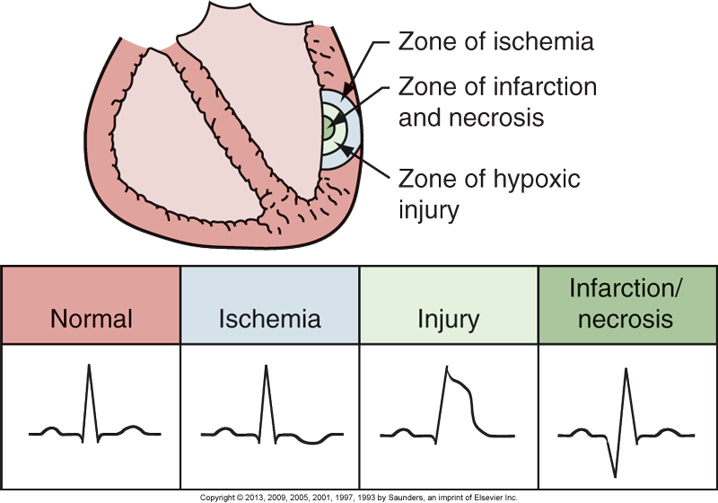
Diagnosis of AMI (continued)
FIGURE 12-9. Electrocardiographic alterations associated with the three zones of myocardial infarction. (From McCance, K. L., & Huether, S. E. [Eds.]. [2006]. Pathophysiology: The biologic basis for disease in adults and children [5th ed., p. 1114]. St. Louis: Mosby.)
Notes:
Review the zones of injury and related changes on the ECG.

Slide 12
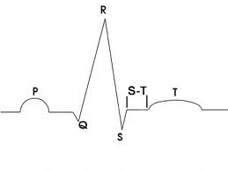

Slide 13
Inversion of the T wave
Depression of ST segment

Slide 15
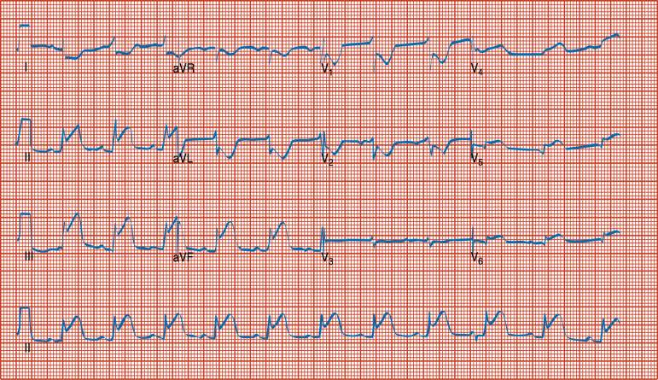

Slide 16
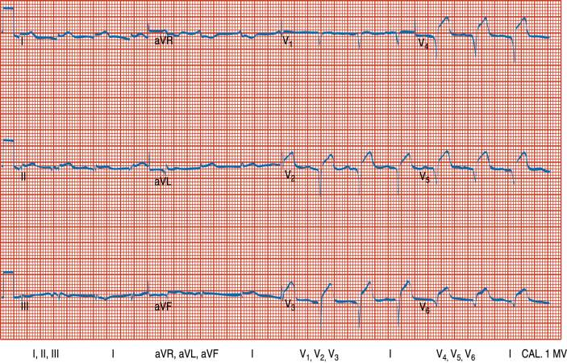

Slide 17
Various descriptions are used to further identify an MI:
The type of MI (ST-segment elevation( STEMI), non–ST-segment elevation (NSTEMI).
location of the injury to the ventricular wall (anterior, inferior, posterior, or lateral wall)
the point in time within the process of infarction (acute or old).

Slide 18
Patients are diagnosed with one of the following forms of ACS:
Non–ST-segment elevation MI: The patient has elevated cardiac biomarkers but no definite ECG evidence of acute MI.
ST-segment elevation MI: The patient has ECG evidence of acute MI with characteristic changes in two contiguous leads on a 12-lead ECG. In this type of MI, there is significant damage to the myocardium.

Slide 19
Nursing Goals: AMI
Maintain cardiac output
Treat pain
Assess for complications
Increase activity tolerance
Relieve anxiety
Ongoing and discharge teaching
Notes:
See Nursing Care Plan for the Patient with an AMI and review key concepts.

Slide 20
Complications of AMI
Dysrhythmias
Sudden death
Congestive heart failure; cardiogenic shock
Ventricular aneurysm or rupture
Papillary muscle dysfunction
Pericarditis
Notes:
Several complications of AMI; several are life-threatening.
Important for ongoing assessment (physical exam, rhythm, etc.).

Slide 21
Medical Management: AMI
Pain relief: morphine, nitroglycerin
Oxygen
Drugs affecting platelets
ASA
Glycoprotein IIb/IIIa inhibitors
Beta-blockers
Nitrates
ACE inhibitors
Antidysrhythmics
Notes:
Treatment goals for AMI:
Establish reperfusion.
Reduce infarct size.
Prevent and treat complications.
Provide emotional support and education.
Medical treatment of AMI is aimed at relieving pain, providing adequate oxygenation to the myocardium, preventing platelet aggregation, and restoring blood flow to the myocardium through thrombolytic therapy or acute interventional therapy, such as angioplasty.

Slide 22
Pharmacological Therapy
Time is muscle; 6-hour window
Several Fibrinolytics /thrombolytic agents available, such as:
Alteplase – tPA
Tenecteplase – tNK
Reteplase –r-PA
Anticoagulants
Low-molecular-weight heparins
Heparin
Platelet Inhibitors
Aspirin
Glycoprotein IIb/IIIa inhibitors

Slide 23
Pharmacological Therapy
Thrombolytics or Fibrinolytics
The purpose of thrombolytics is to dissolve and lyse the thrombus in a coronary artery (thrombolysis)
Allowing blood to flow through the coronary artery again (reperfusion)
Minimizing the size of the infarction
Preserving ventricular function

Slide 24
Pharmacological Therapy
Alteplase is a tissue plasminogen activator (t-PA) that activates the plasminogen present on the blood clot.
An IV bolus dose is given and followed by an infusion. Aspirin and unfractionated heparin or LMWH may be used with t-PA to prevent another clot from forming at the same lesion site.

Slide 25
Interventional Cardiology
Variety of procedures
Emergent PCI procedures (Percutaneous Coronary Intervention) (eg, percutaneous transluminal coronary angioplasty [PTCA], intracoronary stents, and atherectomy)
and CABG.
Notes:
PTCA is done to compress intracoronary plaque to increase blood flow to the myocardium.
Treatment of choice for patients with uncompromised collateral flow, noncalcified lesions, and lesions not present at bifurcations of vessels.

Slide 26
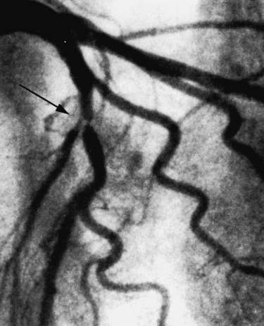

Slide 27
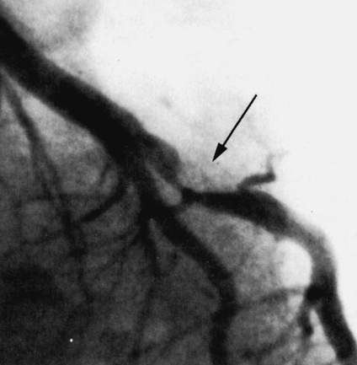

Slide 28
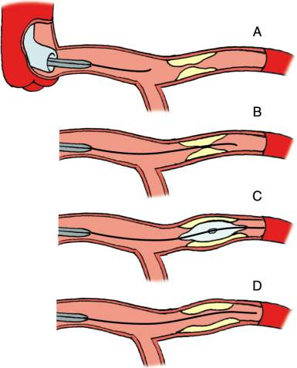

Slide 29
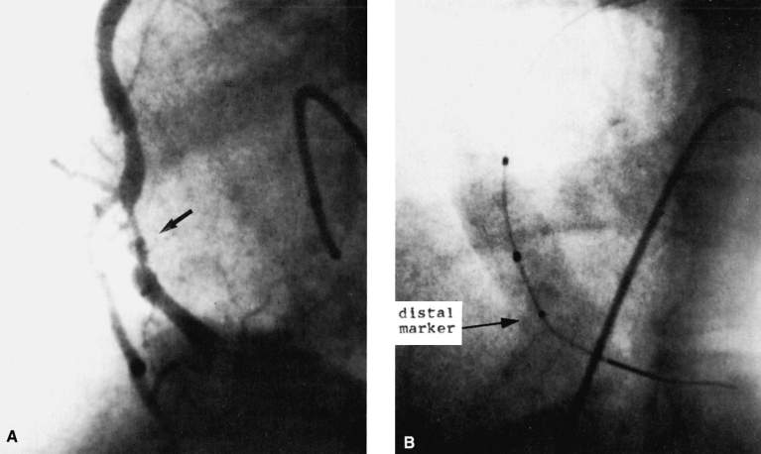

Slide 30
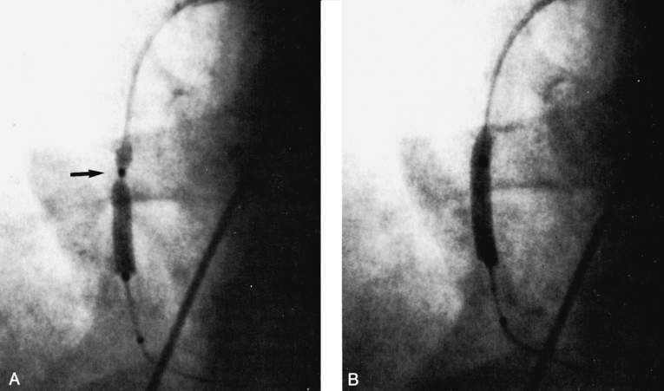

Slide 31
PTCA
Goal to increase blood flow to myocardium
Criteria
Uncompromised collateral flow
Noncalcified lesions
Lesions not on bifurcations of vessels
Balloon catheter is inflated
Notes:
Review Figures 12-10 and 12-11 to show how PTCA works to restore coronary artery blood flow.

Slide 32
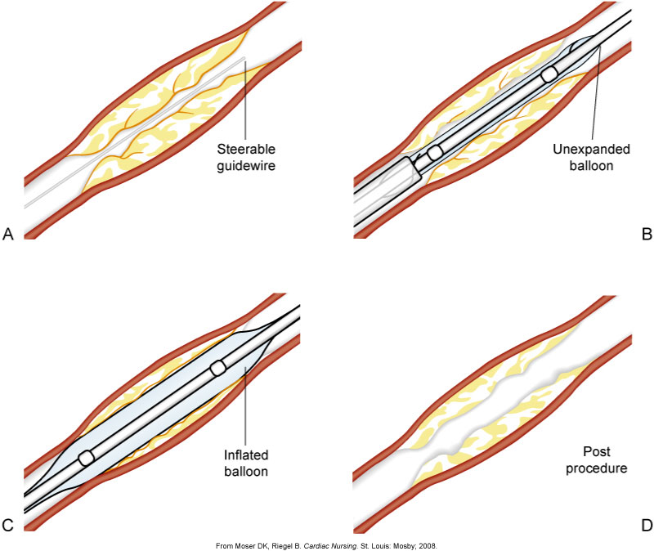
PTCA (continued)
Figure 12-10. Coronary angioplasty procedure. A-D, Order of procedure. (From Moser DK, Riegel B. Cardiac Nursing. St. Louis: Mosby; 2008.)
Notes:
Figure 12-10. Coronary angioplasty procedure. A-D, Order of procedure.

Slide 33
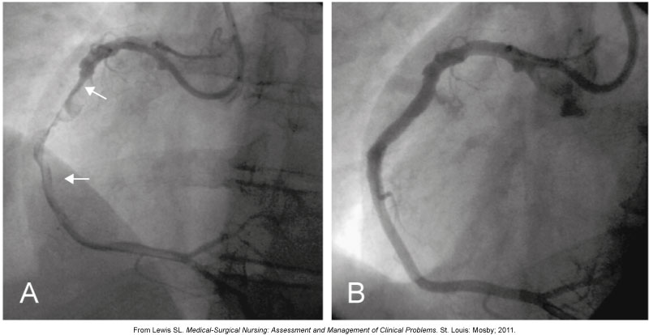
Coronary Angiogram Before and After PTCA
Figure 12-11. A, A thrombotic occlusion of the right coronary artery is noted (arrows). B, Right coronary artery is opened and blood flow restored following angioplasty and placement of a 4-mm stent. (From Lewis SL. Medical-Surgical Nursing: Assessment and Management of Clinical Problems. St. Louis: Mosby; 2011.)
Notes:
Figure 12-11. A, A thrombotic occlusion of the right coronary artery is noted (arrows). B, Right coronary artery is opened and blood flow restored following angioplasty and placement of a 4-mm stent.

Slide 34
Intracoronary Stents
Tubes placed in conjunction with angioplasty to keep vessel patent
Help prevent the restenosis associated with angioplasty
Similar procedure as PTCA
Anticoagulation therapy
Notes:
Angioplasty is often enhanced by inserting intracoronary stents, tubes that are implanted at the site of stenosis to widen the arterial lumen by squeezing atherosclerotic plaque against the artery’s walls.
Stents provide structural support to maintain patency.
Some stents have medications (called “drug-eluting stents”) to maintain patency as well.
The procedure for placing a stent is similar to the procedure in PTCA.
Antiplatelet agents are given after the procedure.

Slide 35
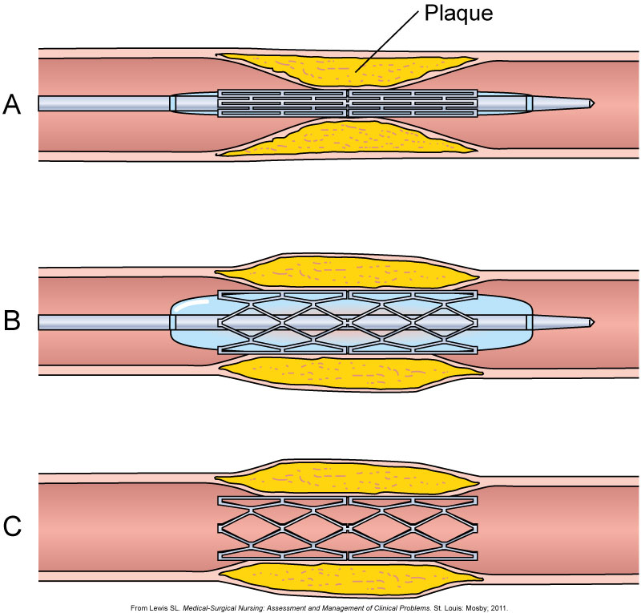
Intracoronary Stent
Figure 12-12. Placement of coronary artery stent. A, The stent is positioned at the site of the lesion. B, The balloon is inflated, expanding the stent. The balloon is then deflated and removed. C, The implanted stent is left in place. (From Lewis SL. Medical-Surgical Nursing: Assessment and Management of Clinical Problems. St. Louis: Mosby; 2011.)
Notes:
Review procedure for inserting stents.

Slide 36
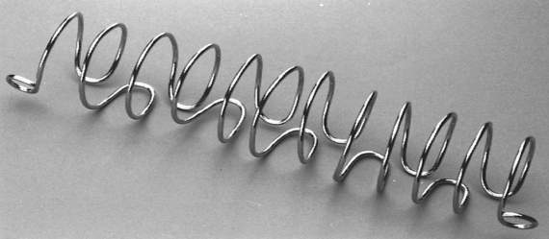
Atherectomy

Slide 37
Nursing Diagnoses
Ineffective cardiac tissue perfusion related to reduced coronary blood flow from coronary thrombus and atherosclerotic plaque
Risk for imbalanced fluid volume
Risk for ineffective peripheral tissue perfusion related to decreased cardiac output from left ventricular dysfunction
Death anxiety
Deficient knowledge about post-MI self-care

Slide 38
Surgical Revascularization
Coronary artery bypass graft (CABG) surgery
Minimally invasive direct coronary artery bypass (MIDCAB) surgery
Transmyocardial revascularization (TMR)
Notes:
Surgical approaches used for revascularization include coronary revascularization by coronary artery bypass graft (CABG), minimally invasive coronary artery bypass (MIDCAB) surgery, and transmyocardial revascularization (TMR).
Surgically restore circulation.

Slide 39
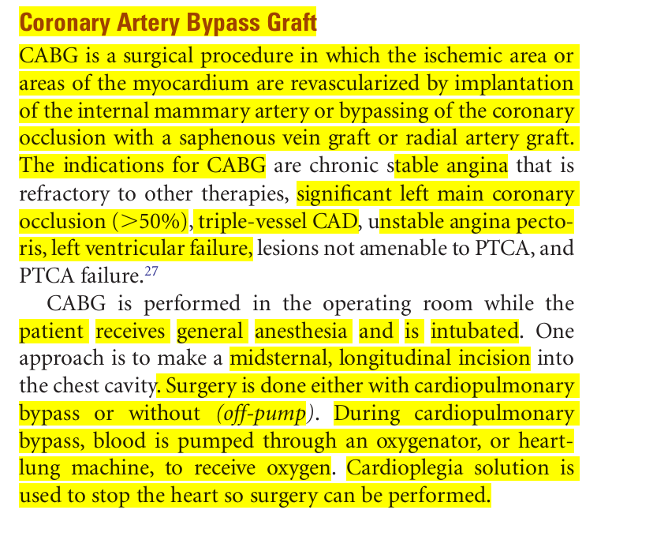

Slide 40
CABG Surgery
Provides additional conduits for blood flow
Saphenous vein : blood vesselsin in the leg ,help spend blood from legs and back up to your heart .
Internal mammary artery :come from subclavian artery .
Radial artery : one of two continues of the brachial artery.
Arteries longer patency
Notes:
CABG is a surgical procedure in which the ischemic area or areas of the myocardium are revascularized.
Implantation of the internal mammary artery, saphenous vein graft, radial artery graft.
The indications for CABG are chronic stable angina that is refractory to other therapies, significant left main coronary occlusion (>50%), triple-vessel CAD, unstable angina pectoris, left ventricular failure, lesions not amenable to PTCA, and PTCA failure.

Slide 41
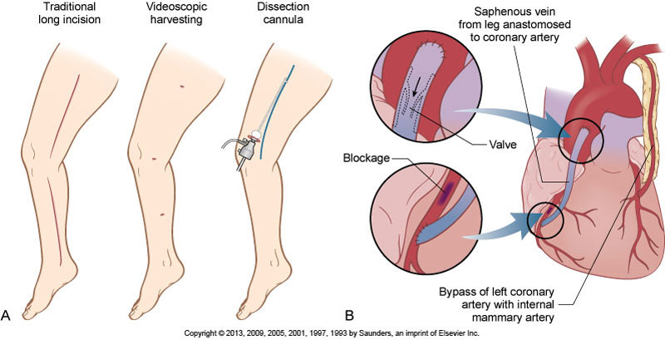
CABG Surgery (continued)
Figure 12-13. Coronary artery bypass graft surgery. A, Saphenous vein is harvested from the leg using either a traditional long incision or less invasive videoscopic harvesting. B, The vein is then anastomosed to the coronary artery.
Notes:
Figure 12-13. Coronary artery bypass graft surgery.

Slide 42
internal mammary artery better than saphenous vein for CABG , Why ?
Have long term patency .

Slide 43
Indications for CABG
Unstable angina
AMI : Lateral MI , anterior MI , inferior MI
* Lateral MI : occlusion in LAD , ST elevation in V2 , V3 , V4 , in this case , if occlusion ( > 50 ) , CABG is perform .
Failure of percutaneous interventions

Slide 44
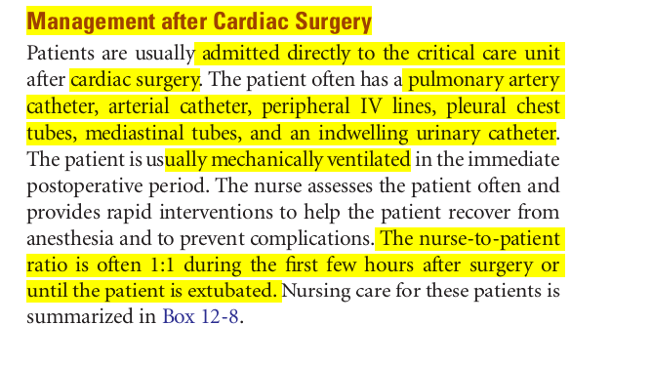

Slide 45
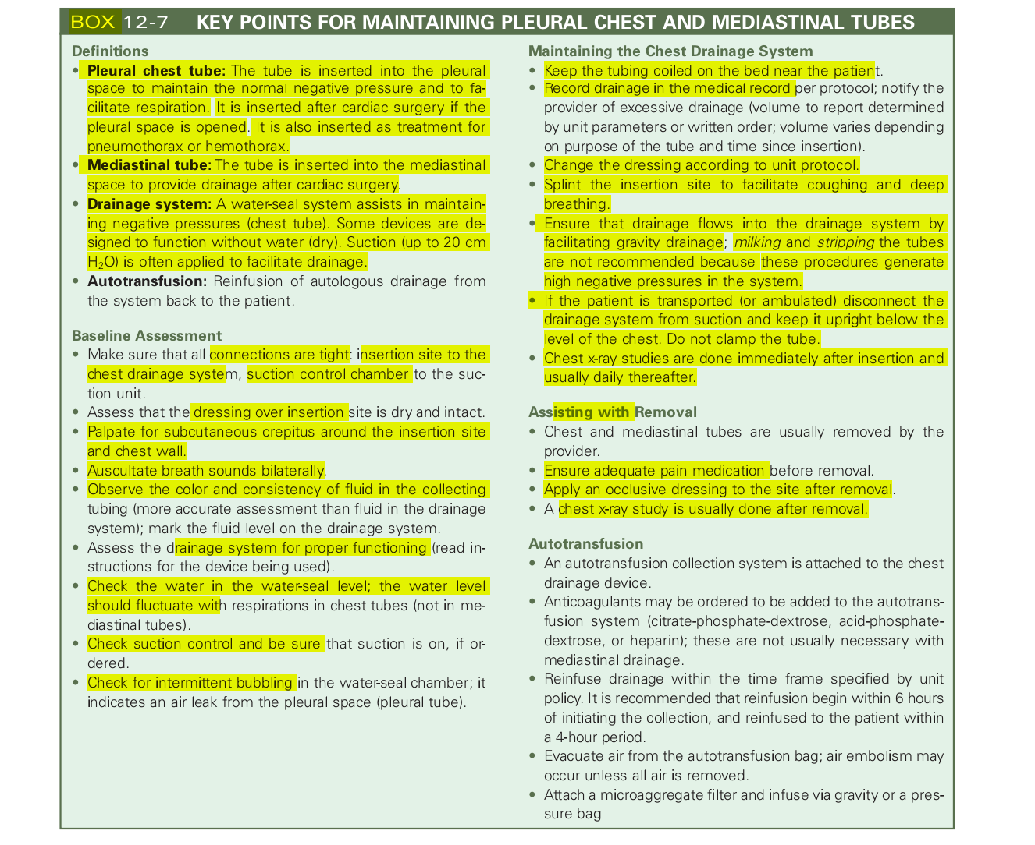

Slide 46
Risks Associated with CABG
Increased mortality associated with:
Left ventricle dysfunction
Emergency surgery
Age
Sex (female)
Number of diseased vessels
Decreased ejection fraction with congestive heart failure
Notes:
Mortality after CABG is influenced by many factors.

Slide 47
Traditional bypass surgery involves an incision through the breastbone and the use of a heart-lung bypass machine. In this procedure, the heart is stopped and a heart-lung machine is used to pump blood and perform the functions normally achieved by the lungs. The surgeon performs the bypass operation on the stopped heart, and then revives the heart later during the procedure.

Slide 48
Traditional CABG
Median sternotomy or sternum split
Excision of pericardium
Cardiopulmonary bypass
Myocardial preservation or cardioplegia
** Cardioplegia serves to intentionally and temporarily arrest the heart for myocardial protection during cardiac surgery.
Notes:
CABG is performed under general anesthesia.
One approach is to make a midsternal, longitudinal incision into the chest cavity.
Surgery is done either with cardiopulmonary bypass or without (off-pump). During cardiopulmonary bypass, blood is pumped through an oxygenator, or heart-lung machine, to receive oxygen. Cardioplegia solution is used to stop the heart so surgery can be performed.

Slide 49
Traditional CABG (continued)
Grafts Grafting refers to a surgical procedure to move tissue from one site to another on the body, or from another creature, without bringing its own blood supply with it.
They prefer using RIMA and LIMA because it has long term patency (Artery)
Wean bypass; defibrillate if needed
Mediastinal and chest tubes
Epicardial pacing wires
Notes:
Procedure for CABG

Slide 50
Goals of CABG Surgery
Increase blood flow to myocardium
Relieve symptoms
Prolong survival
Improve quality of life

Slide 51
Cardiac Surgery Complications
Low cardiac output
Renal impairment
Gastrointestinal dysfunction
Impaired peripheral circulation
Mediastinal bleeding
Infection: very serious if sternal
Atrial dysrhythmias
Hypovolemia
Notes:
Several complications of cardiac surgery.
See Boxes 12-7 and 12-8 for related care.

Slide 52
Complications of CABG
Dysrhythmias
Impaired contractility; low cardiac output
Intraoperative myocardial infarction
Pericardial tamponade
Respiratory insufficiency
Pain
Emboli; stroke
Death
Notes:
Many complications of cardiac surgery.
Patients are closely monitored.
Discuss why these complications occur, and what assessments indicate the presence.

Slide 53
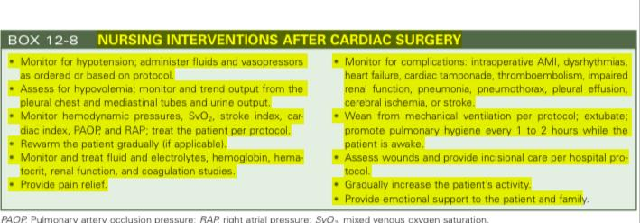

Slide 54
Permanent Pacemakers
Multiprogrammable for:
Rate
Voltage
Sensitivity
Stimulus duration
Refractory period
Intersociety Commission for Heart Disease (ICHD)
Notes:
Many different types of permanent pacing.
The ICHD code is used to interpret the programming done when pacemakers are inserted.
Use the ICHD table to discuss how each pacemaker works (e.g., DDD) and what would be expected on a rhythm strip if the pacemaker is functioning properly (Table 12-10).

Slide 55
Permanent Pacemakers (continued)
Can pace atria, ventricles, or dual chamber
Inserted transvenously
Notes:
See Table 12-10.

Slide 56
Implantable Cardioverter-Defibrillator (ICD)
Used to treat survivors of sudden cardiac arrest
Some have built-in pacemakers
Delivers high-energy shock
Patient education
Emergency procedures
Notes:
Implantable cardioverter-defibrillators (ICDs) are placed in patients for primary or secondary prevention of potentially lethal dysrhythmias.
Implanted by electrophysiologists.
All ICDs are developed with pacemaker capabilities in the rare instance when the patient needs back-up pacing after receiving an ICD shock.
Indications are listed in Box 12-9.

Slide 57
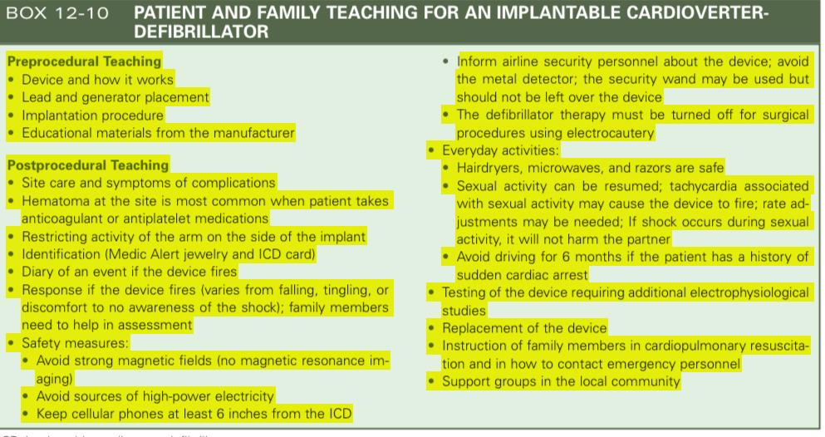

Slide 58
Vascular Alterations
Aortic aneurysms
Dilation or thinning of wall
Thoracic aortic
Thoracoabdominal aortic
Abdominal aortic
Treat based on size and symptoms
False versus true

Slide 59
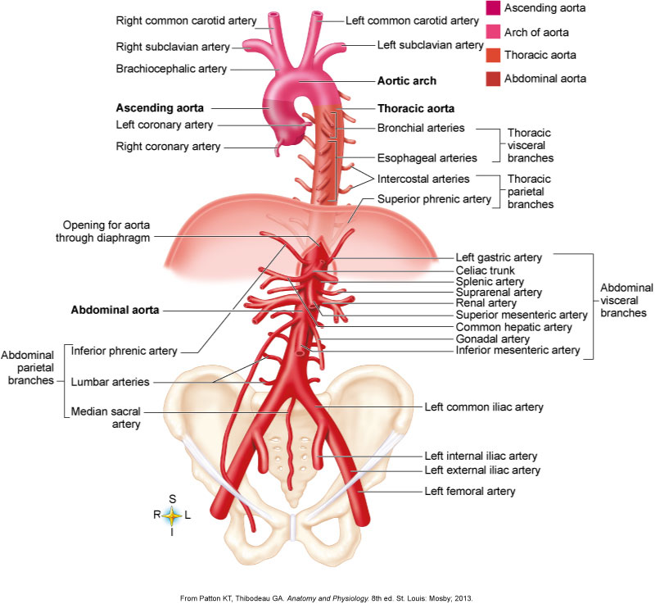
Anatomy of the Aorta
Figure 12-15. Anatomy of the aorta and its major branches. (From Patton KT, Thibodeau GA. Anatomy and Physiology. 8th ed. St. Louis: Mosby; 2013.)
Notes:
Figure 12-15. Anatomy of the aorta and its major branches.
Review to look at sites for aneurysm formation.

Slide 60
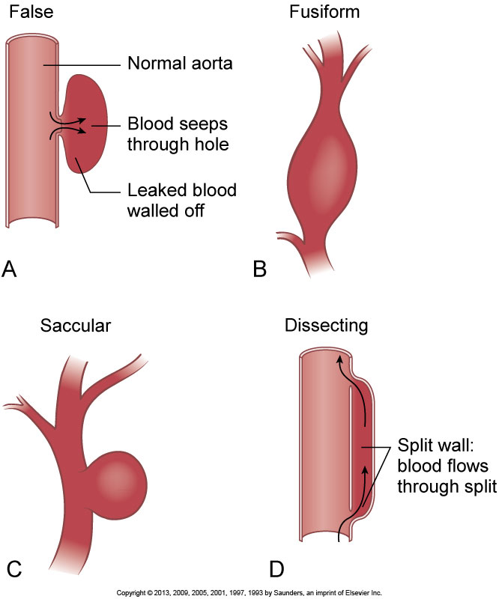
Aneurysms
Figure 12-16. The four types of aneurysms. A, False. B, Fusiform. C, Saccular. D, Dissecting.
Notes:
An aneurysm is a diseased area of an artery causing dilatation and thinning of the wall.
Several types exist (review figure).
Risk is rupture. Monitor until it reaches a size warranting surgical intervention.

Slide 62
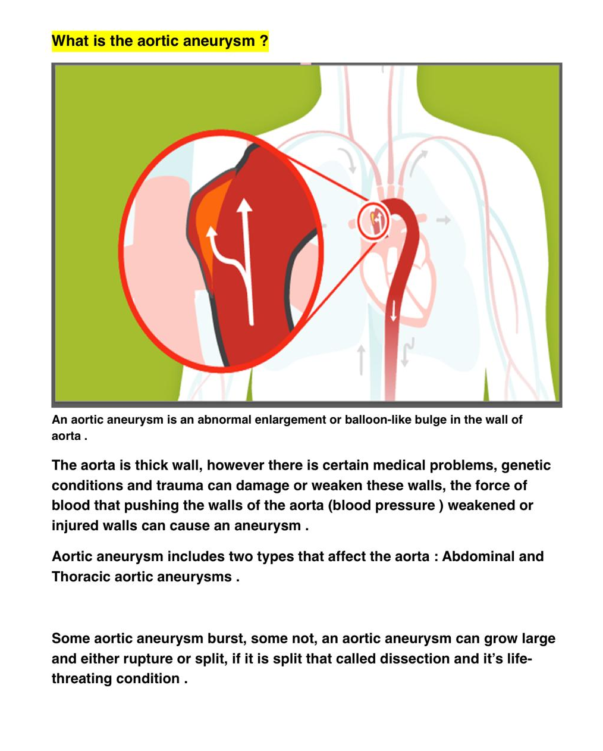

Slide 63
Vascular Alterations (continued)
Aortic dissection
Tear of intimal layer of the vessel
Sudden
Sharp
Shifting pain
Marfan syndrome
Notes:
Aortic dissection is a life-threatening emergency that requires immediate medical attention.
Dissection is a tear in the intimal layer of the vessel creating a “false” lumen, causing blood flow diversion into the false lumen. Sudden, severe chest pain is the most common presenting symptom of aortic dissection.
Emergent surgery is needed.

Slide 64
Vascular Alterations (continued)
Surgical Treatment
Open approach
Endovascular approach
Notes:
The open or conventional repair of aortic aneurysm is the endoaneurysmal repair (Figure 12-17). This surgery requires a midline, transverse anterior, or a retroperitoneal approach.
Care of the vascular surgery patient is detailed in Box 12-13.

Slide 65
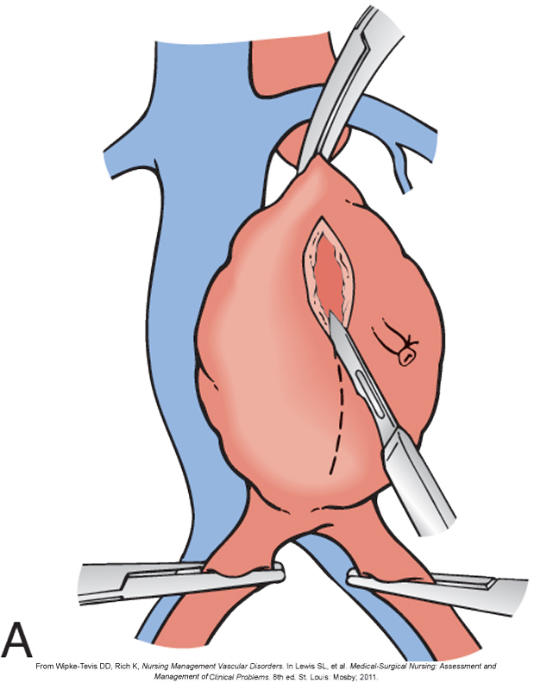
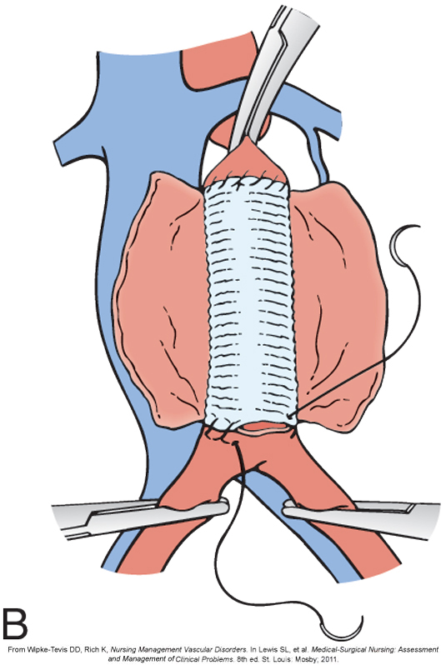
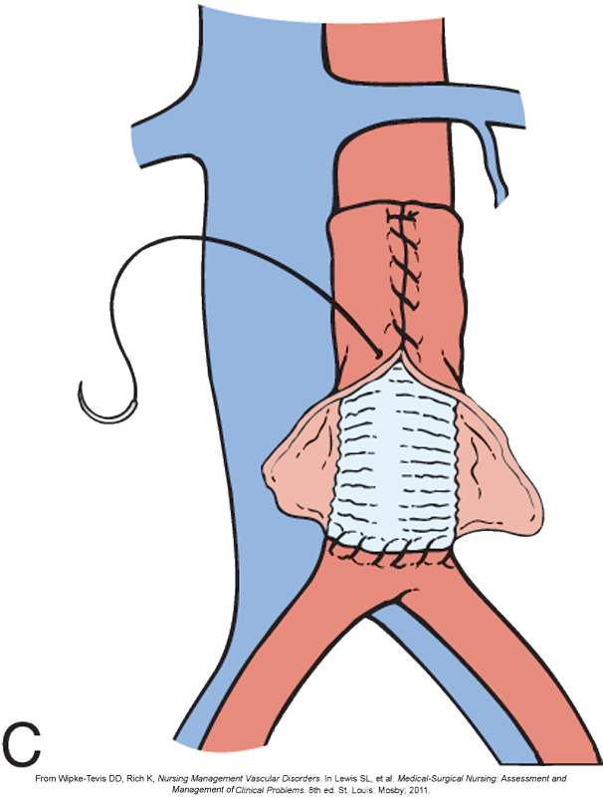
Endoaneurysmal Repair
Figure 12-17. Surgical repair of an abdominal aortic aneurysm. A, The aneurysmal sac is incised. B, The synthetic graft is inserted. C, The native aortic wall is sutured over the synthetic graft (From Wipke-Tevis DD, Rich K, Nursing Management Vascular Disorders. In Lewis SL, et al. Medical-Surgical Nursing: Assessment and Management of Clinical Problems. 8th ed. St. Louis: Mosby; 2011.)
Notes:
Endovascular repair is one method to treat aneurysms.

