Slide 1
Myocardial Infarction (MI)
Prepared by
Miss Fatima Hirzallah
RNS, MSN ,CNS

Slide 2
Objectives
Describe the pathophysiology, clinical manifestations, and treatment of myocardial infarction.
Use the nursing process as a framework for care of a patient with acute coronary syndrome.
Describe percutaneous coronary interventional and coronary artery revascularization procedures

Slide 3
Pathophysiology
In an MI, an area of the myocardium is permanently destroyed.
MI is usually caused by reduced blood flow in a coronary artery due to rupture of an atherosclerotic plaque and subsequent occlusion of the artery by a thrombus.
In unstable angina, the plaque ruptures but the artery is not completely occluded .

Slide 4
Pathophysiology
Other causes of MI include :
vasospasm (sudden constriction or narrowing) of a coronary artery
decreased oxygen supply (eg, from acute blood loss, anemia, or low blood pressure)
increased demand for oxygen (eg, from a rapid heart rate, thyrotoxicosis, or ingestion of cocaine). In each case, a profound imbalance exists between myocardial oxygen supply and demand.
Coronary occlusion, heart attack, and MI are terms used synonymously, but the preferred term is MI

Slide 5
Pathophysiology
The area of infarction develops over minutes to hours. As the cells are deprived of oxygen, ischemia develops, cellular injury occurs, and the lack of oxygen results in infarction, or the death of cells.

Slide 6
Pathophysiology
Various descriptions are used to further identify an MI:
the type of MI (ST-segment elevation STEMI, non–ST-segment elevation NSTEMI)
the location of the injury to the ventricular wall (anterior, inferior, posterior, or lateral wall)

Slide 7
Clinical Manifestations
chest pain
shortness of breath, indigestion, nausea, and anxiety.
may have cool, pale, and moist skin.
heart rate and respiratory rate may be faster than normal.

Slide 8
Clinical Manifestations
In many cases, the signs and symptoms of MI cannot be distinguished from those of unstable angina.

Slide 9
Assessment and Diagnostic Findings
Patient History
The patient history has two parts: the description of the presenting symptom (eg, pain) and the history of previous illnesses and family history of heart disease
the ECG
laboratory test results (eg, serial cardiac biomarker values).

Slide 10
Electrocardiogram(ECG)
The classic ECG changes are:
T-wave inversion, ST-segment elevation, and development of an abnormal Q wave
Because infarction evolves over time, the ECG also changes over time

Slide 11
Inversion of the T wave
Depression of ST segment

Slide 12
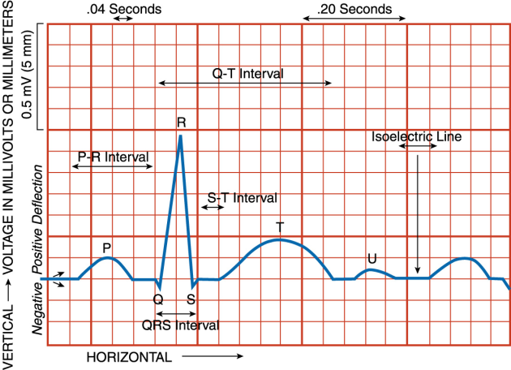

Slide 13
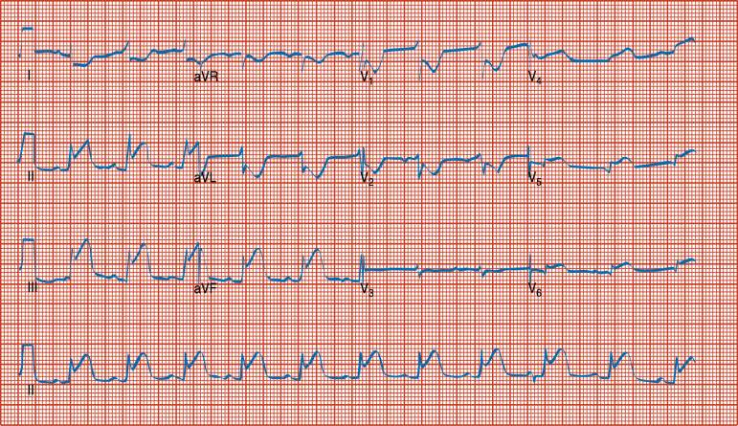

Slide 14
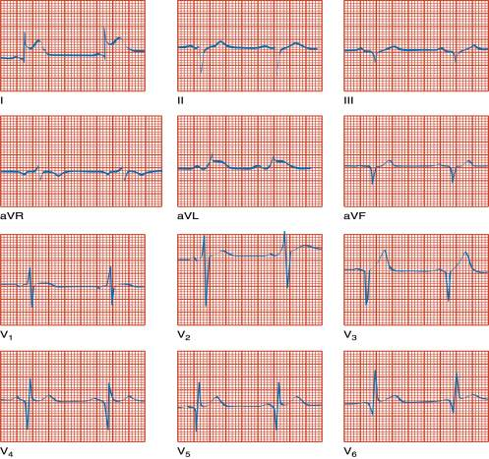

Slide 15
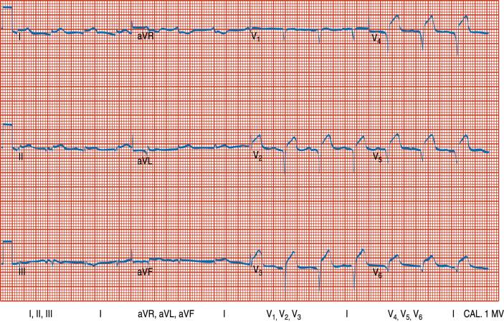

Slide 16
patients are diagnosed with one of the following forms of ACS:
Unstable angina: The patient has clinical manifestations of coronary ischemia, but ECG or cardiac biomarkers show no evidence of acute MI.
Non–ST-segment elevation MI: The patient has elevated cardiac biomarkers but no definite ECG evidence of acute MI.
ST-segment elevation MI: The patient has ECG evidence of acute MI with characteristic changes in two contiguous leads on a 12-lead ECG. In this type of MI, there is significant damage to the myocardium.

Slide 17
Laboratory Tests
Creatine Kinase and Its Isoenzymes
There are three creatine kinase (CK) isoenzymes:
CK-MM (skeletal muscle)
CK-MB (heart muscle),
CK-BB (brain tissue).
CK-MB is the cardiac-specific isoenzyme; CK-MB is found mainly in cardiac cells and therefore increases only when there has been damage to these cells. its level begins to increase within a few hours and peaks within 24 hours of an MI

Slide 18
Laboratory Tests
Troponin
Troponin, a protein found in the myocardium, regulates the myocardial contractile process. There are three isomers of troponin: C, I, and T. Troponins I and T are specific for cardiac muscle, and these tests are currently recognized as reliable and critical markers of myocardial injury

Slide 19
Medical Management
Pharmacologic Therapy
The patient with suspected MI is given
aspirin, nitroglycerin, morphine, a beta-blocker

Slide 20
Pharmacological Therapy
Fibrinolytics
Alteplase – tPA
Tenecteplase – tNK
Reteplase –r-PA
Anticoagulants
Low-molecular-weight heparins
Heparin
Platelet Inhibitors
Aspirin
Glycoprotein IIb/IIIa inhibitors

Slide 21
Pharmacological Therapy
Thrombolytics or Fibrinolytics
The purpose of thrombolytics is to dissolve and lyse the thrombus in a coronary artery (thrombolysis)
allowing blood to flow through the coronary artery again (reperfusion)
minimizing the size of the infarction
preserving ventricular function

Slide 22
Pharmacological Therapy
Alteplase is a tissue plasminogen activator (t-PA) that activates the plasminogen present on the blood clot.
An IV bolus dose is given and followed by an infusion. Aspirin and unfractionated heparin or LMWH may be used with t-PA to prevent another clot from forming at the same lesion site.

Slide 23
Pharmacological Therapy
Analgesics (morphine sulfate).
Angiotensin-Converting Enzyme Inhibitors (ACE) inhibitors
Emergent PCI procedures (Percutaneous Coronary Intervention)
(eg, percutaneous transluminal coronary angioplasty [PTCA], intracoronary stents, and atherectomy) and CABG.

Slide 24
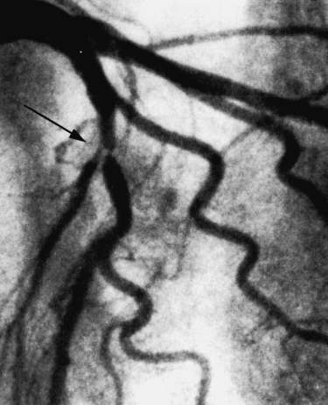

Slide 25
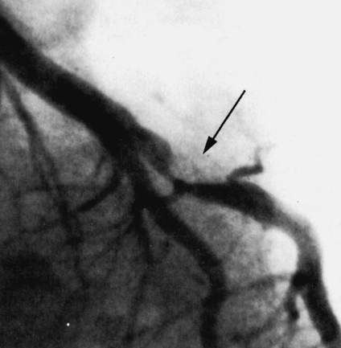

Slide 26
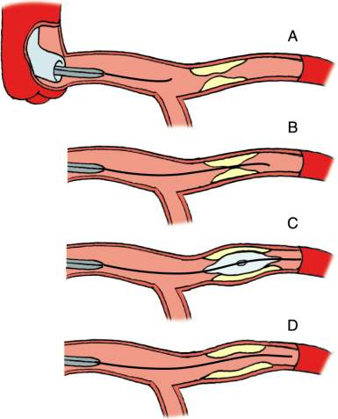

Slide 27
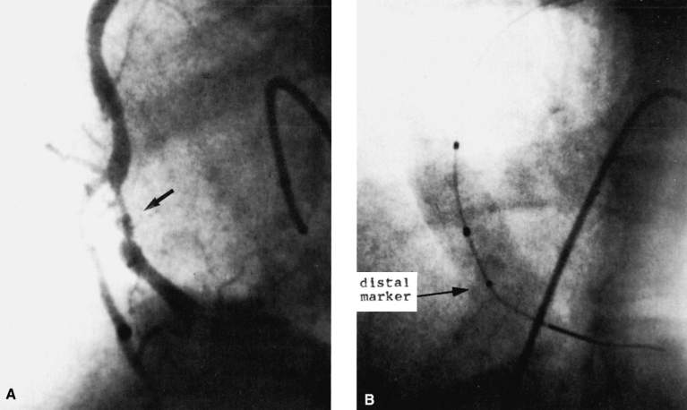

Slide 28
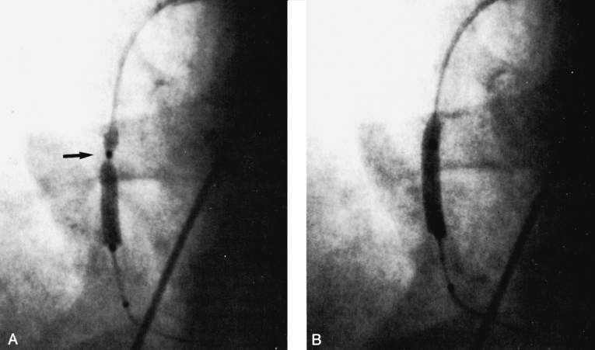

Slide 29
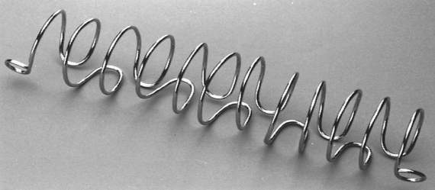

Slide 30
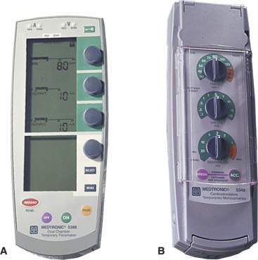
Setting on a pacer
Rate
Sensitivity
mA - milliamperage

Slide 31
Nursing Diagnoses
Ineffective cardiac tissue perfusion related to reduced coronary blood flow from coronary thrombus and atherosclerotic plaque
Risk for imbalanced fluid volume
Risk for ineffective peripheral tissue perfusion related to decreased cardiac output from left ventricular dysfunction
Death anxiety
Deficient knowledge about post-MI self-care

