Slide 1
Investment Portfolio Management
Second Semester 20-21

Slide 2
Today’s Agenda
Three Messages:
What is Investment?
What is Investable Assets?
What is an Investment Portfolio?

Slide 3
Investment Definition
The sacrifice of current consumption for future consumption whose objective is to increase future wealth.
Examples: Buying 100 shares of Google, taking this course.

Slide 4
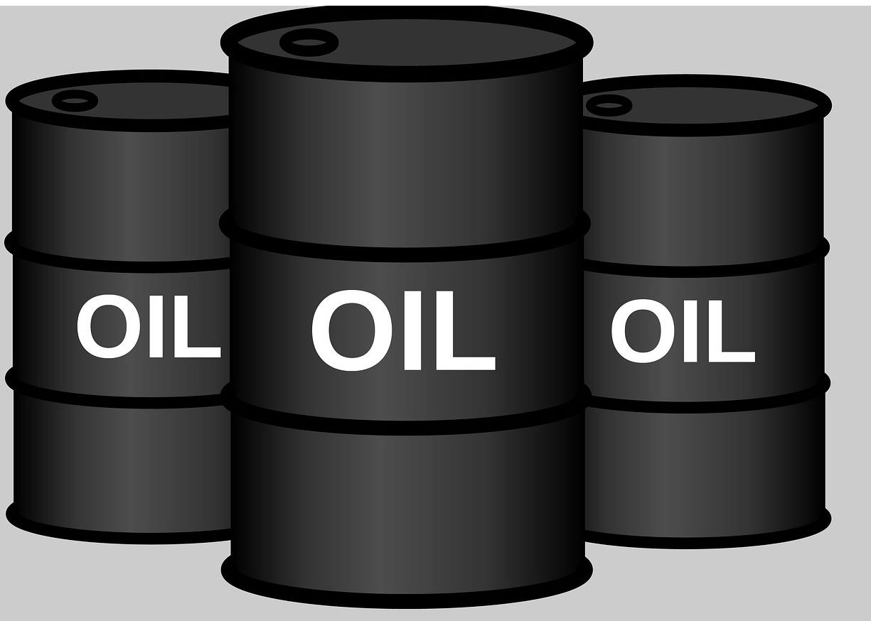
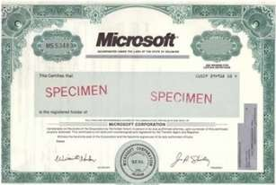
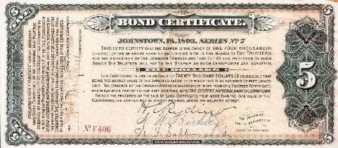
Investable Assets
Real Assets
Financial Assets

Slide 5
Investable Assets

Slide 6
Portfolio Definition
Investment Portfolio is group of financial assets such as shares, stock, bond, debt instruments, cash equivalent etc.

Slide 7
Aim of Investment Portfolio Management

Slide 8
Case Study
For each case you have, identify:
• Identify the nine
Group Discussion:
What assets do you
/your family own?
Do you think that we need a systematic approach to portfolio management?
What do you think are
building blocks of
the business model
• Rank the three feasibilities in terms of the business
model
completeness.
• Write the
assumptions made for each block.
the steps investment management Process?
of the portfolio

