Slide 1
Healthcare Service Management
Wafaa Menawi
Ph.D. Health Care Management
Head of Quality Assurance Unit
An-Najah BioSciences Unit (NBU)
Mobile: +972 568279063
E. mail: w.menawi@najah.edu
STRATEGIC MANAGEMENT OF HEALTH CARE ORGANIZATIONS
Peter M. Ginter, W. Jack Duncan, Linda E. Swayne. — 7th ed.
A : Analyzing Strategic Health Care Cases

Slide 2
Hospitals, HMOs, long-term care facilities, public health and other health services organizations prefer to trust important decision making to experienced managers and leaders.
Case studies have been used successfully as a surrogate method to provide aspiring managers and leaders with experience in strategic thinking, strategic planning, and making decisions without undue risk.
The best case studies contain real situations actually faced by managers and leaders in health care organizations and are documented in a way that makes them useful in providing experience for future strategic decision makers.
This appendix has been included, not to prescribe how cases should always be solved, but to offer some initial direction on how to surface and address the real issues.

Slide 3
An Overview of Case Analysis
The fundamental task of the case analyst is to make decisions that will serve as a map to guide the organization into the future.
Most case instructors will expect a comprehensive plan for the organization that addresses relevant current issues and provides a viable and reasonably complete strategy for the future.
In order to achieve this goal, the case analyst typically should:
● surface and summarize the key issues,
● analyze the situation,
● develop an organizational strategy,
● develop an implementation plan, and
● set some benchmarks to measure success.

Slide 4
Strategic thinking about the external environment
The political/legal, …and competitive situations
The service area competitors should be assessed
Strengths and weaknesses must be evaluated
Strategy formulation
Directional strategies
Adaptive strategies
Market entry strategies
Competitive strategies
Alternative for each type of strategy must be evaluated
A recommendation
Strategy can be implemented
Service delivery and support strategies and action plans
The success of the proposed strategy should be measured
An Overview of Case Analysis

Slide 5
Cases, Strategic Management, and Health Care Organizations
Risk taking in case analysis- making decisions in low-risk environments
Solving case problems
solving a case is much like solving any problem. First, information is gathered and issues are deﬁned; the competitive situation is analyzed; alternatives are generated, evaluated, selected, and implemented
Recommendations must be tempered by the limitations imposed on the organization in terms of its resources, competencies, and capabilities.

Slide 6
Reading the Case
Listing the possible strengths and weaknesses in the initial reading provides some perspective concerning the organization ’s resources, competencies, and capabilities.

Slide 7
Reading the Case - Gathering Information
A ﬁrst type of information is given as part of the case
A second type of information is “obtainable

Slide 8
Case Analysis Using the Strategic Thinking Maps
Tips on Surfacing the Issues
In case analysis, issues include not only problems but also situations where things may be working well but improvements are possible.
Fundamental issues, not mere symptoms, begin to emerge.
Problems vs. Symptoms
what analysts observe are the symptoms of more serious core problems.
Using Tools
Identifying key issues requires that information be carefully examined and analyzed.
Check Facts
Information, either given or obtained, must never be accepted at face value , the ﬁnancial ratios in a historical perspective.
Relevant issues
Once the issues are identiﬁed, they must be precisely stated and their selection defended

Slide 9
Case Analysis Using the Strategic Thinking Maps
Tips on Analyzing the Situation
External Environmental Analysis
a trend analysis
stakeholder analysis
the development of a scenario
service area competitive analysis.
Internal Environment
strengths and weaknesses
resources
competencies
capabilities.
evaluation of directional strategies

Slide 10
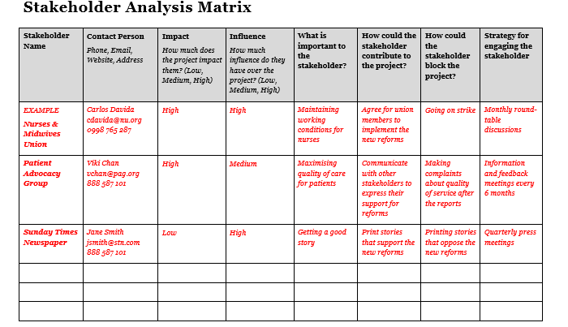

Slide 11
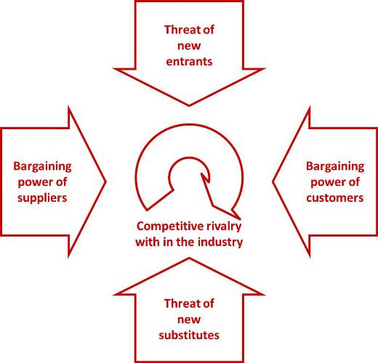
service area competitive analysis

Slide 12
Case Analysis Using the Strategic Thinking Maps
Tips on Formulating the Strategy
Effective Alternatives
Good alternatives possess speciﬁc characteristics;
They should be practical
Alternatives should be speciﬁc
Alternatives should be related to the key issue they are intended to address.
Alternatives should be usable
Alternatives should be ones that can be placed into action in a relatively short period of time
Alternative Evaluation
external/internal strategy matrix
PLC analysis
BCG portfolio analysis
extended portfolio matrix analysis
SPACE analysis, or program evaluation
show the ends–means decision logic for each strategic initiative and provide an excellent overview of the strategy of the organization.

Slide 13
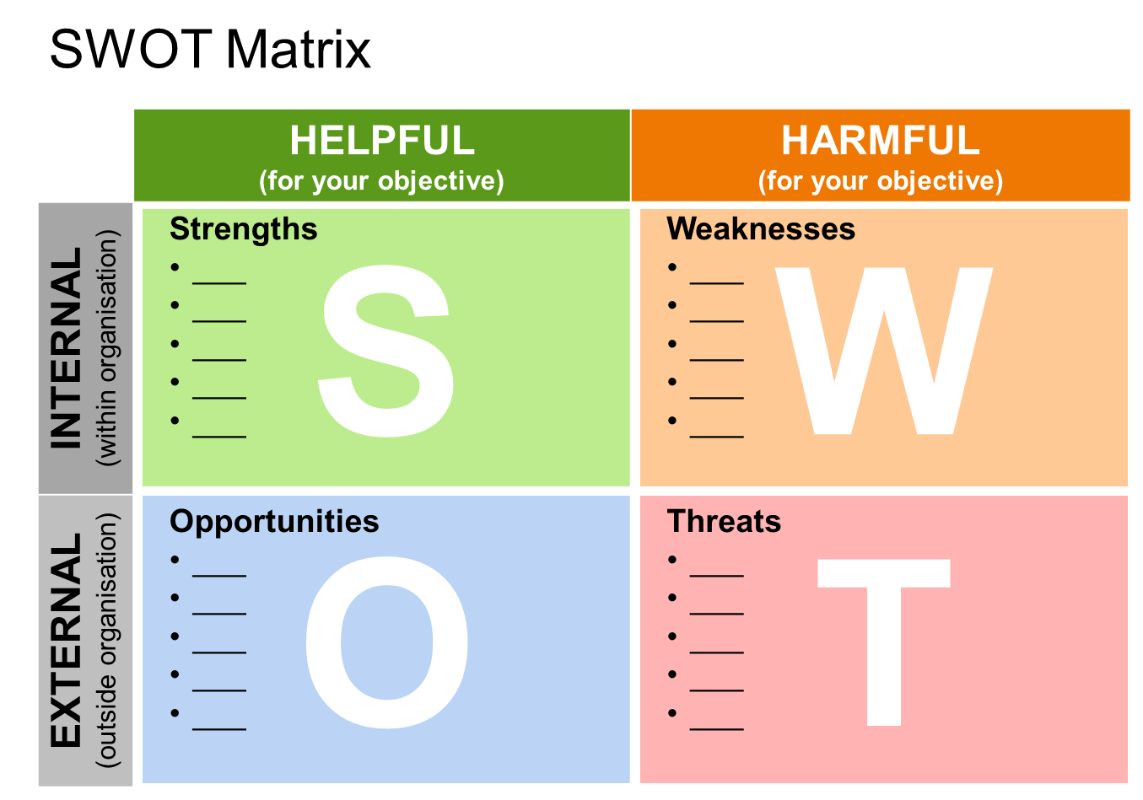

Slide 15
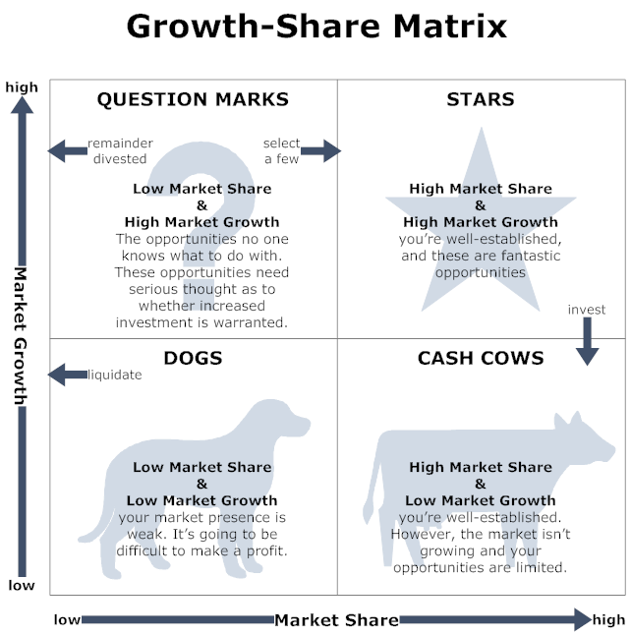

Slide 16
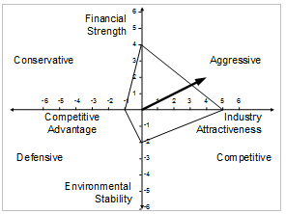

Slide 17
Case Analysis Using the Strategic Thinking Maps
Tips on Developing Implementation Strategies
“How does the group accomplish the work in the most effective and efﬁcient way possible?”
Value-adding service delivery and support strategies must be developed as well as action plans.
Objectives, action plans, and budgets should be addressed
Responsibility for accomplishing the different groups of tasks must be clearly assigned

Slide 18
Case Analysis Using the Strategic Thinking Maps
Making Recommendations
It will be particularly useful to ask the following questions when making recommendations:
● Does the health care organization have the ﬁnancial resources needed to make the recommendation work?
● Does the organization have the personnel with the right skills to accomplish what will be required by each recommendation?
● Does the organization have methods to monitor whether or not the recommendations are being accomplished?
● Is the timing right to implement each recommendation? If not, when will the timing be right? Can the organization afford to wait?

Slide 19
Case Analysis Using the Strategic Thinking Maps
Finalizing the Report
Decision making is the intended result of the report.
entire report should be brief enough to encourage people to read it and
comprehensive enough to ensure that no major factors are overlooked – especially those that might adversely affect the decision.
charts and ﬂow diagrams can be effective.
a case analysis report include:
● Executive summary –the accumulated facts and data.
● Body of the case report
– Key Issues : with the rationale for focusing on them.
– Situational Analysis : results of the external environmental analysis, service area competitor analysis, and internal environmental analysis, as well as analysis of the directional strategies.
– Strategy Formulation : feasible alternatives for directional, adaptive, market entry, and competitive strategies.
– Recommendation : analysis of the feasible alternatives, and which one or ones is/are recommended.
– Implementation Strategies : service delivery and support strategies with linkage to the directional, adaptive, market entry, and competitive strategies.
– Benchmarks for Success and Contingency Plans
- Conclusions

Slide 20
Conclusions
The analyst must keep in mind that case analysis is a logical process that involves:
clearly deﬁning strategic issues;
understanding the situation – the organization, service area/service category, and environment;
developing a strategy to enable the organization to accomplish its mission and vision; and
formulating an implementation plan.

Slide 21
http://asqhcd.org/pages/left-nav-sidebar/hcd-case-studies/

