Slide 1
Organization of the Nervous System, and Supporting Cells.
An-Najah National University
Faculty of Medicine
Department of Physiology
Anatomy and Physiology 1
7102101
Instructor: Heba Salah
Chapter 5:
The Nervous System
Part 2: Neurons

Slide 2
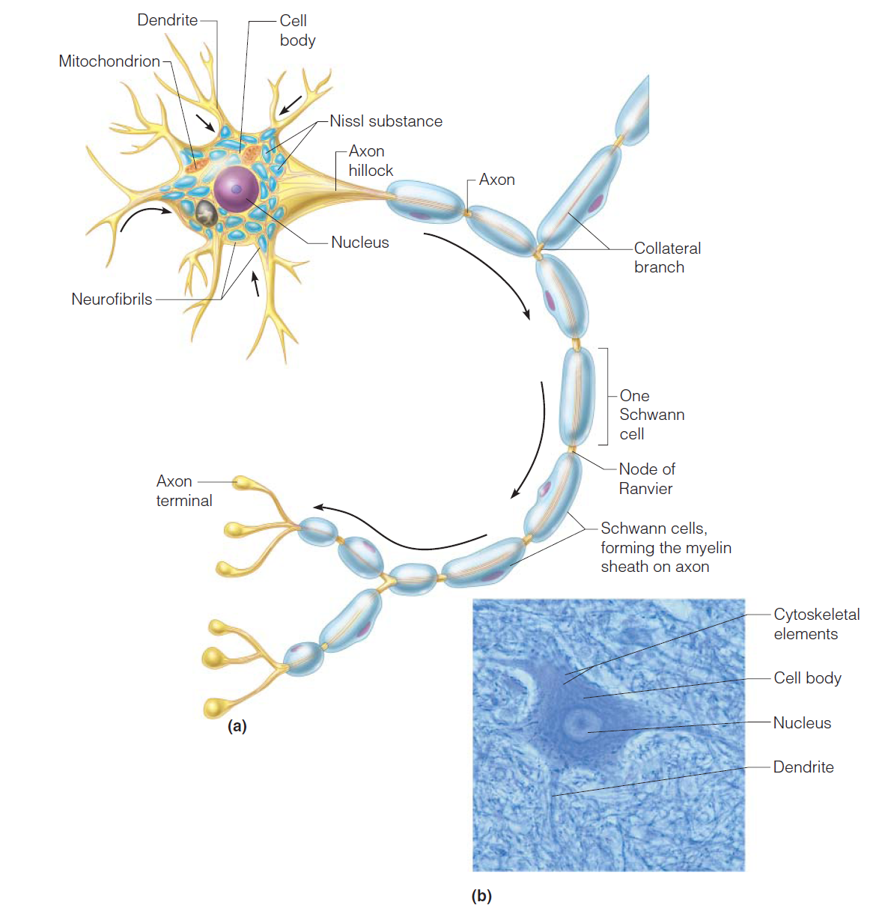
Neurons Anatomy
Neurons = nerve cells
Cells specialized to transmit messages
Major regions of neurons:
1. Cell body – nucleus and metabolic center of the cell
2. Processes – fibers that extend from the cell body (dendrites and axons)

Slide 3
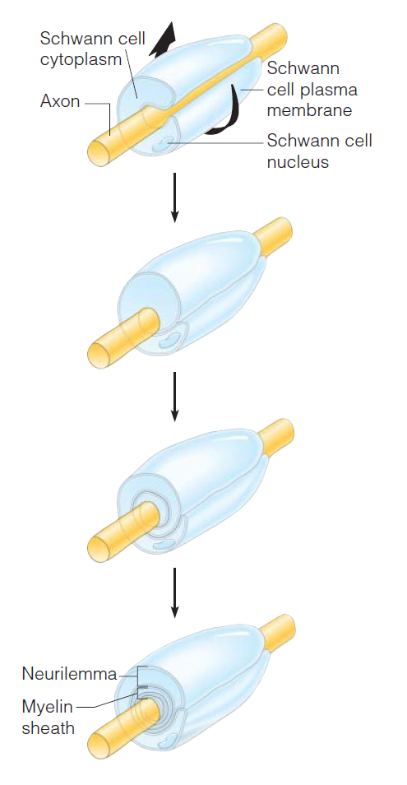
Nerve Fiber Coverings
1. Schwann cells – produce myelin sheaths in jelly-roll like fashion
2. Nodes of Ranvier – gaps in myelin sheath along the axon

Slide 4
Neuron Cell Body Location
Most are found in the central nervous system:
1. Gray matter – cell bodies and unmylenated fibers
2. Nuclei – clusters of cell bodies within the white matter of the central nervous system
Ganglia – collections of cell bodies outside the central nervous system

Slide 5
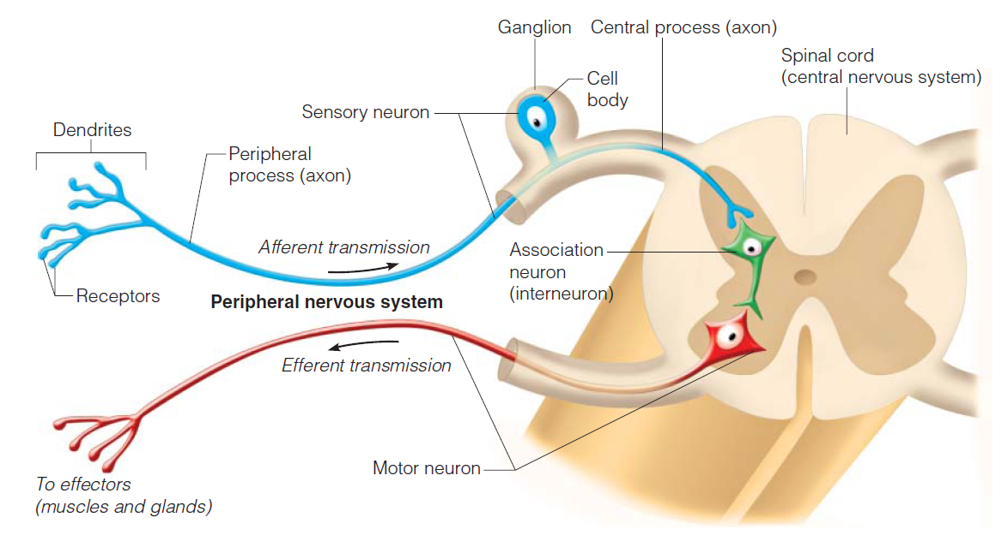
Functional Classification of Neurons

Slide 6
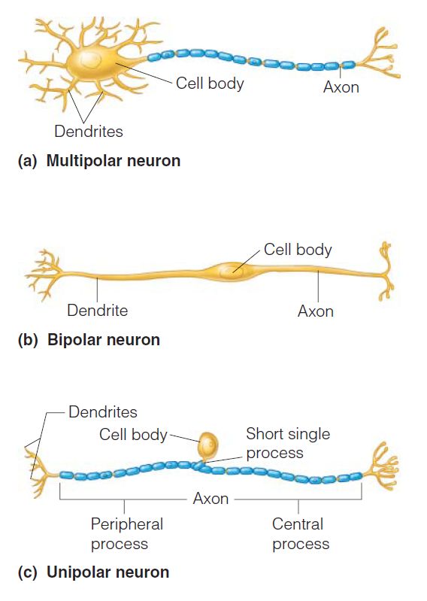
Structural Classification of Neurons
Multipolar neurons – many extensions from the cell body
Bipolar neurons – one axon and one dendrite
Bipolar neurons – one axon and one dendrite

