Slide 1
An-Najah National University
Faculty of Medicine
Department of Physiology
Anatomy and Physiology 1
7102101
Instructor: Heba Salah
Chapter 3:
The Skeletal System
Part 8: Joints

Slide 2
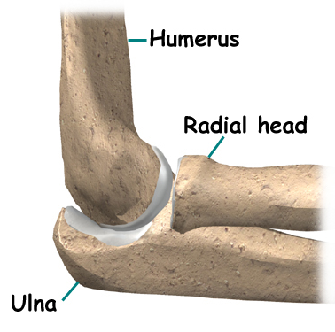
Joints
Articulations of bones
Functions of joints:
Hold bones together
Allow for mobility
Ways joints are classified:
Functionally
Structurally

Slide 3
Classifications of Joints
Functional Classification of Joints:
Synarthroses – immovable joints
Amphiarthroses – slightly moveable joints
Diarthroses – freely moveable joints
Structural Classification of Joints:
Fibrous joints: Generally immovable
Cartilaginous joints: Immovable or slightly moveable
Synovial joints: Freely moveable

Slide 4
Fibrous Joints

Slide 5
Cartilaginous Joints

Slide 6
Synovial Joints

Slide 7
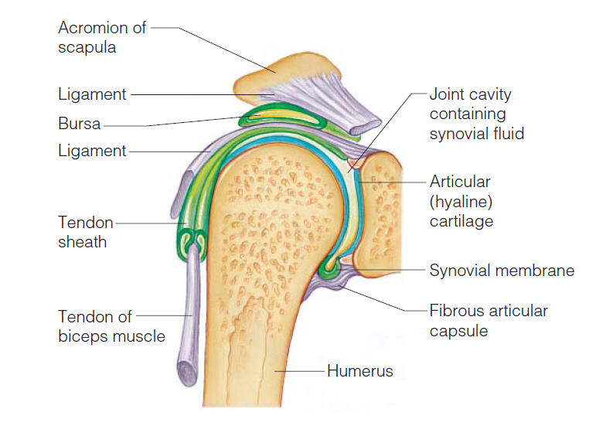
The General Structure of Synovial Joint

Slide 8
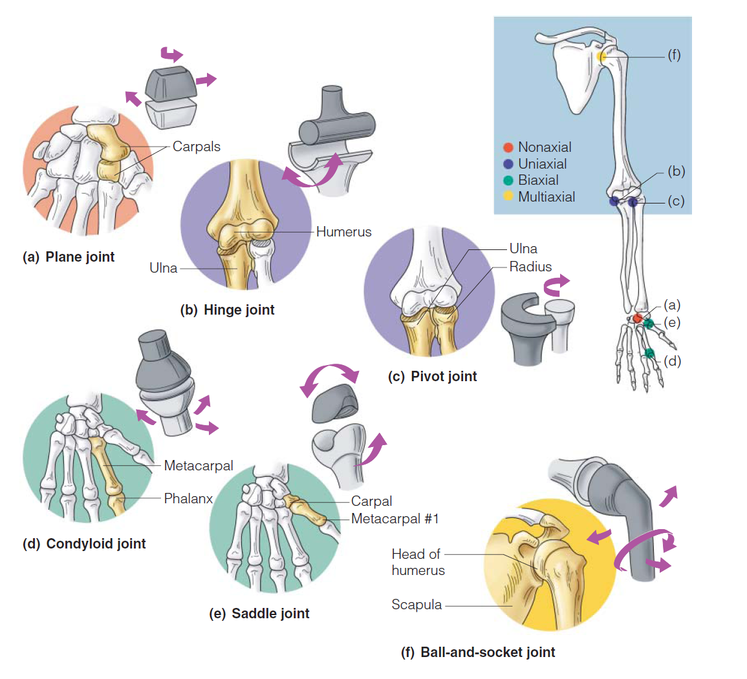
Types of Synovial Joints Based on Shape

