Slide 1
Marker Assisted Selection
(MAS)

Slide 2
Types of markers
Morphological markers
Seed color e.g. Kernel color in maize
Function based e.g. Plant height associated with salt tolerance in rice
Molecular markers
Non-DNA such as isozyme markers: Restricted due limited number of enzyme systems available.
DNA based markers: Markers based on the differences in the DNA profiles of individuals

Slide 3
Some molecular markers are pieces of DNA that have no know function or impact on plant performance (Linked Markers):
Detected via mapping.
Linked markers are near the gene of interest and are not part of the DNA of the gene.
Other markers may involve the gene of interest itself (Direct Markers):
Based on part of the gene of interest.
Hard to get but great once you have it.

Slide 4
What is MAS?
Concept of using molecular markers particularly DNA based to detect and track presence of gene transfer in breeding programs
MAS works on the principle of linkage dis-equilibrium where markers that are tightly linked to target genes segregate together in a non random manner (due linkage)

Slide 5
Advantages of MAS

Slide 6
Improvement of response to selection (Rs)
Assays require small amount of tissue, therefore no destructive sampling.
Use of codominant markers allows accurate identification of individuals for scoring without ambiguity
Multiple sampling for various QTLs is possible from same DNA prep
Can assay for traits before they are expressed, e.g. before flowering
Time saving.

Slide 7
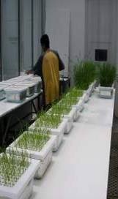
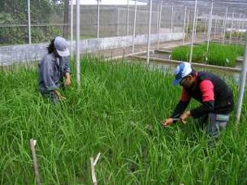
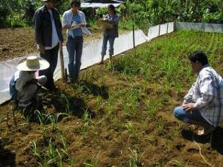
CONVENTIONAL PLANT BREEDING
P₁
x
P₂
Recipient
Donor
F₁
large populations consisting of thousands of plants
F₂
PHENOTYPIC SELECTION
Salinity screening in phytotron
Bacterial blight screening
Phosphorus deficiency plot
Glasshouse trials
Field trials

Slide 8
MARKER-ASSISTED BREEDING
P₁
x
P₂
Susceptible
Resistant
F₁
large populations consisting of thousands of plants
F₂
MARKER-ASSISTED SELECTION (MAS)
Method whereby phenotypic selection is based on DNA markers

Slide 9
Requirements for a useful molecular marker
Molecular markers must be tightly linked to a target gene. The linkage must be really tight such that the presence of the marker will reliably predict the presence of the target gene.
The marker should be able to predict the presence of the target gene in most if not all genetic backgrounds.

Slide 10
MAS
Marker 1 (more tightly linked than 2)
1
2
Target gene

Slide 11
-
Marker
Plant A
Plant B
Plant C
Monomorphic bands
Polymorphic bands
+
Presens of a band, ”1”
Absence of a band, ”0”

Slide 12
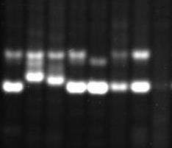
Markers must be polymorphic
RM84
RM296
1 2 3 4 5 6 7 8
1 2 3 4 5 6 7 8
P₁ P₂
P₁ P₂
Not polymorphic
Polymorphic!

Slide 13
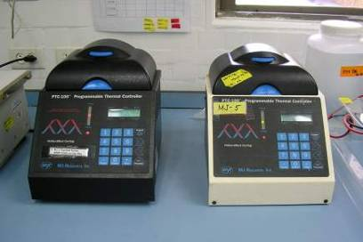
PCR-based DNA markers
Generated by using Polymerase Chain Reaction
Preferred markers due to technical simplicity and cost
PCR Buffer +
MgCl₂ +
dNTPS +
Taq +
Primers +
DNA template
PCR
THERMAL CYCLING
GEL ELECTROPHORESIS
Agarose or Acrylamide gels

Slide 14
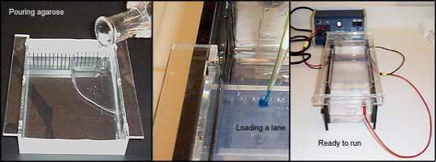
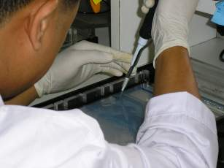
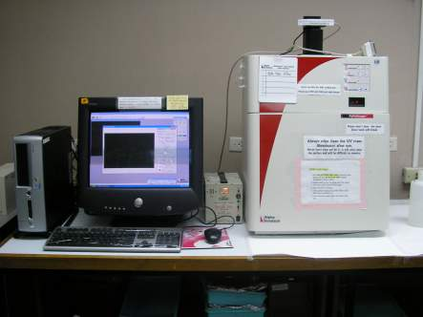
Agarose gel electrophoresis
UV transilluminator
UV light

Slide 15
Conditions under which MAS is valuable
Low heritability traits
Traits too expensive to score: Soybean Cyst Nematode (SCN) resistance. Young (1999)
Recessive genes: Pyramiding of dominant and recessive genes conferring resistance to important crop diseases which would otherwise be very difficult
Multiple genes (Quantitative traits): QTLs underlying phenotypic and physiological traits can be traced using markers.
Quarantine: No need to grow plants to screen for viral diseases that can not be visually detected, and small tissues can be used for DNA typing.

Slide 16
Limitations of MAS
Cost of equipment, reagents and personnel.
Data collected in the field is assumed to be normally distributed, but usually is not.
Integration of the DNA information into existing systems is difficult.
Linkage drag. As the marker distance from the target gene increases, more of the donor DNA is retained in the desired background resulting in need for more backcrosses.

