Slide 1
Human Nutrition
Alma Irshaid
Mon/Wed

Slide 2
CHAPTER OBJECTIVES
What is nutrition, its roles?
Difference between essential and non-essential nutrients
Understand some of the basic nutritional terms
Classes and functions of nutrients
Caloric value of energy-yielding nutrients

Slide 3
Define Nutrition..
Science of food
Nutrients
Substances
Action, interaction and balance
Relation to health and diseases
Digestion, absorption, transportation, utilization and excretion
A broader definition includes the social, economic, cultural, and psychological implications of food and eating.

Slide 4
Foods: products derived from plants or animals that can be taken into the body to yield energy and nutrients for the maintenance of life and the growth and repair of tissues.
Diet: the foods and beverages a person eats and drinks.

Slide 5
Why Do We Eat?
Biological reason– must supply our cells with energy and building blocks
Social Reasons
Choices depend on many factors
Diet as child
Ethnicity
Socio-economic status
Advertising
Flavor, texture

Slide 6
Role of Nutrition
Developing and maintaining optimal health
Poor diet and sedentary lifestyle may contribute to death
Risk factors and chronic diseases ( CVD, Strokes, hypertension, diabetes,..)

Slide 7
Ten leading Causes of Death in the world
For more details:p http://www.who.int/mediacentre/factsheets/fs310/en/
Notes:
Pneumonia: Inflammation of lungs

Slide 10
Nutrients Vs. Food
Food → energy + nutrients
Essential vs. Inessential
Examples on essential:
Essential amino acids
Essential fatty acids (linoleic acid and alpha-linolenic)
Vitamins
Dietary minerals

Slide 11
Characteristics of essential nutrients
Specific biological function.
Body cannot synthesize enough amounts needed for physiological function.
Normal functionality can be regained if the substance is regained before permanent damage occurs

Slide 12
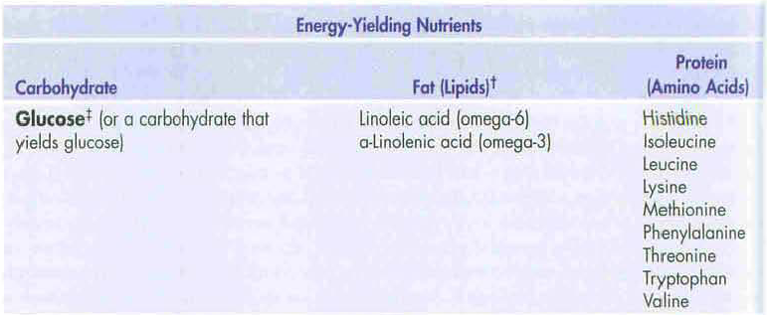
Essential Nutrients in the Human Diet and Their Classes

Slide 13
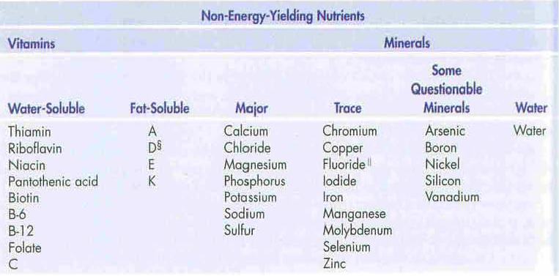

Slide 14
Dietary problems
Lack of enough consumption of essential nutrients
Younger years
Later in life
Examples:
Osteoporosis.
Iron-deficiency anemia

Slide 15
Taking too much of a nutrient supplements
Vitamin A, vitamin B6, calcium, or copper can be harmful to organs (Toxicity)
3. Alcohol
Cirrhosis, some cancers

Slide 16
Terms to be fully understood
Anemia: A reduction in the oxygen-carrying capacity of the blood.
Iron deficiency
Blood loss
Body mass index (BMI): Weight (in kilograms) divided by height in meters) squared.
Cancer: Uncontrolled growth of abnormal cells (mutations)

Slide 17
Carbohydrate: A compound containing carbon, hydrogen, and oxygen atoms
Sugars, starches, and fibers
4 kcal/g.
Cardiovascular (heart) disease: Any disease of the heart and circulatory system.
Atherosclerosis
Coronary Heart Disease (CHD)

Slide 18
Cholesterol: A waxy lipid found in all body cells; it has a structure containing multiple chemical rings (steroid structure).
Only in foods that contain animal products.
Chronic: long-standing, developing over time.
Vs. acute
Cardiovascular disease, kidney diseases, DM.

Slide 19
Cirrhosis: replacement of functioning liver cells with a non-functioning, connective tissues
Alcohol
Diabetes: A disease characterized by high blood glucose
Lack or Insufficient insulin production
Insulin resistance
Type1 vs. type2

Slide 20
Fat: Carbon and hydrogen, with relatively small amounts of oxygen and other elements
9 kcal/g
Hypertension: Elevated blood pressure
- Risk factors: Obesity, inactivity, alcohol, excess salt intake

Slide 21
kilocalorie (kcal): The heat energy needed to raise the temperature of 1000 g (1 liter) of water 1°Celsius.
Calorie, with a capital C.
Minerals: Elements (iron, calcium, zinc, ..)
Promote chemical reactions
Form body structures.

Slide 22
Obesity: A condition characterized by excess body fat.
Body mass index (BMI) > 30 or above.
Osteoporosis: Decreased bone mass.
Risk factors: Age, genetics, diet, hormonal changes

Slide 23
Protein: amino acids
Contain carbon, hydrogen, oxygen, nitrogen, and sometimes other atoms
4 kcal/g
Stroke: A blood clot or other changes in the artery that supplies the brain with oxygenated blood.
Death of brain tissue.

Slide 24
Vitamins: Compounds needed to regulate and support chemical reactions in the body
Needed in small amounts
Fat or water soluble
Water: The universal solvent; chemically, H20 . The body is composed of up to 75% water.

Slide 25
Classes of Nutrients
Carbohydrates
Lipids
Proteins
Vitamins
Minerals
Water

Slide 26
Macronutrients vs. Micronutrients

Slide 27
Functions of Nutrients
Provide the body with energy: kilocalories (kcal);
Carbohydrates
Proteins
Lipids
Alcohol (Provides energy, however not a nutrient)

Slide 28
Growth and development
Proteins
Lipids
Some vitamins
Some minerals
Water

Slide 29
Regulation of body function
Proteins
Some lipids
Some vitamins
Some minerals
Water

Slide 30
Non-Nutrient Components
Phytochemicals

Slide 31
Mode of action of phytochemicals :
Phytochemicals are derived from plant based foods ONLY and have a biological activity in the body.
Phytochemicals act as:
Antioxidants (lycopenes)
Mimicking hormones (Phytoestrogens)
Supressing the development of disease (cancer)

Slide 32
How to increase our intake of phytochemicals?
Add vegetables to our meals (side dishes)
Broccoli, mushrooms, peas, carrots or corn to rice, pasta, omelets and potato
Choose fruit flavored/filled sweets
Fruits pudding, fruity breakfast bars, …
Have a combination of cooked and fresh fruits and vegetables.

Slide 33
Use fresh or dried fruit for snacks
Add slices of vegetables to the sandwiches
Choose fruit or vegetable juices instead of soft drinks (fresh and varied)
Use whole-grain options

Slide 35
Energy Sources and Uses
Carbohydrates, proteins and fat
One type of food provides many energy sources
except: plant oils which provide 100% fat

Slide 36
Then the energy (found in carbs, protein, fat) is transformed to other forms to:
Build tissue and other components
Muscle’s movement
Nerves transmissions
Ion’s balance (ECF/ICF)

Slide 37
Calculate the energy in food
4 kcal for carbohydrates
4 kcal for protein
9 kcal for Fat
7 kcal for alcohol

Slide 38
Example:
Calculate the caloric content of this burger sandwich which contains:
Carbohydrate 39 grams
Protein 30 grams
Fat 32 grams

Slide 39
Carbohydrate: 39 grams X 4 = 156 kcal
Protein: 30 grams X 4 = 120 kcal
Fat : 32 grams X 9 = 288 kcal
→ Total: 156 + 120 + 288 = 564 kcal

Slide 40
Total kcal consumed per day and the percentages of each nutrient can also be calculated using these estimates:
290 g of carbohydrates
70 g of protein
60 g of fat
→ [290 X 4 ] + [70 X 4 ] + [60 X 9 ] = 1980 kcal.
This consumption yields a total of 1980 kcal

Slide 41
The percentage of each nutrient from the total energy intake can be calculated as following:
% of energy intake as carbohydrate = (290 X 4 ) 1980 = 0.5858 X 100 = ~59%
% of energy intake as protein = (70 X 4 ) 1980 = 0.1414 X 100 = 14%
% of energy intake as fat = (60 X 9 ) 1980 = 0.2727 X 100 = 27%

Slide 42
Acceptable Macronutrient Distribution Range (AMDR):
Range of intake for a specific macronutrient
providing for recomendad intakes of essential nutrients
Acceptable: it is associated with a reduced risk of chronic diseases
Guidance in dietary planning for carbohydrates, protein and fat

Slide 43
Generally:
45%to 65% as the percentage of carbohydrate intake from the total energy intake
10% to 35% percentage of protein
20% to 35% percentage of fat

