Slide 1
Fat Soluble Vitamins
Vitamins A, D, E and K

Slide 2
The fat-soluble vitamins are vitamins A, D, E, and K. Fat-soluble vitamins are found in the liver and the fatty tissues of the body where they are stored and used.
Fat-soluble vitamins require bile in order to be absorbed into the lymph system from the intestines.

Slide 3
Vitamin A
As long ago as 300 B.C., the Hippocratic School of Medicine recommended liver (rich in vitamin A) for children with night blindness or infections.
Vitamin A was the first vitamin discovered. In 1907, the fat-soluble vitamin A was found necessary for growth.
In 1930 it was learned that there were two related forms—beta-carotene and a fat-soluble Vitamin A.
Vitamin A was first synthesized in 1947.
Most of the vitamin A in the body is stored in the liver in the form of retinyl palmitate.

Slide 4
Vitamin A and Beta-Carotene
Also known as retinol, retinal, retinoic acid
Vitamin A is found in the body in compounds known as retinoids: retinol, retinal, and retinoic acid.
These have functional roles in vision, healthy epithelial cells, and growth.

Slide 6
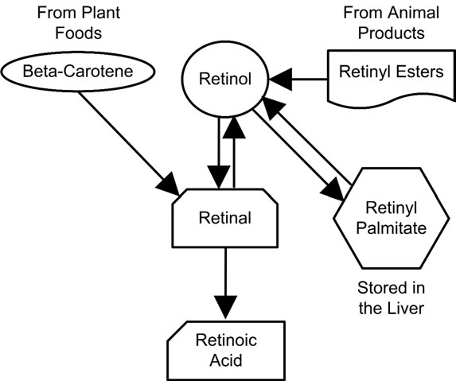

Slide 7
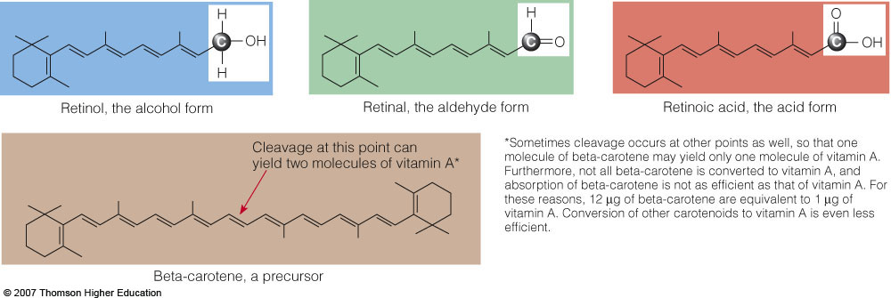

Slide 9
Vitamin A and Beta-Carotene
Vitamin A deficiency is a major health problem in the world.
Toxicity is often associated with abuse of supplements.
Plant foods provide carotenoids, such as beta-carotene, some of which have vitamin A activity.
Animal foods provide compounds that are easily converted to retinol.
Retinol binding protein (RBP) allows vitamin A to be transported throughout the body.

Slide 10
Vitamin A and Beta-Carotene
Roles in the Body
Vitamin A in Vision
Helps to maintain the cornea
Conversion of light energy into nerve impulses at the retina
Rhodopsin is a light-sensitive pigment of the retina that contains a protein called opsin.

Slide 11
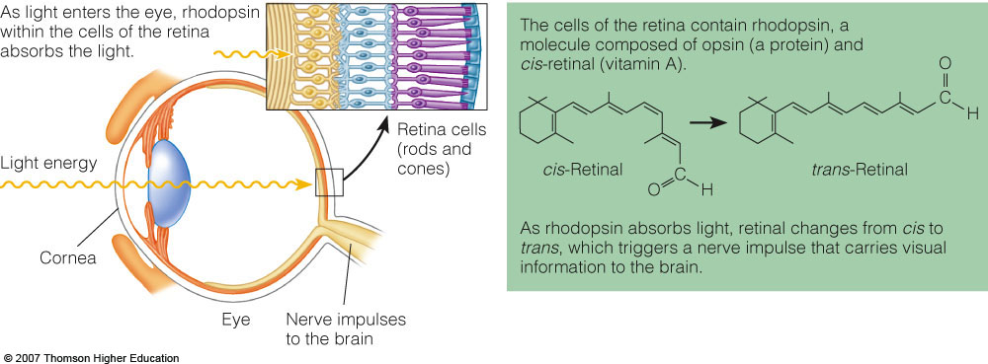

Slide 12
Vitamin A and Beta-Carotene
Roles in the Body
Vitamin A in Protein Synthesis and Cell Differentiation
Through cell differentiation, vitamin A allows cells to perform specific functions.
Epithelial cells
Epithelial tissues on the outside of the body form the skin.
Epithelial tissues on the inside of the body form the mucous membranes.

Slide 13
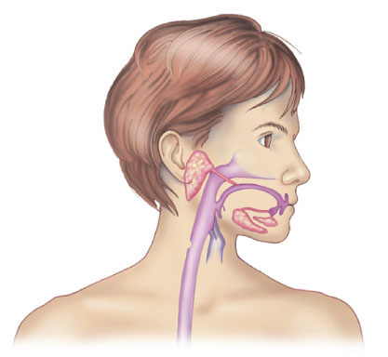
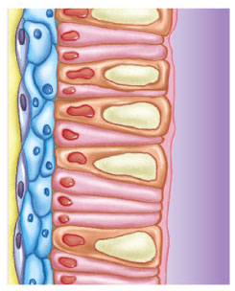
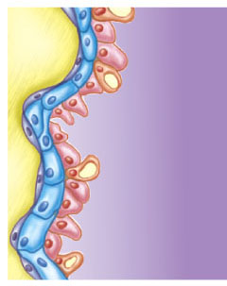
Without vitamin A, the normal structure and function of the cells in
the mucous membranes are impaired.
Vitamin A maintains healthy cells in the mucous membranes.
Mucus
Goblet cells
Stepped Art
Fig. 11-4, p. 372
Notes:
Figure 11.4: Mucous Membrane Integrity.

Slide 14
Vitamin A and Beta-Carotene
Roles in the Body
Vitamin A in Reproduction and Growth
Sperm development in men
Normal fetal development in women
Growth in children
Remodeling of the bone involves osteclasts, osteoblasts, and lysosomes.
Osteoclasts are cells that destroy bone growth.
Osteoblasts are cells that build bones.
Lysosomes are sacs of degradative enzymes that destroy bones.

Slide 15
Vitamin A and Beta-Carotene
Roles in the Body
Beta-Carotene as an Antioxidant
Beta-carotene helps protect the body from diseases, including cancer.

Slide 16
Vitamin A and Beta-Carotene
Vitamin A Deficiency
Because vitamin A is stored in the body, it would take a year or more to develop a deficiency in the presence of inadequate intake.
Infectious Diseases
Impaired immunity correlates with vitamin A deficiency in children.
The goals of worldwide health organizations include vitamin A supplementation.
Night Blindness
First detectable sign of vitamin A deficiency
Inability to see in dim light or inability to recover sight after a flash of bright light

Slide 18
Vitamin A and Beta-Carotene
Vitamin A Deficiency
Blindness
Xerophthalmia
Xerosis is the first stage where the cornea becomes dry and hard.
Keratomalacia is the softening of the cornea.
Keratinization
Epithelial cells secrete a protein called keratin—the hard, inflexible protein of hair and nails.
Changes in epithelial cells results in keratinization, rough, dry and scaly skin.
Deficiency disease is called hypovitaminosis A

Slide 19
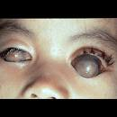
Xerophthalmia

Slide 20
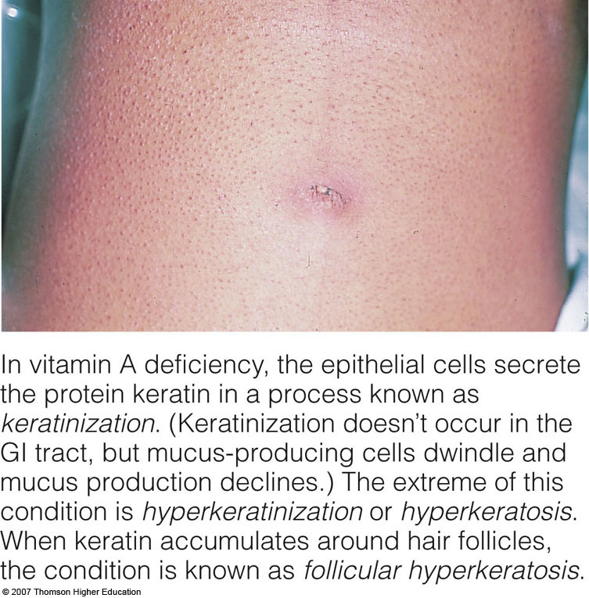

Slide 21
Vitamin A and Beta-Carotene
Vitamin A Toxicity
Can occur with concentrated amounts of the preformed vitamin A from animal foods, fortified foods, or supplements.
Consuming excessive amounts of beta-carotene from supplements can be harmful.
Bone Defects
Increased activity of osteoclasts causes weakened bones and contributes to osteoporosis and fractures.

Slide 22
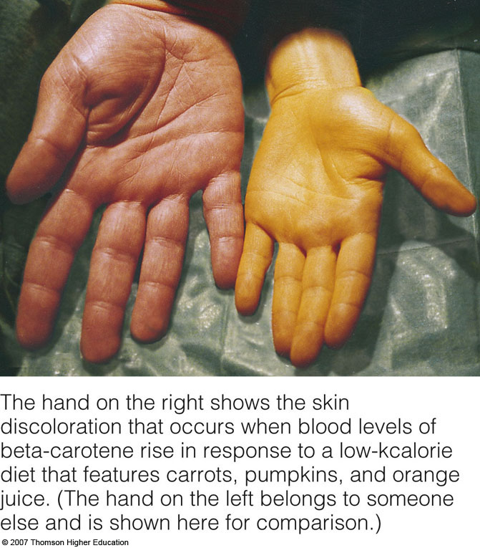

Slide 23
Vitamin A and Beta-Carotene
Vitamin A Toxicity
Birth Defects
Teratogenic risk is possible, resulting in abnormal fetal development and birth defects.
Vitamin A supplements are not recommended the first trimester of pregnancy.
Not for Acne
Massive doses for teens are not effective on acne.
Accutane is made from vitamin A, but is chemically different. It is toxic during growth and can cause birth defects.
Retin-A fights acne, the wrinkles of aging, and other skin disorders.

Slide 25
Vitamin A and Beta-Carotene
Vitamin A Toxicity
Toxicity is called hypervitaminosis A
Chronic toxicity symptoms include liver abnormalities.
Acute toxicity symptoms include blurred vision, nausea, vomiting, vertigo, headaches, and pressure in the skull.
Upper level for adults: 3000 μg/day

Slide 26
Vitamin A and Beta-Carotene
Vitamin A Recommendations (2001 RDA)
Expressed as retinal activity equivalents (RAE) because sources include all forms of retinoids and beta-carotene
RDA men: 900 μg RAE/day
RDA women: 700 μg RAE/day

Slide 27
Vitamin A and Beta-Carotene
Vitamin A in Foods
Retinol is found in fortified milk, cheese, cream, butter, fortified margarine, and eggs.
Beta-carotene
Spinach and other dark green leafy vegetables (chlorophyll pigment masks the color)
Deep orange fruits like apricots and cantaloupe
Deep orange vegetables like squash, carrots, sweet potatoes, and pumpkin
White foods are typically low in beta-carotene.
Liver is rich in vitamin A.

Slide 28
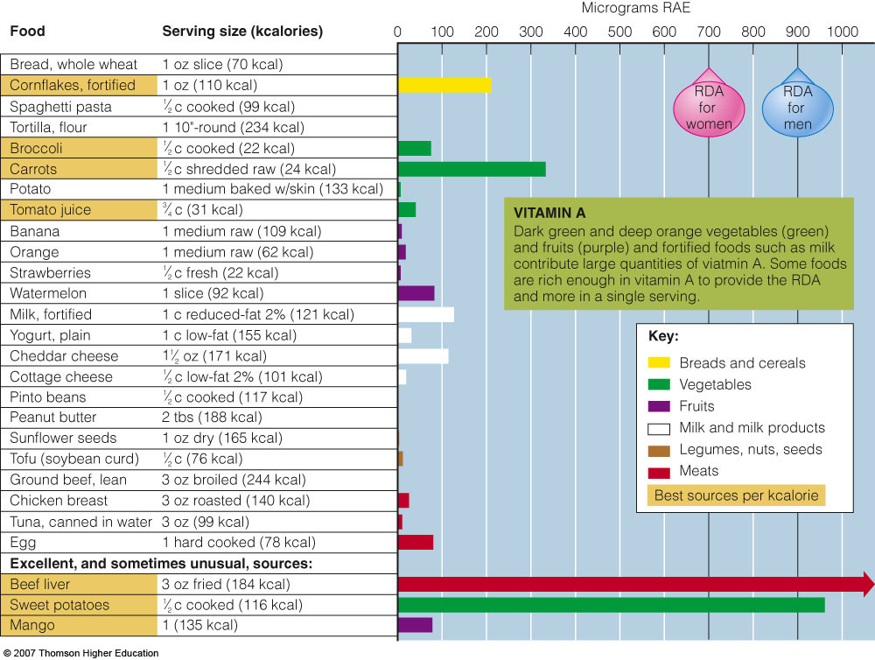

Slide 29
Vitamin A status assessment
Vitamin A status may be assessed in a variety of ways, including:
histological tests,
biochemical measures,
and functional tests.
These tests include assessing for night blindness or dark adaptation threshold.
Electrophysiological measurements made by electroretinograms measure the level of rhodopsin and its rate of regeneration.
Conjunctival impression cytology (CIC), a histological method of assessment, involves examining the eye.
The conjunctiva is examined for changes, specifically a reduction in goblet cells and the derangement of epithelial cells, that occur with impaired vitamin A status

Slide 30
Plasma retinol concentrations are frequently measured as a biochemical indicator of vitamin A status. Plasma retinol levels reflect status best if the person has exhausted his or her stores
Use of plasma retinol concentrations, depends on the adequacy of dietary energy, protein, and zinc because of their roles in the synthesis of retinol-binding protein.
Moreover, use of plasma retinol is unreliable as an indicator of vitamin A status in people with infection or inflammation, both of which depress plasma concentrations of the vitamin

Slide 31
Vitamin D
Vitamin D is a nonessential nutrient that acts like a hormone in the body.
The body can make vitamin D with help from sunlight.

Slide 32
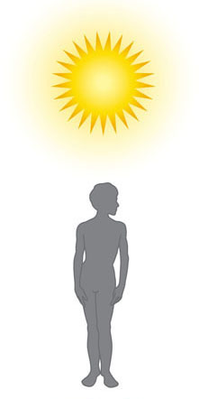
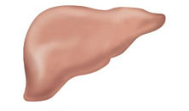
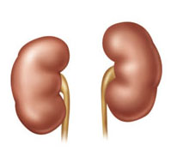
In the skin:
7-dehydrocholesterol
(a precursor made in the liver from cholesterol)
Ultraviolet light from the sun
Previtamin D₃
Foods
Vitamin D₃
(an inactive form)
In the liver:
Hydroxylation
25-hydroxy vitamin D₃
In the kidneys:
Hydroxylation
1,25-dihydroxy vitamin D₃ (active form)
Stepped Art
Fig. 11-9, p. 377
Notes:
Figure 11.9: Animated! Vitamin D Synthesis and Activation.
The precursor of vitamin D is made in the liver from cholesterol (see Figure 5-11 on p. 147 and Appendix C). The activation of vitamin D is a closely regulated process. The final product, active vitamin D, is also known as 1,25-dihydroxycholecalciferol (or calcitriol).

Slide 33
Vitamin D
Roles in the Body
Vitamin D in Bone Growth
Helps to maintain blood levels of calcium and phosphorus
Works in combination with other nutrients and hormones
Vitamin A, vitamin C, vitamin K
Parathyroid hormone and calcitonin
Collagen
Calcium, phosphorus, magnesium, and fluoride

Slide 34
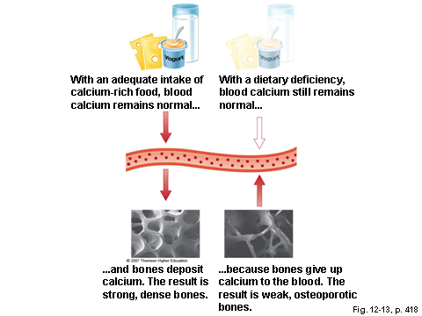
Vitamin D

Slide 35
Vitamin D
Roles in the Body
Vitamin D in Other Roles
Immune system
Brain and nervous system
Pancreas, skin, muscles, cartilage, and reproductive organs

Slide 36
Vitamin D
Vitamin D Deficiency
Factors that contribute to deficiency
Dark skin
Breastfeeding without supplementation
Lack of sunlight
Use of nonfortified milk

Slide 37
Vitamin D Deficiency
Rickets
Affects mainly children worldwide
Deficiency symptoms
Inadequate calcification of bones
Growth retardation
Misshapen bones- bowing of the legs
Enlargement of the ends of long bones
Deformities of ribs,
Lax muscles (resulting in a protruding abdomen) and muscle spasms

Slide 38
Vitamin D Deficiency
Osteomalacia
Affects adults
Soft, flexible, brittle, deformed bones
Progressive weakness
Pain in pelvis, lower back, and legs

Slide 39
Vitamin D Deficiency
Osteoporosis
Loss of calcium from the bones due to inadequate synthesis of vitamin D
Results in a reduced bone density
How can vitamin D affect the bone mineralization?
The Elderly
Deficiency is likely due to inadequate production and activation of vitamin D ( old skin, old liver , old kidney) , a decreased consumption of milk, and having little time in the sun.
There is an increased risk for bone loss and fractures.

Slide 40
Vitamin D Toxicity
More likely compared to other vitamins
Vitamin D from sunlight and food is not likely to cause toxicity.
High-dose supplements may cause toxicity.
Toxicity symptoms
Elevated blood calcium
Calcification of soft tissues (blood vessels, kidneys, heart, lungs, and tissues around joints)
Frequent urination

Slide 41
Vitamin D
Vitamin D Recommendations (1997 Adequate Intake) and Sources
AI 5 μg/day for adults 19-50 years old
AI 10 μg/day for adults 51-70 years old
AI 15 μg/day for adults if older than 70 years of age

Slide 42
Vitamin D Recommendations
Vitamin D in Foods
Fortified milk, butter, and margarine
Cereals
Chocolate mixes
Veal, beef, egg yolks, liver, fatty fish and their oils (Cod liver oil)
Vegans may need fortification or supplements if they do not have adequate sun exposure.

Slide 43
Vitamin D Recommendations
Vitamin D from the Sun
Synthesized in the body from cholesterol
SPF of 8 or above prevents the synthesis of vitamin D from sunlight.
Can be obtained from tanning beds depending on type of UV radiation.

Slide 44
Rickets Belt

Slide 45
Assessment of vitamin A status
The plasma concentration of 25-OH D3 (calcidiol) is often used as an index of vitamin D status.
Concentrations <~37 nmol/L (15 ng/mL) are associated with subclinical deficiency,
and concentrations <28 nmol/L (11 ng/mL) suggest vitamin D deficiency.
Newer findings report insufficient vitamin D status with circulating 25-OH D3 concentrations of <80 nmol/L (32 ng/mL); a concentration of 80 nmol/L is associated with a plateau in PTH concentrations .
Optimal serum 25-OH D3 concentrations are suggested as 80–120 nmol/L or about 30–60 ng/mL[14,26].
Toxicity is considered when serum 25-OH D3 concentrations typically exceed 375 nmol/

Slide 46
Vitamin E
There are four different tocopherol compounds, but only the alpha-tocopherol has vitamin E activity in human beings.
Vitamin E as an Antioxidant
Stops the chain reaction of free radicals
Protection of polyunsaturated fatty acids and vitamin A
Protects the oxidation of LDLs ( oxidized LDL is a threat to your cardiovascular health)

Slide 47
Vitamin E Deficiency
Primary deficiency due to inadequate intake is rare
Erythrocyte hemolysis ( mechanism? )
Occurs in premature infants
Hemolytic anemia can be treated with vitamin E.

Slide 48
Vitamin E
Vitamin E Deficiency - Symptoms
Loss of muscle coordination and reflexes
Impaired vision and speech
Nerve damage
Erythrocyte hemolysis (breaking open of red blood cells)
Supplements do not prevent or cure muscular dystrophy.
Fibrocystic breast disease responds to vitamin E treatment.
Intermittent claudication responds to vitamin E treatment.

Slide 49
Vitamin E
Vitamin E Toxicity
Rare and the least toxic of the fat-soluble vitamins
Upper level for adults: 1000 mg/day
May augment the effects of anticlotting medication
Vitamin E Recommendations (2000 RDA)
RDA adults: 15 mg/day

Slide 50
Vitamin E in Foods
Polyunsaturated plant oils such as margarine, salad dressings, and shortenings
Leafy green vegetables
Wheat germ
Whole grains
Liver and egg yolks
Nuts and seeds
Easily destroyed by heat and oxygen

Slide 51
Assessment
Accurately evaluating vitamin E status in humans remains difficult with current techniques. Normal serum vitamin E concentrations range from about 5 to 20 μg/mL in adults, and values <5 μg/mL indicate deficiency. In vitamin E deficiency, plasma α-tocopherol concentrations correlate with vitamin E intake

Slide 52
A crude estimate of vitamin E status can be obtained from an erythrocyte hemolysis test that compares the amount of hemoglobin released by red cells during incubation with dilute hydrogen peroxide with the amount released during distilled water incubation. The result is expressed as a percentage, with >20% indicating deficiency
Concentrations of α-tocopherol of 6 μg/mL are usually sufficient to prevent hemolysis; however, variables other than vitamin E status influence in vitro hemolysis

Slide 53
Vitamin K
Also known as phylloquinone, menaquinone, menadione, and naphthoquinone
Vitamin K is unique in that half of human needs are met through the action of intestinal bacteria.
Vitamin K is essential in blood clotting.
deficiency can cause uncontrolled bleeding.
Deficiencies can occur in newborn infants and people taking antibiotics.

Slide 54
Vitamin K
Roles in the Body
Synthesis of blood-clotting proteins
Synthesis of bone proteins that regulate blood calcium
Without vitamin K, a hemorrhagic disease may develop.
Hemophilia is a hereditary disorder and is not cured with vitamin K.

Slide 55
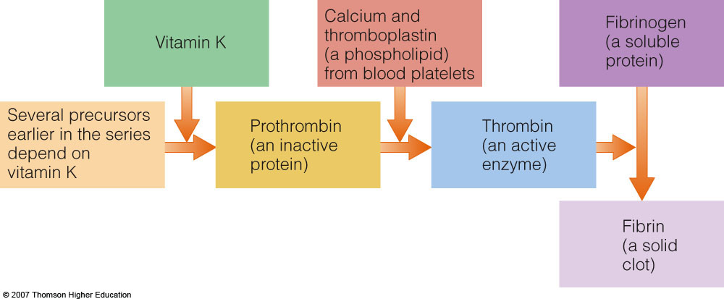

Slide 56
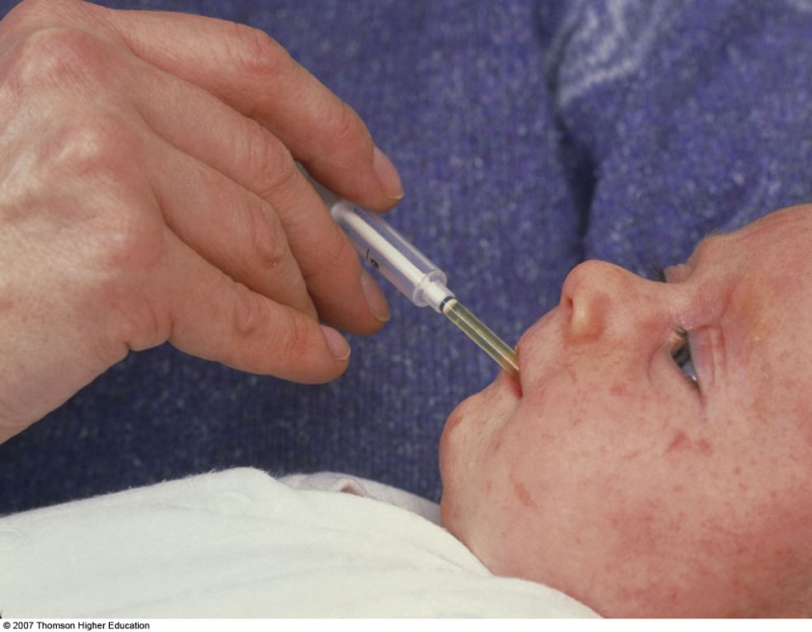
Vitamin K
Vitamin K Deficiency
Symptoms include hemorrhaging
Secondary deficiencies may occur with use of antibiotics.
Newborn infants receive a single dose of vitamin K at birth because of a sterile intestinal tract.

Slide 57
Vitamin K
Vitamin K Toxicity
Uncommon
No known toxicities
High doses can decrease the effectiveness of anticlotting medications.

Slide 58
Vitamin K
Vitamin K Recommendations (2001 AI) and Sources
AI men: 120 μg/day
AI women: 90 μg/day
Vitamin K Sources
Bacterial synthesis in the digestive tract
Significant Food Sources
Liver
Leafy green vegetables and cabbage-type vegetables
Milk

Slide 59
Assessment
Plasma or serum concentrations of phylloquinone have been shown to reflect recent (within about 24 hours) intake of the vitamin
Whole blood clotting times and prothrombin (or other blood-clotting proteins) time are routinely measured and used to identify potential deficiency of vitamin K.
A normal prothrombin time is considered to be between about 11 and 14 seconds; times greater than 25 seconds are associated with major bleeding and may indicate possible vitamin K deficiency.

Slide 60
The Fat-Soluble Vitamins--In Summary
The function of fat-soluble vitamins depends on the presence of other fat-soluble vitamins.
There are many interactions of fat-soluble vitamins with minerals.
It is important to eat a wide variety of foods every day.

Slide 61
Antioxidant Nutrients in Disease Prevention

Slide 62
Antioxidant Nutrients in Disease Prevention
Oxidants are compounds in the body that oxidize other compounds.
Antioxidants have a role in preventing oxidation, and thus assist in the prevention of chronic disease.
Researchers and medical experts are still clarifying the roles of these nutrients in relationship to health and disease.

Slide 63
Free Radicals and Disease
Produced by normal body processes and environmental factors such as ultraviolet light, air pollution and tobacco smoke
Free radicals are highly unstable due to unpaired electrons and are often damaging.
Antioxidants stabilize free radicals and protect against oxidative stress.
Cognitive performance, aging, cancer, arthritis, cataracts and heart disease may be protected with antioxidants.

Slide 64
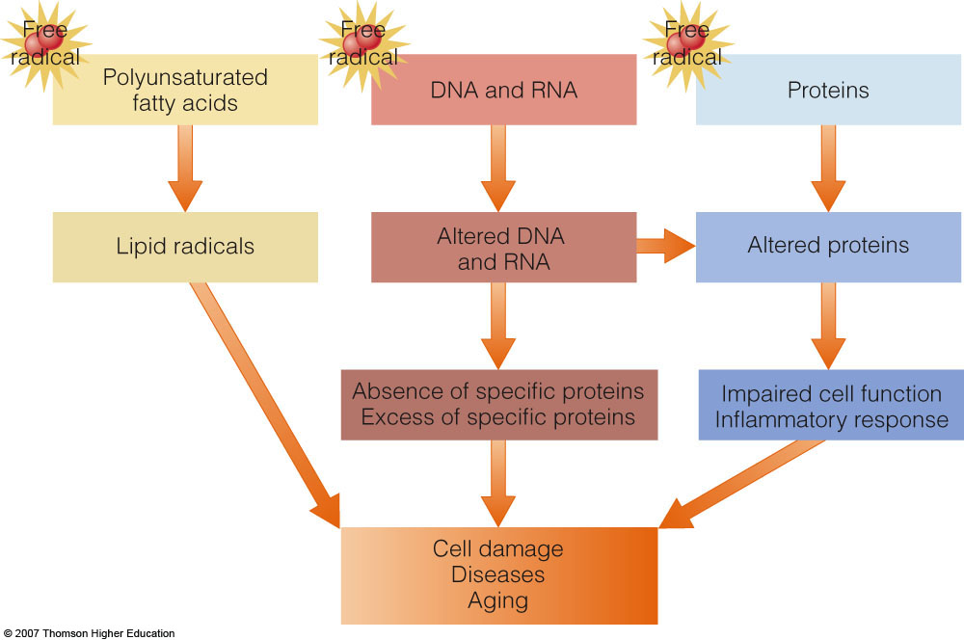

Slide 65
Defending against Free Radicals
Limiting free radical formation
Destroying free radicals or their precursors
Stimulating antioxidant enzyme activity
Repairing oxidative damage
Stimulating repair enzyme activity

Slide 66
Defending against Cancer
Antioxidants may protect DNA.
Fruits and vegetables have antioxidants such as vitamin C and beta-carotene.

Slide 67
Defending against Heart Disease
Fruits and vegetables strengthen antioxidant defenses against LDL oxidation.
Vitamin E defends against LDL oxidation, inflammations, arterial injuries and blood clotting.
Vitamin C may protect against LDL oxidation, raises HDL, lowers total cholesterol and improves blood pressure.

Slide 68
Food, Supplements, or Both?
Food and diet
Reduce saturated or trans-fat
Select foods rich in omega-3 fatty acids.
Fruits and vegetables offer antioxidants among other vitamins and minerals.
High in whole grains and low in refined grains
Exercise, control weight and eliminate smoking to prevent disease.

Slide 69
Food, Supplements, or Both?
Supplements
Not enough data to confirm benefits of supplements only
Contents of supplements are limiting
Still need research to define optimum and dangerous levels with supplements
At high levels, supplements may act as prooxidants.

Slide 70
Food, Supplements, or Both?
High-antioxidant foods
Fruits – pomegranates, berries and citrus
Vegetables – kale, spinach and Brussels sprouts
Grains – millet and oats
Legumes – pinto beans and soybeans
Nuts - walnuts

