Slide 1
Literary Genres

Slide 2
)literature)Literary Genres(types/forms)
Poetry
Drama
prose
Speeches

Slide 3
Prose
Prose is the most common form of writing. It is not restricted by rhythm or dialogue, and it most closely resembles everyday speech. It is usually straightforward, and may utilize figurative language, dialogue, characters, and imagery.

Slide 4
Prose
Fiction
Non-fiction

Slide 5
Fiction : is narrative writing that originates from the author’s imagination. It is designed to entertain, but it can also inspire, inform, or persuade.
It includes:
Novel
Novella
Short Story
Myths and Legends
Fables

Slide 6
Non-fiction is writing that is based on true events, people, places, and facts. It is designed
to inform, and sometimes to entertain:
It includes:
Autobiography
Biography
Essay
Diaries and Journals
Narrative Nonfiction

Slide 7
Biography is the life story of someone written by someone else
The author should know a lot about the person
A lot of research must be done and interviews

Slide 8
Examples of biographies

Slide 9
Autobiography is the story of a person’s life written by that person himself/hersef.

Slide 10
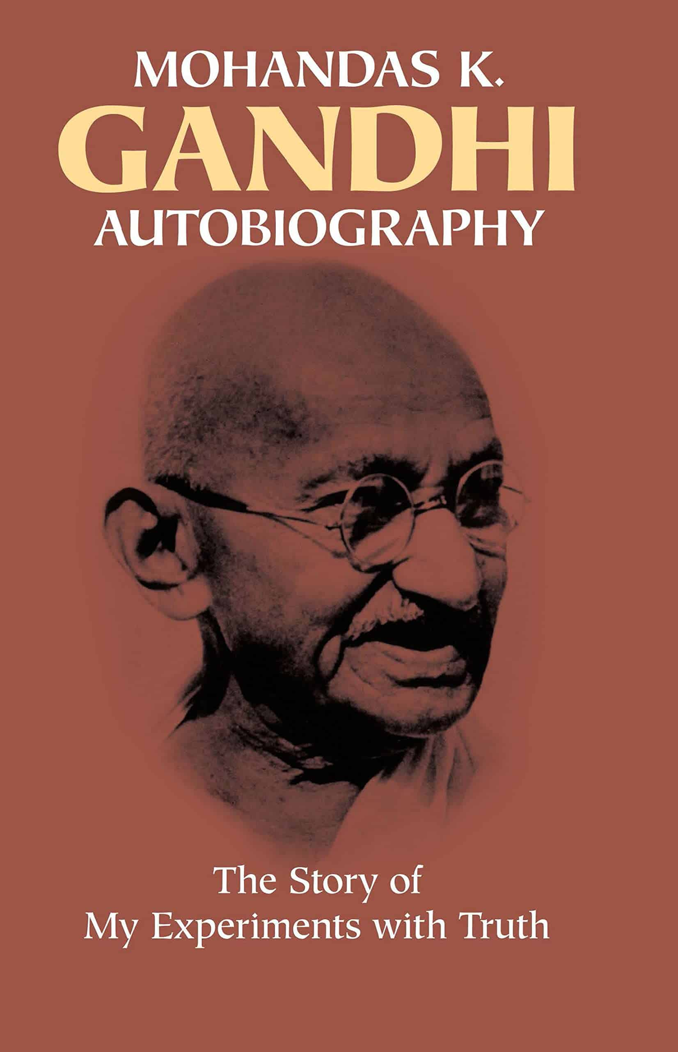
Examples of autobiographies

