Slide 1
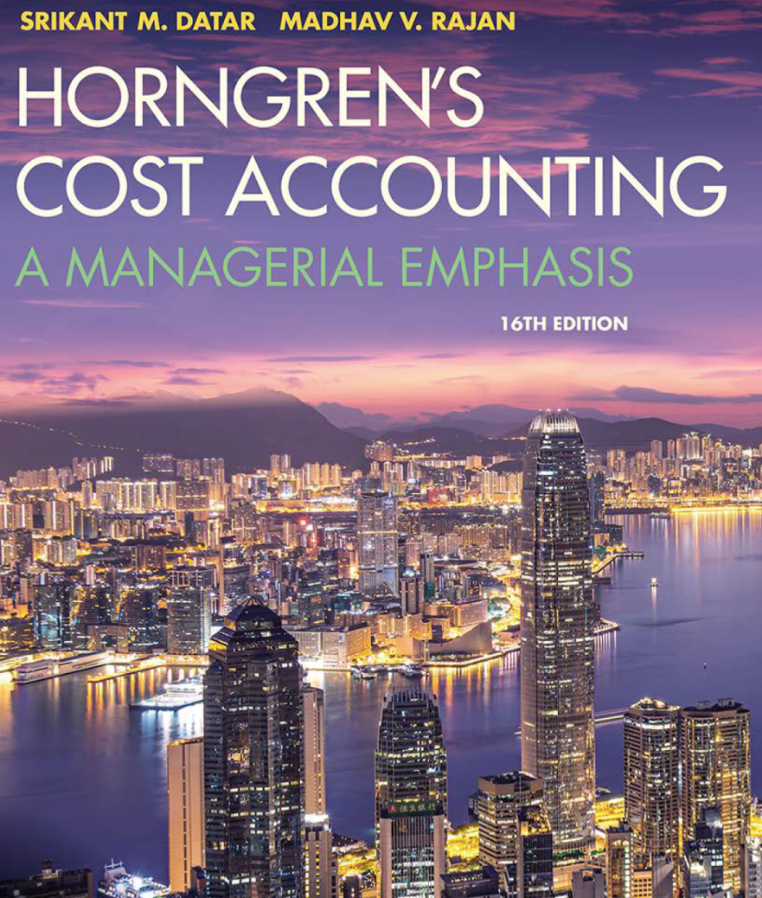
Cost Accounting
Sixteenth Edition
Chapter 3
Cost-Volume-Profit Analysis
Copyright © 2018, 2016, 2015 Pearson Education, Inc. All Rights Reserved.
Notes:
This PowerPoint presentation contains mathematical equations, you may need to check that your computer has the following installed:
1) Math Type Plugin
2) Math Player (free versions available)
3) NVDA Reader (free versions available)

Slide 2
Learning Objectives (1 of 2)
1.1 Explain the features of cost-volume-profit (CVP) analysis
1.2 Determine the breakeven point and output level needed to achieve a target operating income
1.3 Understand how income taxes affect CVP analysis
1.4 Explain how managers use CVP analysis to make decisions
1.5 Explain how sensitivity analysis helps managers cope with uncertainty
Notes:
Slide 2 is list of textbook LO numbers and statements

Slide 3
Learning Objectives (2 of 2)
1.6 Use CVP analysis to plan variable and fixed costs
1.7 Apply CVP analysis to a company producing multiple products
1.8 Apply CVP analysis in service and not-for-profit organizations
Notes:
Slide 3 continues the list of textbook LO numbers and statements

Slide 4
Essentials of CVP Analysis
Managers want to know how profits will change as the units sold of a product or service changes.
Managers like to use “what-if” analysis to examine the possible outcomes of different decisions so they can make the best one.
In chapter 2, we discussed total revenues, total costs and income.
In this chapter, we take a closer look at the relationship among the elements (selling price, variable costs, fixed costs)
Notes:
CVP is an abbreviation for Cost Volume Profit. This is an analysis tool that managers use to understand how profits will change as units sold, variable costs, fixed costs, selling price, or some combination of these, change.
CVP is about the relationship among these elements.

Slide 5
Case study

Slide 6
A Five-step Decision-Making Process in Planning and Control-Revisited
Identify the problem/uncertainties
Obtain information
Make predictions about the future
Make decisions by choosing between alternatives using cost-volume-profit (CVP) analysis
Implement the decision, evaluate performance and learn.
Notes:
In chapter 1, we illustrated the five-step decision-making process we see here.

Slide 7
Foundational Assumptions Used in CVP Analysis (1 of 2)
Changes in production/sales volume are the sole cause for cost and revenue changes.
Total costs consist of fixed costs and variable costs.
Revenue and costs behave and can be graphed as a linear function (a straight line).
Selling price, variable cost per unit and fixed costs are all known and constant.
Notes:
To conduct a CVP analysis, we need to correctly distinguish fixed from variable costs, recognizing that whether a cost is variable or fixed depends on the time period within which a decision will be made and also on the cost object. Additional assumptions followed in a CVP analysis are explored on this slide and the next slide.

Slide 8
Foundational Assumptions Used in CVP Analysis (2 of 2)
In many cases, only a single product will be analyzed. If multiple products are studied, their relative sales proportions are known and constant.
The time value of money (interest) is ignored.
Notes:
There are 6 foundational assumptions used in CVP analysis. Here are the final two.

Slide 9
Basic CVP Equations
Contribution Margin =
Total Revenues - Total Variable Costs
Contribution Margin per unit =
Selling price - Variable cost per unit
Operating Income =
Contribution margin - Fixed costs
Contribution Margin Ratio (or Percentage) = Contribution Margin / Revenues
Notes:
These equations express the CVP relationships. To make good decisions using CVP analysis, we must understand these relationships.
Contribution Margin can also be obtained by multiplying contribution margin per unit by the number of units sold.
Contribution Margin per Unit can be obtained by taking contribution margin divided by number of units sold.
Contribution margin percentage can also be obtained by contribution margin per unit divided by selling price.

Slide 10
More CVP Relationships
Manipulation of the basic equations (prior slide) yields an extremely important and powerful tool called Contribution Margin.
Contribution margin equals revenue less variable costs.
Contribution margin per unit equals unit selling price less unit variable costs, but can also be determined by taking contribution margin divided by number of units sold
Notes:
Looking at one of the basic formulas from the prior slide, we can calculate contribution margin by subtracting variable costs from revenue.

Slide 11
Cost-Volume-Profit Equation and Contribution Margin Methods
Equation METHOD: REVENUE - VARIABLE costs - FIXED costs = operating income
CM Method: WHERE: [(SP X Q) - (VC X q)] - FC = oi
REVENUE = SELLING PRICE (SP) * QUANTITY OF UNITS SOLD (Q)
VARIABLE COSTS (VC) = UNIT VARIABLE COSTS * QUANTITY OF UNITS SOLD
CONTRIBUTION MARGIN (CM) = REVENUE - VARIABLE COSTS
OPERATING INCOME (OI) = CONTRIBUTION MARGIN - FIXED COSTS
Notes:
If we dissect our basic equation in this manner, it helps to emphasize the relationships between these cost elements. That understanding of the relationships will provide a greater understanding of the concepts that follow such as breakeven. We can look at these relationships in three ways (methods). The Equation Method and the Contribution Margin method are two of the three methods. You see them on this slide. We’ll discuss the graph method a bit later.

Slide 12
Cost-Volume-Profit – You Try It! Problem
REVENUE - VARIABLE - FIXED = OPERATING COSTS COSTS INCOME
Tiny’s Cabinets sells cabinets for $600 each
Variable cost is $350 each
Annual fixed costs are $20,000
If Tiny sells 100 cabinets, what it his operating income?
Notes:
In this slide, we work on a CVP problem for Tiny’s Cabinets.

Slide 13
Cost-Volume-Profit – You Try It! Solution
Tiny’s Cabinets sells cabinets for $600 each
Variable cost is $350 each
Annual fixed costs are $20,000
If Tiny sells 100 cabinets, what it his operating income?
Solution: [(SP X Q) - (VC X q)] - FC = oi
($600*100) - ($350*100) = Contribution Margin
CM - $20,000 = Operating Income
$60,000 - $35,000 - $20,000 = $5,000
Notes:
Using the CM method ([(SP X Q) – (VC X q)] – FC = oi), we learn that Tiny’s OI would be $5,000

Slide 14
Breakeven Point
The breakeven point (BEP) is that quantity of output sold at which total revenue equals total cost - that is, the quantity of output sold results in $0.00 of operating income.
Recall our contribution margin method equation:
[(SP x Q) - VC x Q)] - FC = OI
If we set OI to 0 and solve, we’ll get the BEP.
Notes:
In this slide, we are using the contribution margin equation to calculate the breakeven point. That is the point at which CM = FC and Operating Income is zero.

Slide 15
Breakeven Point-Example (1 of 2)
Let’s try this for Tiny’s Cabinets. Recall that his SP = $600, VC = $350 and Fixed Costs are $20,000, annually.
[(SP x Q) - (VC x Q)] - FC = OI
($600 x Q) - ($350 x Q) - $20,000 = 0
$250 x Q = 20,000
Q = 80
Here’s another way to find the answer:
Breakeven revenues = FC / CM%
Breakeven units = FC / CM per unit
Notes:
Breakeven is the point at which a firm has no profit or loss. It can be calculated in terms of unit sales or dollars (revenue). In both cases, the numerator will be fixed costs. To calculate breakeven in units, divide fixed costs by contribution margin PER UNIT. To calculate breakeven in sales dollars, divide fixed costs by contribution margin percentage.
To confirm your calculations, 80 x $250 = $20,000, the amount of Tiny’s fixed costs.

Slide 16
Breakeven Point-Example (2 of 2)
Let’s try this for Tiny’s Cabinets. Recall that his SP = $600, VC = $350 and Fixed Costs are $20,000
Here’s another way to find the answer:
Breakeven revenues = FC / CM per unit
Tiny’s CM per unit = $600 - $350 = $250
Tiny’s CM % = $250/$600 = 41.67%
$20,000 / $250 = 80
Or, in revenues $20,000/41.67% = $47,996 which is equal to 80 x $600, allowing for rounding
Notes:
Breakeven is the point at which a firm has no profit or loss. It can be calculated in terms of unit sales or dollars (revenue). In both cases, the numerator will be fixed costs. To calculate breakeven in units, divide fixed costs by contribution margin PER UNIT. To calculate breakeven in sales dollars, divide fixed costs by contribution margin percentage.

Slide 17
Breakeven Point-Extended: Profit Planning/Target Income
The breakeven formula can be modified to become a profit planning tool by adding target operating income to fixed costs in the numerator.
Let’s say that Tiny wants to make $30,000 Operating Income:
Qty of Units = (FC + Target Operating Income)/CM per unit
Q = ($20,000 + $30,000)/$250
Q = 200
Notes:
Using this formula as a profit planning tool is very powerful. Here we see that if Tiny wants to make $30,000 Operating Income, he needs to sell 200 units. This knowledge provides him with valuable information about his business.

Slide 18
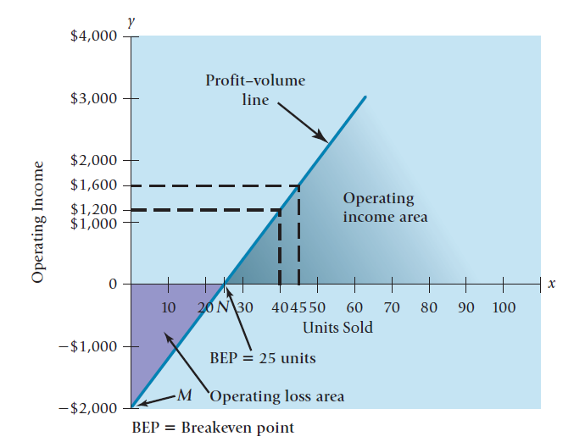
CVP: Graphically
EXHIBIT 3.3 Profit-Volume Graph for GMAT Success
Notes:
Recall from the textbook that we have three related ways, we called them methods, to think about and model the CVP relationships.
The graph method helps managers visualize the relationship between units sold and operating income over a wide range of quantities.
Caption: A PV graph shows how changes in the quantity of units sold affect operating income. This exhibit is the PV graph or GMAT Success where fixed costs are $2,000, Selling price is $200 and Variable cost per unit is $120.

Slide 19
CVP and Income Taxes
After-tax profit (Net Income) can be calculated by:
Net Income = Operating Income * (1-Tax Rate)
Net income can be converted to operating income for use in the CVP equation
Operating Income = I I Net Income I
(1-Tax Rate)
Note: the CVP equation will continue to use operating income. We’ll use this conversion formula to obtain the operating income value when provided with Net Income.
Notes:
In our chapter so far, we’ve been assuming that nonoperating revenues and nonoperating expenses are zero. For purposes of this income tax illustration, we will continue that assumption.
We’ve been ignoring the effect of income taxes thus far but must now recognize that in many companies, managers’ income targets are expressed in terms of net income rather than operating income.
The key is to convert target net income into the corresponding target operating income which is what we use in our CVP formulae.
The conversion formula, also shown on this slide, is net income divided by (1 – tax rate) = operating income.

Slide 20
CVP and Income Taxes – Tiny’s Cabinets
Net income can be converted to operating income for use in the CVP Equation Operating Income = I I Net Income I
(1-Tax Rate)
What if Tiny wanted to earn $30,000 Net Income instead of Operating Income? His tax rate is 35%.
Quantity of Units = (FC + Target Operating Income)/CM per unit
Q = ($20,000 + [$30,000/(1-35%)]/$250
Q = ($20,000 + $46,154)/$250 = 265
Notes:
$30,000 / 65% = $46,154
To check, go through the formulas for breakeven plus target profit:
$66,154/$250 = 265 units
265 x $250 = $66,250
Differences due to rounding.

Slide 21
Using CVP Analysis for Decision Making (1 of 3)
Remember Tiny? As is, he expects to sell 100 cabinets. What if Tiny spent $5,000 on advertising and estimated that it would increase his sales by 10%. Should he do it?
To find out, we can use CVP analysis as follows:
Blank | Sales without Advertising | Sales with Advertising
Units Sold | 100 | 110
Revenues (SP $600) | $60,000 | $66,000
Variable Cost ($350) | $35,000 | $38,500
Fixed Costs | $20,000 | $25,000
Operating Income | $ 5,000 | $ 2,500
Notes:
CVP can be a powerful tool when put to work with various decisions that have to be made. Instead of guessing whether $5,000 spent on advertising will improve Operating Income, Tiny can make some assumptions, then make a decision based on that information.

Slide 22
Using CVP Analysis for Decision Making (2 of 3)
As we see from the prior screen, though Tiny’s sales increase with the advertising expenditure, his Operating Income decreases by $2,500.
Tiny will be better off if he doesn’t advertise.
What if I told you that a more detailed analysis indicated that Tiny’s sales would increase by 25% instead of 10%. Should he do it?
Here’s a quick way to check that. If sales increase 25%, they’ll increase by 25 units. 25 units X Contribution Margin per unit of $250 ($600 - $350) = $6,250.
That is $1,250 greater than the $5,000 Tiny would have to spend. So, in this case, Tiny will be better off spending money on the advertising.
Notes:
In this slide, we change one of our assumptions and then do the same analysis. This ability to quickly change the assumptions and rework the formula allows managers to view an entire array of possibilities as they decide how to proceed.

Slide 23
Using CVP Analysis for Decision Making (3 of 3)
The concept of using CVP analysis for decision making works just as well if you are thinking about decreasing prices. If you decrease your price, you’d expect more unit sales. To determine if the combination of lower price with higher unit sales will improve Operating Income, use CVP analysis.
This type of strategic decision entails risk. We use CVP to evaluate how the Operating Income will change but we cannot be certain that our estimates of increased sales will occur.
Managers use electronic spreadsheets to systematically and efficiently conduct CVP-based sensitivity analysis to test how sensitive their conclusions are to different assumptions.
Notes:
CVP analysis can be used in a wide variety of decision making processes.

Slide 24
Sensitivity Analysis
CVP provides structure to answer a variety of “what-if” scenarios.
“What” happens to profit “if”:
Selling price changes
Volume changes
Cost structure changes
Variable cost per unit changes
Fixed costs change
As an example, if a company determines that an ad campaign costing $15,000 is expected to increase sales 25%, should they proceed? This is very similar to the analysis we did for Tiny’s Cabinets. The question cannot be properly answered without doing this type of analysis.
Notes:
CVP analysis is used in many decisions. It is used to decide whether or not to advertise, whether or not to increase or decrease prices. Sensitivity analysis is a what-if technique we use to examine how an outcome will change if the original predicted data are not achieved or if an underlying assumption changes. This type of analysis can answer, for an example, the question: What will operating income be if the quantity of units sold decreases by 5% from the original prediction?

Slide 25
Margin of Safety-Defined
The margin of safety calculation answers a very important question:
If budgeted revenues are above the breakeven point, how far can they fall before the breakeven point is reached.
In other words, how far can they fall before the company will begin to lose money.
Notes:
The margin of safety is an aspect of sensitivity analysis that answers the specific question: if budgeted revenues are currently above breakeven, how far can they fall before the breakeven point is reached.
The answer to this question gives managers information they can use to take action and potentially prevent a fall in revenues below breakeven.

Slide 26
Margin of Safety – An Indicator of Risk
The margin of safety (MOS) measures the distance between budgeted sales and breakeven (BE) sales:
MOS = Budgeted Sales - BE Sales
The MOS ratio removes the firm’s size from the output and expresses itself in the form of a percentage:
MOS Ratio = MOS / Budgeted Sales
Notes:
Looking at the MOS as a ratio removes the size of the firm from the output.

Slide 27
Cost Structure
Managers make strategic decisions that affect the cost structure of the company
The cost structure is simply the relationship of fixed costs and variable costs to total costs.
We can use CVP-based sensitivity analysis to highlight the risks and returns as fixed costs are substituted for variable costs in a company’s cost structure.
The risk-return trade-off across alternative cost structures can be measured as operating leverage.
Notes:
Cost structure is simply the relationship of fixed costs and variable costs relative to total costs. Managers make strategic decisions that affect the structure and that information is, of course, used in the CVP analysis we’ve been learning about.

Slide 28
Operating Leverage = CM/Operating Income
The risk-return tradeoff across alternative cost structure can be measured as operating leverage.
Operating leverage describes the effects that fixed costs have on changes in operating income as changes occur in units sold and contribution margin.
Organizations with a high proportion of fixed costs in their cost structures have high operating leverage.
In the presence of fixed costs, the degree of operating leverage is different at different levels of sales.
Notes:
The formula to calculate operating leverage is Contribution Margin / Operating Income. Note that the difference between these two values is our fixed cost.
Organizations with a high proportion of fixed costs in their cost structure are said to have high operating leverage. In this type of cost structure, small decreases in sales result in large decreases in operating income.
It is helpful at this point to remember what fixed costs are and how they behave. They are costs that do not change, in the short run, with the level of sales. The costs will exist regardless of the sales level, within the relevant range.

Slide 29
Using Operating Leverage to Estimate Changes to Operating Income
We can use Operating Leverage to estimate changes to Operating Income that will result from a percentage change in sales.
Operating Leverage X % Change in Sales = Percentage change in Operating Income
For example, if sales increase 50% and operating leverage is 1.67, you should expect operating income to increase 83.5% (50% x 1.67)
Notes:
Operating leverage is more than just an indication of the cost structure. It can also be used to estimate the change in operating income that will result from a change in sales. To do so, take the operating leverage times the percentage change in sales. The result will be the expected percentage change in operating income.

Slide 30
Effects of Sales Mix on CVP
Sales Mix is the quantity or proportion of various products or services that constitute a company’s total unit sales. It is often the case that the various products or services have different contribution margins.
Up to this point, we’ve assumed a single product; more realistically, we’ll have multiple products with different costs and different margins.
We can use the same formula in our CVP calculations but must use an average contribution margin for the products.
This technique assumes a constant mix at different levels of total unit sales.
Notes:
So far, we’ve been contemplating a business with one product and, therefore, one contribution margin. More usually, a company has multiple products with varying contribution margins. We can still use the tools of CVP analysis but instead of using the contribution margin for the one product, we will use an average contribution margin.
The average CM is calculated based on a defined product mix. In other words, the CM is determined based on a specific relationship of sales of product 1 to total sales, sales of product 2 to total sales, etc. If that relationship of sales changes, so will our average CM.

Slide 31
CVP for Service and Not-For-Profit Organizations
CVP isn’t just for merchandising and manufacturing companies.
Service and Not-For-Profit businesses need to focus on measuring their output which is different from the units sold that we’ve been dealing with.
For example, a service agency might measure how many persons they assist or an airline might measure how many passenger miles they fly.
What measure might a hotel use? A restaurant?
Notes:
CVP, though more prevalent for manufacturing and merchandising companies, is certainly useful for service and not-for-profits as well.
The challenge is to focus on a measure of output which is generally going to be different from the measure of “units sold” that we’ve been dealing with so far.

