Slide 1
An-Najah National University
Faculty of Medicine
Department of Physiology
Anatomy and Physiology 1
7102101
Instructor: Heba Salah
Chapter 5:
The Nervous System
Part 8: Autonomic Nervous System

Slide 2
Autonomic Nervous System
The involuntary branch of the nervous system
Consists of only motor nerves
Divided into two divisions
Sympathetic division
Parasympathetic division

Slide 3
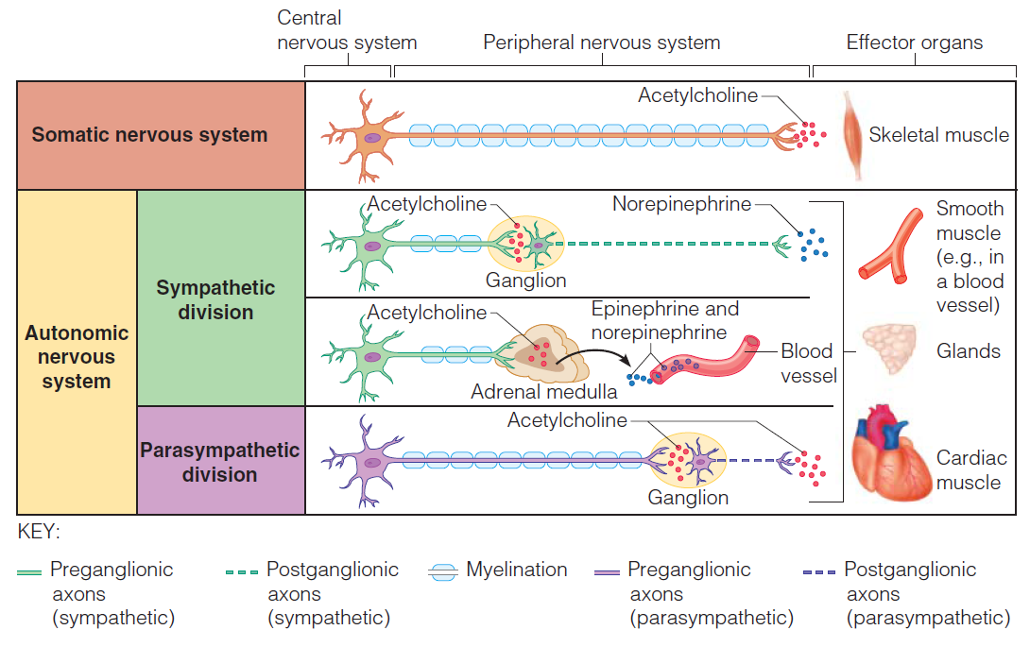
Comparison of Somatic and Autonomic Nervous Systems

Slide 4
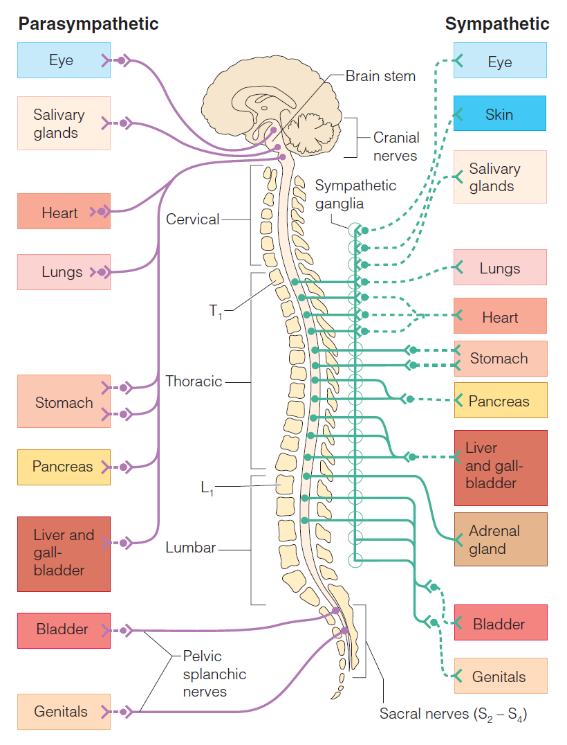
Anatomy of the Autonomic Nervous System

