Slide 1
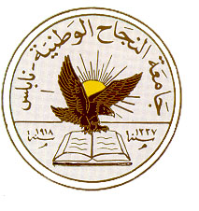
An-Najah National University
Faculty of Medicine
Department of Physiology
Anatomy and Physiology 1
7102101
Instructor: Heba Salah
Chapter 2:
Cells and Tissues
Part 4: Cell Division and Protein Synthesis

Slide 2
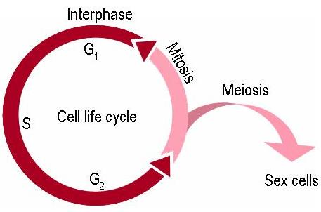
Cell Life Cycle
Cells have two major periods:
1. Interphase
Cell grows
Cell carries on metabolic processes
2. Cell division
Cell replicates itself
Function is to produce more cells for growth and repair processes

Slide 3
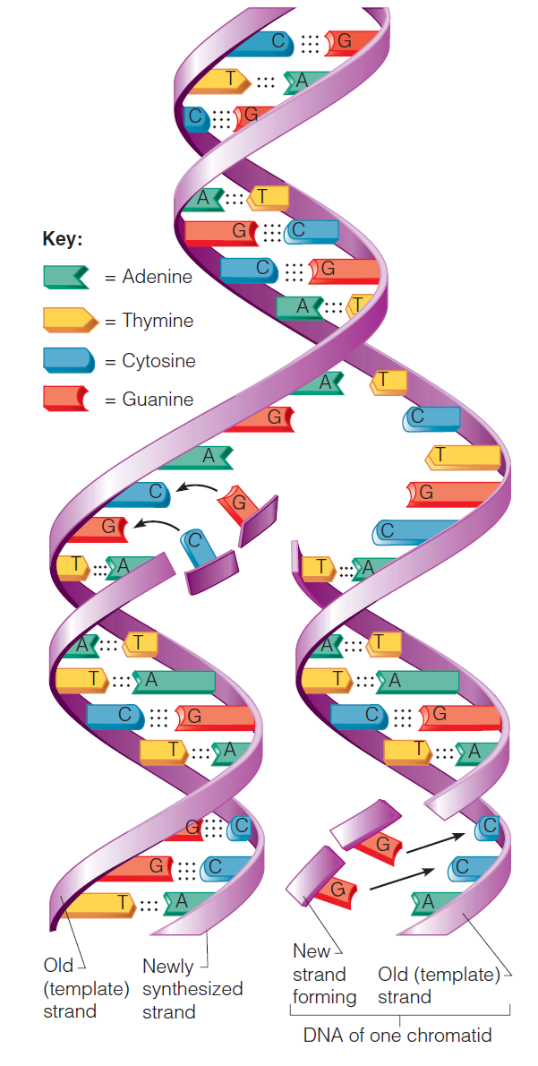
DNA Replication
Genetic material duplicated and readies a cell for division into two cells
Occurs toward the end of interphase
DNA uncoils and each side serves as a template

Slide 4
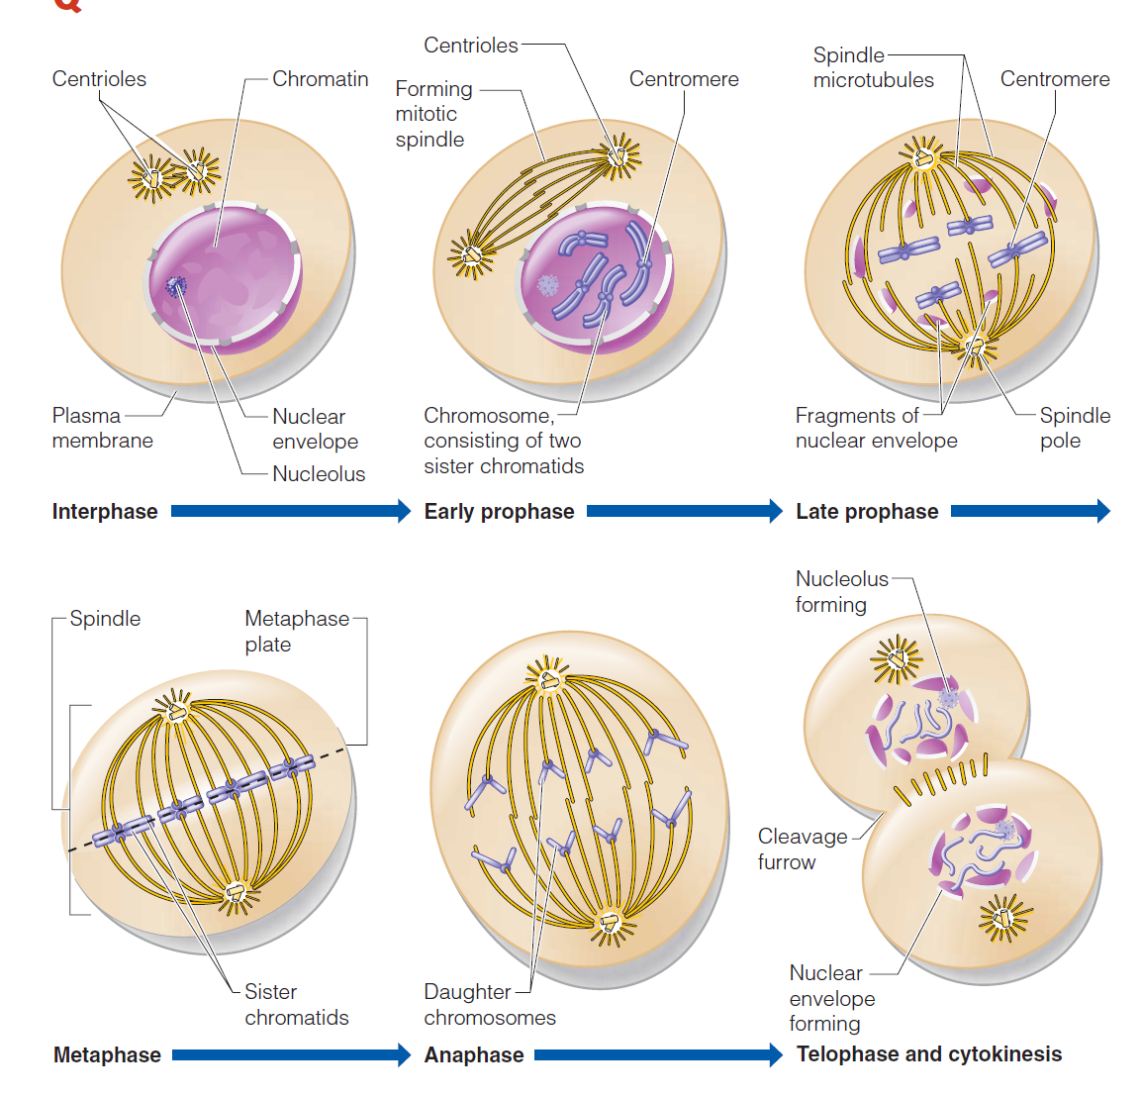
Events of Cell Division

Slide 5
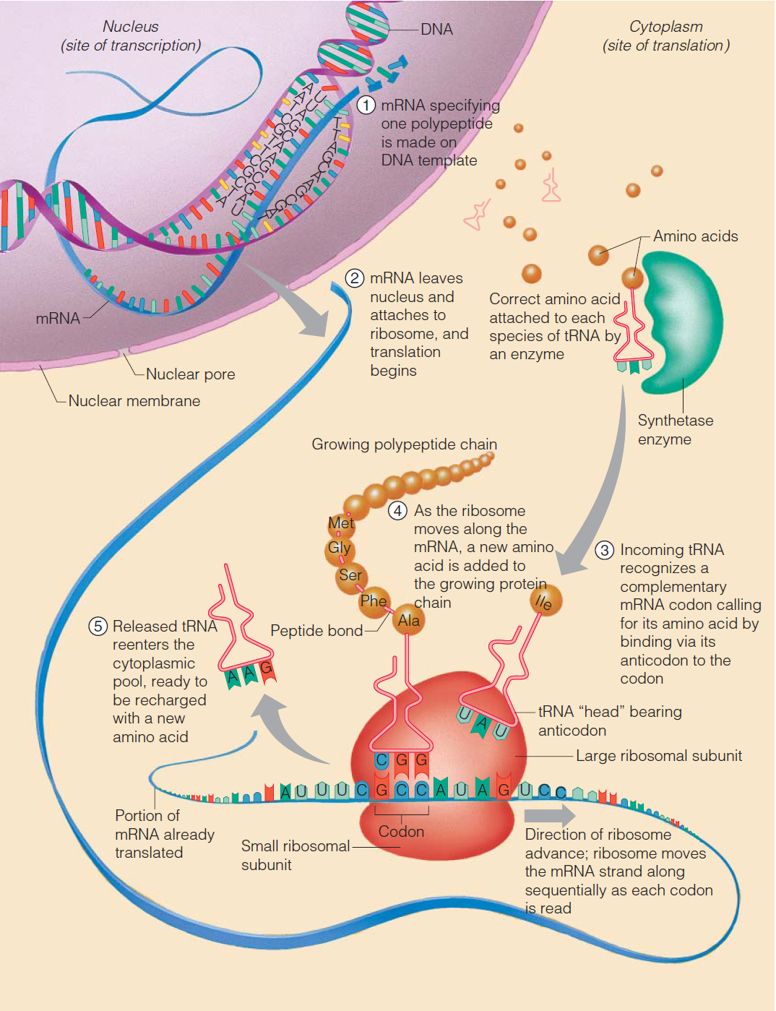
Protein Synthesis

