Slide 1
Chapter 10
Bond Prices and Yields
© McGraw Hill LLC. All rights reserved. No reproduction or distribution without the prior written consent of McGraw Hill LLC.

Slide 2
Bond Prices and Yields, 1.
““More money has been lost reaching for yield than at the point of a gun.”
- Raymond DeVoe

Slide 3
Learning Objectives
Bonds can be an important part of portfolios. You will learn: The different types of mutual funds.
How to calculate bond prices and yields.
The importance of yield to maturity.
Interest rate risk and Malkiel’s theorems.
How to measure the impact of interest rate changes on bond prices.

Slide 4
Bond Prices and Yields, 2.
Our goal in this chapter is to understand the relationship between bond prices and yields.
In addition, we will examine some fundamental tools that fixed-income portfolio managers use when they assess bond risk.

Slide 5
Bond Basics, 1.
A straight bond is an I O U that obligates the issuer of the bond to pay the holder of the bond:
A fixed sum of money (called the principal, par value, or face value) at the bond’s maturity.
Constant, periodic interest payments (called coupons) during the life of the bond.
U.S. Treasury bonds are straight bonds. Special features may be attached:
Convertible bonds.
Callable bonds.
Putable bonds.

Slide 6
Bond Basics, 2.
Two basic yield measures for a bond are its coupon rate and its current yield.

Slide 7
Straight Bond Prices and Yield to Maturity
The price of a bond is found by adding together:
The present value of the bond’s coupon payments, and
The present value of the bond’s face value.
The yield to maturity (Y T M) of a bond is the discount rate that equates today’s bond price with the present value of all the future cash flows of the bond.

Slide 8
The Bond Pricing Formula
The price of a bond is found by adding together the present value of the bond’s coupon payments and the present value of the bond’s face value.
The formula is:
In the formula, C represents the annual coupon payments (in $), F V is the face value of the bond (in $), M is the maturity of the bond, measured in years, and Y T M is the yield to maturity of the bond, expressed as an annual percent.

Slide 9
Example: Using the Bond Pricing Formula
What is the price of a straight bond with: $1,000 face value, coupon rate of 8%, a Y T M of 7%, and a maturity of 20 years?
= 1,142.857 × 0.747428 + 252.5725
= $1,106.78.

Slide 10
Example: Calculating the Price of this Straight Bond Using Excel
Excel has a function that allows you to price straight bonds, and it is called PRICE.
=PRICE(“Today”,“Maturity”,Coupon Rate,Y T M,100,2,3)
Enter “Today” and “Maturity” in quotes, using mm/dd/yyyy format.
Enter the Coupon Rate and the Y T M as a decimal.
The "100" tells Excel to use $100 as the par value.
The "2" tells Excel to use semi-annual coupons.
The "3" tells Excel to use an actual day count with 365 days per year.
Note: Excel returns a price per $100 face in this example.

Slide 11
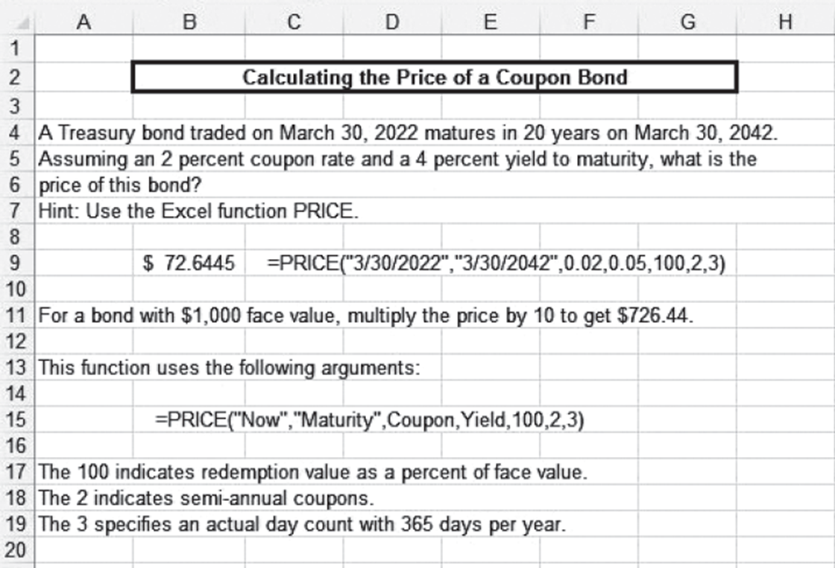
Spreadsheet Analysis 1
Access the text alternative for slide images.

Slide 12
Premium, Par, and Discount Bonds, 1.
Bonds are given names according to the relationship between the bond’s selling price and its par value.
Remember: C Y P F (Can You Pass Finance?)
Premium bonds: If Coupon rate > Y T M then Price > Face (par value)
Discount bonds: If Coupon rate < Y T M then Price < Face (par value)
Par bonds: If Coupon rate = Y T M then Price = Face (par value)
Do you see the relationship between C Y and P F?

Slide 13
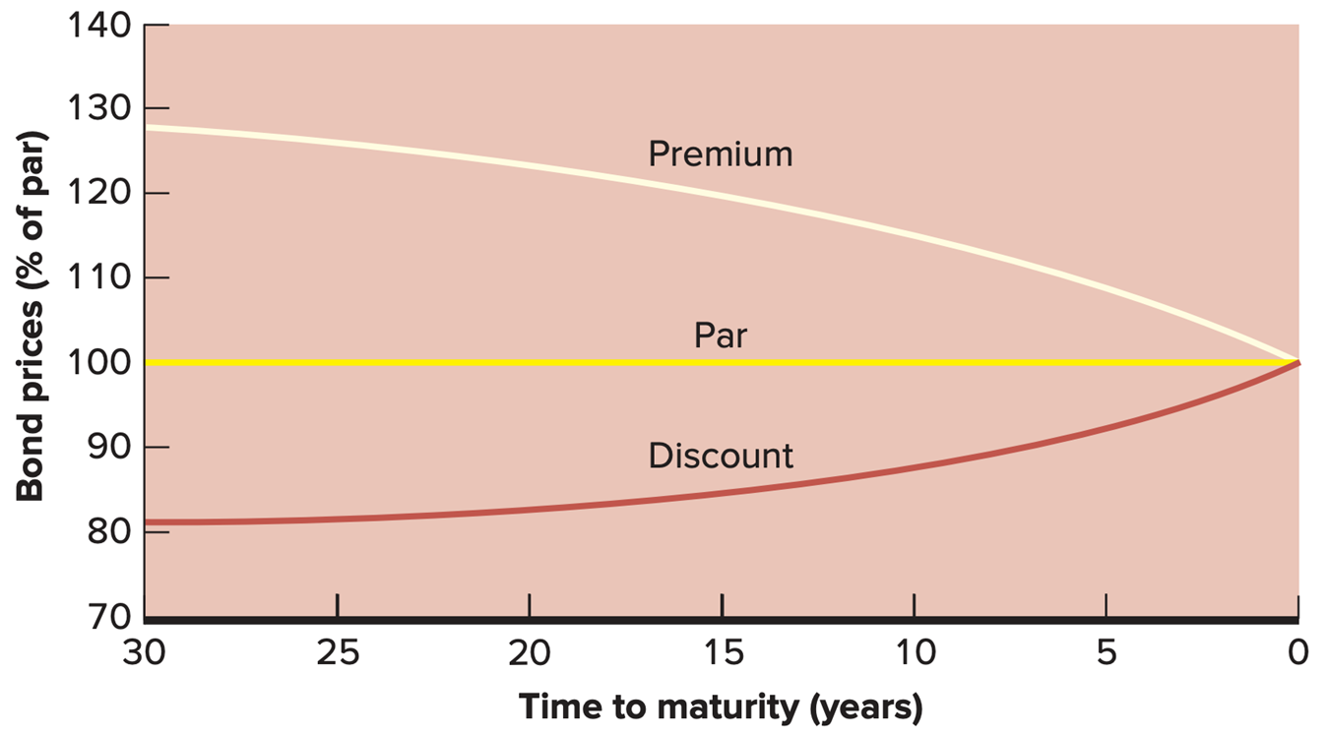
Premium, Par, and Discount Bonds 2.
Access the text alternative for slide images.

Slide 14
Premium, Par, and Discount Bonds, 3.
In general, when the coupon rate and Y T M are held constant:
For premium bonds: the longer the term to maturity, the greater the premium over par value.
For discount bonds: the longer the term to maturity, the greater the discount from par value.

Slide 15
Relationships among Yield Measures
For premium bonds:
Coupon rate > current yield > Y T M
For discount bonds:
Coupon rate < current yield < Y T M
For par value bonds:
Coupon rate = current yield = Y T M
Current yield is the annual coupon payment divided by the bond’s current market price.

Slide 16
Calculating Yield to Maturity, 1.
Suppose we know the current price of a bond ($110), its coupon rate (4%), and its time to maturity (8 years).
How do we calculate the Y T M?
We can use the straight bond formula, trying different yields until we find the one that produces the current bond price.
This process is tedious. So, to speed up the calculation, we use financial calculators and spreadsheets.
Notes:
Price=$110; coupon rate = 8%; time to maturity 8 years

Slide 17
Calculating Yield to Maturity, 2.
We can use the YIELD function in Excel:
=YIELD(“Today”,“Maturity”,Coupon Rate,Price,100,2,3)
Enter “Today” and “Maturity” in quotes, mm/dd/yyyy format.
Enter the Coupon Rate as a decimal.
Enter the Price as a percent of face value.
Note: As before,
The "100" tells Excel to use $100 as the par value.
The "2" tells Excel to use semi-annual coupons.
The "3" tells Excel to use an actual day count with 365 days per year.
Using dates 8 years apart, a coupon rate of 4%, and a price (per hundred) of $110 results in a Y T M of 2.607%.
Notes:
Price=$110; coupon rate = 8%; time to maturity 8 years

Slide 18
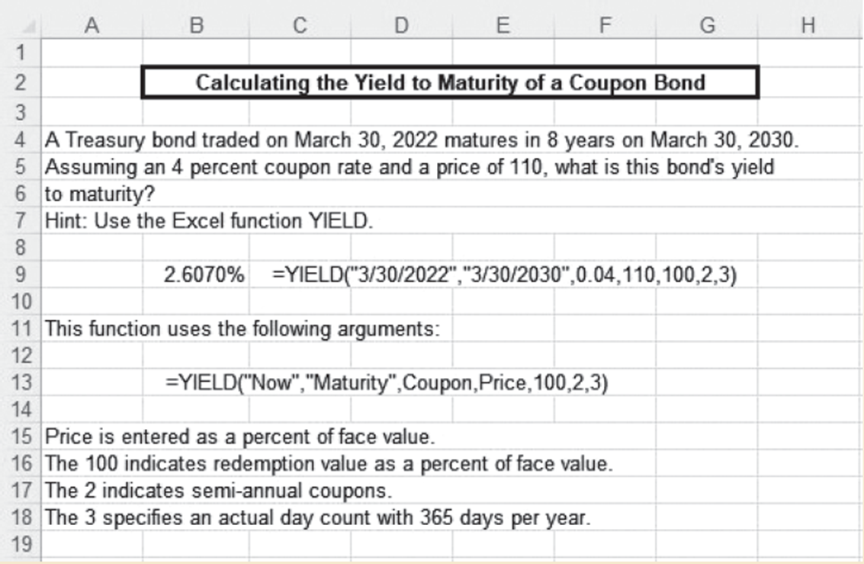
Spreadsheet Analysis, 2.
Access the text alternative for slide images.

Slide 19
A Quick Note on Bond Quotations,1.
We have seen how to calculate bond prices.
We have calculated the price as if the next coupon payment is six months off.
If you buy a bond between coupon dates, you will receive the next coupon payment (and might have to pay taxes on it).
When you buy the bond between coupon payments, you must compensate the seller for any accrued interest.

Slide 20
A Quick Note on Bond Quotations, 2.
The convention in bond price quotes is to ignore accrued interest.
This results in what is commonly called a clean price (that is, a quoted price net of accrued interest).
Sometimes, this price is also known as a flat price.
The price the buyer actually pays is called the dirty price.
The buyer must pay accrued interest and the clean price.
Note: The price the buyer actually pays is sometimes known as the full price, or invoice price.

Slide 21
A Quick Note on Bond Quotations, 3.
Suppose you buy a 10-year bond with a 12 percent annual coupon, payable semiannually. The next coupon payment is in four months.
The bond’s quoted price (that is, its clean price) is $1,060. (What is the Y T M? About 11%, more accurately, 10.996%).
If you are given 10.996% Y T M, 12% coupon, 10 years, semiannual coupons, the bond pricing formula gives the flat, or clean, price of the bond of $1,060.
But you pay $1,080 for this bond (Why?).
The dirty, or invoice, price of the bond is $1,080.
Notice that the next coupon will be $60.
The accrued interest on a bond is calculated by taking the fraction of the coupon period that has passed, in this case two months out of six, and multiplying this fraction by the next coupon, $60.
So, the accrued interest in this example is
Invoice Price ($1,080) = Clean price ($1,060) plus accrued interest ($20).

Slide 22
Callable Bonds
Thus far, we have calculated bond prices assuming that the actual bond maturity is the original stated maturity.
Most bonds, however, are callable bonds.
A callable bond gives the issuer the option to buy back the bond at a specified call price anytime after an initial call protection period.
For callable bonds, Y T M might not be useful.
Notes:
There are not many callable US Treasury bonds now.

Slide 23
Yield to Call
Yield to call (Y T C) is a yield measure that assumes a bond will be called at its earliest possible call date.
The formula to price a callable bond is:
In the formula, C is the annual coupon (in $), C P is the call price of the bond (in $), T is the time (in years) to the earliest possible call date, and Y T C is the yield to call, with semi-annual coupons.
As with straight bonds, we can solve for the Y T C, if we know the price of a callable bond.

Slide 24
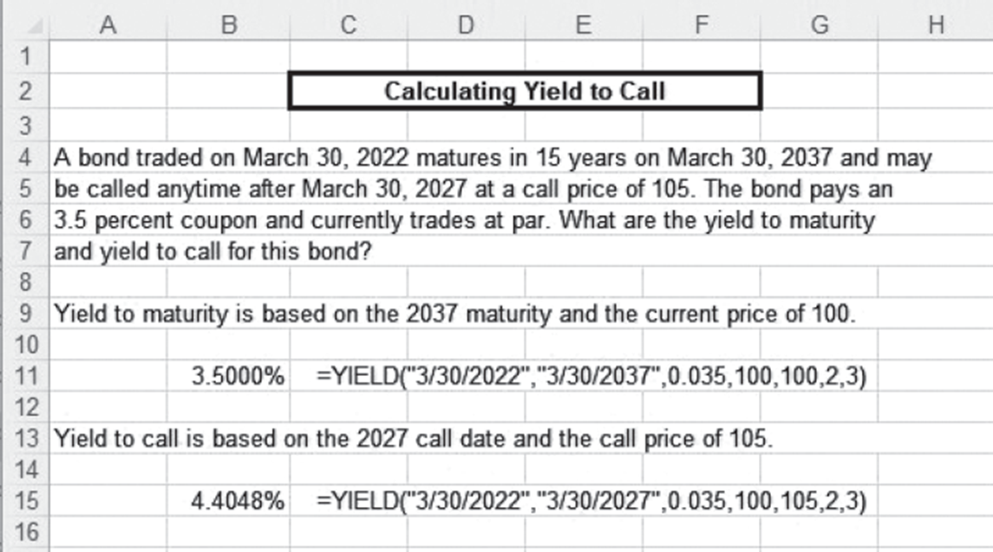
Spreadsheet Analysis 3.
Access the text alternative for slide images.

Slide 25
Interest Rate Risk
Holders of bonds face interest rate risk.
Interest rate risk is the possibility that changes in interest rates will result in losses in the bond’s value.
The yield actually earned or “realized” on a bond is called the realized yield.
Realized yield is almost never exactly equal to the yield to maturity or promised yield.

Slide 26
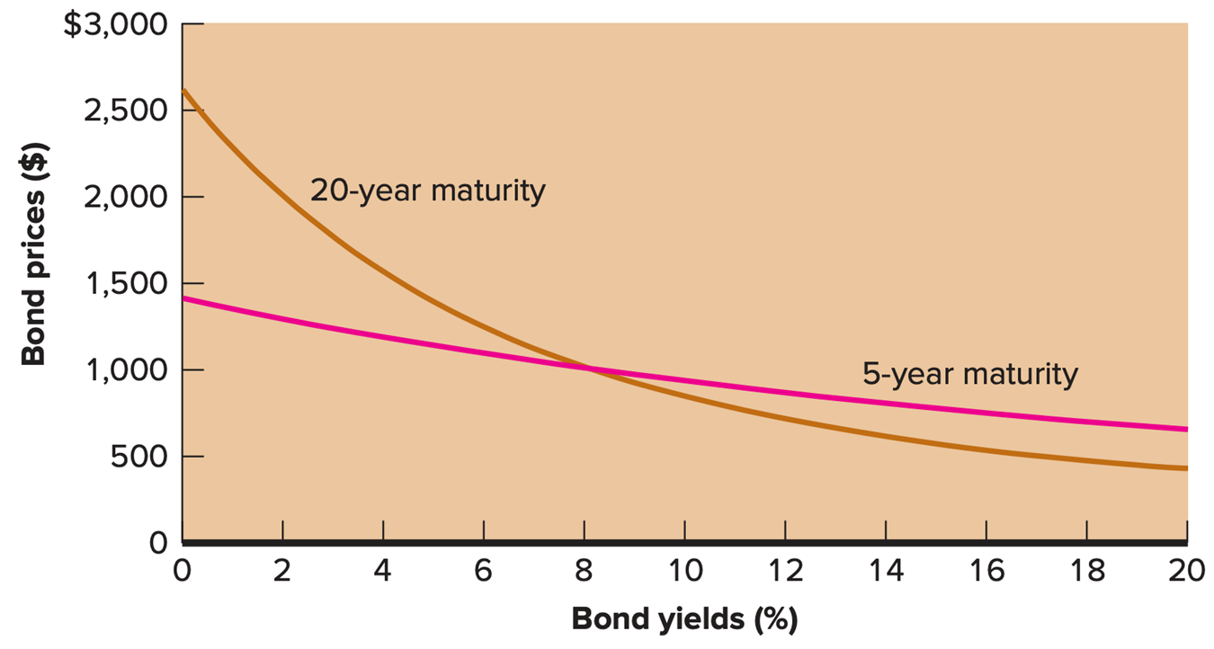
Interest Rate Risk and Maturity
Access the text alternative for slide images.

Slide 27
Malkiel’s Theorems,1.
Bond prices and bond yields move in opposite directions.
As a bond’s yield increases, its price decreases.
Conversely, as a bond’s yield decreases, its price increases.
For a given change in a bond’s Y T M, the longer the term to maturity of the bond, the greater the magnitude of the change in the bond’s price.

Slide 28
Malkiel’s Theorems, 2.
For a given change in a bond’s Y T M, the size of the change in the bond’s price increases at a diminishing rate as the bond’s term to maturity lengthens.
For a given change in a bond’s Y T M, the resulting percentage change change in the bond’s price is inversely related to the bond’s coupon rate.
For a given absolute change in a bond’s Y T M, the magnitude of the price increase caused by a decrease in yield is greater than the price decrease caused by an increase in yield.

Slide 29
Bond Prices and Yields
Bond Prices and Yields
Time to Maturity
Yields | 5 Years | 10 Years | 20 Years
7% | $1,041.58 | $1,071.06 | $1,106.78
9% | 960.44 | 934.96 | 907.99
Price difference | $ 81.14 | $ 136.10 | $198.79
Twenty-Year Bond Prices and Yields
Coupon Rates
Yields | 6% | 8% | 10%
6% | $1,000.00 | $1,231.15 | $1,462.30
8% | 802.07 | 1000.00 | 1,197.93
10% | 656.82 | 828.41 | 1,000.00

Slide 30
Duration
Bondholders know that the price of their bonds change when interest rates change. But,
How big is this change?
How is this change in price estimated?
Macaulay Duration, or Duration, is a way for bondholders to measure the sensitivity of a bond price to changes in bond yields. That is, given a starting Y T M and a change in Y T M:
Two bonds with the same duration, but not necessarily the same maturity, will have approximately the same price sensitivity to a (small) change in bond yields.

Slide 31
Example: Using Duration
Example: Suppose a bond has a Macaulay Duration of 11 years and a current yield to maturity of 8%.
If the yield to maturity increases to 8.50%, what is the resulting percentage change in the price of the bond?
Note that the starting Y T M appears in the denominator.

Slide 32
Modified Duration
Some analysts prefer to use a variation of Macaulay’s Duration, known as Modified Duration.
The relationship between percentage changes in bond prices and changes in bond yields is approximately:

Slide 33
Calculating Macaulay’s Duration,2.
Macaulay’s Duration values are stated in years and are often described as a bond’s effective maturity.
For a zero-coupon bond, duration = maturity.
For a coupon bond, duration = a weighted average of individual maturities of all the bond’s separate cash flows, where the weights are proportionate to the present values of each cash flow.

Slide 34
Calculating Macaulay’s Duration for Par Bonds
If a bond is selling for par value, the duration formula is:
Example: par bond with a 6 percent coupon (and 6 percent Y T M, why?) and 10 years to maturity.
Verify that the duration is 7.66 years.

Slide 35
Calculating Macaulay’s Duration, 2.
In general, for a bond paying constant semiannual coupons, the formula for Macaulay’s Duration is:
In the formula, C P R is the annual coupon rate, M is the bond maturity (in years), and Y T M is the yield to maturity, assuming semiannual coupons.

Slide 36
Calculating Macaulay’s Duration: Example
A bond has a yield to maturity of 7 percent, and it matures in 12 years. The coupon rate is 6 percent.
Tossing these numbers into the formula:
Crank away and verify that the Duration is 8.56 years, and the Modified Duration is 8.27 years.

Slide 37
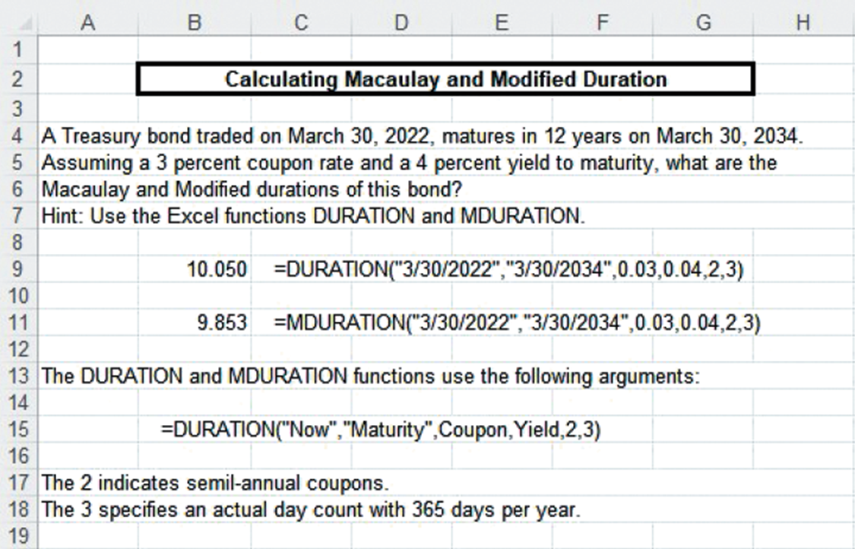
Calculating Macaulay Duration and Modified Duration, using Excel
Access the text alternative for slide images.

Slide 38
Calculating Duration Using Excel, Explanation
We can use the DURATION and MDURATION functions in Excel to calculate Macaulay Duration and Modified Duration.
The Excel functions use arguments like we saw before:
=DURATION(“Today”,“Maturity”,Coupon Rate,Y T M,2,3)
Example: Verify that a 5-year bond, with a 9% coupon and a 7% Y T M, has a Duration of 4.17 and a Modified Duration of 4.03.

Slide 39
Duration Properties
All else the same, the longer a bond’s maturity, the longer its duration.
All else the same, a bond’s duration increases at a decreasing rate as maturity lengthens.
All else the same, the higher a bond’s coupon, the shorter is its duration.
All else the same, a higher yield to maturity implies a shorter duration.

Slide 40
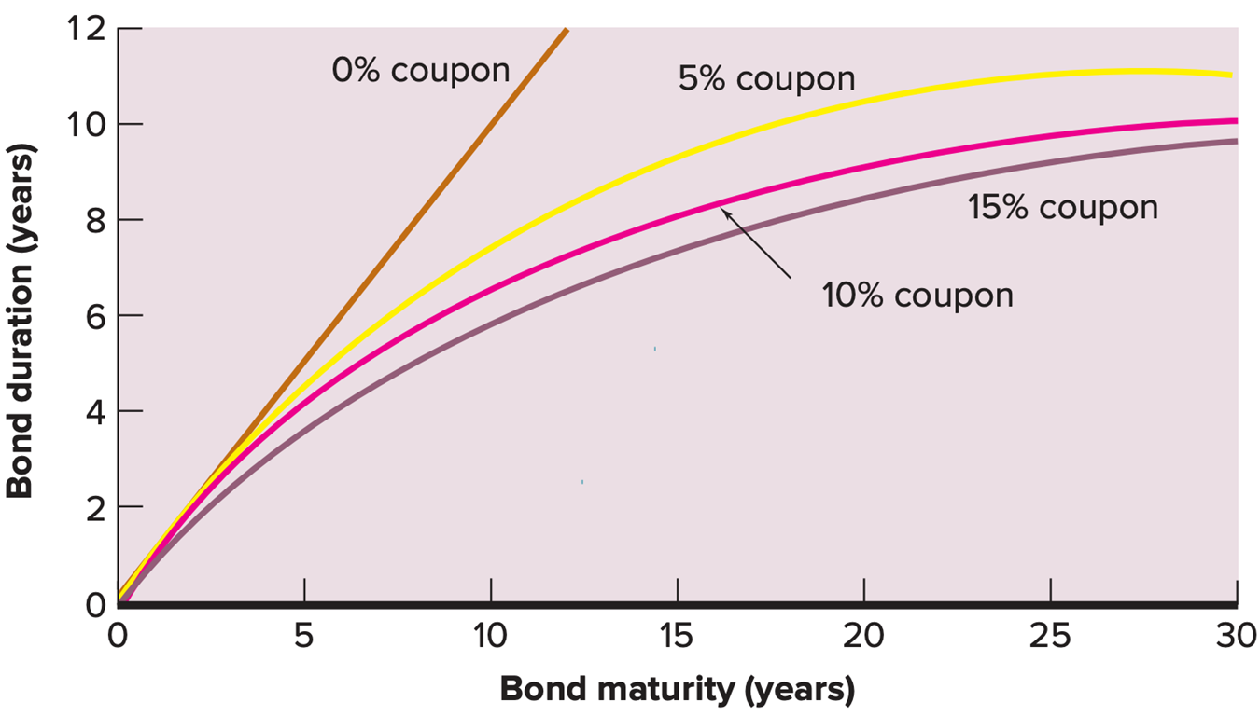
Properties of Duration
Access the text alternative for slide images.

Slide 41
Bond Risk Measures Based on Duration,1.
Dollar Value of an 01: Measures the change in bond price from a one basis point change in yield.
Yield Value of a 32nd: Measures the change in yield that
would lead to a
change in the bond price.
In both cases, the bond price is per $100 face value.

Slide 42
Bond Risk Measures Based on Duration, 2.
Insert
for the Dollar Value of an
01 in Equation (1) but we need to add N as the measure of the number of basis points needed to change the price of the bond by a 32nd. The red text is the Dollar Value of an 01.

Slide 43
Bond Risk Measures Based on Duration, 3.
Suppose a bond has a modified duration of 8.27 years.
What is the dollar value of an 01 for this bond (per $100 face value)?
What is the yield value of a 32nd (per $100 face value)?
First, we need the price of the bond, which is $91.97. Verify:
Y T M = 7%
Coupon = 6%
Maturity = 12 Years.
The Dollar Value of an 01 is $0.07606, which says that if the Y T M changes one basis point, the bond price changes by 7.6 cents.
The Yield Value of a 32nd is .41086, which says that a yield change of .41
basis points changes the bond price by
(3.125 cents).

Slide 44
Dedicated Portfolios
A dedicated portfolio is a bond portfolio created to prepare for a future cash payment, that is. pension funds.
The date the payment is due is commonly called the portfolio’s target date.

Slide 45
Dedicated Portfolios: Scenario
Suppose the Safety First pension fund estimates that it must pay benefits of about $100 million in five years.
Safety First decides to buy coupon bonds yielding 8 percent.
These coupon bonds pay semiannual coupons, mature in five years, and are currently selling at par.
If interest rates do not change over the next five years, how much money does Safety First need to invest today in these coupon bonds to have $100 million in five years?

Slide 46
Dedicated Portfolios: Example
To start, we convert the straight bond pricing formula (which is a present value)
into a future value by multiplying by
For Safety First, we know the future value is $100,000,000. So:
Rearranging, and solving:
Safety First needs to invest about $67.5 million today.

Slide 47
Dedicated Portfolios: How Does it Work?
These bonds sell for par, so $67,556,417 is their total face value.
With this face value, the coupon payment every six months is (Recall Coupon Rate = Y T M for par bonds): $67,556,417 × 0.08/2 = $2,702,257.
If Safety First invests each of these coupons at 8 percent (that is, the Y T M), the total future value of the coupons is $32,443,583.
Safety First also receives the face value of the coupon bonds in five years, or $67,556,417.
In five years, Safety First has $32,443,583 + $67,556,417 = $100,000,000.
Safety First needs about $67.5 million to construct a dedicated bond portfolio to fund a future liability of $100 million.
Huge assumption: interest rates unchanged over the next five years.

Slide 48
Reinvestment Risk
Reinvestment rate risk is the uncertainty about the value of the portfolio on the target date.
Reinvestment rate risk stems from the need to reinvest bond coupons at yields not known in advance.
Simple solution: purchase zero coupon bonds.
Problem with simple solution:
U.S. Treasury S T R I P S are the only zero coupon bonds issued in sufficiently large quantities.
S T R I P S have lower yields than even the highest quality corporate bonds.

Slide 49
The Cost of Removing Reinvestment Risk Using S T R I P S
Suppose that Treasury S T R I P S have a yield of 7.75 percent.
Using semiannual compounding, the present value of these zero coupon bonds providing a principal payment of $100 million in five years is:
$68,373,787 − $67,556,417 = $817,370. (Hmm . . . )
Other methods are available at a lower cost.

Slide 50
Price Risk
Price risk is the risk that bond prices will decrease.
Price risk arises in dedicated portfolios when the target date value of a bond is not known with certainty.

Slide 51
Price Risk versus Reinvestment Rate Risk
For a dedicated portfolio, interest rate increases have two effects:
Increases in interest rates decrease bond prices, but
Increases in interest rates increase the future value of reinvested coupons.
For a dedicated portfolio, interest rate decreases have two effects:
Decreases in interest rates increase bond prices, but
Decreases in interest rates decrease the future value of reinvested coupons.

Slide 52
Immunization
Immunization is the term for constructing a dedicated portfolio such that the uncertainty surrounding the target date value is minimized.
It is possible to engineer a portfolio such that price risk and reinvestment rate risk offset each other (just about entirely).

Slide 53
Immunization by Duration Matching, 1.
A dedicated portfolio can be immunized by duration matching—matching the duration of the portfolio to its target date.
Then, the impacts of price and reinvestment rate risk will almost exactly offset.
This means that interest rate changes will have a minimal impact on the target date value of the portfolio.

Slide 54
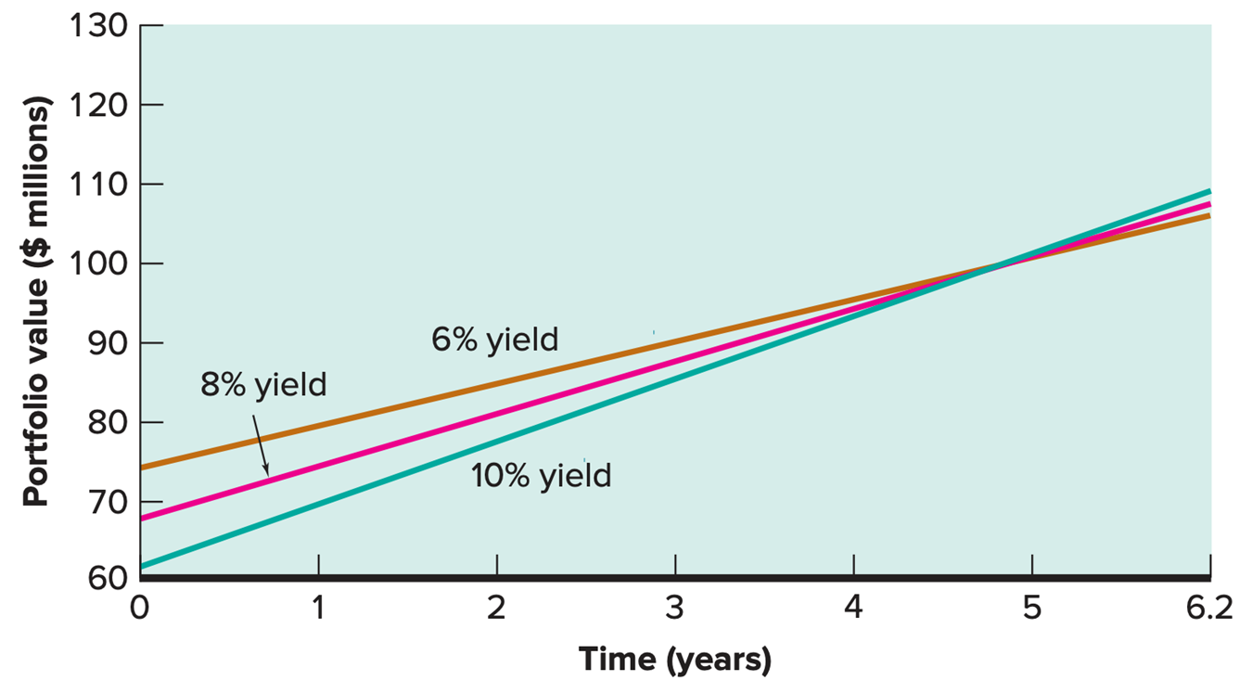
Immunization by Duration Matching 2.
Access the text alternative for slide images.

Slide 55
Dynamic Immunization
Dynamic immunization is a periodic rebalancing of a dedicated bond portfolio for the purpose of maintaining a duration that matches the target maturity date.
The advantage is that the reinvestment risk caused by continually changing bond yields is greatly reduced.
The drawback is that each rebalancing incurs management and transaction costs.

Slide 56
Useful Internet Sites
www.investinginbonds.com (bond basics and current market data)
www.bloomberg.com (for information on government bonds)
www.jmdinvestments.blogspot.com (reference for current financial information)

Slide 57
Chapter Review,1.
Bond Basics.
Straight Bonds.
Coupon Rate and Current Yield.
Straight Bond Prices and Yield to Maturity.
Straight Bond Prices.
Premium and Discount Bonds.
Relationships among Yield Measures.

Slide 58
Chapter Review, 2.
More on Yields.
Calculating Yields.
Yield to Call.
Interest Rate Risk and Malkiel’s Theorems.
Promised Yield and Realized Yield.
Interest Rate Risk and Maturity.
Malkiel’s Theorems.

Slide 59
Chapter Review, 3.
Duration.
Macaulay Duration.
Modified Duration.
Calculating Macaulay’s Duration.
Properties of Duration.
Dedicated Portfolios and Reinvestment Risk.
Dedicated Portfolios.
Reinvestment Risk.
Immunization.
Price Risk versus Reinvestment Rate Risk.
Immunization by Duration Matching.
Dynamic Immunization.

Slide 60
End of Main Content
© McGraw Hill LLC. All rights reserved. No reproduction or distribution without the prior written consent of McGraw Hill LLC.

Slide 61
Accessibility Content: Text Alternatives For Images

Slide 62
Spreadsheet Analysis 1 – Text Alternative
Return to parent-slide containing images.
Calculating the Price of a Coupon Bond. A Treasury bond traded on March 30, 2022, matures in 20 years on March 30, 2042. Assuming a 2 percent coupon rate and a 4 percent yield to maturity, what is the price of this bond? Hint: Use the Excel function PRICE. $ 72.6445 = PRICE (open quotes 3/30/2022, close quotes, open quotes 3/30/2042, close quotes, 0.02,0.05,100,2,3) For a bond with $1,000 face value, multiply the price by 10 to get $726.44. This function uses the following arguments: =PRICE (Open quotes, Now, close quotes, open quotes, Maturity, close quotes, Coupon, Yield, 100, 2, 3).The 100 indicates redemption value as a percent of face value. The 2 indicates semi-annual coupons. The 3 specifies an actual day count of 365 days per year.
Return to parent-slide containing images.

Slide 63
Premium, Par, and Discount Bonds 2 – Text Alternative
Return to parent-slide containing images.
The y-axis of the line graph shows bond prices % of par and the x-axis shows the time of maturity in years. The y-axis ranges from 70 to 140 in increments of 10. The x-axis ranges from 30 to 0 in decrements of 5. There is a straight horizontal line labeled par that starts at 100 on the y-axis and is parallel to the x-axis. There is a concave-up increasing line labeled discount that starts below the line for par with the following estimated values. (30, 81), (25, 82), (20, 83), (15, 84), (10, 87), (5, 92), and (0, 100). There is a concave-down decreasing curve labeled premium that starts above the line for par with the following estimated values. (30, 128), (25, 127), (20, 126), (15, 120), (10, 118), (5, 110), and (0, 100).
Return to parent-slide containing images.

Slide 64
Spreadsheet Analysis, 2. – Text Alternative
Return to parent-slide containing images.
Calculating the yield to maturity of a coupon bond. A Treasury bond traded on March 30, 2022, matures in 8 years on March 30, 2030. Assuming a 4 percent coupon rate and a price of 110, what is this bond's yield to maturity? Hint: Use the Excel function YIELD. 2.6070% =YIELD (open quotes, 3/30/2022, close quotes, open quotes, 3/30/2030, close quotes, 0.04, 110, 100, 2, 3) This function uses the following arguments: =YIELD (open quotes, Now, close quotes, open quotes, Maturity, close quotes, Coupon, Price, 100, 2, 3) Price is entered as a percent of face value. The 100 indicates redemption value as a percent of face value. The 2 indicates semi-annual coupons. The 3 specifies an actual day count of 365 days per year.
Return to parent-slide containing images.

Slide 65
Spreadsheet Analysis 3 – Text Alternative
Return to parent-slide containing images.
Calculating yield to call. A bond traded on March 30, 2022, matures in 15 years on March 30, 2037, and may be called anytime after March 30, 2027, at a call price of 105. The bond pays a 3.5 percent coupon and currently trades at par. What is the yield to maturity and yield to call for this bond? Yield to maturity is based on the 2037 maturity and the current price of 100. 3.5000 % =YIELD (Open quotes, 3/30/2022, close quotes, open quotes, 3/30/2037, close quotes, 0.035, 100, 100, 2, 3). Yield to call is based on the 2027 call date and the call price of 105. 4.4048% =YIELD ("3/30/2022", "3/30/2027, 0.035, 100, 105, 2,3).
Return to parent-slide containing images.

Slide 66
Interest Rate Risk and Maturity – Text Alternative
Return to parent-slide containing images.
The y-axis of the graph shows bond prices in dollars and the x-axis shows bond yields in percentages. The y-axis ranges from 0 to $3,000 in increments of 500. The x-axis ranges from 0 to 20 in increments of 2. There is a concave-up decreasing curve labeled 20-year maturity that starts above 2,500 dollars on the y-axis and falls with the following estimated values. (2, 2000), (4, 1500), (6, 1400), (8, 1100), (10, 900), (12, 800), (14, 700), (16, 600), (18, 550), and (20, 500). There is a falling line labeled 5-year maturity that starts below 1,500 dollars on the y-axis and falls with the following estimated values. (2, 1400), (4, 1300), (6, 1200), (8, 1100), (10, 1000), (12, 800), (14, 700), (16, 600), (18, 550), and (20, 500). The line for 5-year maturity intersects with the line for 20-year maturity at an estimated value of (8, 1000).
Return to parent-slide containing images.

Slide 67
Calculating Macaulay Duration and Modified Duration, using Excel – Text Alternative
Return to parent-slide containing images.
Calculating Macaulay and Modified Duration. A Treasury bond traded on March 30. 2022. matures in 12 years on March 30. 2034. Assuming a 3 percent coupon rate and a 4 percent yield to maturity. what are the Macaulay and Modified duration of this bond? Hint: Use the Excel functions DURATION and MDURATION. 10.050 = DURATION (Open quotes, 3/30/2022, close quotes. Open quotes, 3/30/2034, close quotes, 0.03, 0.04, 2, 3) 9.853 =M DURATION (Open quotes, 3/30/2022, close quotes, open quotes, 3/30/2034, close quotes, 0.03, 0.04, 2, 3) The DURATION and M DURATION functions use the following arguments: =DURATION (open quotes, Now, close quotes, open quotes, Maturity, close quotes, Coupon, Yield, 2, 3) The 2 indicates semil-annual coupons. The 3 specifies an actual day count of 365 days per year.
Return to parent-slide containing images.

Slide 68
Properties of Duration – Text Alternative
Return to parent-slide containing images.
The y-axis of the line graph shows bond duration in years and the x-axis shows bond maturity in years. The y-axis ranges from 0 to 12 in increments of 2. The x-axis ranges from 0 to 30 in increments of 5. There is an upward-sloping line labeled 0 percent coupon that starts from the origin and increases with the following estimated values. (5, 5) and (10, 11). There are three concave-down increasing curves for 5 percent coupon, 10 percent coupon, and 15 percent coupon that start from the origin and rise with the following estimated values. 5 percent coupon (5, 5), (10, 7), (15, 9), (20, 11), (25, 11.5), and (30, 11.5). 10 percent coupon (5, 4), (10, 6.5), (15, 8), (20, 9), (25, 10), and (30, 10.5). 15 percent coupon (5, 3), (10, 5.5), (15, 7), (20, 8.5), (25, 9), and (30, 9.5).
Return to parent-slide containing images.

Slide 69
Immunization by Duration Matching 2 – Text Alternative
Return to parent-slide containing images.
The y-axis of the line graph shows portfolio value in million dollars and the x-axis shows time in years. The y-axis ranges from 60 to 130 in increments of 10. The x-axis ranges from 0 to 6.2 in increments of 1. There is an upward-sloping line labeled 10 percent yield that starts above 60 on the y-axis and rises with the following estimated values. (1, 70), (2, 75), (3, 85), (4, 95), (5, 100), and (6.2, 105). There is another upward-sloping line labeled 8 percent yield that starts below 70 on the y-axis and rises with the following estimated values. (1, 75), (2, 82), (3, 85), (4, 95), (5, 100), (6.2, 106). There is a third upward-sloping line labeled 6 percent yield that starts below 80 on the y-axis and rises with the following estimated values. (1, 80), (2, 85), (3, 90), (4, 95), (5, 100), and (6.2, 109). All the lines intersect at the estimated value of (5, 100).
Return to parent-slide containing images.

