Slide 1
Health Economics
Dr. Russell Kabir
Department of Medical Science and Public Health
Anglia Ruskin University
Email: russell.kabir@anglia.ac.uk

Slide 2
Aim(s) of the session:
Introduce health economics module for Public Health Management Program
Evaluate the learning outcomes
Discuss the course outline
Discuss the teaching methods
Explore the assessment strategies

Slide 3
Discussion
Why students need to study health economics?

Slide 4
Things to consider
Local context
Global context
Employability skills

Slide 5
Learning Outcomes
What are the learning outcomes and what they are assessing?

Slide 6
Discussion on LOs
[Insert here]
[Insert here]
[Insert here]
[Insert here]

Slide 7
Activity
How do you assess that student have understood the module learning outcomes?

Slide 8
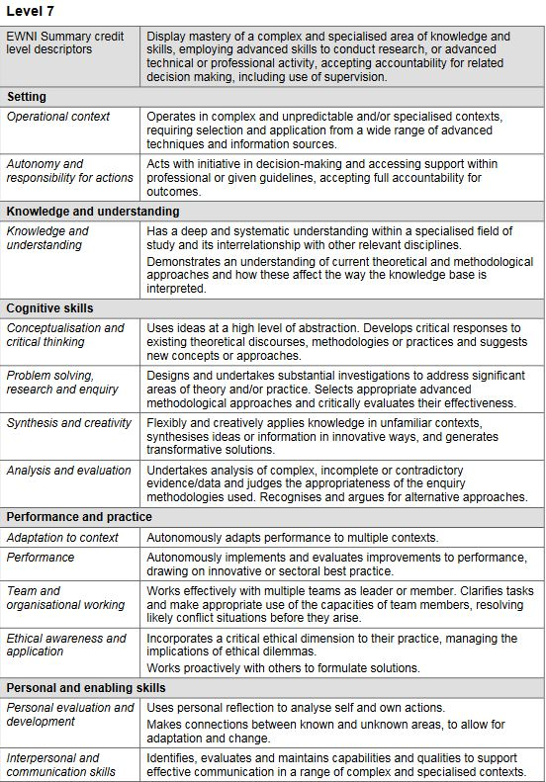
Postgraduate level descriptors
Notes:
Source: SEEC, 2016

Slide 9
Questions on LO

Slide 10
Probable module content
Principles of Health Economics
What is health economics, choice under scarcity, opportunity cost, demand and supply analysis, markets and efficiency
Economic Evaluation
Economic evaluation, cost measurement, outcome measurement

Slide 11
Probable module content
Measuring and Valuing Health Outcomes
Economic Evaluation in Decision Making Process
Health care labor market, health insurance and health care financing
Demand and supply of health care

Slide 12
Teaching Strategies
Lecture based?
Any practical sessions?
Guest speakers?
Team based learning?
Visit to a workplace?

Slide 13
Discussion
What can be done to increase students engagement in the classroom?

Slide 14
Assessment Methods
What are the assessment methods selected for this module?
and why?

Slide 15
Online Learning Resources

Slide 16
Thank you

