Slide 1
An-Najah National University
Faculty of Medicine
Department of Physiology
Anatomy and Physiology 1
7102101
Instructor: Heba Salah
Chapter 4:
The Muscular System
Part 4: Types of Body Movements

Slide 2
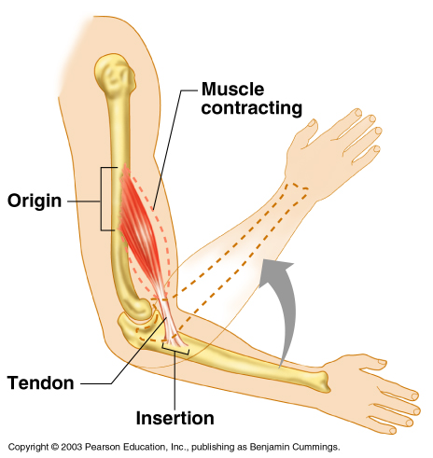
Muscles and Body Movements
Muscles are attached to at least two points:
1. Origin – attachment to a immoveable bone
2. Insertion – attachment to an movable bone

Slide 3
Types of Body Movements

Slide 4
Types of Body Movements

Slide 5
Types of Muscles
Prime mover – muscle with the major responsibility for a certain movement
Antagonist – muscle that opposes or reverses a prime mover
Synergist – muscle that aids a prime mover in a movement and helps prevent rotation

