Slide 1
Solar Energy

Slide 2
Solar Energy Applications
Sun gives energy in two forms: Heat & Light.
The following some applications that can be used in the Palestine.
Solar Thermal Applications:
Today, we are able to harness solar energy in many ways, including using it for:
Water Heating
Solar Heating & Cooling of Buildings
Crop & Vegetable Drying
Greenhouse Agriculture

Slide 3
Solar Energy Applications
Solar Water Heater (SWH)
Solar water heaters come in a variety of configurations.
Each differs in Design, Cost, Performance, & Level of Complexity.
There are two main types of systems: Passive & Active Solar Heating.

Slide 4
Solar Water Heater (SWH)
Passive Solar Heating
It can be inferred by its name, where the sun acting in everything without any mechanical help in any ways.

Slide 5
Solar Water Heater (SWH)
When referring to space heating, Passive Solar Design takes advantage:
of the sun’s warmth through such design features as large, south facing windows & materials in the floors or walls that will absorb warmth during the day and release that warmth at night, when the heat is most needed because the south side of a building always receives the most sunlight.

Slide 6
Solar Water Heater (SWH)
Passive solar water heating refers to a hot water system that is not aided by heat pumps.
These systems will include a solar collector to heat the water & a storage tank to store the hot water.

Slide 7
Active Solar Heating
Active solar heating uses the same concepts in terms of passive solar heating, absorbs sunlight & compounded by using a special mechanical designs.
Active solar heating generates more heat for hot water & space heating more than passive solar heating, there are 2 essential active solar heating system based on whether liquid or air is heated in the solar collector.

Slide 8
Active Solar Heating
An air-based system heats air in an “Air” collector, & a liquid-based system heats water or an antifreeze solution in a “Hydronic” collector.
Both of these systems absorb and collect solar radiation, then transfer the solar heat directly to the interior space or to a storage system; an auxiliary or backup system provides the additional heat.

Slide 9
Active Solar Heating
The technical potential for residential applications of solar heating systems is 0.5 to 1.0 m² of solar collector/inhabitant.
“Solar Countries” such as Israel, Greece, & Cyprus already have high “solar water heating penetration” (Israel has about 0.95 m² per inhabitant), whereas some of the best IEA (International Energy Agency) countries, such as Greece & Austria, have a penetration of between 0.2 and 0.25 m² per inhabitant.

Slide 10
Active Solar Heating
Most solar water-heating systems have 2 main parts:
Solar Collector
A storage tank
The most common collector used in solar hot water systems is the Flat-plate Collector, and the most common water heating methods is Thermosyphon System & Collective Systems.

Slide 11
Active Solar Heating
Flat-Plate Collector
The most solar collectors which are sold in many countries are of flat-plate collector which is composed of insulated metal box covered with transparent front cover plastic or glass, called the glazing, & dark-colored absorber.
The absorber, inside the flat-plate collector, converts sunlight to heat & transfers it to water in the absorber tubes.

Slide 12
Active Solar Heating
The absorber is usually made of materials such as: Copper, Galvanized Steel, Aluminum or Fiber Glass Reinforced Plastic.
The collector housing can be made of plastic, metal or wood and the glass front cover prevent wind and breezes from carrying the collected heat away.
However, the glass also reflects a small part of the sunlight, which does not then reach the absorber at all.

Slide 13
Active Solar Heating
The first accurate model of flat-plate solar collectors was developed by Hottel and Whillier in the 1950’s.
Figure below shows the processes occurring at a flat-plate.

Slide 14
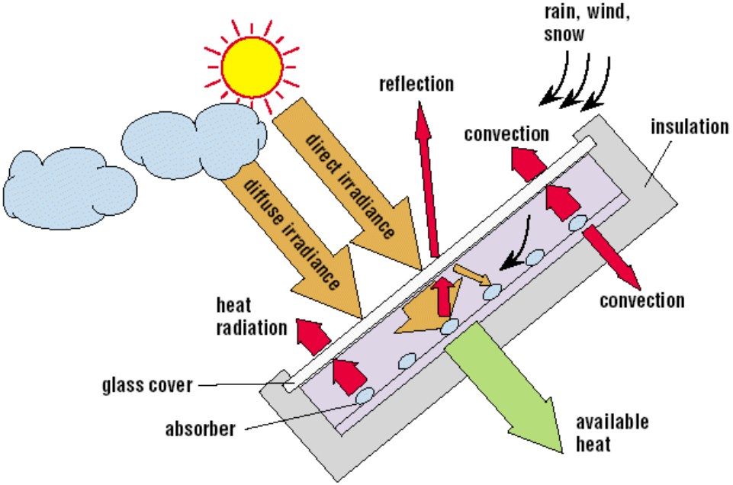
Processes Occurring At A Flat-plate

Slide 15
Thermosyphon Systems
There are several systems for storing water in cloudy days or at night through the use of tanks based on the principle of gravity is the most important of these systems the thermosyphon system is shown in the figure.
This system relies on that cold water has a higher specific density than warm water, making them heavier & thus moves down to the bottom.

Slide 16
Thermosyphon Systems
Therefore, the water storage tank is always mounted above the collector, so that cold water reaches the collector from via a descending water pipe.
After the collector heats up the water, the hot water rises again and reaches the tank through an ascending water pipe at the upper end of the collector.

Slide 17
Thermosyphon Systems
The cycle of tank–water pipe–collector ensures the water is heated up until it achieves an equilibrium temperature.
The consumer can use hot water at the top of the storage tank, and any quantity of hot water used is replaced by cold water at the bottom.
Then the collector heats up the cold water again.

Slide 18
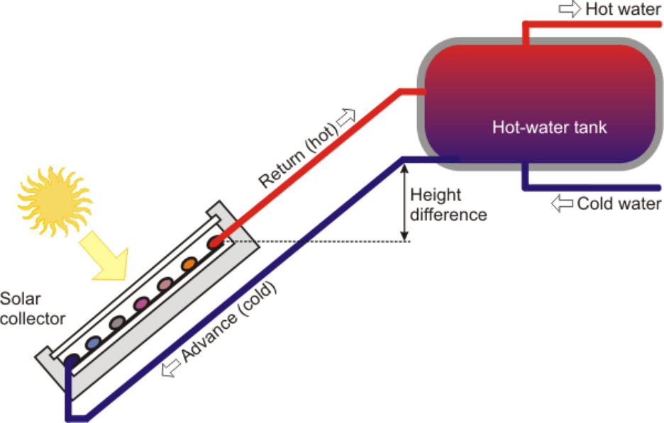
Thermosyphon Systems

Slide 19
Direct Pump Solar Water Heaters
In this system of heating systems depends on using pumps devices to move water between storage tanks and collectors, the site for storage tank is not important as can be level or low level of the collector see figure (3.3).
The goal of using pumps is to raise the efficiency of water heating system compared with systems that rely on thermosyphon system.

Slide 20
Direct Pump Solar Water Heaters
But this system of course has a disadvantage that is using of the electricity for the operation of the pump.
This system often used in commercial applications, & in hospitals in developing countries.

Slide 21
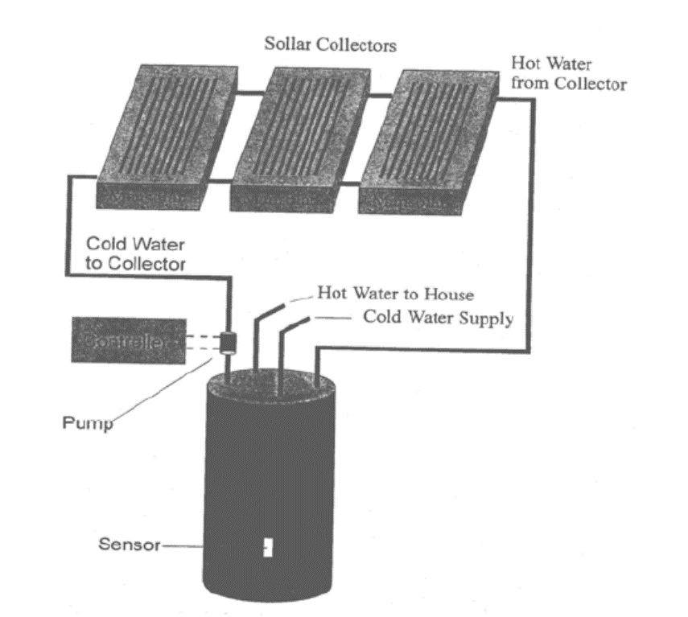
Direct Pump Solar Water Heaters

Slide 22
Solar Energy

Slide 23
Applications of Solar water Heaters in Palestine
The sectors which consume the hot water show significantly in residential & there are other sectors such as services sector (Hospitals, Medical Clinics, & Educations), Commercial (Hotels, Restaurants) & Industrial Sector.
Households: have the fundamental role in the market SWH
About 67.2% of houses are actually using solar family system of water heating in 2005(PCBS survey of house energy 2005).
One of the most common Solar Water Heating Systems is Thermosyphonic open circuit system which allows using hot water directly by consumer.

Slide 24
Applications of Solar water Heaters in Palestine
This system consists of 2 or 3 flat-plate collectors, each measuring 1.7 m², a rating of 2750 kcal/ day (iron collector) as a yearly average output, and it directed to the south with angle 42º.
For climate conditions, 3 collectors are generally used in hilly areas, while 2 collectors are utilized in the Jordan Valley, Jenin, Tulkarm & Gaza Strip.
The hot water storage tank has a capacity of 150-200 litres.
The cold water supply tank is located generally above the hot water storage tank.
The area of a system with 3 collectors is 5 m² which can produce 12 kWh daily, particularly in summer time or 200 litre of hot water (50-60 °C).

Slide 25
Applications of Solar water Heaters in Palestine
Collective systems:
Many of the apartments in residential buildings in the Gaza Strip & Nablus have been using this system as it more than 20 systems are available in 1999, in addition to its use in hospitals see figure below, hotels, universities, fitness clubs, & security residencies.
The perspective of collective systems seems large if real efforts are directed towards the efficient utilization of solar energy by imposition of standards to improve the quality.

Slide 26
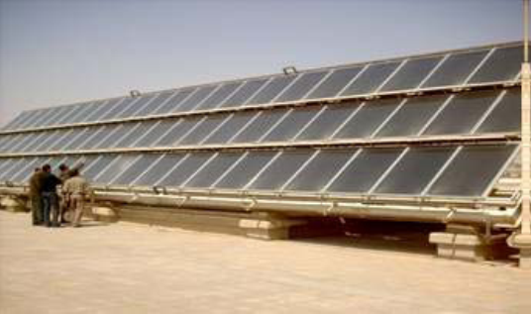
Collective Solar system at Jericho hospital

Slide 27
Direct pump system
This system is used in the roofs of villas where storage tank is kept indoor, sited at the same level as the collector & the pump circulate hot water between storage tank & the collector see figure below.

Slide 28
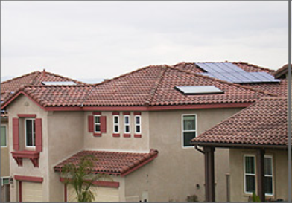
Direct pump system on the roof of villas
The system is considered Direct because no heat exchangers are involved during the heating of water.
The liquid that runs in the collector is the water used by the consumer.

Slide 29
Central (SWH) for apartment buildings
This system successfully used & adopted for apartment buildings in Palestine, Solar collectors are shared for all apartments.
Collectors are connected in arrays and parallel and then in series, as shown in the figure below.
Each 3 collectors are connected in series to form one group and then connected in parallel to the similar groups that is in some designs & within the array itself.
Each apartment uses the domestic hot water separately.

Slide 30
Central (SWH) for apartment buildings
The hot water is a double jacket storage tank & acts as heat exchanger, inside each apartment one storage tank is installed.
A mixture of water & antifreeze is the liquid heat carrier that runs through the solar collector, to circulate the heat carrier liquid from the solar collectors to the heat water exchangers & back a pump is used.
The temperatures are sensed by the differential controller at the coldest point in the storage tank & the hot end of the solar collector.

Slide 31
Central (SWH) for apartment buildings
If the temperature difference is higher than a predetermined value, it will activate the pump.
An electric backup system is installed in each storage tank.
The cost of this type of systems is around that of individual ones.
In 1999 more than 20 systems of this type have been installed in Gaza &West Bank.
They have been working perfectly for the last few years.

Slide 32
Central (SWH) for apartment buildings
This system has observed many advantages such as:
• No needing for stands or cold water on the roof.
• The number of collectors is less than that in traditional system, Almost 20% of collectors could be saved.
• Comparing with thermosyphone system about two third of the space on the roof is needed.
• Neither freeze nor calcification problems observed.
• Saving of 1 to 2 cubic meter of water each month for each apartment, in addition to minimum heat losses from the hot water storage tank, due to placing the storage tank indoor & close to a place of use.
• Better view of the roof and eventually of the city.

Slide 33
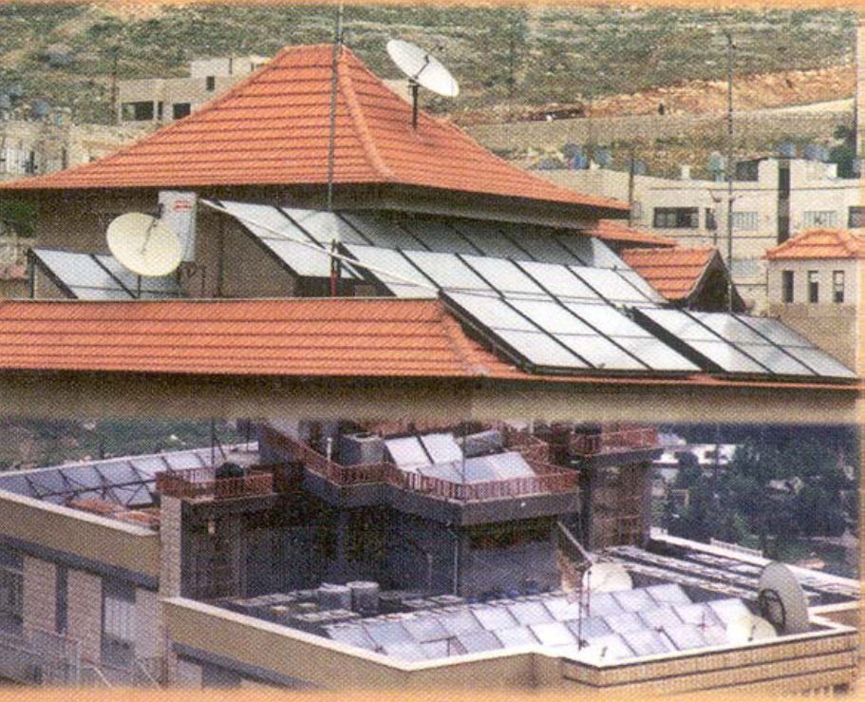
Central solar water heater for apartment buildings

Slide 34
Solar Heating and Cooling of Buildings
Passive solar space heating is used in traditional and wide form in Palestine, particularly when the buildings were constructed and windows were oriented to the direction of the sun to benefit from the direct rays in heating the indoor air but it is an ineffective way, because the duration of the sun is a few hours especially in winter and also there is no way to keep heat inside for more hours.

Slide 35
Solar Heating and Cooling of Buildings
Passive solar heating is the absorption of solar energy in a building to reduce the energy required to warm the habitable areas (i.e. to contribute to space heating).
Air is normally used to circulate & distribute the collected energy, generally without the use of pumps or fans.
The collector may be an integral part of the building, perhaps designed as part of an architectural feature that provides light and heat.

Slide 36
Solar Heating and Cooling of Buildings
Applications in residential & public buildings. These systems include:
Solar Window
Solar Wall
Solar Roof
Solar Chimney &
Greenhouse (Solarium)

Slide 37
Solar Thermal Electricity Generation
Solar thermal energy can be collected at large scale & used to heat a transfer fluid that can then power a steam turbine to generate electricity.
Sunlight may be collected using huge mirror arrays focused on to a receiver at the top of a tower or, at the other extreme, may be based on the temperature gradient produced when sunlight impinges on a "Solar Pond" (a large salty lake) and heats the water at its base.

Slide 38
Solar Thermal Electricity Generation
Most commercially attractive is the solar thermal electricity generation system originally developed by Luz, which uses parabolic reflectors to warm heat-transfer oil running through a pipe at the focus of the reflector.
This heated oil is used to raise steam to power a turbine.

Slide 39
SolarDrying
Using the sun to dry crops, grains, vegetables & to make yogurt is one of the oldest and most widely used applications of solar energy.
The simplest & least expensive technique is to allow crops to dry naturally in the field, or to spread grain and fruit out in the sun after harvesting, but this industry is small & limited in some villages & charitable institutions and voluntary.

Slide 40
Greenhouse Agriculture
Another agricultural application of solar energy is greenhouse heating.
Solar greenhouse is designed to utilize solar energy for both heating & lighting see figure.
Greenhouse is used to plant many flowers and vegetables, medicinal herbs, and it has many benefits such as increase production & reduces the amount of water lost in irrigation in addition to a temperature appropriate for the growth of some plants, but it is still using traditional.

Slide 41
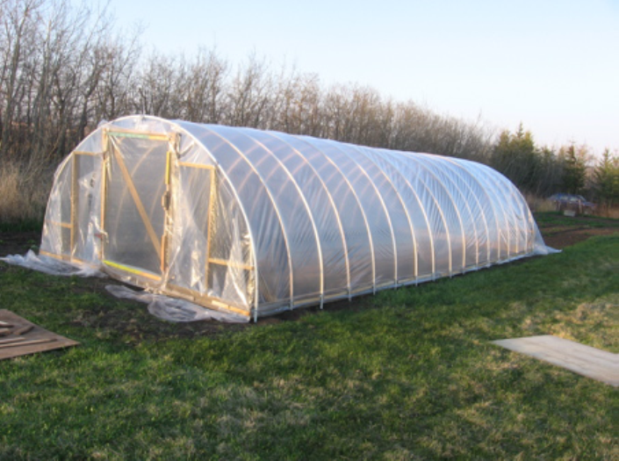
Greenhouse heating in one of The Palestinian Village

Slide 42
Solar cooking
Solar cookers are great educational tools; they fall into two main categories –direct solar concentrators and solar ovens.
The basic design for a solar oven is that a glass cover of a box .
The insulation lined The box and a reflective surface is applied to concentrate the heat into the pots.
The other approach is to reflect the suns rays onto a put, often with a parabolic dish.

Slide 43
Solar cooking
The pots to absorb heat it can be painted black.
It is a real oven, it typically cooks at temperatures between 225 - 275 F. and will cook most anything you would put in your oven at home.
They are considered a slow cooker, usually taking about twice as long as your conventional oven.

Slide 44
Solar cooking
The cookers have limitations in terms of only being effective during hours of strong sunlight on a domestic scale.
However, the main advantage to solar cookers is that wood does not need to be purchased or collected, which is often a very time consuming activity for women.
There are many forms of solar cookers the following figure shows one of them.

Slide 45
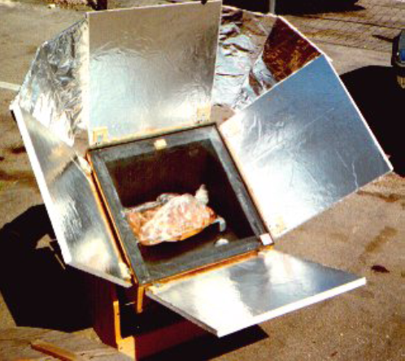
Solar cooking

