Slide 1
An-Najah National University
Faculty of Medicine
Department of Physiology
Anatomy and Physiology 1
7102101
Instructor: Heba Salah
Chapter 1:
The human Body: An Orientation
Part 3: Maintaining Life

Slide 2
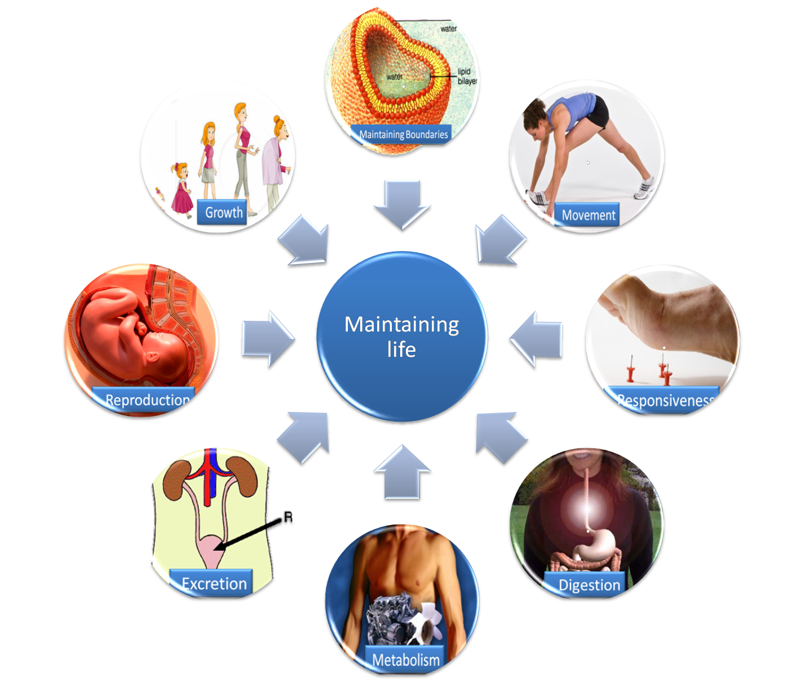
Necessary Life functions

Slide 3
Survival Needs
1. Nutrients:
Chemicals for energy and cell building
Includes carbohydrates, proteins, lipids, vitamins, and minerals
2. Oxygen:
Required for chemical reactions

Slide 4
Survival Needs
3. Water:
60–80% of body weight
Provides for metabolic reaction
4. Stable body temperature
5.Atmospheric pressure must be appropriate

