Slide 1
Geomolg high quality maps
https://geomolg.ps/L5/index.html?viewer=A3.V1

Slide 2
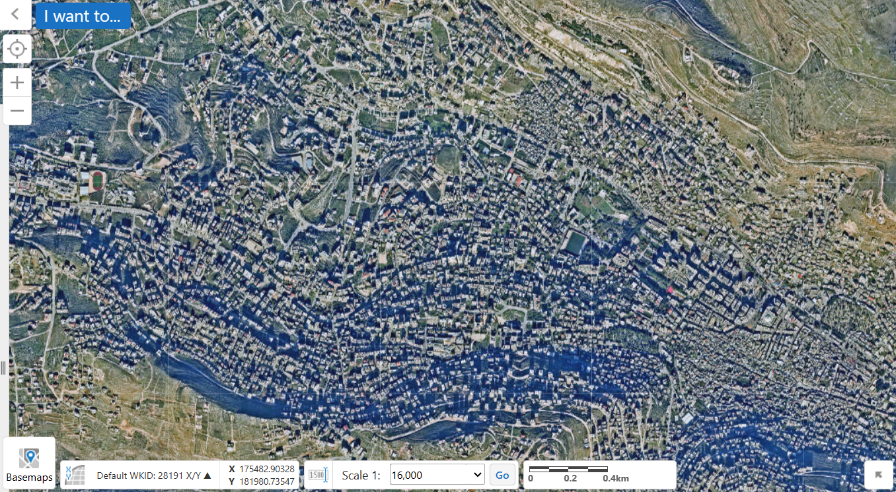

Slide 3
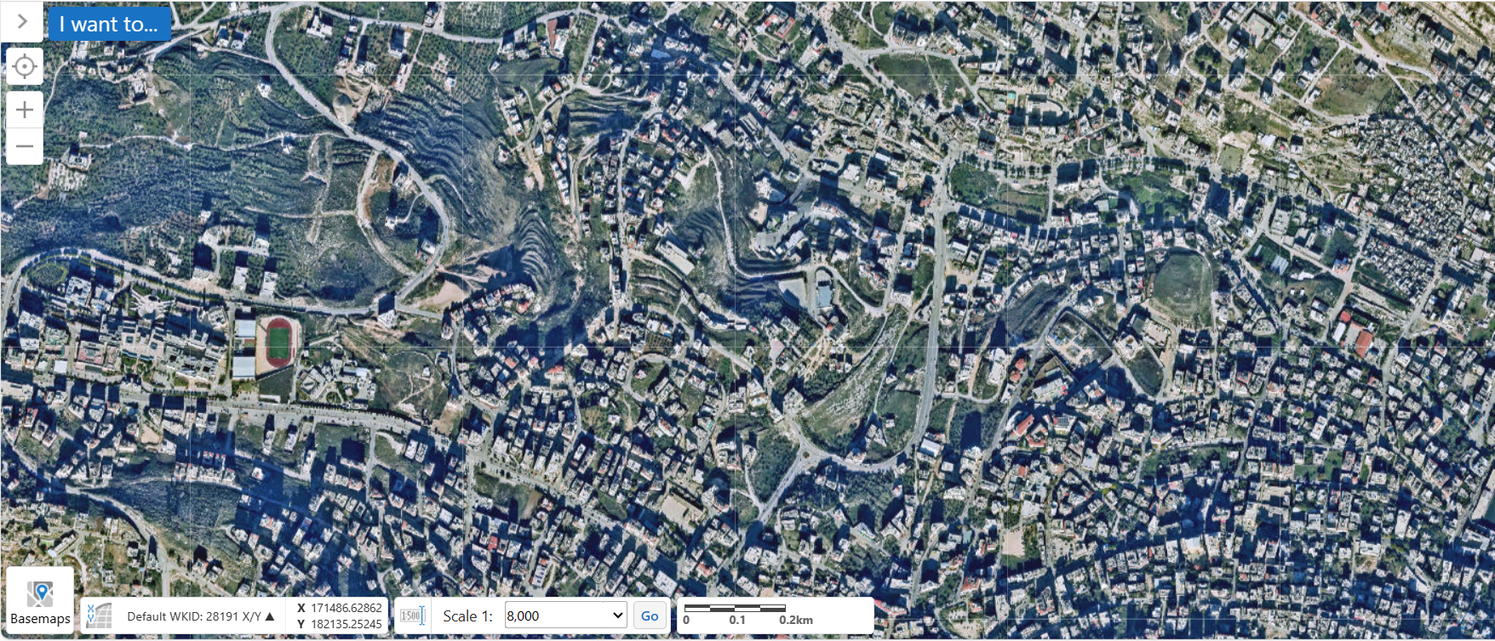

Slide 4
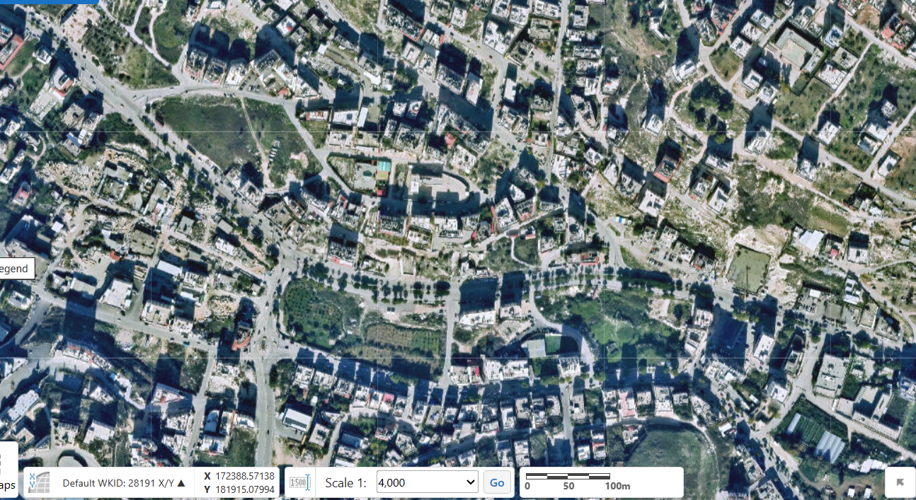

Slide 5
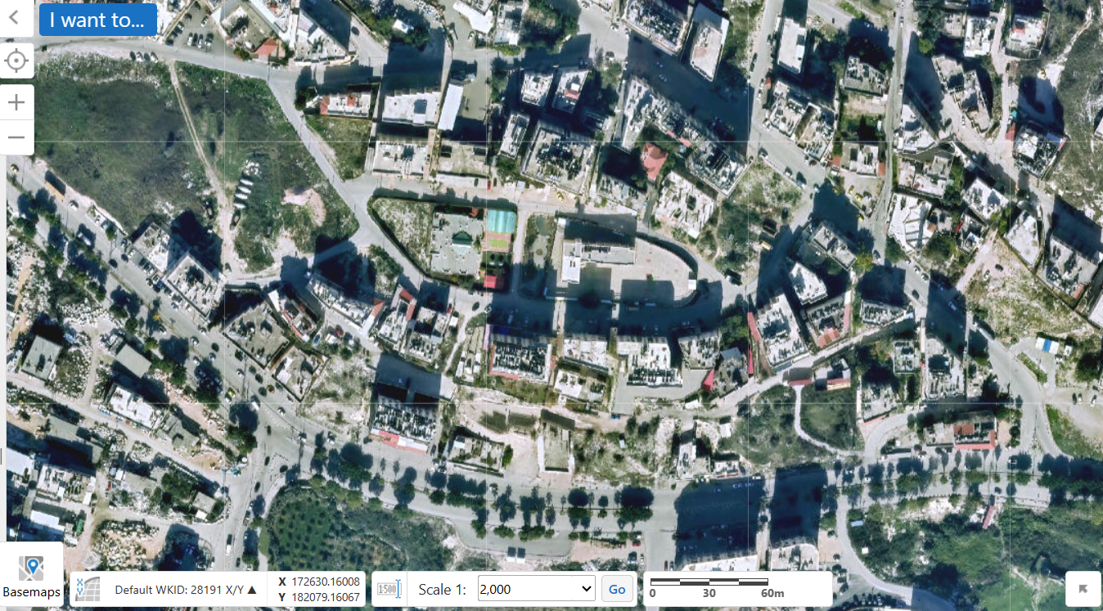

Slide 6
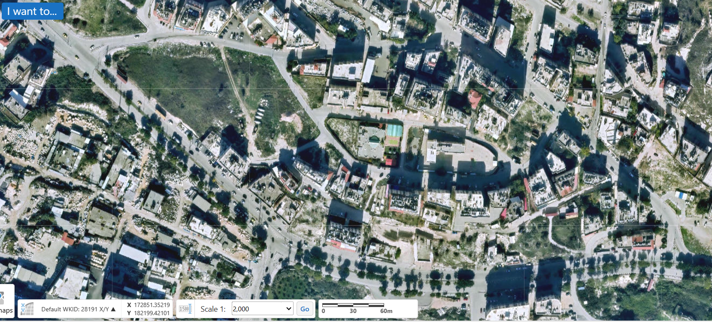

Slide 7
