Slide 1
Introduction to Digital Speech Processing 69451
DRAFT
Presented by
Dr. Allam Mousa
An Najah National University

Slide 2
What is the Speech?
Speech is the primary method of human communication.
To transmit/store a speech waveform using as few bits as possible while retaining high quality

Slide 3
Speech Processing
Speech Processing aims at modeling and manipulating the speech signal to be able to
transmit (code) speech efficiently
produce (synthesis) natural sounding voice
recognize (decode) spoken words
Speech is a natural form of communication between humans and it reflects a lot of the variability and complexity of humans! This makes modeling speech an interesting and challenging task. The speech signal contains information from many levels and encodes information about the speaker and acoustic channel; the words and pronunciation; the language syntax and semantics, etc.
Speech technology is becoming increasingly well established with quite sophisticated technology now incorporated into many widely deployed applications and speech technologists are much in demand!

Slide 4
Speech Processing
Speech processing is the study of speech signals and the processing methods of these signals.
Speech is the way of choice for humans to communicate:
– no special equipment required
– no physical contact required
– no visibility required
– can communicate while doing something else

Slide 6
Speech Process:
1- Production:

Slide 7
Speech Process:
2- Propagation:
the sound waves propagate
through the air at
a speed of 300 m/s,
reaching the
listener’s ears.

Slide 8
Speech Process:
3-· Perception:
the incoming sounds are deciphered by the listener into a received message, thereby completing the chain of events that culminated in the transfer of information from the speaker to the listener.

Slide 9
Some applications of Speech Processing
Coding
Compression
Synthesis
Automatic Speech Recognition (ASR)
Speaker Recognition
Speech Recognition
Spoken Language recognition
Speech Enhancement
Echo Cancellation
Noise Cancellation
… and more

Slide 10
Algorithms (Programming)
Psychoacoustics Room acoustics Speech production
Speech Processing
Acoustics
Signal Processing
Information Theory
Phonetics
Fourier transforms Discrete time filters AR(MA) models
Entropy Communication theory Rate-distortion theory
Statistical SP Stochastic models

Slide 11
Digital signal Processing

Slide 12
Speech Sound Categories
– Voiced: speech sounds where the vocal folds vibrate.
– Vowels: no blockage of the vocal tract and no turbulence (e)
– Consonants: non-vowels (s)
– Plosives: consonants involving an explosion (p)

Slide 13
Speech Waveforms
Extracts from “my speech”
(a) start of “y” vowel
(b) “ee” vowel
(c) “s” consonant

Slide 14
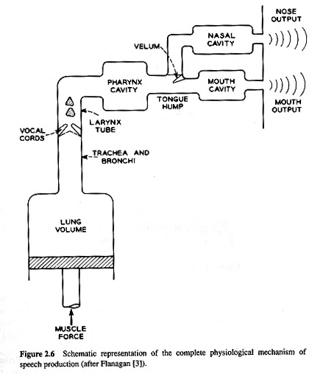
Human Speech Production Mechanism

Slide 15
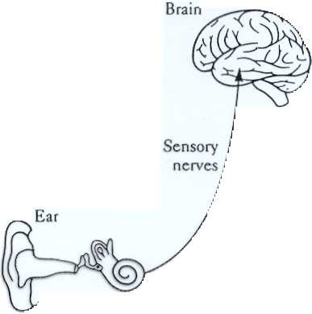
Speech Chain
SPEAKER

Slide 16
Speech Processing Diagram

Slide 17
Sources of Sound Energy
1- Turbulence: air moving quickly through a small hole (e.g./s/ in “size”)
2- Explosion: pressure built up behind a blockage is suddenly released (e.g. /p/ in “pop”)
3- Vocal Fold Vibration: like the neck of a balloon (e.g. /a/ in “hard”)
– airﬂow through vocal folds (vocal cords) reduces the pressure and they
snap shut (Bernoulli eﬀect)
– muscle tension and air pressure build up force the folds open again and
the process repeats
– frequency of vibration (fx) determined by tension in vocal folds and
pressure from lungs
– for normal breathing and voiceless sounds (e.g. /s/) the vocal folds are
held wide open and don’t vibrate

Slide 18
Speech Sound Categories:
1-Voiced: speech sound where the vocal tract folds vibrate.
2-Vowels: no blockage of the vocal tract and no turbulence

Slide 19
Speech Sound Categories:
3-Consonants: non-vowels.
4-Plosives: consonants involving an explosion

Slide 20
The Vocal Tract Filter

Slide 21
Speech Spectrograme:
Ex: my speech

Slide 22
Vocal Tract Filter
The sound spectrum is modified by the shape of the vocal tract. This is determined by movements of the jaw, tongue and lips.
• The resonant frequencies of the vocal tract cause peaks in the spectrum called formants.
• The first two formant frequencies are roughly determined by the distances from the tongue hump to the larynx and to the lips respectively.

Slide 23
http://www.youtube.com/watch?v=uTOhDqhCKQs
http://www.youtube.com/watch?v=X_JvfZiGEek

