Slide 2
Table of Contents
(9.1) Hybridization and the localized electron model
(9.2) The molecular orbital model
(9.3) Bonding in homonuclear diatomic molecules
(9.4) Bonding in heteronuclear diatomic molecules
(9.5) Combining the localized electron and molecular orbital models

Slide 3
Hybridization
The mixing of native orbitals to form special orbitals for bonding
sp³ orbitals - Formed from one 2s and three 2p orbitals
Atoms that undergo this process are said to be sp³ hybridized

Slide 4
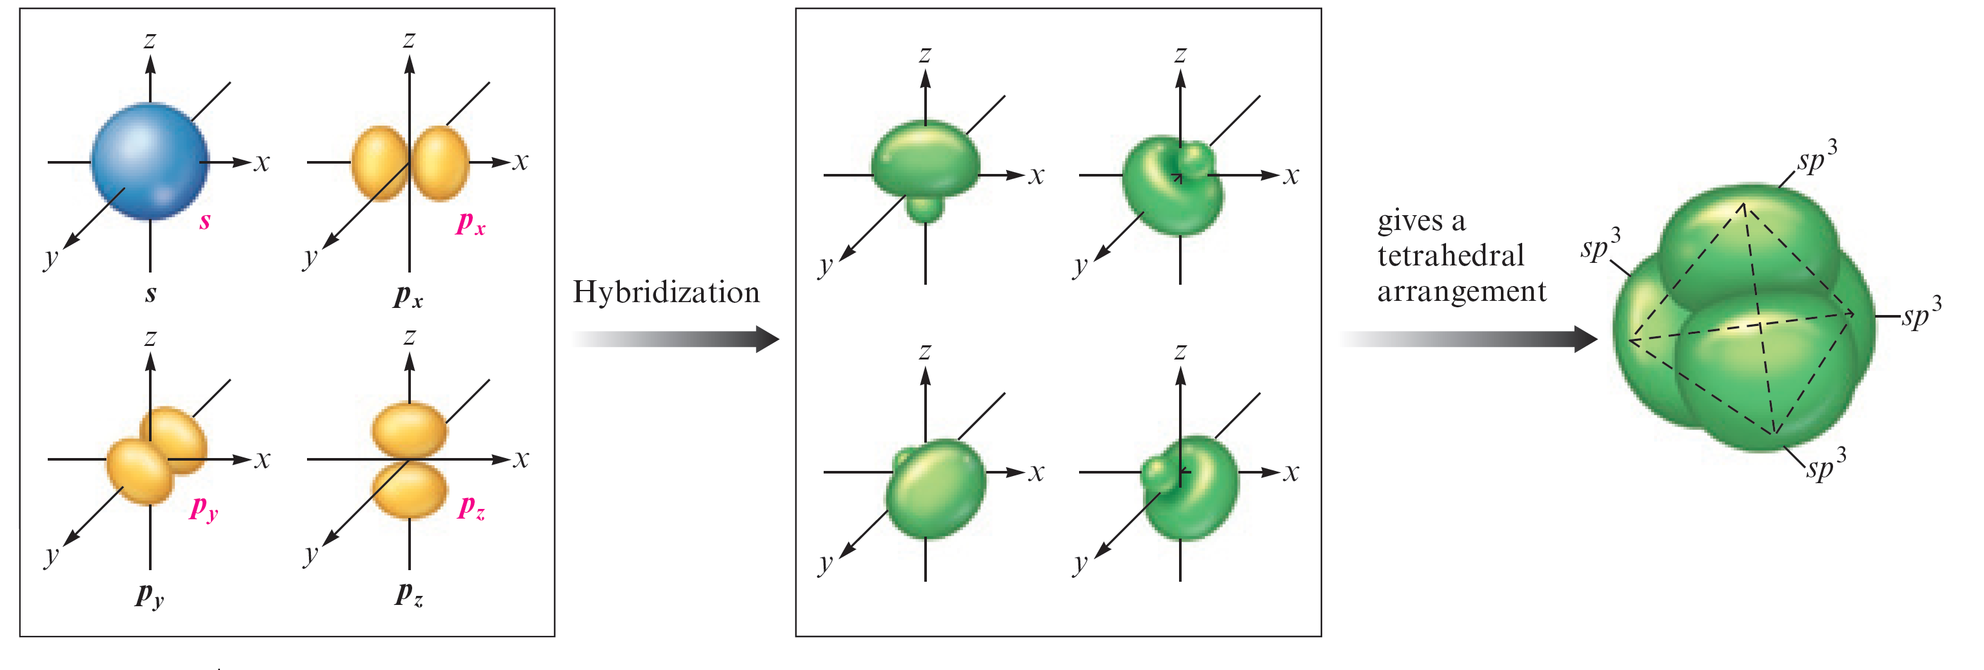
Figure 9.3 - sp³ Hybridization of a Carbon Atom

Slide 5
Orbital Energy-Level Diagram
Gives importance to the total number of electrons and the arrangement of these electrons in the molecule
Example - Hybridization of the carbon 2s and 2p orbitals in methane

Slide 6
Key Principle in sp³ Hybridization
Whenever an atom requires a set of equivalent tetrahedral atomic orbitals, this model assumes that the atom adopts a set of sp³ orbitals
The atom undergoes sp³ hybridization

Slide 7
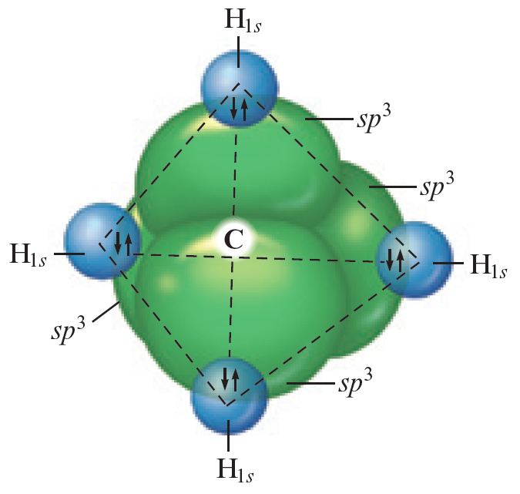
Figure 9.6 - Tetrahedral Set of Four sp³ Orbitals

Slide 8
Critical Thinking
What if the sp³ hybrid orbitals were higher in energy than the p orbitals in the free atom?
How would this affect our model of bonding?

Slide 9
Example 9.1 - The Localized Electron Model I
Describe the bonding in the ammonia molecule using the localized electron model

Slide 10
Example 9.1 - Solution
A complete description of the bonding involves three steps
Writing the Lewis structure
Determining the arrangement of electron pairs using the VSEPR model
Determining the hybrid atomic orbitals needed to describe the bonding in the molecule

Slide 11
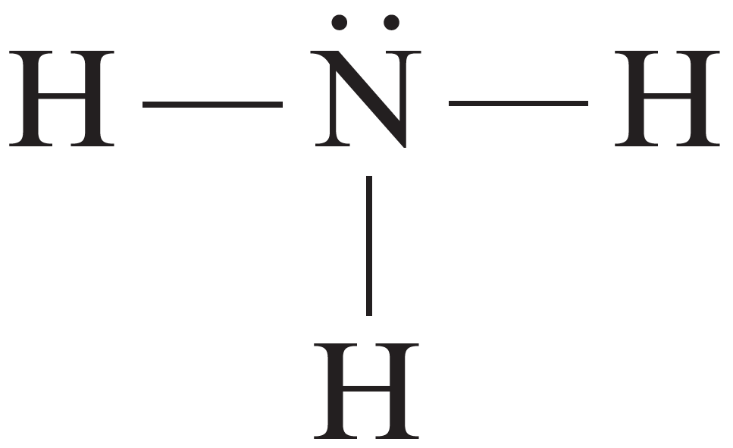
Example 9.1 - Solution (Continued 1)
Lewis structure for NH₃
The four electron pairs around the nitrogen atom require a tetrahedral arrangement to minimize repulsions
A tetrahedral set of sp³ hybrid orbitals is obtained by combining the 2s and three 2p orbitals

Slide 12
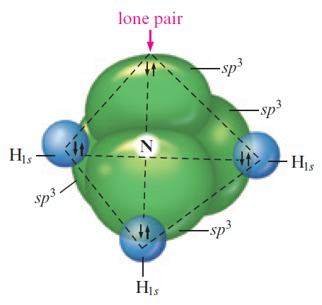
Example 9.1 - Solution (Continued 2)
In the NH₃ molecule, three of the sp³ orbitals are used to form bonds to the three hydrogen atoms, and the fourth sp³ orbital holds the lone pair

Slide 13
sp² Hybridization
Combination of one 2s and two 2p orbitals
Gives a trigonal planar arrangement of atomic orbitals
Bond angles - 120 degrees
One 2p orbital is not used
Oriented perpendicular to the plane of the sp² orbitals

Slide 14
Figure 9.8 - Formation of sp² Orbitals

Slide 15
Figure 9.9 - Orbital Energy-Level Diagram for the Formation of sp² Orbitals in Ethylene

Slide 16
Figure 9.10 - sp² Hybridization

Slide 17
Types of sp² Hybridized Bonds
Sigma (σ) bond: Formed by electron sharing in an area centered on a line running between the atoms
Pi (π) bond: Parallel p orbitals share an electron pair occupying the space above and below the σ bond
A double bond always consists of one σ bond and one π bond

Slide 18
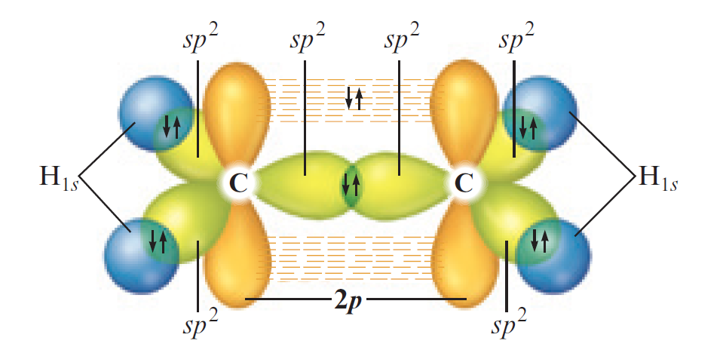
Key Principle in sp² Hybridization
If an atom is surrounded by three effective pairs, a set of sp² hybrid orbitals is required

Slide 19
sp Hybridization
Involves one s and one p orbital
Two effective pairs around an atom will always requires sp hybridization
Example - Carbon atoms in carbon dioxide
Two 2p orbitals are unaffected
Used in formation of π bonds with oxygen atoms

Slide 20
Figure 9.14 - Formation of sp Orbitals

Slide 21
Figure 9.15 - Hybrid Orbitals in the CO₂ Molecule

Slide 22
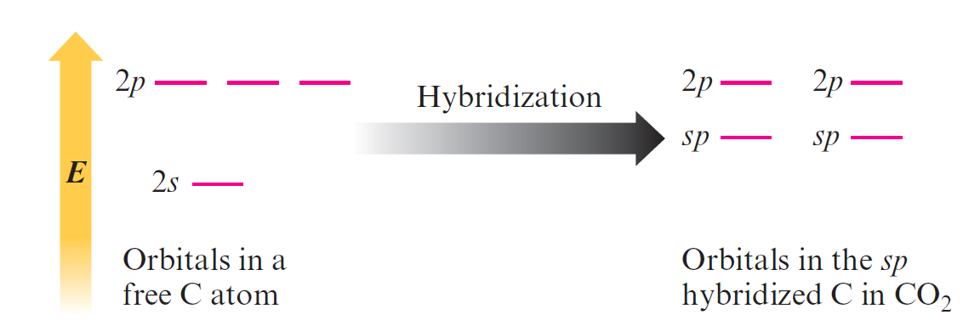
Figure 9.16 - Orbital Energy-Level Diagram for the Formation of sp Hybrid Orbitals on Carbon

Slide 23
Figure 9.17 - An sp Hybridized Carbon Atom

Slide 24
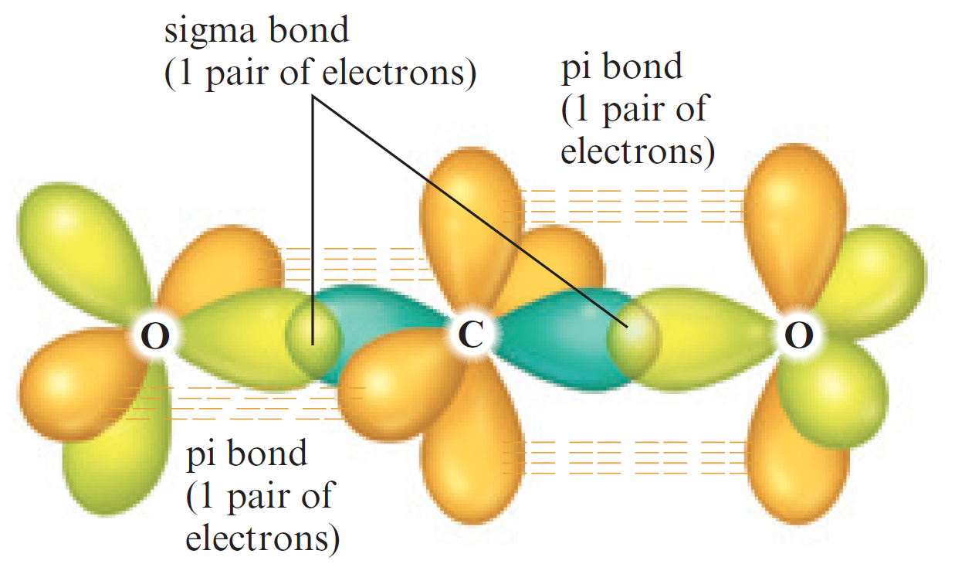
Figure 9.19 (a) - Orbitals Forming Bonds in Carbon Dioxide

Slide 25
Example 9.2 - The Localized Electron Model II
Describe the bonding in the N₂ molecule

Slide 26
Example 9.2 - Solution
The Lewis structure for N₂ is
Each nitrogen atom is surrounded by two effective pairs
Gives a linear arrangement requiring a pair of oppositely directed orbitals
Requires sp hybridization

Slide 27
Example 9.2 - Solution (Continued 1)
Each nitrogen atom has two sp hybrid orbitals and two unchanged p orbitals
sp orbitals form the σ bond between the nitrogen atoms and hold lone pairs
p orbitals form the two π bonds
Each pair of overlapping parallel p orbitals holds one electron pair
Accounts for electron arrangement given in the Lewis structure

Slide 28
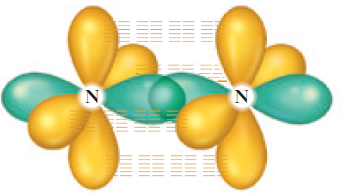
Example 9.2 - Solution (Continued 2)
The triple bond consists of a σ bond and two π bonds
A lone pair occupies an sp orbital on each nitrogen atom

Slide 29
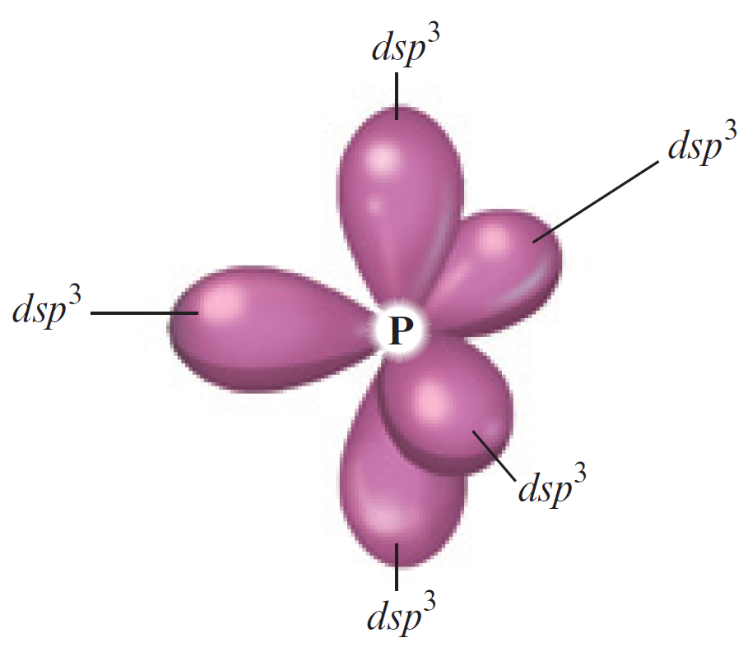
dsp³ Hybridization
Combination of one d, one s, and three p orbitals
A set of five effective pairs around a given atom always requires a trigonal bipyramidal arrangement
Requires dsp³ hybridization of that atom

Slide 30
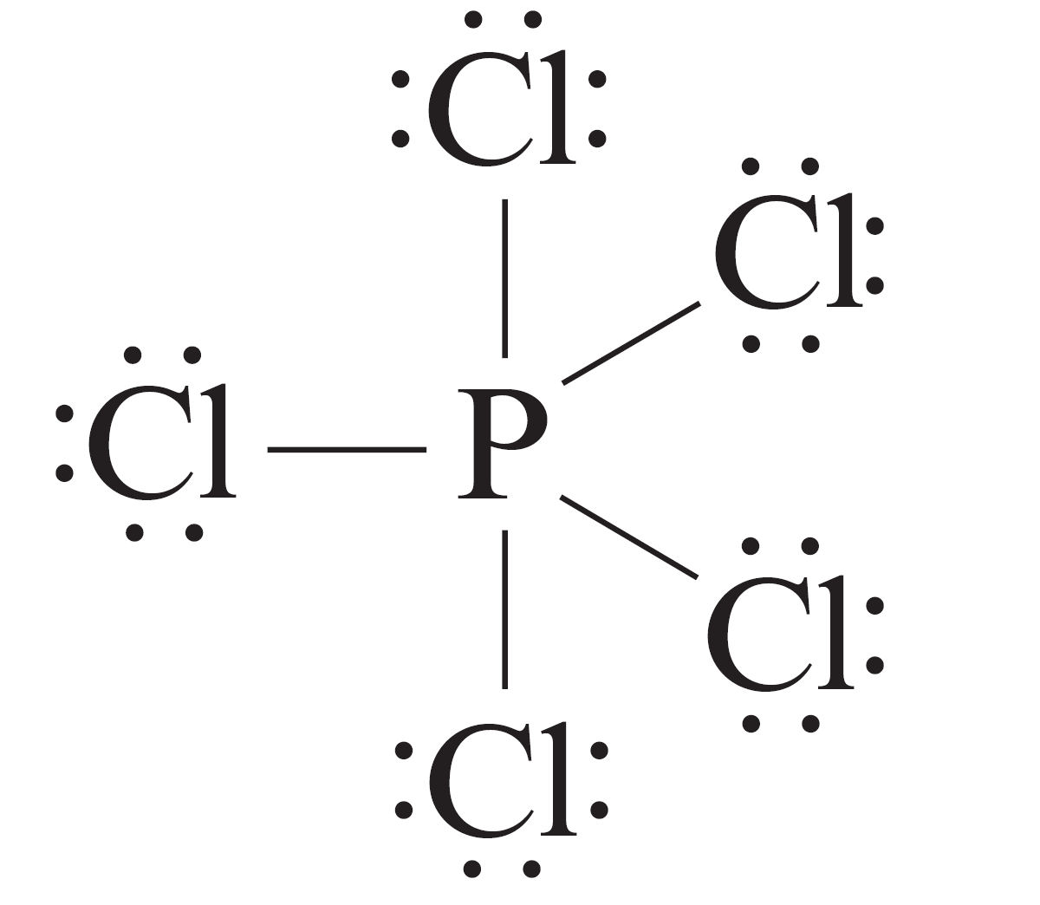
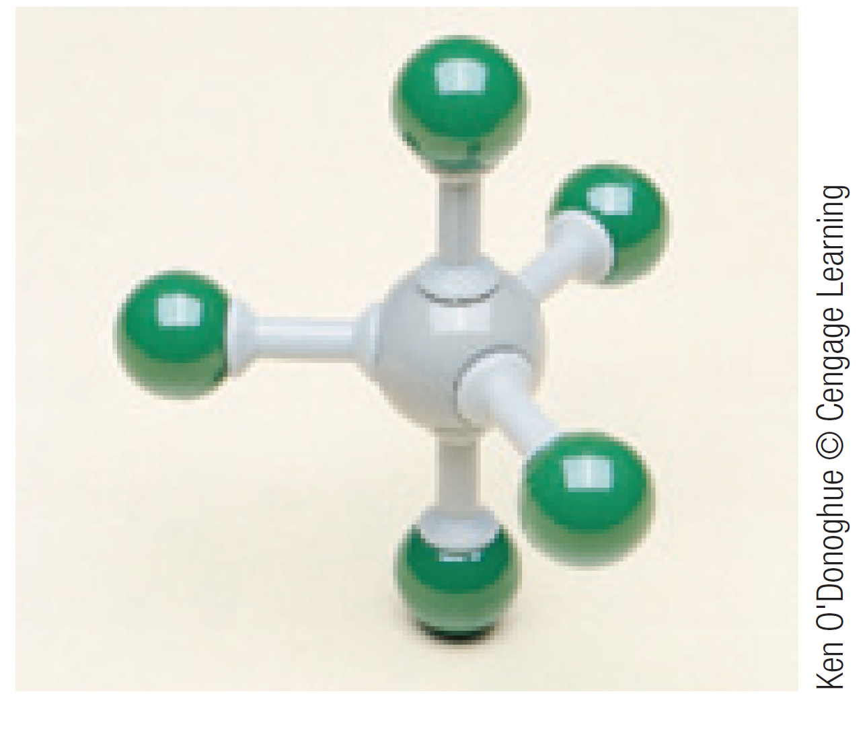
dsp³ Hybridization (Continued)
Each chlorine atom in PCl₅ is surrounded by four electron pairs
Requires a tetrahedral arrangement
Each chlorine atom requires four sp³ orbitals

Slide 31
Example 9.3 - The Localized Electron Model III
Describe the bonding in the triiodide ion (I₃–)

Slide 32
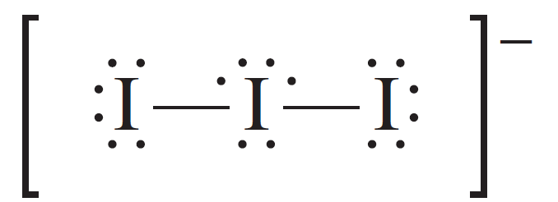
Example 9.3 - Solution
The Lewis structure for I₃–
The central iodine atom has five pairs of electrons
Requires a trigonal bipyramidal arrangement, which in turn requires a set of dsp³ orbitals
Outer iodine atoms have four pairs of electrons
Requires tetrahedral arrangement and sp³ hybridization

Slide 33
Example 9.3 - Solution (Continued)
The central iodine atom is dsp³ hybridized
Three hybrid orbitals hold lone pairs
Two hybrid orbitals overlap with sp³ orbitals of the other two iodine atoms to form σ bonds

Slide 34
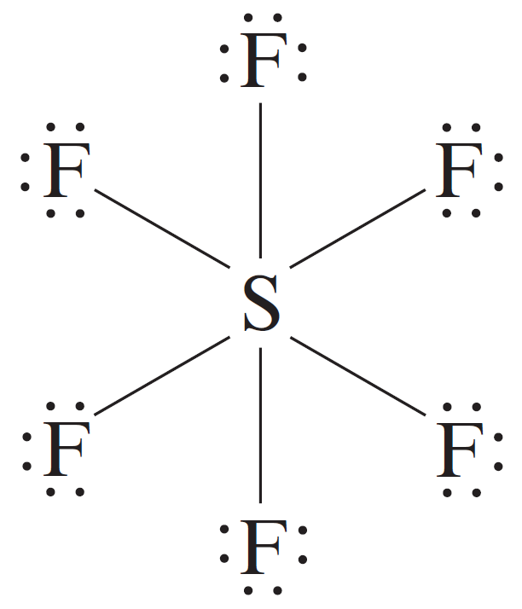
d²sp³ Hybridization
Combination of two d, one s, and three p orbitals
Requires an octahedral arrangement of six equivalent hybrid orbitals
Six electron pairs around an atom are always arranged octahedrally
Require d²sp³ hybridization of the atom

Slide 35
Figure 9.23 - An Octahedral Set of d²sp³ Orbitals on a Sulfur Atom

Slide 36
Interactive Example 9.4 - The Localized Electron Model IV
How is the xenon atom in XeF₄ hybridized?

Slide 37
Interactive Example 9.4 - Solution
XeF₄ has six pairs of electrons around xenon that are arranged octahedrally to minimize repulsions
An octahedral set of six atomic orbitals is required to hold these electrons, and the xenon atom is d²sp³ hybridized

Slide 38
Interactive Example 9.4 - Solution (Continued)

Slide 39
Problem Solving Strategy - Using the Localized Electron Model
Draw the Lewis structure(s)
Determine the arrangement of electron pairs using the VSEPR model
Specify the hybrid orbitals required to accommodate the electron pairs

Slide 40
Figure 9.24 - Relationship between the Number of Effective Pairs, Spatial Arrangement, and Hybrid Orbitals

Slide 41
Figure 9.24 - Relationship between the Number of Effective Pairs, Spatial Arrangement, and Hybrid Orbitals (Continued)

Slide 42
Interactive Example 9.5 - The Localized Electron Model V
For each of the following molecules or ions, predict the hybridization of each atom, and describe the molecular structure
CO
BF₄–
XeF₂

Slide 43
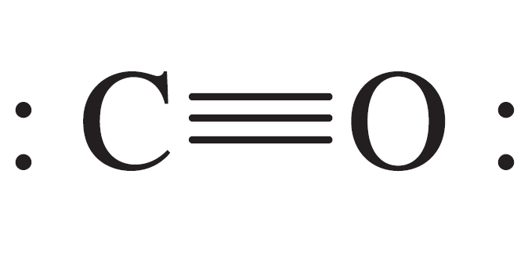
Interactive Example 9.5 - Solution (a)
The CO molecule has 10 valence electrons
Each atom has two effective pairs, which means that both are sp hybridized
The triple bond consists of:
One σ bond produced by overlap of an sp orbital from each atom
Two π bonds produced by overlap of 2p orbitals from each atom

Slide 44
Interactive Example 9.5 - Solution (a) (Continued)
The lone pairs are in sp orbitals
The molecule exhibits a linear arrangement of atoms

Slide 45
Interactive Example 9.5 - Solution (b)
BF₄– ion has 32 valence electrons
The boron atom is surrounded by four pairs of electrons
Requires tetrahedral arrangement and sp³ hybridization of the boron atom

Slide 46
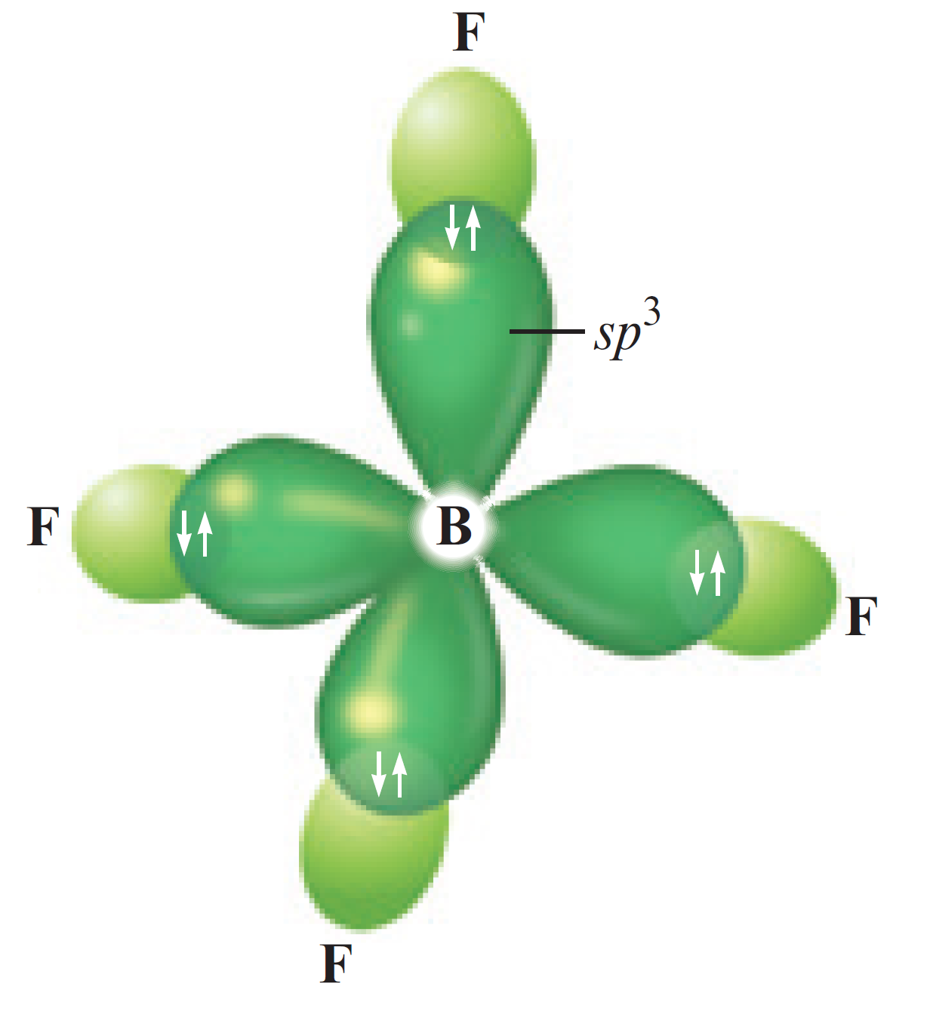
Interactive Example 9.5 - Solution (b) (Continued)
Each fluorine atom has four electron pairs
Assumed to be sp³ hybridized
Molecular structure - Tetrahedral

Slide 47
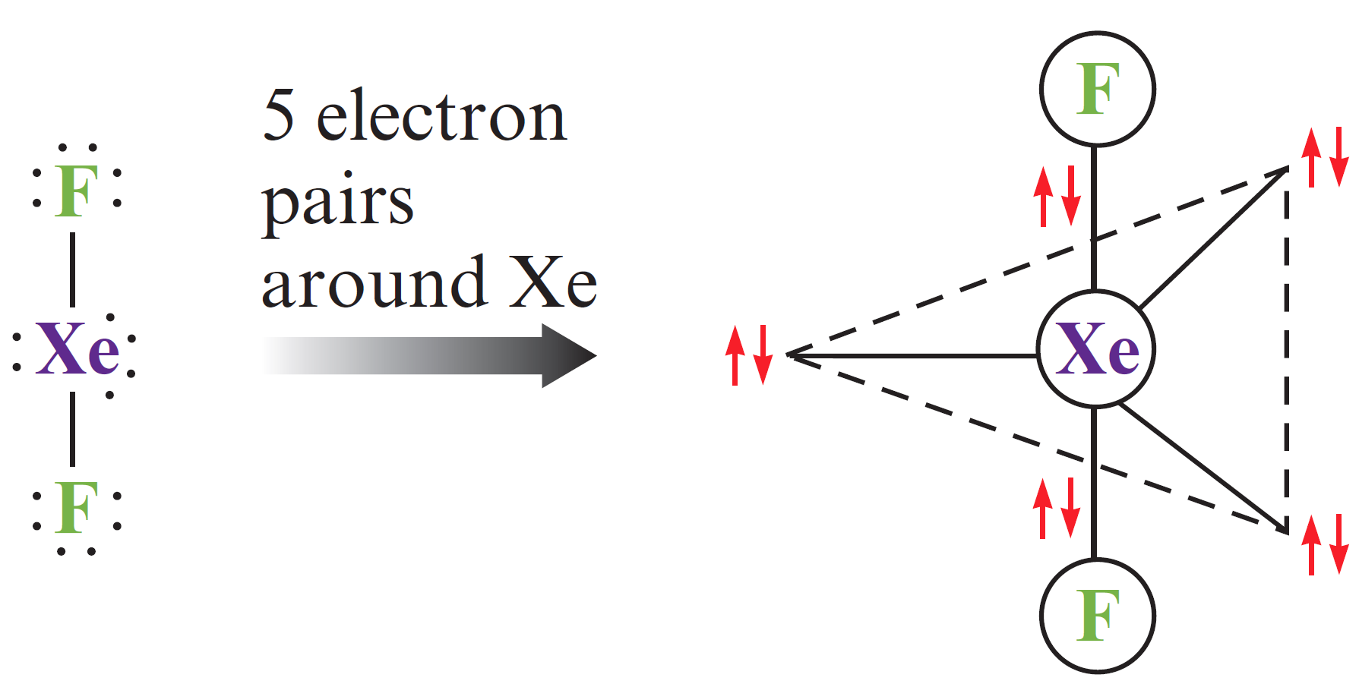
Interactive Example 9.5 - Solution (c)
XeF₂ has 22 valence electrons
The xenon atom is surrounded by five electron pairs
Requires a trigonal bipyramidal arrangement

Slide 48
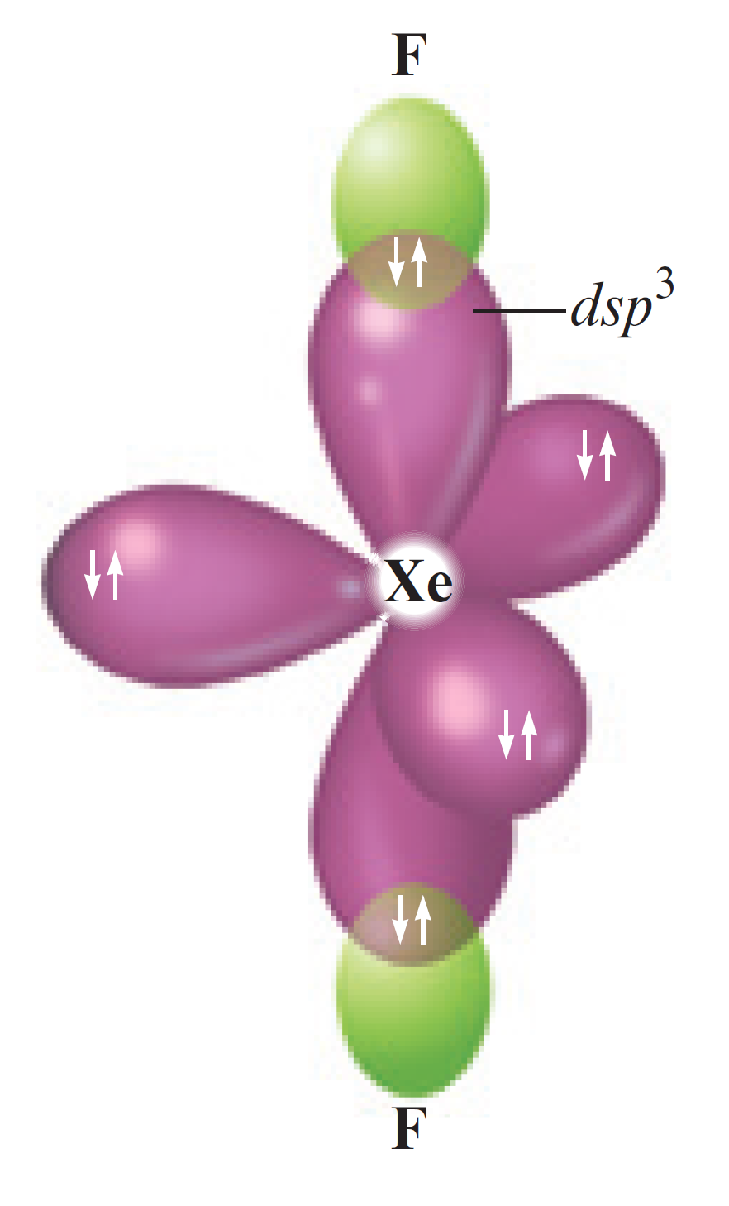
Interactive Example 9.5 - Solution (c) (Continued)
The lone pairs are placed in the plane where they are 120 degrees apart
To accommodate five pairs at the vertices of a trigonal bipyramid requires that the xenon atom adopt a set of five dsp³ orbitals
Each fluorine atom has four electron pairs and is assumed to be sp³ hybridized
The molecule has a linear arrangement of atoms

Slide 49
Limitations of the Localized Electron Model
Incorrectly assumes that electrons are localized
Concept of resonance must be added
Does not deal effectively with molecules containing unpaired electrons
Does not provide direct information about bond energies

Slide 50
Molecular Orbitals (MOs)
Have the same characteristics as atomic orbitals
Can hold two electrons with opposite spins
The square of the molecular orbital wave function indicates electron probability

Slide 51
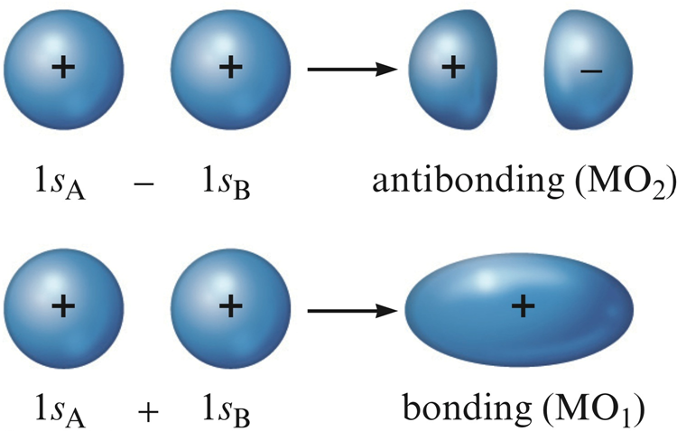
Figure 9.25 - Formation of Molecular Orbitals

Slide 52
Properties of Molecular Orbitals
The electron probability of both molecular orbitals is centered along the line passing through the two nuclei
MO₁ and MO₂ are referred to as sigma (σ) molecular orbitals
In the molecule, only the molecular orbitals are available for occupation by electrons

Slide 53
Properties of Molecular Orbitals (Continued 1)
Bonding and antibonding
Bonding molecular orbital: Lower in energy than the atomic orbitals from which it is composed
Electrons in this orbital will favor bonding
Antibonding molecular orbital: Higher in energy than the atomic orbitals from which it is composed
Electrons in this orbital will favor the separated atoms

Slide 54
Figure 9.27 - Bonding and Antibonding Molecular Orbitals

Slide 55
Properties of Molecular Orbitals (Continued 2)
The MO model is physically reasonable
There is high probability of finding electrons between nuclei in bonding MOs
Electrons are outside the space between the nuclei in antibonding MOs
Labels on molecular orbitals indicate their shape, the parent atomic orbitals, and whether they are bonding or antibonding
Antibonding character is indicated by an asterisk

Slide 56
Properties of Molecular Orbitals (Continued 3)
Molecular electronic configuration can be written in the same way as atomic configurations
Each molecular orbital can hold two electrons
The spins should be opposite
Molecular orbitals are conserved
The number of MOs will be equal to the number of atomic orbitals used to construct them

Slide 57
Figure 9.28 - Molecular Energy-Level Diagram for the H₂ Molecule

Slide 58
Bond Order
Used to indicate bond strength
Bonds are perceived in terms of pairs of electrons
Larger the bond, greater the bond strength

Slide 59
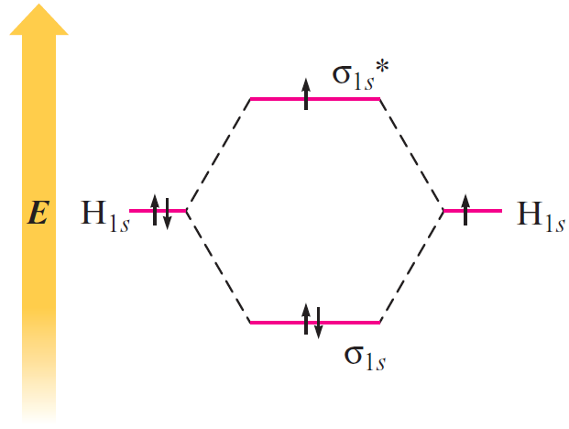
Bond Order (Continued)
Consider the H₂– ion
Contains two bonding electrons and one antibonding electron

Slide 60
Homonuclear Diatomic Molecules
Composed of two identical atoms
Only the valence orbitals of the atoms contribute significantly to the molecular orbitals of a particular molecule

Slide 61
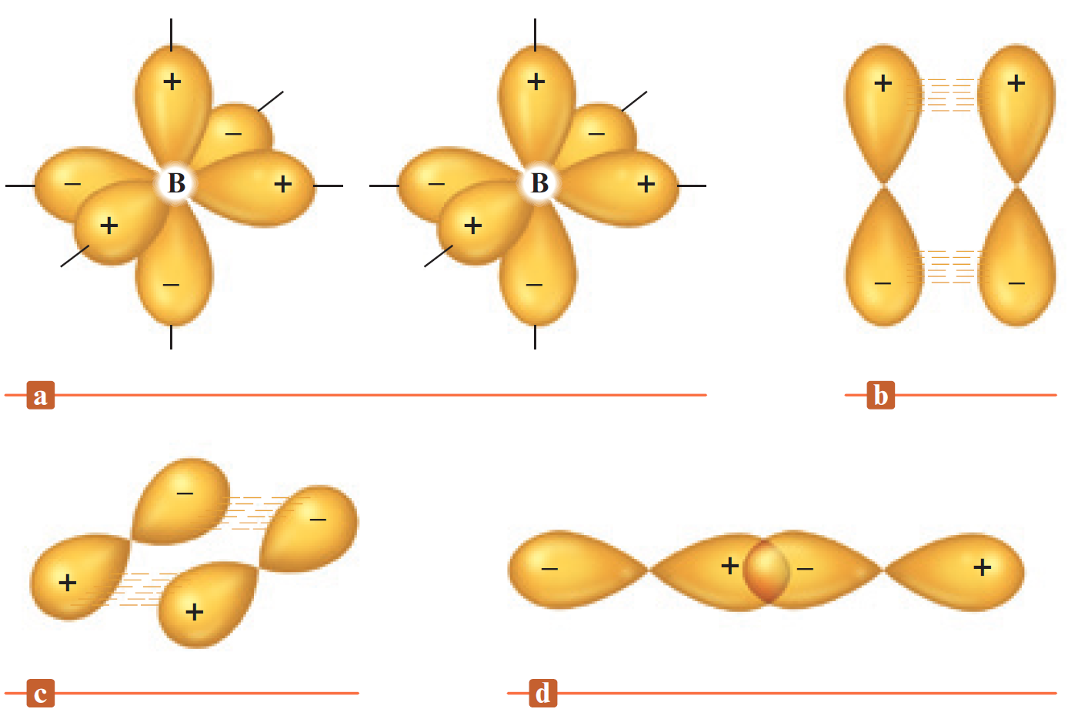
Homonuclear Diatomic Molecules - Boron
Electron configuration - 1s²2s²2p¹
B₂ molecule is described based on how p atomic orbitals combine to form molecular orbitals
p orbitals occur in sets of three mutually perpendicular orbitals
Two pairs of p orbitals can overlap in a parallel fashion and one pair can overlap head-on

Slide 62
Homonuclear Diatomic Molecules - Boron (Continued 1)
Consider the molecular orbitals from the head-on overlap
Bonding orbital is formed by reversing the sign of the right orbital
Produces constructive interference
There is enhanced electron probability between the nuclei
Antibonding orbital is formed by the direct combination of the orbitals
Produces destructive inference
There is decreased electron probability between the nuclei

Slide 63
Homonuclear Diatomic Molecules - Boron (Continued 2)
MOs are σ molecular orbitals
Combination of parallel p orbitals with matched positive and negative phases results in constructive interference
Gives a bonding π orbital
If the signs of one orbital are reversed, an antibonding π orbital is formed

Slide 64
Homonuclear Diatomic Molecules - Boron (Continued 3)
Both p orbitals are pi (π) molecular orbitals
Pi (π) molecular orbitals: Electron probability lies above and below the line between the nuclei
π_{2p} - Bonding MO
π_{2p}* - Antibonding MO

Slide 65
Figure 9.34 - The Expected MO Energy-Level Diagram Resulting from the Combination of the 2p Orbitals on Two Boron Atoms

Slide 66
Figure 9.35 - The Expected Molecular Orbital Energy-Level Diagram for the B₂ Molecule
B₂ should be a stable molecule

Slide 67
Types of Magnetism in the Presence of a Magnetic Field
Paramagnetism: Substance is attracted into the inducing magnetic field
Associated with unpaired electrons
Diamagnetism: Substance is repelled from the inducing magnetic field
Associated with paired electrons
Substance that has both paired and unpaired electrons will exhibit a net paramagnetism

Slide 68
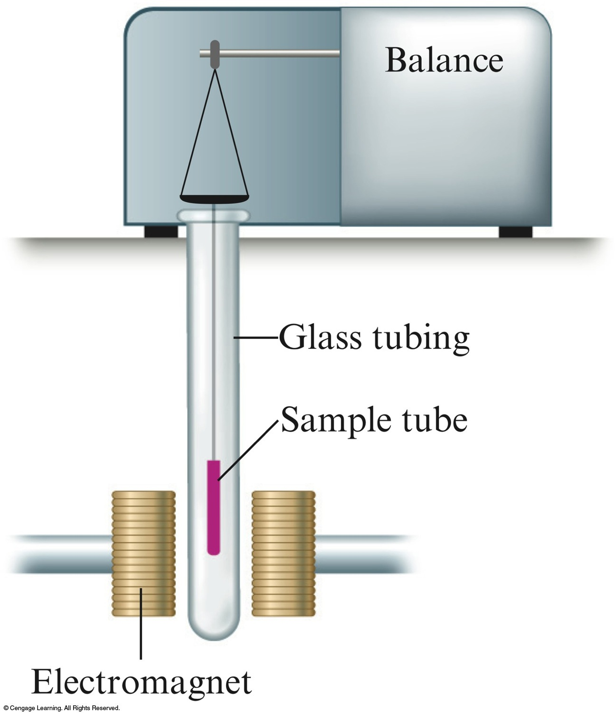
Figure 9.36 - Measuring Paramagnetism

Slide 69
Figure 9.37 - The Correct Molecular Orbital Energy-Level Diagram for B₂
Diagram explains the observed paramagnetism of B₂
When p–s mixing is allowed, the energies of the σ_{2p} and π_{2p} orbitals are reversed
Two electrons from the B 2p orbitals now occupy separate, degenerate π_{2p} molecular orbitals and have parallel spins

Slide 70
Critical Thinking
What if π_{2p} orbitals were lower in energy than σ _{2p} orbitals?
What would you expect the B₂ molecular orbital energy-level diagram to look like (without considering p–s mixing)?
Compare the expected diagram to figures 9.34 and 9.35, and state the differences from each

Slide 71
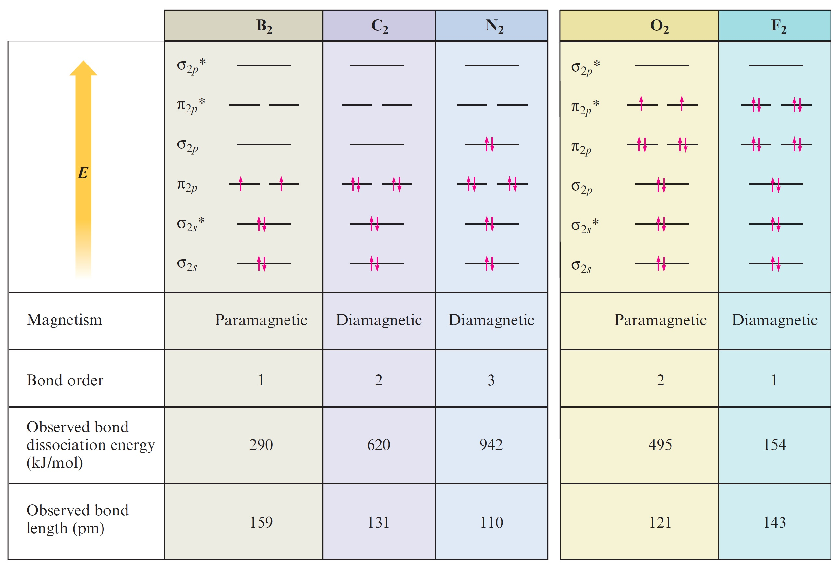
Figure 9.38 - Molecular Orbital Summary of Second Row Diatomic Molecules

Slide 72
Key Points regarding Period 2 Diatomics
There are definite correlations between bond order, bond energy, and bond length
Bond order cannot be associated with a particular bond energy
The large bond energy associated with the N₂ molecule will have a triple bond
The O₂ molecule is paramagnetic

Slide 73
Interactive Example 9.7 - The Molecular Orbital Model II
Use the molecular orbital model to predict the bond order and magnetism of each of the following molecules
Ne₂
P₂

Slide 74
Interactive Example 9.7 - Solution (a)
The valence orbitals for Ne are 2s and 2p
The Ne₂ molecule has 16 valence electrons (8 from each atom)

Slide 75
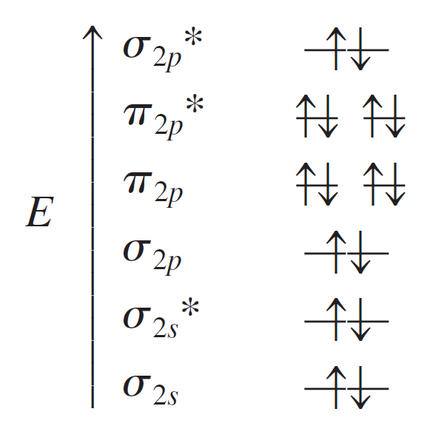
Interactive Example 9.7 - Solution (a) (Continued)
Placing these electrons in the appropriate molecular orbitals produces the following diagram
The bond order is (8 – 8)/2 = 0
Ne₂ does not exist

Slide 76
Interactive Example 9.7 - Solution (b)
P₂ contains phosphorus atoms from the third row of the periodic table
Assume that the diatomic molecules of the Period 3 elements can be treated in a way similar to that which has been used so far
Draw the MO diagram for P₂ analogous to that for N₂
The only change will be that the molecular orbitals will be formed from 3s and 3p atomic orbitals

Slide 77
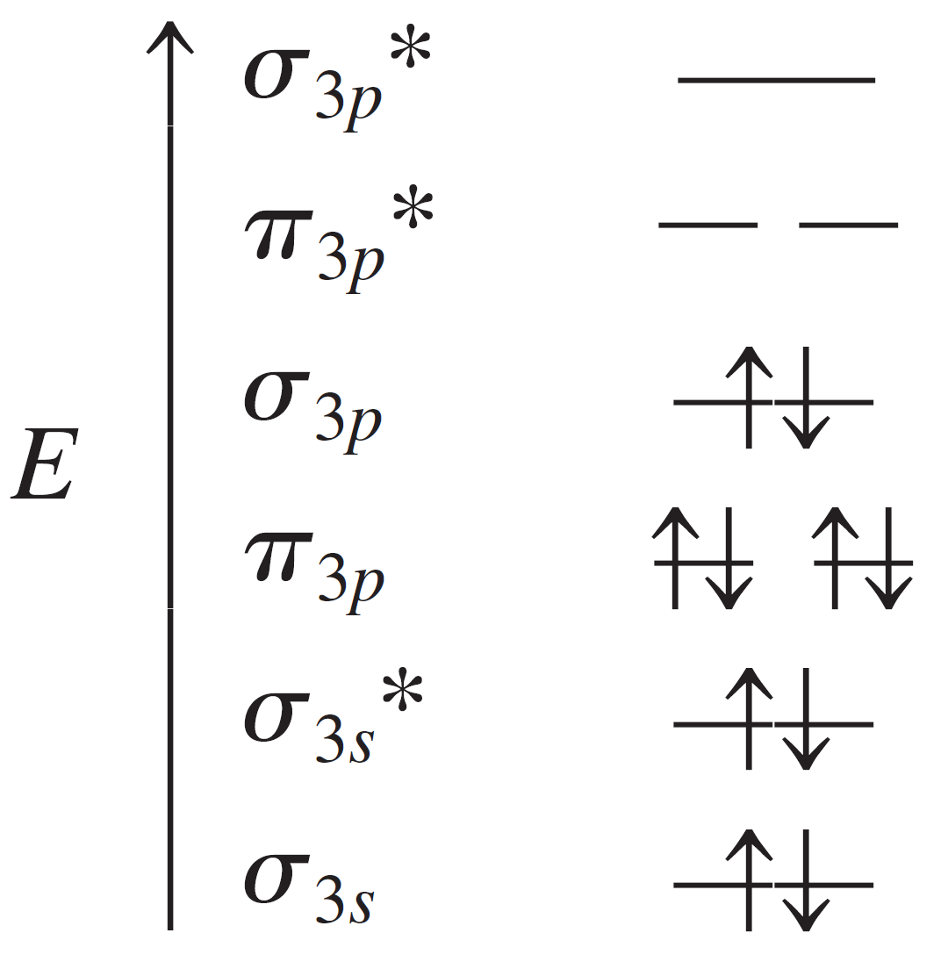
Interactive Example 9.7 - Solution (b) (Continued)
The P₂ molecule has 10 valence electrons (5 from each phosphorus atom)
Bond order = 3
The molecule is expected to be diamagnetic

Slide 78
Heteronuclear Diatomic Molecules
Heteronuclear: Different atoms
A special case involves molecules containing atoms adjacent to each other in the periodic table
MO diagram can be used for homonuclear molecules as atoms involved in such molecules are similar

Slide 79
Interactive Example 9.8 - The Molecular Orbital Model III
Use the molecular orbital model to predict the magnetism and bond order of the NO⁺ and CN– ions

Slide 80
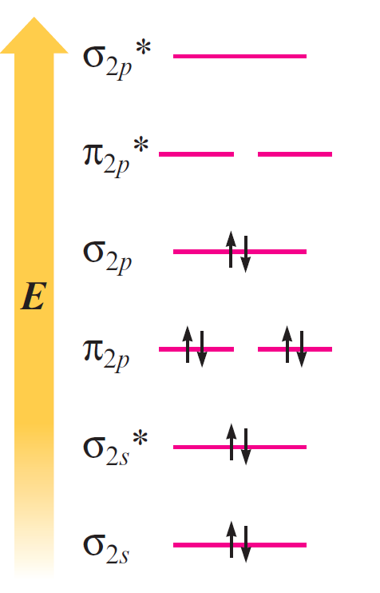
Interactive Example 9.8 - Solution
The NO⁺ ion has 10 valance electrons (5 + 6 – 1)
The CN– ion also has 10 valance electrons (4 + 5 + 1)
Both ions are diamagnetic

Slide 81
Energy-Level Diagrams for Diatomic Molecules
When the two atoms of a diatomic molecule are very different, the energy-level diagram for homonuclear molecules cannot be used
Consider the hydrogen fluoride (HF) molecule
Electron configuration of hydrogen - 1s¹
Electron configuration of fluorine - 1s²2s²2p⁵
Assume that fluorine uses only one of its 2p orbitals to bond to hydrogen

Slide 82
Figure 9.42 - Partial Molecular Orbital Energy-Level Diagram for HF

Slide 83
Energy-Level Diagrams for Diatomic Molecules (Continued)
The HF molecule should be stable as both electrons are lowered in energy relative to their energy in the free hydrogen and fluorine atoms
Electrons prefer to be closer to the fluorine atom
The electron pair is not shared equally
Fluorine has a slight excess of negative charge, and hydrogen is partially positive

Slide 84
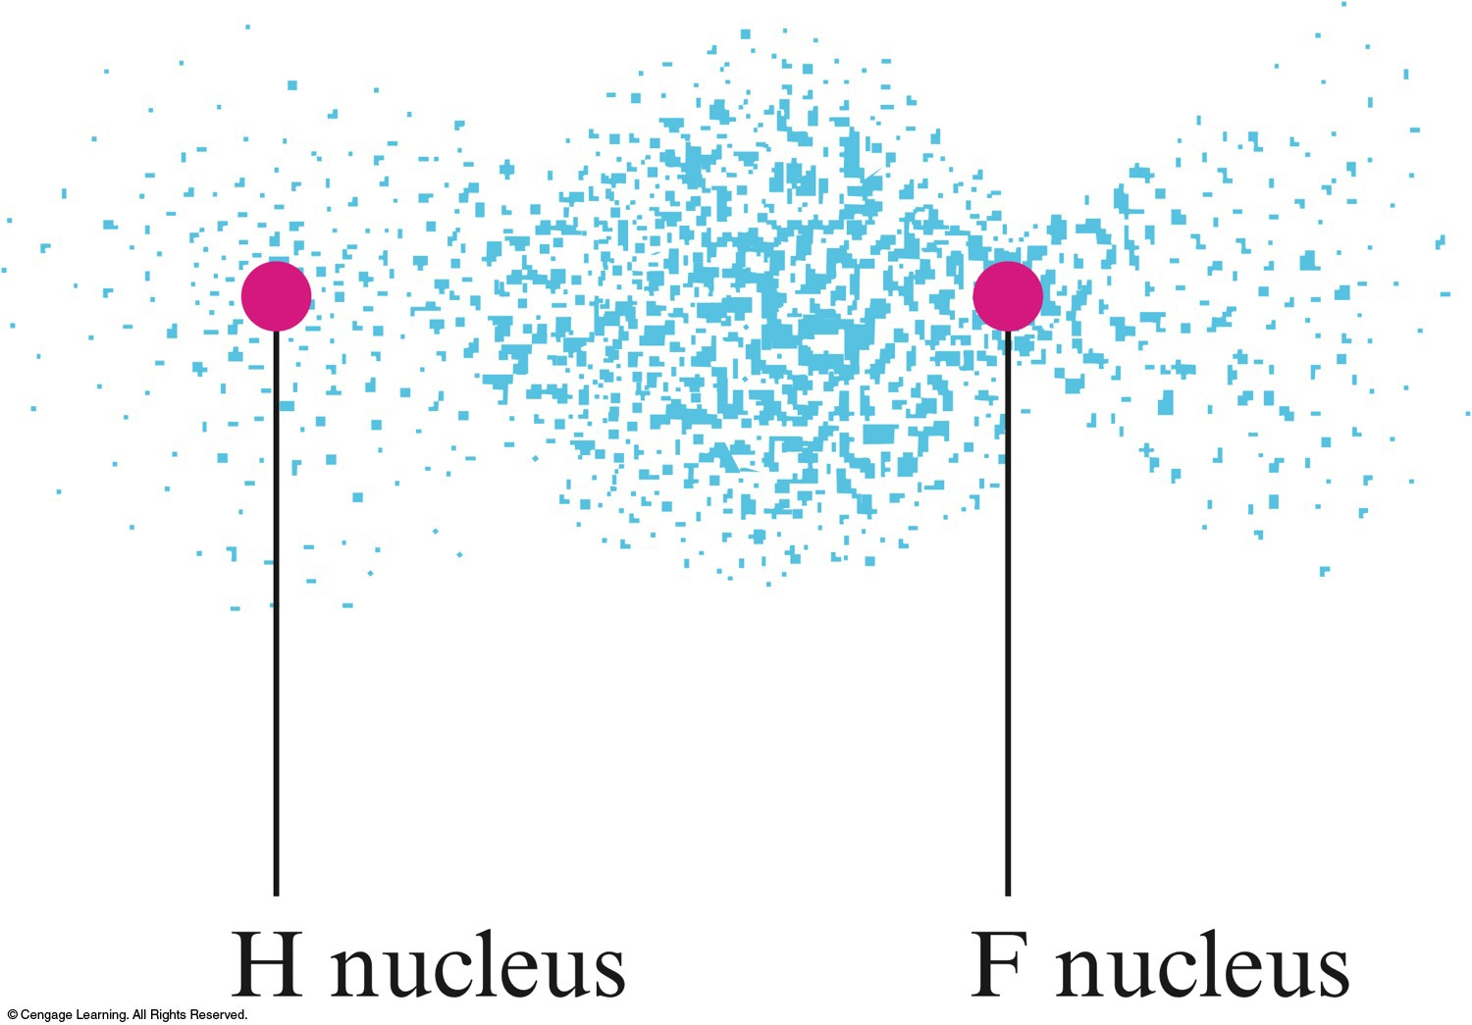
Figure 9.43 - Electron Probability Distribution in the Bonding Molecular Orbital of the HF Molecule

Slide 85
Combining the Localized Electron and MO Models
The σ bonds in a molecule can be described as being localized
The π bonds must be treated as being delocalized
For molecules that require resonance:
The localized electron model can be used to describe the σ bonding
The MO model can be used to describe the π bonding

Slide 86
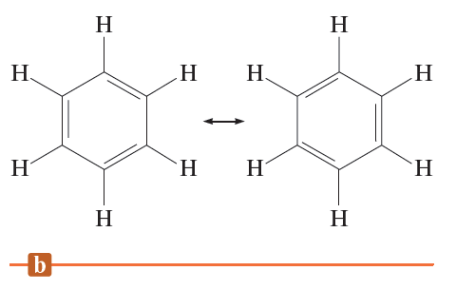
General Model - Benzene Molecule and its Resonance Structures
All atoms in benzene are in the same plane
All the C—C bonds are known to be equivalent
To account for the six equivalent C—C bonds, the localized electron model must invoke resonance

Slide 87
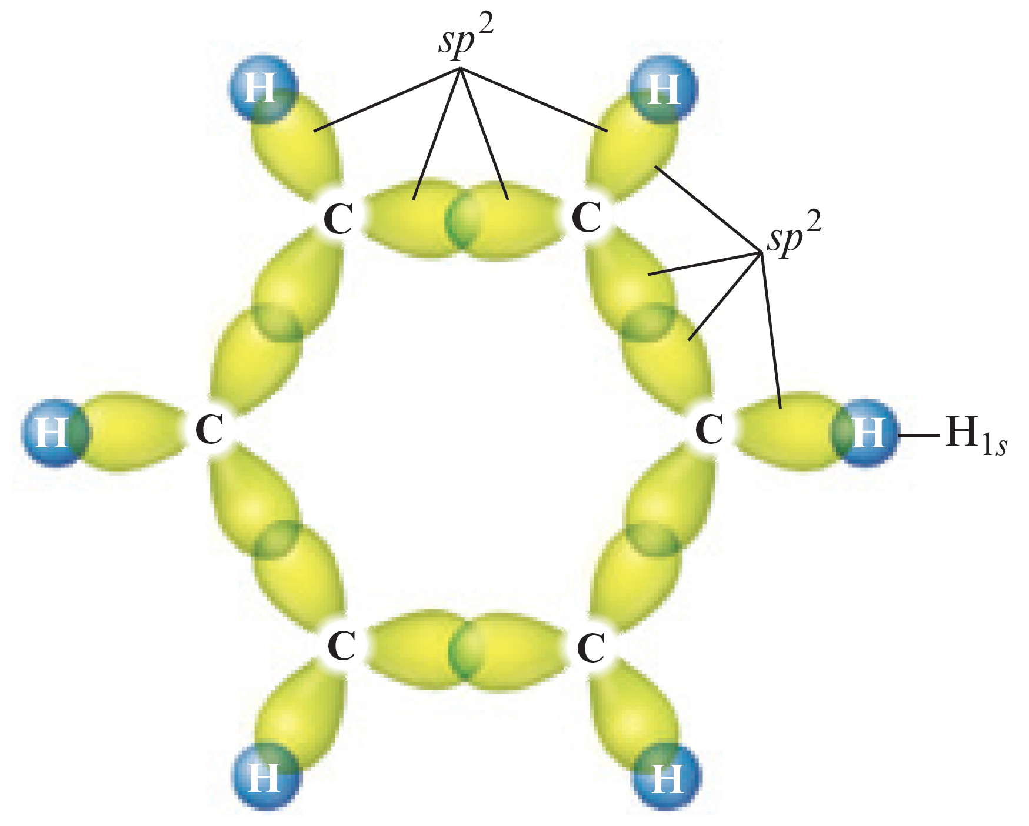
Combination of Models - Identifying σ bonds
Assumption - The σ bonds of carbon involve sp² orbitals
The bonds are centered in the plane of the molecule

Slide 88
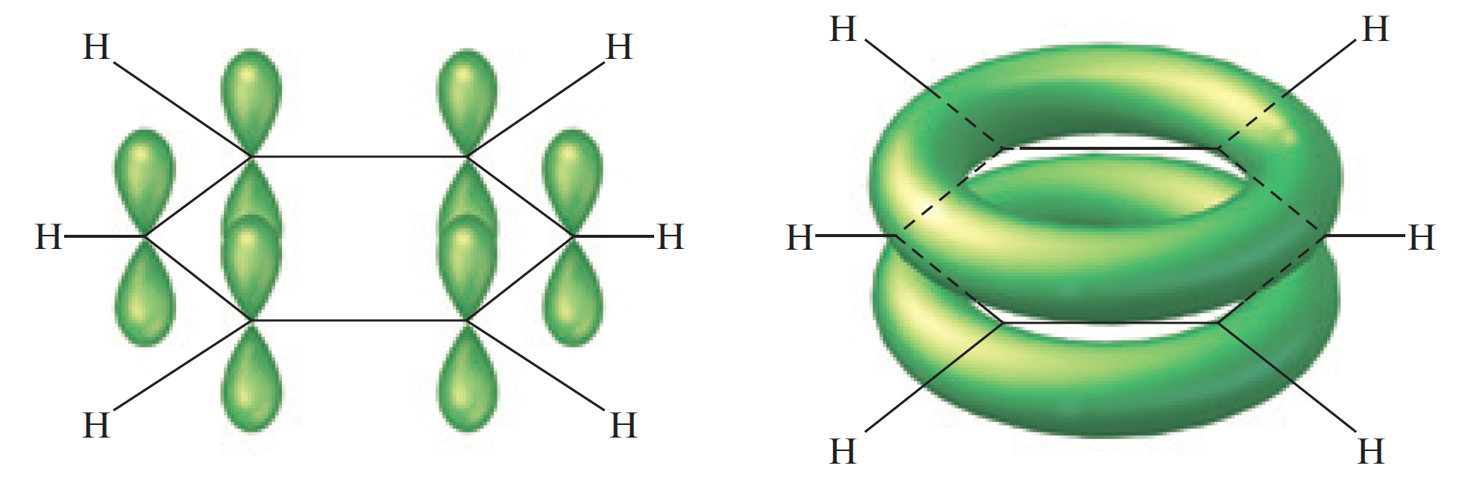
Combination of Models - Identifying π bonds
Each carbon atom is sp² hybridized
A p orbital perpendicular to the plane of the ring remains on each carbon atom
Used to form π molecular orbitals
The electrons in the resulting π molecular orbitals are delocalized above and below the plane of the ring

Slide 89
Benzene Structure
Indicates the delocalized π bonding in the molecule

