Slide 1
Learning Objective 3 Explain how a ledger and posting help in the recording process.
LO 3

Slide 2
The Ledger دفتر الأستاذ and Posting ترحيل
Ledger: The entire group of accounts maintained by a company.
Provides the balance in each of the accounts as well as keeps track of changes in these balances.
Companies may use various kinds of ledgers, but every company has a general ledger.
LO 3

Slide 3
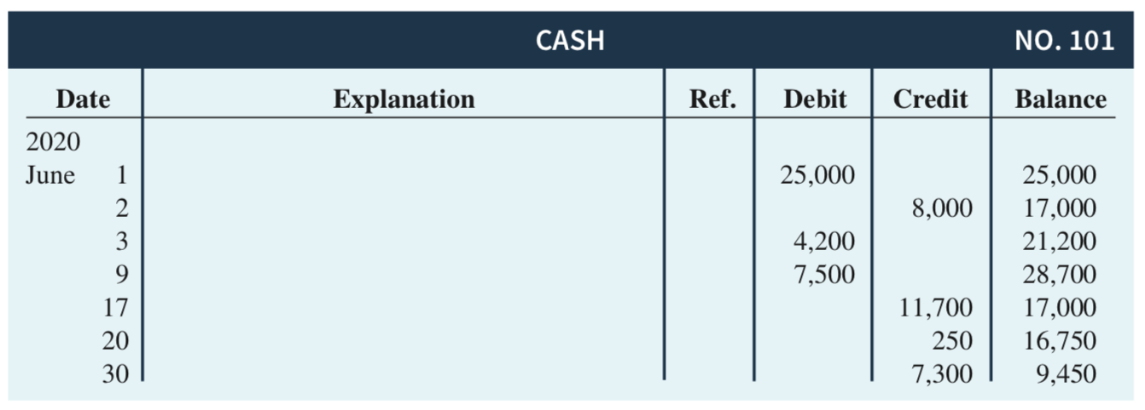
Standard Form of Account
This format is called the three-column form of account. It has three money columns—debit, credit, and balance.
LO 3

Slide 4
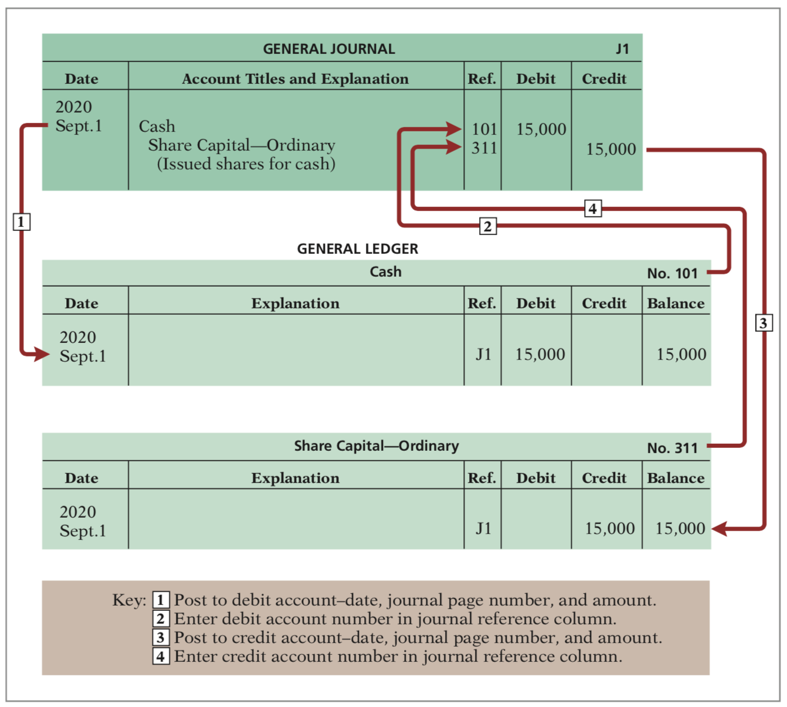
Posting
LO 3

Slide 5
Chart of Accounts
Continues on next slide
LO 3

Slide 6
Chart of Accounts Lists the accounts and the account numbers that identify their location in the ledger. Numbering system: Usually starts with the statement of financial position accounts and follows with the income statement accounts. Number of accounts: Depends on the amount of detail management desires. Companies leave gaps to permit the insertion of new accounts as needed during the life of the business.
LO 3

Slide 7
The Recording Process Illustrated October transactions of Yazici Advertising A.Ş. Accounting period: One month HELPFUL HINT Follow these steps: 1 - Determine what type of account is involved. 2 - Determine what items increased or decreased and by how much. 3 - Translate the increases and decreases into debits and credits.
LO 3

Slide 8
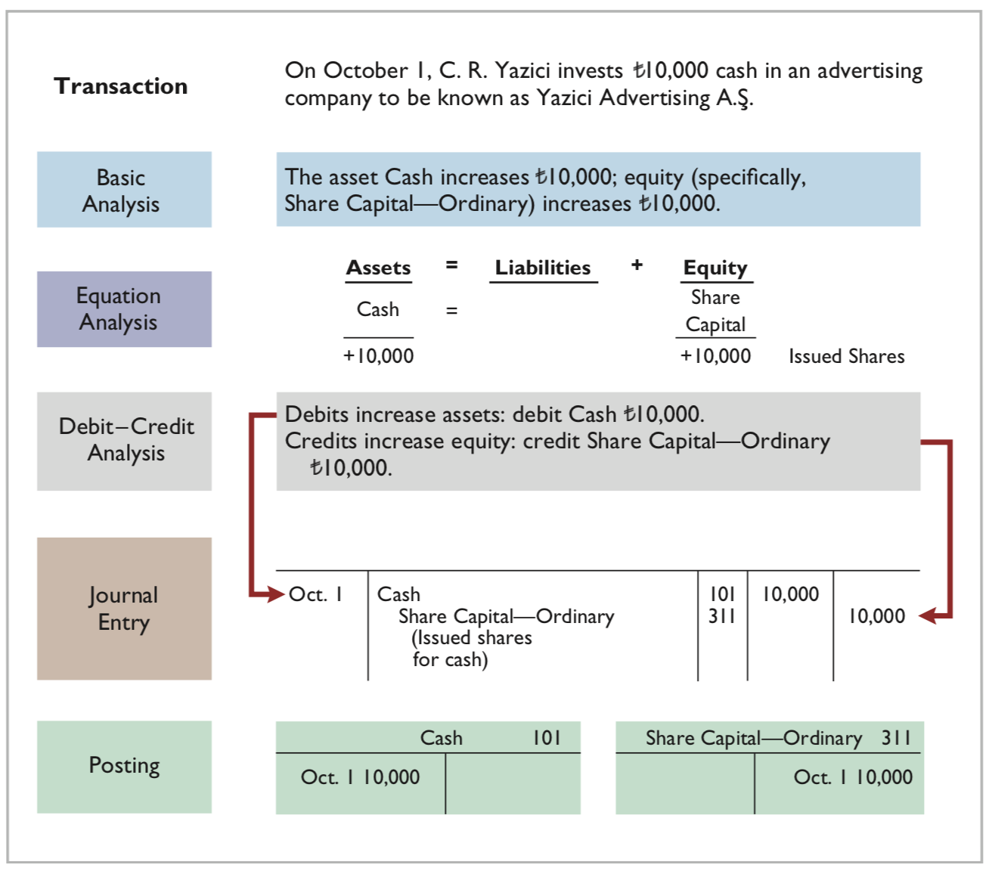
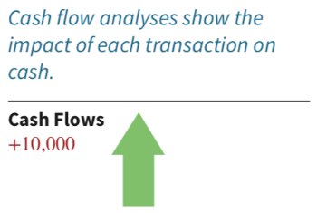
LO 3

Slide 9
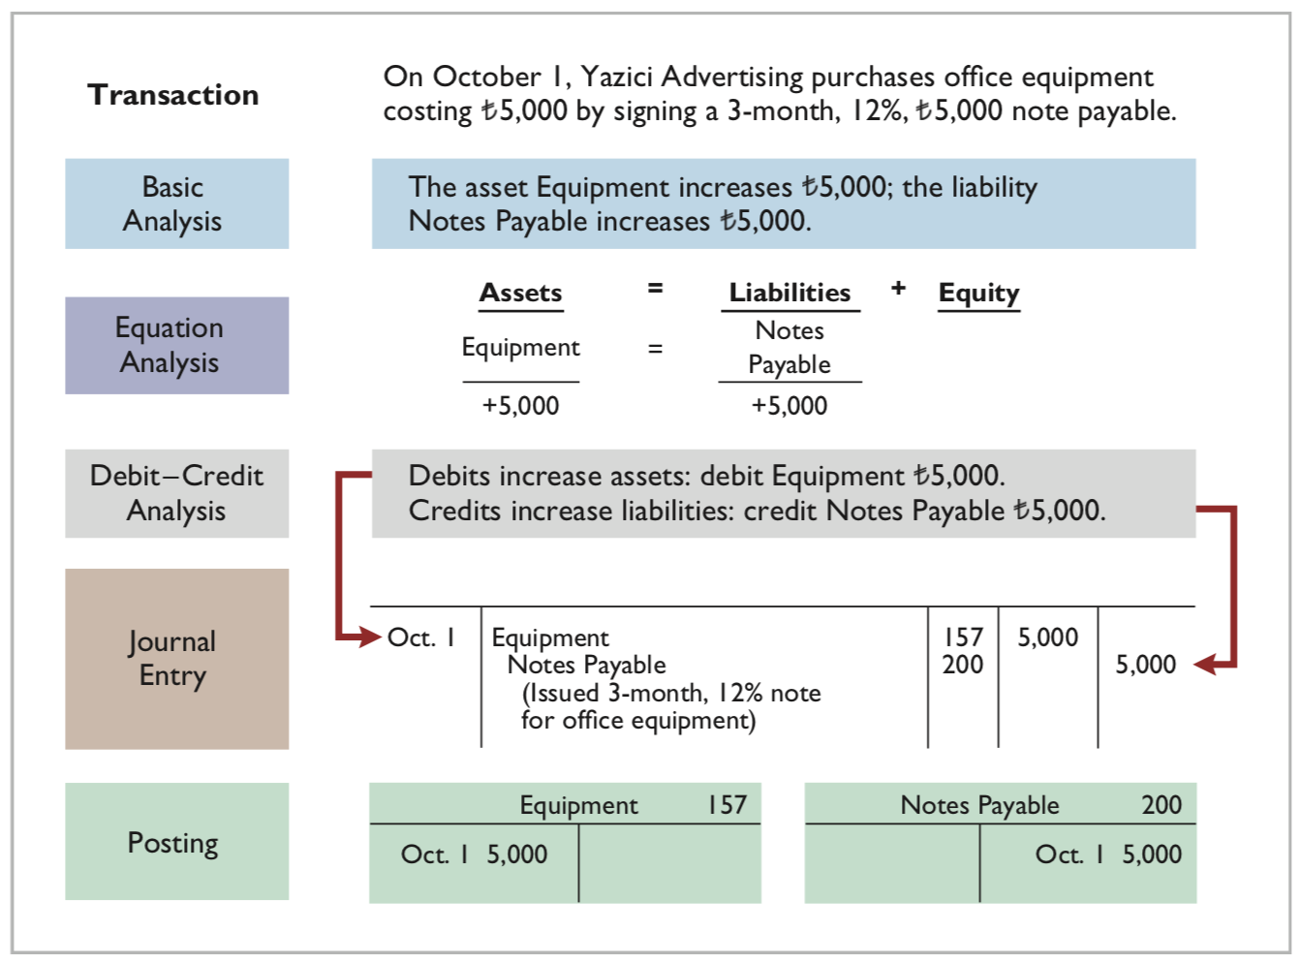
LO 3

Slide 10
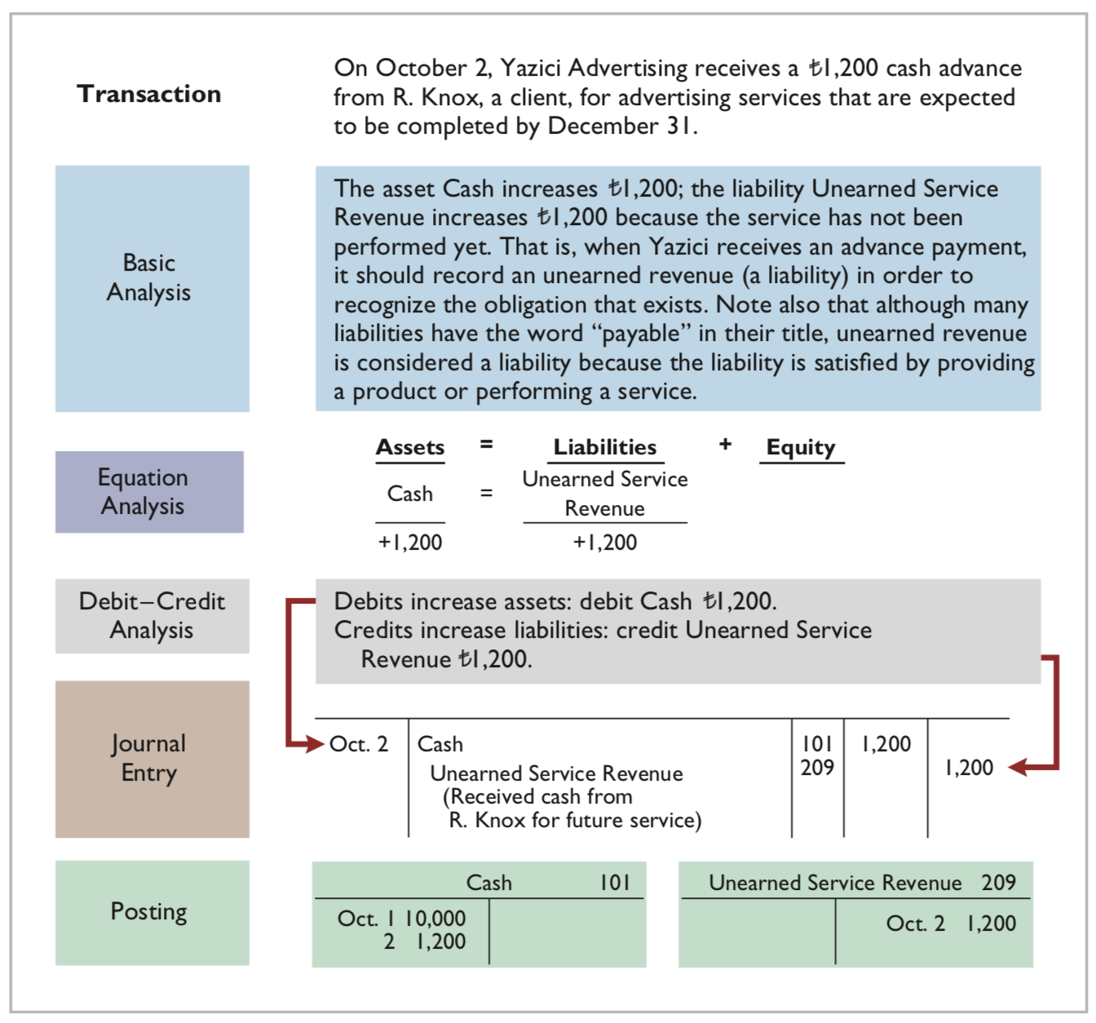
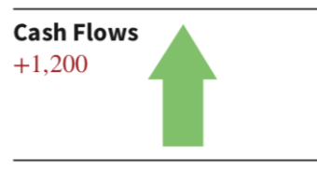
LO 3

Slide 11
Unearned Service Revenue is considered a liability even though the word payable is not used.
LO 3

Slide 12
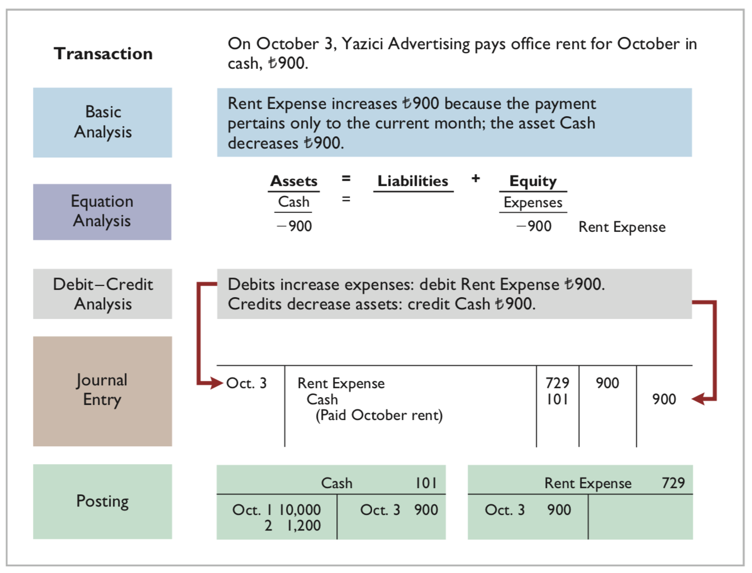
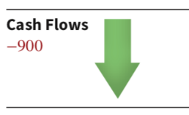
LO 3

Slide 13
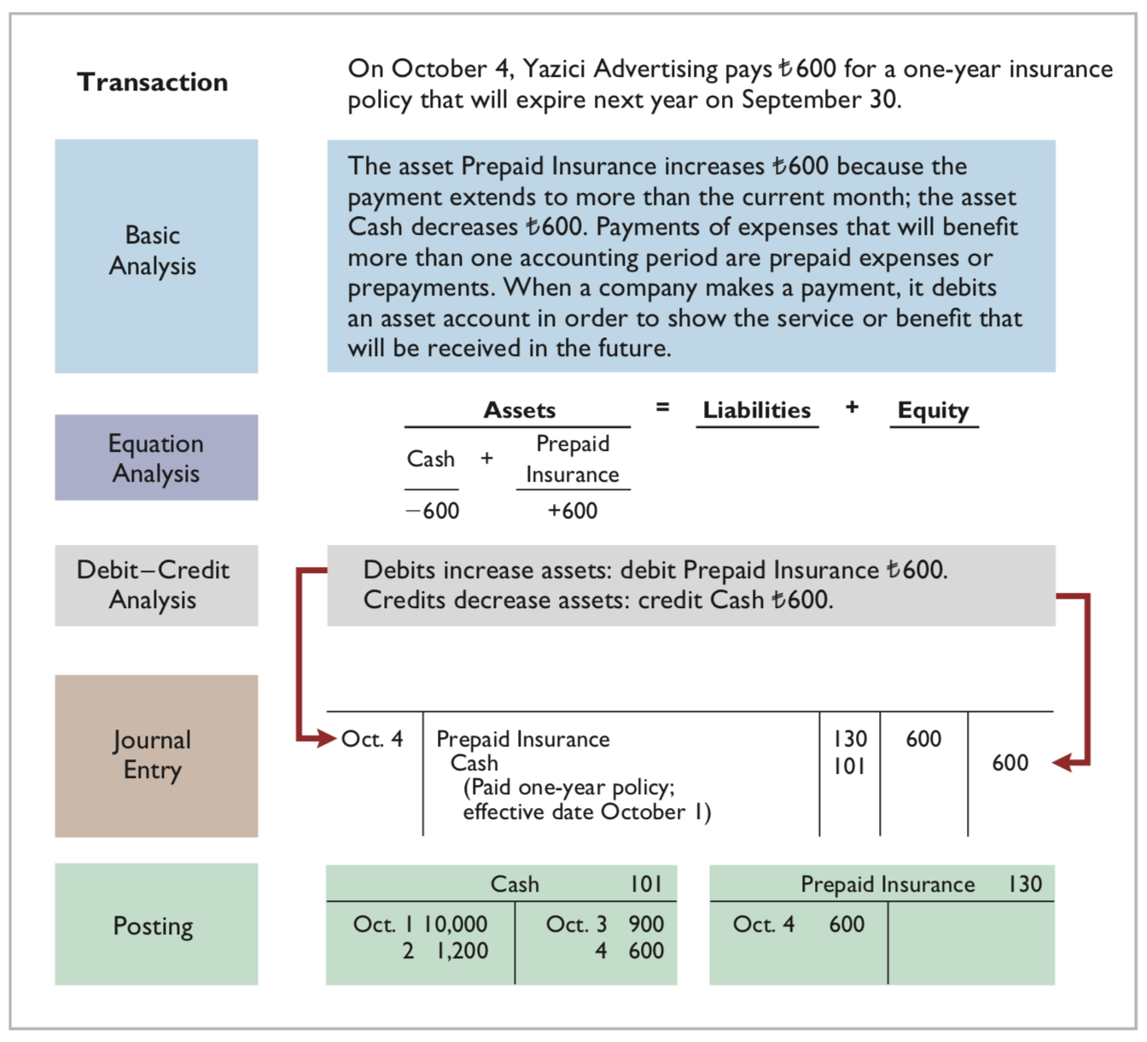
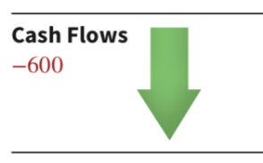
LO 3

Slide 14
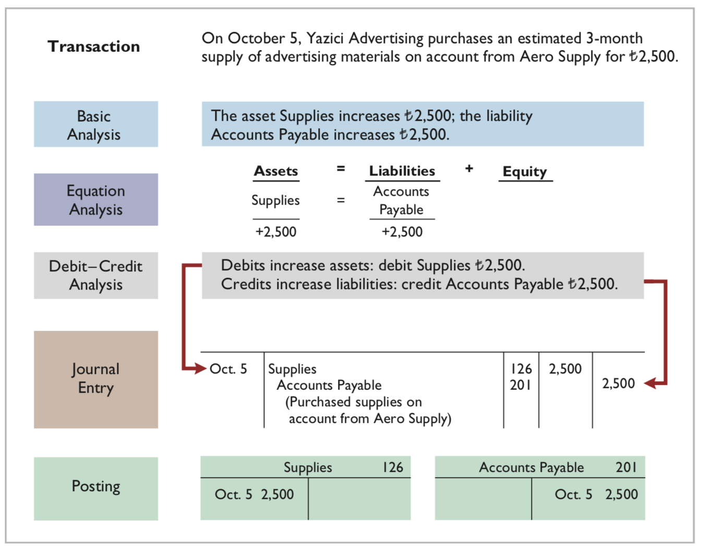
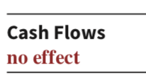
LO 3

Slide 15
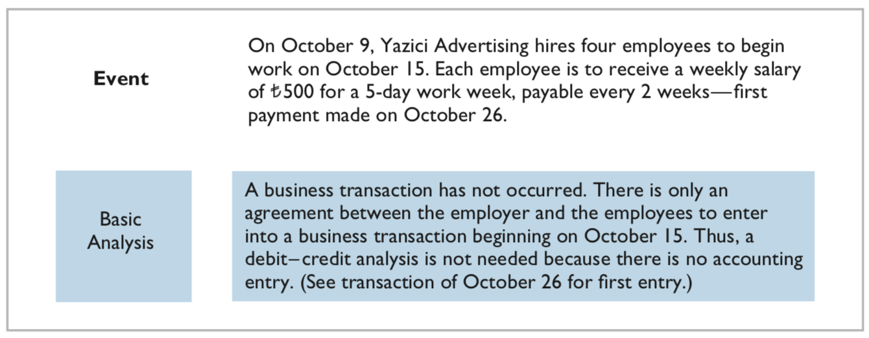
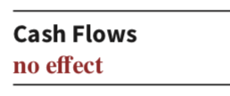
LO 3

Slide 16
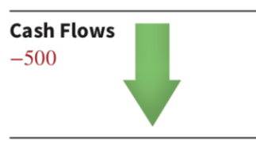
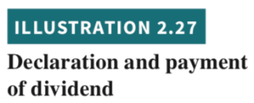
LO 3

Slide 17
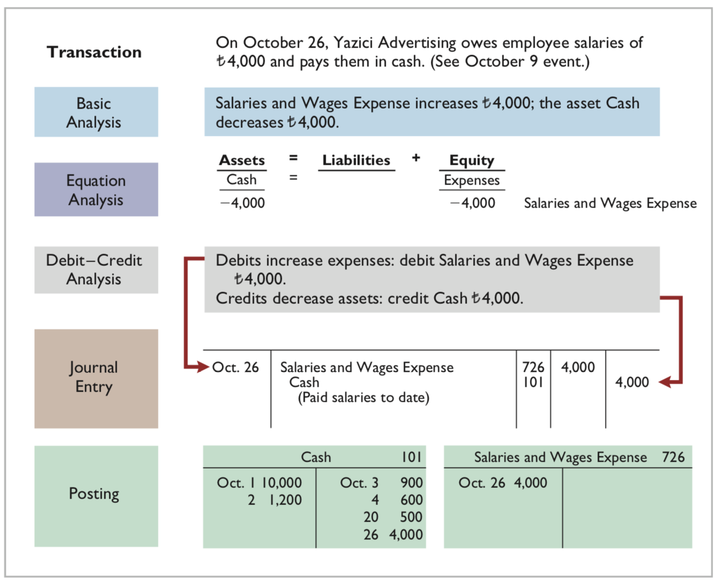
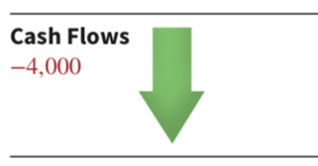
LO 3

Slide 18
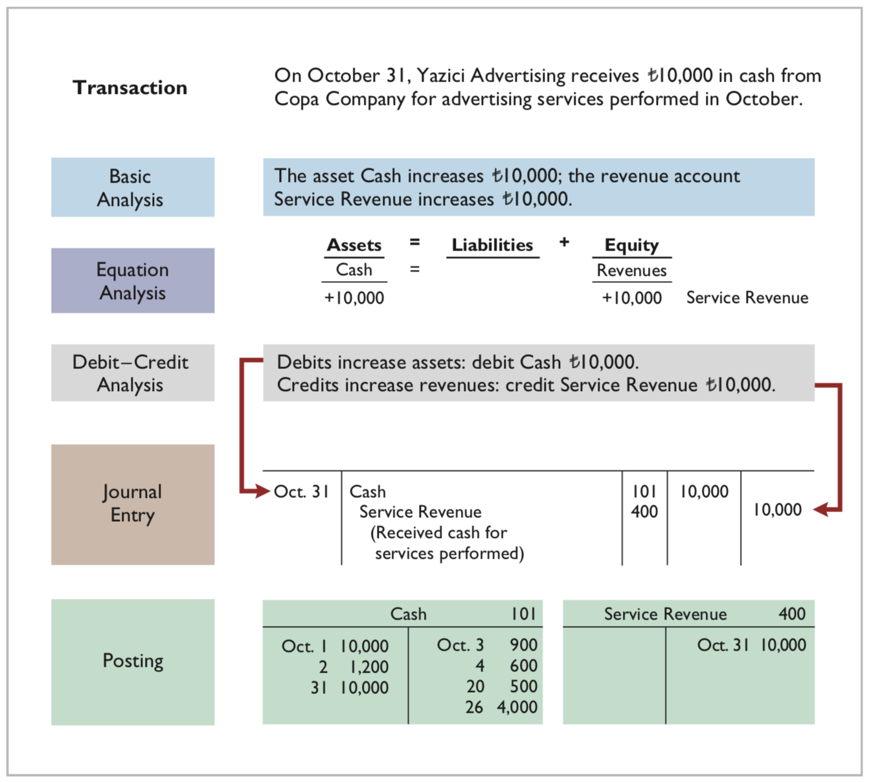
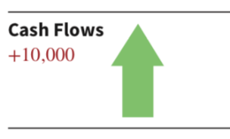
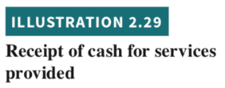
LO 3

Slide 19
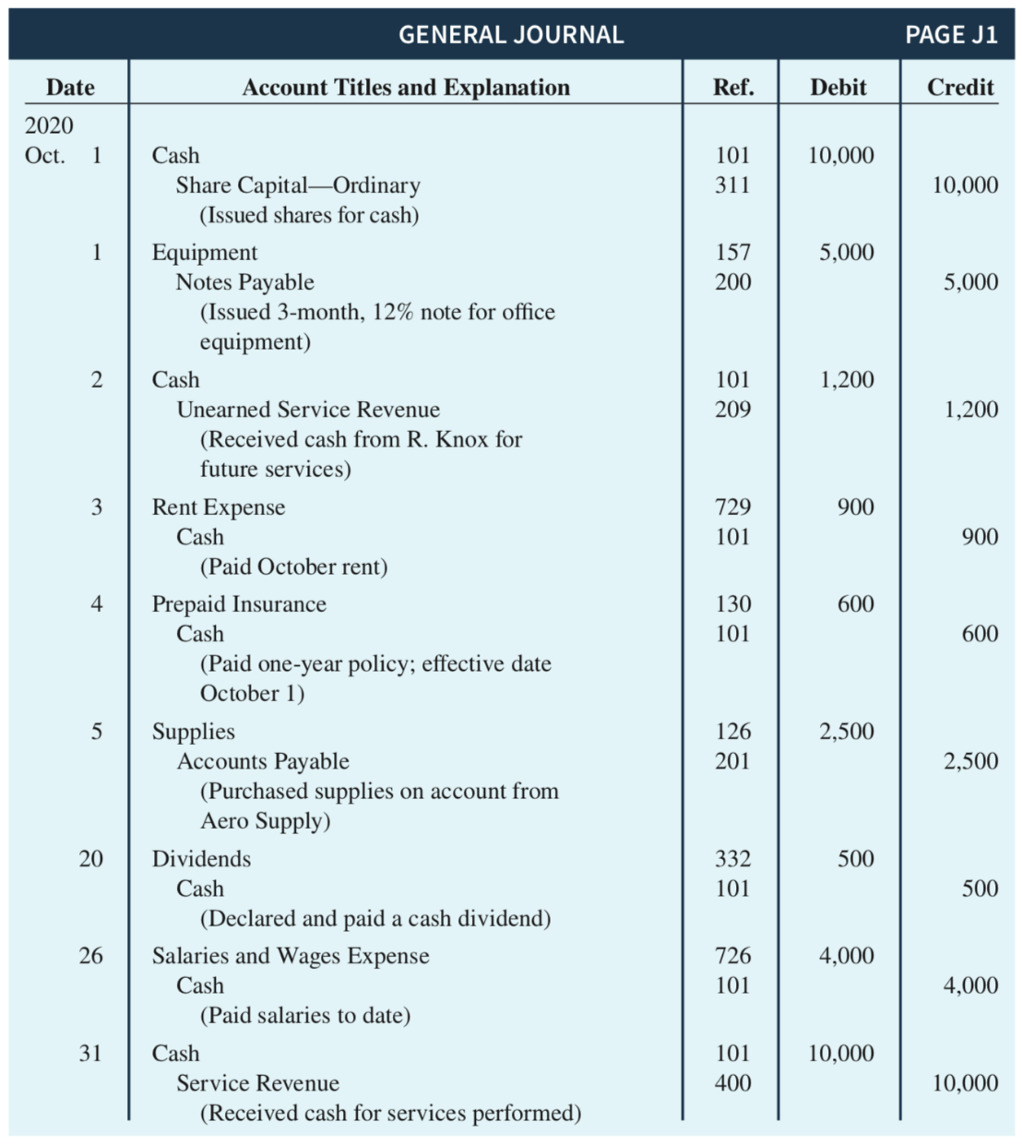
Summary Illustration of Journalizing and Posting
Continues on next slide
LO 3

Slide 20
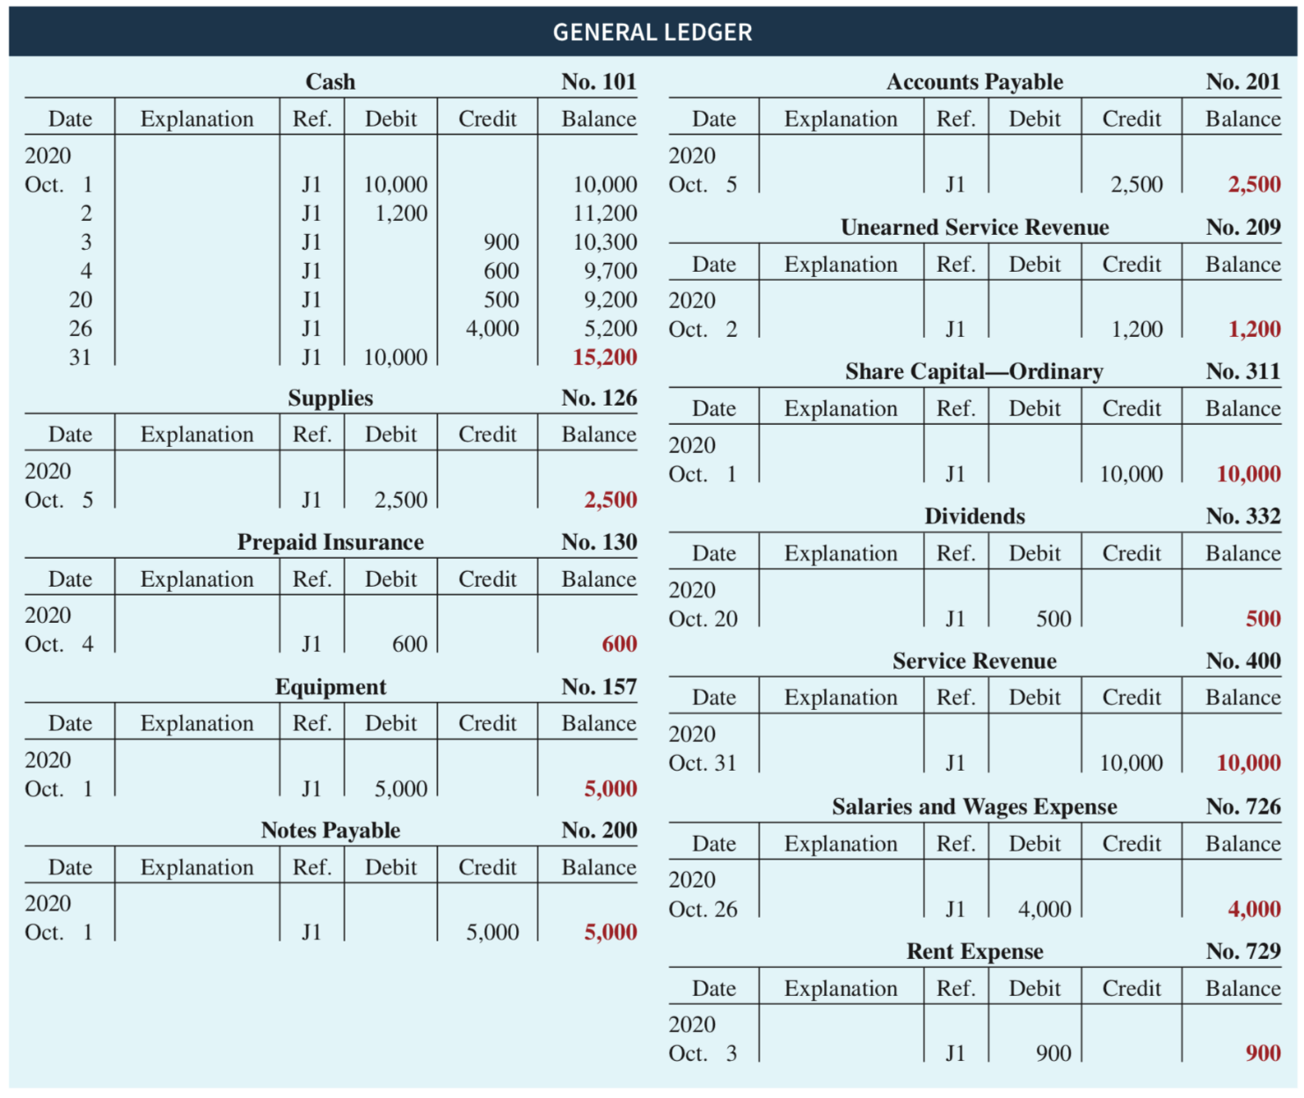
Summary Illustration of Journalizing and Posting
LO 3

