Slide 1
An-Najah National University
Faculty of Medicine
Department of Physiology
Anatomy and Physiology 1
7102101
Instructor: Heba Salah
Chapter 3:
The Skeletal System
Part 5: Axial Skeleton: Vertebral Column, and Bony Thorax

Slide 2
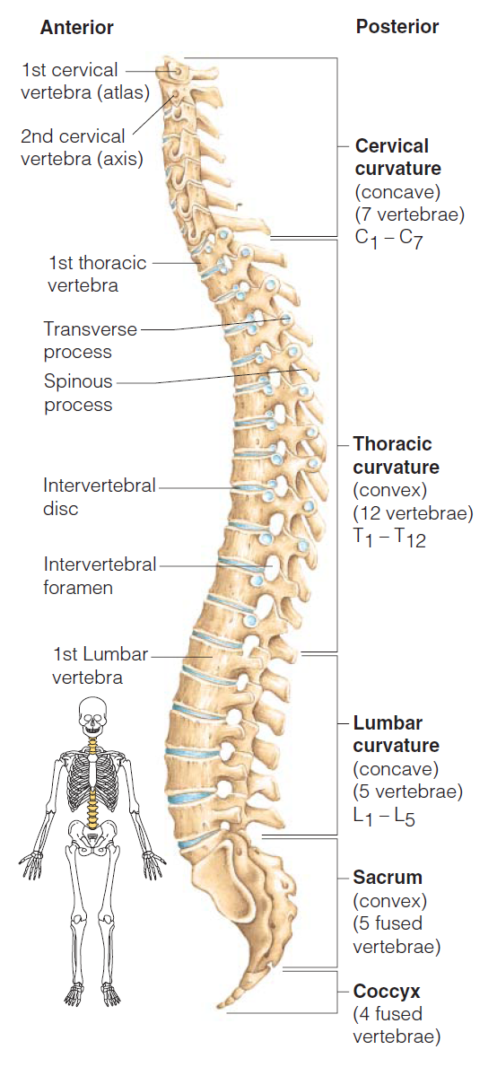
The Vertebral Column
Vertebrae separated by intervertebral discs
The spine has a normal curvature
Each vertebrae is given a name according to its location

Slide 3
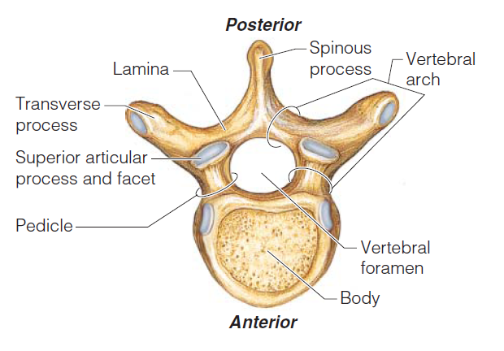
Structure of a Typical Vertebrae

Slide 4
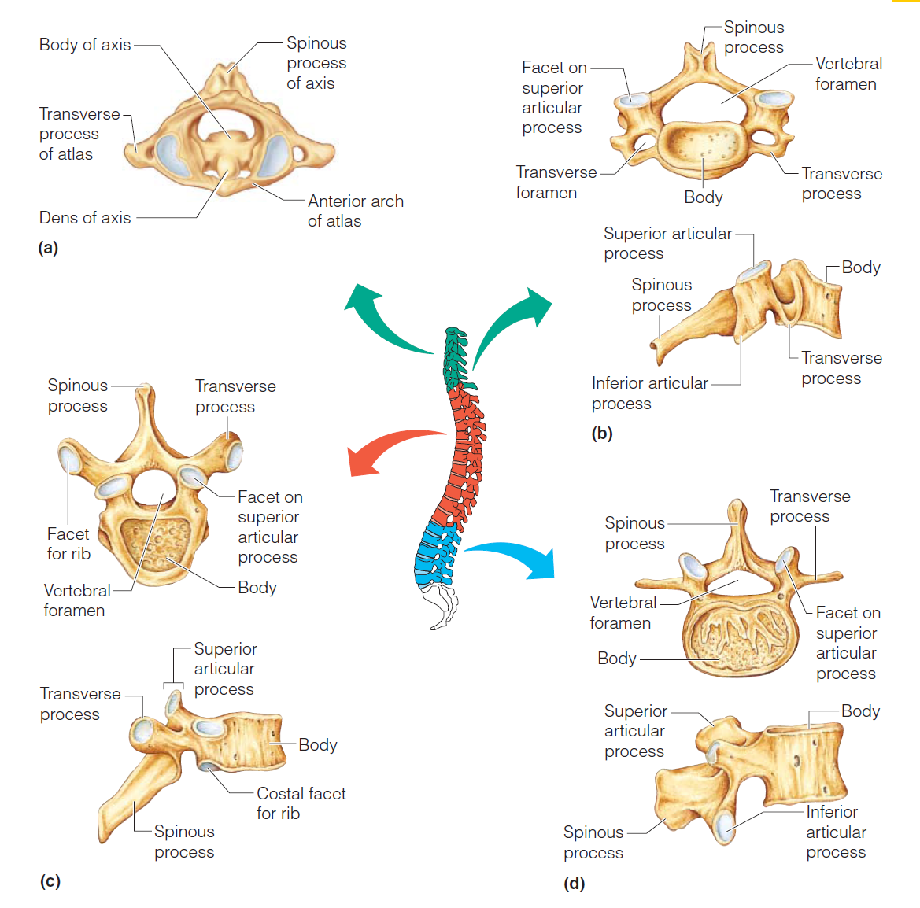
Regional Characteristics of Vertebrae

Slide 5
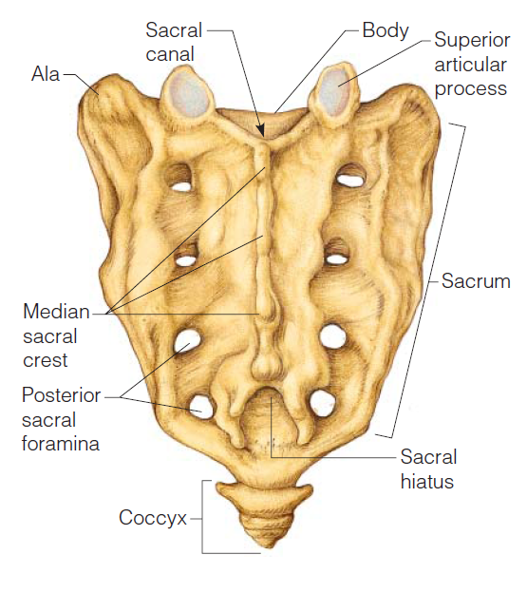
Regional Characteristics of Vertebrae

Slide 6
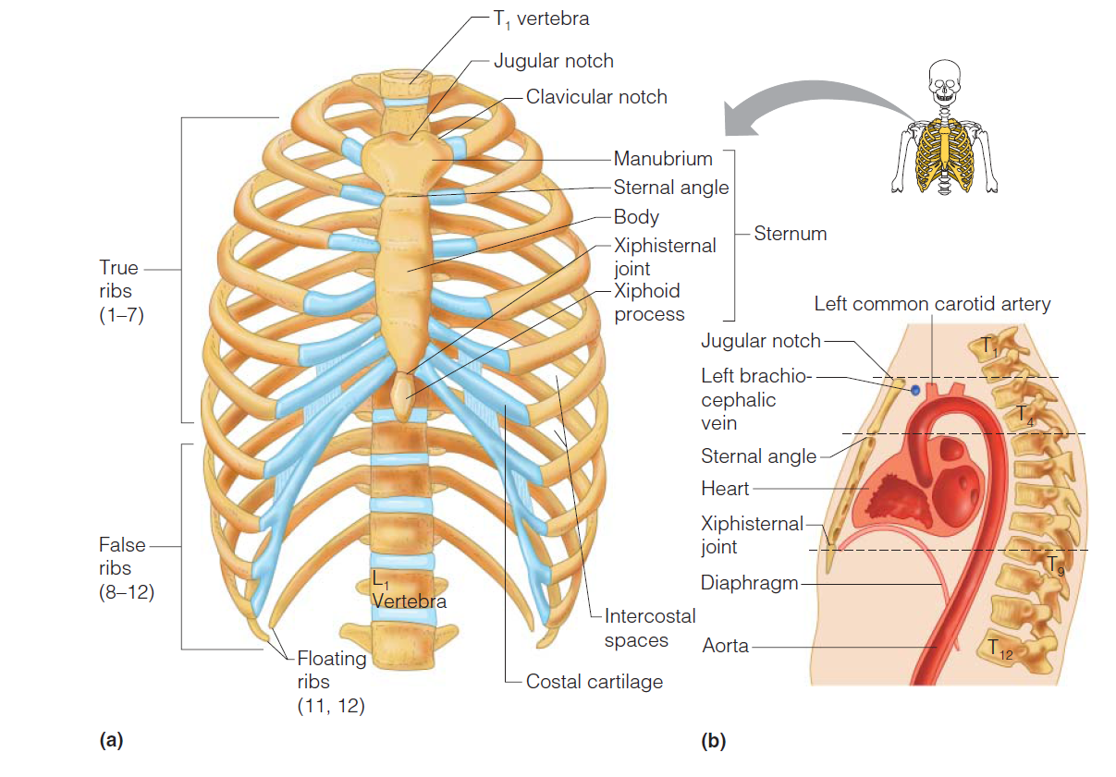
The Bony Thorax

