Slide 1
An-Najah National University
Faculty of Medicine
Department of Physiology
Anatomy and Physiology 1
7102101
Instructor: Heba Salah
Chapter 1:
The human Body: An Orientation
Part 4: Homeostasis

Slide 2
Homeostasis
Maintenance of a stable internal environment = a dynamic state of equilibrium
Homeostasis must be maintained for normal body functioning and to sustain life
Homeostatic imbalance – a disturbance in homeostasis resulting in disease

Slide 3
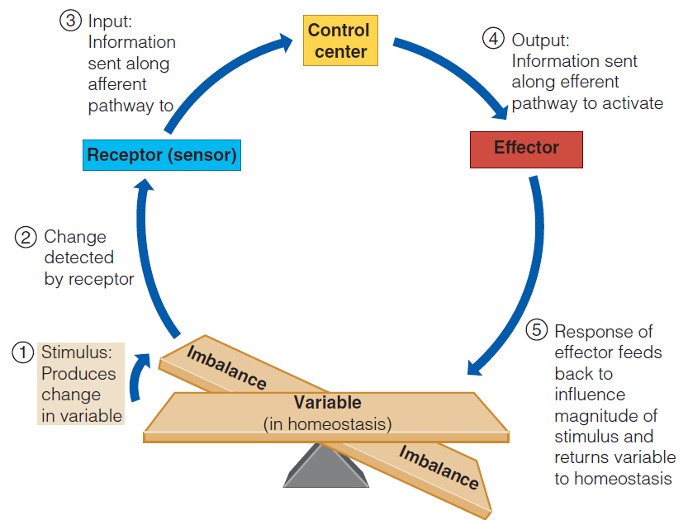
Homeostatic Control Mechanisms
Elements of a homeostasis control system

Slide 4
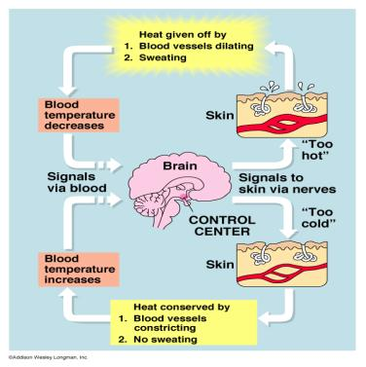
Homeostatic Control Mechanisms
1. Negative feedback:
Includes most homeostatic control mechanisms
Shuts off the original stimulus, or reduces its intensity

Slide 5
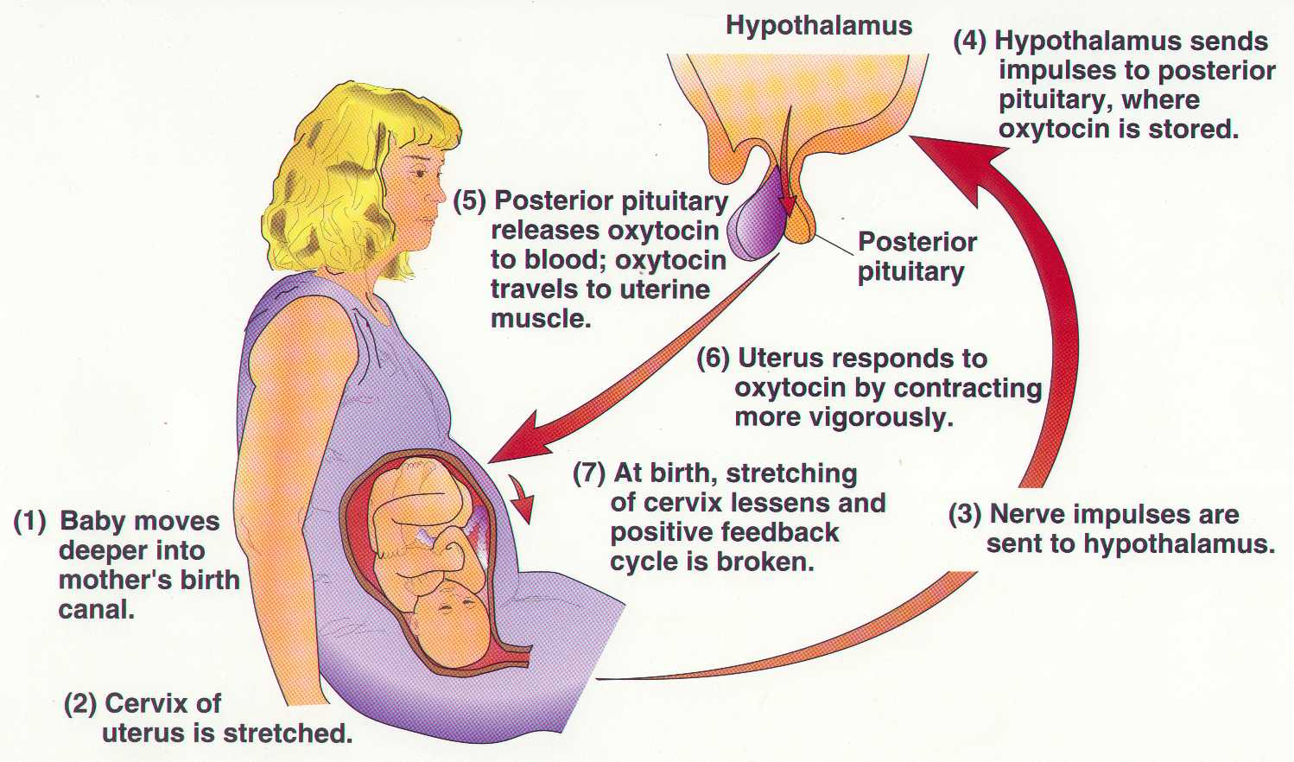
Homeostatic Control Mechanisms
2. Positive feedback:
Increases the original stimulus to push the variable farther
In the body this only occurs in blood clotting and birth of a baby

